Slide 1

CIS 700: “algorithms for Big Data”
Lecture 10:
Massively Parallel Algorithms
Slides at http://grigory.us/big-data-class.html
Grigory Yaroslavtsev
http://grigory.us

Slide 2
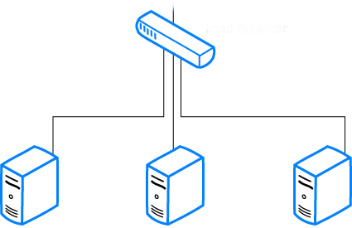

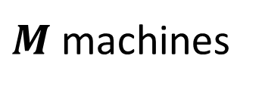
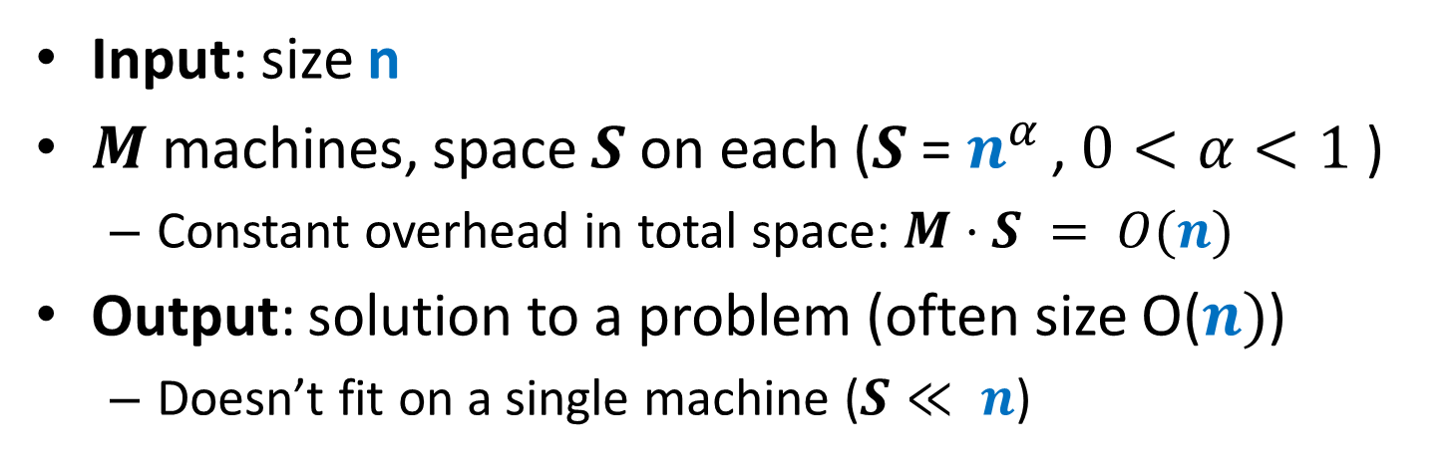

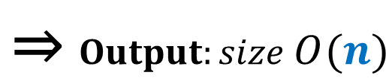
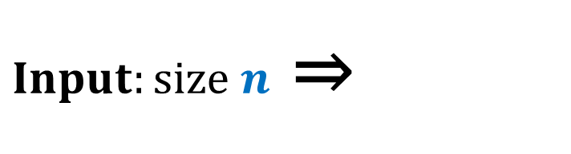
Computational Model
Input: size n
$M$ machines, space $S$ on each ($S$ = $n^{α }$, $0<α<1$ )
Constant overhead in total space: $M⋅S = O(n)$
Output: solution to a problem (often size O($n)$)
Doesn’t fit on a single machine ($S≪ n$)
$Input:size n$ ⇒
$$\text{⇒} Output:size O(n)$$
$M$machines
S space

Slide 3



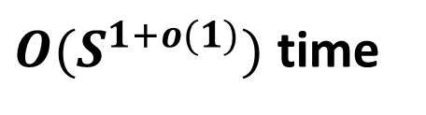
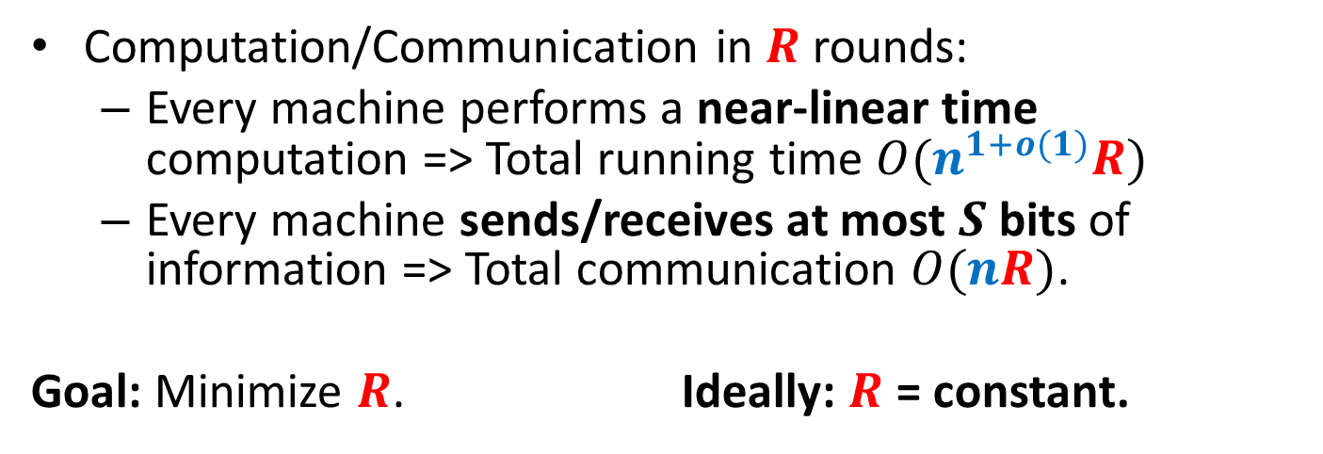
Computational Model
Computation/Communication in $R$ rounds:
Every machine performs a near-linear time computation => Total running time $O(n^{1+o(1)}R)$
Every machine sends/receives at most $S$ bits of information => Total communication $O(nR)$.
Goal: Minimize $R$. Ideally: $R$ = constant.
$≤S$ bits
$M$machines
S space
$O(S^{1+o(1)})$ time

Slide 4

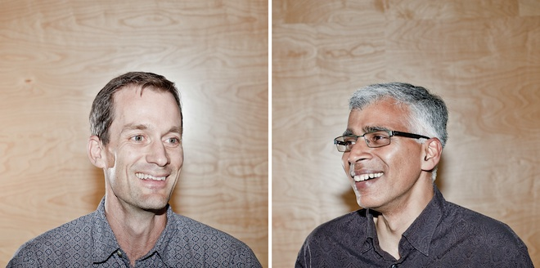


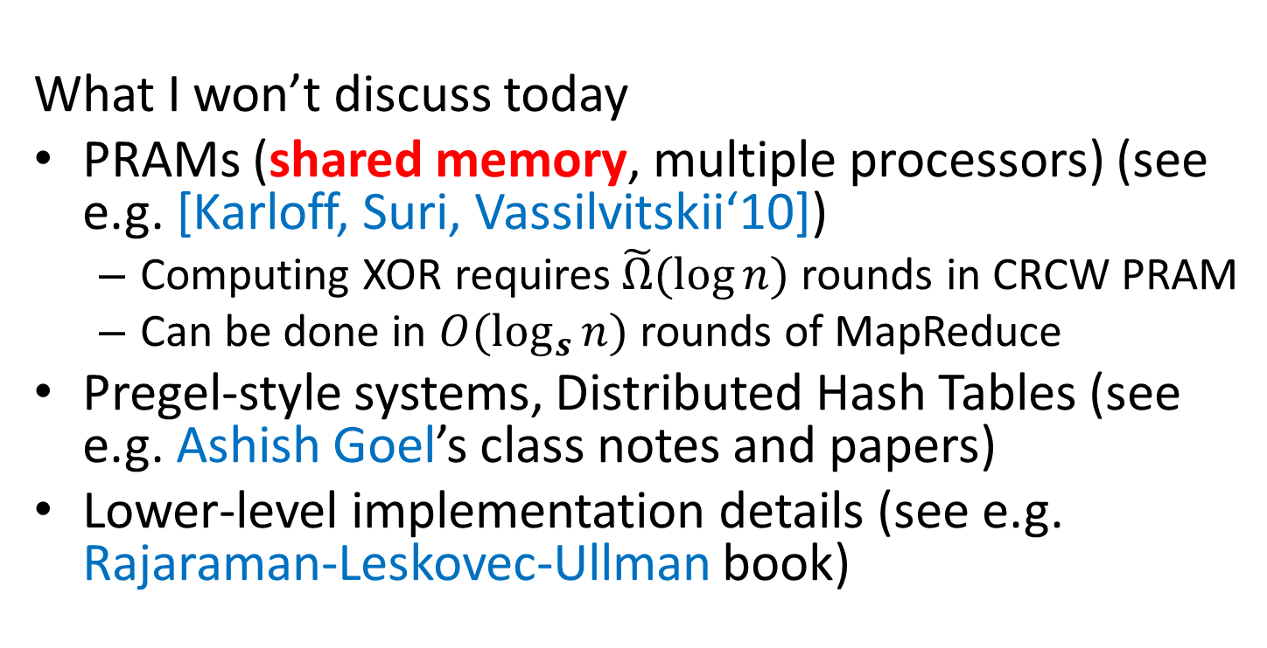
MapReduce-style computations
What I won’t discuss today
PRAMs (shared memory, multiple processors) (see e.g. [Karloff, Suri, Vassilvitskii‘10])
Computing XOR requires$\tilde{Ω}(\log{n})$ rounds in CRCW PRAM
Can be done in $O(\log_{s}{n})$ rounds of MapReduce
Pregel-style systems, Distributed Hash Tables (see e.g. Ashish Goel’s class notes and papers)
Lower-level implementation details (see e.g. Rajaraman-Leskovec-Ullman book)

Slide 5
Models of parallel computation
Bulk-Synchronous Parallel Model (BSP) [Valiant,90]
Pro: Most general, generalizes all other models
Con: Many parameters, hard to design algorithms
Massive Parallel Computation [Feldman-Muthukrishnan-Sidiropoulos-Stein-Svitkina’07, Karloff-Suri-Vassilvitskii’10, Goodrich-Sitchinava-Zhang’11, ..., Beame, Koutris, Suciu’13]
Pros:
Inspired by modern systems (Hadoop, MapReduce, Dryad, … )
Few parameters, simple to design algorithms
New algorithmic ideas, robust to the exact model specification
# Rounds is an information-theoretic measure => can prove unconditional lower bounds
Between linear sketching and streaming with sorting

Slide 6
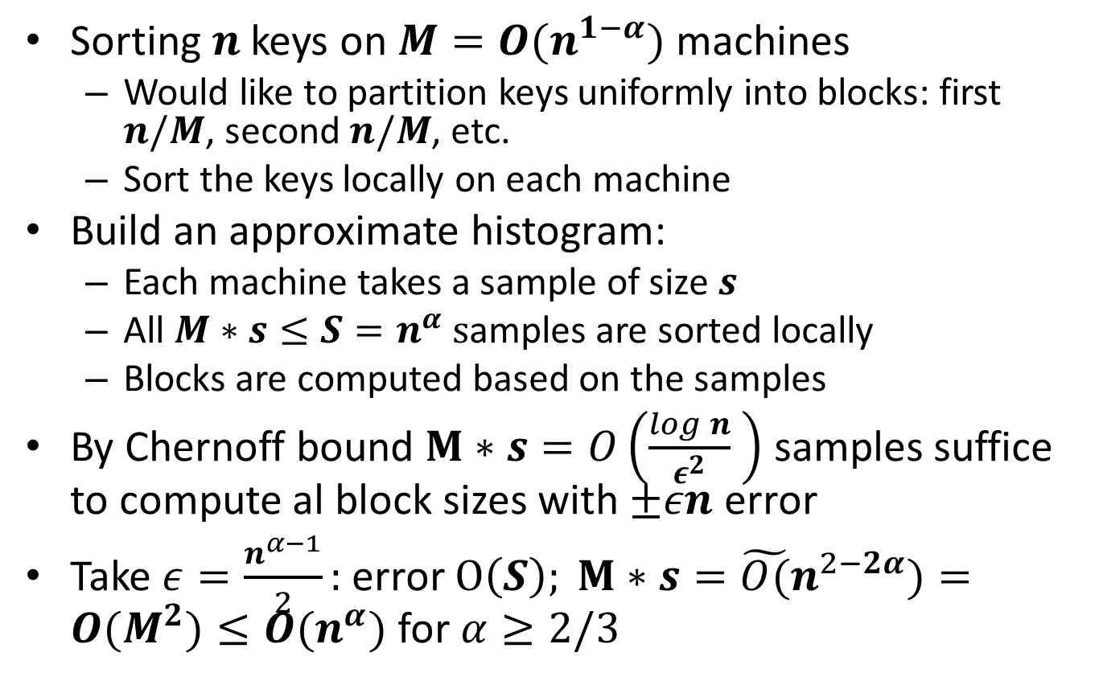
Sorting: Terasort
Sorting $n$ keys on $M=O(n^{1−α})$ machines
Would like to partition keys uniformly into blocks: first $n/M$, second $n/M$, etc.
Sort the keys locally on each machine
Build an approximate histogram:
Each machine takes a sample of size $s$
All $M∗s≤S=n^{α} s$amples are sorted locally
Blocks are computed based on the samples
By Chernoff bound $M∗s=O\left(\frac{log n}{ε^{2}} \right)$ samples suffice to compute al block sizes with $±εn$ error
Take $ε=\frac{n^{α−1}}{2}:$ error $O\left(S\right); M∗s={\tilde{O(}n}^{2−2α})=O(M^{2})≤O(n^{α})$ for $α≥2/3$

Slide 7
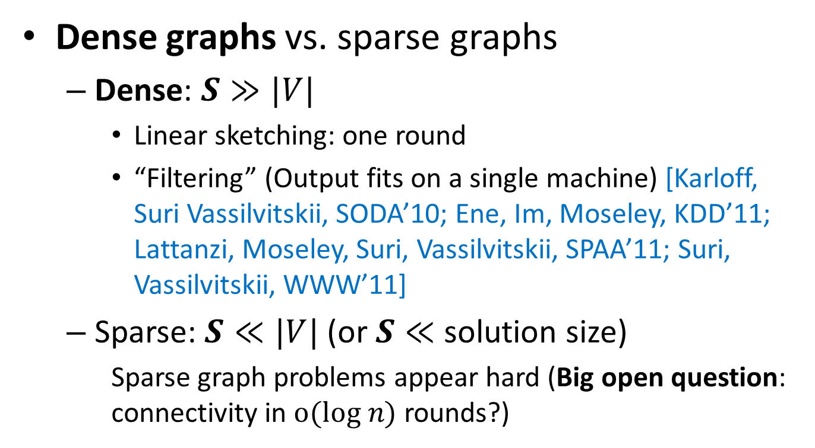
Algorithms for Graphs
Dense graphs vs. sparse graphs
Dense: $S≫|V|$
Linear sketching: one round
“Filtering” (Output fits on a single machine) [Karloff, Suri Vassilvitskii, SODA’10; Ene, Im, Moseley, KDD’11; Lattanzi, Moseley, Suri, Vassilvitskii, SPAA’11; Suri, Vassilvitskii, WWW’11]
Sparse: $S≪|V|$(or $S≪$ solution size)
Sparse graph problems appear hard (Big open question: connectivity in $o(log n)$ rounds?)
VS.

Slide 8
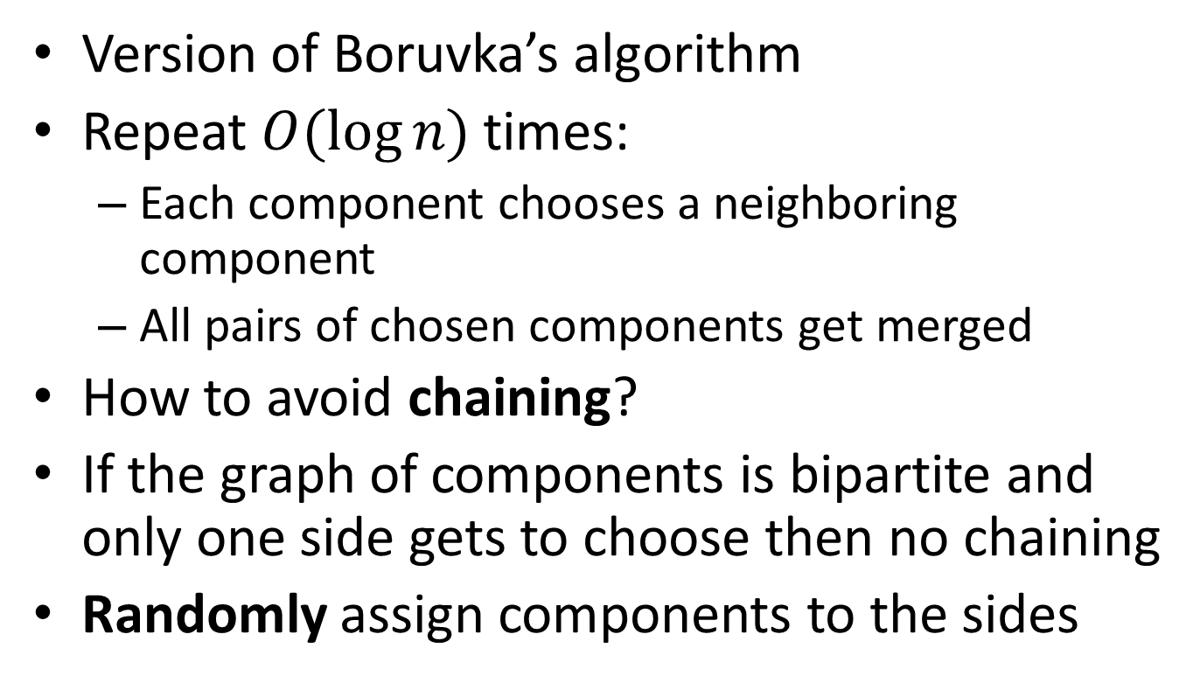
Algorithm for Connectivity
Version of Boruvka’s algorithm
Repeat $O(\log{n})$ times:
Each component chooses a neighboring component
All pairs of chosen components get merged
How to avoid chaining?
If the graph of components is bipartite and only one side gets to choose then no chaining
Randomly assign components to the sides

Slide 9
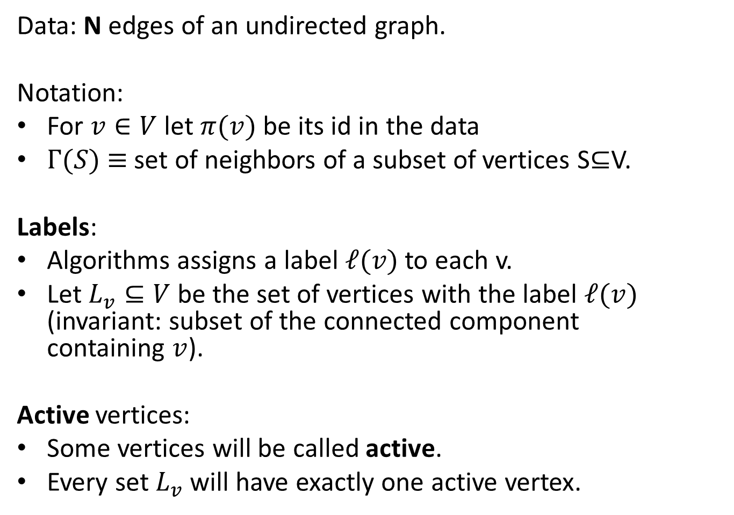
Algorithm for Connectivity: Setup
Data: N edges of an undirected graph.
Notation:
For $v∈V$ let $π(v)$ be its id in the data
$Γ(S)$ $≡$ set of neighbors of a subset of vertices S⊆V.
Labels:
Algorithms assigns a label $ℓ(v)$ to each v.
Let $L_{v}⊆V$ be the set of vertices with the label $ℓ(v)$ (invariant: subset of the connected component containing $v$).
Active vertices:
Some vertices will be called active.
Every set $L_{v}$ will have exactly one active vertex.

Slide 10
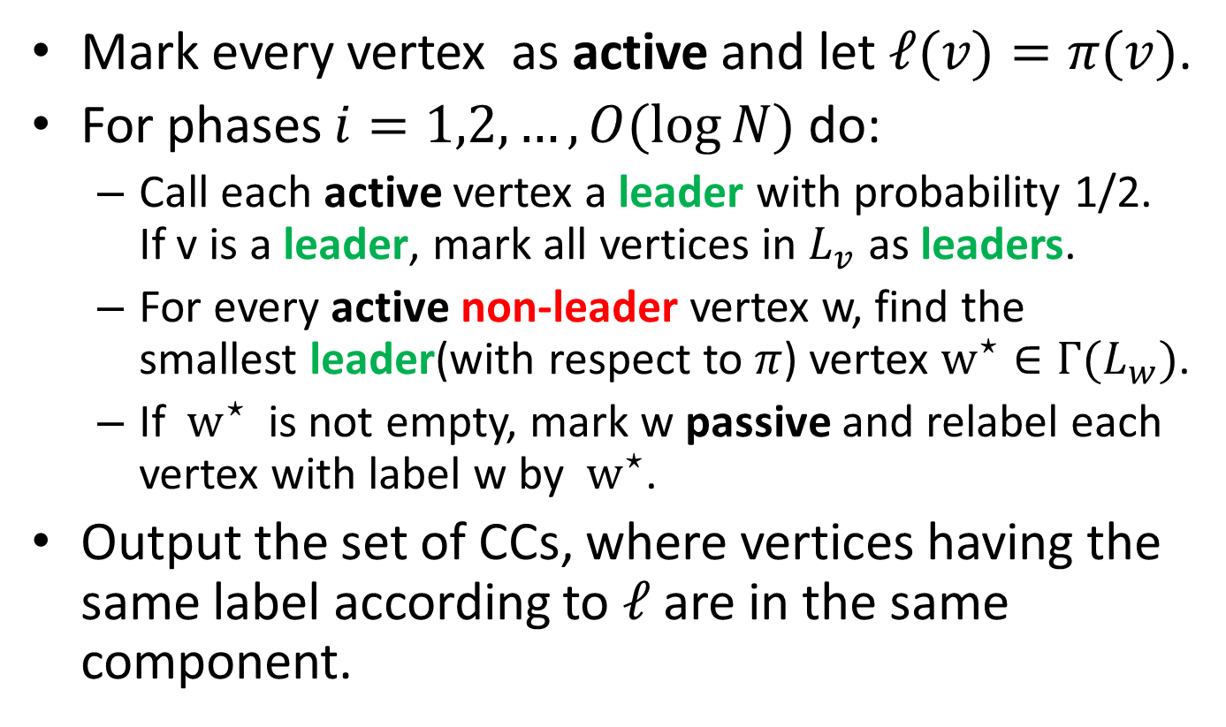
Algorithm for Connectivity
Mark every vertex as active and let $ℓ(v)=π(v)$.
For phases $i=1,2,…,O(log⁡N)$ do:
Call each active vertex a leader with probability 1/2. If v is a leader, mark all vertices in $L_{v}$ as leaders.
For every active non-leader vertex w, find the smallest leader(with respect to $π$) vertex $w^{⋆}∈Γ(L_{w})$.
If $w^{⋆}$ is not empty, mark w passive and relabel each vertex with label w by $w^{⋆}$.
Output the set of CCs, where vertices having the same label according to $ℓ$ are in the same component.

Slide 11
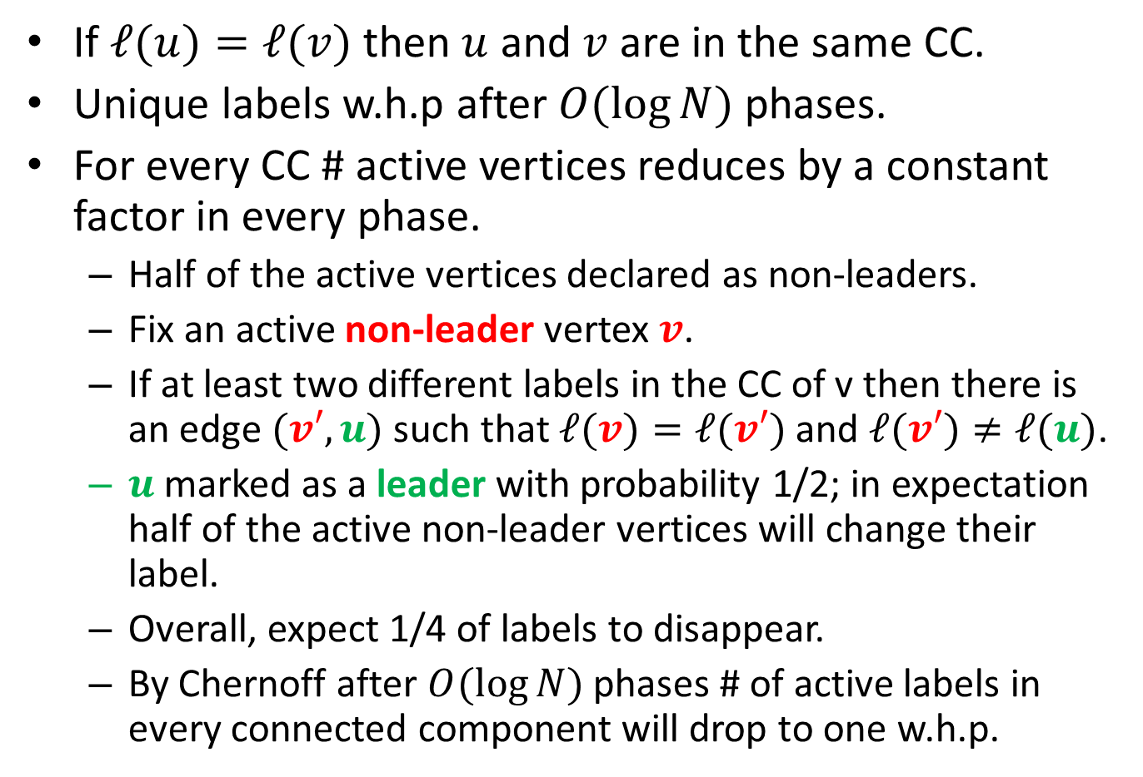
Algorithm for Connectivity: Analysis
If $ℓ(u)=ℓ(v)$ then $u$ and $v$ are in the same CC.
Unique labels w.h.p after $O(\log{N})$ phases.
For every CC # active vertices reduces by a constant factor in every phase.
Half of the active vertices declared as non-leaders.
Fix an active non-leader vertex $v$.
If at least two different labels in the CC of v then there is an edge $(v′,u)$ such that $ℓ(v)=ℓ(v′)$ and $ℓ(v′)≠ℓ(u)$.
$u$ marked as a leader with probability 1/2; in expectation half of the active non-leader vertices will change their label.
Overall, expect 1/4 of labels to disappear.
By Chernoff after $O(\log{N})$ phases # of active labels in every connected component will drop to one w.h.p.

Slide 12
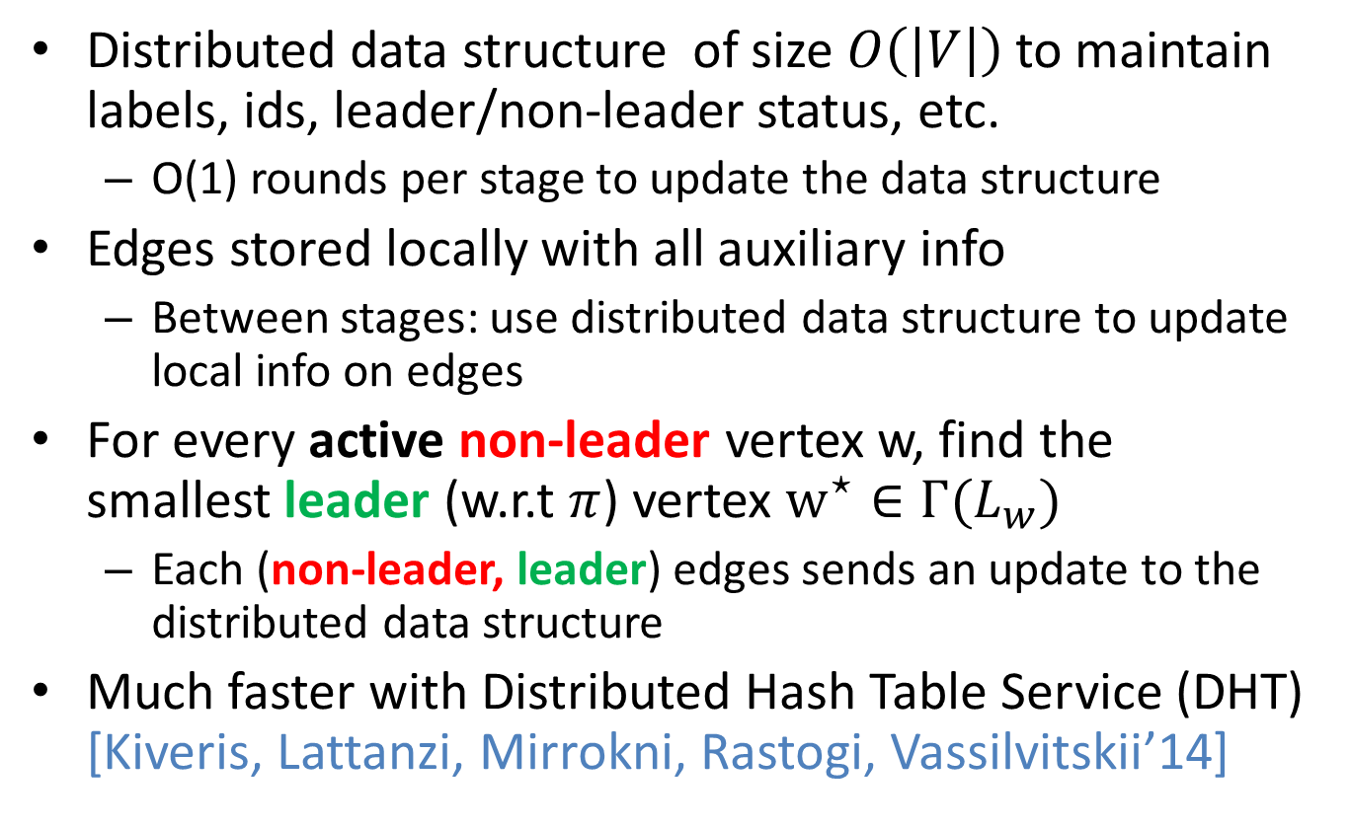
Algorithm for Connectivity: Implementation Details
Distributed data structure of size $O\left(\left|V\right|\right)$to maintain labels, ids, leader/non-leader status, etc.
O(1) rounds per stage to update the data structure
Edges stored locally with all auxiliary info
Between stages: use distributed data structure to update local info on edges
For every active non-leader vertex w, find the smallest leader (w.r.t $π$) vertex $w^{⋆}∈Γ(L_{w})$
Each (non-leader, leader) edges sends an update to the distributed data structure
Much faster with Distributed Hash Table Service (DHT) [Kiveris, Lattanzi, Mirrokni, Rastogi, Vassilvitskii’14]

Slide 13
Applications
Using same reductions as in streaming:
Bipartiteness
k-connectivity
Cut-sparsification

