Slide 1
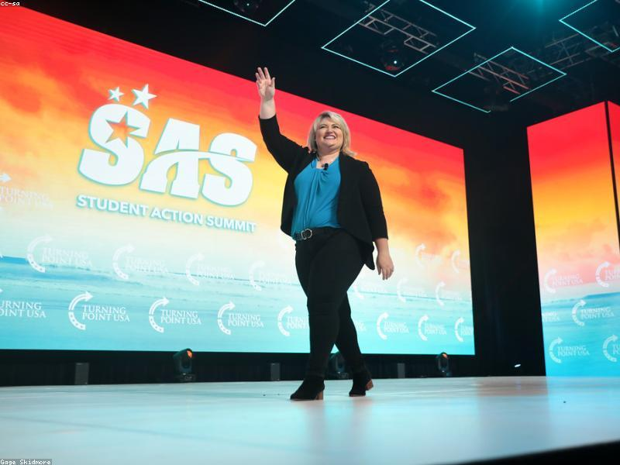
Create a 6-slide Presentation on the Student
Generated by MCP Auto-PPT Agent

