Slide 1
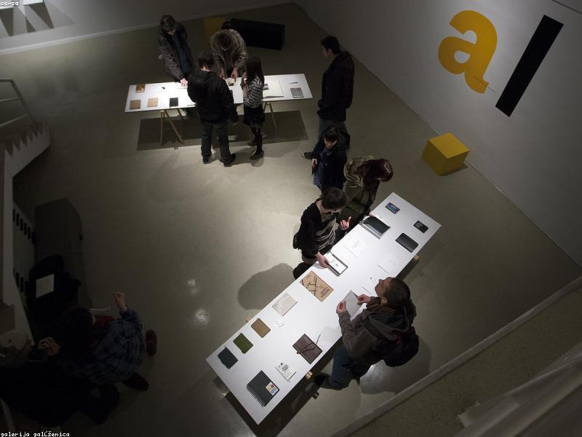
ABook Overview
Generated by MCP Auto-PPT Agent

