Slide 1
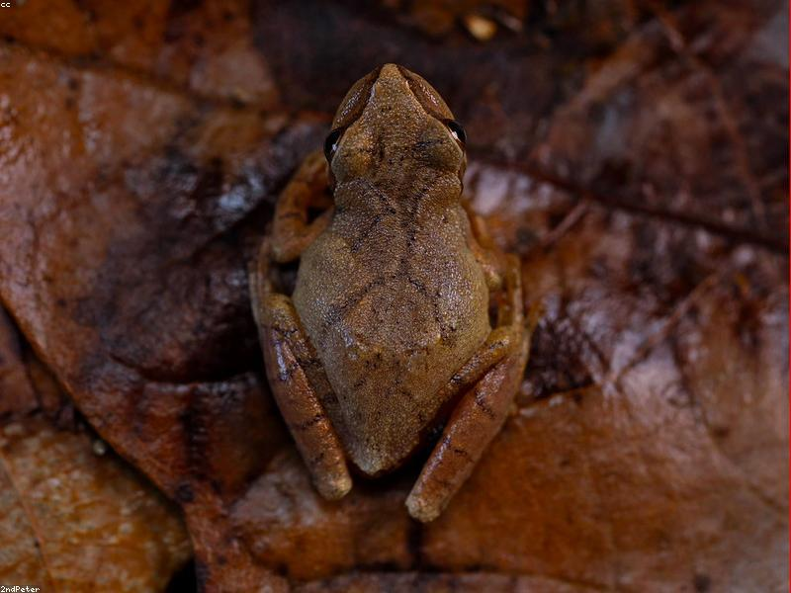
Life Cycle of a Frog
Generated by MCP Auto-PPT Agent

Slide 2
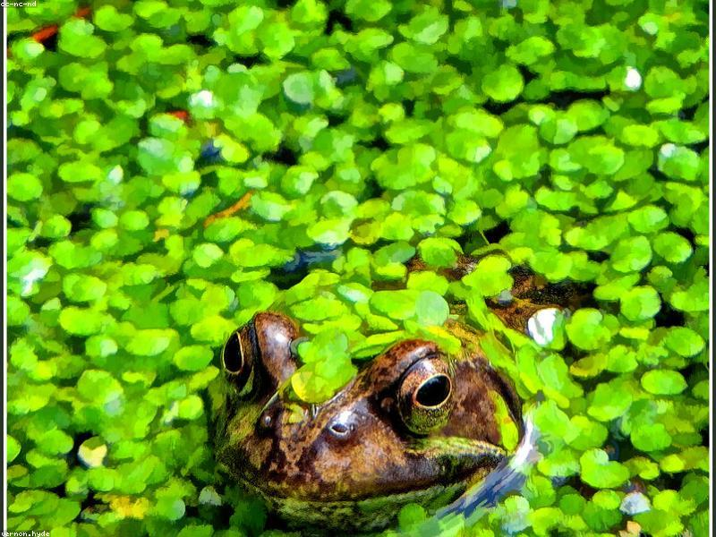
Egg Stage
Frogs lay hundreds of eggs in water, often encased in a protective jelly-like substance to enhance survival.
The developmental period for frog eggs ranges from 6 to 21 days, during which they transform into larvae.
A cluster of frog eggs is referred to as 'frogspawn' and plays a crucial role in the species' reproductive strategy.

Slide 3
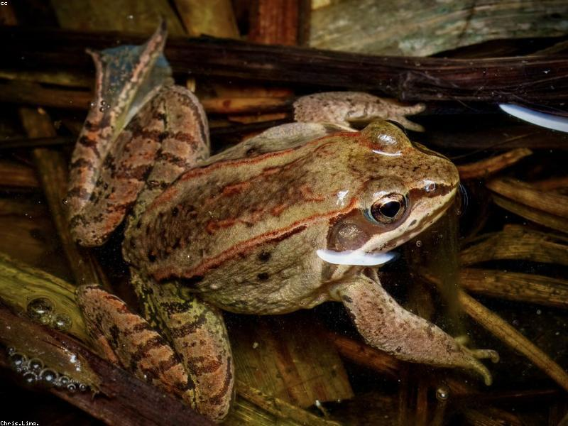
Metamorphosis
(No facts found)
During metamorphosis, the organism undergoes a transformation where hind legs and subsequently front legs develop, facilitating a shift to a terrestrial lifestyle.
As part of the metamorphosis process, the tail is gradually absorbed by the body, providing essential nutrients that support further development.
Metamorphosis involves the evolution of lungs to replace gills, enabling the organism to breathe air and adapt to new environmental conditions.

Slide 4
Adult Frog
Adult frogs are classified under the order Anura and are characterized by their fully developed hind legs, which are adapted for powerful jumping movements.
Their permeable skin is a key feature of adult frogs, facilitating respiration and osmoregulation, but necessitating a moist environment to prevent desiccation.
Carnivorous in nature, adult frogs employ a rapid tongue projection to capture insects and other small prey, showcasing their specialized feeding mechanism.

