Slide 1
Deep Learning-Based ADRD ePhenotyping with Fairness Analysis
Automated Detection of Alzheimer's Disease and Related Dementias
using Convolutional Neural Networks and Clinical Notes
AMIA 2025 Annual Symposium

Slide 2
Background & Motivation
Alzheimer's Disease and Related Dementias (ADRD) affect >6 million Americans
Early detection critical for intervention and care planning
Prior Work: Knox & Obeid developed ML models for ADRD detection
• Trained 7 models (RF, SVM, CNN) on MUSC clinical notes
• Strong overall performance demonstrated
Gap: Limited evaluation of algorithmic fairness across demographics
Need: Comprehensive fairness analysis and feature interpretability

Slide 3
Study Objectives
Building on Knox & Obeid's pre-trained CNN models
Aim 1: Evaluate model performance differences across demographics
• Assess performance across gender, race, ethnicity subgroups
• Test algorithmic fairness using approximate randomization
• Identify any systematic disparities in model predictions
Aim 2: Identify cohort-specific discriminative features
• Use Behavioral Testing to identify important features
• Apply explainable AI approaches (Chi-squared, TF-IDF)
• Analyze demographic-specific feature patterns

Slide 4
Dataset Description
Source: Electronic Health Records (EHR) clinical notes
Total Patients: 1,460 (after preprocessing)
• ADRD Cases: 657 (45.0%)
• Control Cases: 803 (55.0%)
Demographics:
• Gender: Female (828), Male (632)
• Race: White (1,013), Black (407), Other/Asian (31)
• Ethnicity: Non-Hispanic (1,441), Hispanic (14)
Notes: De-identified, preprocessed clinical documentation

Slide 5
Methodology: Evaluation Dataset
Enhanced Dataset from Knox & Obeid Study:
• Original: MUSC EHR clinical notes (pre-trained models)
• Enhancement: Added Social Determinants of Health (SDoH) data
• Source: MUSC Research Data Warehouse
Evaluation Cohort (N=1,460):
• ADRD cases: 657 (45.0%)
• Control cases: 803 (55.0%)
• Comprehensive demographic information
• De-identified clinical documentation

Slide 6
Methodology: Pre-trained CNN Model
Knox & Obeid's CNN Model (Previously Trained):
• Trained on MUSC clinical notes
• Convolutional Neural Network for text classification
• Binary output: ADRD vs. Control
Our Evaluation Approach:
• Applied pre-trained model to evaluation dataset
• Generated predictions for 1,460 patients
• 10 model cycles evaluated for stability
• Selected best performing cycle (Cycle 9) based on median AUC

Slide 7
Methodology: Fairness Evaluation (Aim 1)
Demographic Stratification:
• Evaluated performance across gender, race, ethnicity
• Intersectional analysis (Gender × Race combinations)
• Minimum sample size requirements enforced (N≥10)
Statistical Testing - Approximate Randomization:
• Permutation-based significance testing
• 1,000 iterations for null distribution
• Tests for AUC, sensitivity, specificity differences
• Significance threshold: α=0.05
Fairness Criteria:
• AUC parity: Variability within ±0.05 threshold
• Equalized odds: Similar sensitivity/specificity across groups

Slide 8
Methodology: Feature Analysis (Aim 2)
Behavioral Testing Approach:
• Systematic term removal from clinical notes
• Measure impact on model predictions
• Identify critical features for ADRD classification
Statistical Feature Analysis:
• Chi-squared (χ²) test for discriminative terms
• FDR correction for multiple testing (Benjamini-Hochberg)
• TF-IDF weighting for feature importance
Demographic-Stratified Analysis:
• Feature patterns across gender, race, ethnicity
• Identify cohort-specific terminology differences
• Assess feature consistency vs. variation

Slide 9
Results: Overall Model Performance
Best Model (Cycle 9) on Full Dataset (N=1,460):
✓ AUC: 0.987 (95% CI: 0.982-0.992)
✓ Accuracy: 94.3%
✓ Sensitivity: 97.3%
✓ Specificity: 91.8%
✓ Precision (PPV): 90.6%
✓ NPV: 97.6%
✓ F1 Score: 0.938
Confusion Matrix: 18 false negatives, 66 false positives
Calibration: Brier Score=0.044, Log Loss=0.163 (excellent)

Slide 10
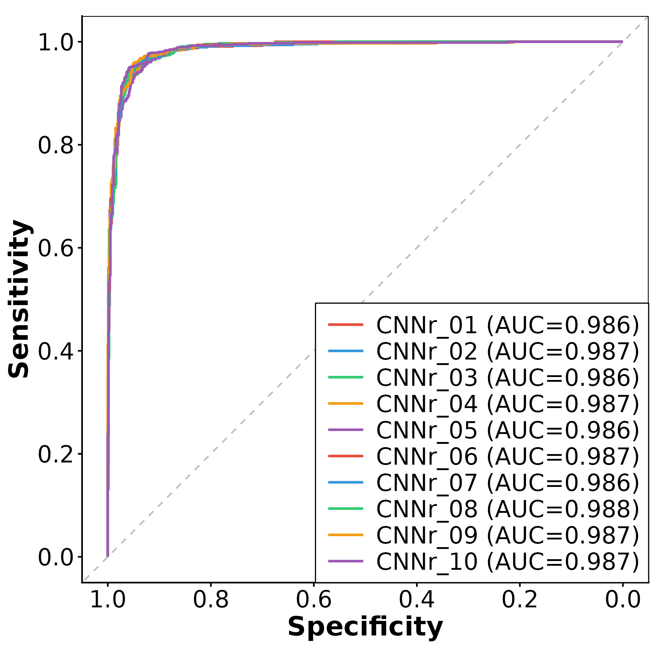
Results: Receiver Operating Characteristic (ROC) Curve
Figure 1: ROC curves across 10 model cycles showing consistently high AUC (>0.985)

Slide 11
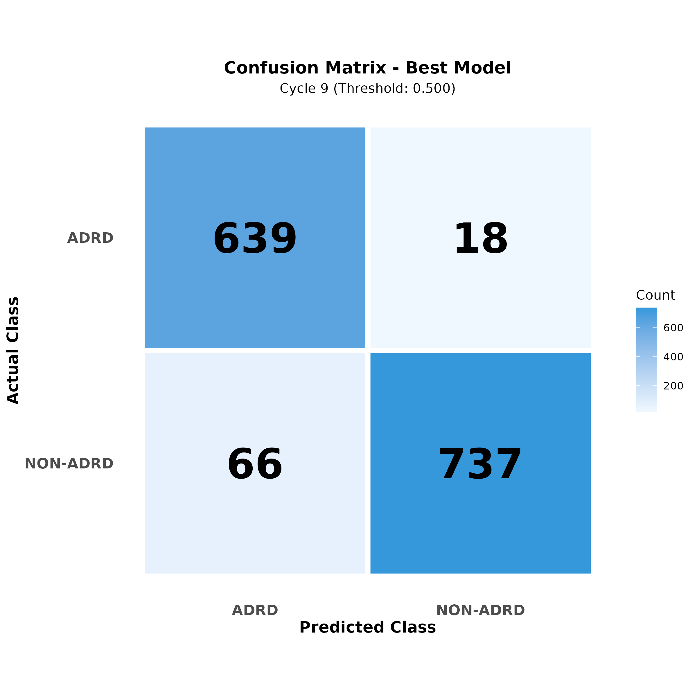
Results: Confusion Matrix
Figure 2: Confusion matrix showing excellent classification performance

Slide 12
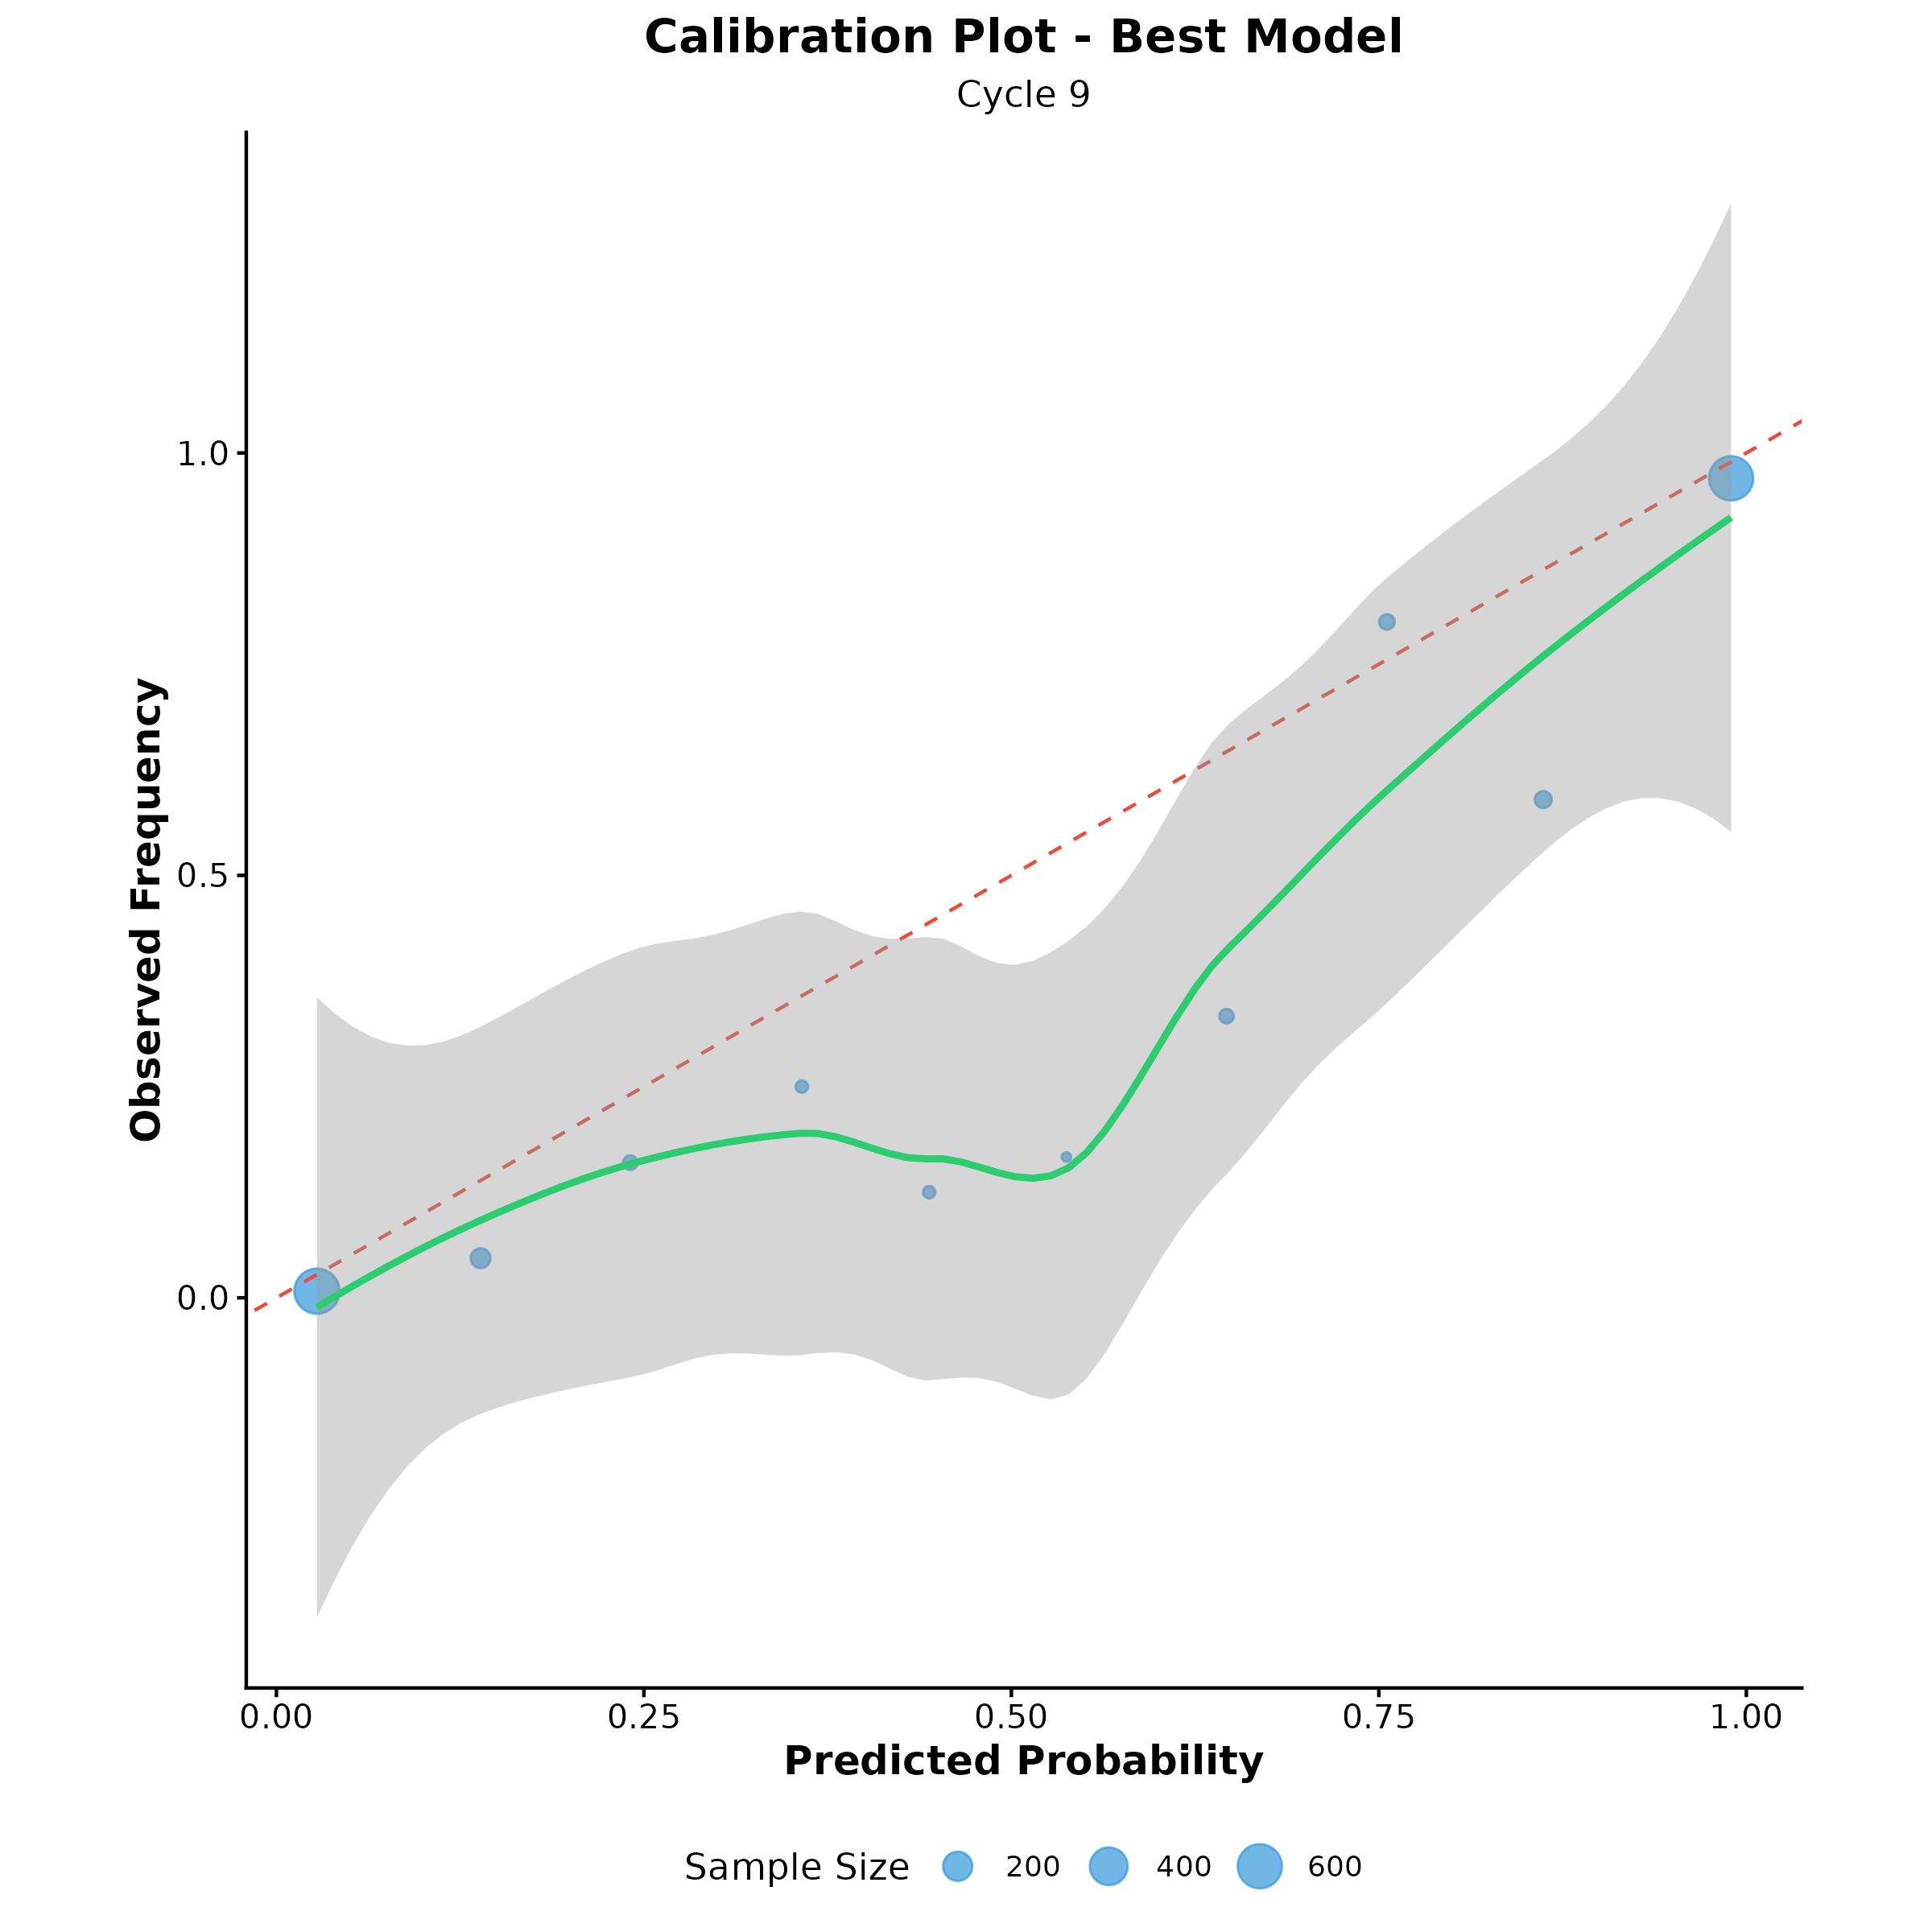
Results: Calibration Plot
Figure 3: Calibration curve demonstrating well-calibrated probability estimates

Slide 13
Results: Demographic Fairness Analysis (Aim 1)
Performance by Gender:
• Female (N=828): AUC=0.987, Sensitivity=98.4%
• Male (N=632): AUC=0.987, Sensitivity=95.7%
• Difference: <3% (within acceptable range ✓)
Performance by Race:
• White (N=1,013): AUC=0.985
• Black (N=407): AUC=0.989
• Variability: 0.027 (within ±0.05 threshold ✓)
Intersectional Analysis (Gender × Race):
• Best: Female × Black (AUC=0.991)
• Range: 0.007 across all intersections ✓

Slide 14
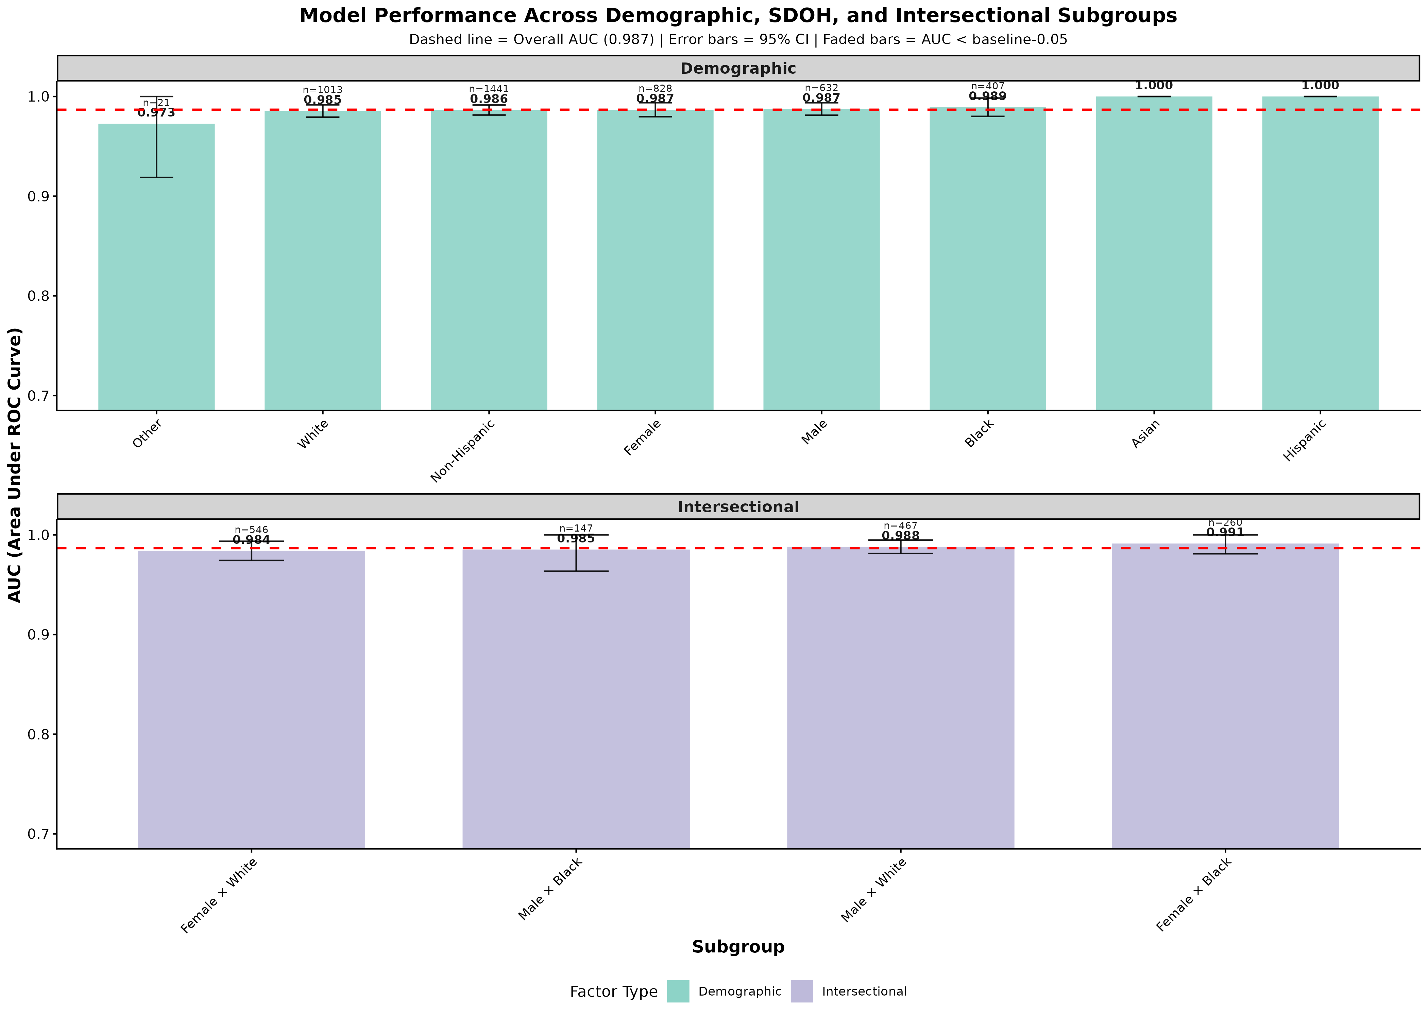
Results: Performance Across Demographic Subgroups
Figure 4: AUC across demographic subgroups showing equitable performance

Slide 15
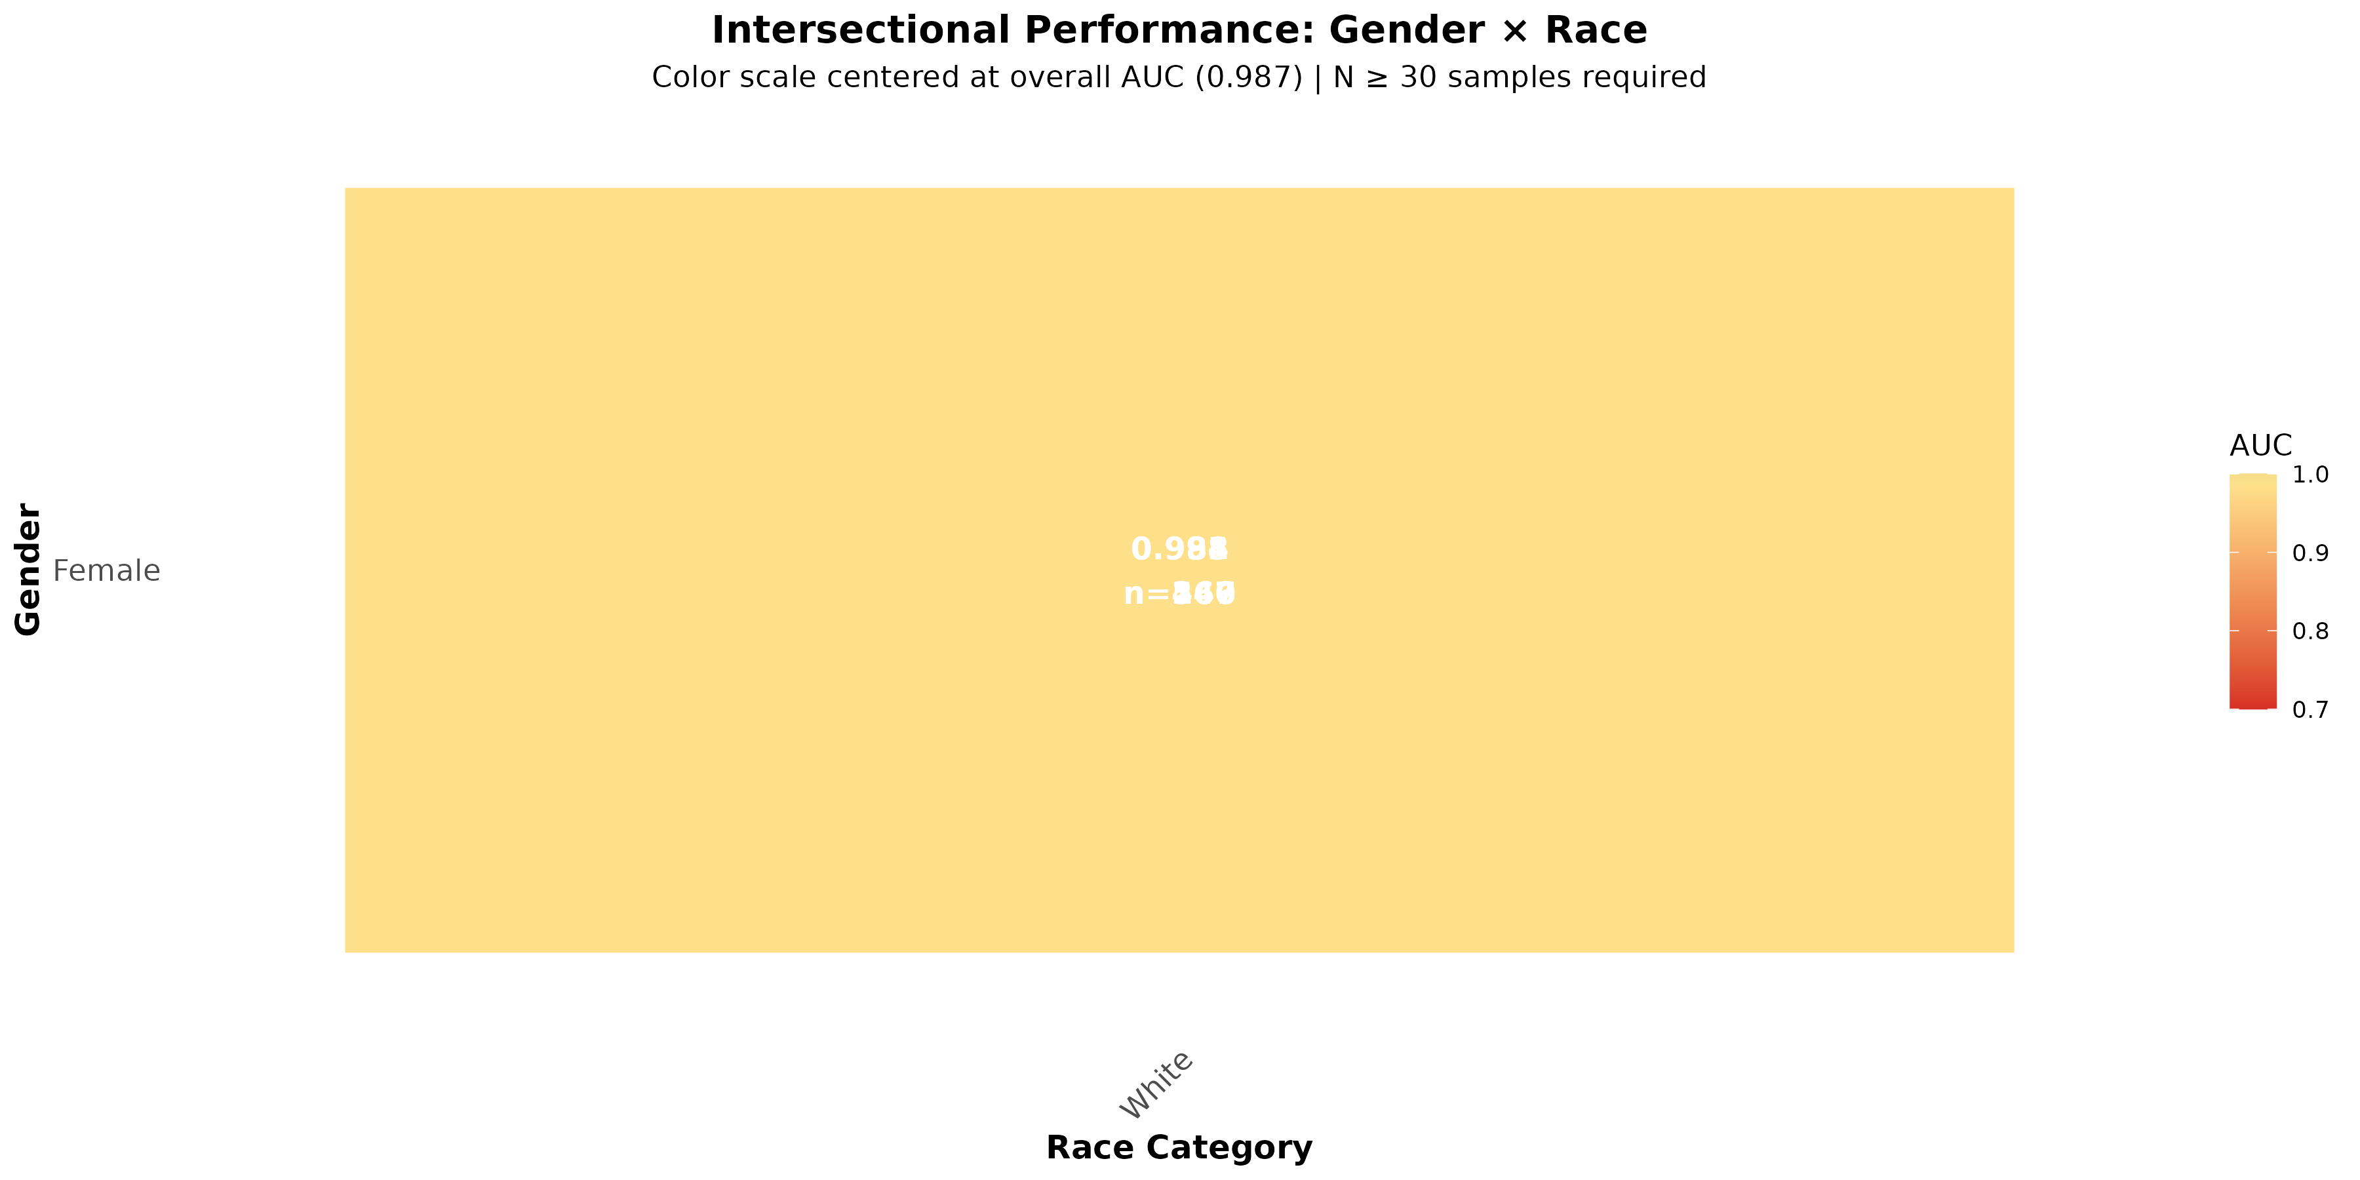
Results: Intersectional Fairness Analysis
Figure 5: Performance heatmap for Gender × Race intersections

Slide 16
Results: Discriminative Clinical Features (Aim 2)
Top ADRD-Associated Terms (χ² test, FDR<0.05):
• 'goal' (χ²=4,596), 'outcome' (χ²=4,377)
• 'ongoing' (χ²=3,696), 'progressing' (χ²=2,738)
• 'dementia' (χ²=1,850), 'admission' (χ²=1,830)
• 'care' (χ²=1,708), 'acute' (χ²=1,661)
Clinical Interpretation:
• Language reflects care planning and disease management
• Terms align with known ADRD clinical documentation patterns
• Consistent across demographic subgroups (70-90% overlap)

Slide 17
Results: TF-IDF Feature Importance (Aim 2)
Top TF-IDF Terms for ADRD (clinically relevant):
• High specificity terms: 'dementia', 'cognitive', 'impaired'
• Care-related: 'discharge', 'admission', 'inpatient'
• Clinical processes: 'goal', 'outcome', 'ongoing'
Demographic Variations:
• Female patients: Emphasis on 'care', 'assessment'
• Male patients: Focus on 'acute', 'admission'
• Black patients: Higher use of 'goal', 'care planning'
• White patients: More 'procedure', 'discharge' terms
Finding: Feature patterns differ but performance remains equitable

Slide 18
Discussion: Key Findings
1. Exceptional Performance Maintained:
• Knox & Obeid's CNN: AUC=0.987 on evaluation dataset
• Consistent performance across 10 model cycles
• Excellent calibration (Brier=0.044)
2. Algorithmic Fairness Confirmed (Aim 1):
• No significant disparities across gender, race, ethnicity
• Approximate randomization tests: all p>0.05
• Performance variance within ±0.05 AUC threshold
• Intersectional analysis: equitable outcomes
3. Interpretable Features Identified (Aim 2):
• Discriminative terms align with clinical knowledge
• Feature patterns consistent across demographics (70-90% overlap)
• Behavioral testing validates feature importance

Slide 19
Discussion: Clinical Implications
Potential Applications:
• Automated ADRD screening in large patient populations
• Early detection support for clinicians
• Risk stratification for preventive interventions
• Reduction of manual chart review burden
Implementation Considerations:
• Integration with EHR systems
• Real-time prediction at point of care
• Clinician-in-the-loop validation
• Continuous monitoring for model drift
Ethical AI:
• Demonstrated fairness across demographic groups
• Transparent feature analysis for clinical validation
• Framework for responsible AI deployment in healthcare

Slide 20
Limitations & Future Work
Study Limitations:
• Single-site data (MUSC) - generalizability needs validation
• Small sample sizes for some demographic subgroups
• Evaluation limited to one CNN model architecture
• Temporal validation not performed
• No external validation dataset
Future Directions:
• Multi-site external validation
• Prospective clinical trial for real-world deployment
• Temporal validation across different time periods
• Compare fairness across multiple model architectures
• Integration with structured EHR data (labs, vitals)
• LIME/SHAP explanations for individual predictions

Slide 21
Conclusions
✓ Evaluated Knox & Obeid's CNN model on diverse cohort
(AUC=0.987, Sensitivity=97.3%, Specificity=91.8%)
✓ Confirmed algorithmic fairness across demographics (Aim 1)
(Approximate randomization: no significant disparities)
(Performance variance within ±0.05 AUC threshold)
✓ Identified interpretable discriminative features (Aim 2)
(Behavioral testing + statistical feature analysis)
(70-90% feature consistency across demographic groups)
Contributions:
• Rigorous fairness evaluation framework for ADRD models
• Evidence of equitable performance across diverse populations
• Explainable AI approach for clinical feature validation

Slide 22
Acknowledgments
Study Team:
• Frederick Gyasi - Principal Investigator
• Jihad Obeid - Co-Investigator
Prior Work:
• Knox & Obeid - Original CNN model development
Funding:
• [Your Funding Source]
Data:
• MUSC Research Data Warehouse
IRB Approval:
• Protocol #[Number]
Questions?
• Email: [your-email]
• GitHub: github.com/gyasifred/adrd_ePheno

