Slide 1
Cloud & Autonomous Overview
George Yates
Solution Engineer, Oracle
Notes:
Introduce yourself – Your Journey, your passion –tech/non-tech
Get into the Role of a Solutions Engineer presenting to customers that are only barely aware of cloud computing
- Here to make our products work for you

Slide 2



The Most Complete Cloud
DaaS
SaaS
PaaS
CLOUD
IaaS
Copyright © 2018 Oracle and/or its affiliates. All rights reserved.
Notes:
Today you are going to explain why Oracle is the most complete cloud
Suggestion: https://www.youtube.com/watch?v=M-muLK1i-OA to get a better understanding of what Oracle offers –so you can talk to slides that follow better.

Slide 3
The Most Complete Cloud
Infrastructure-as-a-Service
Hardware and software that powers it all – servers, storage, networks, operating systems
DaaS
DaaS
SaaS
SaaS
PaaS
PaaS
CLOUD
IaaS
IaaS
Copyright © 2018 Oracle and/or its affiliates. All rights reserved.
Notes:
Fundamental cloud service that combines best-in-class networking, compute and storage

Slide 4
The Most Complete Cloud
Platform-as-a-Service
Set of tools and services designed to make coding and deploying those applications quick and efficient
DaaS
DaaS
SaaS
SaaS
PaaS
PaaS
CLOUD
IaaS
IaaS
Copyright © 2018 Oracle and/or its affiliates. All rights reserved.
Notes:
Our Platform as a Service layer: Oracle offers the broadest range of PaaS services in the industry that enables developers, IT professionals, and business leaders to develop, extend, and secure applications that leverage advanced analytics.

Slide 5
The Most Complete Cloud
Software-as-a-Service
Applications are designed for end-users, delivered over the web
DaaS
DaaS
SaaS
SaaS
PaaS
PaaS
CLOUD
IaaS
IaaS
Copyright © 2018 Oracle and/or its affiliates. All rights reserved.
Notes:
Our Software as a Service layer: Oracle offers the most integrated, complete Cloud suite of SaaS applications, enabling customers to modernize their business using the latest technologies such as artificial intelligence and machine learning.
services on demand

Slide 6
The Most Complete Cloud
The Most Complete Cloud
Data-as-a-Service
Data Cloud provides data from a wide variety of Oracle and third-party sources that customers can leverage for deeper insights into their clients to enable modern marketing campaigns.
DaaS
DaaS
SaaS
SaaS
PaaS
PaaS
CLOUD
CLOUD
IaaS
IaaS
Copyright © 2018 Oracle and/or its affiliates. All rights reserved.
Notes:
On top is Data as a Service layer.
Data Cloud provides data from a wide variety of Oracle and third-party sources that customers can leverage for deeper insights into their clients to enable modern marketing campaigns.

Slide 7
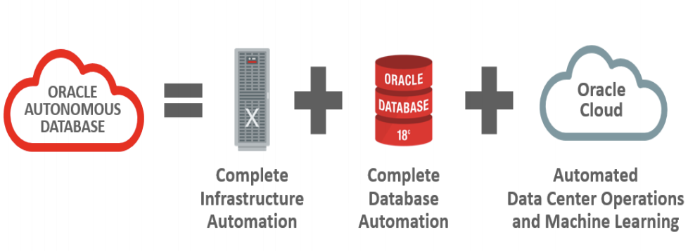
Autonomous Database
Oracle’s Autonomous Database offers a cloud based data storage service that is self-driving, self-securing, and self-repairing, giving you a database that is run at maximum efficiency, while freeing up your workforce to generate value for the enterprise.
Notes:
1. Using links above, review information about Oracle’s Autonomous Database –
2. Build a slide to communicate what is an Autonomous Database and why is the best course of action for a customer looking to store data in the cloud.
https://www.oracle.com/database/autonomous-database.html
https://www.oracle.com/database/autonomous-database/feature.html

Slide 8
Questions?

