Slide 1
AI Tutorial Presentation – Level 1
Outline
Date of Revision – 9/6/25
Key Resource Links
Generative AI
Chatbots
ChaGPT
References

Slide 2
Key Resource Links
https://academy.openai.com
https://academy.openai.com/home
(knowledge and skills related to AI)
https://aistudio.google.com
(a powerful, web-based IDE that makes it easy to prototype, explore, and build with Google’s advanced generative AI models)
https://anthropic.skilljar.com/
(Anthropic’s training and learning portal hosted on Skilljar)
https://www.canva.com
(A graphic design tool)
https://claude.ai/new
(A web-based interface to interact with Claude, Anthropic’s large language model, LLM)

Slide 3
Key Resource Links Continued
https://www.genspark.ai/agents
(a no-code AI agent platform that helps users automate complex tasks using simple prompts)
https://generativeai.pub/
(All the latest news and updates on generative AI space)
https://github.com/microsoft/AI-For-Beginners
(Various AI courses and labs)
https://ai.meta.com/get-meta-ai
(AI assistant that's integrated across Meta’s ecosystem)
https://huggingface.co
(Models, Datasets, Spaces, Tasks, Learn, Docs)

Slide 4
Key Resource Links Continued
https://www.linkedin.com/feed/
(Various information)
https://www.mygreatlearning.com/ai/free-courses
(Free AI Courses)
https://www.genspark.ai/agents
(a no-code AI agent platform that helps users automate complex tasks using simple prompts)
https://generativeai.pub/
(All the latest news and updates on generative AI space)
https://github.com/microsoft/AI-For-Beginners
(Various AI courses and labs)
https://ai.meta.com/get-meta-ai
(AI assistant that's integrated across Meta’s ecosystem)

Slide 5
AI
Artificial Intelligence (AI):
Simulation of human intelligence by machines
Goal:
Enable machines to perform tasks that require human-like reasoning, learning, and decision-making.
Types of AI:
Narrow AI (Weak AI):
Specialized in specific tasks (e.g., Siri, Google Translate)
General AI (Strong AI):
Hypothetical AI that can perform any intellectual task like a human.
Super AI:
Future AI surpassing human intelligence.

Slide 6
AI Continued
Key Technologies
Machine Learning (ML)
Deep Learning (DL)
Natural Language Processing (NLP)
Computer Vision
Robotics
Common Applications:
Virtual assistants (e.g., Alexa, ChatGPT)
Autonomous vehicles
Healthcare diagnostics
Recommendation systems (Netflix, Amazon)
Fraud detection

Slide 7
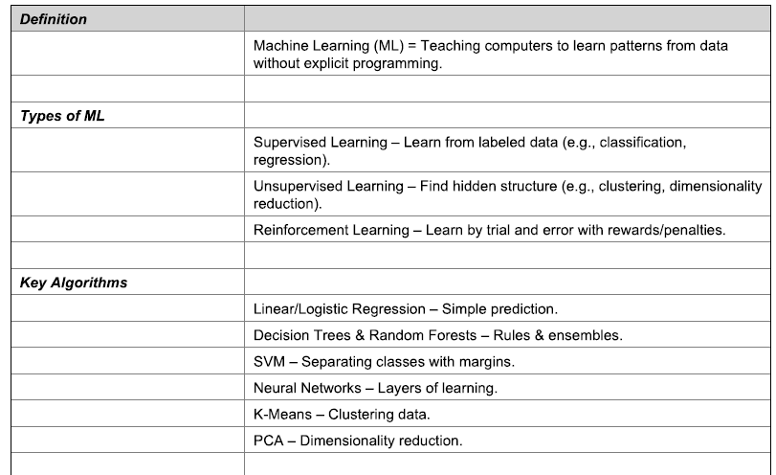
ML

Slide 8
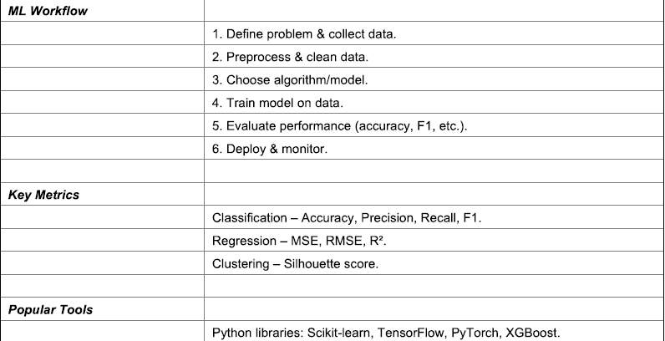
ML Continued

Slide 9
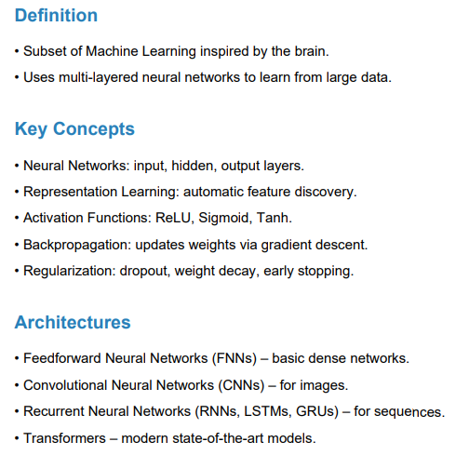
DL (Deep Learning)

Slide 10
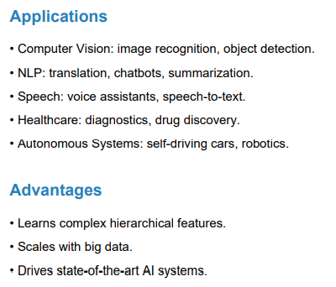
DL (Deep Learning) Continued

Slide 11
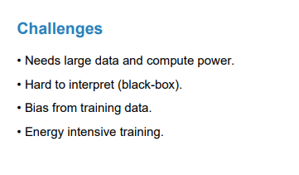
DL (Deep Learning) Continued

Slide 12
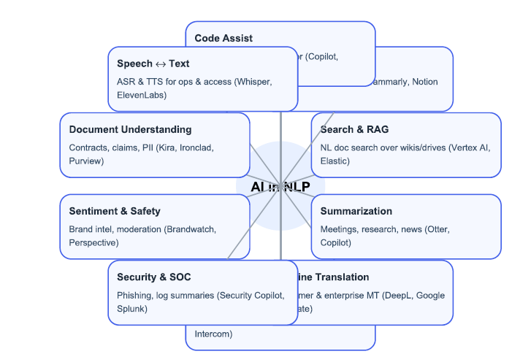
NLP (Natural Language Processing)

Slide 13
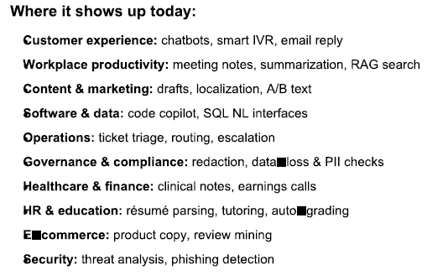
NLP Continued

Slide 14
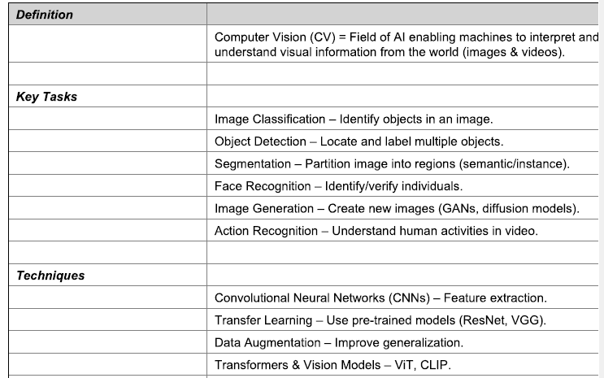
Computer Vision

Slide 15
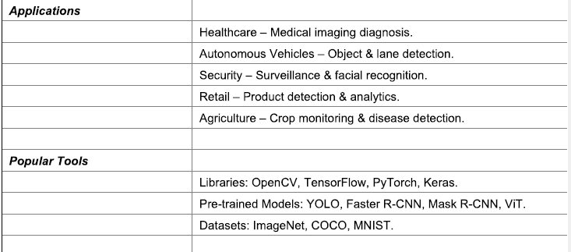
Computer Vision Continued

Slide 16
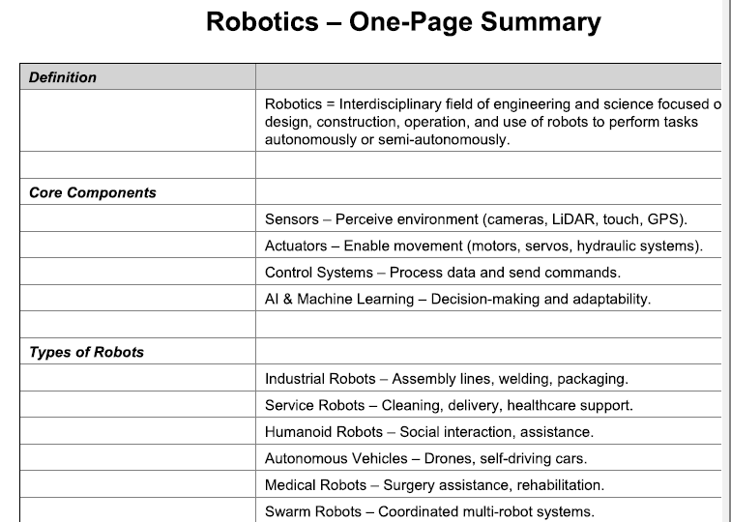
Robotics

Slide 17
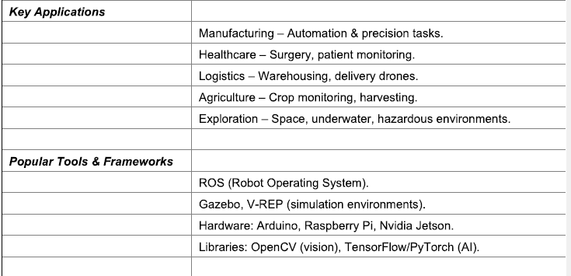
Robotics Continued

Slide 18
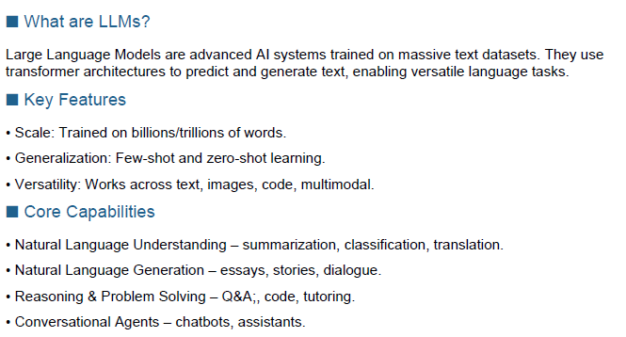
LLM

Slide 19
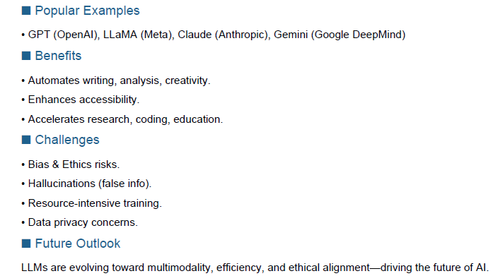
LLM Continued

Slide 20
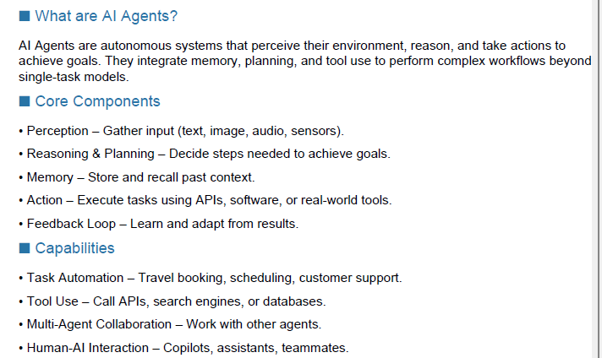
AI Agents

Slide 21
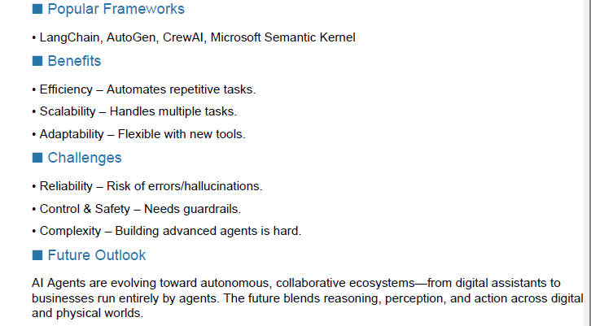
AI Agents Continued

Slide 22
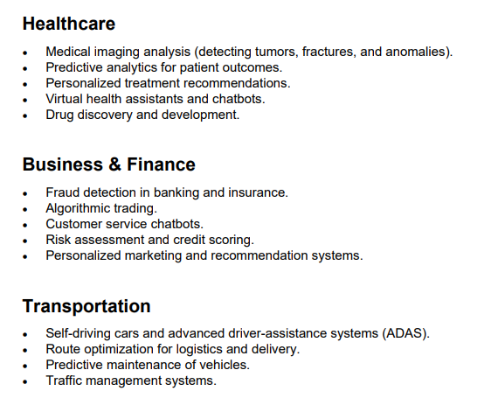
Common Applications of AI

Slide 23

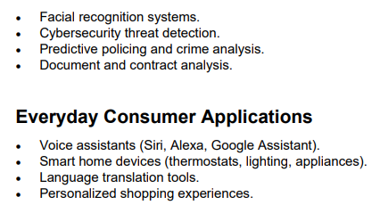
Common Applications of AI Continued

Slide 24
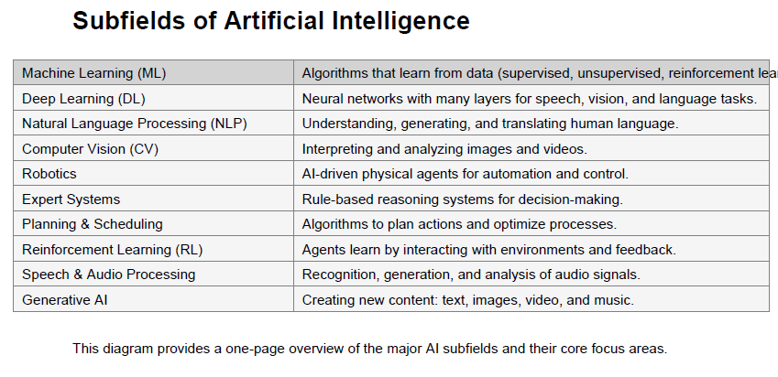
Subfields of AI

Slide 25
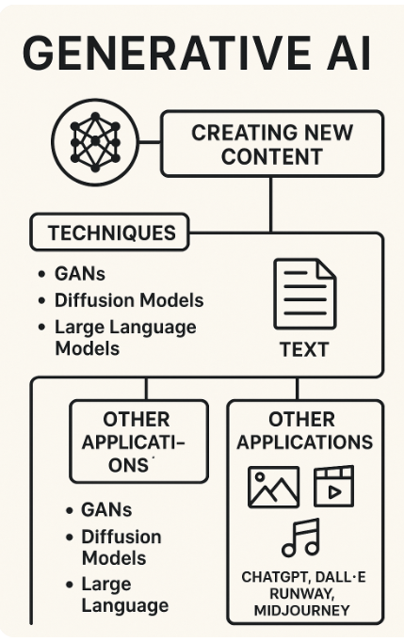
Generative AI

Slide 26
Chatbots
https://docs.base44.com
https://claude.ai/new
https://www.deepseek.com/en
https://gemini.google.com/app
https://aistudio.google.com/prompts/new_chat
https://grok.com
https://x.ai/grok
https://openai.com/
https://www.perplexity.ai/

Slide 27
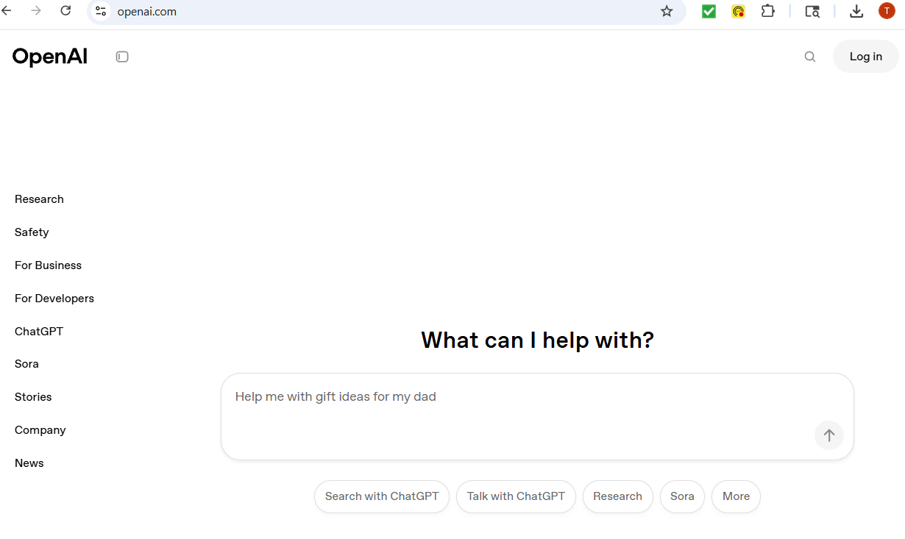
Openai - ChatGPT
https://openai.com/

Slide 28
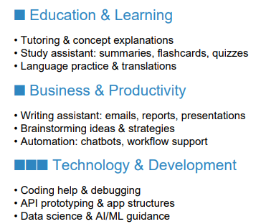
Applications of ChatGPT

Slide 29
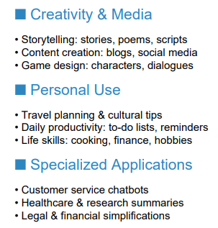
Applications of ChatGPT Continued

Slide 30
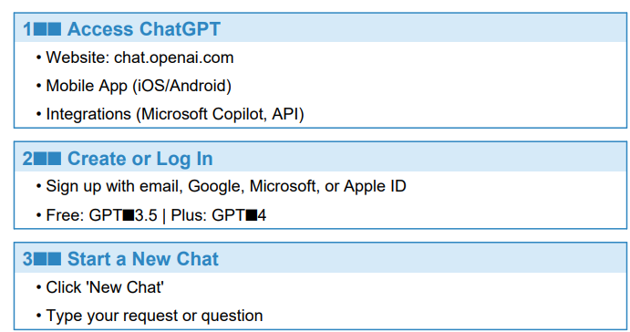
How to Use ChatGPT – Quick Start Guide

Slide 31
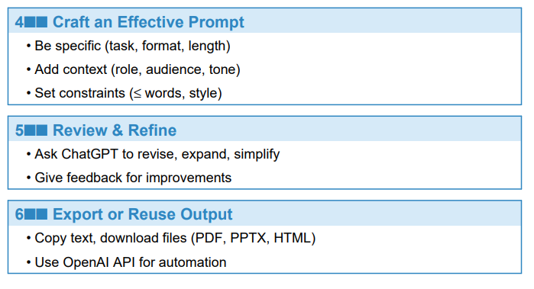
ChatGPT Quick Start Guide Continued

Slide 32
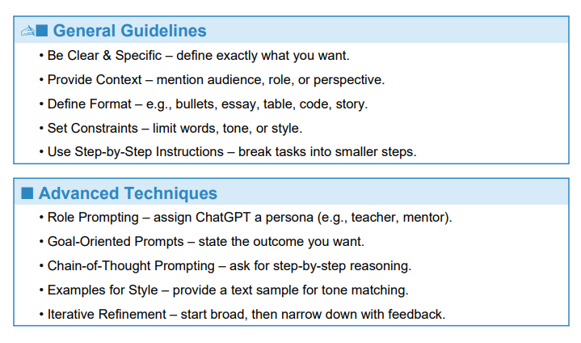
ChatGPT Prompt Writing Guidelines

