Slide 1
Introductory Level
Generative AI And Chatbots Tun Aung Gyaw
Date of Revision September 6th, 2025

Slide 2
Platforms
Suppa : It is a platform that enables users to create smart AI chatbots designed to enhance customer trust
AnythingLLM is an all-in-one AI application designed to be flexible, secure, and private
Ape: an AI prompt engineer designed to enhance the performance of language model applications
AI writing tools automate various writing tasks, such as grammar and spelling checks, which speeds up the writing and editing process
Capitol AI is a platform focused on data storytelling powered by generative AI

Slide 3
Platforms Continued
Llama 3.2 : https://www.llama.com/
Azure: https://azure.microsoft.com/en-us/products/ai-services/ai-translator
Microsoft-Copilot Mode for Edge Browser

Slide 4
Tools and Platforms -1
Tonic → Synthetic data for AI developers
Ducky → AI for customer support teams
Sierra → Conversational AI for your customers
Layerpath → Interactive product demos with AI
Notable → AI platform for healthcare operations
Hugging Face launches HuggingChat Assistants
Google Maps adds new generative AI features
Google releases MobileDiffusion, on-device text-to-image
Amazon unveils Rufus for AI-assisted shopping

Slide 5
Tools and Platforms - 2
Meta labels AI-generated images across platformsOpenAI adds C2PA metadata to DALL·E 3 images
OpenAI adds C2PA metadata to DALL·E 3 images
Microsoft collaborates with journalists on AI newsrooms
Apple releases MGIE for AI image editing
Apple publishes paper on new approach to speech recognition
Cedars-Sinai launches AI health app for Apple Vision Pro
Hong Kong firm loses $25 million in deepfake heist
Website uses AI to generate fake IDs
FCC bans AI voices in robocalls

Slide 6
Reference - History of AI - 1
Groundwork for AI
(1921- Rossum’s Universal Robots)
(1929 - Gakutensoku.)
(1949 - Giant Brains, or Machines that Think)
Birth of AI: 1950-1956
(1950 - Computer Machinery and Intelligence)
(1952 - Arthur Samuel - a program to play checkers)
(1955 - John McCarthy – 1st use of artificial intelligence)
AI maturation: 1957-1979
1958: John McCarthy created LISP
1959: Arthur Samuel created the term “machine learning
1961: The first industrial robot Unimate

Slide 7
Reference - History of AI - 2
AI maturation: 1957-1979
1965:Edward Feigenbaum and Joshua Lederberg created the first expert system
1966: Joseph Weizenbaum – ELIZA - chatbot – NLP
1973 - James Lighthill - strides were not as impressive, Reduced funding
1979: James L. Adams created The Standford Cart, an autonomous vehicle
1979: (AAAI)

Slide 8
Reference - History of AI -3
AI boom: 1980-1987
1980: First conference of the AAAI
1980: The first expert system in commercial market, known as XCON
1981: The Japanese government allocated $850 million (over $2 billion dollars in today’smoney) to the Fifth Generation Computer project
1984: The AAAI warns of an incoming “AI Winter”
1985: An autonomous drawing program known as AARON is demonstrated at the AAAIconference.
1986: Ernst Dickmann and his team at Bundeswehr University of Munich created 1st driverless car
1987: Commercial launch of Alacrity 1st strategy managerial advisory system, a complex expert system with 3,000+ rules

Slide 9
Reference – History of AI -4
1987: Department of CS - RASU (Burma) – Development of Expert systems, Burmese Language Processing, Semantic Graphs, Development of Robot Control Language, Development of LISP, Prolog interpreters
AI winter: 1987-1993
AI agents: 1993-2011
1997: Deep Blue (developed by IBM) beat the world chess champion, Gary Kasparov
1997: Windows released a speech recognition software (Dragon)
2000: Professor Cynthia Breazeal developed the first robot that could simulate human emotions with its face
2002: The first Roomba was released.

Slide 10
Reference - History of AI -5
AI agents: 1993-2011
2003: Nasa landed two rovers onto Mars (Spirit and Opportunity) and they navigated the surface of the planet without human intervention
2006: Companies such as Twitter, Facebook, and Netflix started utilizing AI as a part oftheir advertising and user experience (UX) algorithms
2010: Microsoft launched the Xbox 360 Kinect, the first gaming hardware designed to track body movement and translate it into gaming directions

Slide 11
Reference – History of AI - 6
2011: An NLP computer programmed to answer questions named Watson (created byIBM) won Jeopardy against two former champions in a televised game
2011: Apple released Siri, the first popular virtual assistant
Artificial General Intelligence: 2012-present
2012: Google (Jeff Dean and Andrew Ng) - a neural network to recognize cats by showing it unlabeled images and no background information.
2015: Elon Musk, Stephen Hawking, and Steve Wozniak (and over 3,000 others) signed an open letter to the worlds’ government systems banning the development of (and later, use of) autonomous weapons for purposes of war.

Slide 12
Reference – History of AI - 7
Artificial General Intelligence: 2012-present
2016: Hanson Robotics - humanoid robot named Sophia, with a realistic human appearance and the ability to see and replicate emotions, as well as to communicate.
2017: Facebook - two AI chatbots to converse and learn how to negotiate, but as they went back and forth they ended up forgoing English and developing their own language, completely autonomously

Slide 13
Reference – History of AI - 8
2018: A Chinese tech group called Alibaba’s language-processing AI beat human intellect on a Stanford reading and comprehension test
2019: Google’s AlphaStar reached Grandmaster on the video game StarCraft 2,outperforming all but .2% of human players
2020: OpenAI started beta testing GPT-3, a model that uses Deep Learning to createcode, poetry, and other such language and writing tasks
2021: OpenAI developed DALL-E, which can process and understand images enough to produce accurate captions, moving AI one step closer to understanding the visual world

Slide 14
Reference – AI Terms
Prompt - The text or question you give to an AI to get a response. Think of it as giving instructions to a very smart intern.
Model - The final AI program that can do tasks after learning from data. ChatGPT is a model. Claude is a model.
Training - The process where AI learns from examples to get better at its job. Like teaching someone to recognize cats by showing them 10,000 cat photos.
Fine-Tuning - Training an AI a bit more on specific data to make it better at particular tasks. Like giving your intern specialized training for your industry
Chatbot - A computer program that talks to people in text or voice. Your customer service chat window probably has one

Slide 15
Reference – AI Terms Continued
Algorithm - Step-by-step instructions for solving a problem. Like a recipe, but for computers.
Bias - When an AI unfairly prefers some answers, often because of limited training data. The AI equivalent of having blind spots.
Hallucination - When AI makes up stuff that isn't true or isn't based on facts. Yes, that's the actual technical term

Slide 16
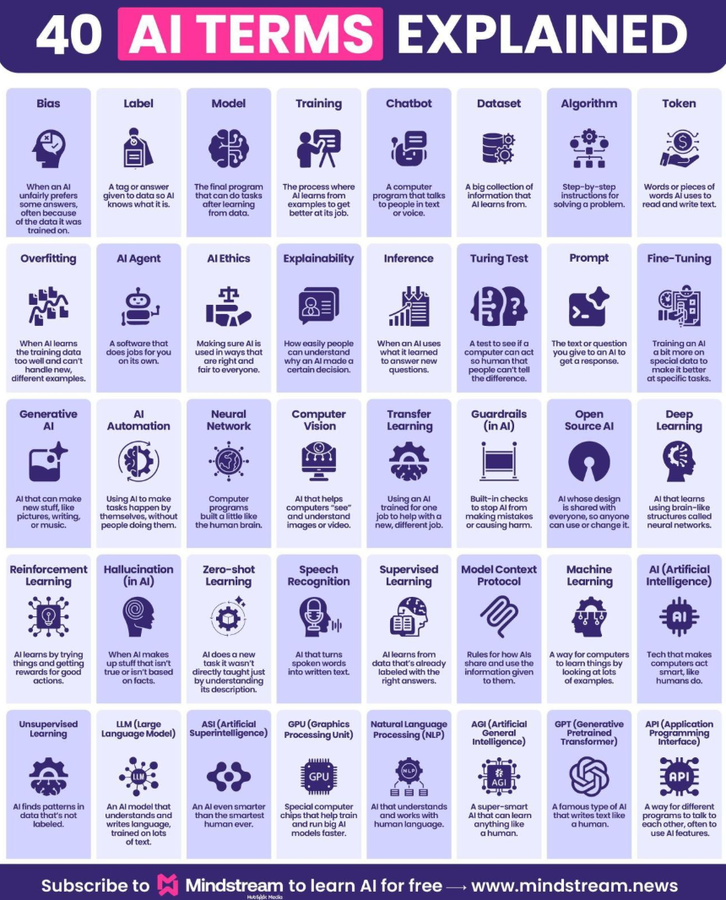
Reference – AI Terms Continued

Slide 17
Reference – Best AI Search Engine
Perplexity:is a search engine built with AI from the ground up
Google AI Overviews: traditional search engines and generative AI in one place
Arc Search: It is great on mobile. Only available on iPhones and iPads
Brave Search: an AI search engine
Microsoft Bing: It now supplements its traditional search engine with AI-generated overviews
SearchGPT: an AI search engine
You.com: an AI assistant tool

Slide 18
Tools That WILL Make You RICH
1. Elicit — Transforming Tech Consulting and Research:
https://elicit.com/
2. Perplexity — Your AI Knowledge Engine:
https://www.perplexity.ai
3. Adobe Firefly — Unleashing Creative Potential with AI
https://www.adobe.com/products/firefly.html
4. Durable — Effortless Website Building:
https://durable.co
5. QuillBot — AI-Powered Content Creation:
https://quillbot.com

Slide 19
Tools That WILL Make You RICH
6. Mojo AI — Animate Logos to Stand Out:
https://mojo.vn
7. Luna AI Dream Machine — From Text and Images to Video
https://lumalabs.ai/dream-machine
8. LogoFast — Speedy Logo Design:
https://shipfa.st/tools/logo-fast

Slide 20
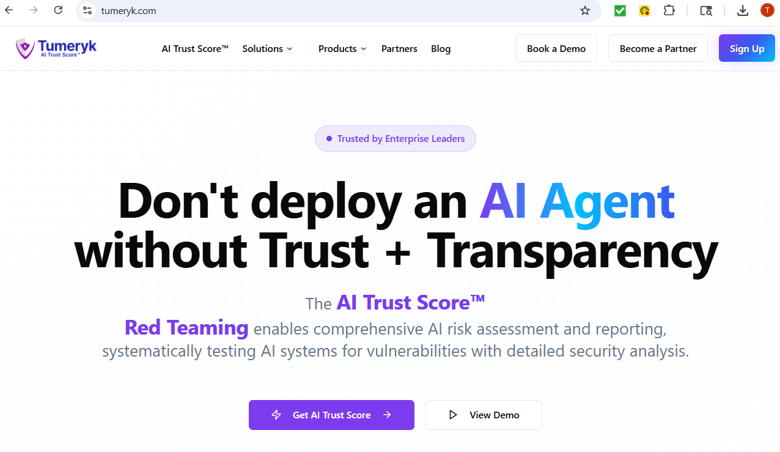
Reference – AI for Business
https://tumeryk.com/

Slide 21
Reference – AI Music Generator
ချစ်ခြင်းသည်လှစွာသောတေးသံတစ်ခု၊ မျှော်လင့်ခြင်းနှင့်အိပ်မက်များနှင့်အတူ
[Verse 1]
အိပ်မက်ထဲမှာ မင်းအမြဲရှိတယ်၊
ညအလင်းစဉ်တွေအောက်မှာရယ်စကားတစ်ချပျော်လှတဲ့မျက်နှာ၊
ငါ့ရဲ့နှလုံးသားက လွမ်းနေတယ် မင်းအတွက်ပဲ။
[Chorus]
မင်းကသာနားမှာရှိရင် ဘဝလုံးကျနော်ပျော်မယ်၊
အချစ်မီးအလင်းလိုပဲ မင်းရဲ့နွေးထွေးမှုကြောင့် ရွှင်ပါတယ်။
နောင်တမရှိဘဲ ရင်ခုန်သံထဲမှာ
မင်းနဲ့ငါ — အနာဂတ်တစ်ခုတည်း။

Slide 22
Reference – AI Music Generator Continued
[Verse 2]
မင်းပြုံးတဲ့အခါ ငါ့အတွင်းမှာ တိတ်တဆိတ်တေးသံတစ်ပုဒ်သံလာတယ်၊
လေသံထဲကပင် မင်းရဲ့အမည်ကိုဆွတ်ခေါ်နေသလို၊
တစ်စုံတစ်ယောက်လုံးငါဖြစ်ချင်တယ် မင်းအတွက်။
[Chorus]
မင်းကသာနားမှာရှိရင် ဘဝလုံးကျနော်ပျော်မယ်၊
အချစ်မီးအလင်းလိုပဲ မင်းရဲ့နွေးထွေးမှုကြောင့် ရွှင်ပါတယ်။
နောင်တမရှိဘဲ ရင်ခုန်သံထဲမှာ
မင်းနဲ့ငါ — အနာဂတ်တစ်ခုတည်း။

Slide 23
Reference – AI Music Generator Continued
[Bridge]
သက်တမ်းထဲမှာ အမြဲတမ်းနားရမယ်ဆိုရင်
မင်းရဲ့အသံကိုတော့ငါမင်းနဲ့အမြဲလိုချင်တယ်။
[Finale]
အလင်းတန်းထဲမှာ စိတ်လှုပ်ရှားမှုတိုးလာတယ်
မင်းနဲ့အတူရှိခြင်းက ငါ့ရဲ့အချစ်တော်ပဲ…
[End]

Slide 24
Tools and Resources
https://github.com/microsoft/AI-For-Beginners
https://github.com/microsoft/ai-agents-for-beginners
https://github.com/HandsOnLLM/Hands-On-Large-Language-Models
https://academy.openai.com
https://academy.openai.com/home
https://aistudio.google.com (to run Gemma 3)
https://www.airtable.com/ (Visual Business Database)
https://analytics.google.com
https://anthropic.skilljar.com/
https://base44.com/

Slide 25
Tools and Resources Continued
https://www.canva.com (design tools, templates, Magic Studio)
https://claude.ai/new
https://www.copy.ai/ (Content creation)
https://dia-tts.com/ (Open-Source Text to Speech)
https://www.genspark.ai/agents (Real Good)
https://x.ai/news/grok-4
https://generativeai.pub/
https://huggingface.co
https://ai.meta.com/get-meta-ai
https://imgtoimg.ai/ (Harness AI to morph, stylize, and recreate any image effortlessly)

Slide 26
Tools and Resources Continued
https://theresanaiforthat.com/@taaft/image-to-image-generator/
https://lovable.dev/ (Create apps and websites)
https://ai.meta.com/get-meta-ai
https://ollama.com/download
OpenAI Cookbook (openaiopenai-cookbook)
https://www.perplexity.ai/ (Smart Search Engine)
https://www.pictory.ai (Convert a written script into a full video with stock footage, captions, and voiceovers.)
https://www.notion.so/product/ai (to enhance productivity by combining AI writing and knowledge management inside a single workspace)

Slide 27
Tools and Resources Continued
https://surferseo.com/ (SEO & Content Marketing)
https://translate.google.com/
https://zapier.com (Automation & Productivity)
https://www.jasper.ai/ (Content Marketing)
Prompt Engineering GitHub
https://github.com/NirDiamant/RAG_Techniques
FlowGPT (https://flowgpt.com)– Prompt sharing
https://generativeai.pub/
PromptHero (https://prompthero.com)– Prompt examples
https://github.com/patchy631/ai-engineering-hub

Slide 28
Tools and Resources Continued
https://github.com/youssefHosni/Data-Science-Interview-Questions-Answers
https://stanford-cs221.github.io/autumn2019/?utm_source=chatgpt.com

Slide 29
Free AI Courses
https://github.com/microsoft/ML-For-Beginners
Google AI Essentials
https://lnkd.in/gby_5vns ()
AI For Everyone
https://lnkd.in/grgJGawB ()
Anthropic Academy - Claude tutorials from the creators themselves (I use Claude daily now)
https://anthropic.skilljar.com/
https://docs.anthropic.com/en/home (Developer platform)

Slide 30
Free AI Courses Continued
Coursera RAG Systems - Build AI that uses your company data (game-changer for businesses)
deeplearning.ai MCP - Create AI apps that connect to real systems (advanced but worth it)
Google Data Analytics
https://lnkd.in/grBjis42 ()
Google Project Management
https://lnkd.in/g2JEEkcS(☺
Google Cybersecurity
https://lnkd.in/gdQT4hgA ()

Slide 31
Free AI Courses Continued
Google Digital Marketing & E-commerce
https://lnkd.in/garW8bFk()
Google UX Design
https://lnkd.in/gnP-FK44()
Google Veo Video Generation - Learn AI video creation from Google’s team (cutting-edge stuff)
Harvard Machine Learning - Deep dive into how AI actually works (surprisingly practical)
Microsoft Power BI Data Analyst
https://lnkd.in/gCaHF8kT()

Slide 32
Free AI Courses Continued
Machine Learning
https://lnkd.in/gFad6pNE()
Foundations: Data, Data, Everywhere
https://lnkd.in/gw4BwhJ2 ()
IBM Data Analyst
https://lnkd.in/g3PsGrKy
IBM Data Science
https://lnkd.in/gHYZ3WKn Deep Learning https://lnkd.in/gaa5strv
Writing in the Sciences
https://lnkd.in/gHewehvu

Slide 33
Free AI Courses Continued
Neural Networks and Deep Learning
https://lnkd.in/g53wXSHA
Google Advanced Data Analytics https://lnkd.in/gnG-SMAA
Google Responsible AI - Understand AI ethics and limitations (prevents costly mistakes at work)
Google IT Support https://lnkd.in/gb5EdRwg
Indigenous Canada https://lnkd.in/gu3y2X_p
Data Analysis with R Programming https://lnkd.in/gbAH3JYc

Slide 34
Free AI Courses Continued
Stanford Introduction to Food and Health https://lnkd.in/gQdsGqKP
Meta Social Media Marketing https://lnkd.in/gT86tcF9
Mindstream
https://www.mindstream.news/
Foundations of Project Management https://lnkd.in/gHhuE-j8
Buenas Prácticas en Libre Competencia https://lnkd.in/gTcJ5Xrw

Slide 35
Free AI Courses Continued
Blockchains, Tokens, and The Decentralized Future https://lnkd.in/gQy8F7UB
Breastfeeding: Public Health Perspectives https://lnkd.in/gNdG_Z-k
Big Data Integration and Processing https://lnkd.in/g2Qe8KY2
Big History - From the Big Bang until Today https://lnkd.in/gZ7Fdt-E
Battery Pack Balancing and Power Estimation https://lnkd.in/gP_bvV6K

Slide 36
Free AI Courses Continued
Being Smart about Cycling Futures https://lnkd.in/gYKmEkeQ
Basics of Fire Protection, Detection and Life Safety Systems https://lnkd.in/gbQUPZGZ
Artificial Intelligence in Social Media Analytics https://lnkd.in/gF6hGiQJ
Artificial Intelligence on Microsoft Azure https://lnkd.in/gXmiRPiK
Approximation Algorithms and Linear Programming https://lnkd.in/gPh9JGJ8
Automated Cyber Security Incident Response https://lnkd.in/gbBNsczg

Slide 37
Free AI Courses Continued
Applying Data Analytics in Marketing https://lnkd.in/g3BNJnvv
Artificial Intelligence in Social Media Analytics https://lnkd.in/gF6hGiQJ
Artificial Intelligence on Microsoft Azure https://lnkd.in/gXmiRPiK
Approximation Algorithms and Linear Programming https://lnkd.in/gPh9JGJ8
Automated Cyber Security Incident Response https://lnkd.in/gbBNsczg

Slide 38
Free AI Courses Continued
Applying Data Analytics in Marketing https://lnkd.in/g3BNJnvv
AWS Prompt Engineering - Master the science behind effective prompts (no more “please” and “thank you” in prompts)
Stanford Introduction to Food and Health https://lnkd.in/gQdsGqKP
Meta Social Media Marketing https://lnkd.in/gT86tcF9
NVIDIA AI Courses
Generative AI Explained: Understanding the Technology Transforming Industries
AI for All: From Basics to Generative AI Practice
Getting Started with AI on Jetson Nano: Edge AI Development

Slide 39
Free AI Courses Continued
NVIDIA AI Courses
Building Video AI Applications on Jetson Nano
Building A Brain in 10 Minutes: Neural Network Essentials
Building RAG Agents with Large Language Models
Accelerate Data Science Workflows with Zero Code Changes
Introduction to AI in the Data Center
Stanford Introduction to Food and Health https://lnkd.in/gQdsGqKP
Meta Social Media Marketing https://lnkd.in/gT86tcF9

Slide 40
Free AI Courses Continued
OpenAI Academy - Learn ChatGPT from the people who built it (saves you weeks of trial-and-error)
https://lnkd.in/gHhuE-j8
OpenAI Agent Building Guide - Create AI assistants that actually work (step-by-step PDF tutorial)
Buenas Prácticas en Libre Competencia https://lnkd.in/gTcJ5Xrw
https://www.mygreatlearning.com/ai/free-courses
https://careerservices.cwu.edu/blog/2025/01/08/free-ai-courses/
https://lnkd.in/gdgauv_7 (Getting Started with AI)

Slide 41
Free AI Courses Continued
Foundations of Project Management https://lnkd.in/gHhuE-j8
Buenas Prácticas en Libre Competencia https://lnkd.in/gTcJ5Xrw
https://www.mygreatlearning.com/ai/free-courses
https://careerservices.cwu.edu/blog/2025/01/08/free-ai-courses/
https://lnkd.in/gdgauv_7 (Getting Started with AI)

Slide 42
Reference – Python locations
https://learn.microsoft.com/en-us/windows/python/beginners
https://www.python.org/downloads/
https://replit.com/

