Slide 1
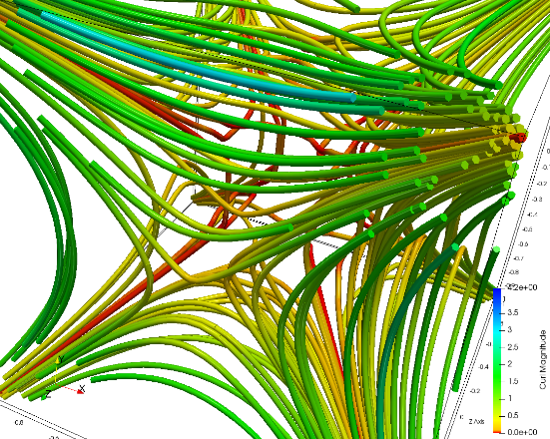
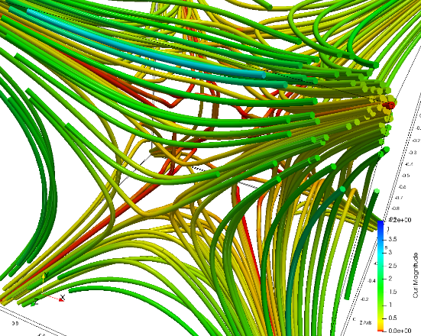
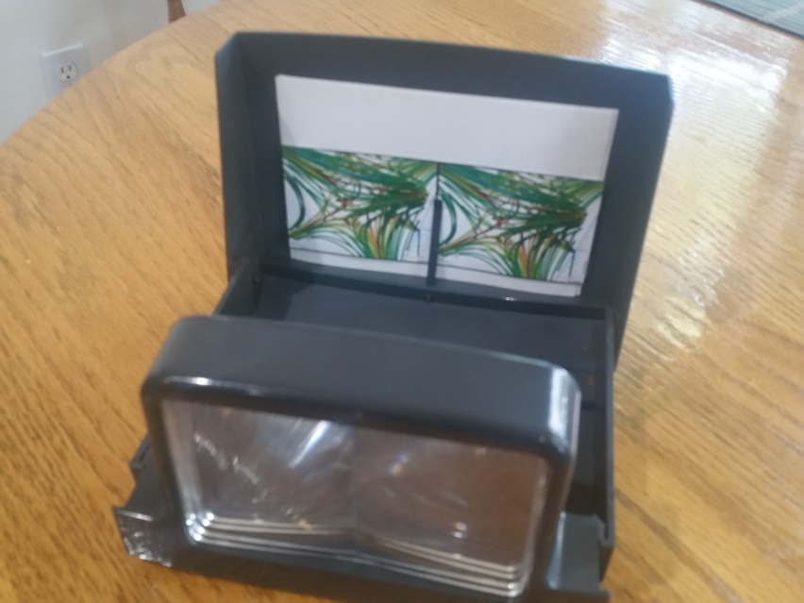
The Left Two Images Work Well Together in my Handheld Stereo Viewer
L
R
Print this page and cut out the two images together
Don’t resize these images – they fit perfectly in the viewer as they are now.

