Slide 1
Holographic
Virtual Librarian
An AI librarian who sees you, listens to you,
and knows the book on your desk.
floating in mid-air
Yidan Gao · UCL CASA · MSc Dissertation 2026
Notes:
Hello everyone! My name is Yidan. This is my project - the Holographic Virtual Librarian.

Slide 2
How the hologram works
1
An iPad lies flat on the desk
clear acrylic sheet · 45°
2
A clear acrylic sheet stands over it, at 45°
the librarian
appears here
3
The reflection floats in mid-air
— a Victorian trick called "Pepper's Ghost"
iPad (screen up)
Notes:
An iPad lies flat on the desk. A clear acrylic sheet stands over it, at 45 degrees. The screen reflects on the sheet - so a 3D librarian floats in the air. This old trick is called Pepper's Ghost.

Slide 3



Skill 1 — She can SEE
A camera tracks the visitor's face with AI
52 facial expressions, live on the 3D avatar
Neural network runs ON the iPad — no cloud
→
you smile
she smiles
in real time
Notes:
She has three skills. First, she can SEE. A camera tracks my face with AI. When I smile - she smiles. All in real time. (DEMO: smile at the iPad)

Slide 4



Skill 2 — She can LISTEN
“Hello”
“space”
→
→
→
wake word
ding! she wakes
any topic
A Brief History
of Time
Speech recognition runs fully offline, on the device — no internet at the exhibition.
Notes:
Second, she can LISTEN. Say Hello to wake her up. Then say a topic, like space - and she recommends a book. All offline, no internet. (DEMO: say Hello, then space)

Slide 5


Skill 3 — She can FEEL the room
ToF distance
temperature
humidity
NFC book tags
a self-made sensor box, talking to the iPad over its own Wi-Fi
→
Put a book on the desk
…she recommends a matching film
she reads the NFC tag inside
“Image of the City” → Blade Runner 2049
Notes:
Third, she can FEEL the room. My sensor box reads distance, temperature, and NFC tags inside books. Put a book on the desk - she knows it, and recommends a matching film. (DEMO: put the book on the reader)

Slide 6


Inside the sensor box
Custom PCB shield
self-designed board on an Arduino MKR WiFi 1010 —
no loose wires, exhibition-solid
sensor box
iPad
reads the room
asks every 1 s
its own Wi-Fi hotspot
VL53L0X
laser distance — is a reader there?
sensor data travels as tiny JSON messages over the local hotspot — one request per second
BME280
temperature & humidity of the room
no internet · no cloud · no server —
everything stays on this desk
PN532 NFC
reads the tag inside each book
Notes:
Inside the box: a custom PCB connects three sensors to an Arduino. The box makes its own Wi-Fi. The iPad asks it for data every second. No internet, no cloud - everything stays on the desk. (point at the sensor box)

Slide 7

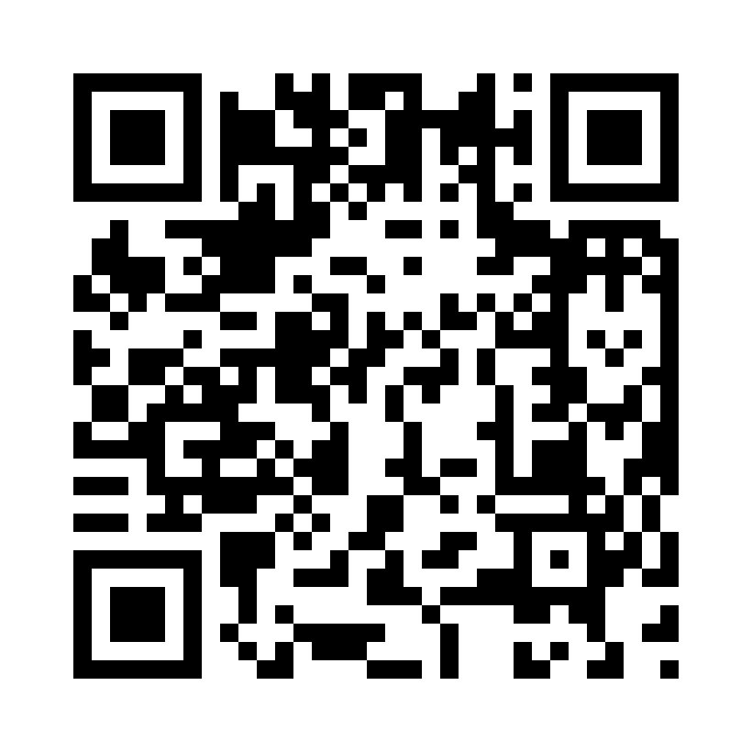
All self-made
Hardware
Firmware
App
Arduino sensor box
ToF · BME280 · PN532 NFC
self-healing:
hardware watchdog + auto-recovery
offline AI on a 2018 iPad (2 GB)
face + speech + hologram render
Runs unattended for a whole week — it heals itself.
Thank you!
scan for the project page
Notes:
The hardware, the firmware, and the app - all self-made. It runs alone for a whole week. Thank you!

