Slide 1
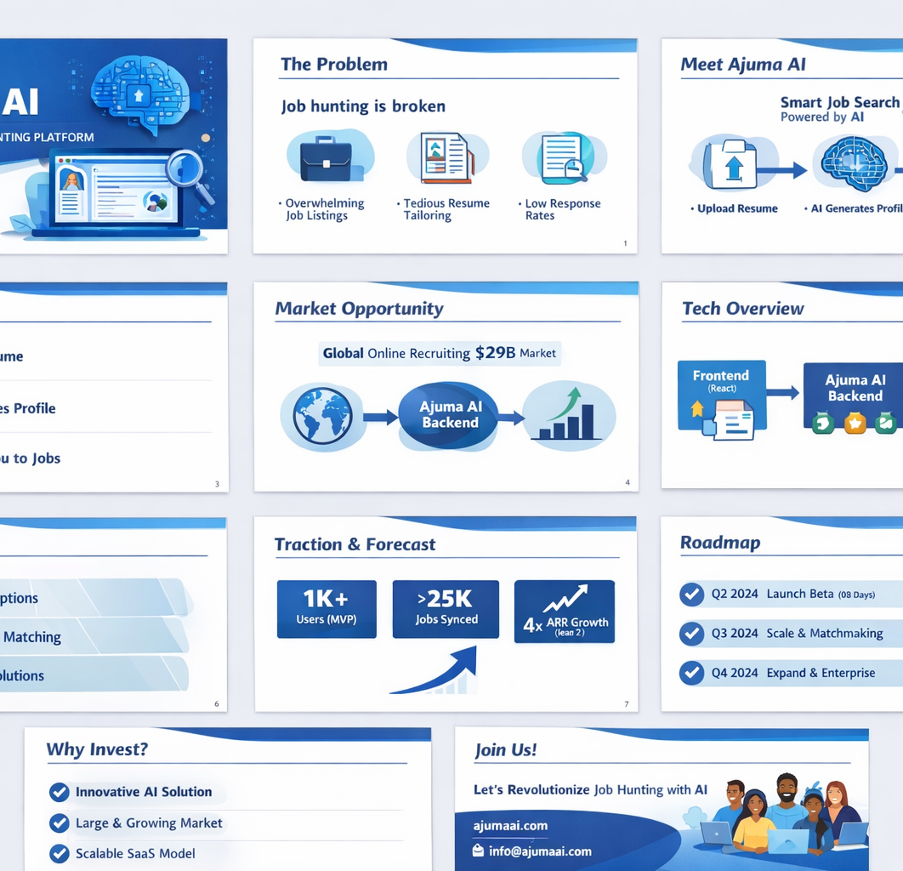
AJUMA AI
AI-powered job-hunting platform for emerging-market talent
Investor-ready overview
Problem • Product • Architecture • Business Model • Risks • Roadmap
April 2026
1

Slide 2
Why this matters
Job search is fragmented, noisy, and low-conversion
Too much noise
Weak positioning
Manual workflow
Candidates sift through hundreds of listings with little fit or feedback.
Most resumes are not translated into a clear, compelling professional profile.
Applications, tracking, and follow-up are repetitive and time-consuming.
Ajuma AI reduces friction from resume to opportunity.
2

Slide 3
What Ajuma AI does
Current MVP foundation plus investor-ready product direction
1. Upload resume
PDF resume upload and text extraction
2. Generate profile
AI converts raw resume text into structured profile data
3. Sync jobs
Jobs are pulled from external sources and deduplicated
4. Match & improve
Next: scoring, skill-gap analysis, and tailored recommendations
3

Slide 4
Technical architecture and live API surface
Combined from the two project write-ups
Frontend
Backend API
Data & AI
Job ingestion
React / Vite
Express + Firebase Auth
Firestore + OpenAI
Arbeitnow + sync logic
Confirmed / discussed endpoints
GET /health
Why this architecture works for an MVP
GET /protected
Fast to ship with managed infrastructure
POST /resume/upload
Secure auth with Firebase ID tokens
POST /ai/generate-profile
Simple AI loop from resume text to profile
GET /ai/ping (debug)
Clear path to matching and premium features
POST /jobs/sync
Recommended next: GET /jobs
4

Slide 5
What makes a SaaS platform successful
The operating checklist investors expect founders to understand
Security & trust
Ease of use
Authentication, authorization, secrets management, backups, auditability, privacy by design
Fast onboarding, intuitive UX, clear error states, mobile-friendly flows
Monetization
Reliability
Free-to-paid conversion, pricing tiers, expansion revenue, healthy unit economics
High uptime, resilient integrations, graceful failures, observability
Scalability
Retention
Cloud-native infrastructure, queueing, caching, efficient database patterns
Repeat value, personalization, notifications, measurable outcomes for users
5

Slide 6
Business model and monetization
From freemium utility to premium career outcomes
Free
Pro
B2B / Enterprise
Resume upload
Basic AI profile
Job sync and search
Advanced matching
Tailored recommendations
Application tracking
Recruiter sourcing
University / bootcamp partnerships
White-label career tools
Key metrics to watch: CAC, activation rate, resume-to-profile conversion, profile-to-application rate, retention, and ARPU.
6

Slide 7
Why Ajuma AI can win
The opportunity is not just job listings; it is workflow ownership
Potential moat
Why now
Structured talent profiles built from unstructured resumes
AI lowers the cost of profile creation and personalization
Growing user dataset on skills, intent, and job interactions
Managed cloud services accelerate lean execution
Localized focus for underserved job seekers
Users increasingly expect intelligent assistance, not static job boards
Workflow expansion from discovery to matching to outcomes
Employers and training partners want better candidate signal
7

Slide 8
Key risks and mitigation
Strong founders name the risks early and show control
AI cost / rate limits
Use caching, retries, model fallback, and stricter prompts
Data privacy
Minimize stored PII, use token verification, and protect secrets
Integration dependency
Abstract external APIs and keep ingestion modular
User churn
Deliver clear value quickly: profile quality, matching quality, and saved time
Execution risk
Prioritize a narrow wedge before expanding the product surface
8

Slide 9
Roadmap and investor take
A strong MVP with a credible next step
Near-term roadmap
Harden current APIs and strict JSON AI outputs
Investor take
Add GET /jobs and frontend job display
Ajuma AI already demonstrates the right MVP primitives: secure auth, protected backend, resume ingestion, AI profile generation, and job syncing. The next value unlock is matching, retention, and monetization discipline.
Launch profile-to-job matching and scoring
Add dashboards, alerts, and better UX states
Prepare analytics, security, and billing for scale
Recommended use of this deck: fundraising conversations, partner outreach, technical roadmap alignment, and hiring.
9

