Slide 1
Clipper: A Low-Latency Online Prediction Serving System
Daniel Crankshaw, Xin Wang, and Guilio Zhou, Michael J. Franklin, Joseph E. Gonzalez and Ion Stoica, University of California, Berkeley
14th USENIX Symposium on Networked Systems
Design and Implementation (NSDI ’17)

Slide 2
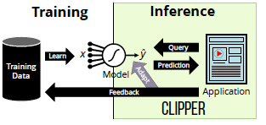
Introduction
The most ML frameworks and systems only address model training not deployment
ML applications
Training
The process of building a model from data
Computationally expensive
Inference
The process of using the model to make a prediction given an input
Run in real-time on orders of magnitude queries
Deploying service
Training
Choose ML frameworks with API, model, algorithms, hardware requirement
Migrate models and frameworks as new versions are updated
Inference
Models must be deployed to a prediction serving system to provide low-latency
Notes:
,

Slide 3
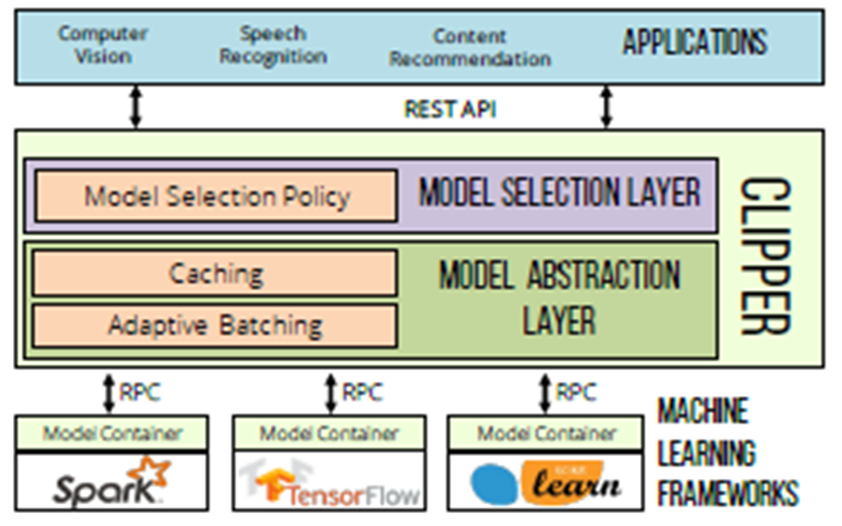
Introduction - Clipper
Layered Architecture
Property
Low latencies
High throughputs
Improved accuracy
Model Selection Layer - accuracy
Select model dynamically with bandits algorithm
Combine predictions by ensemble methods
Model Abstraction Layer – latency & throughput
Prediction caches – to render predictions without evaluating model
Adaptive batching queue – maximize throughput given a query latency target
Straggler mitigation – technique to render predictions without waiting for slow models

Slide 4
Applications workload
Object Recognition
Computer vision – the task of identifying and labeling the objects in a picture
User provides feedback about accuracy of the predictions
Explicitly labeling images. (e.g., type label for the image)
Implicitly indicating whether the provided prediction was correct. (e.g., click suggested label)
Benchmark datasets
MNIST, CIFAR-10, ImageNet datasets
Automatic Speech Recognition
A function from a spoken audio signal to the corresponding sequence of words.
Providing real-time predictions with real-time translation
Build speech recognition service with TIMIT speech corpus and HTK
Benchmark datasets
Dataset consists of voice recording for 630 speakers in eight dialects of English

Slide 5

Experimental Setup
Datasets
Machine Configuration
2 Intel Haswell-EP CPUs and 256 GB of RAM
Ubuntu 14.04 on Linux 4.2.0
Nvidia Tesla K20c GPUs with 5 GB of GPU memory and 2496 cores
Both 10Gbps and 1Gbps network

Slide 6

Complexity of Deploying ML
No dominant ML framework
Each one has strengths and weaknesses
Optimized for specific model and domain of applications
Changes over time
complexity of integrating and supporting multiple ML frameworks
Clipper’s solution
Model abstraction layer
Common prediction interface that isolates applications from ML framework
Simplifies the process of deploying a new model or framework

Slide 7
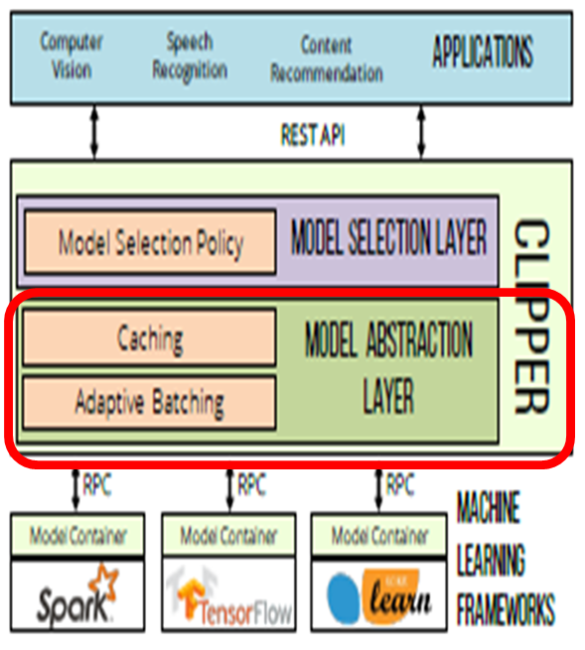
Prediction Latency and Throughput
Prediction Latency
The time it takes to render a prediction given a query
ML - batch
모델을 한번 학습(forward– backward) 할 때 사용되는 data의 set
Gradient Descent by batch size
batch (mini-batch = training data), mini-batch, stochastic (mini-batch=1)
논문에서 batch
모델이 예측요청을 처리하기 위해 받는 input data의 set
Challenge
Predictions must both be fast and bounded tail latencies to meet several service level
More sophisticated, accurate model have substantial latencies (50-100ms)
Batch prediction requests
when you have a large number of instances to get predictions for
Heavy query load
Clipper’s solution
Adaptive batches prediction requests
Straggler mitigation techniques

Slide 8
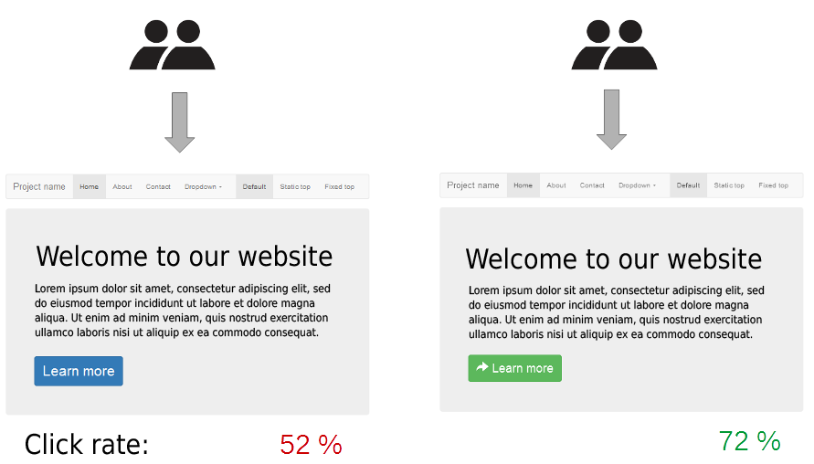
Model Selection
Challenges
Decide which of models to deploy based on
Offline evaluation - Stale datasets
Heavily biased by previous modeling results
Online A/B testing
The resulting of choice of model is static
Local optimization
Predictions from several model in ensembles can often boost prediction accuracy
Clipper’s solution
Adaptive online model selection – bandit approach
Ensemble techniques to incorporate feedback

Slide 9

System Architecture

Slide 10
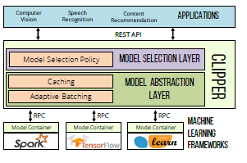

System Architecture
REST API (Representational State Transfer)
웹에 있는 자원(이미지, 동영상, DB data)에 대한 주소(URI)를 지정하는 방법
표현 = 자원 + HTTP method (GET, POST, PUT, DELETE)
ex) GET /users/1 , PUT /users
JSON ,XML을 통해 데이터를 주고 받음
RPC API (Remote Procedure Call)
Client가 네트워크상에서 원격에 있는 server가 제공하는 함수 API를 호출

Slide 11




System Architecture
Prediction Requests (Query)
Model Selection Layer
Process and dispatches the prediction request
Model Abstraction Layer
Checks the prediction cache for the query
Assign queries to adaptive batching queue
Model container
Prediction with batches of query
Model Abstraction Layer
Populates the prediction cache
Model Selection Layer
Combines one or more predictions
Render a final prediction (<= 20ms)
End-user Applications

Slide 12
Model Abstraction Layer - overview
Interface across ML framework
Component
Prediction cache
Pre-materialization
Help accelerate model selection
Adaptive query batching
Mini-batch dynamically resized
Connect model containers via RPC
Minimize the overhead
Simplifies cross-language integration

Slide 13
Model Abstraction Layer - Caching
Clipper can serve frequent queries without evaluating the model
Reduce latency and system load
Important role in model selection
Join the original predictions with any feedback it receives
Prediction Cache
Acts as function cache for the generic prediction function:
x: query, y: model prediction
Exposes request and fetch API
Request
Notifies the cache to compute the prediction if not present in entry
Return Boolean indicating whether hit or not
Fetch
Checks the cache and returns query result if present
LRU eviction policy

Slide 14
Model Abstraction Layer - Batching
Latency – service level object (SLO)
서비스 목표 수준: 서비스 수준을 표현하기 위한 항목
Allow user to specify a latency objective
Why does batching increase throughput?
Amortizes the cost of RPC calls and framework overhead (ex. copy input to GPU memory)
Enable framework to exploit existing data-parallel optimizations
Each model container has its own adaptive batching queue
Developer doesn’t need to tune the batch size manually
Find and adapt the maximum batch size dynamically

Slide 15
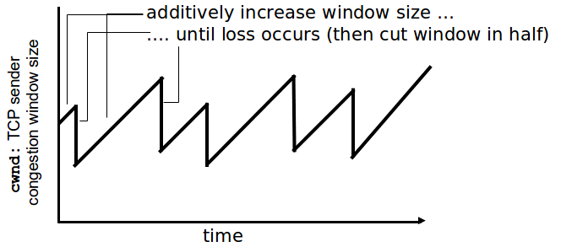
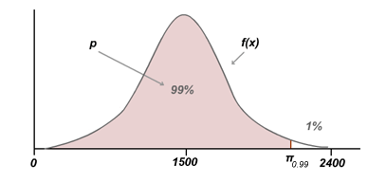
Batching - Dynamic Batch Size
Define optimal batch size
batch size that maximizes throughput subject to latency under target SLO
How?
AIMD(Additive-Increase Multiplicative-Decrease)
Additive-Increase
Increase batch size by a fixed amount
until latency exceeds objective SLO
Multiplicative-Decrease
Reduce batch size by 10 %
Quantile regression – 데이터의 평균 값이 아닌 특정 분위값 예측 (99%)
SLO를 넘지 않는 전체 latency 중에서 99%의 latency 에 해당하는 batch size를 예측

Slide 16
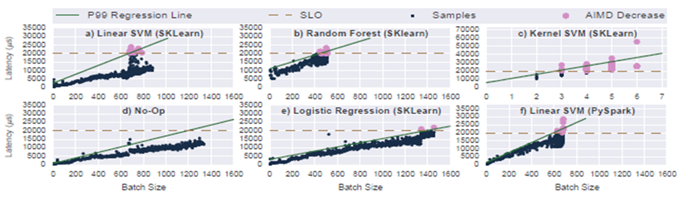

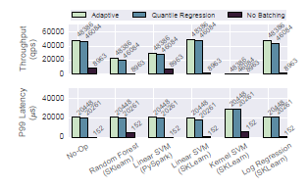
Batching - Dynamic Batch Size
Why?
Early performance measurement
Stable linear relationship between batch size and latency
Evaluation

Slide 17
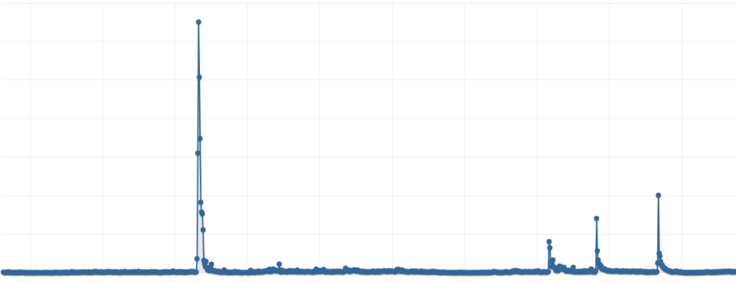
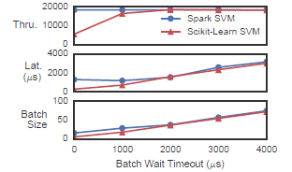



Batching – Delayed Batching
Bursty load

Slide 18

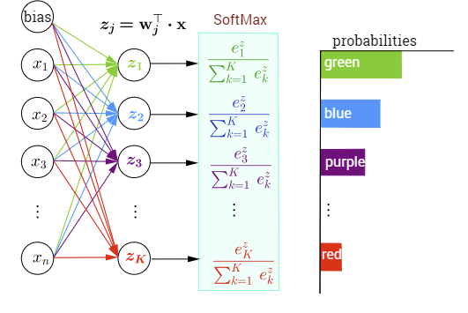
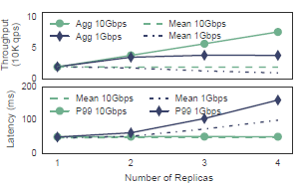
Model Abstraction Layer – Model Container
Prediction Interface for Model container bindings C++, JAVA, Python
Only few lines of code to add a new type of model
and language
Simplifies cross-language integration
Separate Docker container
Process isolation
ML frameworks doesn’t interfere with the overall availability of Clipper
State (e.g., model parameter) is provided during initialization -> stateless
Support replicating model containers
Locally and across cluster
Linear throughput scaling
Network will continue to be bottleneck to scaling
out prediction serving applications

Slide 19
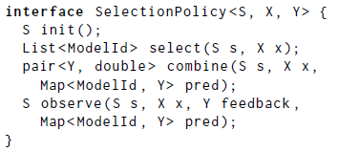
Model Selection Layer – overview
Uses feedback to dynamically select one or more of the deployed models
the layer compensates for failing models without human intervention.
Model Selection Policy Interface
select, combine, observe API
X: query type, Y: prediction type
S: learned state of selection policy
init(): initial instance of the state
select(): which model to query
combin():
combine the result
compute other inform about prediction
observe():
update the state based on feedback
Singel Model Selection Policy
Bandit Approach + Exp3 Algorithm -> trade-off between computation overhead and accuracy
Ensemble Model Selection Policy
Ensemble + Exp4 Algorithm

Slide 20
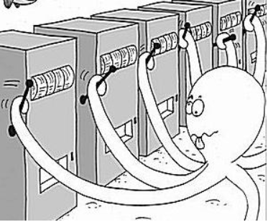
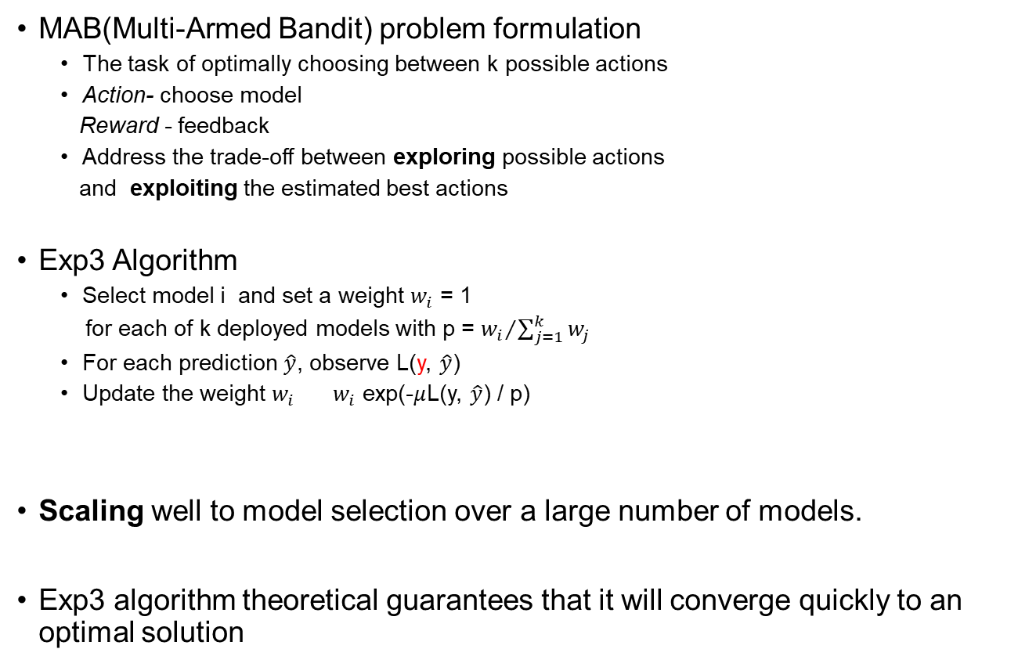
Single Model Selection Policy
MAB(Multi-Armed Bandit) problem formulation
The task of optimally choosing between k possible actions
Action- choose model
Reward - feedback
Address the trade-off between exploring possible actions
and exploiting the estimated best actions
Exp3 Algorithm
Select model i and set a weight $w_{i}$ = 1
for each of k deployed models with p = ${w_{i}}/{\sum_{j=1}^{k}{w_{j}}}$
For each prediction $\hat{y}$, observe L(y, $\hat{y}$)
Update the weight $w_{i}$ ${ w}_{i}$ exp(-$μ$L(y, $\hat{y}$) / p)
Scaling well to model selection over a large number of models.
Exp3 algorithm theoretical guarantees that it will converge quickly to an optimal solution

Slide 21
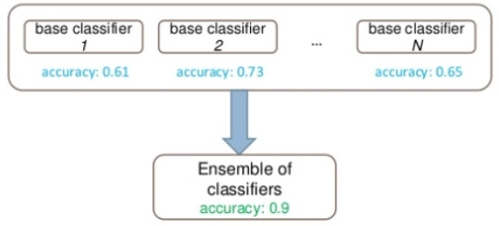
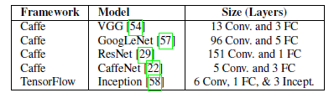
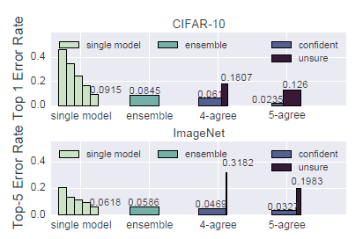

Ensemble Model Selection Policy
Combine the predictions from
all available models
Ensemble prediction Accuracy
5 deep learning models with CIFAR-10 and ImageNET
Exp4 algorithm
A weighted combination of all base model
predictions
Improve prediction accuracy as the # of model

Slide 22
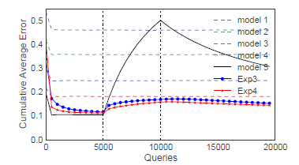
Evaluation on Policy
Behavior of Exp3 and Exp4 under Model Failure
Quickly compensate for the failure

Slide 23
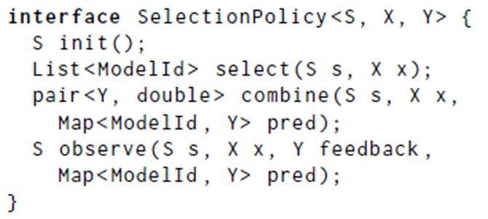
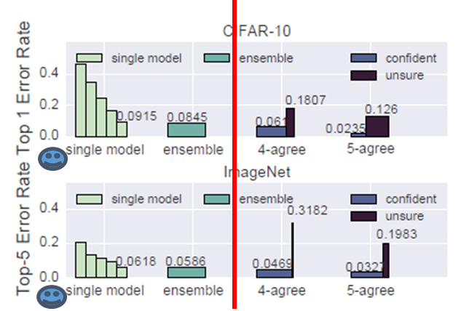
Ensemble – Robust Predictions
Choose predictions only above a confidence threshold
Confidence – by estimator of confidence when evaluating predictions
combine() calculates # of number of models that agree

Slide 24
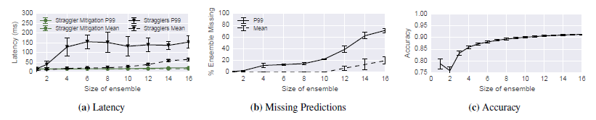
Ensemble – Straggler Mitigation
Additional system cost – the worst case: resource starvation
Simple best stategy
the design choice that rendering a late prediction is worse than rendering an inaccurate prediction.
At the latency deadline (SLO target), combine function of the model selection policy is invoked with the subset of the predictions that are available

Slide 25
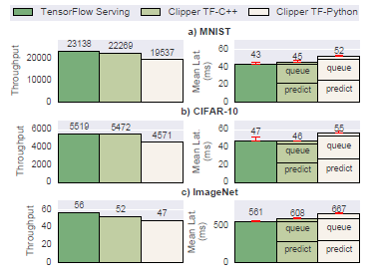
System Comparison
Tensorflow Serving
Empolys batching
Batch size – static
Timeout to avoid starvation
Serve one model at a time
Model | Data | batchsize
4-layer CNN | MNIST | 512
8-layer AlexNet | CIFAR-10 | 128
22-layer Inception-v3 | ImageNet | 16

Slide 26
Limitations
Clipper doesn’t optimize the execution of models
Slow model will remain slow
Tensorflow-Serving
Integrated with model evaluation -> leverage GPU acceleration
Clipper doesn’t manage training or re-training of the base models
All models are out-of-date

Slide 27
Conclusion
Propose a layered architecture by interposing between end-user applications and ML frameworks.
New ML frameworks and models can be introduced without modifying end-user applications.
Modular container-based architecture and additional functionality with minimal performance penalty.

Slide 28
References
Online A/B test
https://ko.wikipedia.org/wiki/A/B_%ED%85%8C%EC%8A%A4%ED%8A%B8
REST API
https://ko.wikipedia.org/wiki/REST
https://gmlwjd9405.github.io/2018/09/21/rest-and-restful.html
RPC
https://ko.wikipedia.org/wiki/%EC%9B%90%EA%B2%A9_%ED%94%84%EB%A1%9C%EC%8B%9C%EC%A0%80_%ED%98%B8%EC%B6%9C
AIMD
http://movefast.tistory.com/38
http://jwprogramming.tistory.com/36
Quantile regression
https://brunch.co.kr/@gimmesilver/38
Bandit Algorithm
http://hub.zum.com/kimws/2586
https://brunch.co.kr/@chris-song/62

