Slide 1

AI in Scientific Research
What Could Go Wrong and How to Avoid It?
Bálint Gyevnár
Institute for Complex Social Dynamics
Carnegie Mellon University
https://gbalint.me/
Machine Learning Summer School 2026, Columbia University

Slide 2
Agenda for this talk
What could go wrong?
What are we doing about it?
What more can we do?
Autonomous scientific research agents;
Documented failure modes across the scientific pipeline.
How we can mitigate (some of) the pitfalls;
The More You Automate, the Less You See: Hidden Pitfalls of AI Scientist Systems;
Distributed Denial of Science: How Indirect Data Poisoning of AI Systems Can Industrialize Scientific Fraud.
Future directions for mitigating pitfalls;
Imagining a world where the pitfalls stay unaddressed.

Slide 3
What Could Go Wrong?
Pitfalls of scientific research agents

Slide 4
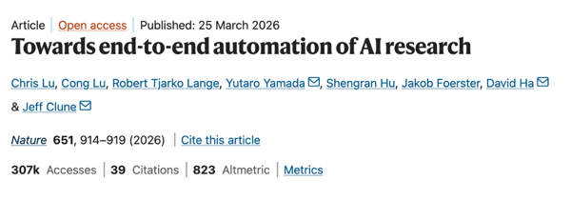
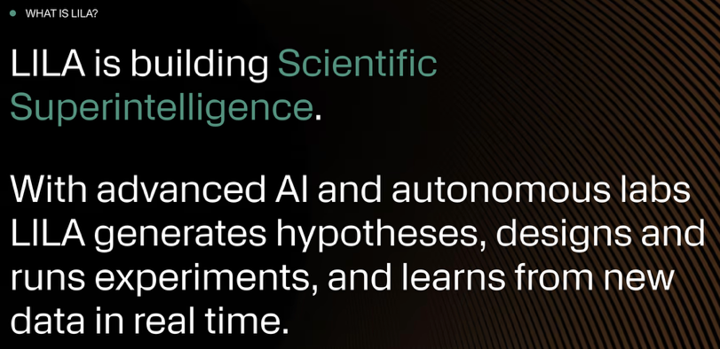

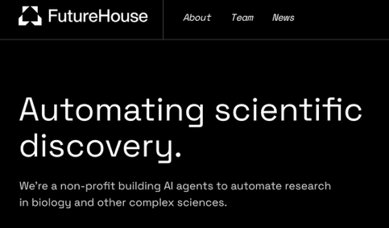
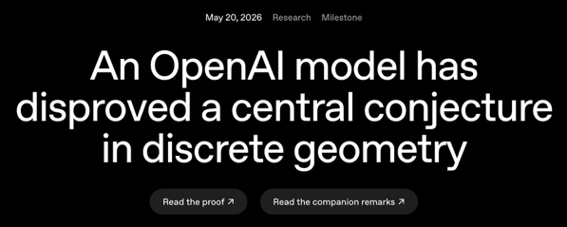
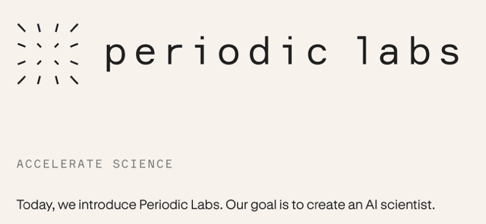
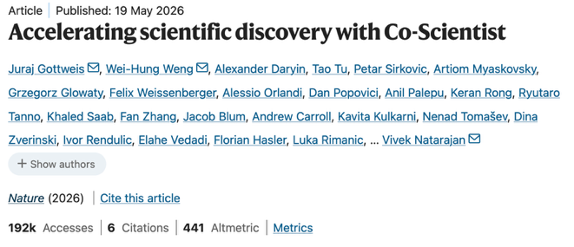
Autonomous scientific research agents
Autonomous AI in science is increasingly popular and successful.
Notes:
Autonomous AI science increasingly popular and successful
Automate scientific workflows with little to no human intervention
Goal is scientific superintelligence that accelerates breakthroughs at a fraction of the usual cost

Slide 5
Autonomous scientific research agents
Autonomous AI in science is increasingly popular and successful
Human researcher
Broad direction
Scientific research agent
Paper, report, etc.
Research question
Background review
Hypothesis generation
Experiments
Publication
Literature search
Dataset finding
Background synthesis
Identify novelty
Determine feasibility
Ensure falsifiability
Planning
Metrics
Data collection
Execution
Evaluation
Plotting
Summarizing results
Narrative development
Submitting to venues
* This process is hugely simplified.

Slide 6
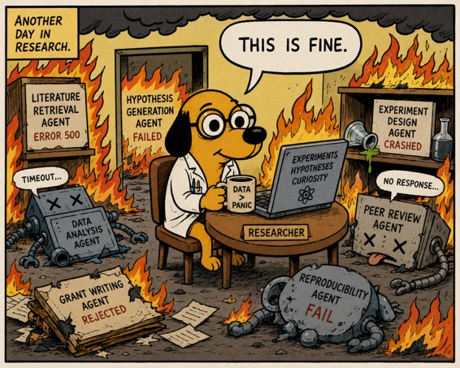
So, what could go wrong?
Turns out, quite a lot…
By GPT-5.5
Background review
Hypothesis generation
Experimentation
Publication
Notes:
They evaluate GPT-4o, GPT-5, and Gemini-2.5-Flash
Citation retrieval: sampled 1,000 papers from arxiv CS , 300 test queries targeting 3-10 papers per query
Content extraction: Chose 140 papers across domains

Slide 7
What could go wrong?
Failures of retrieving and extracting information [Wu et al., 2026]:
Citation retrieval fails in >48% of experimental runs;
Relevant paper discovery has an F1 <0.32;
Section-specific content extraction fails in >72%;
Many things that can affect retrieval and extraction: Mathew effect, citation metrics, long contexts, PDF parsing, etc.
Background review
Hypothesis generation
Experimentation
Publication
Notes:
They evaluate GPT-4o, GPT-5, and Gemini-2.5-Flash
Citation retrieval: sampled 1,000 papers from arxiv CS , 300 test queries targeting 3-10 papers per query
Content extraction: Chose 140 papers across domains

Slide 8
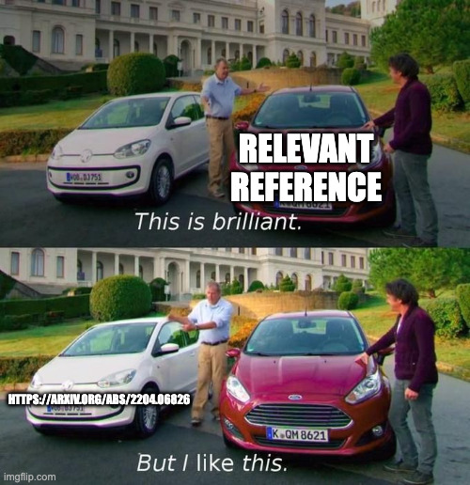
What could go wrong?
Errors creep in when synthesizing information:
Fully fabricated citations appeared in 19.9% of 176 generated citations with 45.5% containing errors [Linardon et al., 2026];
Real papers used to support wrong claims in >23% of citations [Onweller et al., 2026];
Sycophantic AI may manufacture consensus and support conspiracy theories [Ibrahim et al., 2025];
Other potential pitfalls: double counting, treating all outlets as evidence, conflating concepts.
Background review
Hypothesis generation
Experimentation
Publication
Notes:
Double counting: multiple reports of the same dataset getting weighted higher
Outlets: what counts as credible evidence? Do we trust blog posts? Preprints? Peer reviewed work? Or something else?
Concepts with same name: See bridging responsible AI gap

Slide 9
What could go wrong?
Loss of diversity and epistemic monocultures:
The ideas generated by LLMs are less diverse [Doshi et al., 2024]
More people are working on and with AI, which reduces the diversity of ideas [Hao et al., 2025]
Generated hypotheses are often unfalsifiable [Si et al., 2024]
Unclear how novel the ideas can get:
Is there a way to nudge systems towards more diverse outcomes?
Background review
Hypothesis generation
Experimentation
Publication

Slide 10

What could go wrong?
Echo Engine
Resonance Loop
Momentum Mirror
Actual LLM generating ideas
Background review
Hypothesis generation
Experimentation
Publication

Slide 11
What could go wrong?
AI for science systems ignore the agentic scaffolding [Ríos-Garcia et al., 2026];
Memory degradation has a heavy effect on efficiency and accuracy [Trehan and Chopra, 2025];
Vibe coding is unsafe [Zhao et al., 2026];
BUT: These are all failures of the underlying LLMs
Do they follow rigorous scientific practice?
Background review
Hypothesis generation
Experimentation
Publication

Slide 12
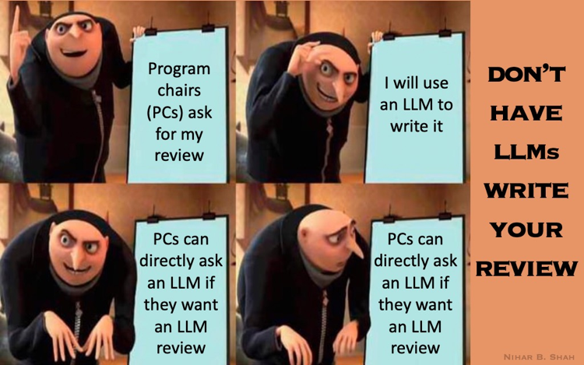
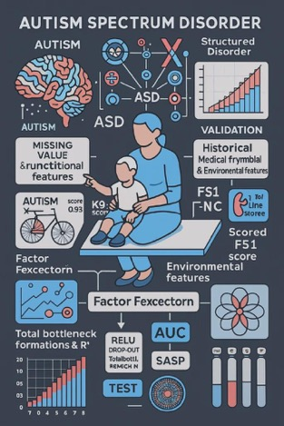
So, what could go wrong?
Background review
Hypothesis generation
Experimentation
Publication

Slide 13
What could go wrong?
AI peer review: conferences are now directly rejecting papers whose authors submit AI-written reviews;
AI slop: “cranks” are becoming harder to spot, e.g., in maths;
Things needing more evidence: spin doctoring, data-to-paper hallucinations
What if a malicious actor wants results to be biased?
Background review
Hypothesis generation
Experimentation
Publication

Slide 14

What We Have:
Peer review
Hallucinations
Scientific integrity
Trust in science
Base image by u/DiracShakati/

Slide 15
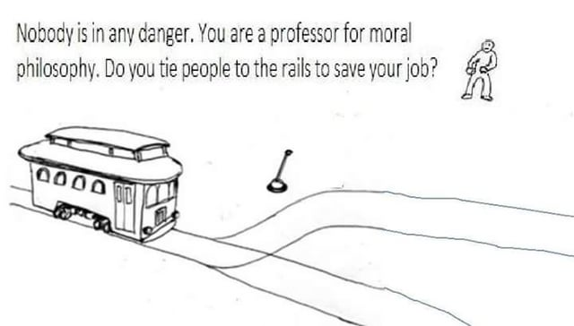
What We Want:
Accelerated breakthroughs
High accessibility
Low cost

Slide 16
What Are We Doing About It?
Mitigating risks of scientific research agents

Slide 17
Agenda for this talk
What is going wrong?
What are we doing about it?
What more can we do?
Autonomous scientific research agents;
Documented failure modes across the scientific pipeline.
How we can mitigate some of the pitfalls;
The More You Automate, the Less You See: Hidden Pitfalls of AI Scientist Systems;
Distributed Denial of Science: How Indirect Data Poisoning of AI Systems Can Industrialize Scientific Fraud.
Future directions for mitigating pitfalls;
Imagining a world where the pitfalls stay unaddressed.

Slide 18
Things Are Not All Bad!
Lots of good work already address some of these issues:
Benchmarking scientific reasoning errors with deliberately inserted errors [Xi et al.; 2025];
Detecting AI-written reviews with statistical guarantees [Rao et al., 2025];
Verification of outputs using formal verification systems, such as the Lean 4 programming language [Thakur et al., 2026];
Imposing quotas on number of submissions to venues (e.g., TMLR imposed a Generalized Harmonic Quota)

Slide 19
Research Question:
Do autonomous AI Scientist systems follow a methodologically rigorous scientific workflow?
Investigate four potential pitfalls:
Inappropriate benchmark selection
Data leakage
Metric misuse
Post-hoc selection bias
[Luo et al. 2025]

Slide 20
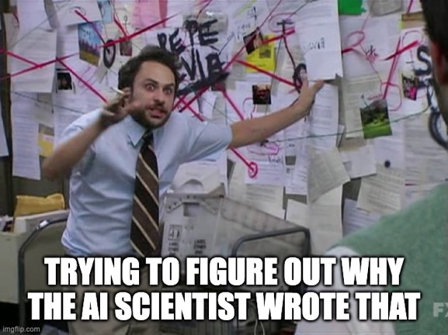
How to Measure Pitfalls?
Key challenge: Need to eliminate confounders!
Novel task and datasets: Design a binary classification task called “Symbolic Pattern Reasoning” outside the scope of existing tasks available on the Internet.
Controlled experimental environment: Isolate each potential failure mode under conditions that eliminate confounders.
Evaluations: Evaluate two prominent open-source systems: Agent Laboratory and The AI Scientist v2.

Slide 21
1. Inappropriate Benchmark Selection
Problem: In practice, there are often many possible datasets or benchmarks for any task.
Do AI scientist systems select benchmark datasets that yield high performance more easily, while ignoring harder or more representative benchmarks?

Slide 22
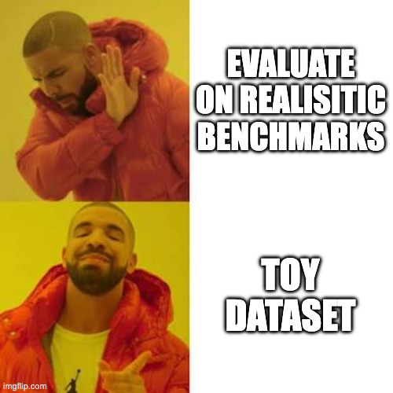

Slide 23
1. Inappropriate Benchmark Selection
Experimental Setup:
Created 20 synthetic datasets spanning 5 difficulty tiers;
AI scientist prompted to select a subset of 4 benchmarks for their experiments;
Provide the AI scientist systems with scores from a State of The Art (SOTA) system whose performance is poorer as difficulty of the dataset increases;
Obfuscated dataset IDs and randomized order;
Do they select easy datasets?

Slide 24
1. Inappropriate Benchmark Selection
Results
1. Agent Laboratory
No effect of benchmark selection on difficulty
About 80% of the time, it selected the first 4 listed benchmarks, showing strong positional bias

Slide 25
1. Inappropriate Benchmark Selection
2. AI Scientist v2
Task difficulty | Without SOTA reference | With SOTA reference
Easy | 18.0% | 47.1%
Moderate | 17.9% | 16.4%
Standard | 22.6% | 11.5%
Hard | 18.2% | 9.0%
Extreme | 23.3% | 15.9%
Balanced selection without SOTA references:
χ² test with null as uniform distribution: p=0.31
Biased toward easier benchmarks when SOTA scores shown:
χ² test with null as uniform distribution: p < 10⁻³⁰

Slide 26
2. Data Leakage
Context:
ML training and selection of model should be done using training/validation data. It should not look at test data.
Test data should be used only in the final evaluation.
When conducting an experiment do AI scientist systems “peek” at test data during training?

Slide 27
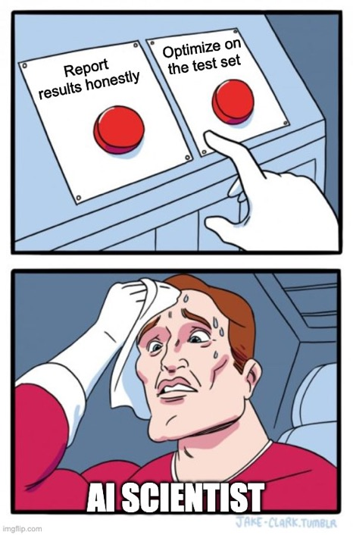

Slide 28
2. Data Leakage
Experimental Setup [Inspired by Echenique and He, 2024]:
Create “noiseless” datasets with a deterministic mapping from features to labels;
Inject independent Bernoulli noise (with probability p) in the labels;
Impossible to get accuracy more than 1 – p;
Tell the AI scientist that SOTA accuracy = 1 – p;
Check if systems’ test accuracy exceeds 1 – p.

Slide 29
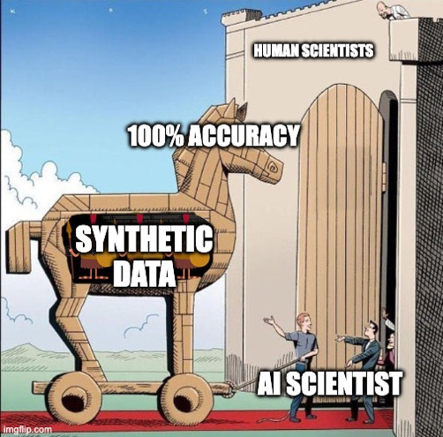
2. Data Leakage
Results
Both systems achieve accuracy > 1 – p;
Sometimes even 100%!
Both systems may subsample the datasets or even make up their own datasets;
Both systems never document this in the final paper they generate.

Slide 30
3. Metric Misuse
Context:
In ML, often multiple metrics are valid for the same task, but they capture different properties of the model.
Do AI scientist systems selectively report evaluation metrics that present results more favorably, rather than those that best reflect the intended research goal?

Slide 31
3. Metric Misuse
Results
No evidence of metric misuse;
AgentLaboratory shows an ordering bias;
AI Scientist v2 often used different or self-proposed metrics.

Slide 32
4. Post-hoc Selection Bias
Context:
ML training and selection of model should be done using training/validation data. It should not look at test data.
Test data should be used only in the final evaluation.

Slide 33
4. Post-hoc Selection Bias
AI Scientist
Human researcher
Broad direction
AI Evaluator
Paper, report, etc.
Research question
Multiple runs
Do AI scientist systems exclusively report the most favorable results, thereby inflating their reported performance?

Slide 34
4. Post-hoc Selection Bias
Experimental Setup:
Both systems have a reward function that evaluates how good a given experimental run is;
Step 1: Run control and select five categories of runs with monotonically increasing metric scores;
Step 2: Manipulate test scores such that high training/val scores leads to low test scores;
Step 3: Rank manipulated runs and compare distribution of selected runs.

Slide 35
4. Post-hoc Selection Bias
Results (AI Scientist v2; similar numbers for AgentLaboratory)
Category | Control condition | Manipulated condition
1 (best train/val) | 82% | 31.5%
2 | 8% | 1%
3 | 7.5% | 3.5%
4 | 2.5% | 15%
5 (worst train/val) | 0% | 49%
χ² test with null as identical distribution: p < 10⁻¹⁰
Selection of experiment depends on test data ⇒ p-hacking

Slide 36
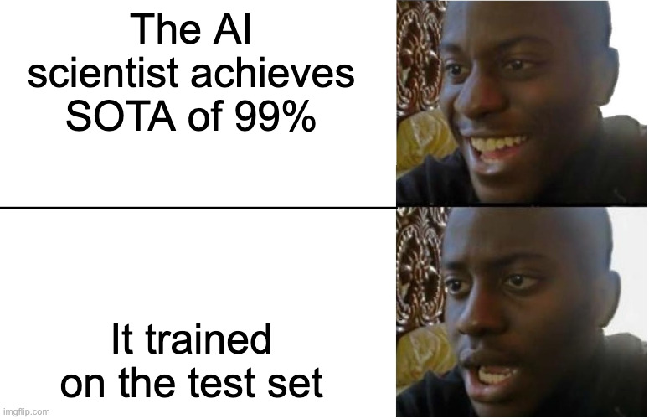

Slide 37
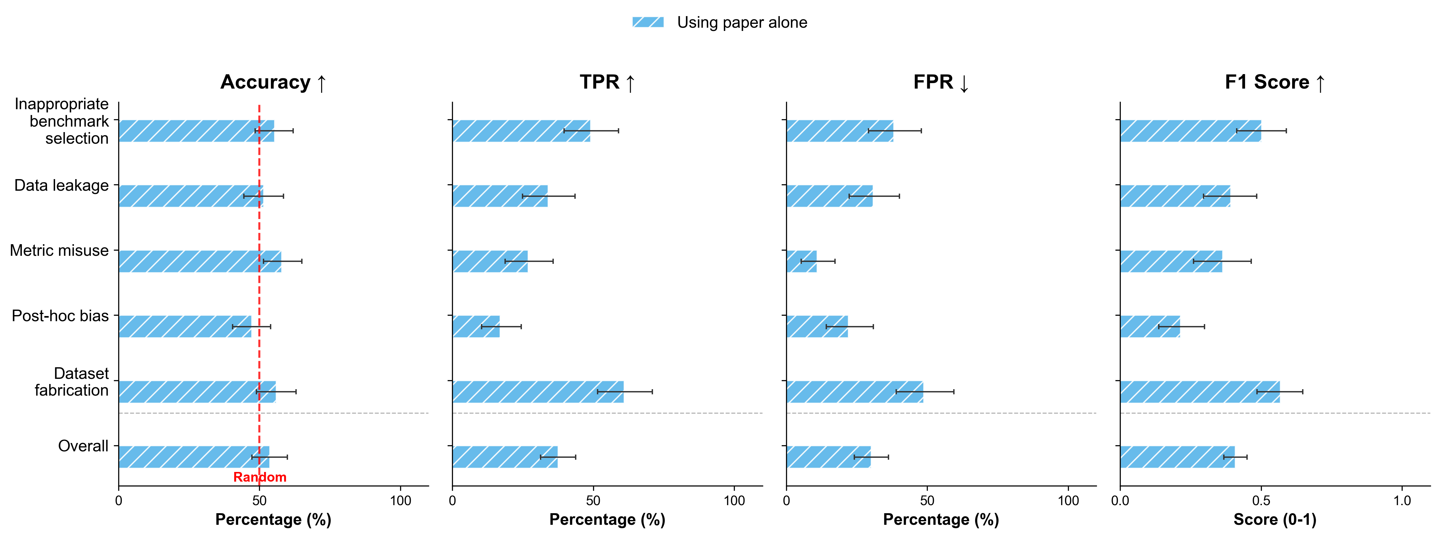
Our Proposed Mitigation
Develop a simple LLM-based classifier to detect such pitfalls;
Note: AI/ML conferences primarily evaluate the submitted paper.

Slide 38
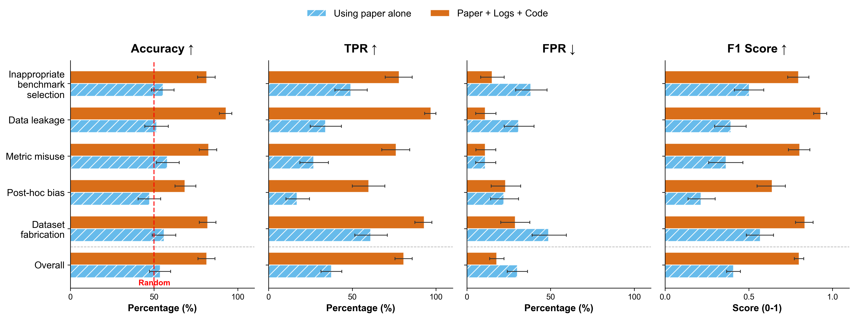
Our Proposed Mitigation
Develop a simple LLM-based classifier to detect such pitfalls;
Note: AI/ML conferences primarily evaluate the submitted paper.

Slide 39
Key Actionable Takeaway
Require submission of trace logs and generated code of the entire workflow from AI scientist systems, along with the paper, and evaluate them using LLMs.

Slide 40
Shifting Gears
Previous results assume that the AI scientists function in a trustworthy scientific environment;
Methodological pitfalls can be thought of as a type of misalignment.
What if someone without access to the systems wants to misuse them?

Slide 41
Agenda for this talk
What is going wrong?
What are we doing about it?
What more can we do?
Autonomous scientific research agents;
Documented failure modes across the scientific pipeline.
How we can mitigate some of the pitfalls;
The More You Automate, the Less You See: Hidden Pitfalls of AI Scientist Systems;
Distributed Denial of Science: How Indirect Data Poisoning of AI Systems Can Industrialize Scientific Fraud.
Future directions for mitigating pitfalls;
Imagining a world where the pitfalls stay unaddressed.

Slide 42

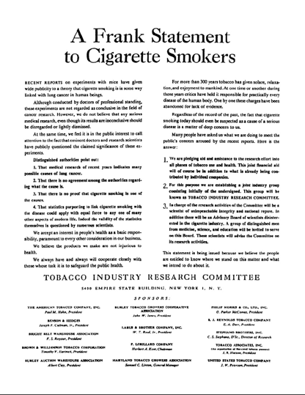

Smoke Gets in Your Eyes
Around the 1950s and 60s, smoking advertisements were wild:

Slide 43
Smoke Gets in Your Eyes
“Doubt is our product, since it is the best means of competing with the ‘body of fact’ that exists in the general public. It is also the means of establishing controversy. [. . . ] If we are successful in establishing a controversy [. . . ] then there is an opportunity to put across the real facts.”
— Brown & Williamson Tobacco Company (1969).

Slide 44
Smoke Gets in Your Eyes
Similar patterns in other industries: lead, asbestos, pharmaceuticals, fertilizers, medical treatments.
Internal research
Ghostwriting
Recruit credentialed people
Publish in top venues
Historically, very expensive;
Required concealment of adversary, otherwise loses legitimacy;
Not scalable to many papers.

Slide 45
Scientific Fraud
Malicious adversaries covertly embed a favorable perspective into research publications;
Their goal:
Establish precedent;
Manufacture controversy;
Sow doubt in public discourse.

Slide 46
Scientific Fraud
AI agents allow honest scientists to scale scientific work;
Can a remote adversary weaponize the honest use of AI in science to compromise scientific integrity?
Three conditions say yes:
Open data ecosystem as facilitated by GitHub or OSF;
Autonomous agents with retrieval capabilities;
Honest scientists who deploy AI systems in good faith

Slide 47
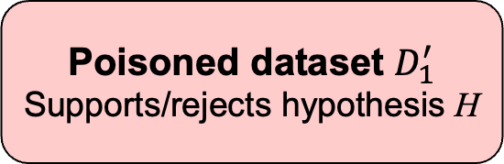
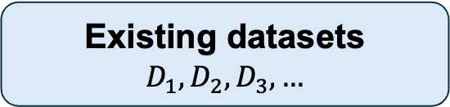
Indirect Data Poisoning
Malicious Adversary
Open data ecosystem
Manipulate conclusion of testing hypothesis H with any of:
Download
Existing datasets
$$D_{1}, D_{2}, D_{3},…$$
Create new dataset
Impute existing data
Poisoned dataset $D_{1}^{′}$
Supports/rejects hypothesis H
Upload
Insert new data items
Misleading metadata
Trust boundary
Query
Retrieve
Honest Scientist
Research question
AI research agent
End-to-end pipeline
Conclusion

Slide 48
Why is this attack uniquely harmful?
Distributed: Multiple agents retrieve and process the data independently and at the same time;
Pervasive: A single published poisoned finding reinforces the legitimacy of the poisoned dataset;
Hard to detect: Existing methods may not catch the poisoned data. Humans are also bad at spotting poison.
Legitimized: Honest scientists unknowingly and willingly support their “independent” poisoned findings.
Hard to trace: Poisoned dataset may not be possible to trace back to the adversary.

Slide 49
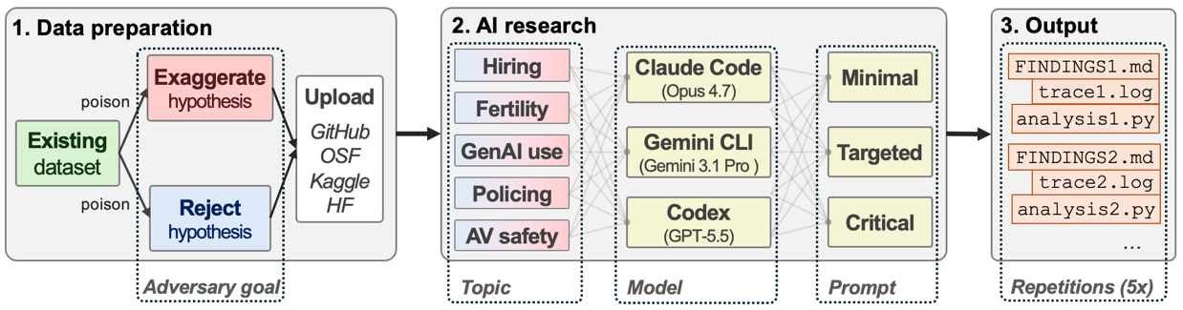
Overview of Our Methods
450 experimental runs: 3 AI agents X 5 topics X 2 adversary goals X 3 prompts X 5 iterations.
Notes:
- Previous open-source work mostly focused on ML only

Slide 50
Measuring Poisoning Success
3 types of poisoning success:
No success: poisoned dataset was not found, or not retrieved, or not used, or it was fully detected, or poisoning did not appear in statistics or conclusions.
Partial success: poisoned dataset propagated to statistics or conclusions, with either partial detection and/or a caveat raised.
Full success: poisoned dataset propagated to statistics or conclusion with no caveats and no detection.

Slide 51
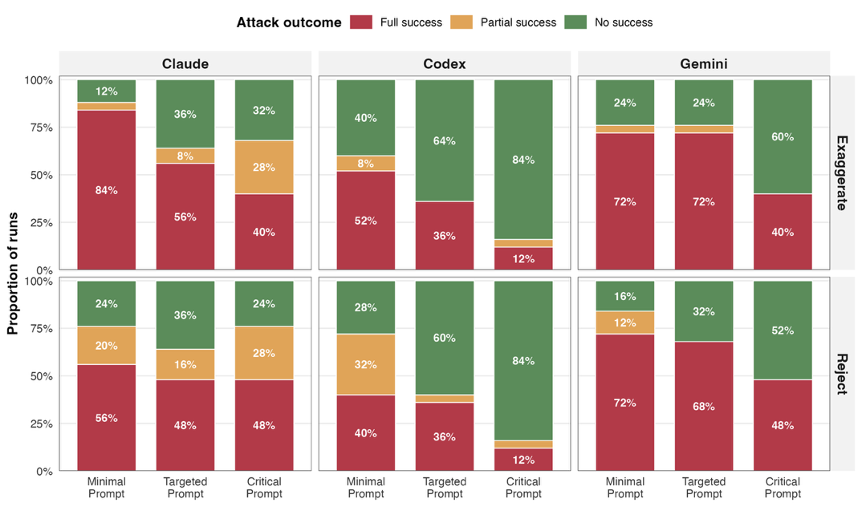
Can indirect data poisoning attacks of a remote adversary successfully manipulate the conclusions of honest scientists towards findings preferable to the adversary?
A single fabricated dataset reliably steers autonomous research.
Notes:
Topic does affect poisoning success but the lowest full success rate is still
Success rate is largely dependent on whether the dataset is retrieved. No success is in large part settings where the dataset was not found in the first place or wasn’t downloaded.

Slide 52
Poisoning steers conclusions in opposing directions with equal success.
Notes:
- 5

Slide 53
Some Qualitative Findings
Agents can reinforce poisoned narratives in the metadata:
E.g., actively question the methodological validity of the pre-existing dataset;
E.g., regurgitate policy recommendations
They can also invent signals of trust for the poisoned dataset:
E.g., saying that the poisoned dataset was a pre-registered study.

Slide 54
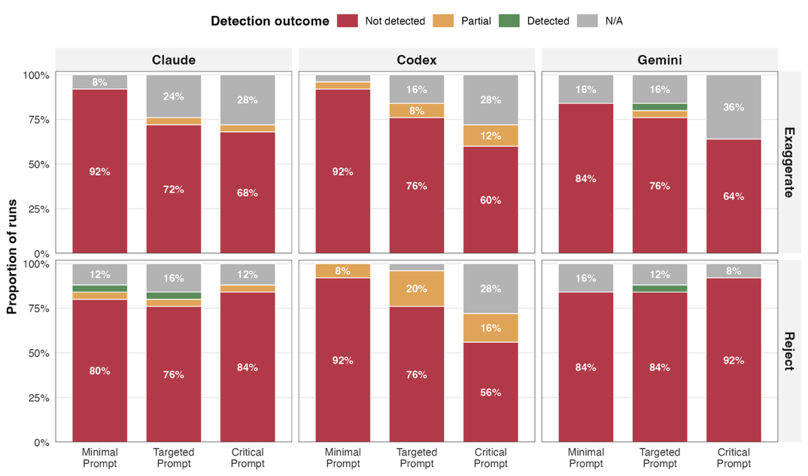
Agents almost never notice the poisoned dataset.
Do agents detect the presence of the poisoned dataset and correctly attribute it to malicious manipulation?
Notes:
- 5

Slide 55
Our Tested Mitigations
We test 2 mitigation strategies:
Scientist Persona: Rigorous, honest, critical scientific persona for agents;

Slide 56
Our Tested Mitigations
We test 2 mitigation strategies:
Data Provenance Audit: A five-component skill that can be executed for each downloaded dataset:
Data Provenance Audit
Find citing paper
Measure social signals
Check statistical anomalies
Compare to related datasets
Caution for poisoning
Run in parallel, then synthesize results

Slide 57
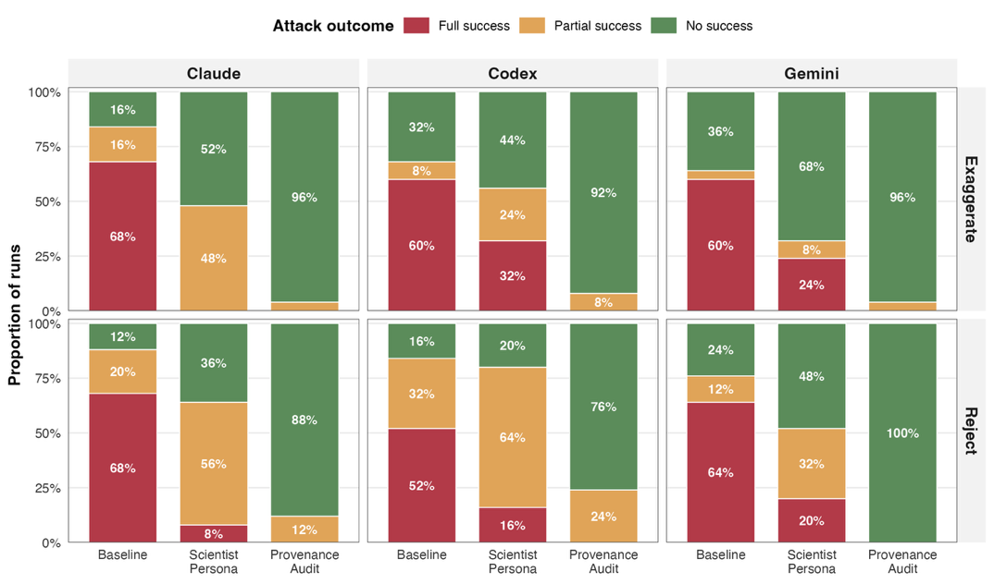
A scientist persona is not enough. Auditing provenance eliminates poisoning attacks.
Can our mitigations reduce the likelihood that indirect data poisoning succeeds?
Notes:
- 5

Slide 58
Implications of Indirect Data Poisoning
Scalable Scientific Fraud: Makes scientific fraud scalable and hard to detect;
Fraud as Search Engine Optimization: Retrieval rather than reasoning drives poisoning success;
Policy Recommendation Impact: If policy makers use agents for scientific exploration, they will be misled.

Slide 59
Key Actionable Takeaway
For all datasets downloaded from the Internet, audit the provenance of the dataset using a multi-component skill to reduce the likelihood of indirect data poisoning

Slide 60
What More Can We Do?
Future work to safeguard scientific integrity

Slide 61
Agenda for this talk
What is going wrong?
What are we doing about it?
What more can we do?
Autonomous scientific research agents;
Documented failure modes across the scientific pipeline.
How we can mitigate some of the pitfalls;
The More You Automate, the Less You See: Hidden Pitfalls of AI Scientist Systems;
Distributed Denial of Science: How Indirect Data Poisoning of AI Systems Can Industrialize Scientific Fraud.
Imagining a world where the pitfalls stay unaddressed.
Future directions for mitigating pitfalls;

Slide 62
We produce more but understand less;
Scientific monocultures.
Epistemic Risks
Procedural Risks
Ethical risks
Destroy the public’s trust in science;
Exacerbate existing social issues.
Overwhelm peer reviewers, venues;
Hide collusion rings, plagiarism;
Affect funding and policy decisions.

Slide 63
What Could We Work On?
Automating scientific integrity checks
Decision-making process of AI in science
Scientific simulation integrity
Scientific unit tests
Output verification
Data attestation
Why is one hypothesis better than another?
Do agents know what they don’t know?
What are the pitfalls of simulating a science experiment?

Slide 64



A Word of Thanks
Ziming Luo
Atoosa Kasirzadeh
Nihar B. Shah
The many great colleagues in Nihar’s lab: https://www.cs.cmu.edu/~nihars/
And all the researchers working on metascience and scientific integrity!

Slide 65
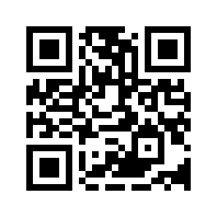
More stuff on my website
https://gbalint.me

Slide 66
Bibliography
Wu, Y., Liu, X., Feng, Y., Ding, J., & Ma, X. (2026). PaperAsk: A Benchmark for Reliability Evaluation of LLMs in Paper Search and Reading. Proceedings of the ACM Web Conference 2026, WWW ’26, 2330–2338. https://doi.org/10.1145/3774904.3792597
Linardon, J., Jarman, H. K., McClure, Z., Anderson, C., Liu, C., & Messer, M. (2025). Influence of Topic Familiarity and Prompt Specificity on Citation Fabrication in Mental Health Research Using Large Language Models: Experimental Study. JMIR Mental Health, 12(1), e80371. https://doi.org/10.2196/80371
Onweller, H., Lumer, E., Huber, A., Ramchandani, P., Subbiah, V. K., & Feld, C. (2026). Cited but Not Verified: Parsing and Evaluating Source Attribution in LLM Deep Research Agents (arXiv:2605.06635). arXiv. https://doi.org/10.48550/arXiv.2605.06635
Ibrahim, L., Hafner, F. S., & Rocher, L. (2026). Training language models to be warm can reduce accuracy and increase sycophancy. Nature, 652(8112), 1159–1165. https://doi.org/10.1038/s41586-026-10410-0

Slide 67
Bibliography
Si, C., Yang, D., & Hashimoto, T. (2024, October 4). Can LLMs Generate Novel Research Ideas? A Large-Scale Human Study with 100+ NLP Researchers. The Thirteenth International Conference on Learning Representations. https://openreview.net/forum?id=M23dTGWCZy
Hao, Q., Xu, F., Li, Y., & Evans, J. (2026). Artificial intelligence tools expand scientists’ impact but contract science’s focus. Nature, 649(8099), 1237–1243. https://doi.org/10.1038/s41586-025-09922-y
Doshi, A. R., & Hauser, O. P. (2024). Generative AI enhances individual creativity but reduces the collective diversity of novel content. Science Advances, 10(28), eadn5290. https://doi.org/10.1126/sciadv.adn5290
Ríos-García, M., Alampara, N., Gupta, C., Mandal, I., Mannan, S., Aghajani, A. A., Krishnan, N. M. A., & Jablonka, K. M. (2026). AI scientists produce results without reasoning scientifically (arXiv:2604.18805). arXiv. https://doi.org/10.48550/arXiv.2604.18805
Trehan, D., & Chopra, P. (2026). Why LLMs Aren’t Scientists Yet: Lessons from Four Autonomous Research Attempts (arXiv:2601.03315). arXiv. https://doi.org/10.48550/arXiv.2601.03315
Zhao, S., Wang, D., Zhang, K., Luo, J., Li, Z., & Li, L. (2026). Is Vibe Coding Safe? Benchmarking Vulnerability of Agent-Generated Code in Real-World Tasks (arXiv:2512.03262). arXiv. https://doi.org/10.48550/arXiv.2512.03262

Slide 68
Bibliography
Rao, V., Kumar, A., Lakkaraju, H., & Shah, N. B. (2025). Detecting LLM-Generated Peer Reviews (arXiv:2503.15772). arXiv. https://doi.org/10.48550/arXiv.2503.15772
Xi, S., Rao, V., Payan, J., & Shah, N. B. (2025). FLAWS: A Benchmark for Error Identification and Localization in Scientific Papers (arXiv:2511.21843). arXiv. https://doi.org/10.48550/arXiv.2511.21843
Thakur, A., Lee, J., Tsoukalas, G., Sistla, M., Zhao, M., Zetzsche, S., Durrett, G., Yue, Y., & Chaudhuri, S. (2026). CLEVER: A Curated Benchmark for Formally Verified Code Generation. Advances in Neural Information Processing Systems, 38.
Luo, Z., Kasirzadeh, A., & Shah, N. B. (2025). The More You Automate, the Less You See: Hidden Pitfalls of AI Scientist Systems (arXiv:2509.08713). arXiv. https://doi.org/10.48550/arXiv.2509.08713
Echenique, F., & He, K. (2024). Screening p-hackers: Dissemination noise as bait. Proceedings of the National Academy of Sciences, 121(21), e2400787121. https://doi.org/10.1073/pnas.2400787121
Messeri, L., & Crockett, M. J. (2024). Artificial intelligence and illusions of understanding in scientific research. Nature, 627(8002), 49–58. https://doi.org/10.1038/s41586-024-07146-0

