Slide 1


Deep Spatio-Temporal Residual Networks for Citywide Crowd Flows Prediction
作者：Junbo Zhang, Yu Zheng，Dekang Qi
刊载：Thirty-First AAAI Conference on Artificial Intelligence (AAAI-17)
Notes:
亮亮图文旗舰店https://liangliangtuwen.tmall.com

Slide 2

背景以及贡献
背景：人群流量预测对交通管理和公共安全具有重要意义，且受跨区域交通、事件、天气等多种复杂因素影响，具有很强的挑战性。
贡献：提出了一种基于深度学习的方法，称为ST-ResNet，来综合预测城市每个区域的人群流入和流出。在北京和纽约两个人流量数据集上进行实验，比六种先进方法效果更好。

Slide 3
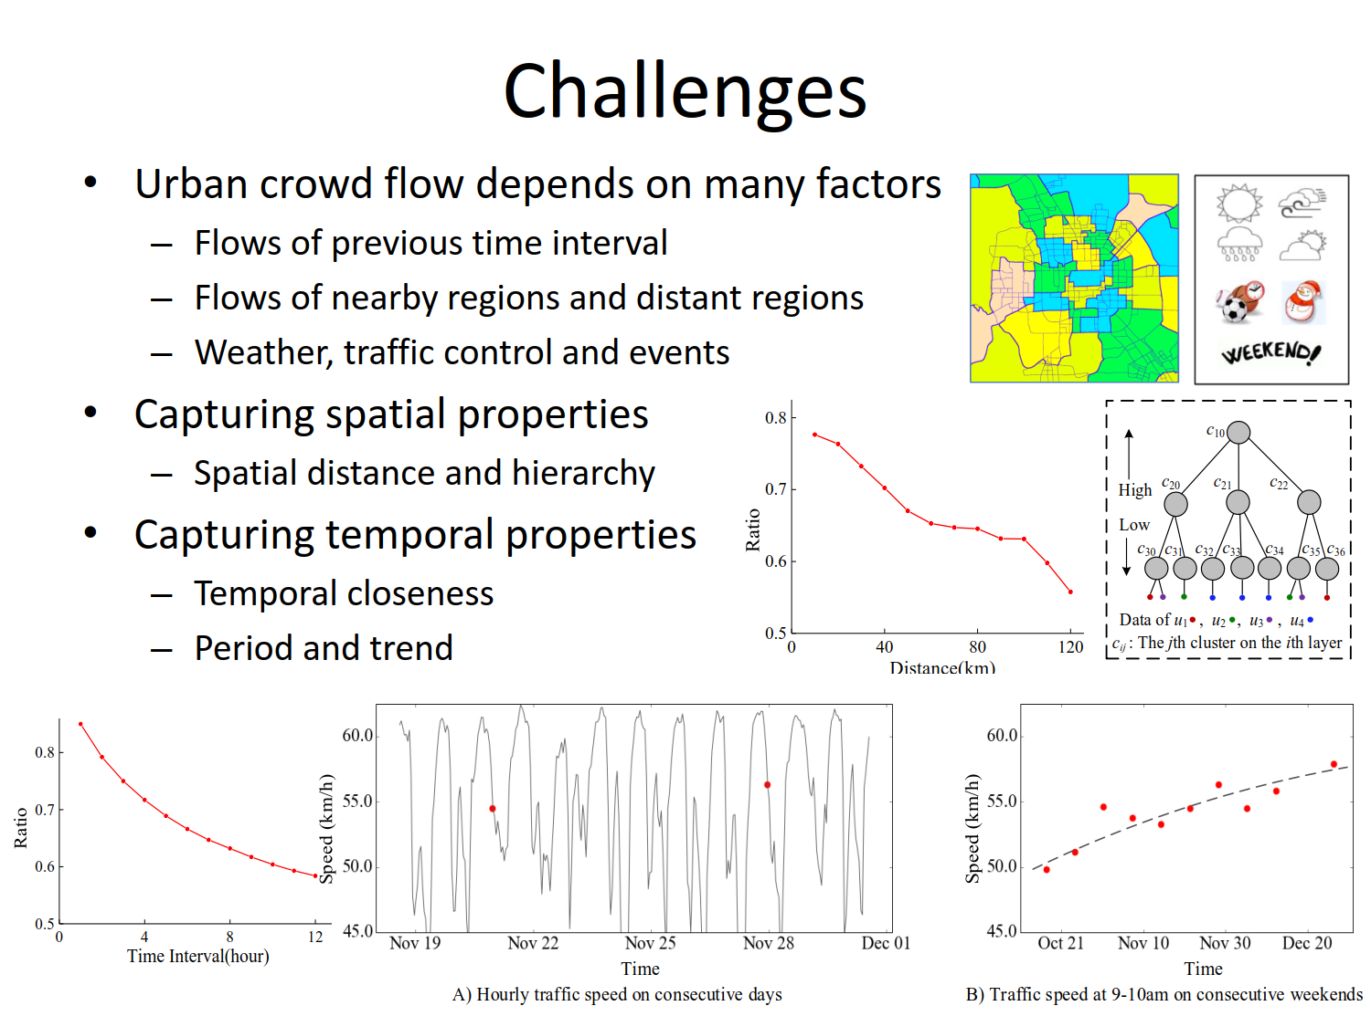
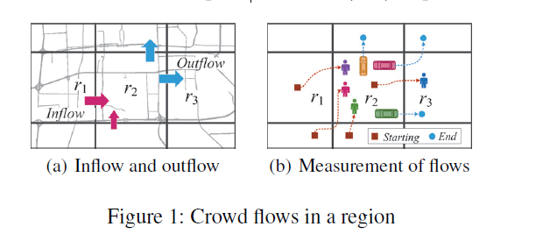
人流量预测
1

Slide 4
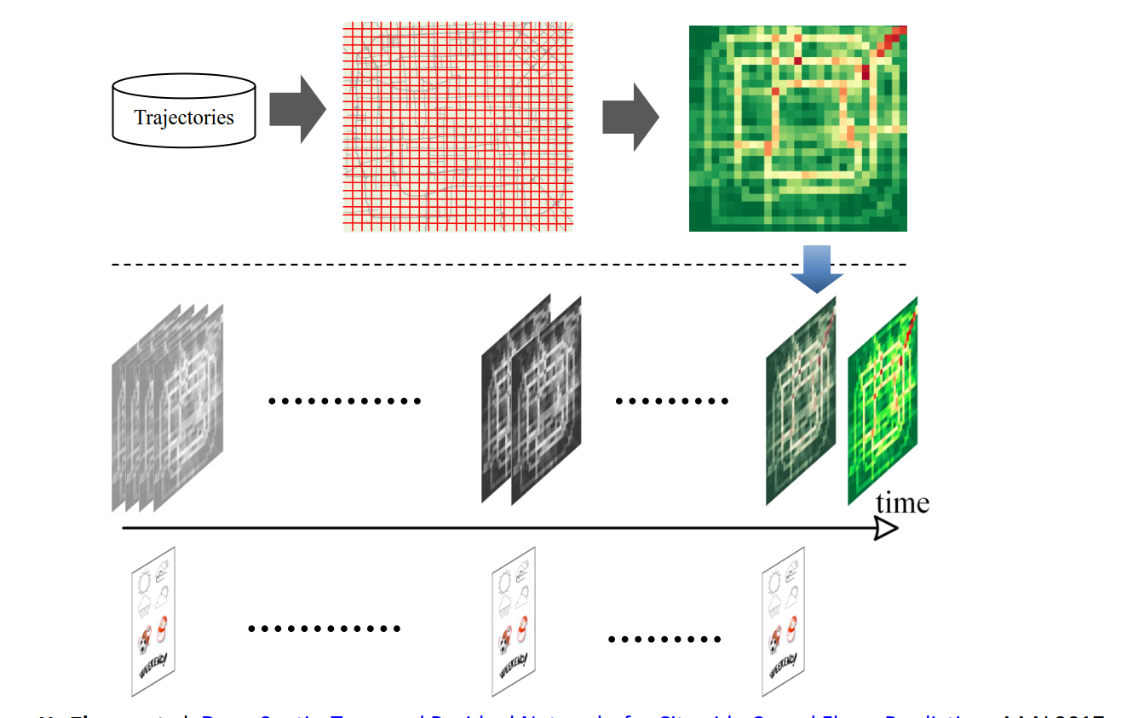
思路
将轨迹数据转换为类似视频的数据，再进行分析处理。

Slide 5
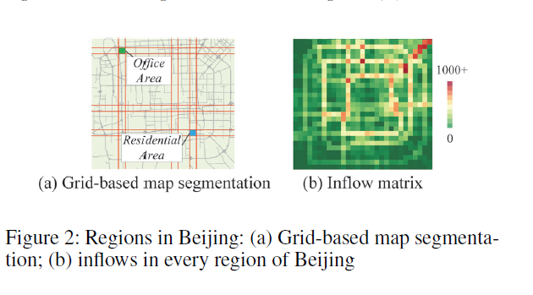
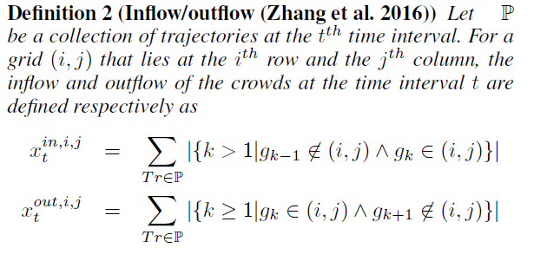
问题描述
where Tr : g1 → g2 → · · · → g|Tr| is a trajectory in P,
and gk is the geospatial coordinate; gk ∈ (i, j) means the
point gk lies within grid (i, j), and vice versa; | · | denotes
the cardinality of a set.
Definition 1 we partition a city into an I×J grid map based on the longitude and latitude where a grid denotes a region

Slide 6
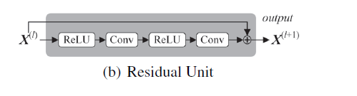
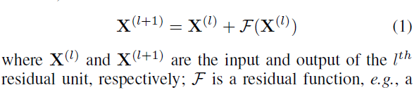
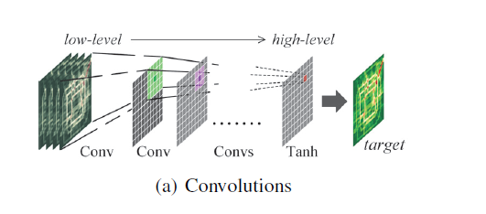
模型构建
问题：Given the historical observations {Xt|t =0, · · · , n − 1}, predict Xn.
给定历史数据进行预测
定义残差块
捕获空间依赖

Slide 7
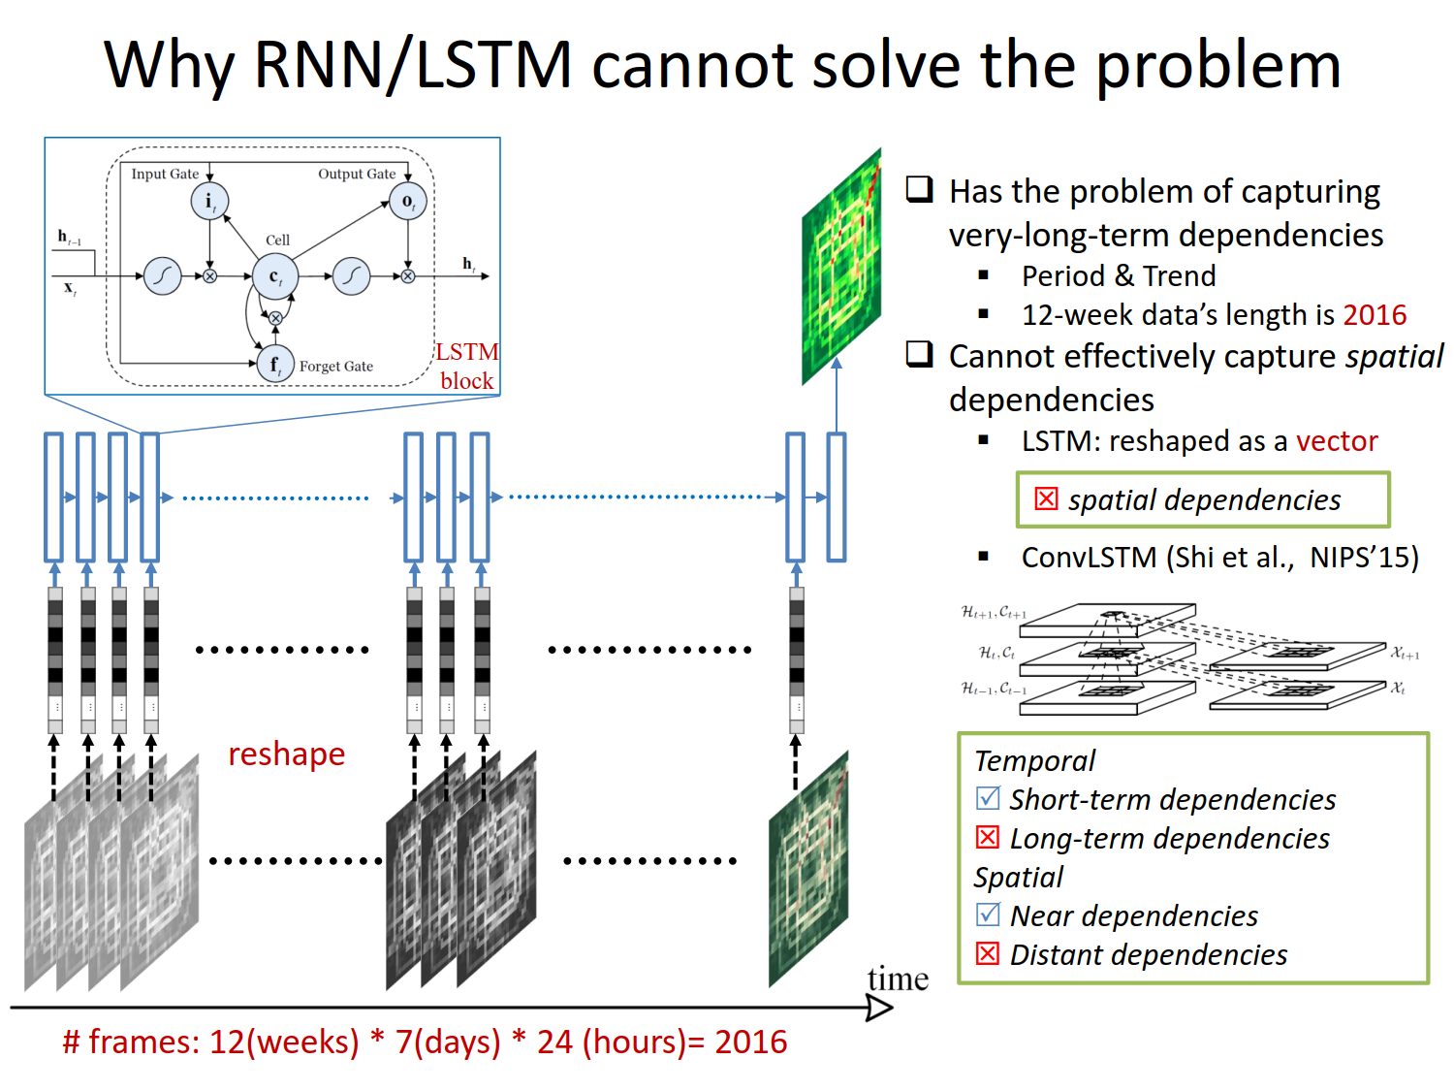

Slide 8
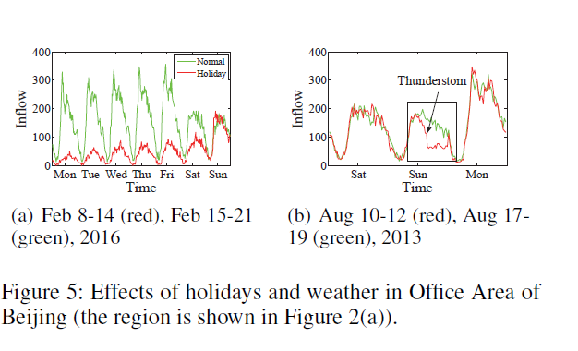
外部因素
Traffic flows can be affected by many complex external
factors, such as weather and event.

Slide 9
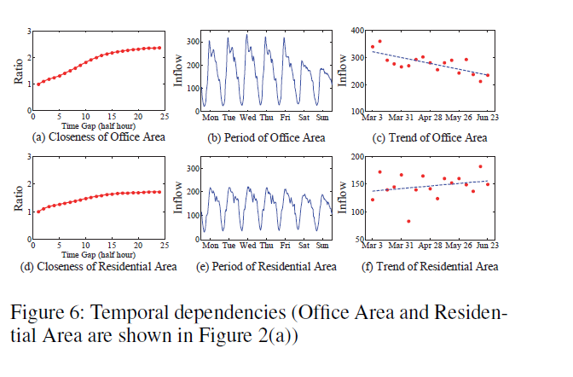
数据融合
The different regions are all affected by closeness,
period and trend, but the degrees of influence may be different.

Slide 10
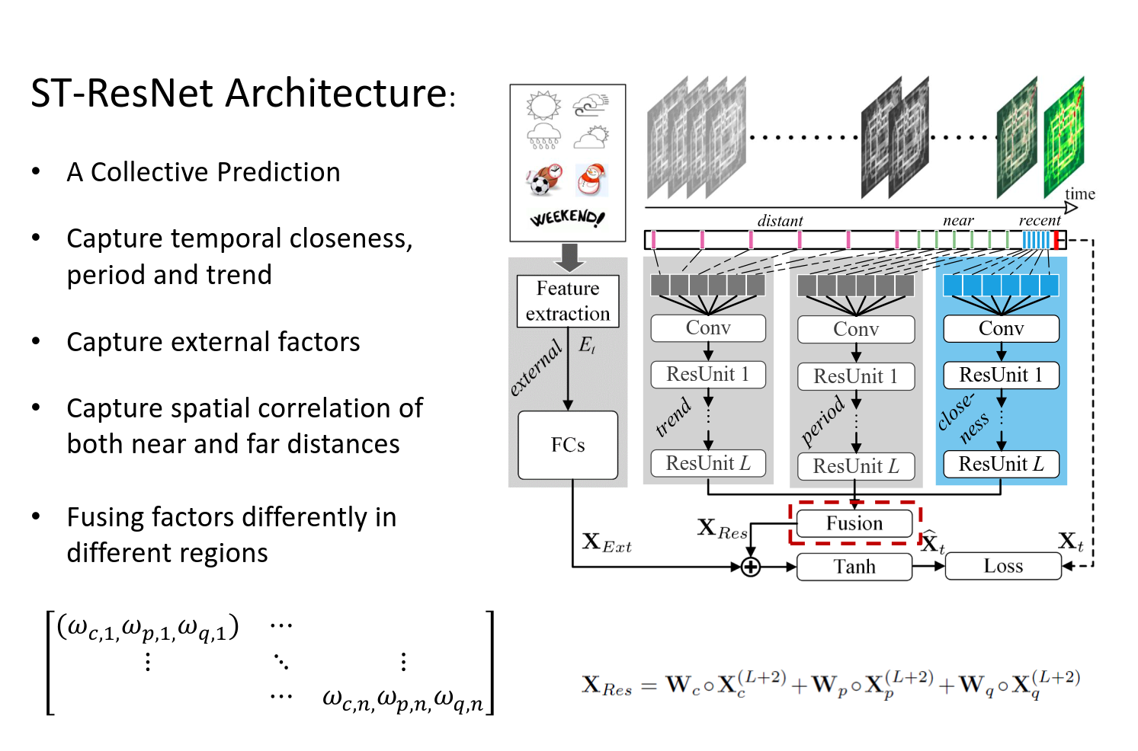
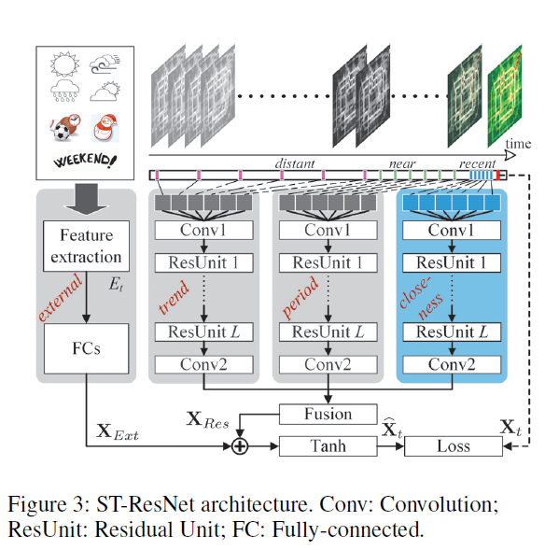

Slide 11
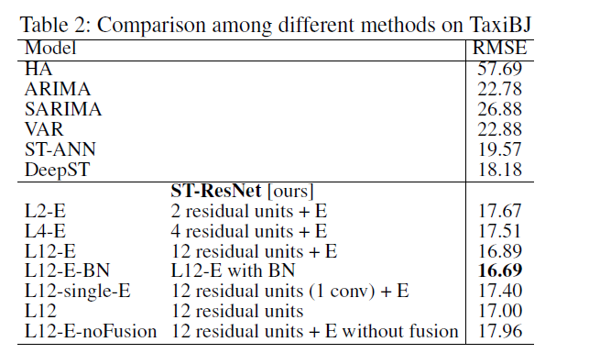
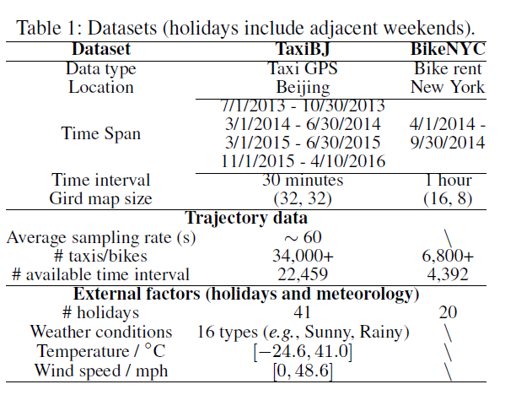
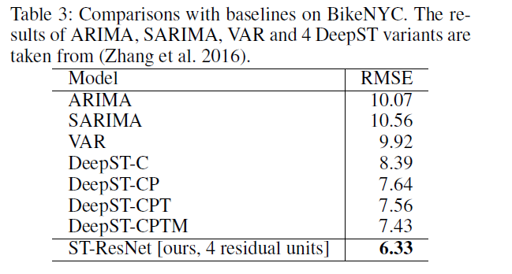
数据及实验结果

