Slide 1
Final project
Yifei Guo (yg2496)

Slide 2
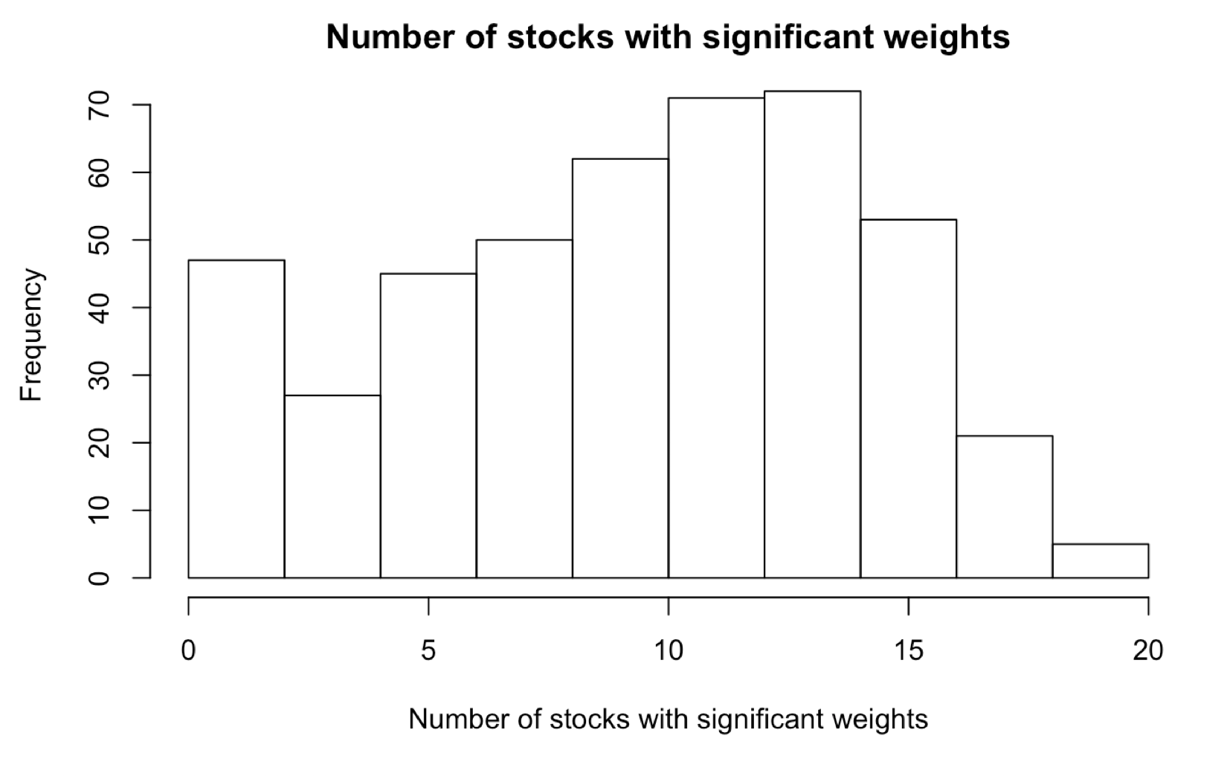
Lessons from midterm
Invest in 20 stocks instead of 30 stocks.

Slide 3
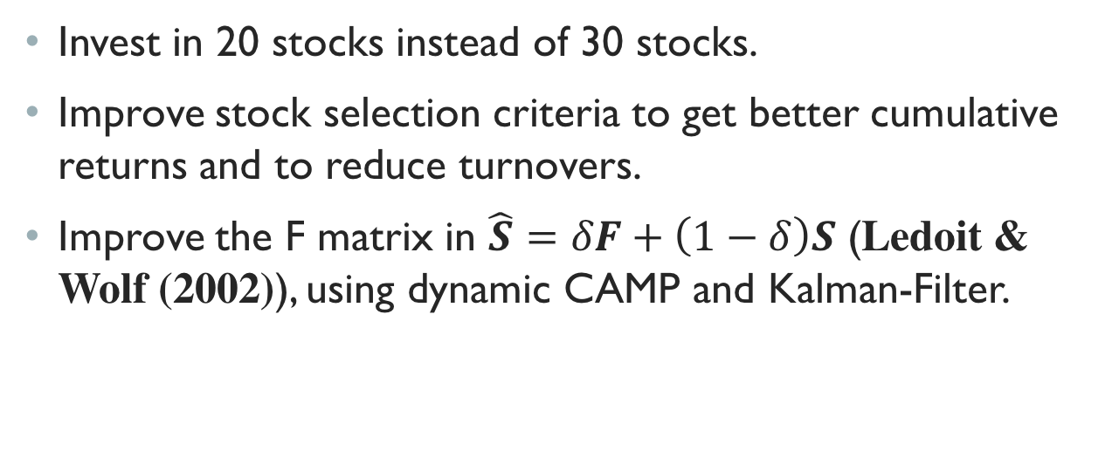
Lessons from midterm
Invest in 20 stocks instead of 30 stocks.
Improve stock selection criteria to get better cumulative returns and to reduce turnovers.
Improve the F matrix in $\hat{S}=δF+\left(1−δ\right)S$ (Ledoit & Wolf (2002)), using dynamic CAMP and Kalman-Filter.

Slide 4
Data cleaning
Total of 3258 stocks.
na.interp() and tsclean()
Total number of outliers is about 1% of the entire dataset.
Use cleaned data (log returns) to recalculate prices for all 3258 stocks. (initial prices are set as 100)

Slide 5
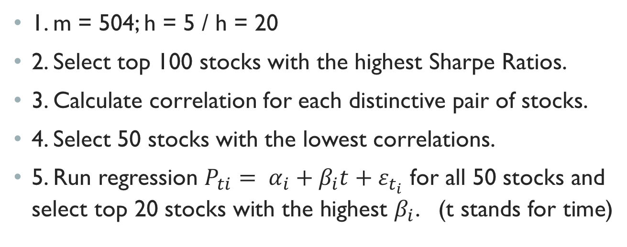
Stock Selection—Rolling window 1
1. m = 504; h = 5 / h = 20
2. Select top 100 stocks with the highest Sharpe Ratios.
3. Calculate correlation for each distinctive pair of stocks.
4. Select 50 stocks with the lowest correlations.
5. Run regression $P_{ti}= α_{i}+β_{i}t+ε_{t_{i}}$ for all 50 stocks and select top 20 stocks with the highest $β_{i}$. (t stands for time)

Slide 6
Stock Selection—Rolling window 2 and beyond
Calculate Sharpe Ratios for all 20 stocks after each rolling window exercise.
Exclude one stock with the lowest Sharpe Ratio
Add one stock with the highest Sharpe Ratio but not yet selected.

Slide 7
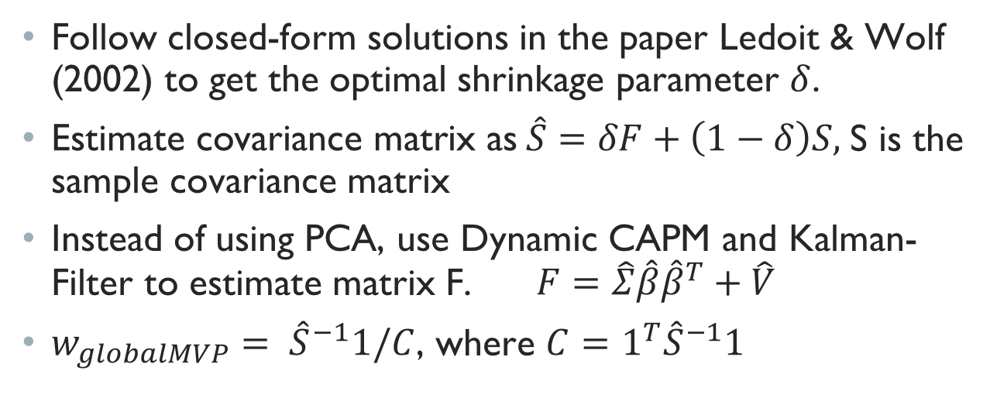
Portfolio Optimization
Follow closed-form solutions in the paper Ledoit & Wolf (2002) to get the optimal shrinkage parameter $δ$.
$\text{Estimate} \text{covariance} \text{matrix} \text{as} \hat{S}=δF+\left(1−δ\right)S,$S is the sample covariance matrix
Instead of using PCA, use Dynamic CAPM and Kalman-Filter to estimate matrix F. $F=\hat{Σ}\hat{β}{\hat{β}}^{T}+\hat{V}$
$w_{globalMVP}= {\hat{S}}^{−1}1/C$, where $C=1^{T}{\hat{S}}^{−1}1$

Slide 8
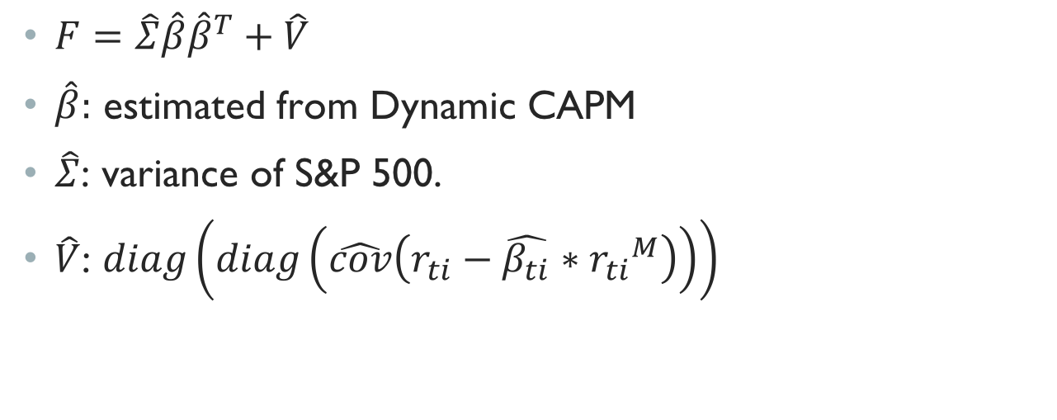
Estimate Matrix F
$F=\hat{Σ}\hat{β}{\hat{β}}^{T}+\hat{V}$
$\hat{β}:$ estimated from Dynamic CAPM
$\hat{Σ}$: variance of S&P 500.
$\hat{V}$: $diag\left(diag\left(\hat{cov}\left(r_{ti}−\hat{β_{ti}}∗{r_{ti}}^{M}\right)\right)\right)$

Slide 9


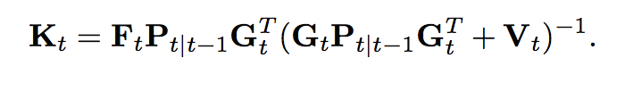

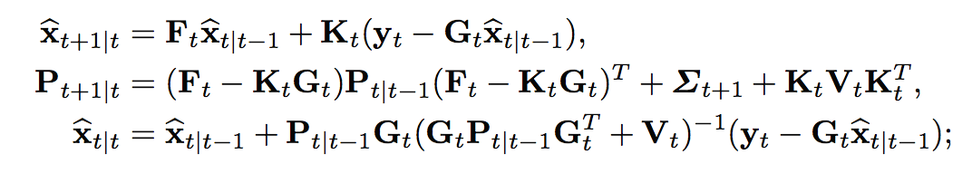



Estimate $\hat{β}$
Model:
For simplicity, $r_{f,t}$=0
Recursive Formulas:
$\hat{β_{t|t}}$ ←

Slide 10
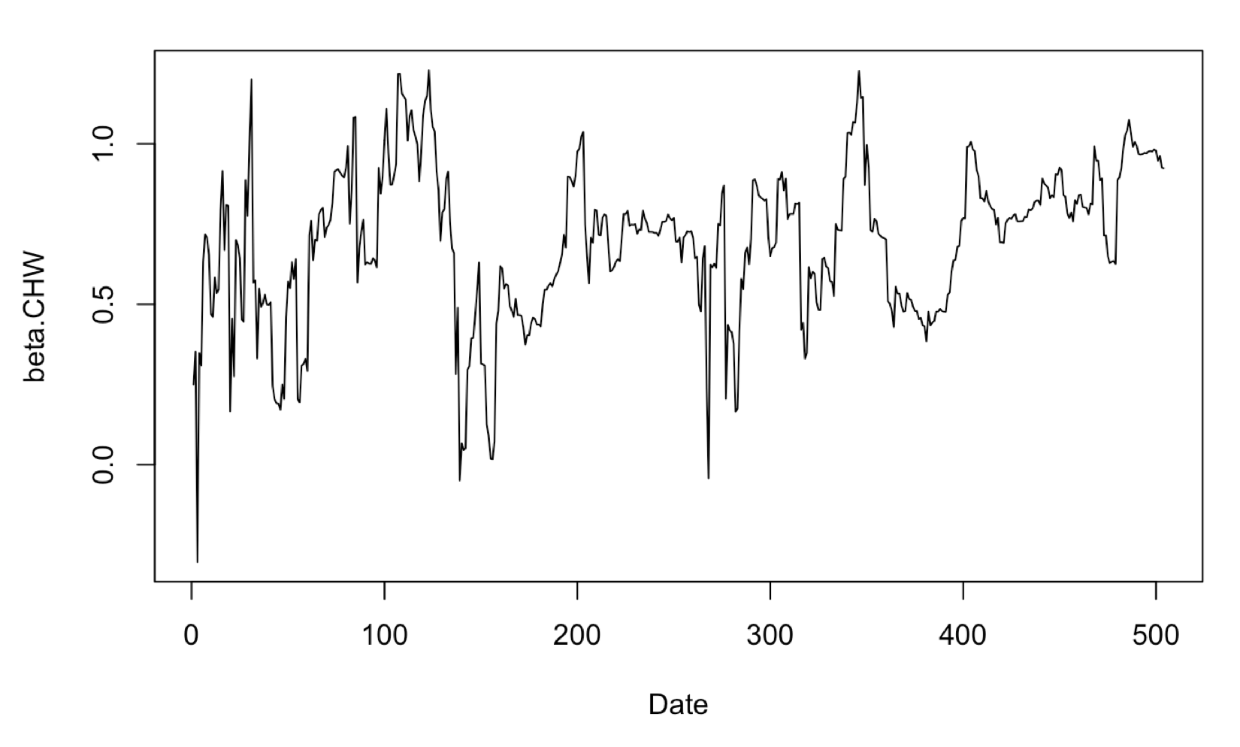


Estimate $\hat{β}$
First use CAPM to get Initial conditions. $\hat{β_{1|0}}$ & $P_{1|0}$
Then follow the recursive formulas to get $\hat{β_{t|t}}$ (one period).

Slide 11
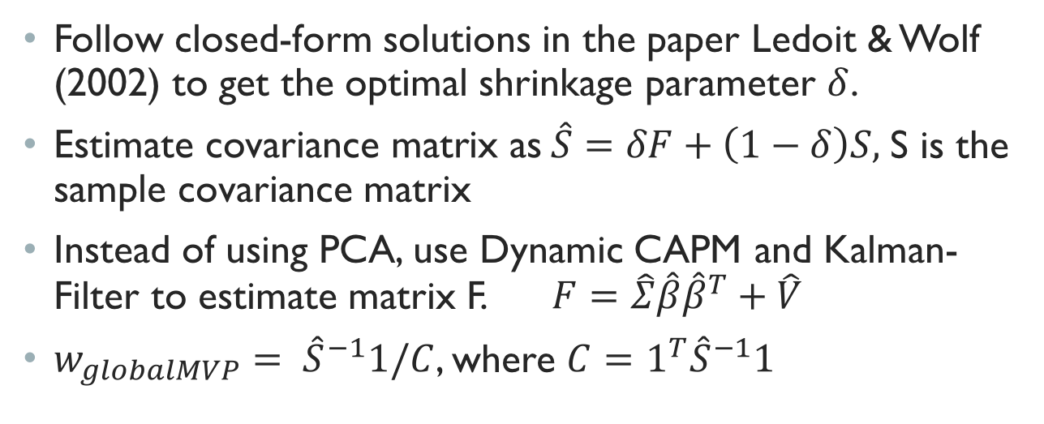
Portfolio Optimization
Follow closed-form solutions in the paper Ledoit & Wolf (2002) to get the optimal shrinkage parameter $δ$.
$\text{Estimate} \text{covariance} \text{matrix} \text{as} \hat{S}=δF+\left(1−δ\right)S,$S is the sample covariance matrix
Instead of using PCA, use Dynamic CAPM and Kalman-Filter to estimate matrix F. $F=\hat{Σ}\hat{β}{\hat{β}}^{T}+\hat{V}$
$w_{globalMVP}= {\hat{S}}^{−1}1/C$, where $C=1^{T}{\hat{S}}^{−1}1$

Slide 12
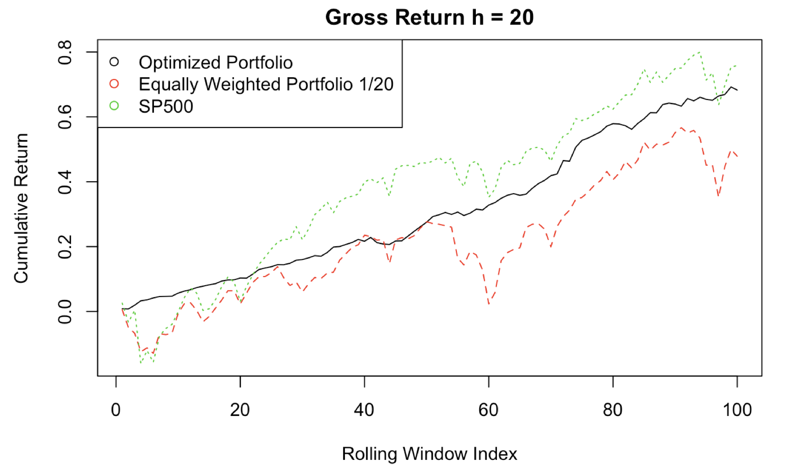
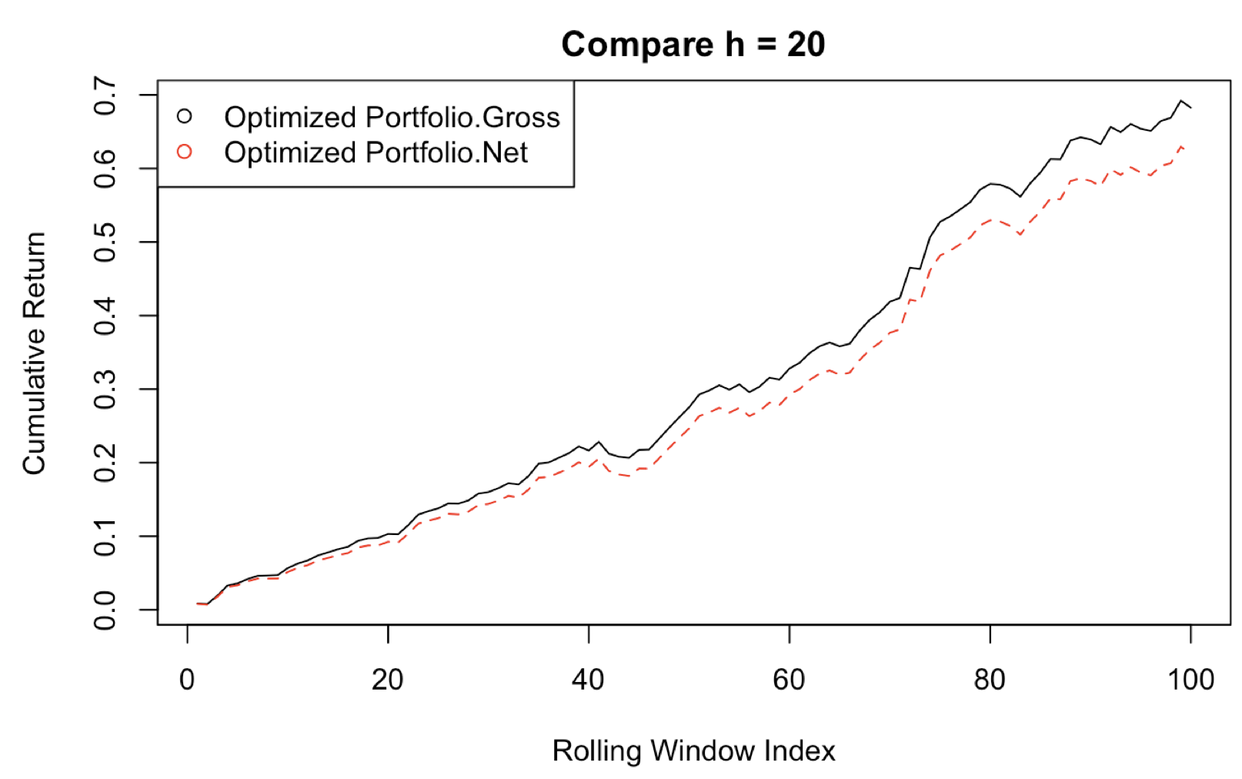
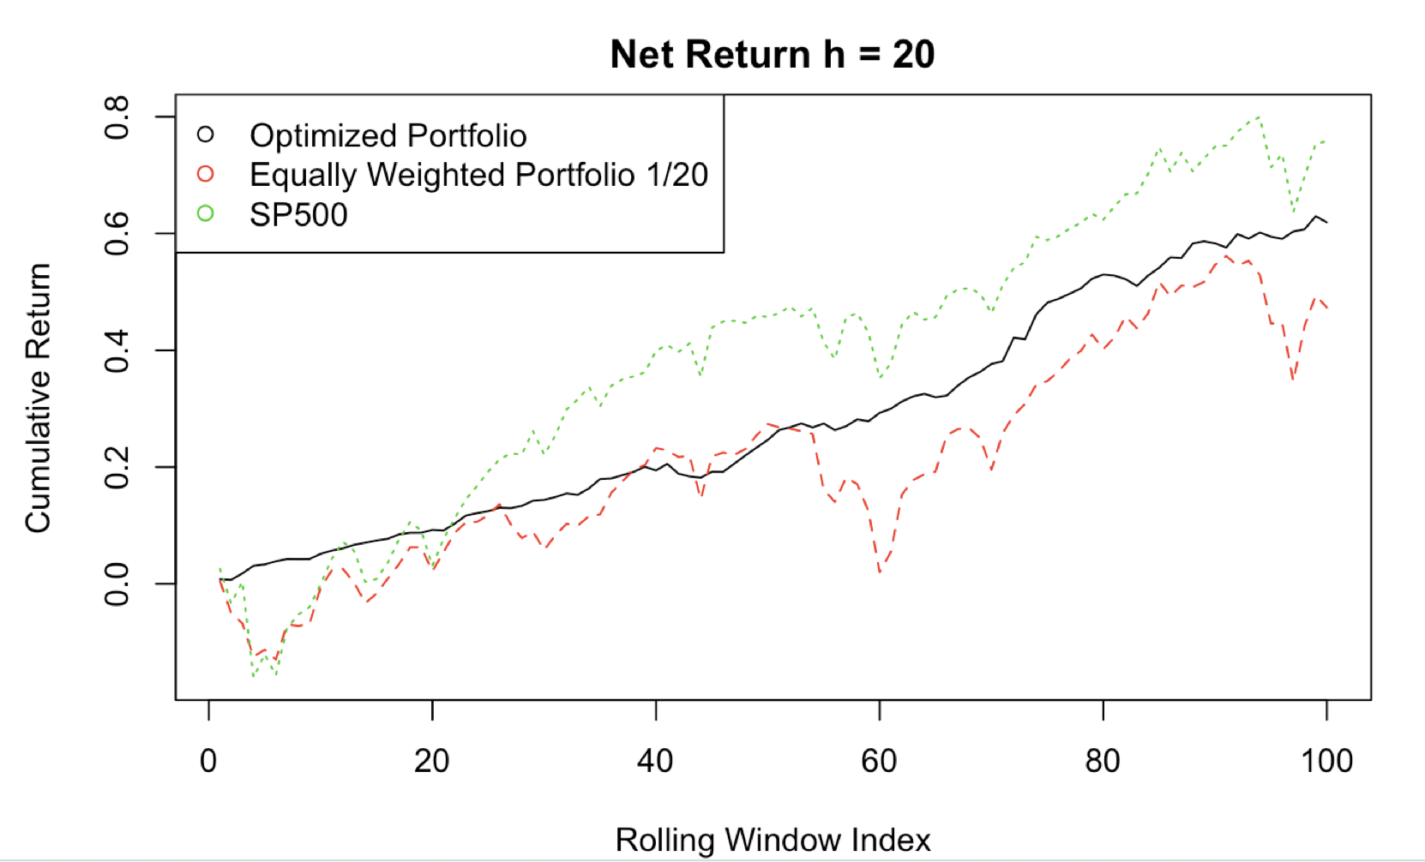
M = 504, h =20

Slide 13
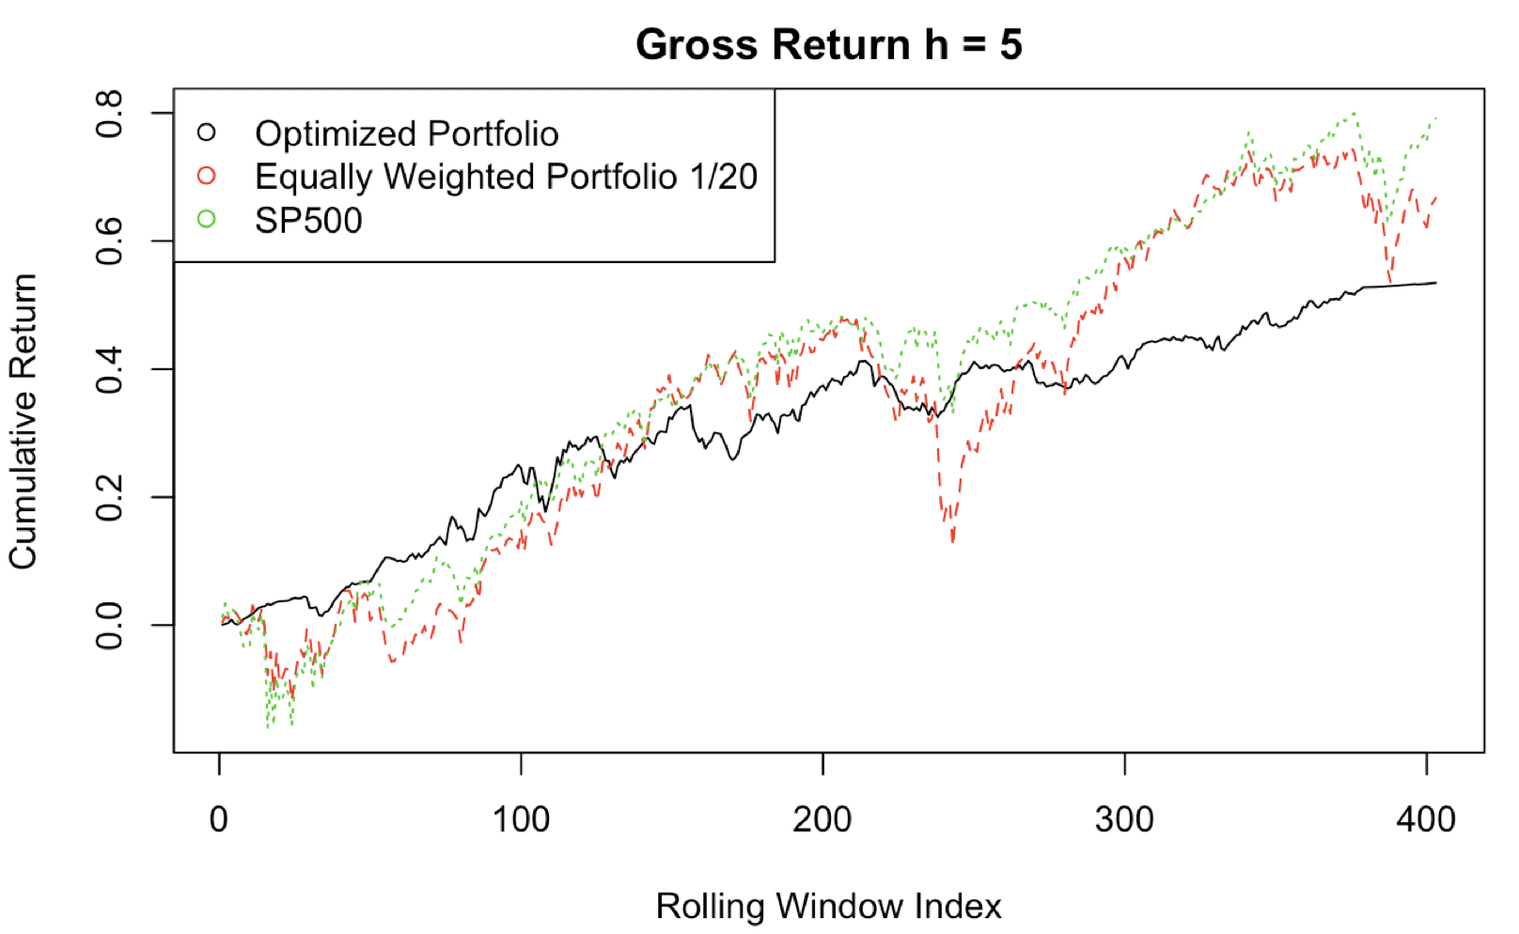
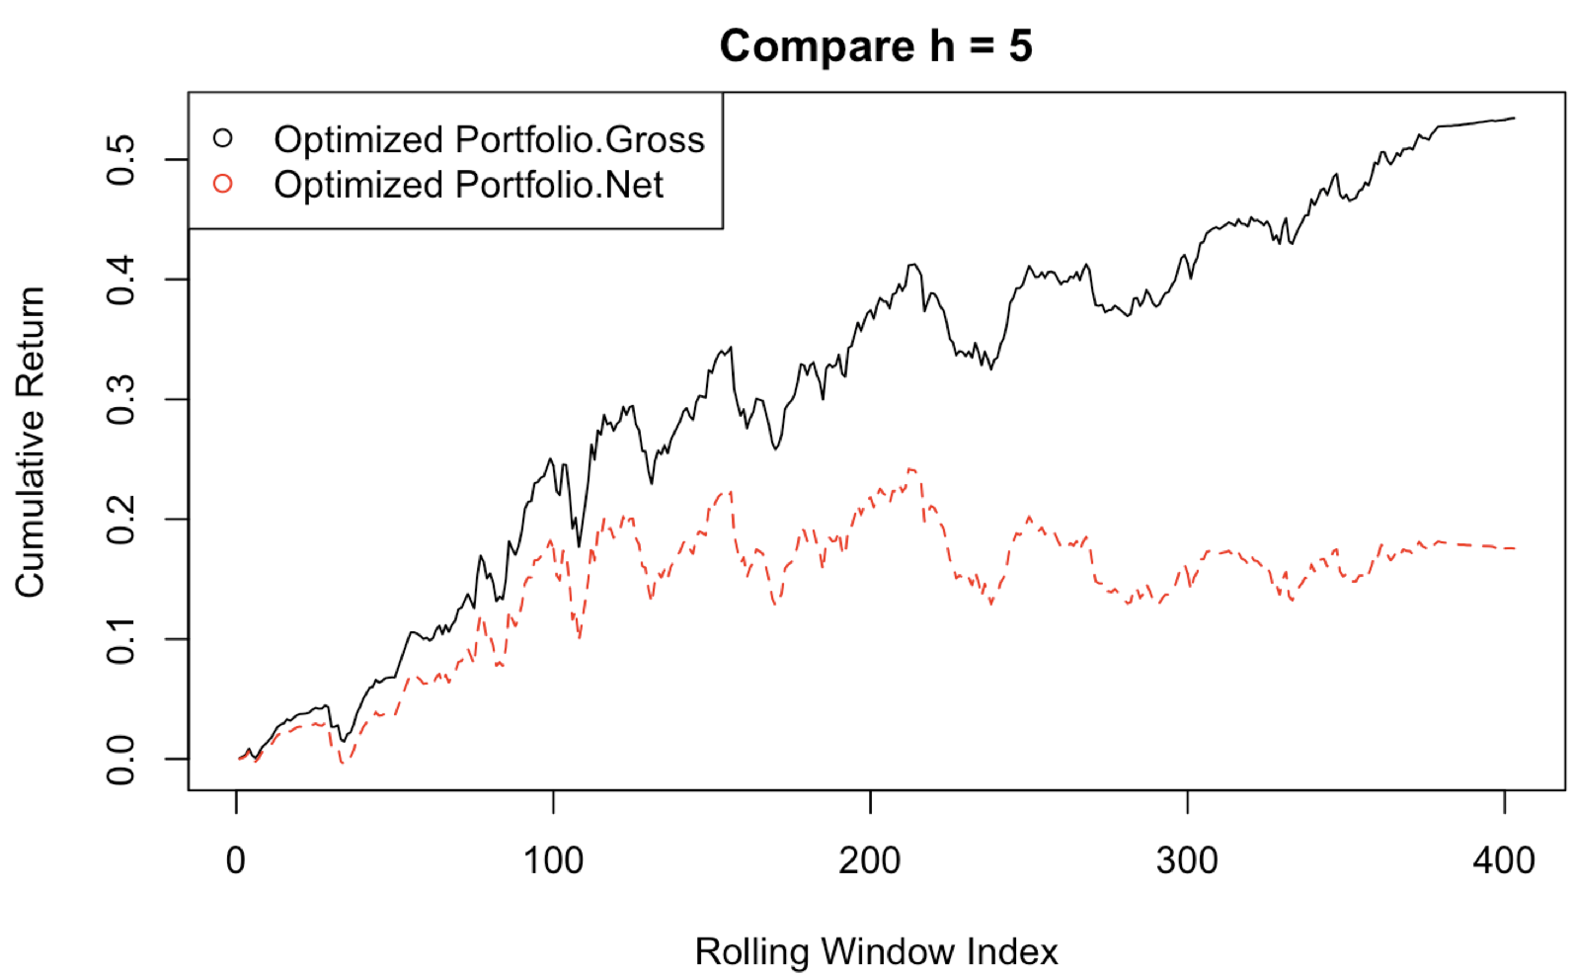
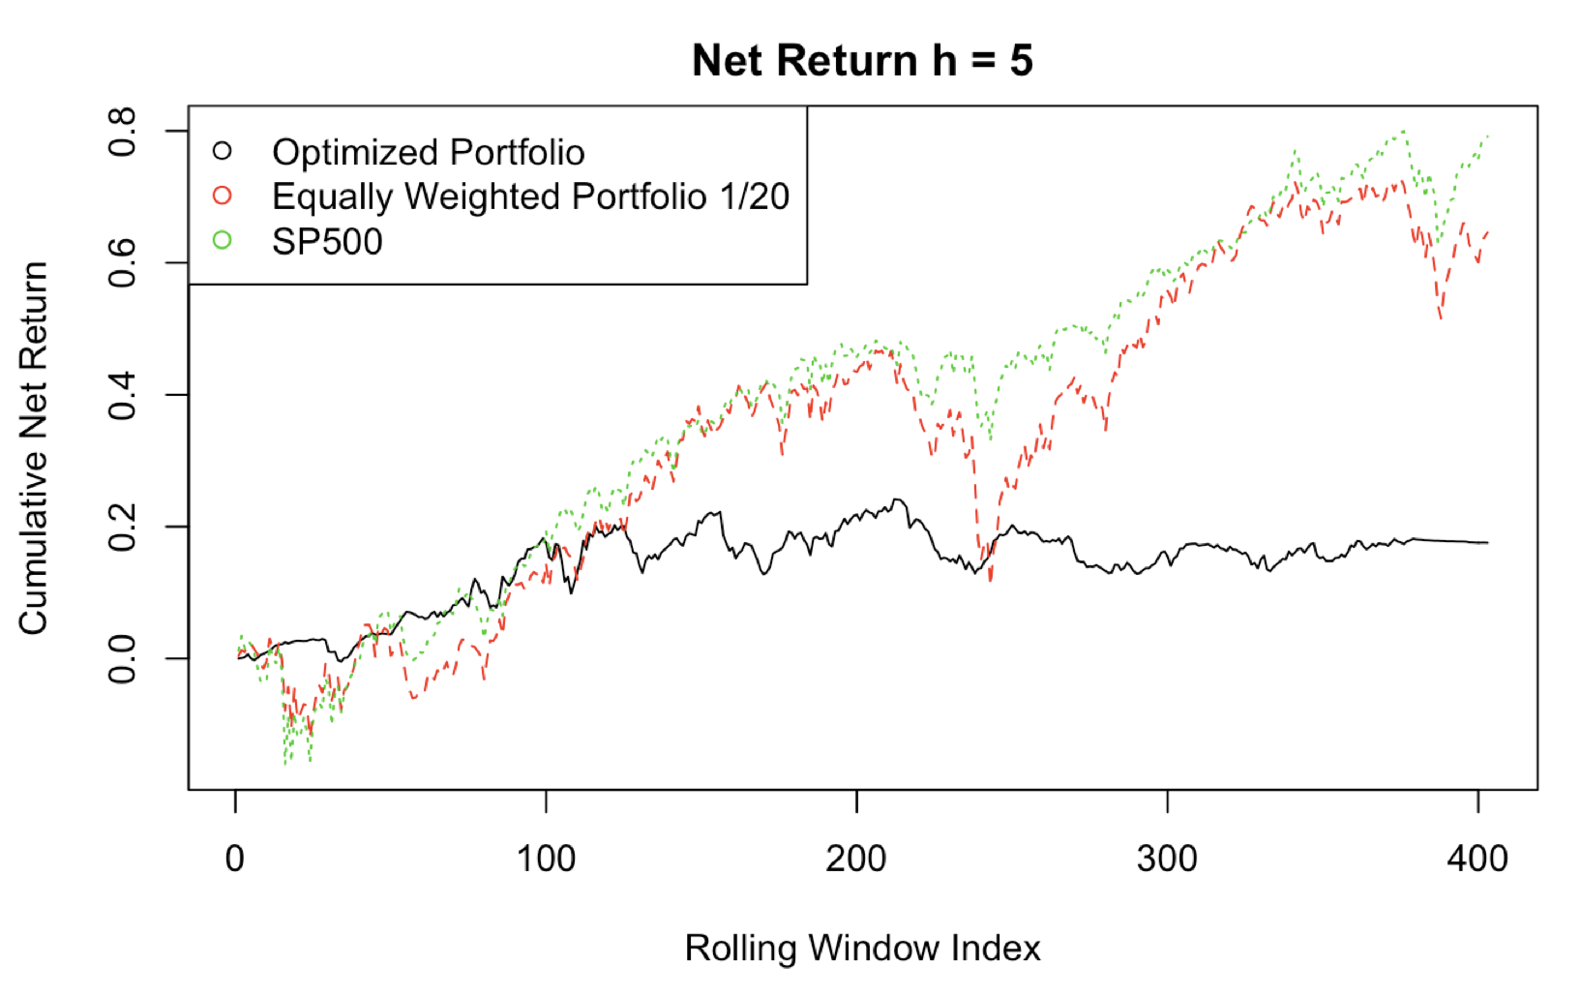
M = 504, h = 5

Slide 14
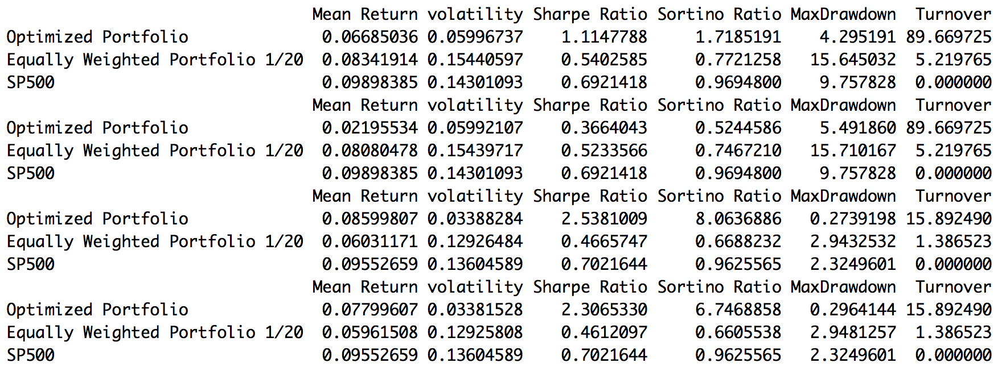
Annualized Final Statistics
M = 504
h = 5 Gross
h = 5 Net
h = 20 Gross
h = 20 Net

Slide 15
Pros
Smooth growth
high Sharpe Ratios, high Sortino Ratios, low volatilities
Conservative but resistant to risks.
Perform better than equally-weighted 1/20 portfolio so the portfolio optimization part is successful. (only true for h = 20)
Lower turnovers(only true for h = 20)

Slide 16
Cons
Cumulative returns (gross and net) are less than that of sp500.
Cumulative returns (gross and net) are sensitive to changes in h.
ALSO sensitive to changes in m.

Slide 17
Sensitivities to h
Both GROSS and NET cumulative returns are sensitive to changes in h.
Possible Explanations:
Stock selection for rolling window 2 and beyond may work better for larger h by ruling out stocks with higher volatilities. If this is true then it explains why cumulative returns grow smoother for h = 20. However, equally weighted portfolio 1/20 still performs better for h = 5 but with lower Sharpe Ratios.
If stocks selected for each rolling window are more stable for h=20 than for h=5, weight optimization may amplify turnovers for h=5 by constantly changing weights over stocks to get smoother growth.

Slide 18
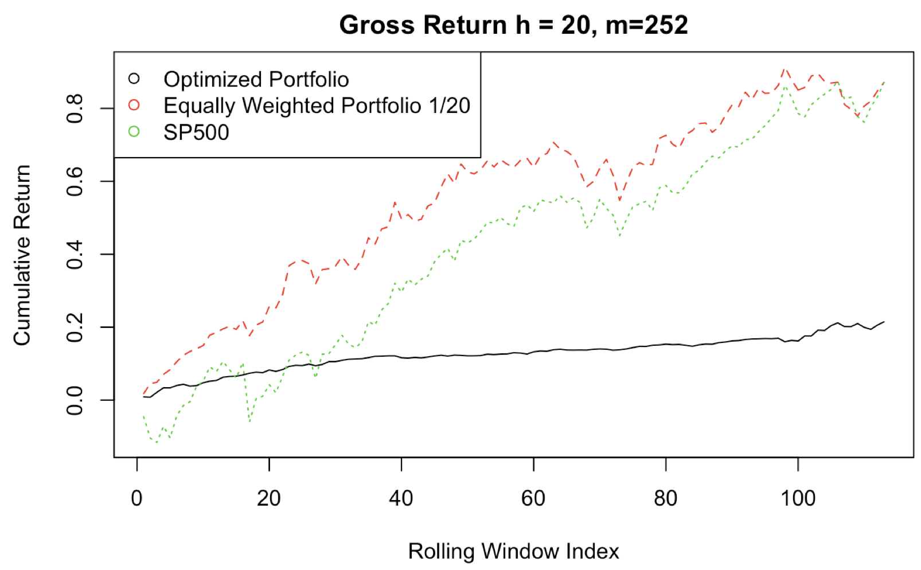
Sensitivities to M
m = 504

Slide 19
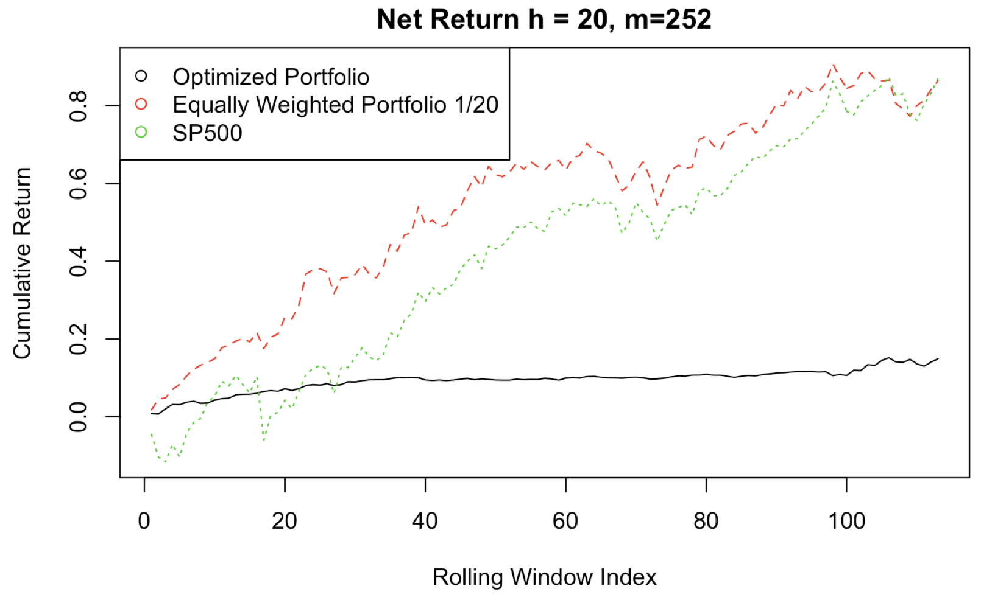
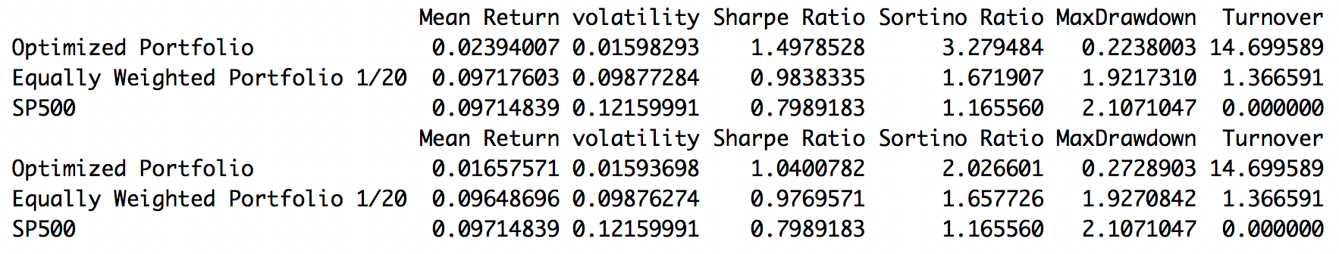
m = 504
m =252 Gross
m =252 Net
H = 20
m =504 Gross
m =504 Net

Slide 20
Sensitivities to M
For both m = 252 and m = 504, volatilities and turnovers are low. Sharpe Ratios are high. Good!
Equally weighted portfolio 1/20 performs better for m = 252, even starting from the beginning. Puzzling…
Still, mean returns are low; portfolio optimization works better for m = 504.
Possible Explanations:
Dynamic CAPM needs longer prediction intervals to be effective.

Slide 21
Possible Improvements and Conclusions
Possible Improvements:
Try other portfolio optimization strategies with higher expected return, such as the tangency portfolio instead of the global minimum variance portfolio.
Consider better stock-selection criteria for rolling windows 2 and beyond.
Try other initial conditions for the Dynamic CAPM.
Incorporate Kalman-Filter smoothing and time-series forecasts for the dynamic betas to get smoother betas.
Conclusions:
Incorporating trend-detections to improve initial stock selections.
Replacing only stocks with the lowest volatility reduces turnovers.
Dynamic CAPM and Kalman-Filter may not be a good estimation for matrix F

Slide 22
Thanks!
I would like to say “thank you” to Thuy Linh!
Codes are posted on: https://github.com/gyf1217/Statistical-Methods-for-Finance

