Slide 1



Drone
GV
Hospital
Base
Low
Priority
Medium
Priority
High
Priority
ATM Alert

Slide 2
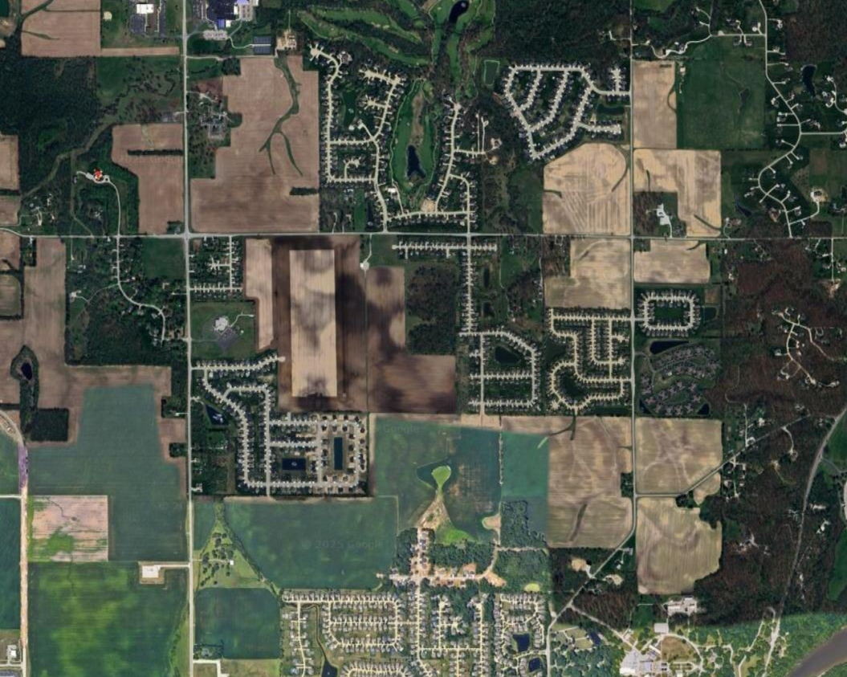

Slide 3


