Slide 1



PREDICTING FOOTBALL PLAYER MARKET VALUE
Position-Specific Machine Learning Pipeline
DAMA Hackathon 26
PETRIDIS DIMITRIOS — AM 170264
YFANTIDIS IOANNIS — AM 168057

Slide 2

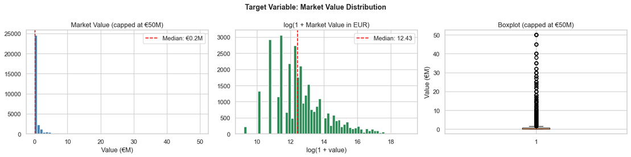
THE PROBLEM
WHY IS THIS HARD?
- Transfer fees exceed €200M for top players
- Valuations are subjective — clubs, agents, media shape prices
- A striker's value depends on different signals than a goalkeeper's
OUR GOAL
Predict market_value_in_eur from publicly available performance statistics — separately per position group
Market value distribution — heavily right-skewed; log-transform applied
01

Slide 3
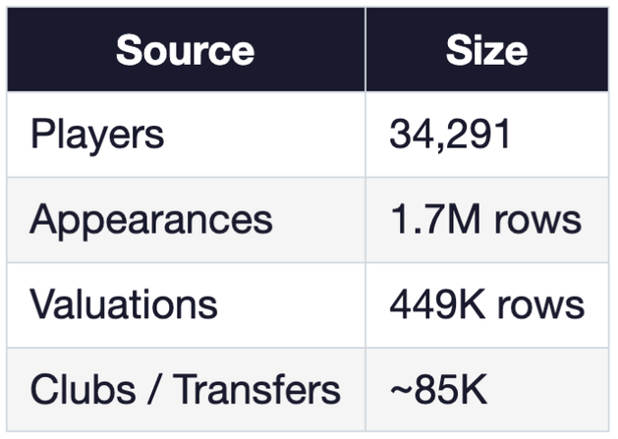
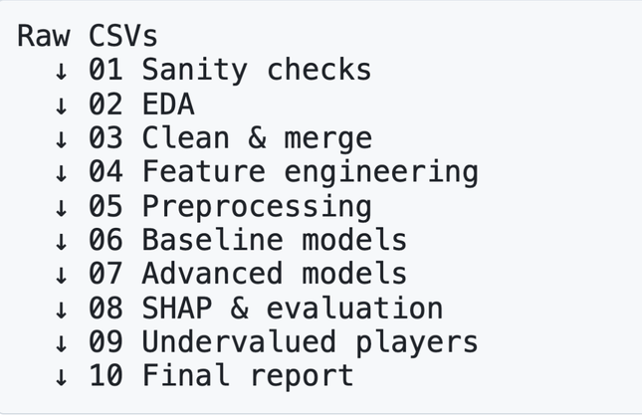
DATA & PIPELINE
7 TRANSFERMARKT CSVS
10-STEP PIPELINE
After cleaning: 30,710 labelled players
4 positon groups:
GK - DEF - MID- ATT
02

Slide 4
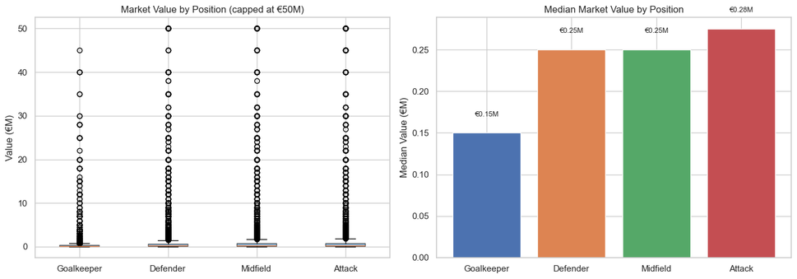
FEATURE ENGINEERING
SHARED BASE FEATURES (ALL POSITIONS)
age + age² — non-linear career arc
log_minutes, log_appearances — experience
Rate stats: goals, assists, contributions per 90
log_highest_mv — career peak reputation
league_mean_value — target-encoded league prestige
transfer_count, log_total_fees
WHY SEPARATE MODELS?
03

Slide 5
FEATURE ENGINEERING
POSITION-SPECIFIC ADDITIONS
GK - save percentage proxy, clean sheet rate, offensive contribution
DEF - defensive solidity, discipline score, defensive attack rate
MID - creative output per 90, attack-defense ratio
ATT - goals per appearance, minutes per goal, assist-to-goal ratio
04

Slide 6
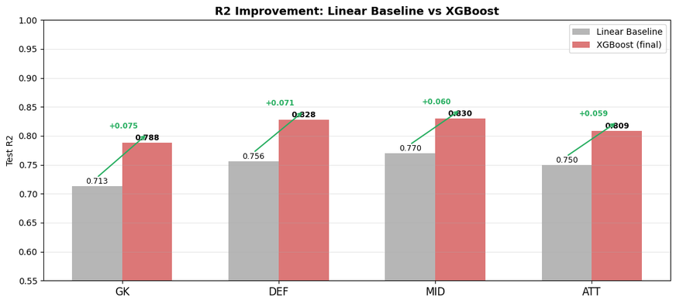
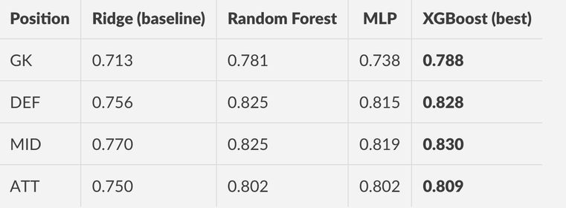
MODELS & RESULTS
WHAT WE TRAINED
Linear regression (plain)
Ridge (L2 regularisation)
Lasso (L1 regularisation)
Random Forest (RandomizedSearchCV)
XGBoost (hist method, tuned)
MLP (Adam, early stopping, 3 layers)
No data leakage: split → encode → scale
XGBOOST GAINS +5–8 R² POINTS OVER RIDGE BASELINES
TEST-SET R² BY POSITION
05

Slide 7
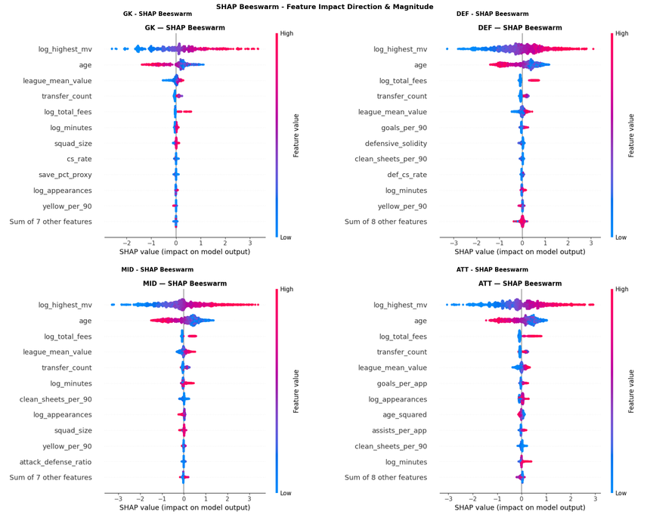
SHAP: WHAT DRIVES VALUE?
CROSS-POSITION FINDINGS
league_mean_value — top-3 in every position: where you play matters as much as how
- log_highest_mv — market anchors to career reputation
- age² — value peaks mid-20s, accelerates decline post-30
POSITION-SPECIFIC SIGNALS
- ATT: goals_per_90 becomes the strongest driver
- GK: performance stats matter less; reputation & league dominate
- MID: creative_per_90 and contributions_per_90 provide lift
- DEF: defensive_solidity and transfer_count add beyond base
06

Slide 8
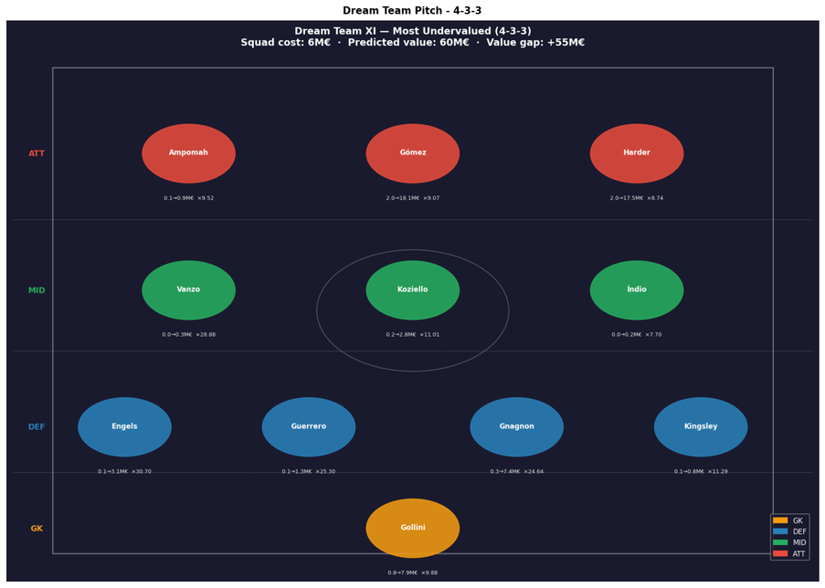
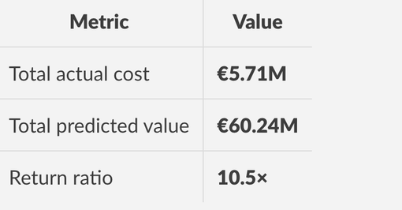
APPLICATION: DREAM TEAM
SCORING ALL 33,500+ PLAYERS
Using serialised preprocessors — no leakage
Undervaluation ratio = predicted ÷ actual
Minimum 10 appearances filter applied
4-3-3 SQUAD — COST VS. PREDICTED VALUE
TOP PICKS:
· MAXI GÓMEZ (ATT, ES1, €16.15M GAP)
· CONRAD HARDER (ATT, L1, €15.48M GAP)
· JORIS GNAGNON (DEF, ES1, 24.6×)
07

Slide 9
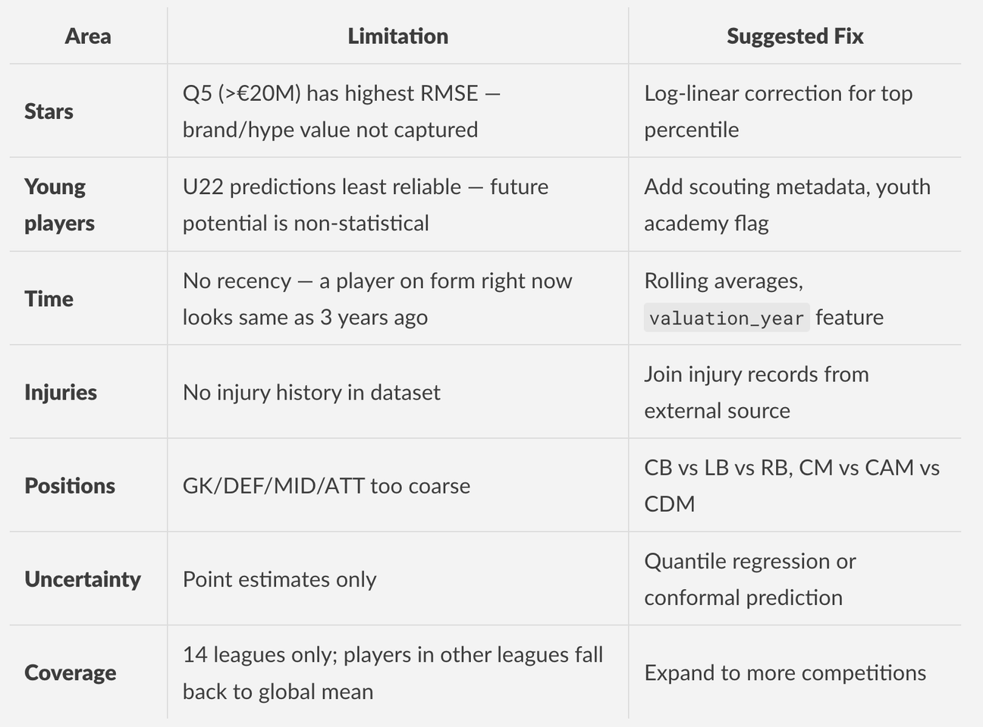
LIMITATIONS & FUTURE WORK
08

Slide 10
CONCLUSIONS
WHAT WE ACHIEVED
R² 0.79–0.83 ACROSS ALL POSITIONS
XGBOOST OUTPERFORMS RF, MLP, AND LINEAR BASELINES
SHAP PROVIDES ACTIONABLE INTERPRETATION
FULL REPRODUCIBLE PIPELINE (10 NOTEBOOKS)
KEY INSIGHTS
LEAGUE PRESTIGE = STRONGEST CROSS-POSITION SIGNAL
CAREER PEAK VALUE ANCHORS MARKET ESTIMATES
POSITION-SPECIFIC FEATURES ADD MEANINGFUL LIFT
HIGH-VALUE PLAYERS SYSTEMATICALLY UNDERESTIMATED (COMPRESSION EFFECT)
FUTURE WORK
FINER POSITION GRANULARITY (CB/LB/RB, CM/CAM/CDM)
TEMPORAL MODELLING (LSTM/TRANSFORMER) FOR CAREER TRAJECTORY
QUANTILE REGRESSION FOR UNCERTAINTY ESTIMATES
EXPAND BEYOND 14 LEAGUES; JOIN INJURY RECORDS
09

Slide 11
THANK YOU
REPOSITORY: FOOTBALL-PLAYER-VALUE-PREDICTOR
PIPELINE: 10 NOTEBOOKS · 7 RAW CSVS → DREAM TEAM
BEST MODEL: XGBOOST · R² UP TO 0.830 (MID)
10

