Slide 1
ILCP clustering

Slide 2
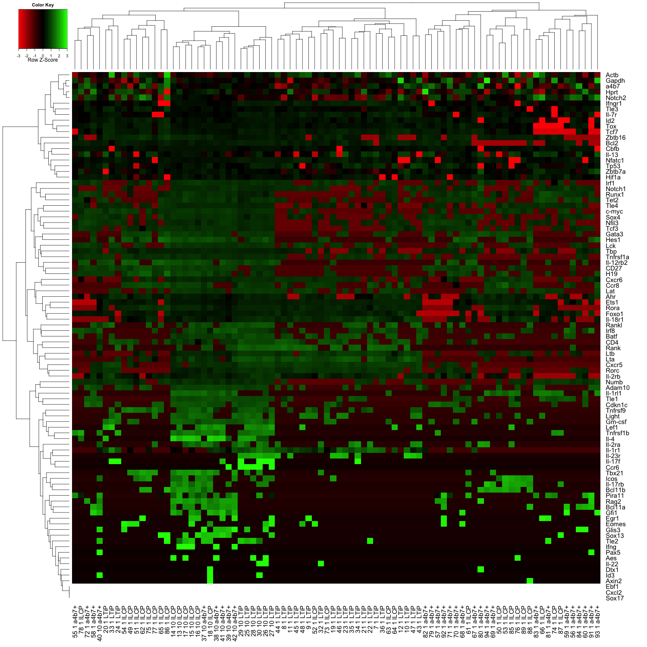
Hierarchical clustering based on all a4b7+, ILCP, and LTiP samples – 4 distinct clusters of ILCP
ILCP-B primarily clustered with LTiP
2 a4b7+ cells clustered with ILCP-C
8 a4b7+ cells clustered with ILCP-D
A
B
C
D

Slide 3
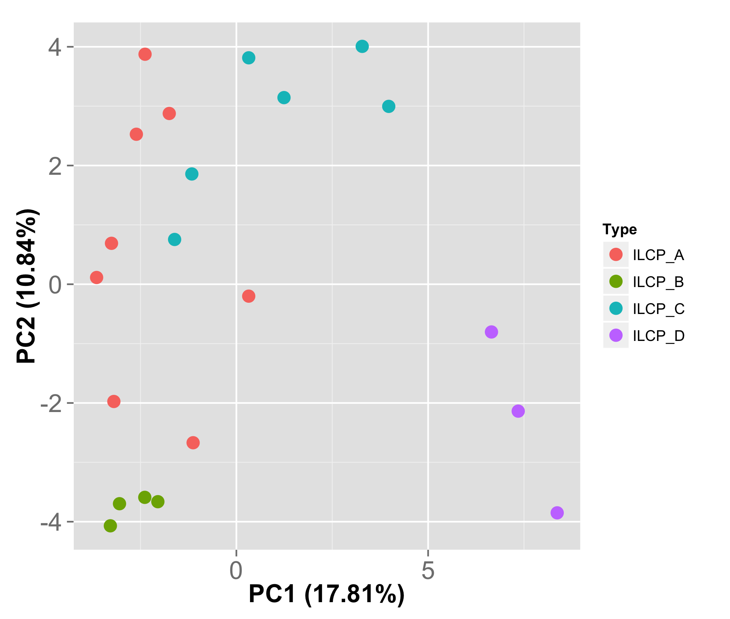
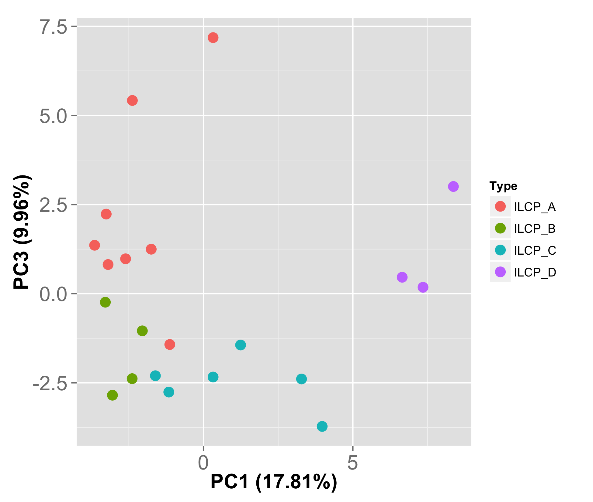
PC1 | Tle1 | Tox | Tcf7 | Tnfrsf1a | Il-1rl1 | Il-2rb | Id2 | Tnfrsf1b | H19
PC2 | Bcl11b | Icos | Notch1 | Irf1 | Cxcr5 | Rank | Gata3 | Ccr8 | Cxcr6
PC3 | Il-18r1 | Zbtb16 | Sox13 | Ltb | Foxo1 | Ifngr1 | Il-17rb | Rorc | Il-12rb2

Slide 4
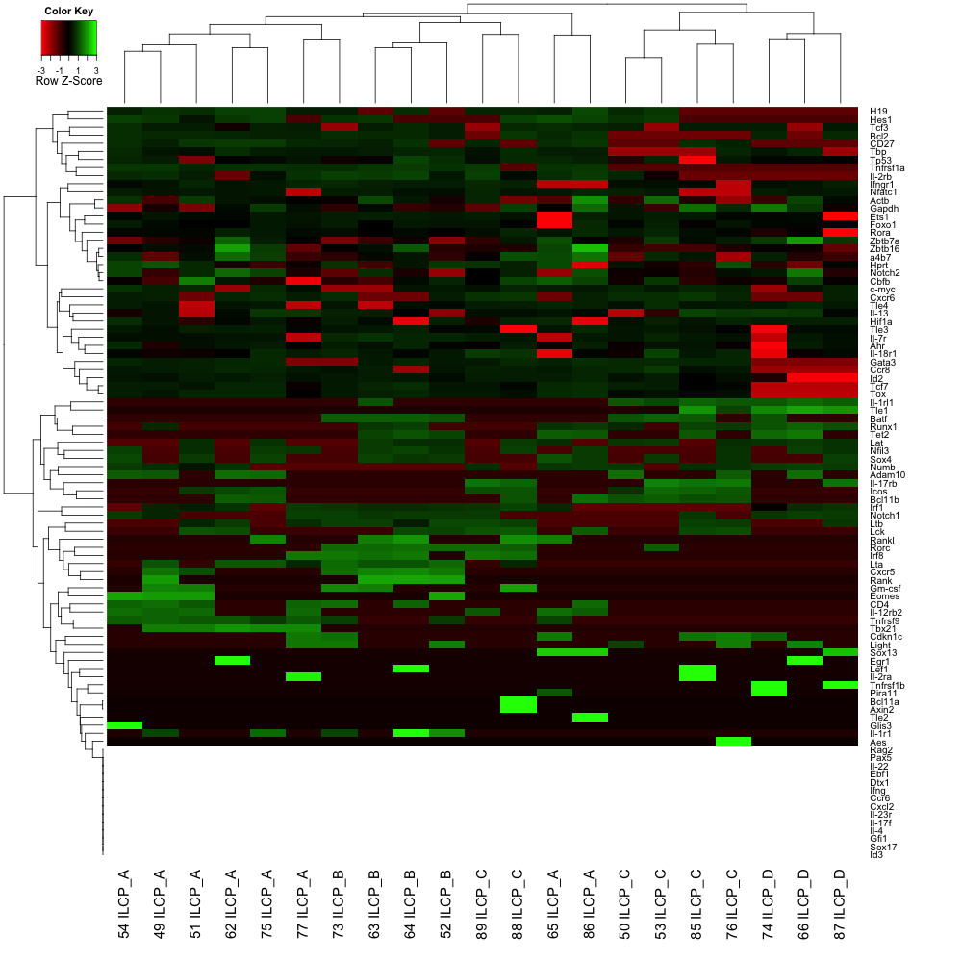
ILCP-A and ILCP-C appear to have additional internal structure
A
B
C
A
C
D

Slide 5
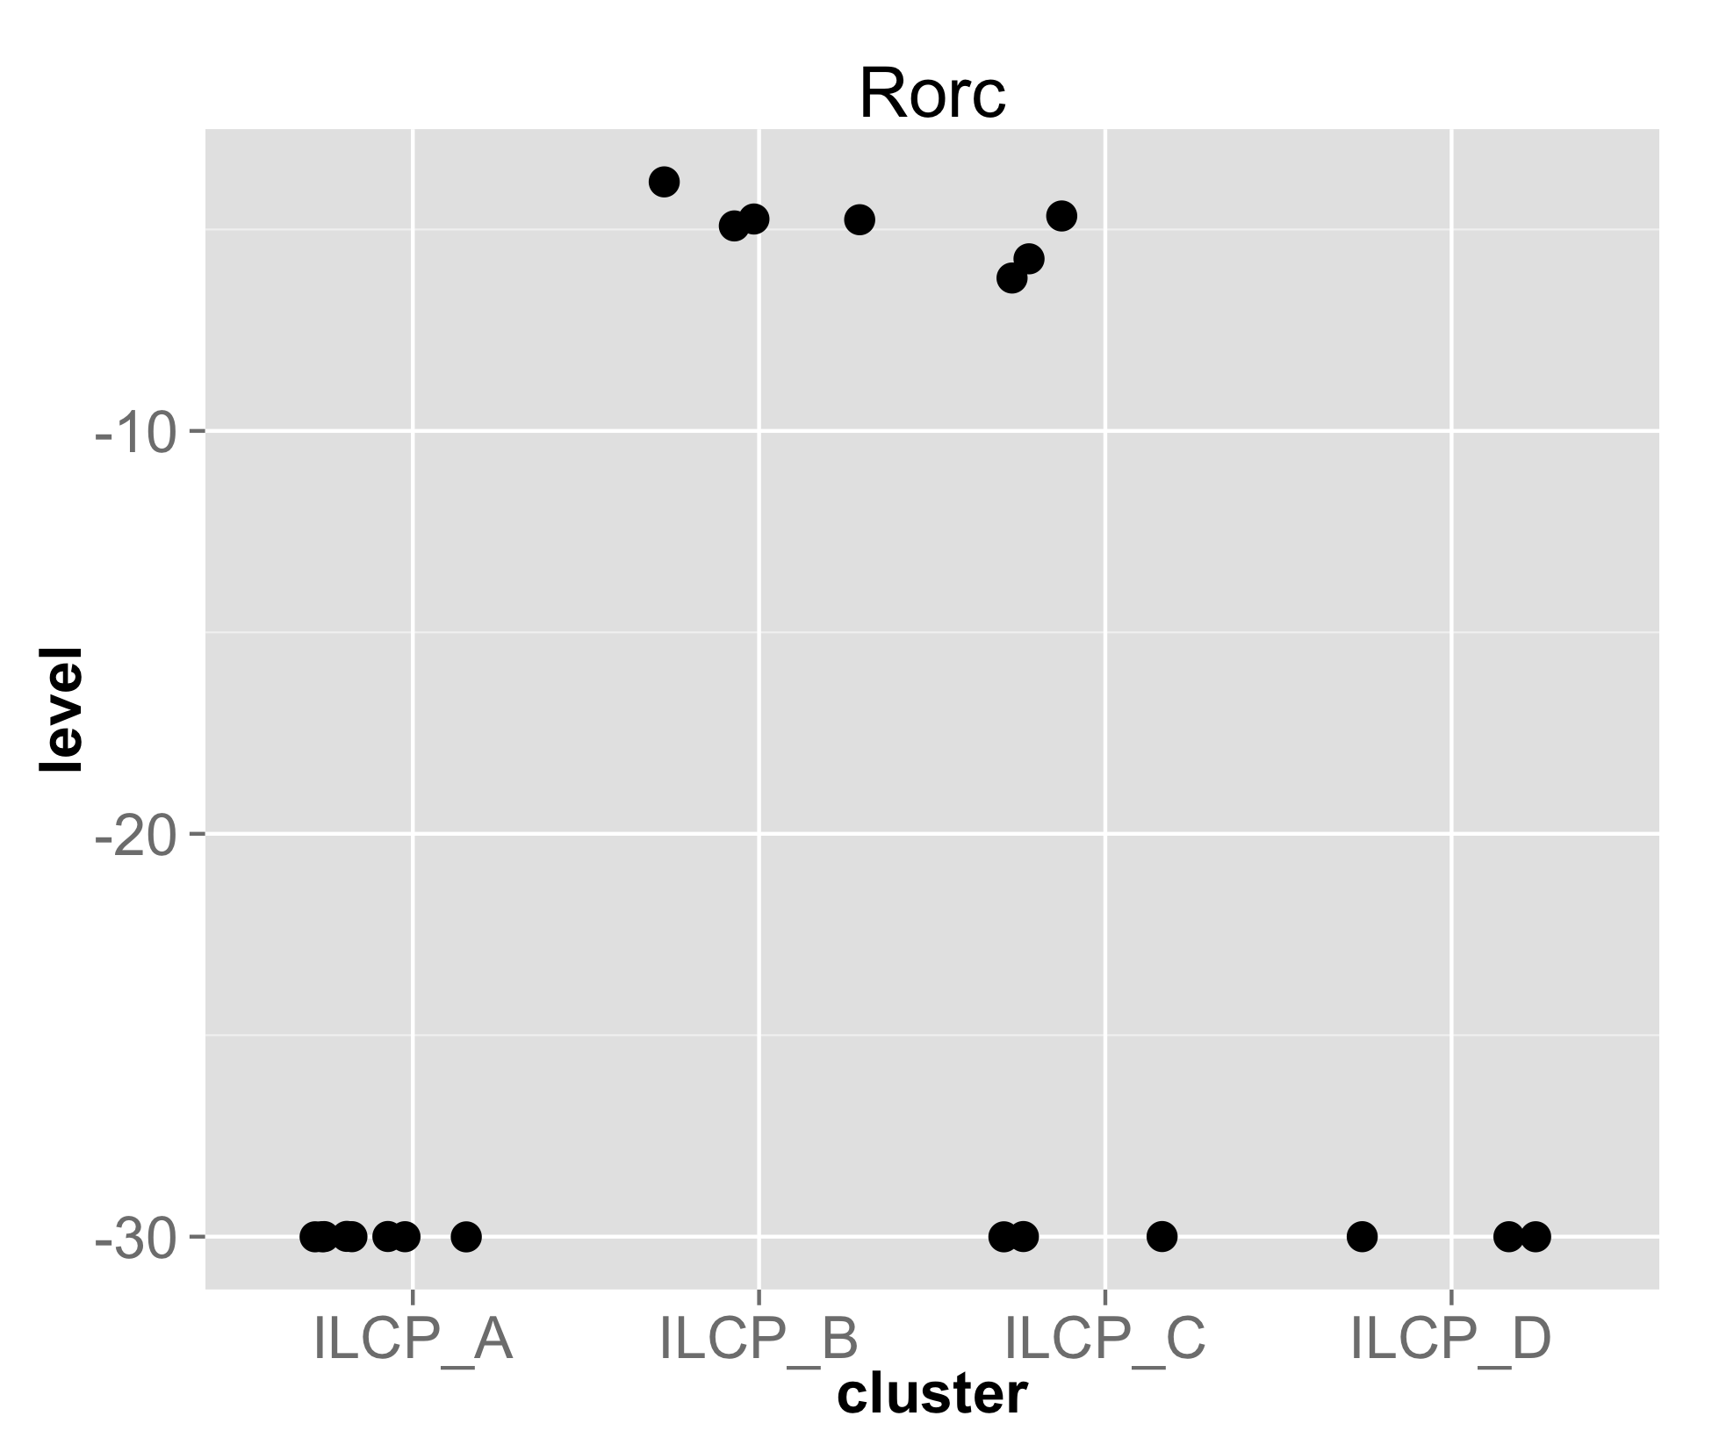
Finding cluster specific genes by anova
lm(formula = level ~ cluster, data = anova_test.df)
Coefficients:
Estimate Std. Error t value Pr(>|t|)
(Intercept) -3.000e+01 2.572e+00 -11.662 1.56e-09 ***
clusterILCP_B 2.544e+01 4.456e+00 5.710 2.55e-05 ***
clusterILCP_C 1.223e+01 3.929e+00 3.113 0.00632 **
clusterILCP_D 1.385e-17 4.926e+00 0.000 1.00000
Residual standard error: 7.276 on 17 degrees of freedom
Multiple R-squared: 0.6924, Adjusted R-squared: 0.6381
F-statistic: 12.76 on 3 and 17 DF, p-value: 0.0001298
Analysis of Variance Table
Response: level
Df Sum Sq Mean Sq F value Pr(>F)
cluster 3 2025.94 675.31 12.757 0.0001298 ***
Residuals 17 899.94 52.94
---
Signif. codes: 0 ‘***’ 0.001 ‘**’ 0.01 ‘*’ 0.05 ‘.’ 0.1 ‘ ’ 1

Slide 6
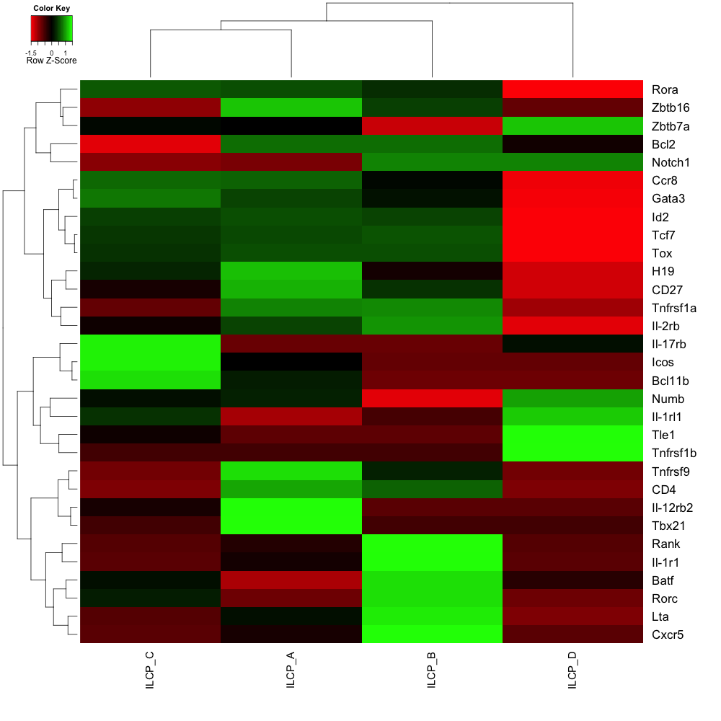
31 out of 93 genes significantly distinguished individual clusters by anova (F-test < 0.05)
Higher levels of PLZF and Il-2rb are seen in ILCP-A and ILCP-B
Notch signaling components upregulated in ILCP-D

