Slide 1
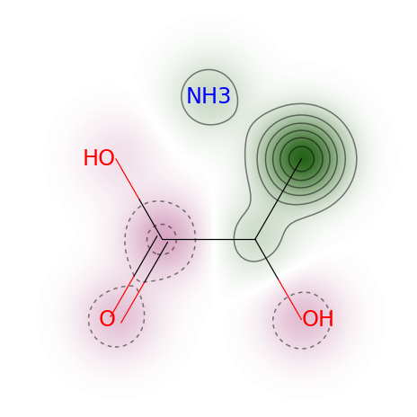
Ammonium_Lactate_solution_score_0.8119

Slide 2
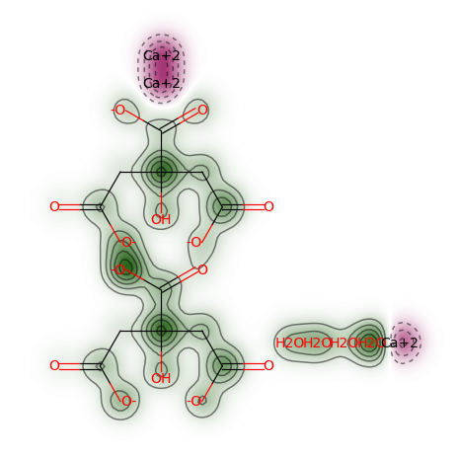
Calcium_Citrate_Tetrahydrate_score_0.6737

Slide 3
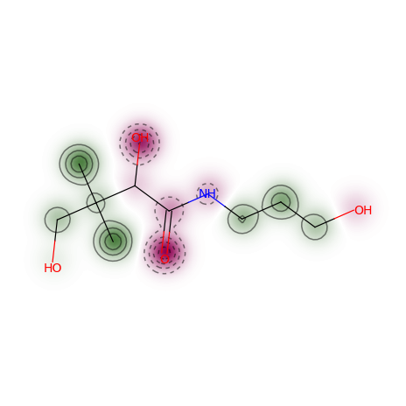
Dexpanthenol_score_0.8373

Slide 4
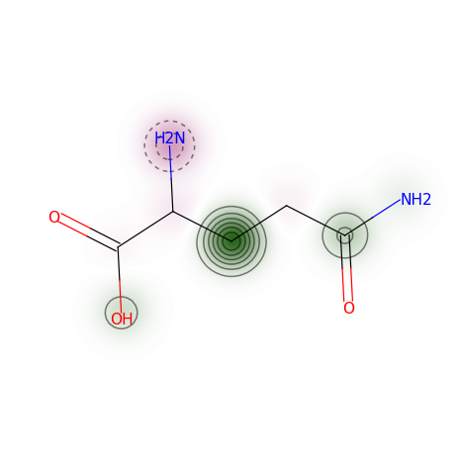
L-Glutamine_score_0.7276

Slide 5
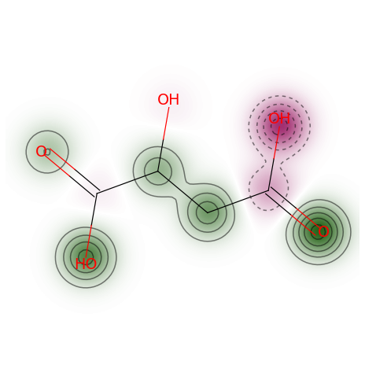
Malic_Acid_score_0.6370

Slide 6
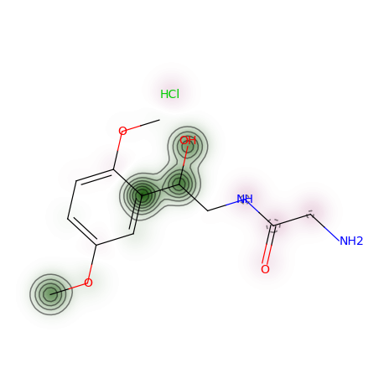
Midodrine_Hydrochloride_score_0.8316

Slide 7
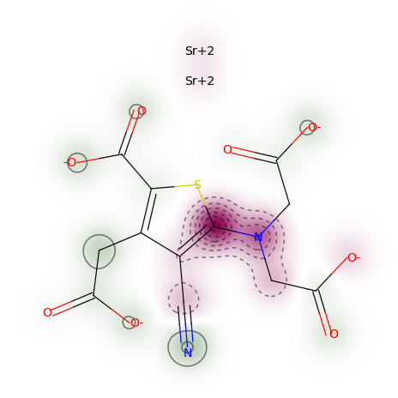
Strontium_Ranelate_score_0.1115

