Slide 2
Problems
NP/UFP
Human Body
Path
Production
Applications
Immune system

Slide 3
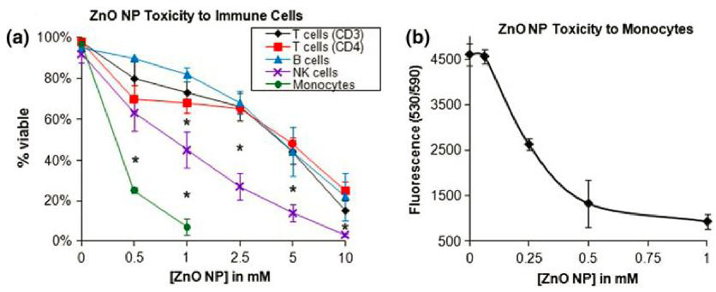
Research I – ZnO NP Toxicity

Slide 4
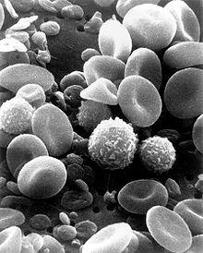
Research II – Disruptions

