Slide 1





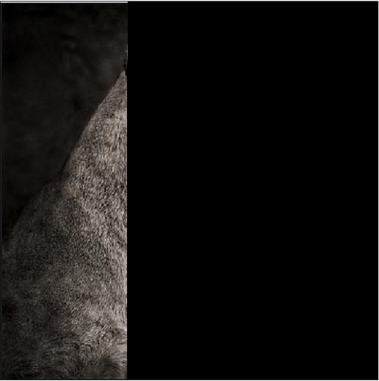

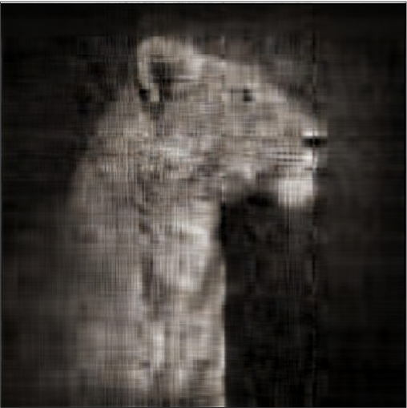


Probability in Image Processing
Yifan Ge, Priscilla Huang, Chi Tran
Advisor: Karl Voss
Bucknell University, Lewisburg, PA
Image Processing
In the de
Singular Value Decomposition (SVD)
SVD Compression
0.4 %
5 %
20 %
33.3 %
Pixel-by-Pixel
SVD Based
Relation to Probability
References
Kern Entrepreneurship Education Network (KEEN)
Bucknell received a grant from the Kern Family Foundation for more than $1 million to
implement a three-year, multi-phased program to instill engineering students with an
entrepreneurial mindset.
Annual Talks Event
A talk will take place at Bucknell on April 12th. This event invites successful alumni and
faculty with an entrepreneurial mindset to talk about their understanding of innovation,
creativity, and entrepreneurship. The goal of the event is to inspire students' interests in
innovation, foster the entrepreneurial campus culture, and promote the Innovation and
Entrepreneurship ecosystem at Bucknell.
Credit to Prof. Robert Nickel from Bucknell University in providing the

