Slide 1
“Efficient Recovery from False State in Distributed Routing Algorithms”
  Daniel Gyllstrom, Sudarshan Vasudevan, Jim Kurose, and Gerome Miklau
  University of Massachusetts, Amherst USA

Slide 2
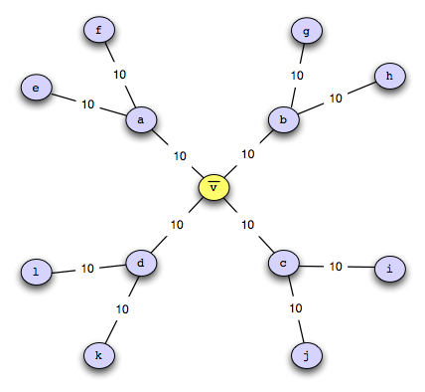
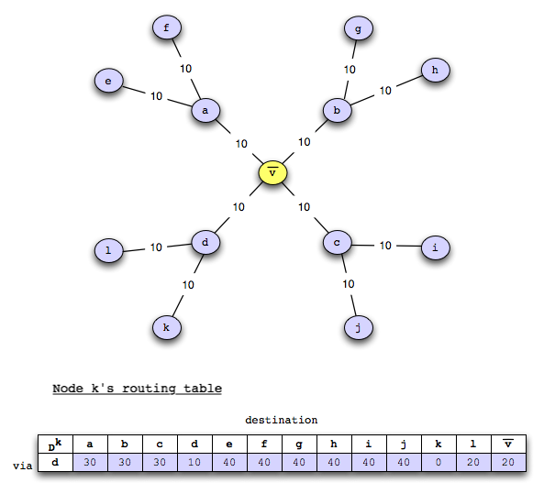
I can reach any destination with cost 0 !!!
The Problem
Notes:
We are considering the case of network routing. Routing is determining how to get to one place from another, while minimizing some cost function. Typically want to know how to reach all nodes in the network (destinations).

Slide 3
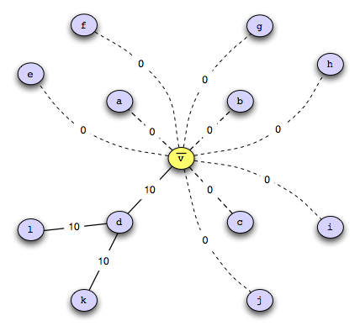
The Problem
\
Notes:
System-wide

Slide 4
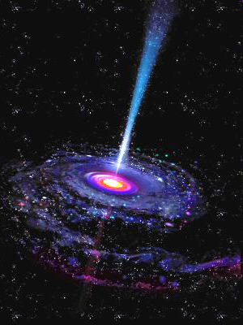
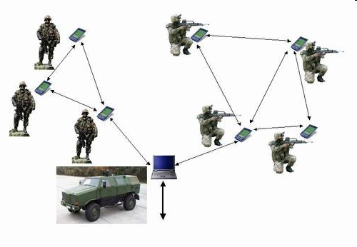
The Problem
Notes:
Internet routing black holes – incident where an ISP in Paikistan wanted to block service to youtube. Accidently shared across internet via BGP causing youtube to be unreachable

Slide 5
Detecting compromised node (see paper for references)
The Problem
Recovering after compromised nodes detected
Notes:
Not focusing on detecting the compromised node. Rather we are focusing on how to recover after nodes are notified that a node has been compromised

Slide 6
Problem Statement
Outside algorithm identifies compromised nodes
Recover
  Remove compromised nodes from graph
  Compute least cost paths that route around compromised node
Notes:
Make this an animation.

Slide 7
Presentation Simplifications
Assume synchronous communication model
Assume only single node is compromised: v

Slide 8
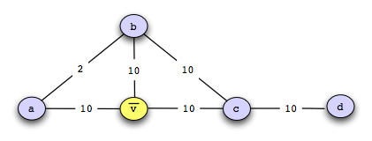
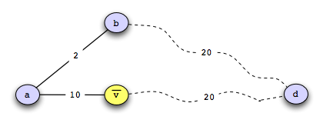
destination
Distance Vector Routing Review
Node a’s Perspective
Node a’s state
Neighbors = b,v
Cost to d via b and v
Notes:
Run through a simple example

Slide 9
Our Recovery Algorithms
2nd Best Algorithm
purge Algorithm
cpr Algorithm

Slide 10
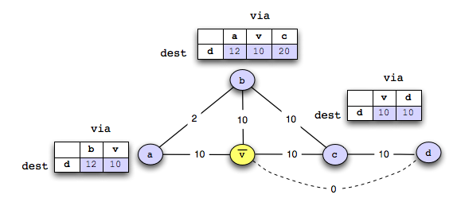
Running Example

Slide 11

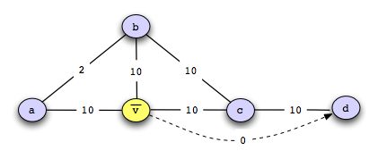
2nd Best algorithm
Remove v as a destination
`
Run Distance Vector
∞

Slide 12
2nd Best Algorithm
Strengths = Simple + no synchronization
Weakness = loops
Route via node a with cost 12
Route via node b with cost 12
∞
∞

Slide 13
purge algorithm
Remove v as destination
Run Distance Vector
Set cost to d via node a to d = ∞
Use v to reach d, so set cost to d = ∞
∞

Slide 14
purge algorithm
Strengths
+ no synchronization needed
+ no routing loops
Weaknesses
2

Slide 15
cpr algorithm
1. Periodically take snapshot of routing table

Slide 16
cpr algorithm
1. Periodically take snapshot of routing table
2. Rollback to a checkpoint taken before node is compromised

Slide 17
cpr algorithm
1. Periodically take snapshot of routing table
2. Rollback to a checkpoint taken before node is compromised

Slide 18
cpr algorithm
1. Periodically take snapshot of routing table
2. Rollback to a checkpoint taken before node is compromised
3. Remove compromised node

Slide 19
cpr algorithm
1. Periodically take snapshot of routing table
2. Rollback to a checkpoint taken before node is compromised
3. Remove compromised node
4. Run Distance Vector

Slide 20
cpr algorithm
Strengths
+ quickly remove false state w/ rollback
Weaknesses
- requires loosely synchronized clocks
- can have stale state after rolling back

Slide 21
Related Work
DUAL algorithm for loop-free routing
Malicious but committed database transactions
Database crash recovery
Notes:
Not aware of any previous work that directly address this problem. However, Luna-Aceves DUAL algorithm uses diffusing computations to ensure loop free DV routing. With some minor changes to the algorithm, it can work to solve the problem we consider.

Slide 22
Simulations
Synchronous communication model
Measure message and time overhead

Slide 23
Simulation Scenario
All nodes correctly compute least cost paths
A node is compromised and claims cost of ‘1’ to every node
Outside algorithm identifies compromised node and notifies neighbors of compromised node
Run recovery algorithm (we count messages here)

Slide 24
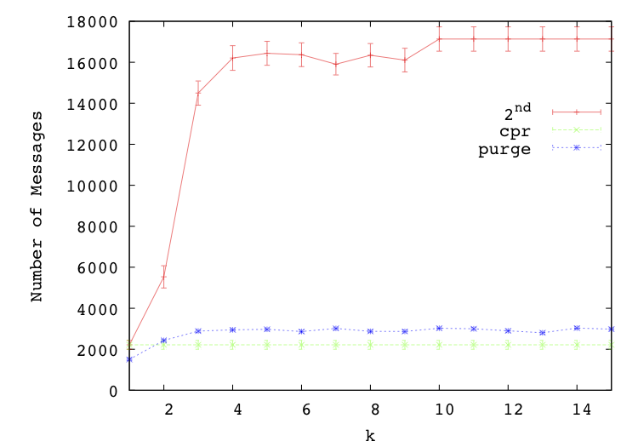
Experiment 1 – Graphs with Fixed Link Costs
2nd Best has many routing loops
2nd Best + purge use iterative distance vector
cpr removes state by rolling back
Notes:
In the first experiment, we consider topologies in which link costs remain fixed. We ran our experiment over Internet like graphs and Erdos Renyi graphs. This plott is for ER graphs with 100 nodes and link weights set uniformely at random between 1 and 100. We introduce a new variable k which controls how many hops the false state has spread from the compromised node.

Slide 25
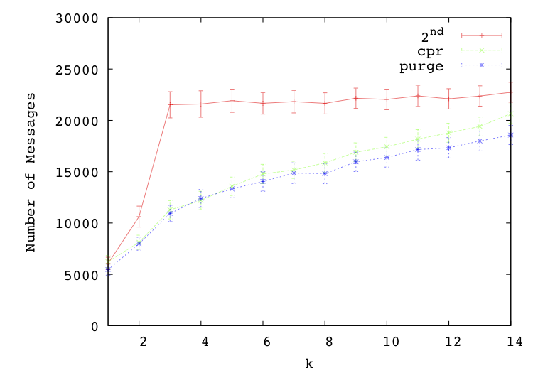
Experiment 2 – Graphs with Changing Link Costs
2nd Best has many routing loops
cpr has stale state after rolling back
purge has no stale state
Notes:
Here we use the same experimental setup but introduce link cost changes btw the time the node is compromised and now.

Slide 26
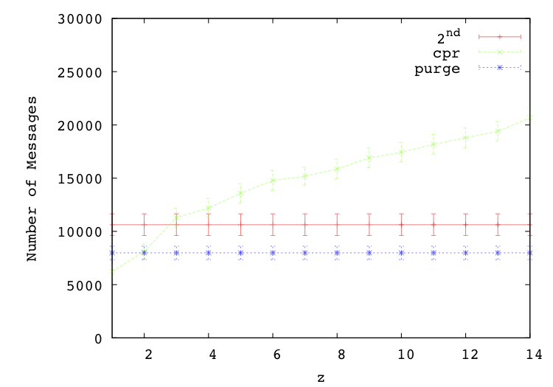
Experiment 3 – Vary Checkpoint Frequency
cpr – less frequent checkpoints implies more overhead when rolling back
2nd Best and purge have constant overhead b/c don’t checkpoint
Notes:
Use same setup as previous experiment but vary the frequency in which cpr checkpoints.

Slide 27
Conclusions
+ cpr is effective because rolling back quickly removes false state
- cpr assume synchronized clocks
- 2nd best suffers from routing loops
+ purge removes routing loops and no stale state
Winner for fixed link costs
Winner for changing link costs

Slide 28
Questions + Comments
Notes:
practice

Slide 29
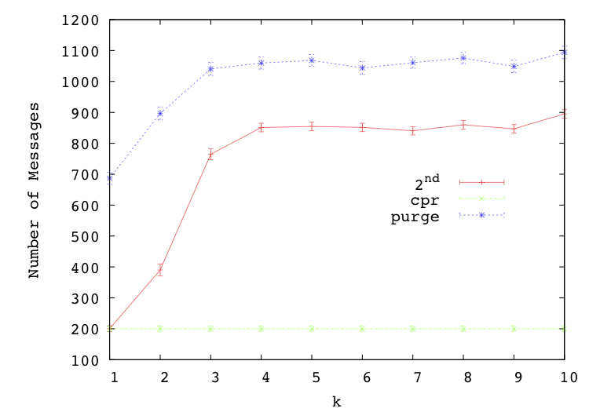
Experiment 0 – Graphs with Fixed Link Costs + Unit Link Weights
2nd Best has few routing loops
purge global state invalidation = wasteful
cpr removes state by rolling back

Slide 30
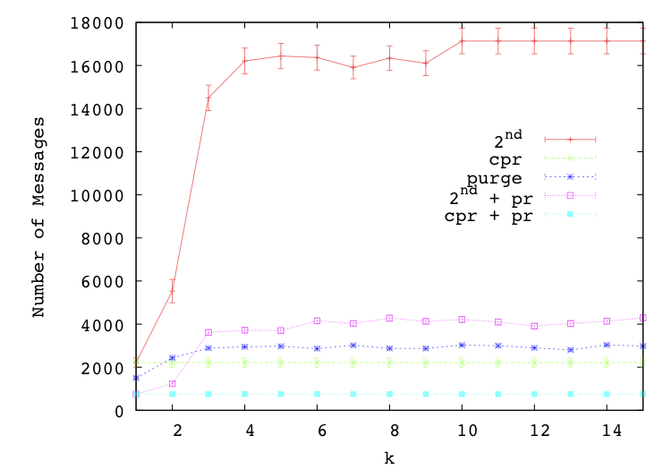
Experiment 1b – Graphs with Fixed Link Costs + Poison Reverse
Poison Reverse effective
2nd Best + pr much better than 2nd Best
cpr+pr modest improvements over cpr

Slide 31
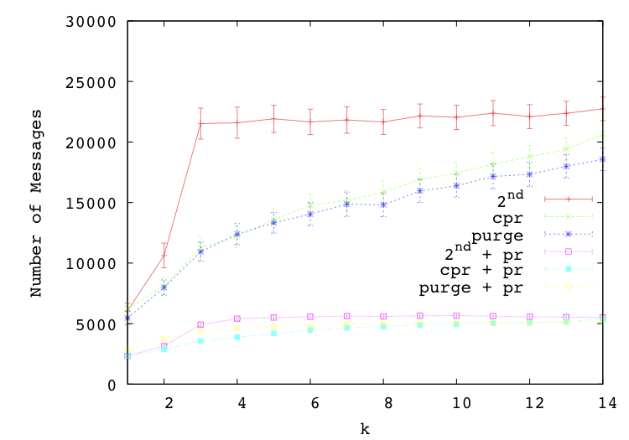
Experiment 2b – Graphs with Changing Link Costs+ Poison Reverse
Poison reverse makes removing stale state cheap, thus cpr + pr is best
purge + pr almost as good as cpr+pr

Slide 32
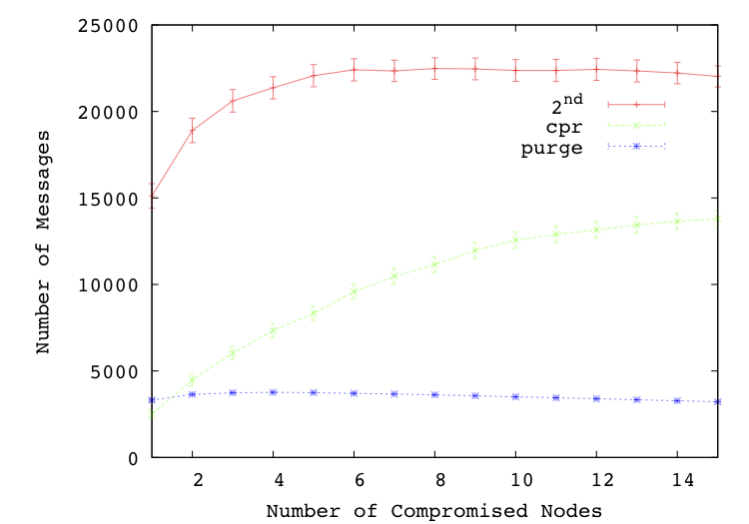
Experiment 4 – Multiple Compromised Nodes
purge – no routing loops
2nd Best and cpr have routing loops

Slide 33
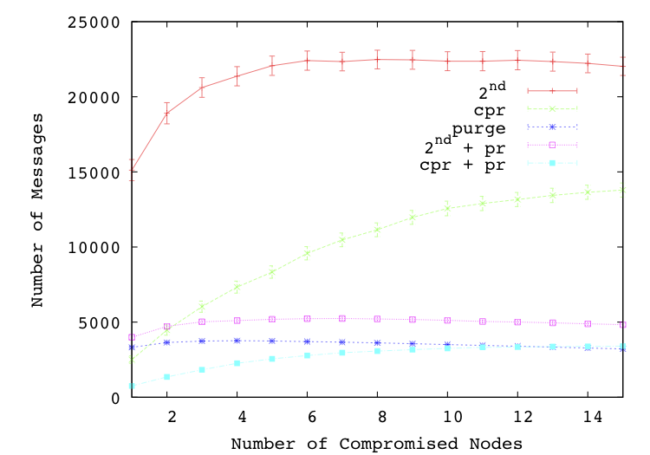
Experiment 4 – Multiple Compromised Nodes + Poison Reverse
Poison reverse yields great improvements
purge and cpr+pr perform best

Slide 34
Possible Questions
How do nodes rollback?
How does this apply to BGP scenario?
Multiple compromised nodes?
Does 2nd best ever do well?
Theoretical results -

