Slide 1
Networking (related) Challenges for the Smart Grid
Jim Kurose
Department of Computer Science
University of Massachusetts
Amherst MA USA
IIT Mumbai, January 2013

Slide 2
Overview
yesterday’s, today’s and tomorrow’s electric grid: a networking perspective
five (networking) smart grid challenges
richer data gathering and distribution architecture
monitoring, measurement
dealing with demand: network-inspired approaches
security and privacy
power routing
grid v. Internet: similarities and dis-similarities
reflections on Keshav’s 1st and 2nd hypotheses
This talk: part tutorial, part research, part speculation

Slide 3



A word on my background …
+
= ?
computer networks
power grid networks
joint IITB/UMass smart grid
reading seminar

Slide 4
Overview
yesterday’s, today’s and tomorrow’s electric grid: a networking perspective
five (networking) smart grid challenges
ultra-reliable, multi-destination transport
monitoring, measurement
security and privacy
dealing with demand: network-inspired approaches
power routing
grid v. Internet: similarities and dis-similarities
reflections on Keshav’s 1st and 2nd hypotheses

Slide 5
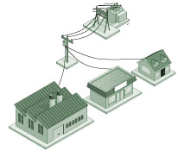

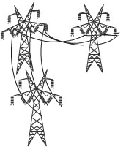
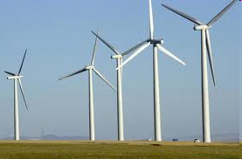
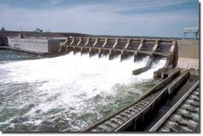
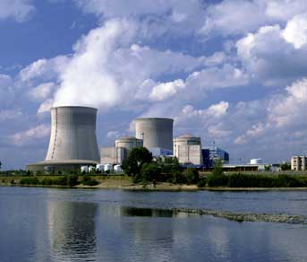


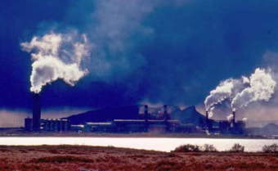


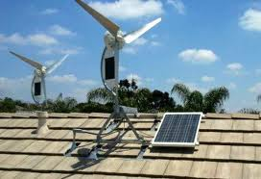
The electric grid: structure (US-centric)
inter-connected regional
transmission network operators (RTOs)
edge (distribution)
networks
power
sources
Mesh transmission network
hierarchical
distribution network
transmission network
(backbone)
distribution
network (edge)
power
consumers
distributed
generation (DG)

Slide 6
The electric grid: structure (US-centric)
electricity flows from producers to consumers
overall supply must equal demand, flowing over links of given capacity
brownouts, blackouts
smart grid
using ICT to efficiently, reliably, flexibly and sustainably monitor and control the generation, distribution and use of electricity

Slide 7
Selected smart grid applications
∂∂∂
∂∂∂
∂∂∂
∂∂
∂
∂

Slide 8
SG applications: communication requirements
Bakken, D.E.; Bose, A.; Hauser, C.H.; Whitehead, D.E.; Zweigle, G.C., “Smart Generation and Transmission With Coherent, Real-Time Data,” Proceedings of the IEEE, 99(6), 2011

Slide 9




The smart grid: communication flows
large-scale
electricity
generators
regional
transmission
operator(s)
distribution
network
operator(s)
monitoring, control
Monitoring, control
monitoring
control
demand/
response
distributed
generation
smart
scheduling, AMI
transmission network
(backbone)
distribution
network (edge)

Slide 10
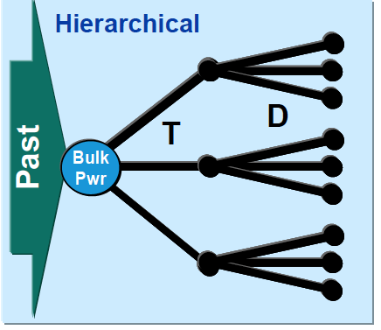
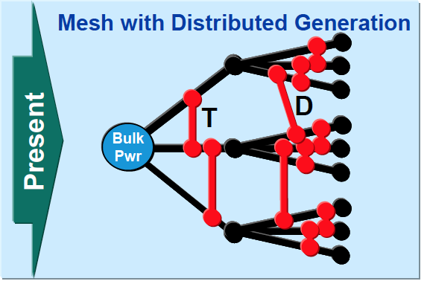
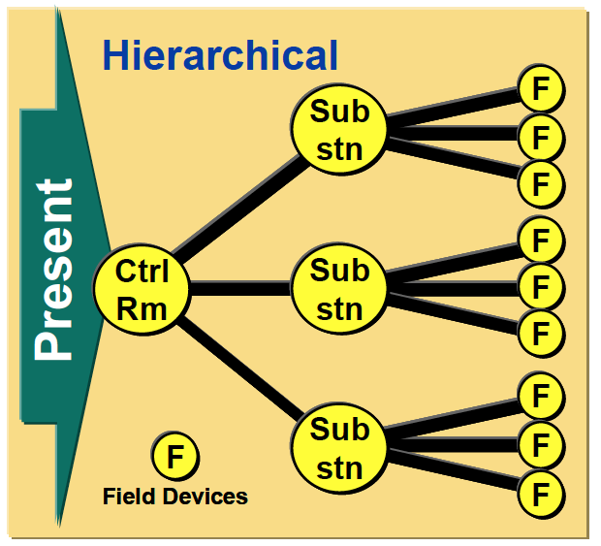
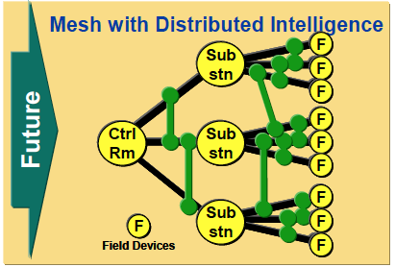
Grid communication network topology: from hierarchical to mesh topologies
Electricity flow (distribution network)
Data communication flow between control room, substations and field devices
Focus: “ enhancing the distributed control signaling architecture such that some level of device collaboration can be performed even when there are losses of control capability from the still dominant hierarchical control system
architecture.”
T.M. Overman and R.W. Sackman, "High Assurance Smart Grid: Smart Grid Control Systems Communications Architecture," 2010 SmartGridComm, 2010.

Slide 11
Today’s grid control architecture: SCADA
supervisory control & data acquisition
centralized industrial measurement/control system:
master terminal unit (MTU)
remote terminal units (RTUs): data gathering, control units, polled by MTU
SCADA protocols: often proprietary, sometimes open
MTU
RTU
RTU
RTUs
DNP3: point-to-point link-layer polling protocol: addressing multiplexing, fragmentation, error checking/retrans, link control, prioritization
DNP3: can poll over TCP/IP

Slide 12
Smart grid communication and the Internet
grid communication:
stringent reliability, delay requirements for control
Internet: “best effort” service model
network layer (IP):
“best effort” to deliver packet between hosts, but no promises
unreliable host-host delivery
no delay guarantees
transport layer (TCP): “laid back” transmission: “send … data in segments at its own convenience.” [RFC 793]
transport layer (UDP): unreliable datagram transfer between

Slide 13
Smart grid communication and the Internet
grid communication:
stringent reliability, delay requirements for control
Internet: “best effort” service model
network layer (IP):
“best effort” to deliver packet between hosts, but no promises
unreliable host-host delivery
no delay guarantees
transport layer (TCP): “laid back” transmission: “send … data in segments at its own convenience.” [RFC 793]
transport layer (UDP): unreliable datagram transfer between
Internet’s traditional best effort delivery, transport protocols not well-suited for high assurance grid communication (but that doesn’t mean they can’t be fixed or used!)

Slide 14

How can we, as networking researchers and computer scientists
inform design, analysis of smart grid communications

Slide 15
Overview
yesterday’s, today’s and tomorrow’s electric grid: a networking perspective
five (networking) smart grid challenges
richer data gathering and distribution architecture
monitoring, measurement
security and privacy
dealing with demand: network-inspired approaches
power routing
grid v. Internet: similarities and dis-similarities
reflections on Keshav’s 1st and 2nd hypotheses

Slide 16


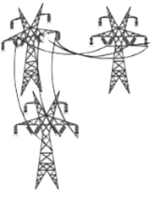




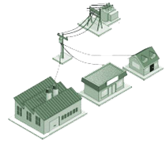
1. Rich data gathering, distribution architecture
smart grid: many data sources and sink with interests in subsets of data:
real-time control, data analytics, archiving
SCADA: simple centralized polling
richer communication paradigms:
self-healing mesh network
QoS bandwidth, delay guarantees
multicast (1-many)
higher-level abstractions (pub-sub, e.g., Gridstat)

Slide 17
Challenge: self healing, multicast mesh
healed
multicast
QoS tree
multicast
QoS tree
X

Slide 18
Challenge: self healing, multicast mesh
healed
multicast
QoS tree
multicast
QoS tree
X
Multicast QoS: path reservation, as in MPLS
compute source-specific multicast trees, with known link bandwidths and source-to-destination traffic rates
different from public Internet, which has unknown demand
compute backup multicast trees
offline, in case of each link failure scenario
minimize # affected hosts, or # affected routers

Slide 19
Challenge: self healing, multicast mesh
healed
multicast
QoS tree
multicast
QoS tree
X
Down link, packet loss detection:
in-network, per-link measurement, monitoring of link flows
rapid, local link,/flow failure detection
installation of pre-computed backup multicast forwarding trees
This requires changes to existing routers ….. how?

Slide 20
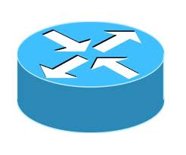
Openflow: open network control plane
protocol
protocol
Network OS
protocol
protocol
Operating
System
protocol
protocol
protocol
protocol
Custom Hardware
Operating
System
Operating
System
protocol
protocol
Custom Hardware
Custom Hardware
Operating
System
protocol
protocol
Custom Hardware
Operating
System
Custom Hardware

Slide 21
Openflow: open smart grid control plane
Smart grid protocol
protocol
Network OS
Custom Hardware
Custom Hardware
Custom Hardware
Custom Hardware
Custom Hardware

Slide 22
Challenge: higher-level abstractions
healed
multicast
QoS tree
multicast
QoS tree
X
grid-specific communication protocols (e.g., high reliability data dissemination) enabled via SDN
high-level data distribution abstractions:
publish-subscribe [Gridstat, NASPInet]
data-gathering + analytics: closed-loop cyber-physical system
network virtualization: one physical network to home carrying multiple logically separate networks?
smart-grid, security, entertainment

Slide 23
Overview
yesterday’s, today’s and tomorrow’s electric grid: a networking perspective
five (networking) smart grid challenges
richer data gathering and distribution architecture
monitoring, measurement
dealing with demand: network-inspired approaches
security and privacy
power routing
grid v. Internet: similarities and dis-similarities
reflections on Keshav’s 1st and 2nd hypotheses

Slide 24
Control plane: measurement
large-scale
electricity
generators
regional
transmission
operator(s)
distribution
network
operator(s)
monitoring, control
Monitoring, control
monitoring
control
Phasor Measurement Units (PMUs)
Intelligent electronic devices (IED)
Advanced Metering Infra. (AMI)
transmission network
(backbone)
distribution
network (edge)

Slide 25
Grid measurement/monitoring
where to place measurement devices to maximize observability?
Observability rule 1: if PMU placed at a, then a and its neighbors are observable
Observability rule 2: if a node is observable and all but one neighbors are observable, then all neighbors observable
MaxObserve: Given graph, G=(V,E) and k PMUs, place k PMUs to maximize number of observed nodes
MaxObserve is NP-complete, Reduce from Planar 3SAT (P3SAT)
D. Brueni and L. Heath. The PMU Placement Problem. SIAM Journal on Discrete Math, 2005

Slide 26
PMU placement with cross validation
where to place measurement devices to maximize measurement cross validation?
Observability rule 3: If PMUs placed on adjacent nodes, they cross-validate each other
Observability rule 4: If two PMUs share a common neighbor, the two PMUs cross-validate each other
PMU
PMU
a
b
PMU
PMU
a
c
b
MaxObserve-XV: Given graph, G=(V,E) and k PMUs, place k PMUs to maximize number of observed nodes, requiring that all PMUs be cross-valided
MaxObserve-XV is NP-complete,
Vanfretti et al. A Phasor-data-based State Estimator Incorporating Phase Bias Correction. IEEE Transactions on Power Systems, 2010

Slide 27
Greedy Solutions to PMU placement
MaxObserveGreedy: iteratively place k PMUs: iteratively at node that results in observation of max # new nodes
MaxObserveGreedy-XV: iteratively place PMU pairs at nodes{u,v}, such that u and v are cross-validated and result in observation of max #new nodes
evaluation:
generate grid networks with same degree distribution as IEEE Bus 57
brute force optimal solution by enumeration for small # PMUs

Slide 28
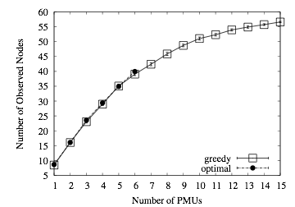
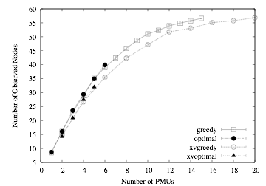
Greedy Solutions: evaluation
MaxObserveGreedy within 98.6% of optimal
MaxObserveGreedyXV within97% of optimal
cross-validation requirement on decreases # observed nodes by ~ 5%
D. Gyllstrom, E. Rosensweig, J. Kurose, “On the Impact of PMU Placement on Observability and Cross-Validation,” Proc. ACM e-Energy 2012

Slide 29
Overview
yesterday’s, today’s and tomorrow’s electric grid: a networking perspective
five (networking) smart grid challenges
richer data gathering and distribution architecture
monitoring, measurement
dealing with demand: network-inspired approaches
security and privacy
power routing
grid v. Internet: similarities and dis-similarities
reflections on Keshav’s 1st and 2nd hypotheses

Slide 30
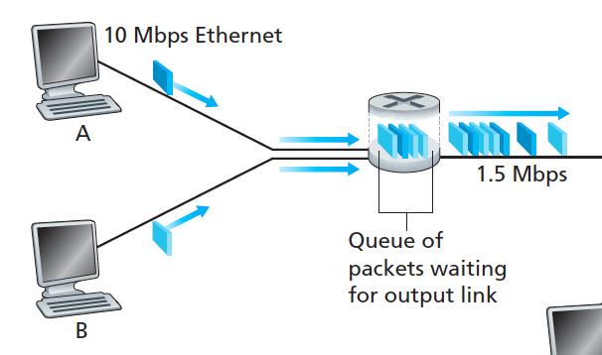
Dealing with demand
computer network:
packet-level congestion
local
reactive: buffer, defer load
smart grid network:
balancing power supply, demand
global
reactive: load, source shedding
proactive: buffering via storage
pumped hydro, battery
prediction crucial

Slide 31
SmartCharge: residential battery storage
Key idea: charge battery at off-peak hours
off-peak price < peak price
shift residential grid use from peak to off peak hours: charge battery when prices are low, use battery (reducing grid use) when prices are high
0.12
7.5
Without SmartCharge
With SmartCharge (12kWh)
0.1
0.08
5
Grid Power (kW)
0.06
0.04
2.5
Hourly Rate ($/kwH)
0.02
Illinois Real-time
0
0
12am
7am
11am
5pm
7pm
11pm
12am
7am
11am
5pm
7pm
11pm
Hour of Day
Hour of Day
Notes:
Flip ordering of smartcharge and smartcap. Complementary. Bring back problem statement. ACM e-Energy 2012, ACM BuildSys 11
Go back to pricing.
Limitations to how much we can do with smartcap.
Solar panel can do the same thing.
Use energy storage as buffer
Analagous to how people have used buffers to smooth out traffic.
Put ACM e-Energy reference.
I’ll first discuss smartcharge, which takes advantage of utilities adopting variable pricing.
The economics of power generation I described earlier make the real-time cost of power differ as demand rises and falls----other factors contribute as well (congested transmission lines, excess demand).
However, most utilities still use fixed-rate pricing that just charges a fixed amount per kWh (or tiered). Even though it costs utilities more to generate electricity at peak times, consumers have no incentive to decrease use during those times. Variety of pricing plans that utilities are trying out: TOU (ontario). Real-time (illinois) (Rod Blagoyavich). Peak-load pricing ( ). In many cases, the off-peak prices can be up to 5X lower than the peak prices.

Slide 32
SmartCharge: Charging-Discharging Decision
given: electricity price from day-ahead market
predict: consumption
compute: optimal battery charge/discharge schedule
Inputs
Outputs
Electricity Prices
(known)
When & how much to Charge Battery
SmartCharge Optimizer (LPF)
When & how much to Discharge Battery
Next Day Demands
(predict)
compute

Slide 33
Demand prediction via machine learning
predict future energy usage, training using past historical data
data features:
weather (temperature + humidity)
time (month, day, weekend, holiday)
history (previous day)
best predictions with SVM-Poly
within 5.75% of real usage
best at night (within 4%)
Notes:
Flip ordering of smartcharge and smartcap. Complementary. Bring back problem statement. ACM e-Energy 2012, ACM BuildSys 11
Lots of approaches. Over TOU periods from Toronto.
I’ll first discuss smartcharge, which takes advantage of utilities adopting variable pricing.
The economics of power generation I described earlier make the real-time cost of power differ as demand rises and falls----other factors contribute as well (congested transmission lines, excess demand).
However, most utilities still use fixed-rate pricing that just charges a fixed amount per kWh (or tiered). Even though it costs utilities more to generate electricity at peak times, consumers have no incentive to decrease use during those times. Variety of pricing plans that utilities are trying out: TOU (ontario). Real-time (illinois) (Rod Blagoyavich). Peak-load pricing ( ). In many cases, the off-peak prices can be up to 5X lower than the peak prices.

Slide 34
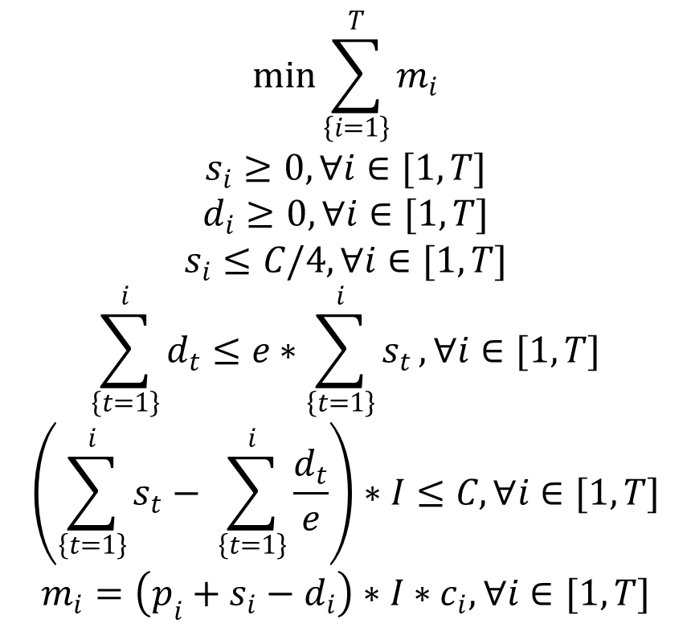
SmartCharge: LPF
Min cost with battery storage for ToU pricing
1. Objective
2. Energy charged >= 0
3. Energy discharged >= 0
4. Max charging rate
5. Charge conservation
6. Capacity constraint
7. Price calculation

Slide 35
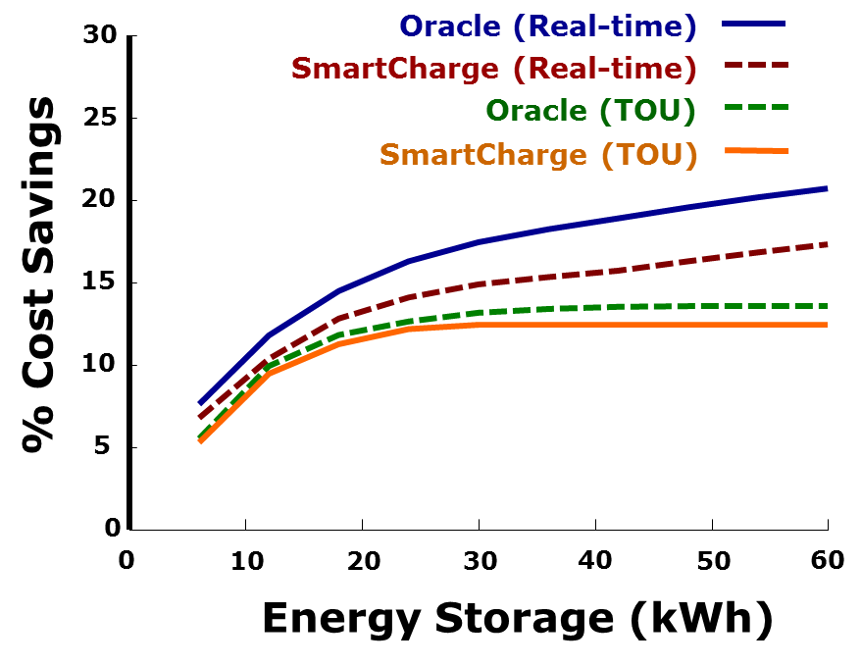
SmartCharge: Household Savings
10-15% savings
within 8-12% of Oracle
savings flatten >24kWh
A. Misra, D. Irwin, P. Shenoy, J. Kurose, T. Zhu, “SmartCharge: Cutting the Electricity Bill in Smart Homes with Energy Storage,” Proc. ACM e-Energy 2012
Notes:
Motivation for peak load reduction and demand-side energy management. Instrumented 3 homes to conduct research. Present deployment (most instrumented).
SmartHome prototype
SmartCharge
Take Insteon switches with me. Works like a normal switch. You can query it. How much power are you drawing. You can toggle the switch.
Other homes instrumented to varying degrees. NEST thermostat. Thermostat can learn. My home is the most instrumented.
Building smart home lab at UMass. Show some live data.
We can control switches, outlets, thermostats
Monitor devices: interrupts vs. polling
We use multiple different types of technology: Insteon (powerline, wireless), Zwave, HomePlug,
Utilities are rolling out smart meters. Not as advanced as the ones in my panel, but they will get there.
Lots of analytics you could think about doing.
Use as a tool for teaching. Sean controlling stuff in my basement.
Keep you honest about implementing these techniques.
Learn interesting engineering issues related to scale, fidelity, granularity of sensors and network. Getting highly accurate readings over low-bandwidth wireless/powerline links for lots of devices.
Use data for a lot of other projects as well.
Take advantage of mature sensing products. Get lot of redundant data that we want to correlate and process.

Slide 36
Prediction: many opportunities
home demand
peak demand flattening (via shiftable loads, storage)
renewable sources (wind, hydro) generation
transmission grid demand
…..

Slide 37
Overview
yesterday’s, today’s and tomorrow’s electric grid: a networking perspective
five (networking) smart grid challenges
richer data gathering and distribution architecture
monitoring, measurement
dealing with demand: network-inspired approaches
security and privacy
power routing
grid v. Internet: similarities and dis-similarities
reflections on Keshav’s 1st and 2nd hypotheses

Slide 38
Security and Privacy
many Internet analogies (indeed, communication infrastructure needs to be protected)
securing infrastructure
securing data
protection from eavesdroppers
detecting injection attacks
privacy: randomized AMI to allow accurate aggregate load prediction, while maintaining individual privacy

Slide 39
Overview
yesterday’s, today’s and tomorrow’s electric grid: a networking perspective
five (networking) smart grid challenges
richer data gathering and distribution architecture
monitoring, measurement
dealing with demand: network-inspired approaches
security and privacy
power routing
grid v. Internet: similarities and dis-similarities
reflections on Keshav’s 1st and 2nd hypotheses

Slide 40










Electric grid: sources, destinations
Observation: transmission networks move power from
sources to destinations - seems analogous to routing!
power flows not distinct, not addressable (no packet headers)
traditionally: power passively flows following Kirchoff’s and Ohm’s laws(no “active” routing)
transmission network
(backbone)
distribution
network (edge)

Slide 41
Electric grid: power routing
FACTS (flexible AC transmission system) devices – dynamically change transmission line impedance, changing passive power flow!
X₁₂
X₁₃
transmission network
(backbone)
distribution
network (edge)

Slide 42
Power routing
i
X_{ij}
j
S_{i}: source (generated) flow at i
L_{i}: load (consumed) flow at i
X_{ij}: flow from node i to node j
Find X_{ij} to minimize some cost function of X_{ij} subject to:
flow conservation (flow in = flow out)
capacity constraints (X_{ij} < C_{ij})
Routing algorithms are the “bread and butter” of networking researchers

Slide 43
Overview
yesterday’s, today’s and tomorrow’s electric grid: a networking perspective
five (networking) smart grid challenges
ultra-reliable, multi-destination transport
monitoring, measurement
security and privacy
dealing with demand: network-inspired approaches
power routing
grid v. Internet: similarities and dis-similarities
reflections on Keshav’s 1st and 2nd hypotheses

Slide 44
What can the smart grid learn from 40 years of computer networking research?

Slide 45
Grid versus Internet: network of networks
?
Q: Regional transmission network == Autonomous System
A: analogy is a bit strained
low degree of inter-RTO connectivity (rather than dense connectivity)
geographic proximity determines RTO connectivity (rather than peering,
customer-provider relationships)
distribution network connects to single RTO (albeit at multiple points for redundancy)

Slide 46
Reflection: what can the Internet teach us?
Keshav 1st hypothesis
Internet technologies, research developed over
past 40 years, can be used to green the grid
similarities (on the surface):
power routing = internet flow routing
AS == RTO
grid management = network management
The “sweet spot” is in developing
the control plane architecture!
but….
Internet best effort service model won’t cut it
manageability, security, reliability (five 9’s) not yet Internet main strengths

Slide 47
Reflection: what can the Internet teach us?
Keshav 2nd hypothesis
The next decade will determine the structure of the grid in 2120
architecture: punctuated equilibrium?
today’s IP v4: 30+ years old
telephone network: manual to stored-program-control to IP over 100 years
today’s meteorological sensing network: 30+ years old
…… the time is indeed now

Slide 48
Conclusions
smart grid: many research opportunities
ICT can/must inform smart grid design operation
importance of working with domain experts
two-way collaboration with significant “start up” costs, e.g., bioinformatics, sense-and-response hazardous weather prediction
IITB/Umass joint seminar: spring 2013

Slide 49
the end
- thank you -
?? || /* */

