Slide 1
“On the Impact of PMU Placement On Observability and Cross-Validation”
Daniel Gyllstrom, Elisha Rosensweig, and Jim Kurose
University of Massachusetts Amherst USA e-Energy 2012

Slide 2
Talk Outline
Background
PMU Placement for Max Observability
PMU Placement with Error Detection
Approximation Algorithms
Evaluation via Simulation
Notes:
I start this presentation by providing some background on electric power grids and describe a sensor called a PMU, which is currently being deployed on power grids to provide voltage and current measurements. Then, I will discuss a PMU placement problem that aims to cover the maximum number of nodes in a power grid. Next, I will discuss a PMU placement problem that address detecting measurement errors. I show that both of these problems are NP-Complete and therefore present approximation algorithms to each. Finally, I present the results of our simulation study to evaluate these approximation algorithms.

Slide 3
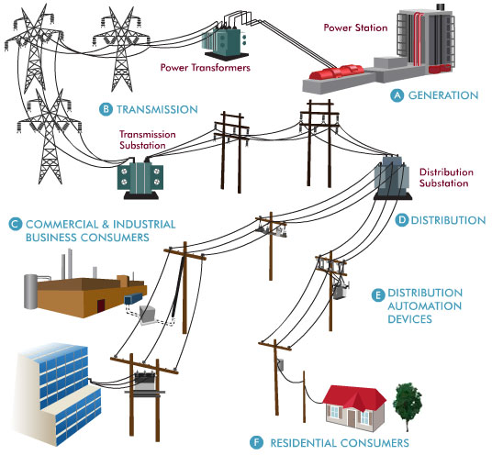
http://venturebeat.com/2010/10/29/super-grid-introduction/
Notes:
If you look at any electric power grid worldwide, it consists of 3 principle components: (1) power generation (2) transmission and (3) distribution. Transmission lines are high voltage and send power over long distances, while the distribution system consists of lower voltage power lines and delivers power to homes, business, and other end consumers. Utilities and grid operators need voltage and current measurements across the grid in order to determine its health and to ensure its effective operation.

Slide 4
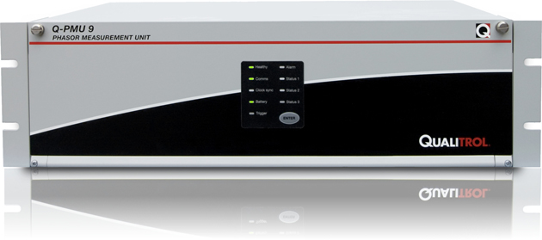
Phasor Measurement Unit (PMU) Sensor
Notes:
A sensor that provides these measurements are Phasor Measurement Units (PMUs). PMUs are currently being deployed on power grids worldwide.

Slide 5
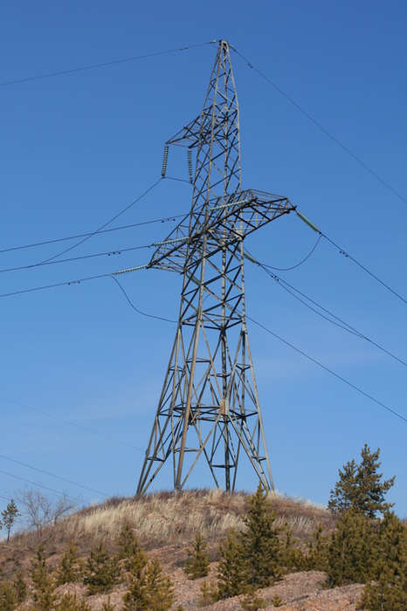
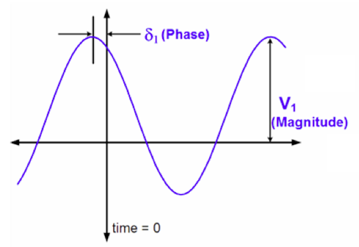
PMU Sensors
=
phasor
Notes:
AC power manifests itself as sine waves. PMUs measure two values: the magnitude of the wave and the phase with respect to a reference. In this example, the phase is a fixed point in time, t=0. The magnitude and phase of the wave are referred to as a phasor.

Slide 6
PMU Sensors
high sampling rate:10-60 samples/sec
+
measurements are synchronized
Notes:
PMUs also sample at a much higher rate than existing sensors, which are of the SCADA system: 10-60 samples per second vs. 1 sample every 1 to 4 seconds. Perhaps most important is that the measurements are synchronized, providing grid operators with a real-time snapshot of the power grid. As a result, PMUs have enabled a completely new set of applications.

Slide 7
PMU Applications
Postmortem analysis
Power grid visualization
Real-time distributed control
Notes:
These applications include postmortem analysis, real-time visualization of power grid dynamics, real-time distributed control. The rich high frequency PMU data can also enable for the more reliable intregration of intermittent power sources such a wind and solar

Slide 8

Reliable
Integration
of
Renewables
Notes:
In addition, the rich, high-frequency data provided by PMUs allow for more reliable integration of intermittent power sources such as wind.

Slide 9
Detailed Look at Power Grid
Notes:
Now, let’s take a closer look at the power grid. In particular, we focus on generation and transmission because this is where PMUs are deployed. In power systems, generation and transmission are modeled as shown in the next slide.

Slide 10
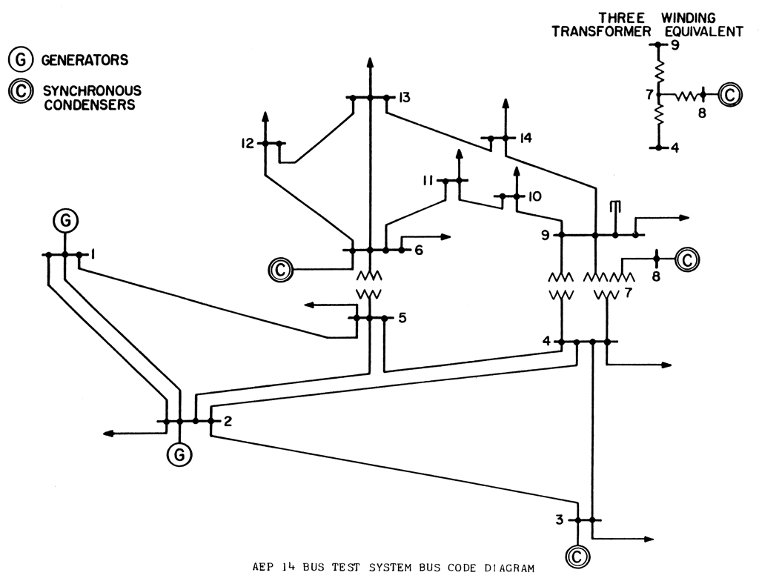
Example Power Grid
= bus (node)
Notes:
This is an example power system. It consists of a set of buses, highlighted here in blue. A bus can either be a power generation center, an aggregation of electrical loads, or an electrical substation. The buses are connected by transmission lines.

Slide 11
Terminology
Node: system bus
  injection node: power generation center or aggregation of loads + either pulls energy from grid or inserts energy into grid
  zero-injection node: substation where electrical lines meet + does not insert or pull energy from grid
Observed: if voltage phasor of node can be directly measured or calculated
Notes:
Let’s pause for a moment and review some terminology. From this point, we refer to a system bus as a node. There are two types of nodes: injection nodes and zero-injection nodes. An injection node is either an aggregation of electrical loads or a power generation center. As the name implies, these nodes inject or pull energy from the grid. A zero-injection node is an electrical substation where transmission lines simply meet. Zero-injection nodes maintain conservation of flow in the sense that all power that enters the node We will see later that the distinction between zero-injection and injection nodes is important. Finally, we refer to a node as observed if the voltage phasor can be directly measured or calculated.

Slide 12
Example Power Grid
= bus (node)
Notes:
Now, let’s revisit the same example power system shown earlier. The state of the power system is defined by the voltage phasor of all the system nodes (the blue dots). That is, we want all nodes to be observed. If we could deploy PMUs at all system nodes we would easily be able to determine the state of the entire system.

Slide 13
PMU Placement Problem
PMUs expensive
  high cost of placing PMU on each node
Solution
  place PMUs on subset of nodes
  indirectly observe non-PMU nodes using basic laws of electricity
Notes:
However, PMUs are expensive and, in practice, they can only be placed at a subset of nodes. Fortunately, we can use Ohm’s Law and KCL to observe other nodes without a PMU.

Slide 14
Our Paper
Define 2 Placement Problems:
  maximize observed nodes while minimizing number of PMUs used
    similar to Vertex-Cover
Notes:
We define 2 placement problems which aim to place a constant number of PMUs to observe the maximum number of nodes. These problems are similar in spirit to the well known vertex cover problem.

Slide 15
Our Paper
PMU errors occur in practice
Error detection
  place PMUs “near” each other
Define 2 more PMU placement problems
  place PMUs for maximum observability and to allow error detection
Notes:
We define 2 additional problems which place PMUs to allow for error detection. PMUs errors have been observed quite frequently in practice. The intuition is that we want to place PMUs near each other so they have overlapping measurements, allowing error detection.

Slide 16
Talk Outline
Background
PMU Placement for Max Observability
PMU Placement with Error Detection
Approximation Algorithms
Evaluation via Simulation
Notes:
This concludes the introduction portion of my talk. Next, I will discuss our first PMU placement problem which aims to maximize the number of observed nodes. Before doing so, I formalize the notion of PMU observability. The rules I present are standard in the literature, deriving from basic laws of energy: Ohm’s Law and KCL.

Slide 17
Key for Figures
A node with a PMU
KwH
An unobserved node
An observed node
Edge
Notes:
In the figures in the coming slides, I use a blue node to refer to

Slide 18
Observability Rule 1
a
b
a
b
v
v
c
c
If a node, v, has a PMU, then v and all of v’s neighbors are observed
D. Brueni and L. Heath. The PMU Placement Problem. SIAM Journal on Discrete Math, 2005
Notes:
The first rule states that if a node, v, has a PMU then v is observed and all of v’s neighbors are observed. In this example, v has a PMU. Observability rule 1 tells us that as a result, v is observed all of v’s neighbors -- a, b,c -- are observed, as shown here on the right.

Slide 19
Observability Rule 2
a
b
a
b
v
v
zero-injection node: substation where electrical lines
meet + does not insert or pull energy from grid
c
c
If a zero-injection node, v, is observed and all of v’s neighbors are observed, except one, then all of v’s neighbors are observed.
D. Brueni and L. Heath. The PMU Placement Problem. SIAM Journal on Discrete Math, 2005
Notes:
The second rule states that if a zero-injection node, v, is observed and all of v’s neighbors, except for one, are observed then v and all of v’s neighbors are observed. [Describe diagrams.] There are 2 important things to notice here. One, is that this rule requires that v is a zero-injection node. Second, notice that none of the nodes has a PMU. Rather, when a PMU is placed, this rule allows the set of observed nodes to propagate outward from the PMU.

Slide 20
MaxObserve Problem
Input: G=(V,E) and k PMUs
Output: placement of k PMUs to maximize number of observed nodes
Key Result: MaxObserve is NP-Complete
Notes:
Now that we have formalized the observability rules, we can state our first problem, MaxObserve. As input, MO takes an undirected graph and k PMUs. The output is a placement of the k PMUs such that the maximum number of nodes are observed. We define a closely related problem in our paper, but due to time constraints I focus on MaxObserve. One our key results is proving that MaxObserve is NP-Complete.

Slide 21
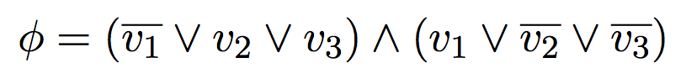


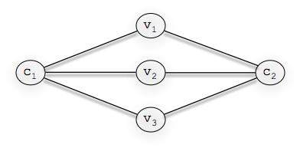
Proof: MaxObserve is NPC
Reduce from Planar 3SAT (P3SAT)
{
{
Notes:
In our NP-Completeness proof we reduce from planar 3SAT. We can think of a 3SAT formula as a graph, with nodes for each variable and clause, and an edge connecting a variable node with clause node if that variable occurs in that clause. Planar 3SAT is when this graph is planar. Consider the example formula, phi. The correspond graph is shown below. It has a node for each variable and 2 clause nodes.

Slide 22
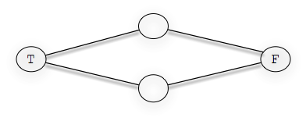
Proof: MaxObserve is NPC
replace each variable with
set of nodes below (gadget)
Notes:
In our proof, we replace each variable node with a set of nodes called a gadget. The gadget has one node that semantically correspond to True and False, labeled T and F, respectively. In this example, we replace v_1, v_2, and v_3 with the gadget shown at the bottom of the slide.

Slide 23
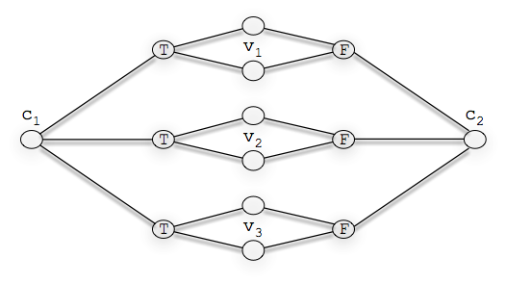
T
Proof: MaxObserve is NPC
T
F
T
F
T
F
Show maximum nodes observed iff PMUs place on nodes corresponding to satisfying instance of P3SAT
Notes:
This yields the graph shown here for our example formula \phi. We show that PMUs must be placed on T or F nodes in order to observe the maximum number of nodes, as shown here in our running example. We also prove that using this placement of PMUs, we can derive a satisfying instance of the P3SAT formula. In this example, we can use this PMU placement to determine that if v_1 = False, v_2 = True, and v_3 is False, we have a satisfying instance of phi.

Slide 24
Related Work for MaxObserve
Adapt proof technique of Brueni and Heath [4]
Unrealistic assumption (Brueni and Heath [4], Aazami and Stilp [2])
  all nodes zero-injection
  in practice, ~5% nodes are zero-injection
Notes:
Problems similar to MaxObserve have been studied in the literature. In fact, our proof techniques are adapted from those used by Brueni and Heath. However, most related work unrealistically assumes that all nodes are zero-injection. In practice, only 5% of nodes in a power system are zero-injection.

Slide 25
Talk Outline
Background
PMU Placement for Max Observability
PMU Placement with Error Detection
Approximation Algorithms
Evaluation via Simulation
Notes:
Now, we shift our focus to a PMU placement problem which considers error detection. First, we define the cross-validation rules which formalize the idea of PMU error detection.

Slide 26
Cross-Validation Rule 1
a
b
If PMUs placed on adjacent nodes, the PMUs cross-validate each other
Vanfretti et al. A Phasor-data-based State Estimator Incorporating Phase Bias Correction. IEEE Transactions on Power Systems, 2010
Notes:
If two PMUs are placed on adjacent nodes, the two PMUs cross-validate each other. Intuitively, both PMUs measure the current phasor of the common transmission line, allowing the PMUs to determine if there is a discrepancy in their measurements.

Slide 27
Cross-Validation Rule 2
a
b
c
If two PMUs share a common neighbor, the two PMUs cross-validate each other
Vanfretti et al. A Phasor-data-based State Estimator Incorporating Phase Bias Correction. IEEE Transactions on Power Systems, 2010
Notes:
The second rule states that if two PMU nodes share a common neighbor, the two PMUs cross-validate each other. When computing the voltage phasor of b, the power system equations include variables to measurement error. Cross-validation is possible because we have more equations than unknowns.

Slide 28
MaxObserve-XV
XV denotes cross-validation
Input: G=(V,E) and k PMUs
Output: placement of k PMUs so maximum number of nodes are observed, under the condition that each PMU is cross-validated
Key Result: MaxObserve-XV is NP-Complete
Notes:
Using these cross-validation rules, we define a new placement problem which considers PMU error detection, MaxObserve-XV. As input, MO takes an undirected graph and k PMUs. The output is a placement of the k PMUs such that maximum number of nodes are observed, under the condition that each PMU is cross-validated. Our second key result is proving that MaxObserve-XV is NP-Complete. In our paper, we describe a closely related problem but I will not present this problem here due to time constraints.

Slide 29
MaxObserve-XV is NP-Complete
Reduce from Planar 3SAT (P3SAT)
  new gadgets for variables nodes
  require PMUs are cross-validated
Proof details in paper
Notes:
Our proof that MO-XV reduces from planar 3SAT, as we saw with MO. However, the gadgets we use for the variable nodes are different from those that we saw with MO. Also our proof must ensure that all PMUs are cross-validated. As a result, our proof differs substantially in its details from MO. Due to time constraints I refer you to the paper for the proof details.

Slide 30
MaxObserve-XV Related Work
Completely new problem
  Chen and Abur [5] add PMUs so PMU loss can be tolerated
  Vanfretti et al. [14] define cross-validation rules
Notes:
MaxObserve-XV has not been defined in the literature. Chen and Abur, reference [5], consider a PMU placement that are resilient to the loss of a PMU. This is closely related but different from our formulation. Vanfretti et al, reference [14] define the cross-validation rules we use.

Slide 31
Talk Outline
Background
PMU Placement for Max Observability
PMU Placement with Error Detection
Approximation Algorithms
Evaluation via Simulation
Notes:
Because MaxObserve and MaxObserve-XV are both NP-Complete, we develop greedy approximation algorithms for each problem.

Slide 32

greedy algorithm
Approximates MaxObserve
S: set of nodes with a PMU
S=
iteratively add, v, to current solution S such that a PMU at v results in observation of max number of new nodes
Notes:
Our first approximation algorithm, which we refer to as ‘greedy’, approximates MaxObserve. The algorithm is simple. Starting with a single PMU, in each iteration of the algorithm we add a PMU to the node that results in the observation of the maximum number of nodes. The algorithm terminates when all k PMUs have been placed.

Slide 33
xvgreedy algorithm
Approximates MaxObserve-XV
S: set of nodes with a PMU
S=
iteratively add,{u,v}, to current solution S such that u and v are cross-validated and a PMU at results in observation of max number of new nodes
Prove greedy and xvgreedy have polynomial running time
Notes:
Our second greedy algorithm, xvgreedy, approximates MaxObserve-XV. The algorithm is identical to “greedy” except that PMUs are added in pairs, such that each PMU is cross-validated using one of our 2 cross-validation rules. We prove that greedy and xvgreedy have polynomial running time.

Slide 34
Talk Outline
Background
PMU Placement for Max Observability
PMU Placement with Error Detection
Approximation Algorithms
Evaluation via Simulation
Notes:
Next, I present the simulations we use to evaluate our greedy approximation algortihms.

Slide 35
Simulation Setup
Topologies
  IEEE bus systems
  synthetic graphs with same degree distribution
  show results for synthetic topologies based on IEEE Bus 57
  trends similar across other topologies
Notes:
As is standard in the power system literature, we use the IEEE bus system topologies to evaluate our algorithms. These are portions of the real power system in North America. In order to establish the statistical significance of our results, we generate synthetic topologies with the same degree distribution as their IEEE counterparts. The results we show here are for synthetic topologies based on IEEE bus system 57, a topology with 57 nodes. The trends we show are consistent across other topologies, both synthetic and real. When possible we compare our greedy solutions to a brute-force optimal solution, one which considers cross-validation, “xvoptimal”, and the other which does not, “optimal”.

Slide 36
Simulation Setup
Compare greedy solutions to brute-force optimal solution when possible
  optimal: no cross-validation
  xvoptimal: cross-validated PMUs
Notes:
When possible we compare our greedy solutions to a brute-force optimal solution, one which considers cross-validation, “xvoptimal”, and the other which does not, “optimal”.

Slide 37
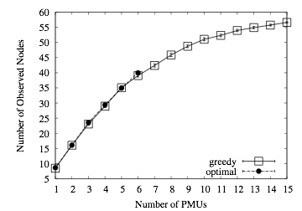
Impact of Number of PMUs
greedy within 98.6% of optimal
Notes:
In our first simulation, we consider the number of observed nodes as a function of the number of PMUs. This plot shows the results for greedy and optimal, with the 90% confidence interval. These represent solutions for MaxObserve. We find that greedy performs quite well. Across all topologies, greedy is, on average, within 98.6% of optimal.

Slide 38
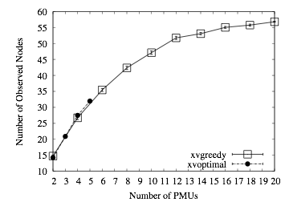
Impact of Number of PMUs
xvgreedy within 97% of xvoptimal
Notes:
Now when we consider cross-validation for the same simulation, we find similar results. Again, we have the number of PMUs on the x-axis and the number of observed nodes on the y-axis. We find that, on average, xvgreedy is within 97% of xvoptimal.

Slide 39
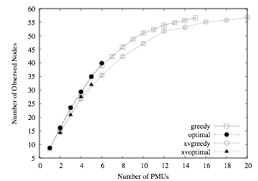
Impact of Number of PMUs
cross-validation adds only 5% overhead
Notes:
Finally, for the same simulation we now plot all 4 curves together to show the small cost of imposing the cross-validation requirement. When we compare greedy vs xvgreedy and optimal vs xvoptimal, we find that cross-validation adds, on average, only 5% overhead.

Slide 40
Refresher Slide
Zero-injection node
  substation where electrical lines meet
  does not insert or pull energy from grid
  node must be zero-injection to apply observability rule 2
How does number of zero-injection nodes effect observability?

Slide 41
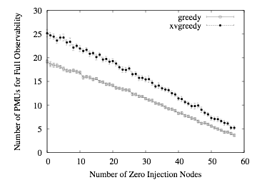
Vary # Zero-Injection Nodes
more zero-injection nodes reduces # of PMUs needed to observe all graph nodes
Notes:
In a second simulation, we examine the impact of the number of zero-injection nodes. For each topology we randomly assign nodes to be zero-injection. Here we plot the number of PMUs required to observe all graph nodes, as a function of the number of zero-injection nodes. Due to the exponential running time of the brute-force optimal algorithms, we only show curves for our greedy approximations. As expected, we find that increasing the number of zero-injection nodes, reduces the number of PMUs required to observe all graph nodes. In fact, we found the relationship to be linear. Fewer PMUs are needed because with more zero-injection nodes, we can apply our second observability rule more frequently.

Slide 42
Conclusions
Defined 4 new PMU placement problems
  proved NP-Complete
Presented 2 simple greedy approximations
Simulations
  greedy gives close to optimal solutions
  cross-validation imposes small cost
Notes:
In conclusion, we defined 4 new PMU placement problems, two of which I focused on in this presentation. Our main contribution was proving that each placement problem is NP-Complete. Thus, we feel that future work should focus on developing approximation algorithms for each problem. As a first step, we presented 2 simple greedy approximations. We found through simulations that the greedy algorithms yield close to optimal solutions. In addition, we found that imposing the cross-validation requirement on PMU placement comes at a small marginal cost, and thus we advise enforcing this constraint.

Slide 43
Thank You
+
Questions?
The End

Slide 44
Backup Slides

Slide 45
Synthetic Graph Generation
start with IEEE graph
swap edges until new graph shares no edges with original
Output = same # number of nodes but new connectivity
a
b
a
b
degree = x
degree = x -1
c
c
degree = x -1
degree = x
Notes:
pick a random node a. select one of its neigbors, b which has degree x. then we pick a random node c with degree x-1. then we remove edge a-b and add edge a-c.

Slide 46
Simulation Topologies
IEEE Bus System 14, 30, 57, 118, and 300
No results for brute-force optimal for larger topologies

Slide 47
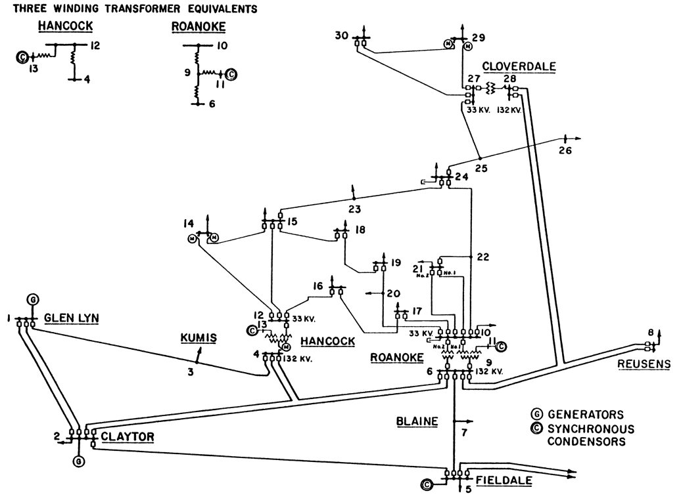
IEEE Bus System 30

Slide 48
Why is XV Limited to 2-hops?
Computing voltage phasor of non-PMU nodes
  equations have variables to account for measurement error
More than 2 Hops
  have more unknowns that equations
      => no error detection
Notes:
When computing the voltage phasor of the shared neighbor, the voltage equations include variables that account for measurement error. When the PMUs are 2 hops from each other there are more equations than unknowns. When PMUs are more than 2 hops from each other the number of unknowns exceeds the number of equations.

Slide 49
Proof: MaxObserve-XV is NPC
Reduce from Planar 3SAT (P3SAT)
Notes:
As with MO, we reduce from planar P3SAT. Recall that P3SAT requires that the graph corresponding
to a P3SAT formula must be planar. Here is an example formula and its graph.

Slide 50
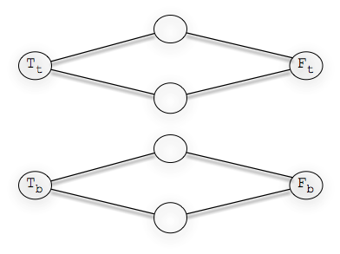
Proof: MaxObserve-XV is NPC
replace each variable with
set of nodes (gadget)
Show maximum nodes observed iff PMU pairs placed on nodes corresponding to satisfying instance of P3SAT. PMUs are cross-validated
Notes:
As with MO, we modify the P3SAT graph by replacing the variable nodes with a set of nodes called a gadget. The gadget for MO-XV is different than the one we used for MO. It consists of two identical copies of the gadget we used in our MO proof. In our running example, we replace v_1, v_2, and v_3 with the gadget shown on the right. We show that the maximum number nodes are observed iff pairs of PMUs are placed on nodes corresponding to a satisfying instance of P3SAT. This corresponds to both T nodes of the gadget or both F nodes. Further, we ensure that the PMUs are cross-validated.

