Slide 1
Stagepay
Freelance milestones, reviewed before payment
A working prototype using test tokens
Shaurya Goyal | 3rd-Web-Hack
Notes:
Project source and actual prototype: https://github.com/gylshaurya/stagepay
Public app: https://gylshaurya.github.io/stagepay/
This is not a production payment service.

Slide 2
The small freelance job
A scope in chat. Files in another place.
A payment record with little context.
When the work changes, both people need to know which version they agreed to and which delivery was accepted.
Stagepay keeps those decisions attached to the same agreement.
Notes:
Problem hypothesis and selected product scope, not a claim of customer interviews or measured adoption. Project explanation: https://github.com/gylshaurya/stagepay/blob/main/submission.md

Slide 3
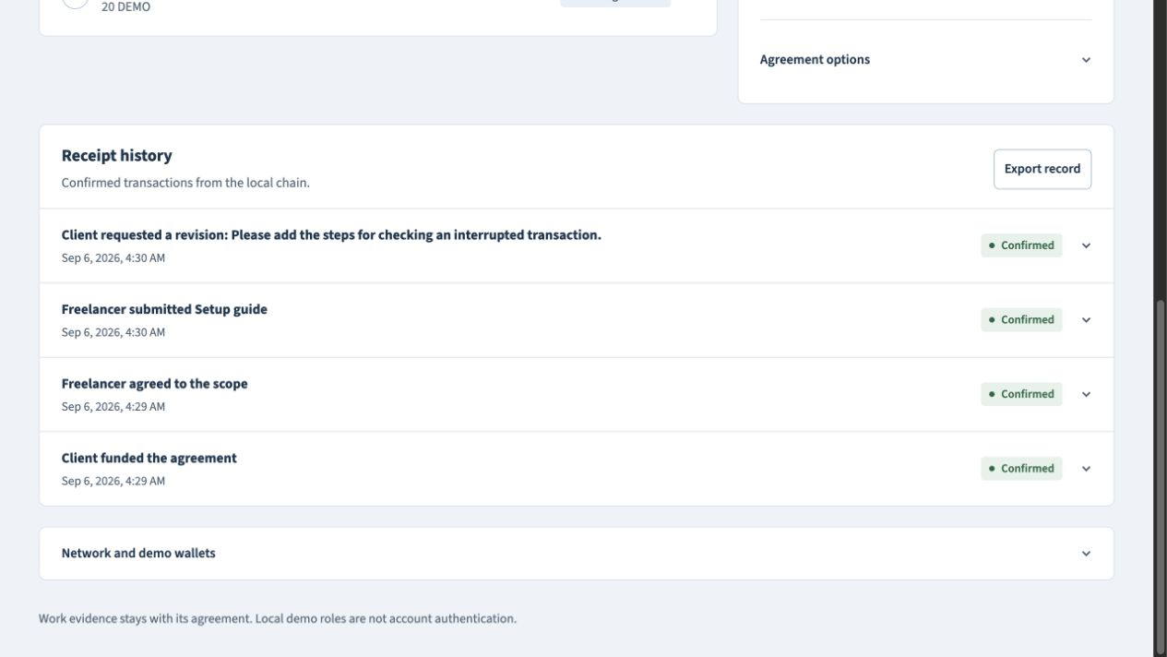
Review before release
The client funds agreed milestones with test tokens.
The freelancer submits a link and a delivery note.
Acceptance pays once.
A revision pays nothing.
Actual local demo: funding, agreement, delivery and revision receipts
Notes:
Screenshot from the actual recorded local workflow, not a public Sepolia receipt. https://github.com/gylshaurya/stagepay/releases/tag/demo-v1
Contract: https://github.com/gylshaurya/stagepay/blob/main/contracts/Stagepay.sol

Slide 4
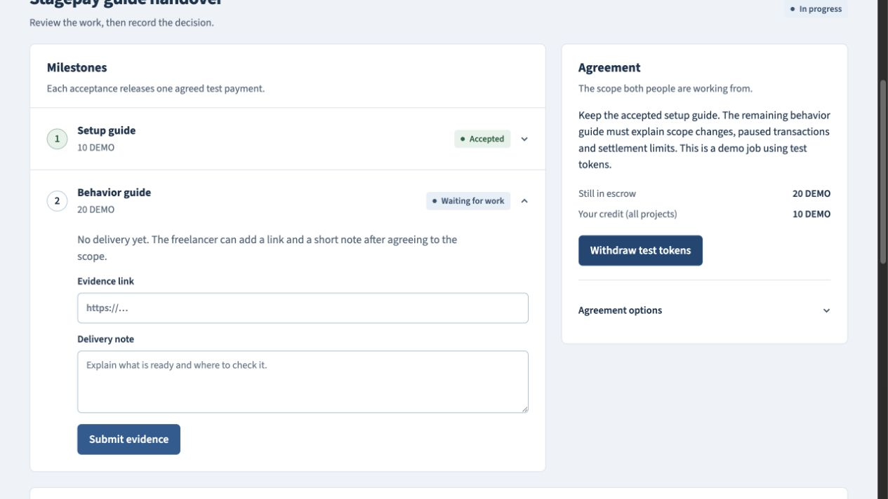
Changing the unpaid scope
Both people must agree to the new version.
Accepted work stays paid. Unpaid work needs new evidence.
The scope and delivery hashes keep old approvals from paying changed work.
Local demo: 10 DEMO credited; 20 DEMO remains for unpaid work
Notes:
Actual local walkthrough screenshot. Acceptance and scope-change invariants are implemented and tested in https://github.com/gylshaurya/stagepay/blob/main/contracts/Stagepay.sol and repository Foundry tests. The useful distinction is binding scope version, delivery evidence and one-time payment in the same workflow; no claim of being the first escrow product.

Slide 5
What the contract checks
Named parties and exact versions
Only the agreed client and freelancer can act. Acceptance checks the current scope and submitted evidence.
A payment can be withdrawn once
Solidity holds the test asset and credits accepted work. The browser uses ethers; OpenZeppelin handles safe token transfers and reentrancy protection.
Notes:
Implementation: https://github.com/gylshaurya/stagepay/blob/main/contracts/Stagepay.sol
Pinned dependencies and setup: https://github.com/gylshaurya/stagepay/blob/main/package.json
No specific event sponsor SDK is claimed. Free GitHub Pages hosts the public browser app; Python/SQLite provide a separate private local workspace.

Slide 6
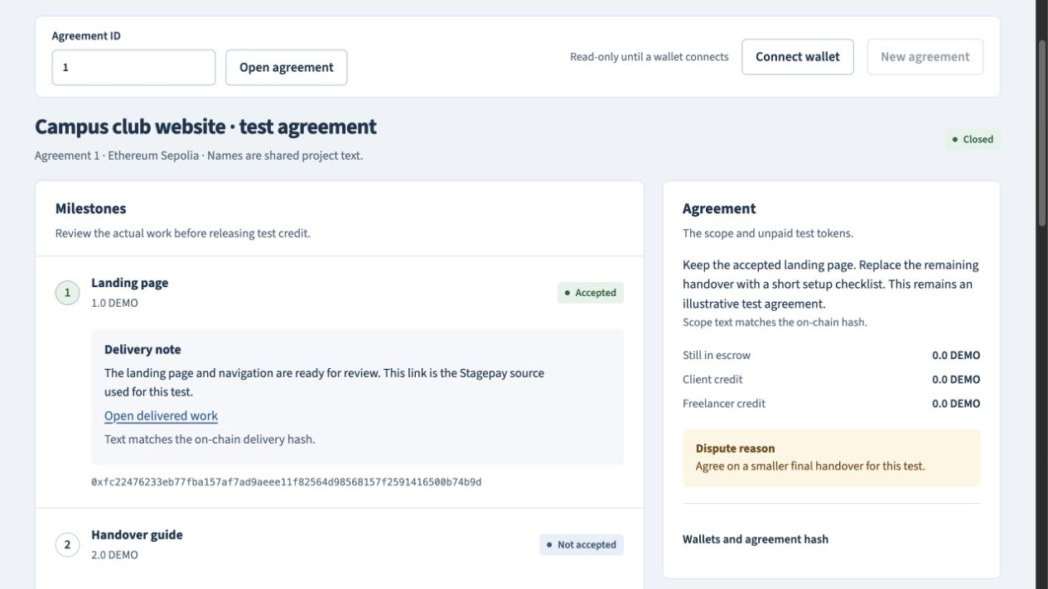
A real testnet result
13 confirmed Sepolia transactions completed the public example.
The agreement closed with no escrow balance or unclaimed credit.
Test tokens only. If both people never agree on a dispute, tokens may stay locked.
App: gylshaurya.github.io/stagepay/
Code: github.com/gylshaurya/stagepay
Notes:
Public walkthrough: https://github.com/gylshaurya/stagepay/blob/main/docs/sepolia-walkthrough.json
Deployment: https://github.com/gylshaurya/stagepay/blob/main/docs/sepolia-deployment.json
Demo: https://github.com/gylshaurya/stagepay/releases/tag/demo-v1
Both contracts have Sourcify exact source matches. Same public core signed real transactions through encrypted project wallets; extension-wallet signing UI was not directly exercised in the in-app browser. No independent security audit or customer outcome study is claimed. Potential impact is clearer handover and fewer ambiguous payment decisions; that impact is not yet measured.

