Slide 1

DESIGN TESTS FOR JIRA
By Team 2

Slide 2
Our team

Slide 3
Anikó
Judit
Bálint
Zoli
Leó
Team Lead
Meet planning
Manual 22
Log in, Log out
Manual 6
Browse projects
Manual 3
Browse issue
Manual 33
Create, edit issue
Manual 2

Slide 4
Daily meetings
On Google Meets
Anyone who could join

Slide 5
Writing test cases
01

Slide 6
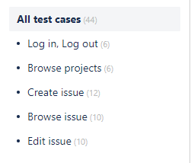
We made folders for tasks…

Slide 7
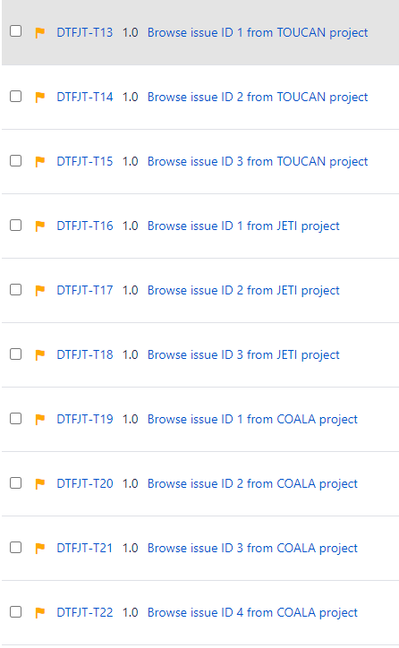
…and filled the folders with test cases

Slide 8
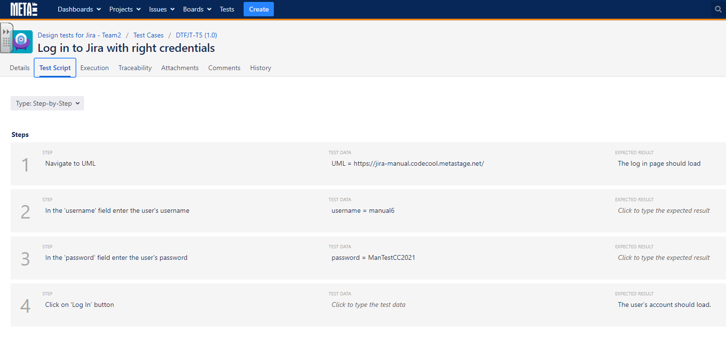
…and filled the test cases with steps,
test data and expected result

Slide 9
Making and running cycles
02

Slide 10
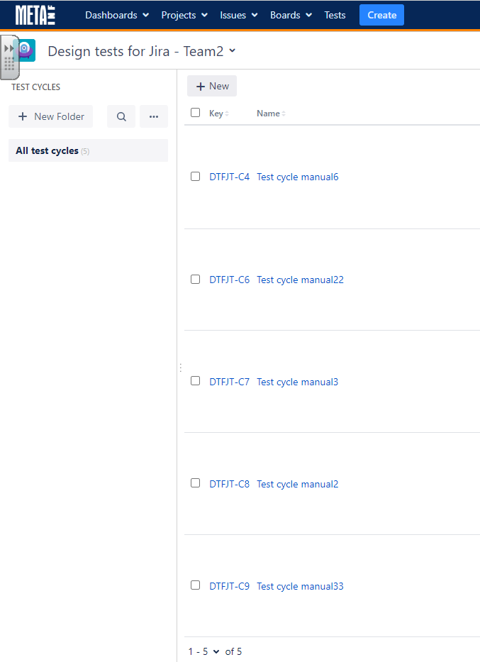
We made a cycle for every tester…

Slide 11





…and ran all test cases

Slide 12
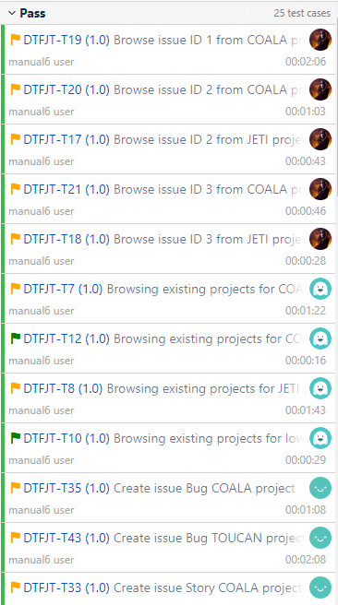
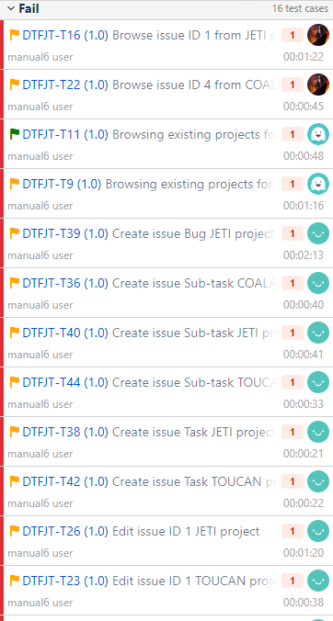
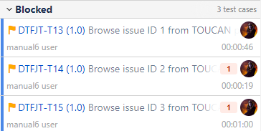
…and grouped them

Slide 13
Making bug issues
03

Slide 14
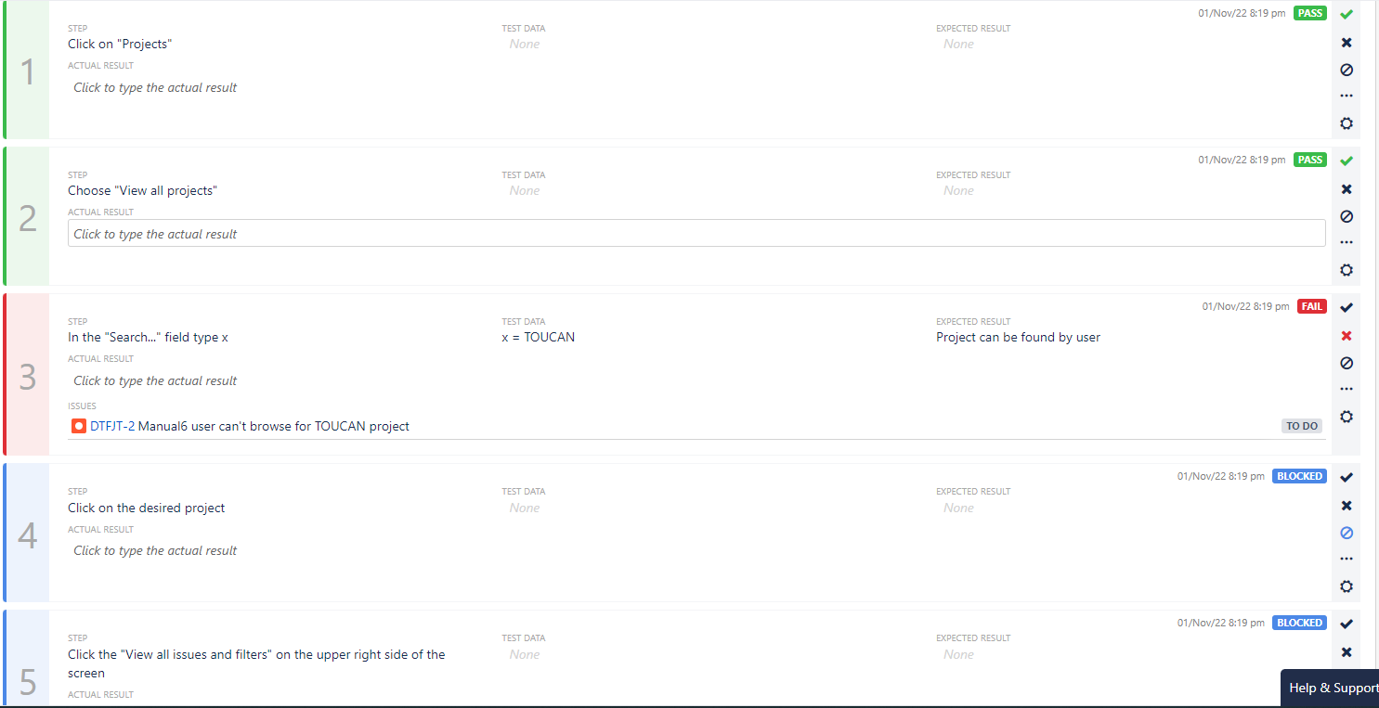

Slide 15
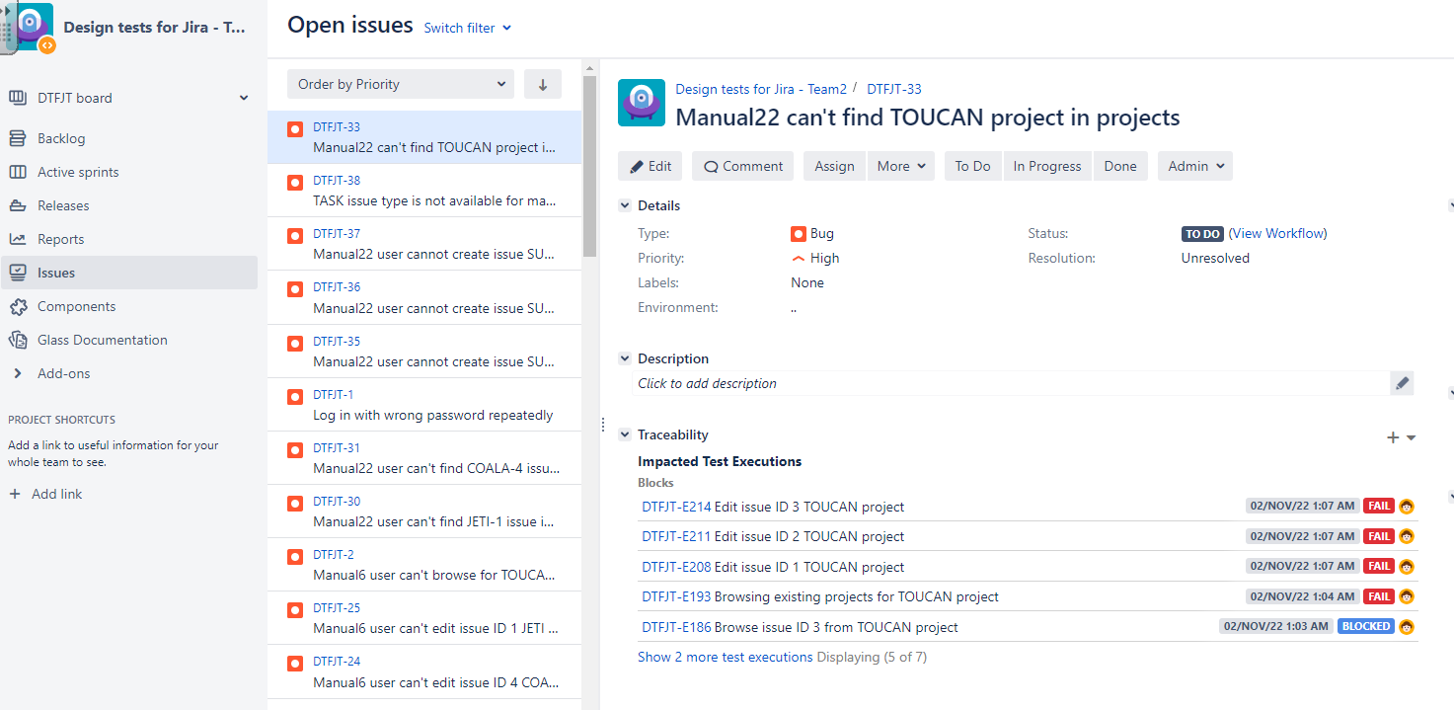

Slide 16
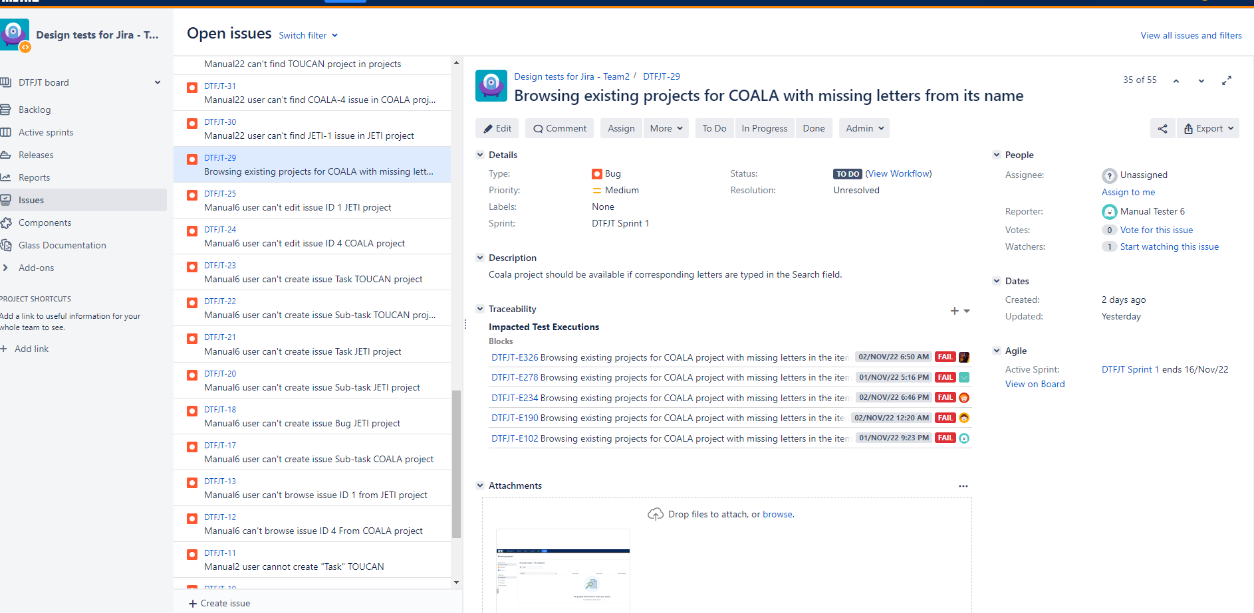

Slide 17
Making reports
04

Slide 18
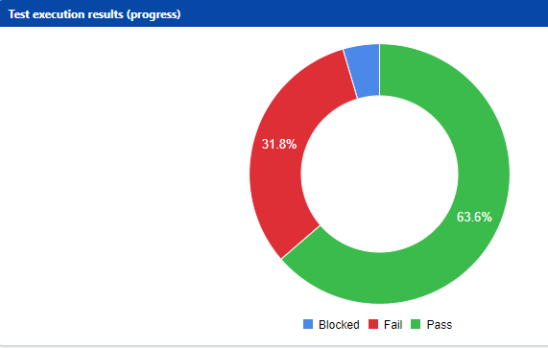
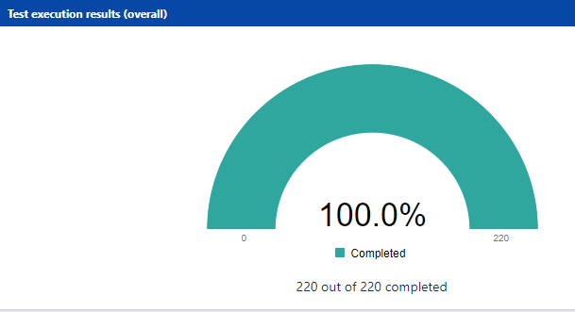

Slide 19
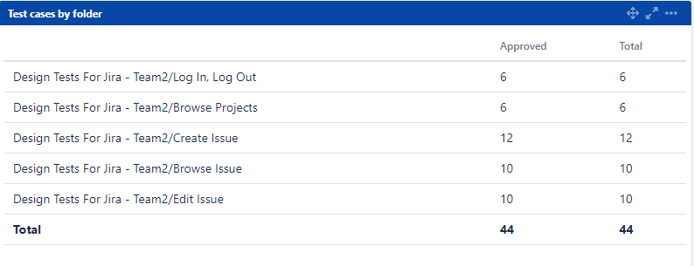

Slide 20
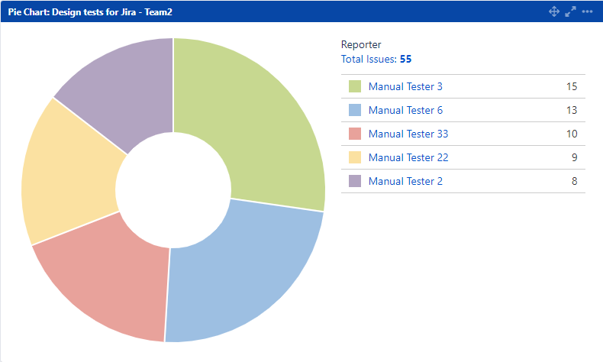

Slide 21
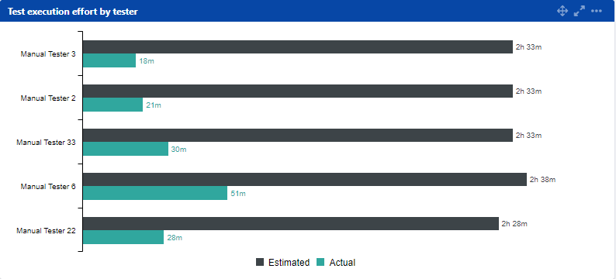

Slide 22
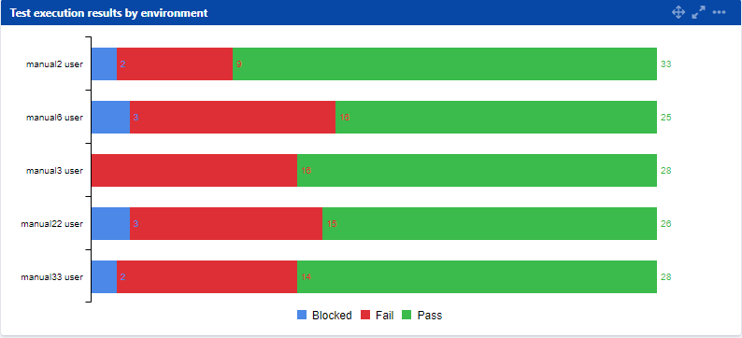

Slide 23
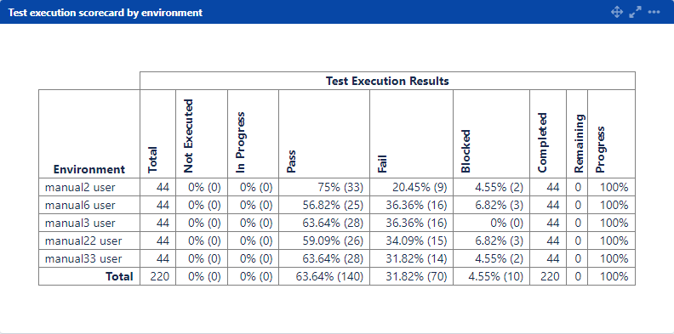

Slide 24
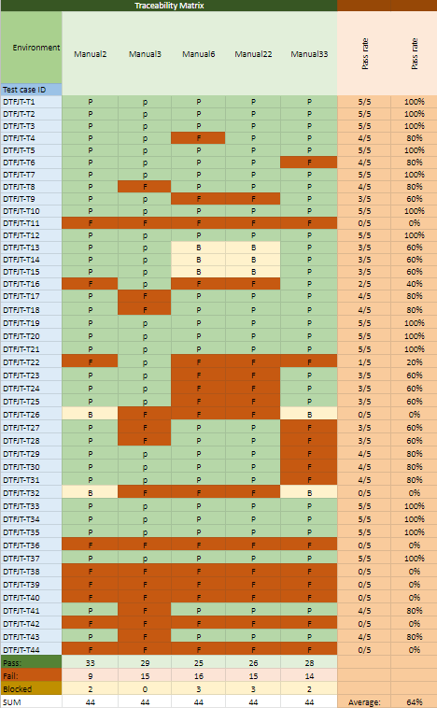
Traceability Matrix

