Slide 1
Data Management and Analysis with Python
CEU, January 2021

Slide 2
Questions and analysis steps
Q1: Is there a difference between Subscriber/Customer in daily/weekly routine?
Reading csv data into pandas dataframes and saving dataframes as csv
Using the os modul to interact with the operating system
Using lists to read several csv files and then concatenate them into one dataframe
Deal with duplicates and missing values
Descriptives
Dealing with date format data
Filtering the dataframe
Grouping and pivoting data
Bar charts
Q2: Is there difference in Subscriber/Customer behavior between days with different weather conditions?
Boxplot
Using dictionary objects to collect data using API service
Using dictionary objects to collect data from web scraping
Joining dataframes
Define custom functions to transform columns
Scatter plots with regression line
Q3: Are there stations more similar to each other? Which stations are those? In what features are they similar?
Applying custom functions for data transformation
Cluster analysis

Slide 3
Trip
'Start Date'
'date_to_join'
'Start Terminal'
'End Date'
'End Station'
'End Terminal'
...
'Subscription Type'
'Start Station'
Weather
'Date'
'Max_Temperature_F'
'Mean_Temperature_F'
...
'date_to_join'
'landmark'
Landmark
'landmark'
'zip_code'
Station
'station_id'
'name'
...
'zip_code'

Slide 4
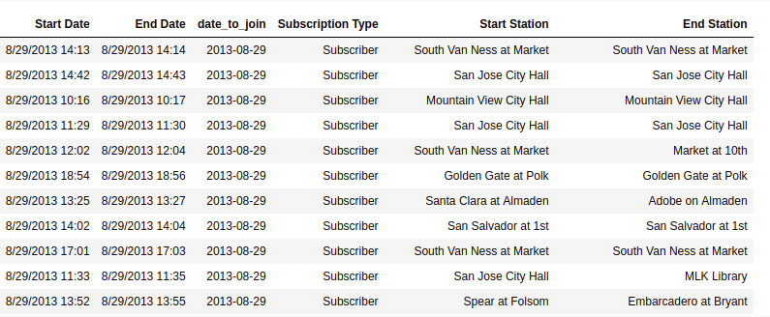
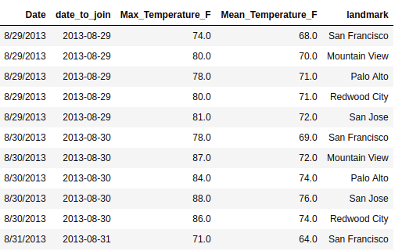
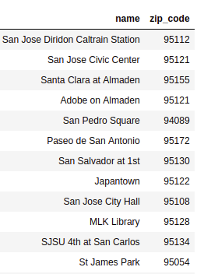
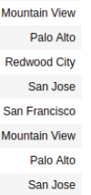
Creating dataframe for answering Q2

Slide 5
Steps we perform today
Checking and correcting the weather dataframe
String manipulation – for correcting column names
Changed datatype of columns
Boxplots
Change values in columns based on condition
Preparing the date column for joinging the weather data to the trip data
Finding common and difference elements of unique values of a columns – for checking if weather data is available for every day in the trip dataframe

