Slide 1
Node.js

Slide 2
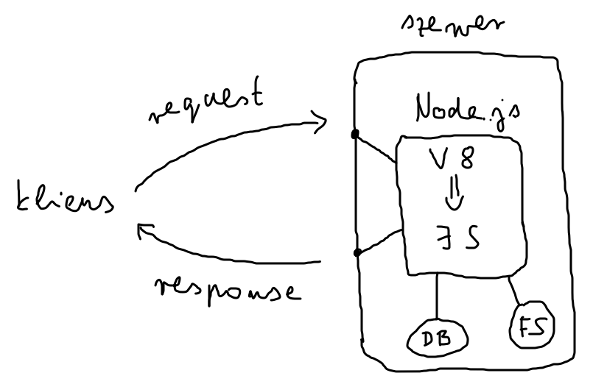
Introduction
Open-source, cross-platform JS runtime environment
(C/C++)
Runs the V8 JS engine (Google Chrome)

Slide 3
Introduction
Installing: https://nodejs.org/en/
No UI → CLI (VSC Terminal)
Version: node --version (node -v)

Slide 4
Node.js As a Runtime Environment
JavaScript runtime environment: node index.js (index1.js)
Source code in a wrapper function
→ global variables (__dirname, __filename, module,
exports, require) (index2.js, calculator.js)

Slide 5
Built-in Modules In Node.js
Node.js Built-in Modules (w3schools.com)
Creating server: ’http’
request and response objects (index3.js)

Slide 6
Request and response objects
Request:
- url (e.g. localhost:8080/<path>)
- method (GET, POST, DELETE, PATCH, PUT)
- QUERY parameters (http://localhost:8080/<path>?priceMore=30&priceLess=40))
- HEADER (metadata; e.g. content-type: application/json)
- BODY (e.g. e-mail address, password)

Slide 7
Request and response objects
Response:
- HEADER
- BODY
- STATUS (200, 404)
(index4.js)

Slide 8
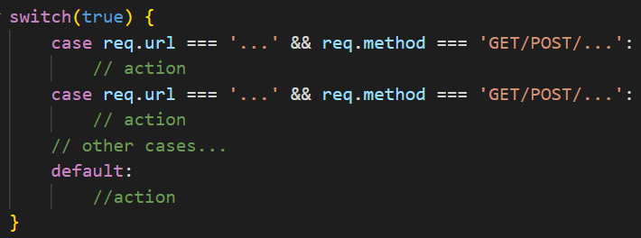
Routing
(index5.js)

Slide 9
Built-in Modules In Node.js
File system operations:
- ’fs’ (readFile, writeFile, response.on(’data’))
- ’path’
(index6.js + Postman + nodemon)

Slide 10
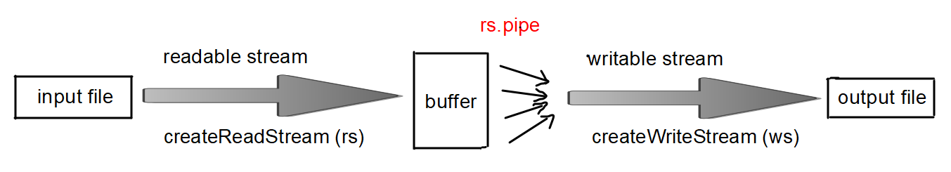
Streams

