Slide 1


Mobile Sales Summary: September 2023
Data analysis and dashboard creation using Python.
by Yesupadham GJ

Slide 2
Project Overview
Objective
Tools
Analyze mobile sales data for September 2023.
Python, Jupyter Notebook, data visualization libraries.

Slide 3

Data Exploration
1
Data Source
2
Cleaning
Sales data from September 2023.
Identify and address data inconsistencies.
3
Exploration
Analyze trends and patterns in sales data.

Slide 4
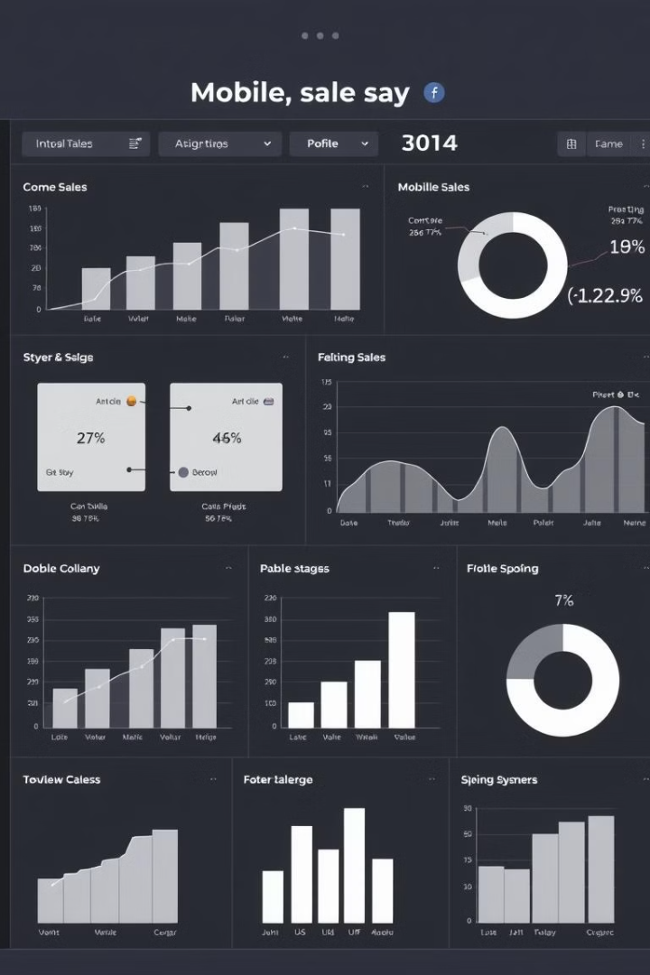
Dashboard Design
Key Metrics
Visualizations
Total sales, average sales per day, top-selling models.
Line charts, bar charts, pie charts, heatmaps.
Interactivity
Filters, drill-down capabilities, dynamic updates.

Slide 5




Insights and Findings
Sales Trends
Customer Behavior
Identify seasonal trends and peak sales periods.
Analyze customer preferences and buying patterns.
Model Performance
Identify top-performing models and understand their popularity.

Slide 6

Recommendations
1
Marketing Strategies
Target specific customer segments with tailored campaigns.
2
Inventory Management
Optimize inventory levels based on sales trends.
3
Product Development
Develop new products based on customer demand.

Slide 7




Conclusion
Data-Driven Insights
Leverage data to make informed business decisions.
Improved Performance
Optimize sales strategies and enhance business performance.
Future Growth
Drive future growth and success in the mobile market.

Slide 8



Next Steps
1
Continuous Monitoring
2
Regular Updates
3
Data-Driven Decisions

