Slide 1
Joy
Low-Fi Prototype “Share happiness and be positive”
Mobile app for sharing happy post, keeping diary of positive thought
-Yunzhou Feng
Description: Our user need is sharing happiness, thinking positively and interacting with friends. My mobile app is to post posts about a happy topic everyday and the users could read other people’s happy posts and communicate with other users. I think the sharing, the topics would motivate the users to think positively and share only happy thoughts.
Scenario: A student who finds himself not happy for a long time hears about my app, “Joy”, and he decides to give it a try. He reads about the topic we suggest and other people’s post about those topics which remind him about the happy things he has gone through. After using my app, he keeps the habit of recording one happy thing or thought everyday and the habit of thinking in a positive way. He finally feels that life is delightful in many ways.

Slide 2
In general
Users could be misled by inappropriate icons. (Ex. The button has the logo of the app on it is reckoned as a logo that is not functional, a button to the homepage, or a emotional tree.)
If a user have used a similar app, they would feel much easier to navigate around. (Ex. Sharing is not easy to find for those who have not used Instagram before.)
However, high level of similarity to popular apps makes my project not that unique.
Overlapping functions could be combined. Some not that relative functions could be separated.
Different users expect “go back” buttons to navigate to various pages.
Some participants found it interesting, but some would not use the app.

Slide 3
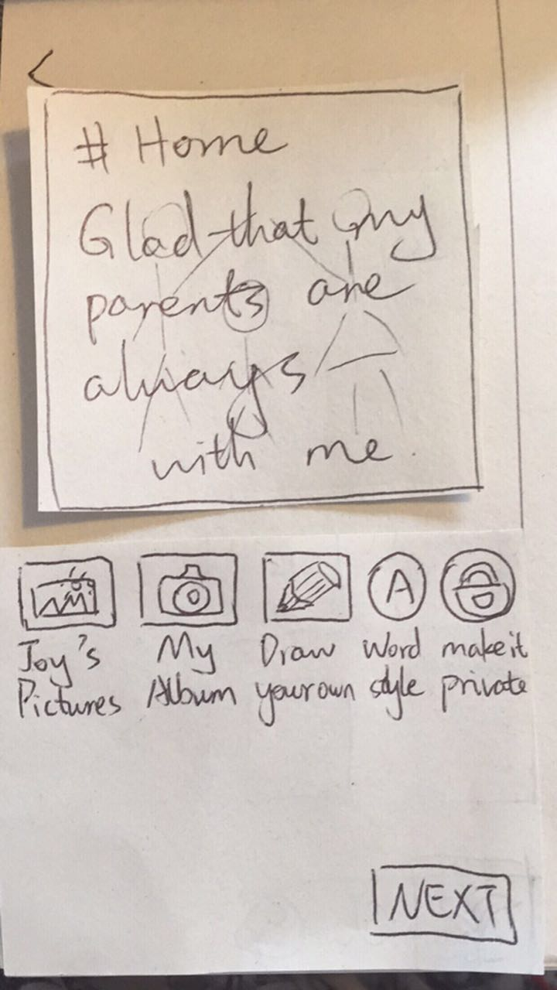
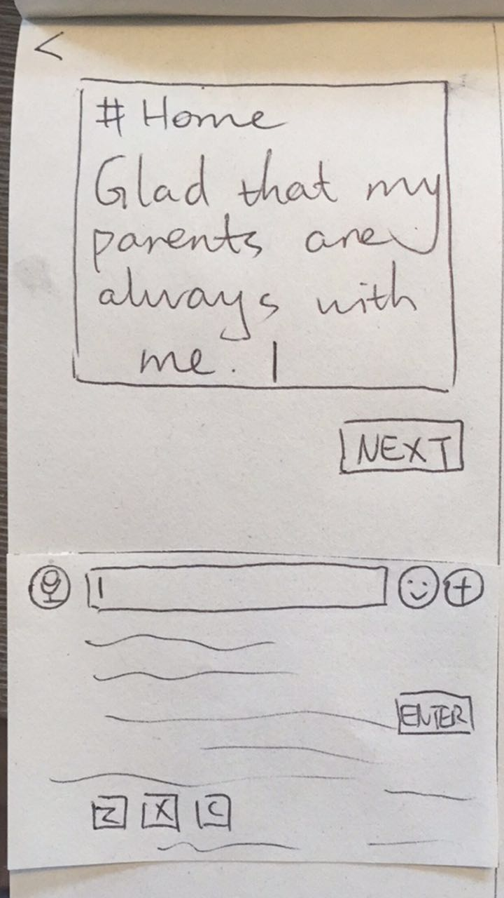
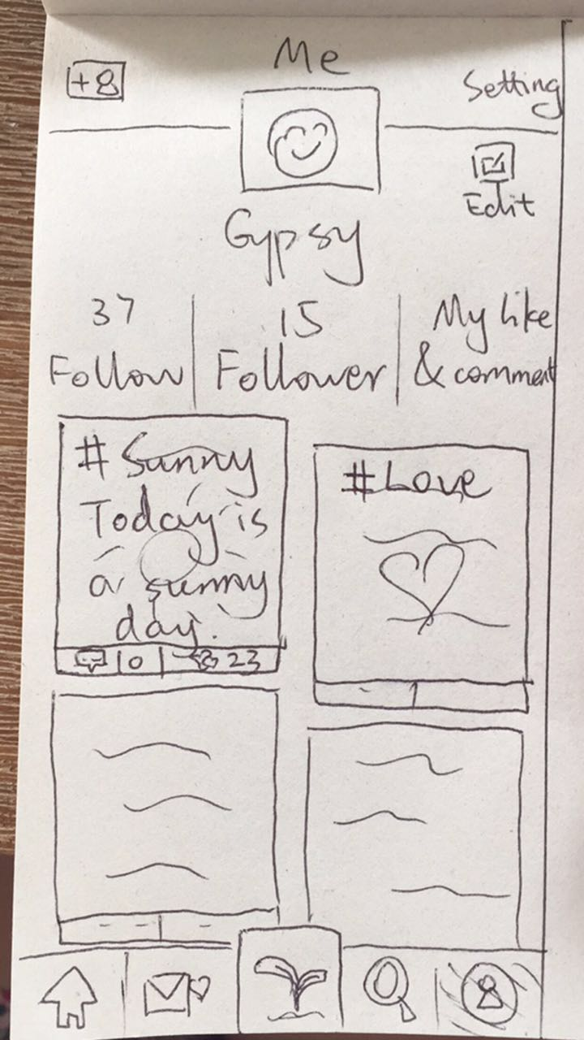
Before
Different users have different thoughts about what “Edit” does. Some users find that the functions of “Setting” and “Edit” might be overlapping.
No date of the post.
Sharing is hidden inside the detail of individual post.
These two pages are very confusing.
Some users think this icon means “only shown to friends”, some think it means “only for myself”.
The “post” button with leaves on it is misleading (not functional, navigation to the homepage, etc).
The purpose of these icons is not clear.

Slide 4
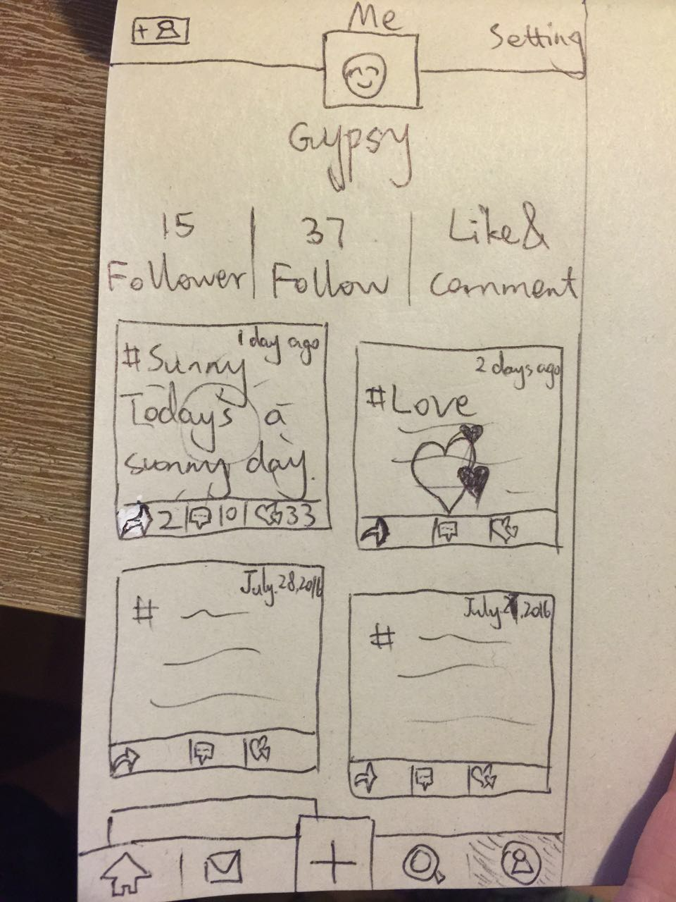
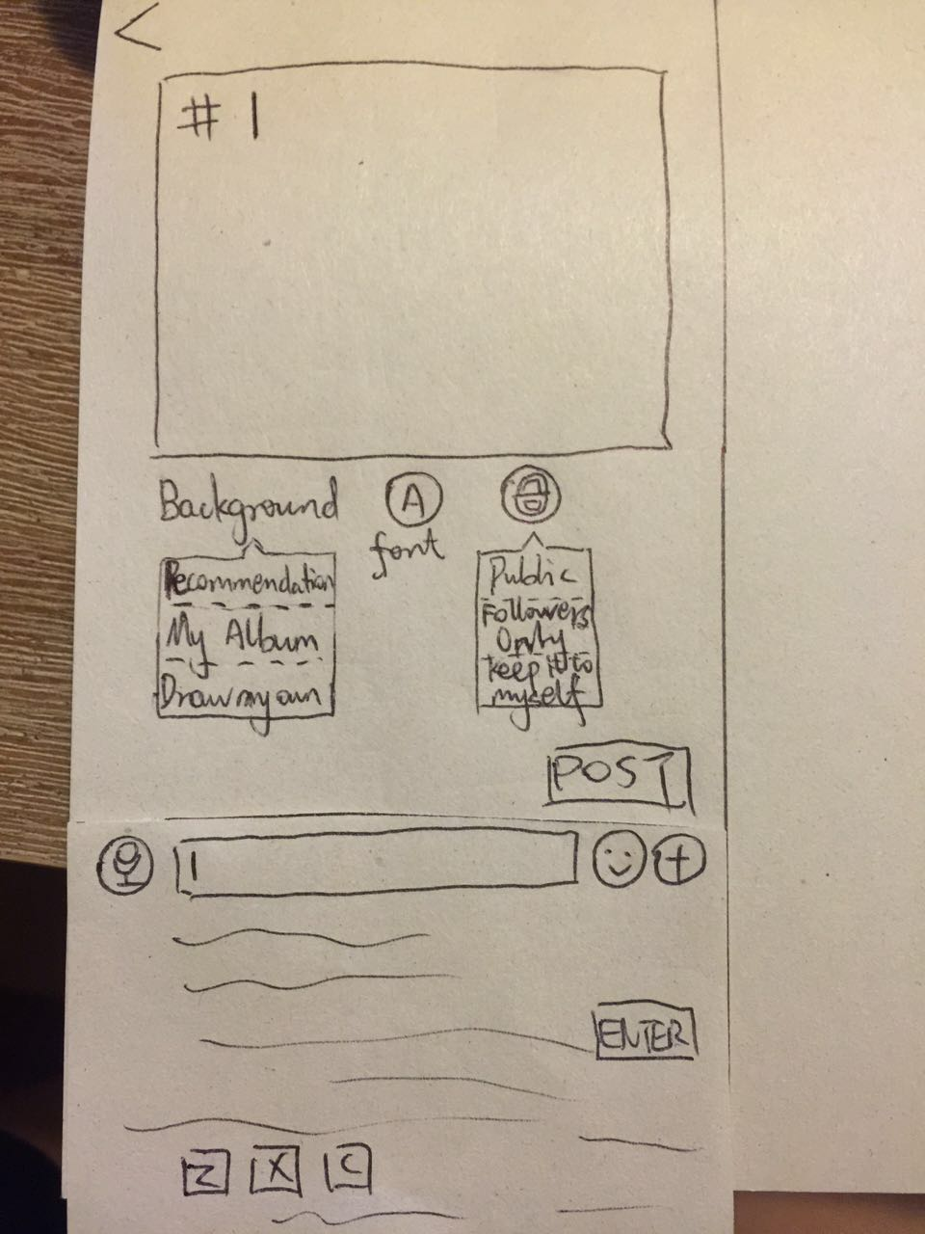
After
Delete Edit, leave only “Setting”.
Add Date.
Add “Share” button.
Change the Leaf “post” button to a plus symbol.
Collect all the choices for choosing background into the dropdown box of “Background”.
Users can set the post into different privacy levels.
Replace “NEXT” button with “POST” button.

