Slide 1
Ticket segmentation Data Addiction
QI Wang, Shijia Bian, Mengrun Li, Yaqian Cheng, Yuan Gao

Slide 2
Ticket Price and Cross-State Selling
Cross State Price Sold Percentage
70% - 90%
50% - 70%
30% - 50%
10% - 30%
< 10%
The Average Price:
50%-70% > 10% -50% > other segmentations
Total Number of Ticket Selling:
50% - 70% > 30% - 50% > 70% - 90%
Max Ticket Price:
<10% has the highest ticket price
Notes:
We investigated the relationship of ticket price and the cross-state selling percentage. Here, we define cross-state selling as a purchase that occurs in a state different from the venue state, and the cross-state selling rate is the proportion of cross-state selling in the total purchases for the particular event. A high cross-state selling rate indicates that a high volume of event attendees are willing to travel to another state in order to attend. We divided the cross-state selling rate into the following segments: less than 10%, 10% to 30%, 30% to 50%, 50% to 70%, 70% to 90%, and over 90%. The findings are as follows:

Slide 3
Ticket Price and the Platform & Device
Platform
Platform
Mobile Device
Mobile
Desktop
PC
Tablet
Linux
Macintosh
Average Price Selling:
mobile > desktop >> tablet
Average Quantity of Ticket Sold:
mobile > desktop >> tablet
Device
Average Price Selling:
Apple > Samsung > Other Brandings
Average Quantity of Ticket Sold:
Apple > Samsung > ZTH > Sharp

Slide 4
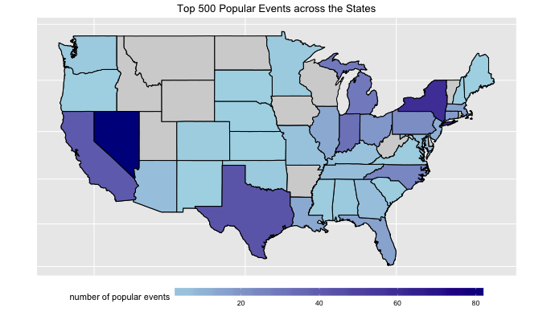
Top 500 Popular Events Across the States
Cross State Popularity Segmentation by Event
Popularity = out of state ratio
Target locations:
Nevada
New York
California
Texas
Indiana

