Slide 1
NLP programming project
Text Emotion Classification Model
Ashraf Saadeh
Hyoseo Kim
Waild Kassem

Slide 2
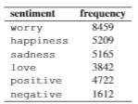
1. Introduction
In this project we created our own model with more than one method that classify the text into 6 categories. We trained the model on an already trained data.(40K labeled data) At the end we applied the model with the Twitter data that we collected.

Slide 3
2. Collecting Data
Our target tweets was just the tweets that contains the bitcoin word and that are only written in English.
content | sentiment
1- "Bitcoin price analysis: Bitcoin spikes to $33,000, retracement higher later today? | 0
2- "@Maggie98811994 @CrytoInformant @TonyStark_19_81 @lle0nii @TheCryptoLark China wants their state controlled CBDC and bitcoin is a threat to that. That’s why China is making the moves it is. China wants a controlled market not a free market. There is a reason bitcoin adoption in China was huge, it’s because Chinese free market thinkers are smart." | 1
3- @bitcoin_brown @Adouble212 😂😂😂 ive been saying this since 2017 ADA fuckin robbing Poor Africa smh | 3
4- @holdmytowel @OTC_Bitcoin love joey tribbiani!! :), | 0
5- @brwngold @ThisBeMbo Get @mrbankstips to 100k followers before end of june and be among the 50 lucky winners to share one 1bitcoin and also learn bitcoin trading and be able to take part in bet challenges 5k to 500k in four days. 11 days to to go. U can be among the lucky ones | 0
7- RT @DocumentingBTC: #Bitcoin now has roughly the same amount of users as the Internet had in 1997 | 4
8- @Investingcom So the poor country is gonna pump the Bitcoin ponzi for the wealthy in the U.S. ?, /* | 2
9- Where Will All the Bitcoin Miners in China Relocate To? | 1
10- "RT @missteencrypto: Give your dad some #Bitcoin for Father’s Day! 🤗❤️ | 0
11- "@ScottCBusiness @CryptoRacer66 Yes, and bitcoin doesn't cost you to own it. | 3
12- We might turn our minera back on. Seems like a good time to start #mining #Bitcoin again., | 0
13- RT @michael_saylor: “No road is long with good company.” - Turkish proverb on #Bitcoin, | 0
14- "Just going to chill out and NOT watch the #crypto market charts for a hot minute, too stressful. Need plenty of sunshine 🌞 and boat drinks 🍹 🍹 🍹until further notice. #Bitcoin do your thing and go parabolic when we least expect it lol", | 2
15- RT @alphasnupe: I sold some $btc and put $100k into $RISE. At peak it was over $2 million. Right now its ~$1 million. I'm holding because i…, / | 2
16- RT @BuzzLightyearz_: When you understand #Bitcoin you realize there was never a bear marke | 0
17- "RT @Bitboy_Crypto: When #Bitcoin makes a new low we can talk about whether or not we are in a bear market.The rest is just noise. The lou… | 2

Slide 4
3. Cleaning Data
We cleaned the data to train and test our model.
Step 1. remove html and urls
Step 2. replace emojis to text
Step 3. remove non-ascii code
Step 4. remove stopwords
Step 5. remove mentions
Step 6. normalize hashtags
Step 7. replace contractions
Step 8. lemmatization with spacy
emoji | sentiment
😀, 🥰 | happiness
😥, 😭 | sad
🤬, 😤 | negative
👌, 🙆 | positive

Slide 5
4. Creation of 4 models
We created 4 model using naive Bayse, LinearSVC, Multi-Layer classifier and RNN from Tensorflow.
precision | recall | F1-score | Support
0.32 | 0.33 | 0.33 | 1592
0.41 | 0.36 | 0.38 | 1166
0.28 | 0.18 | 0.22 | 461
0.34 | 0.41 | 0.37 | 2542
0.18 | 0.13 | 0.16 | 1413
0.29 | 0.25 | 0.27 | 1553
0.34 | 0.40 | 0.37 | 2507
precision | recall | F1-score | Support
0.26 | 0.19 | 0.22 | 1592
0.36 | 0.15 | 0.21 | 1166
0.00 | 0.00 | 0.00 | 461
0.31 | 0.47 | 0.38 | 2542
0.00 | 0.00 | 0.00 | 1413
0.00 | 0.00 | 0.00 | 1553
0.26 | 0.61 | 0.37 | 2507
Tfidf
Word embedding

Slide 6
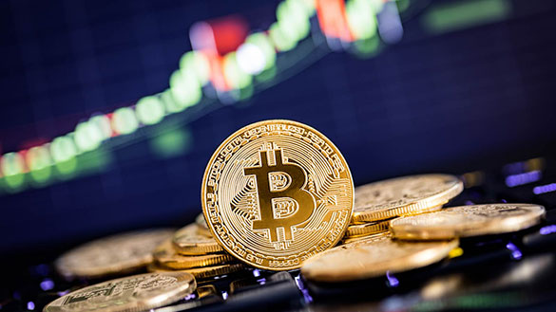
5. Conclusion
We completed the new model, and the accuracy was approximately 70%. After using multiple models, transformation accuracy was better than the others. As a result with the new model, we can see whether the Bitcon price will rise or fall. We can analyze the sentiment of Twitter of celebrities such as Elon Musk and predict the price of Bitcoin.

