Slide 1
 |  | State Prediction |  |  |  |  |  | Transition Prediction
 |  | horizon 1 |  | horizon 2 |  | horizon 3 |  | horizon 1 |  | horizon 2 |  | horizon 3
 |  | MAE | MAPE | MAE | MAPE | MAE | MAPE | MAE | MAPE | MAE | MAPE | MAE | MAPE
Statistical Approach | LR | 1.03±0.18 | 1.2±0.38 | 0.29±0.05 | 0.84±0 | 0.14±0.03 | 0.95±0.07 | 0.45±0.06 | 0.75±0.02 | 0.27±0.06 | 0.81±0.07 | 0.18±0.04 | 2.93±4.18
 | RF | 0.86±0.22 | 0.7±0.01 | 0.25±0.06 | 0.81±0.01 | 0.11±0.02 | 0.87±0.01 | 0.39±0.06 | 0.65±0.01 | 0.2±0.03 | 0.71±0.01 | 0.12±0.02 | 0.78±0.01
 | SVR | 0.53±0.09 | 0.59±0.01 | 0.2±0.03 | 0.8±0.01 | 0.11±0.01 | 0.85±0 | 0.3±0.03 | 0.63±0.01 | 0.21±0.02 | 0.68±0.01 | 0.19±0.01 | 0.68±0.01
Search-based | Euclidean | 0.69±0.12 | 0.77±0.05 | 0.2±0.06 | 0.8±0.05 | 0.08±0.02 | 0.83±0.04 | 0.3±0.07 | 0.79±0.04 | 0.16±0.04 | 0.82±0.05 | 0.1±0.02 | 0.83±0.05
 | chebyshev | 0.67±0.12 | 0.78±0.05 | 0.2±0.03 | 0.8±0.05 | 0.08±0.02 | 0.84±0.06 | 0.29±0.06 | 0.79±0.05 | 0.15±0.04 | 0.81±0.05 | 0.09±0.02 | 0.83±0.04
 | cosine | 0.44±0.1 | 0.93±0.15 | 0.13±0.05 | 0.93±0.13 | 0.05±0.01 | 0.94±0.13 | 0.2±0.05 | 0.93±0.14 | 0.1±0.02 | 0.94±0.12 | 0.06±0.01 | 0.94±0.12
Deep Learning | CNN | 0.44±0.1 | 0.55±0.02 | 0.14±0.03 | 0.74±0.2 | 0.06±0.03 | 0.85±0.3 | 0.19±0.03 | 0.65±0.1 | 0.11±0.02 | 0.98±0.35 | 0.06±0.01 | 0.91±0.11
 | LSTM | 0.45±0.1 | 0.87±0.45 | 0.15±0.03 | 0.95±0.20 | 0.11±0.07 | 0.96±0.15 | 0.21±0.03 | 0.9±0.18 | 0.14±0.06 | 0.96±0.15 | 0.11±0.05 | 0.92±0.20
 | LRCN | 0.44±0.09 | 0.51±0.04 | 0.13±0.04 | 0.66±0.05 | 0.05±0.01 | 0.83±0.02 | 0.19±0.04 | 0.61±0.03 | 0.1±0.02 | 0.82±0.02 | 0.06±0.01 | 0.85±0.14

Slide 2
 |  | State Prediction |  |  |  |  |  | Transition Prediction
 |  | horizon 1 |  | horizon 2 |  | horizon 3 |  | horizon 1 |  | horizon 2 |  | horizon 3
 |  | MAE | MAPE | MAE | MAPE | MAE | MAPE | MAE | MAPE | MAE | MAPE | MAE | MAPE
Statistical Approach | LR | 2.48±0.09 | 0.60±0.01 | 3.42±0.09 | 0.73±0.01 | 3.27±0.10 | 0.79±0.06 | 3.37±0.12 | 1.31±0.05 | 1.14±0.02 | 0.91±0.01 | 1.01±0.02 | 0.93±0.01
 | RF | 2.46±0.08 | 0.60±0.01 | 3.39±0.12 | 0.72±0.01 | 3.23±0.12 | 0.75±0.01 | 3.33±0.10 | 1.31±0.05 | 1.13±0.02 | 0.91±0.01 | 1.01±0.03 | 0.92±0.00
 | SVR | 2.20±0.03 | 0.60±0.01 | 2.9±0.08 | 0.73±0.01 | 2.57±0.09 | 0.78±0.01 | 3.13±0.06 | 1.31±0.05 | 1.02±0.02 | 0.91±0.00 | 0.86±0.02 | 0.93±0.00
Search-based | Euclidean | 1.39±0.05 | 0.38±0.01 | 1.68±0.07 | 0.42±0.01 | 1.60±0.11 | 0.43±0.02 | 0.79±0.05 | 0.21±0.01 | 0.28±0.02 | 0.29±0.02 | 0.29±0.02 | 0.31±0.01
 | Chebyshev | 1.37±0.05 | 0.38±0.01 | 1.72±0.07 | 0.43±0.01 | 1.69±0.09 | 0.45±0.01 | 0.81±0.05 | 0.22±0.01 | 0.29±0.01 | 0.31±0.02 | 0.30±0.02 | 0.33±0.01
 | Cosine | 1.47±0.05 | 0.39±0.02 | 1.73±0.06 | 0.44±0.00 | 1.64±0.07 | 0.43±0.01 | 0.82±0.05 | 0.22±0.01 | 0.29±0.02 | 0.29±0.01 | 0.29±0.02 | 0.31±0.01
Deep Learning | CNN | 1.21±0.05 | 0.37±0.01 | 1.65±0.08 | 1.14±1.26 | 1.62±0.09 | 0.58±0.04 | 1.21±0.03 | 0.34±0.04 | 0.25±0.01 | 0.48±0.07 | 0.26±0.00 | 0.43±0.02
 | LSTM | 1.11±0.05 | 0.45±0.19 | 1.4±0.05 | 0.58±0.12 | 1.36±0.05 | 0.59±0.04 | 0.88±0.04 | 0.29±0.02 | 0.21±0.01 | 0.94±0.86 | 0.22±0.02 | 0.52±0.22
 | LRCN | 1.31±0.05 | 0.43±0.02 | 1.76±0.07 | 0.53±0.02 | 1.78±0.08 | 0.67±0.06 | 1.47±0.06 | 0.44±0.03 | 0.30±0.01 | 0.48±0.04 | 0.31±0.05 | 0.47±0.06
Notes:
어떤 결론을 낼 수 있나?
일부 데이터의 경우 성능의 향상. 하지만 다른 데이터는 성능의 하락. 차원의 저주 (overfitting, 관련 정보 찾아서 썰풀기)
컴퓨테이션 타임의 증가 (training + predicting)
하지만 특수한 경우 예측 성능이 좋지 않음 ((예를 들어, HD state의 performance 값은 variance가 매우 큼. Horizon이 쪼개지면 트레이닝 데이터가 줄어들고 따라서 효과적으로 다루지 못함)
Deep learning 기반의 기법들이 꾸준히 좋은 성능을 보임

Slide 4
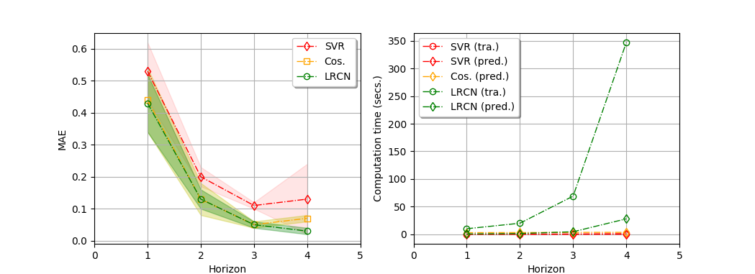
(a) Effect of horizon to MAE
(b) Effect of horizon to computation time

