Slide 1
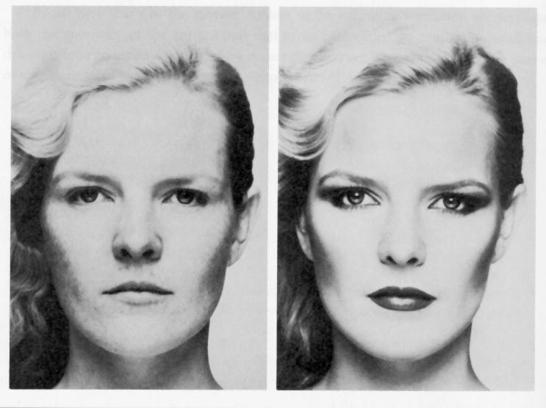
Photometric Stereo
Merle Norman Cosmetics, Los Angeles
Readings
  R. Woodham, Photometric Method for Determining Surface Orientation from Multiple Images. Optical Engineering 19(1)139-144 (1980). (PDF)

Slide 2
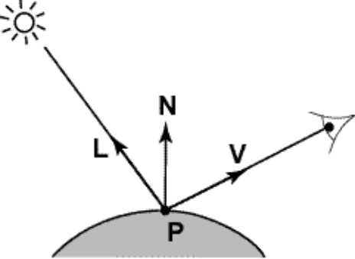
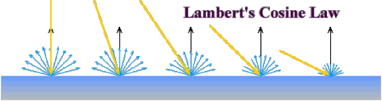

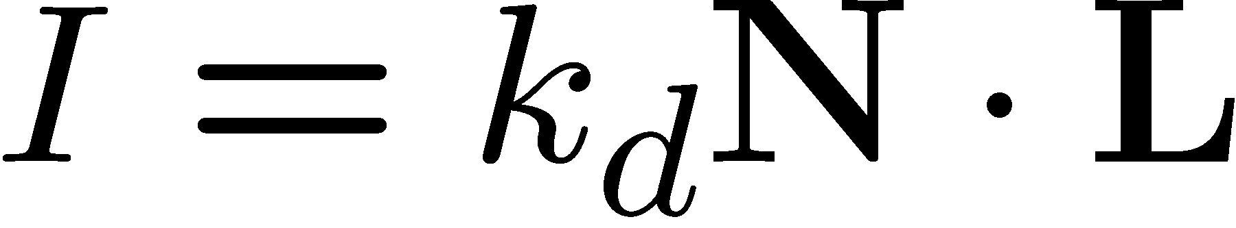
Diffuse reflection
image intensity of P
Simplifying assumptions
  I = R_{e}: camera response function f is the identity function:
    can always achieve this in practice by solving for f and applying f ⁻¹ to each pixel in the image
  R_{i} = 1: light source intensity is 1
    can achieve this by dividing each pixel in the image by R_{i}

Slide 3
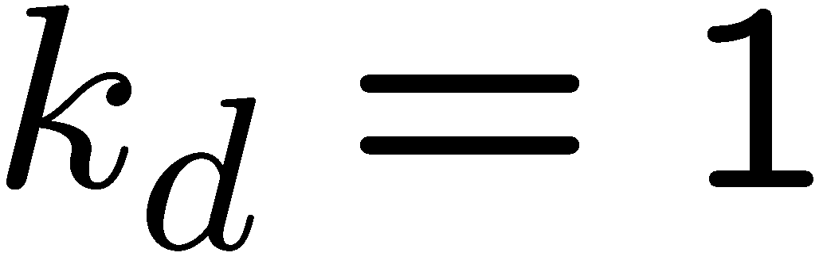
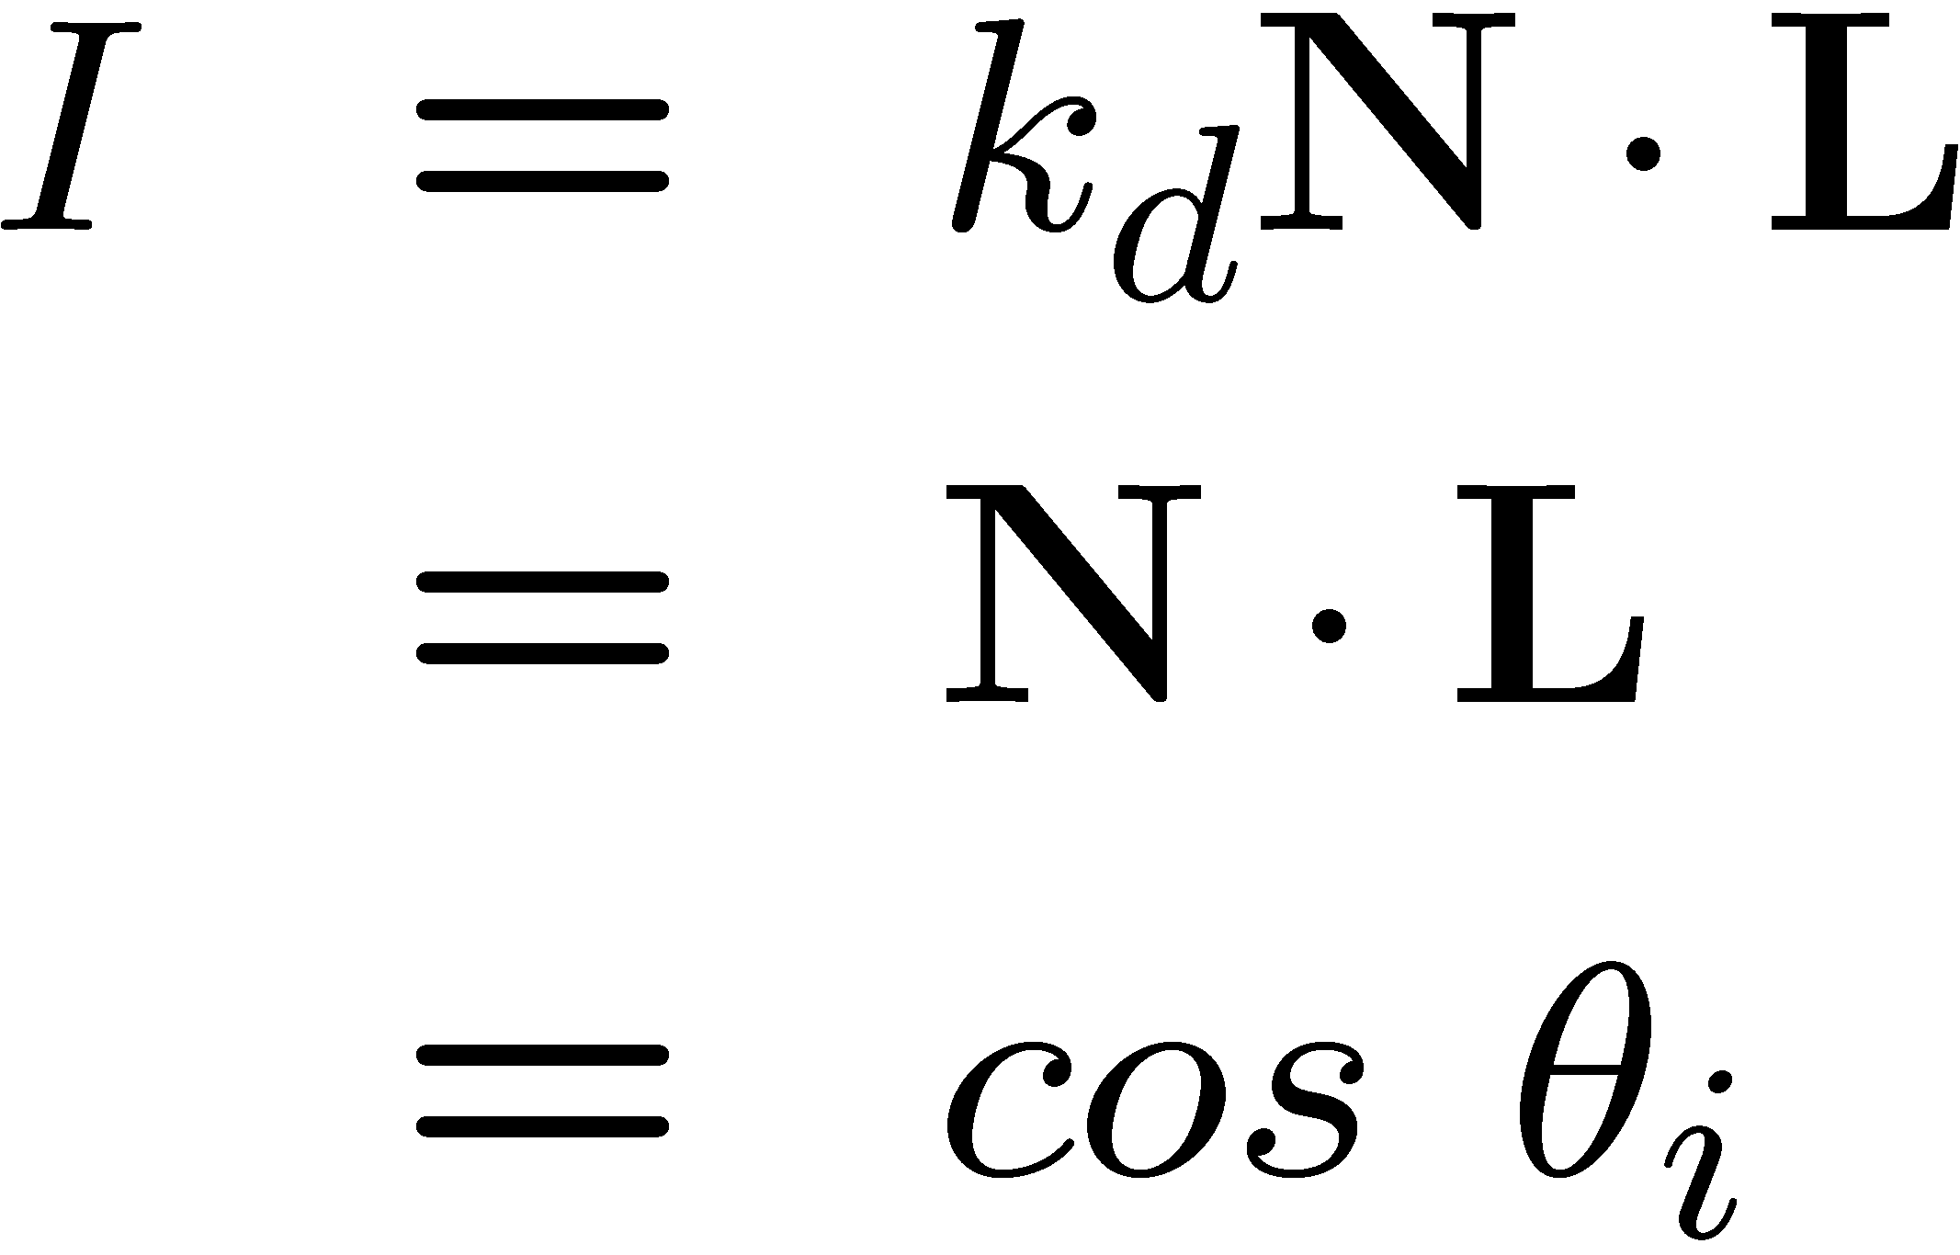

Shape from shading
Suppose
You can directly measure angle between normal and light source
  Not quite enough information to compute surface shape
  But can be if you add some additional info, for example
    assume a few of the normals are known (e.g., along silhouette)
    constraints on neighboring normals—“integrability”
    smoothness
  Hard to get it to work well in practice
    plus, how many real objects have constant albedo?

Slide 4

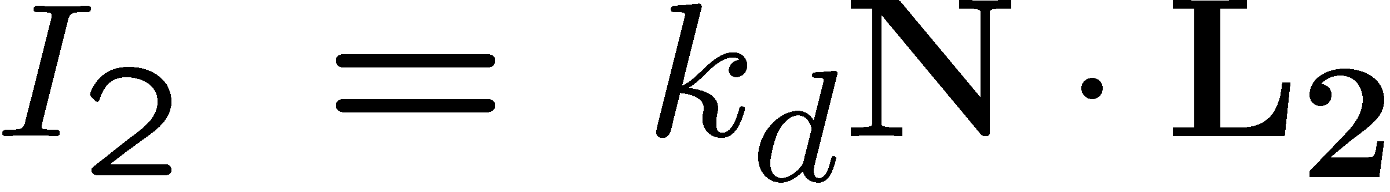
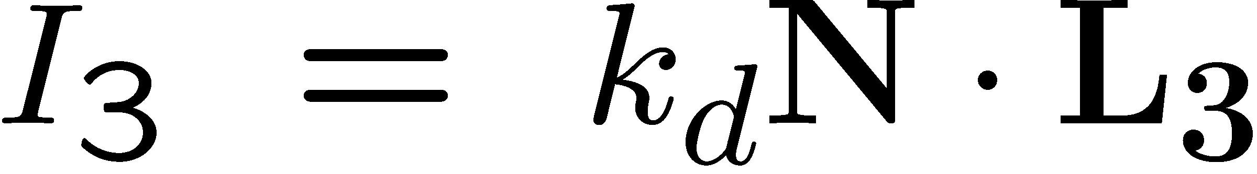
Photometric stereo
N
L₃
L₂
L₁
V
Can write this as a matrix equation:

Slide 5





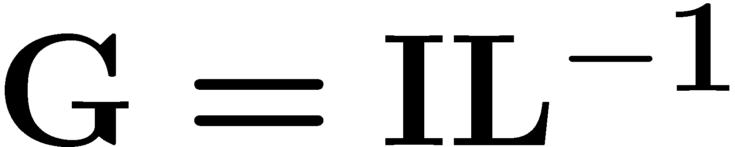

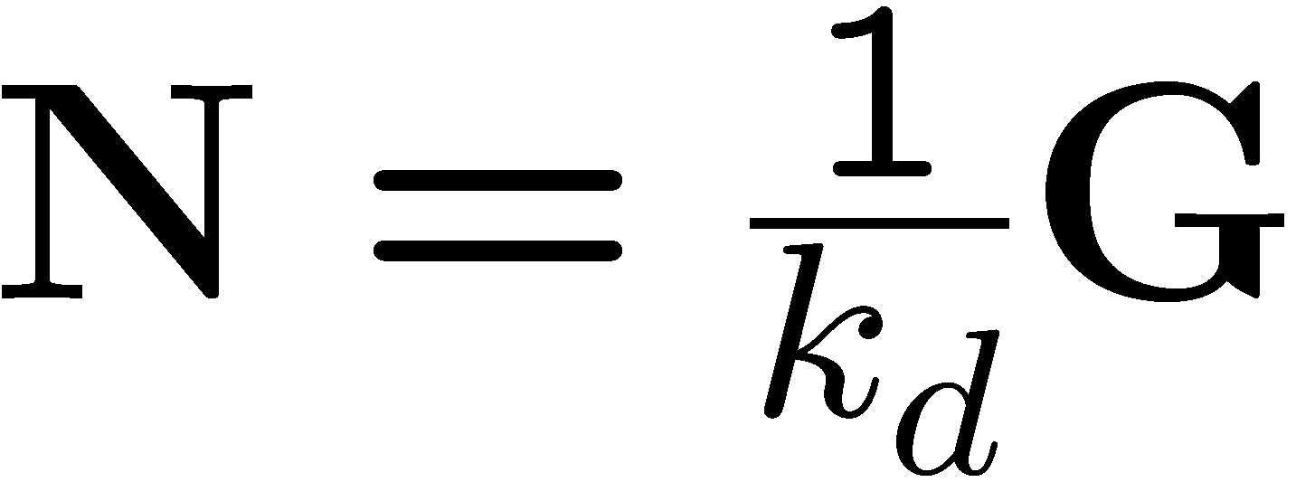
Solving the equations

Slide 6
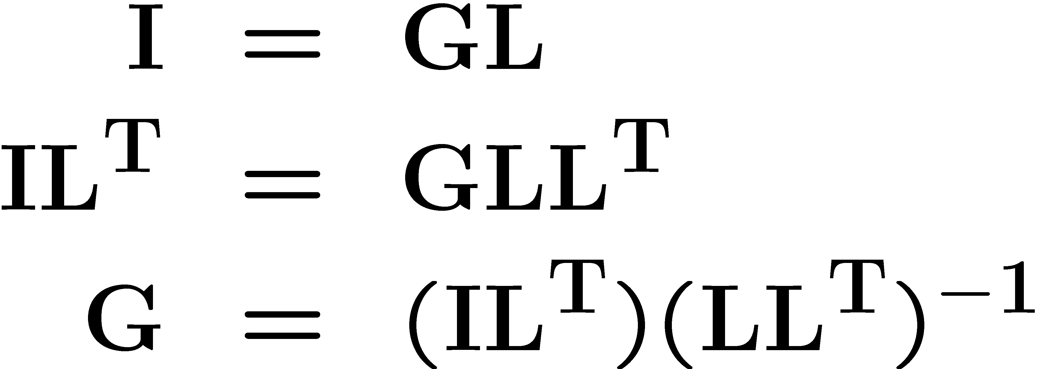
More than three lights
Get better results by using more lights
Least squares solution:
Solve for N, k_{d} as before
What’s the size of LL^{T}?

Slide 7
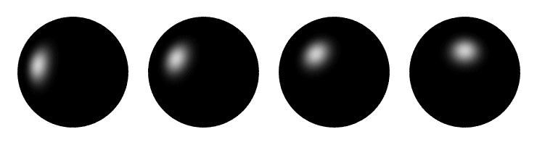
Computing light source directions
Trick: place a chrome sphere in the scene
  the location of the highlight tells you where the light source is

Slide 8

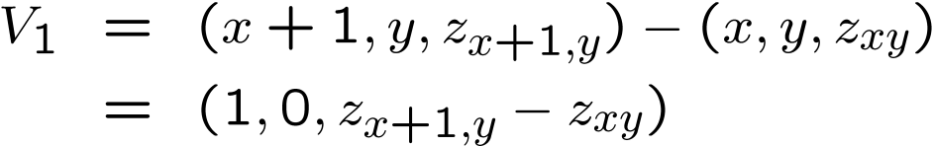


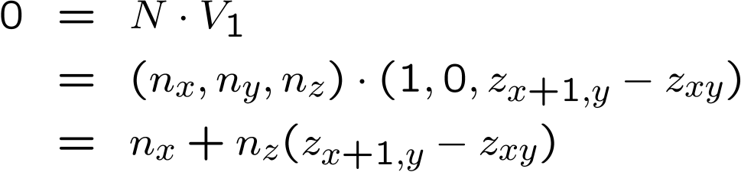

Depth from normals
V₂
orthographic
projection
V₁
N
Get a similar equation for V₂
  Each normal gives us two linear constraints on z
  compute z values by solving a matrix equation

Slide 9
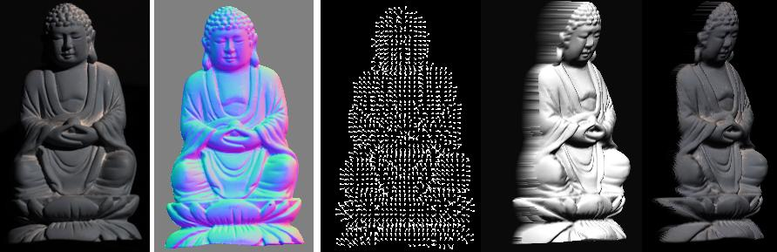
Results…
Input
(1 of 12)
Normals
Normals
Shaded
rendering
Textured
rendering

Slide 10
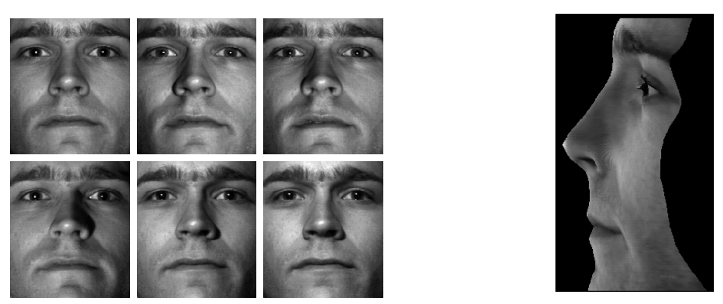
Results…
from Athos Georghiades
http://cvc.yale.edu/people/Athos.html

Slide 11
Limitations
Big problems
  doesn’t work for shiny things, semi-translucent things
  shadows, inter-reflections
Smaller problems
  camera and lights have to be distant
  calibration requirements
    measure light source directions, intensities
    camera response function
Newer work addresses some of these issues
Some pointers for further reading:
  Zickler, Belhumeur, and Kriegman, "Helmholtz Stereopsis: Exploiting Reciprocity for Surface Reconstruction." IJCV, Vol. 49 No. 2/3, pp 215-227.
  Hertzmann & Seitz, “Example-Based Photometric Stereo: Shape Reconstruction with General, Varying BRDFs.” IEEE Trans. PAMI 2005

