Slide 1
LucusEdge Studio
5/18~

Slide 2
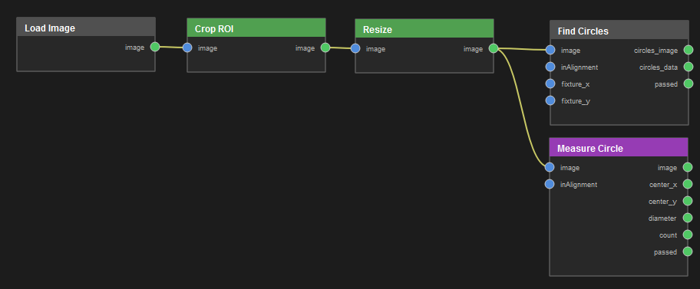
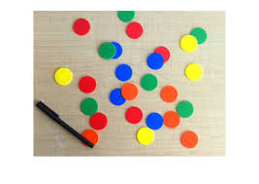
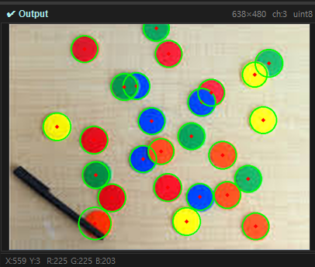
Find Circles
노드 구조
Input image
- Resize
640x480 / LANCZOS / KEEP Aspect 🗸
- Find Circles
Min Dist 15 / Param1 35 / param2 24 / min radius 25 / max radius 100

