Slide 1
LucusEdge Studio
강규리 5/18~20

Slide 2
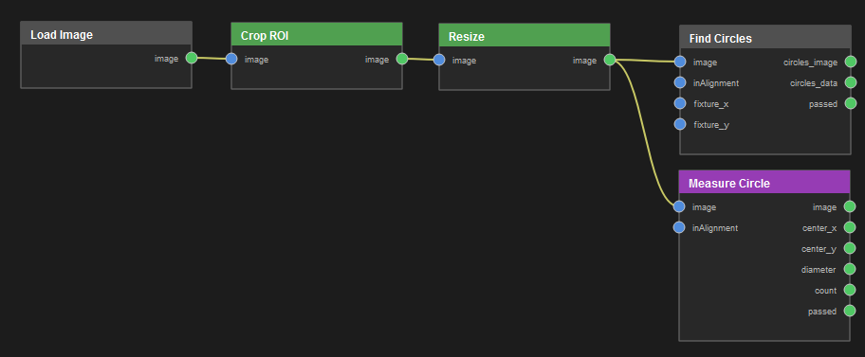
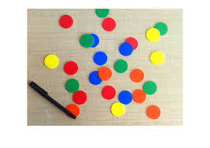
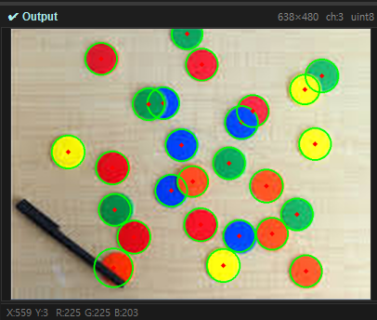
Find Circles
노드 구조
Input image
- Resize
640x480 / LANCZOS / KEEP Aspect 🗸
- Find Circles
Min Dist 15 / Param1 35 / param2 24 / min radius 25 / max radius 100

Slide 3
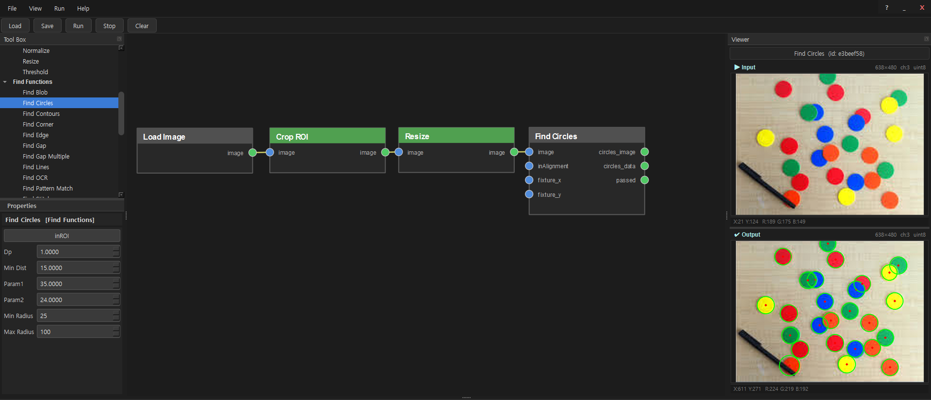

Slide 4
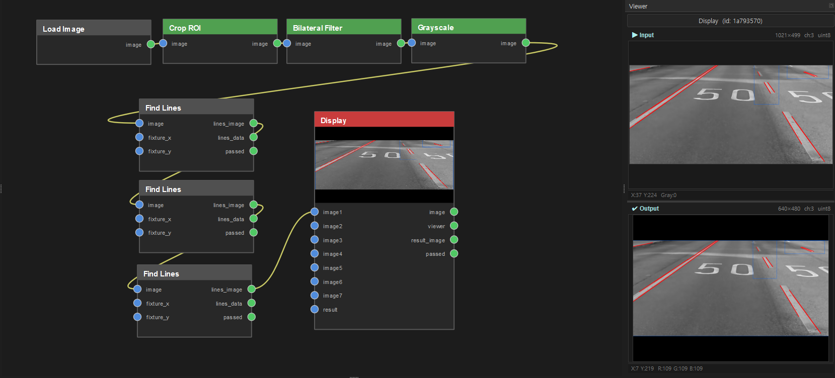
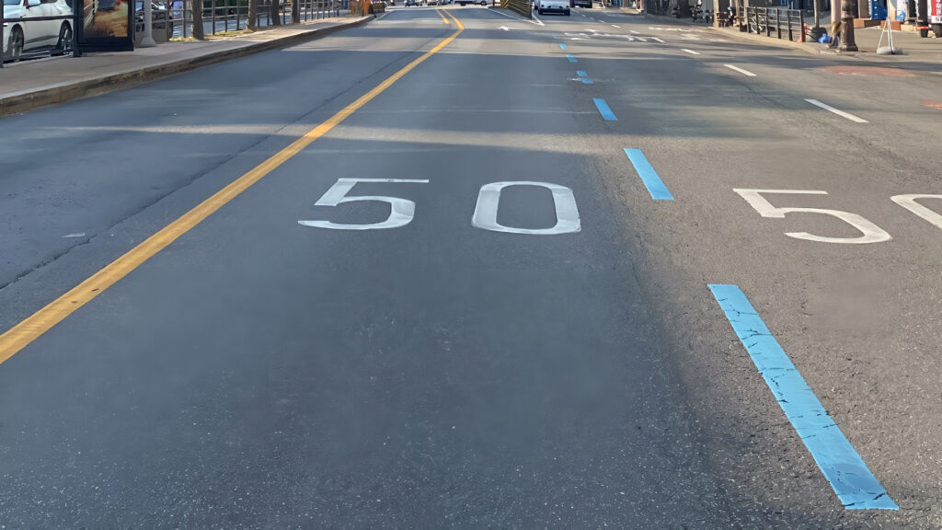
Find Lines
노드 구조
Input image
- Find Lines
Threshold 100 / Min Line Length 90 / Max Line Gap 10
Threshold 50 / Min Line Length 10 / Max Line Gap 10
Threshold 30 / Min Line Length 10 / Max Line Gap 10

Slide 5
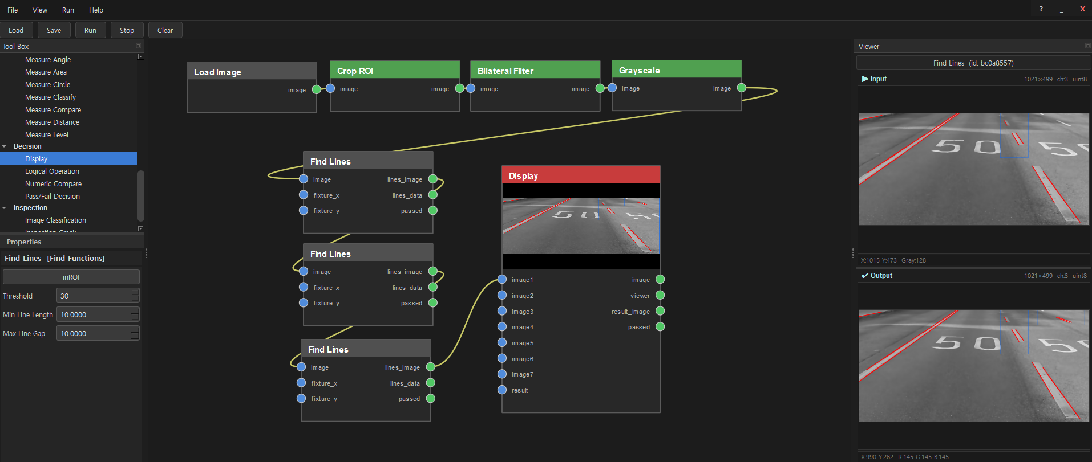

Slide 6
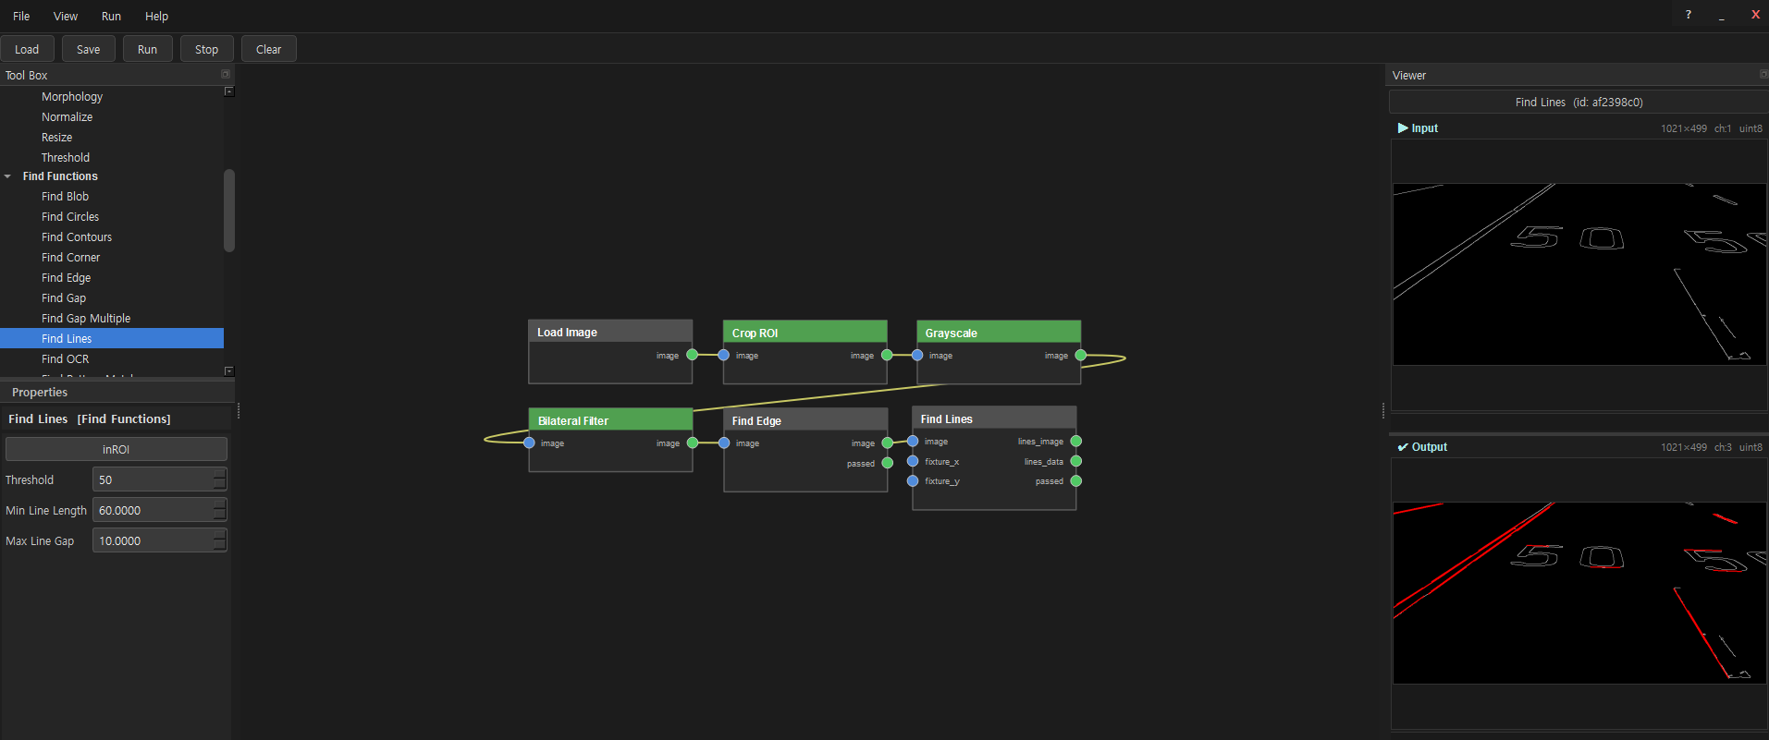

Slide 7
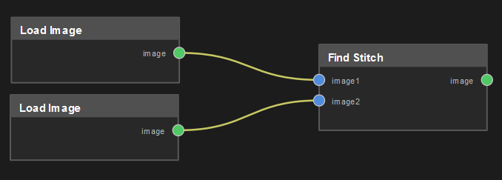


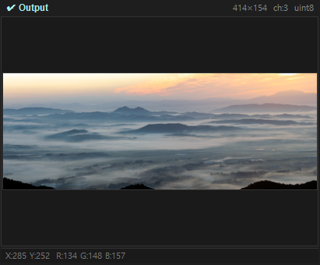
Find Stitch
노드 구조
Input image
- Find Stitch
Horizontal

Slide 8
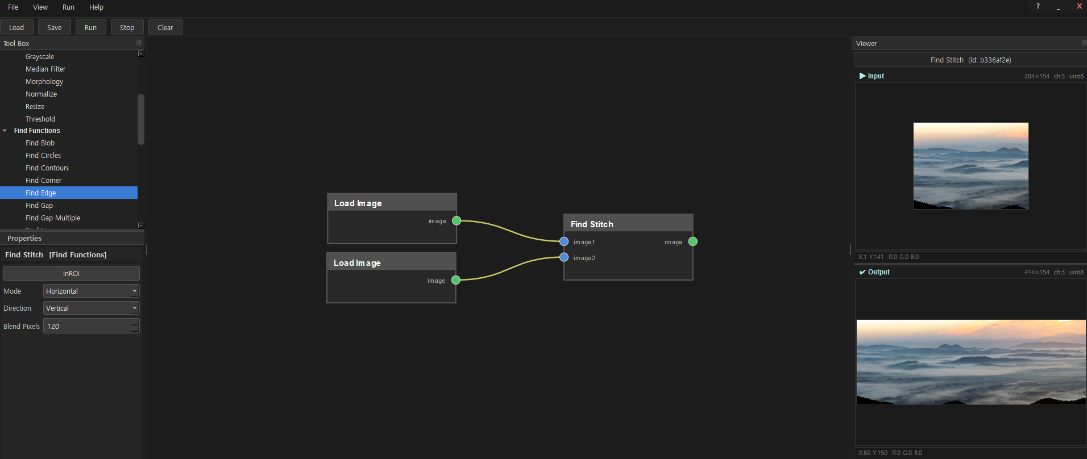

Slide 9
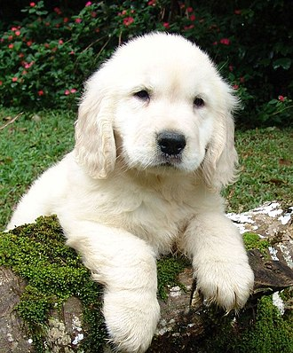
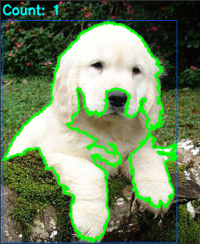
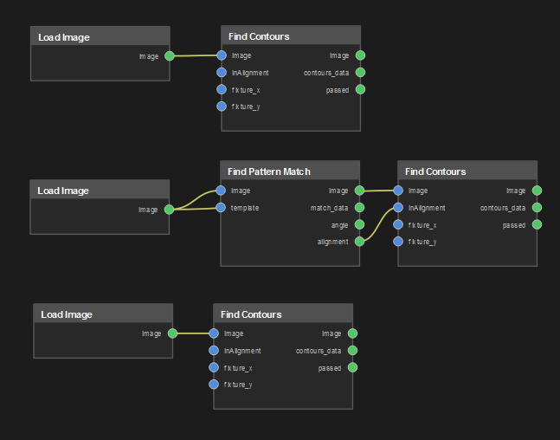
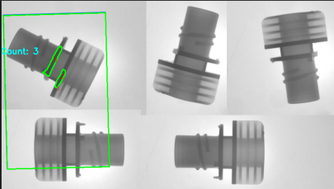
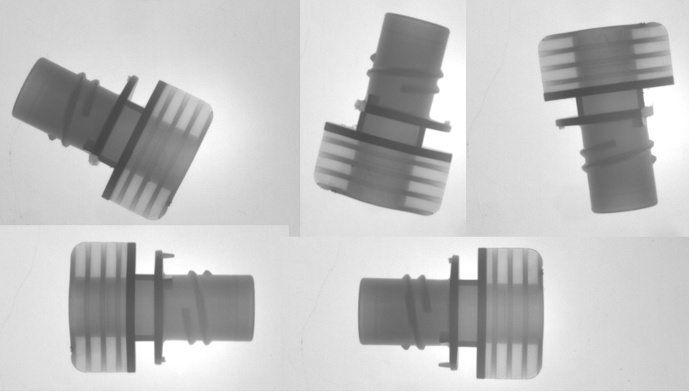
Find Contours
Input image
노드 구조
Find Contours
Threshold 170
Find Contours
Mode TREE
Threshold 80
Input image

Slide 10
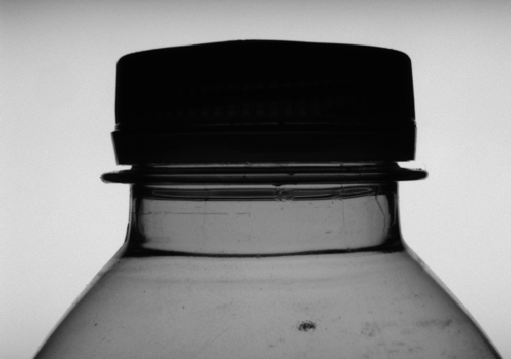
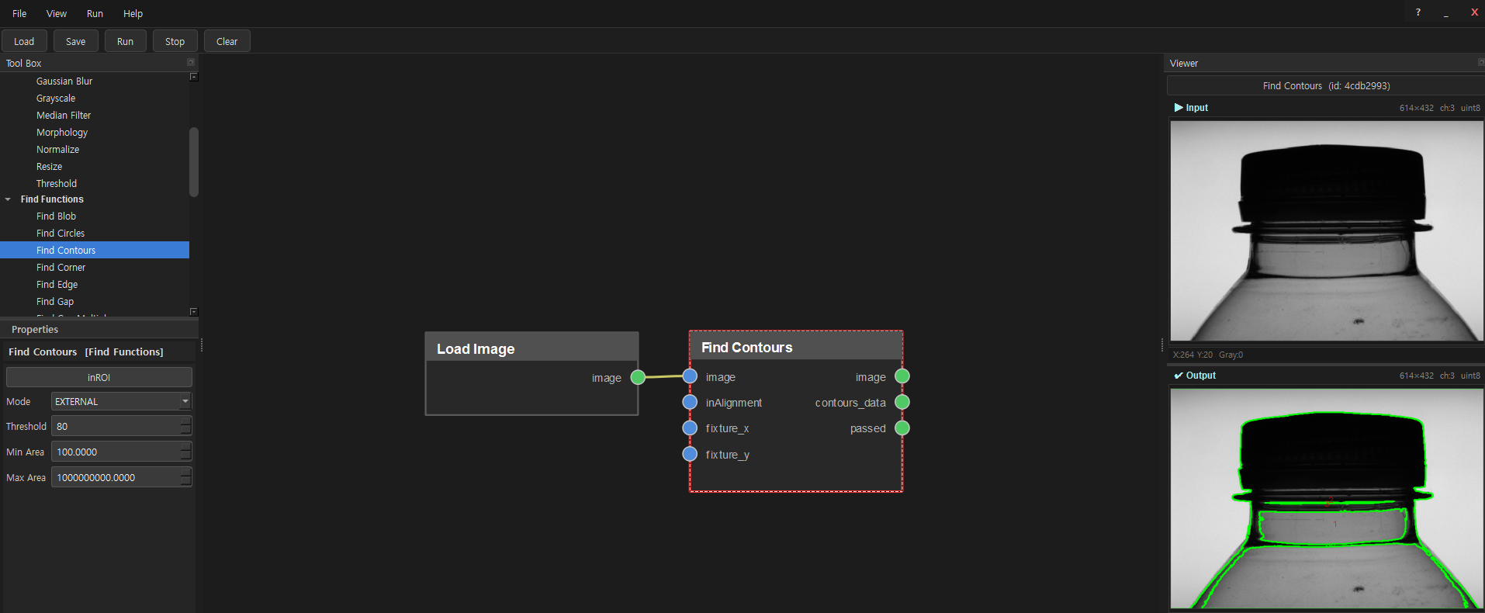
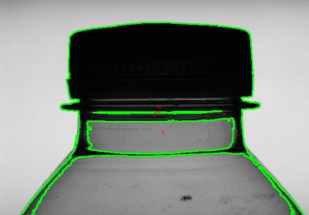
노드 구조
Input image
Find Contours
Threshold 80

Slide 11
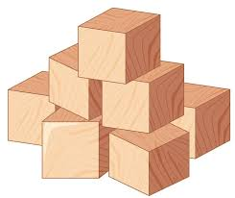
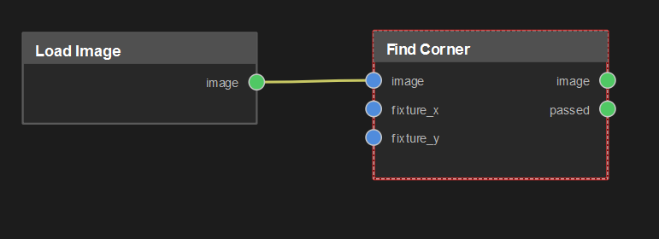
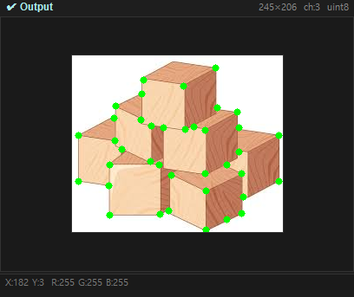
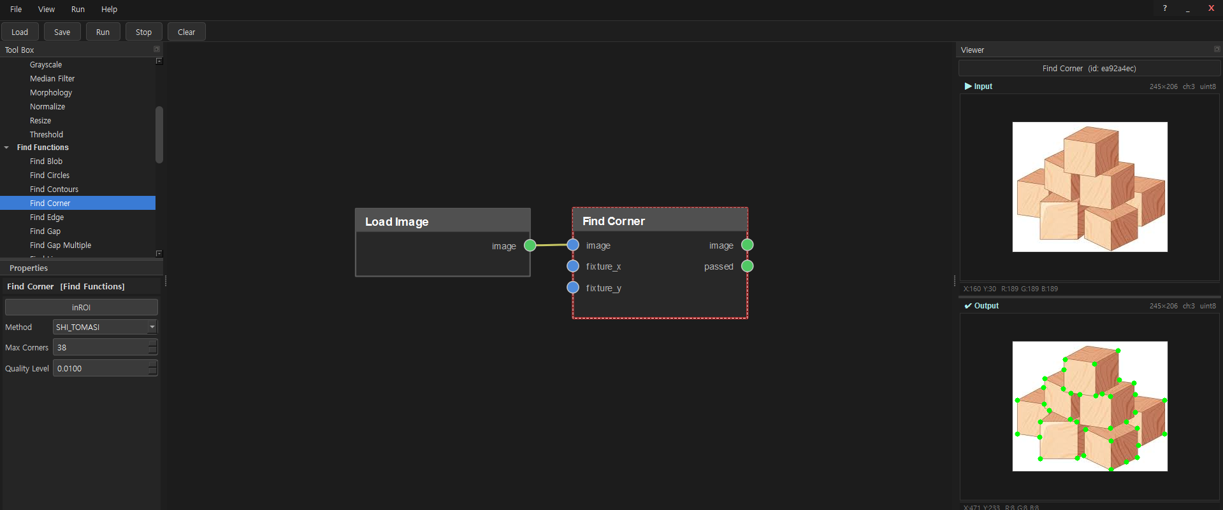
Find Corner
Input image
노드 구조
Find Lines
Method SHI_TOMASI / Max Corners 38

