Slide 1
A-PMA
TPU monthly meeting

Slide 2

TPU/eTPU: Operations Sep 2026
1
2
Shanghai
4
5
QEHS
+ Highlights:
o 0 Y1 NCM and 0 incident, 1 Y6 NCM for C85A15HPM transparency inhomogeneous
o Monthly waste ratio was 1.5%, recycle granule 1.5%, FPR 99.7%
o Bluesign on-site audit completed
Supply and Capacity
+ Highlights:
o Output for Aug. is 1,965tons, plan of Sep is 2,127t TPU +120t ecovio
o SLiac = 9.9%, SLoac = 2.4% due to FHF waiting for ZP9118 from BELT1
- Lowlights:
- BO 19.3% due to less demand, ULiac = 3.0%
Projects
+ Highlights:
o N2 modification for CSR open action physical installation completion, under testing
o REX online rework sorter under procurement
o 2027 Capex/Open plan review finished
Personnel
+ Highlights:
o N.A
PAC
Belt
REX
[kt]
3
PAC
FHF
Only showing the AE of FHF production, Ecovio is exclusive
Notes:
红色框里面的是需要系统自动生成的部分，目前模板展示的是样板，请按照样板的格式自动生成对应的内容：
自动输出Monthly Reports页面顶部filter过滤器中选中的月份 年份
自动输出Plant Name
从Volume & PAC子页面的AE图表输出，对应的Plant的生产线图表。可以直接输出带有数据标签的图片，此图表区域面积固定，输出的图表要在此区域内，请输出合理的图表尺寸且不能产生变形。
从Volume & PAC子页面的各个Plant的右侧簇状柱形图直接输出。可以直接输出图表图片，不需要带数据标签，此图表区域面积固定，输出的图表要在此区域内，请输出合理的图表尺寸且不能产生变形。
从Monthly Report页面中输出对应的Report Category（除了Production update和Quality update以外的其他Report Category），按照模板的样子输出。QEHS，Supply and Capacity，Projects，Personnel这些Report Category下面要分别把+ Highlights:和- Lowlights:区分输出，如果+ Highlights:或- Lowlights中没有任何Content，则直接不需要输出该+ Highlights:或- Lowlights（不需要输出代表连+ Highlights:或- Lowlights这几个字也不需要输出）。如果内容过多，此区域装不下，则缩小字号来匹配。

Slide 3
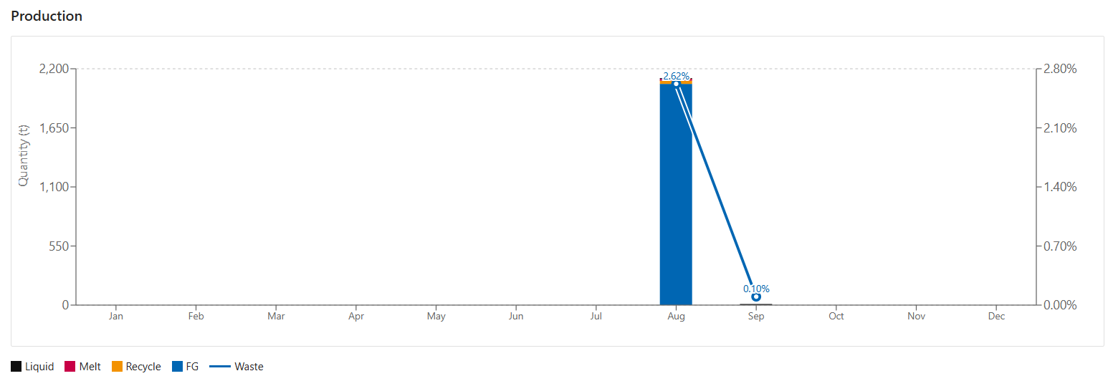
Material Balance & Waste ratio - Shanghai
1
2
3
Production Update
+ Highlights:
o 2,059 ton FG in Aug., including 94 ton FHF precursor. 1,612t from Beltlines, 266t from REX and 181t from FHF. Demand of REX dropped and HPM production was brought forward to Aug.
o 1.5% waste ratio (YTD 1.4%) , 1.5% recycle ratio (YTD 1.7%), both are within target.
+ SP9661 was quickly scaled up from 3t to 25t, and quality of the large campaign is comparable with the small trial.
Notes:
红色框里面的是需要系统自动生成的部分，目前模板展示的是样板，请按照样板的格式自动生成对应的内容：
自动输出Plant Name
Production & Quality子页面，Production区域左上角的横坐标是月份的柱状堆叠图+折线图表。可以直接输出带有数据标签的图片，此图表区域面积固定，输出的图表要在此区域内，请输出合理的图表尺寸且不能产生变形。
从Monthly Report页面中输出Report Category为Production Update的+ Highlights:和- Lowlights:内容，分别把+ Highlights:和- Lowlights:区分输出，如果+ Highlights:或- Lowlights中没有任何Content，则直接不需要输出该+ Highlights:或- Lowlights（不需要输出代表连+ Highlights:或- Lowlights这几个字也不需要输出）。如果内容过多，此区域装不下，则缩小字号来匹配。

Slide 4
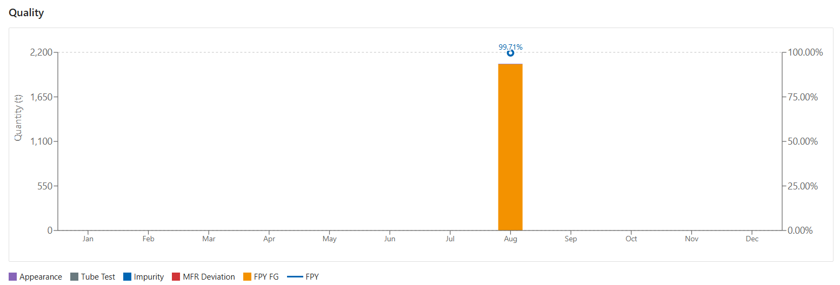
Monthly First Pass Rate - Shanghai
1
2
3
Quality
+ Highlights:
o Monthly first-pass rate is 99.7% (YTD 99.7%).
- Lowlights:
-- 5.3t C85A15HPM was mixed with translucent pellets, which was generated by a short underdosing of PBT. The physical properties of this batches were not impacted. New interlock was under discussion to prevent underdosing/overdosing of PBT.
Notes:
红色框里面的是需要系统自动生成的部分，目前模板展示的是样板，请按照样板的格式自动生成对应的内容：
自动输出Plant Name
Production & Quality子页面，Quality区域左上角的横坐标是月份的柱状堆叠图+折线图表。可以直接输出带有数据标签的图片，此图表区域面积固定，输出的图表要在此区域内，请输出合理的图表尺寸且不能产生变形。
从Monthly Report页面中输出Report Category为Production Update的+ Highlights:和- Lowlights:内容，分别把+ Highlights:和- Lowlights:区分输出，如果+ Highlights:或- Lowlights中没有任何Content，则直接不需要输出该+ Highlights:或- Lowlights（不需要输出代表连+ Highlights:或- Lowlights这几个字也不需要输出）。如果内容过多，此区域装不下，则缩小字号来匹配。

Slide 5
Plant KPI Review - Shanghai
1
2
Plant KPI | Unit | 2025 Actual | 2026 Target | Jan | Feb | Mar | Apr | May | Jun | Jul | Aug | Sep | Oct | Nov | Dec | YTD
LTI/PSI | # | 0/0 | 0/0 | 0/0 | 0/0 | 0/0 | 0/0 | 0/0 | 0/0 | 0/0 | 0/0 |  |  |  |  | 0/0
Yellow card | #/HC/m. | 1.2 | 1.0 | 0.9 | 0.6 | 1.6 | 1.5 | 1.1 | 1.3 | 1.2 | 1.3 |  |  |  |  | 1.2
Closed rate of Yellow card | % | 100 | 90 | 96 | 100 | 99 | 99 | 100 | 100 | 100 | 100 |  |  |  |  | 100
BBS Observation | #/HC/a. | 2.9 | 1.5 | 0.1 | 0.1 | 0.1 | 0.1 | 0.2 | 0.6 | 0.1 | 0.1 |  |  |  |  | 1.4
Permit Inspection in the field | % | 100 | 100 | 100 | 100 | 100 | 100 | 100 | 100 | 100 | 100 |  |  |  |  | 100
Production Volume | kt | 24.7 | 24.5 | 2.1 | 1.8 | 2.4 | 2.6 | 2.6 | 2.3 | 2.3 | 2.0 |  |  |  |  | 18.1
Schedule Loss (iac) | % | 13.4 | 11 | 10.7 | 9.2 | 12.8 | 10.7 | 10.2 | 15.4 | 10.2 | 9.9 |  |  |  |  | 11.1
Unexpected Loss (iac) | % | 2.2 | 4.0 | 3.1 | 1.8 | 1.4 | 2.6 | 1.8 | 3.1 | 1.3 | 3.0 |  |  |  |  | 2.3
Waste Ratio | % | 1.5 | 1.5 | 1.3 | 1.3 | 1.5 | 1.4 | 1.3 | 1.6 | 1.2 | 1.5 |  |  |  |  | 1.4
Recycle Granule Ratio | % | 2.0 | 1.8 | 1.9 | 1.7 | 1.6 | 1.6 | 1.4 | 1.9 | 1.8 | 1.5 |  |  |  |  | 1.7
First Pass Ratio | % | 99.8 | 99.5 | 99.9 | 100 | 99.9 | 99.4 | 99.9 | 98.9 | 99.9 | 99.7 |  |  |  |  | 99.7
FG In-spec Ratio | % | 99.8 | 99.5 | 99.9 | 100 | 99.9 | 99.4 | 99.9 | 98.9 | 99.9 | 99.9 |  |  |  |  | 99.8
Justified NCM | #/kt | 0 | 0 | 0 | 0 | 0 | 0 | 0 | 0 | 0 | 0 |  |  |  |  | 0
Notes:
红色框里面的是需要系统自动生成的部分，目前模板展示的是样板，请按照样板的格式自动生成对应的内容：
自动输出Plant Name
KPI Overview页面，KPI Monthly Matrix tab表直接输出到此区域。

