Slide 1
Rust Workshop
Today 1:30 – 3:45 | Tomorrow 1:30 – 3:45
1a: Control Flow, Data Types, Modules | 2a: Lifetimes & Generics
1b: Ownership: Introduction to Affine Types | 2b: Concurrency in Rust
Typical module format:
~15 min of "theory" (slides)
~30-40 min of exercises (small programming puzzles)
Break

Slide 2
Rust Workshop
Part 1a: Control Flow, Data types, Modules

Slide 3
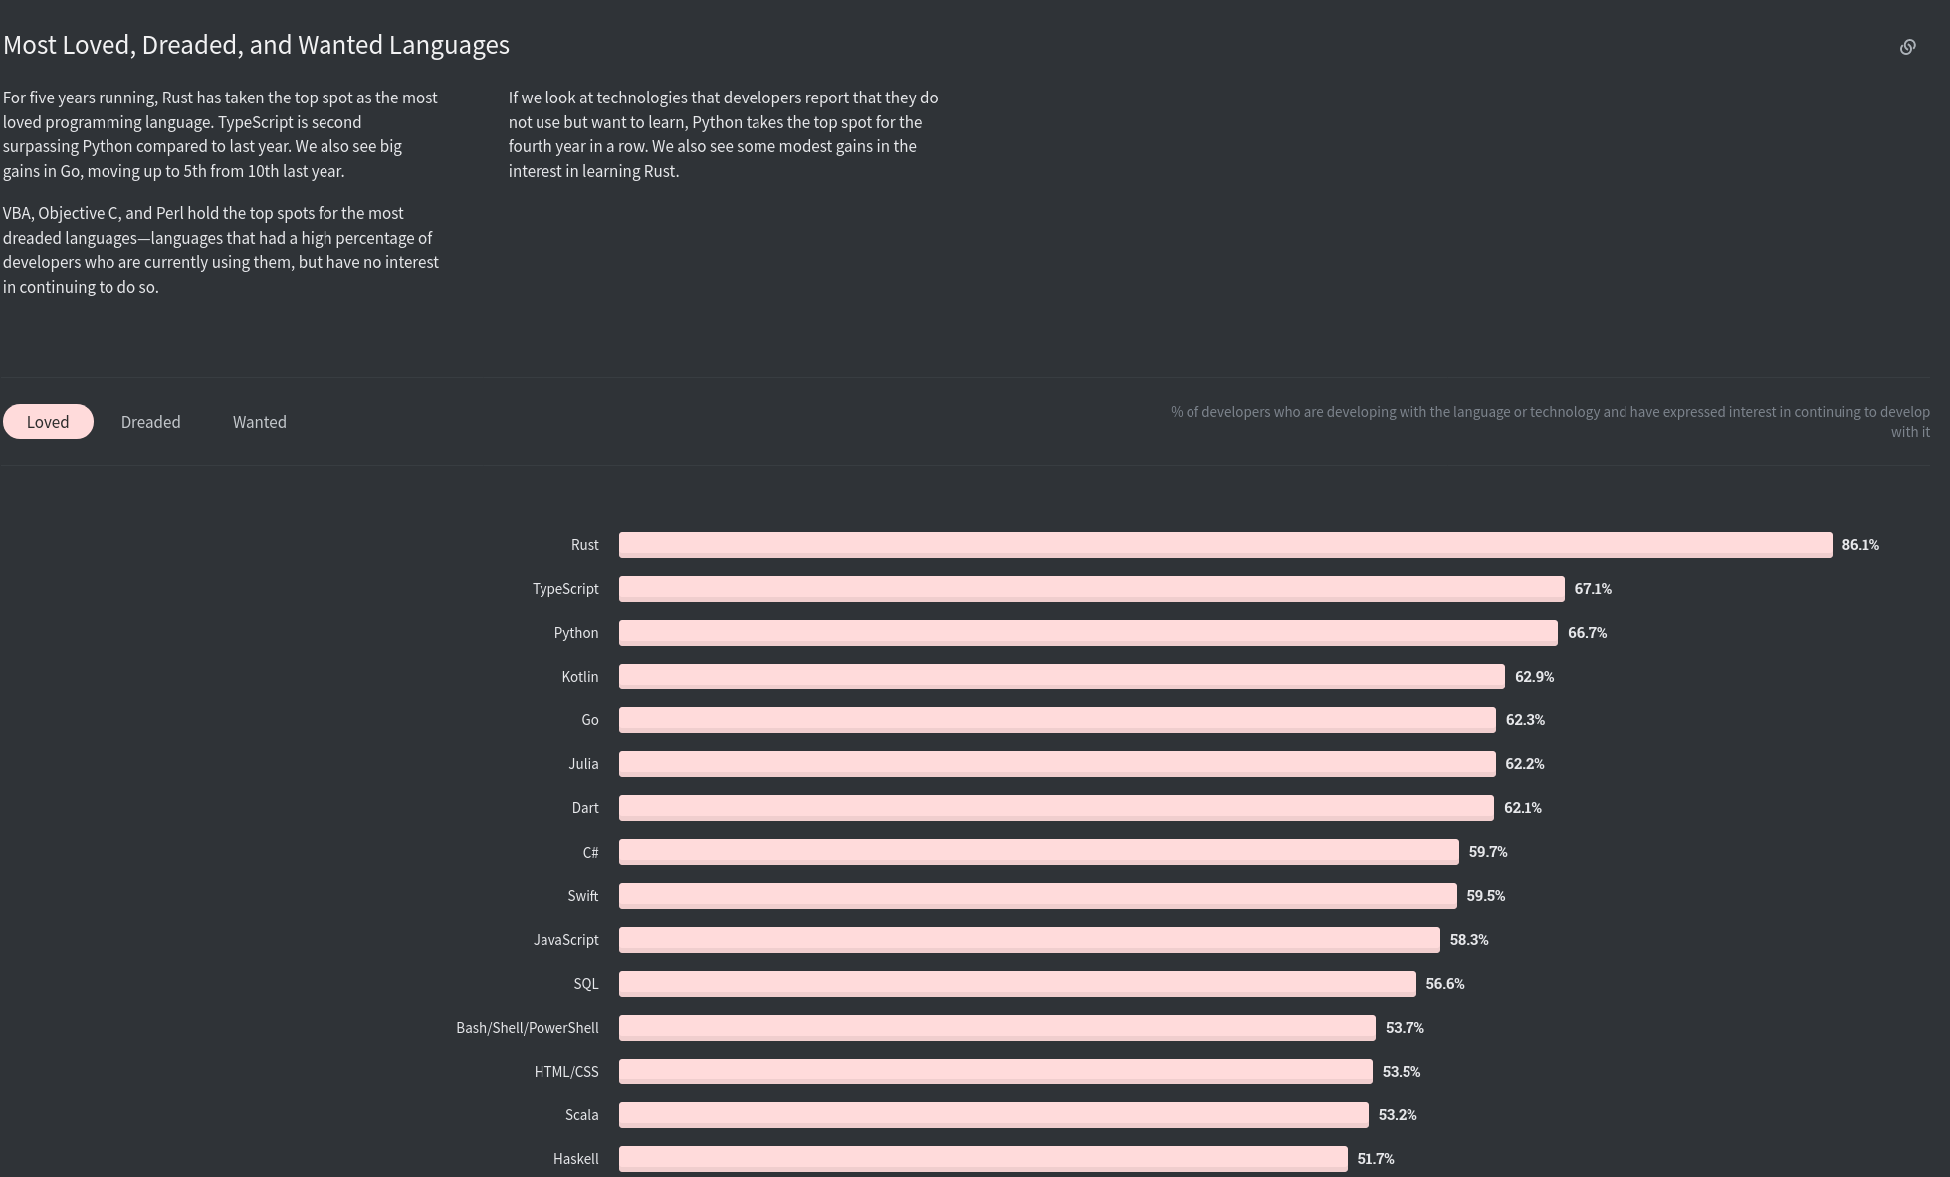
Source: https://insights.stackoverflow.com/survey/2020/#technology-most-loved-dreaded-and-wanted-languages-loved

Slide 4
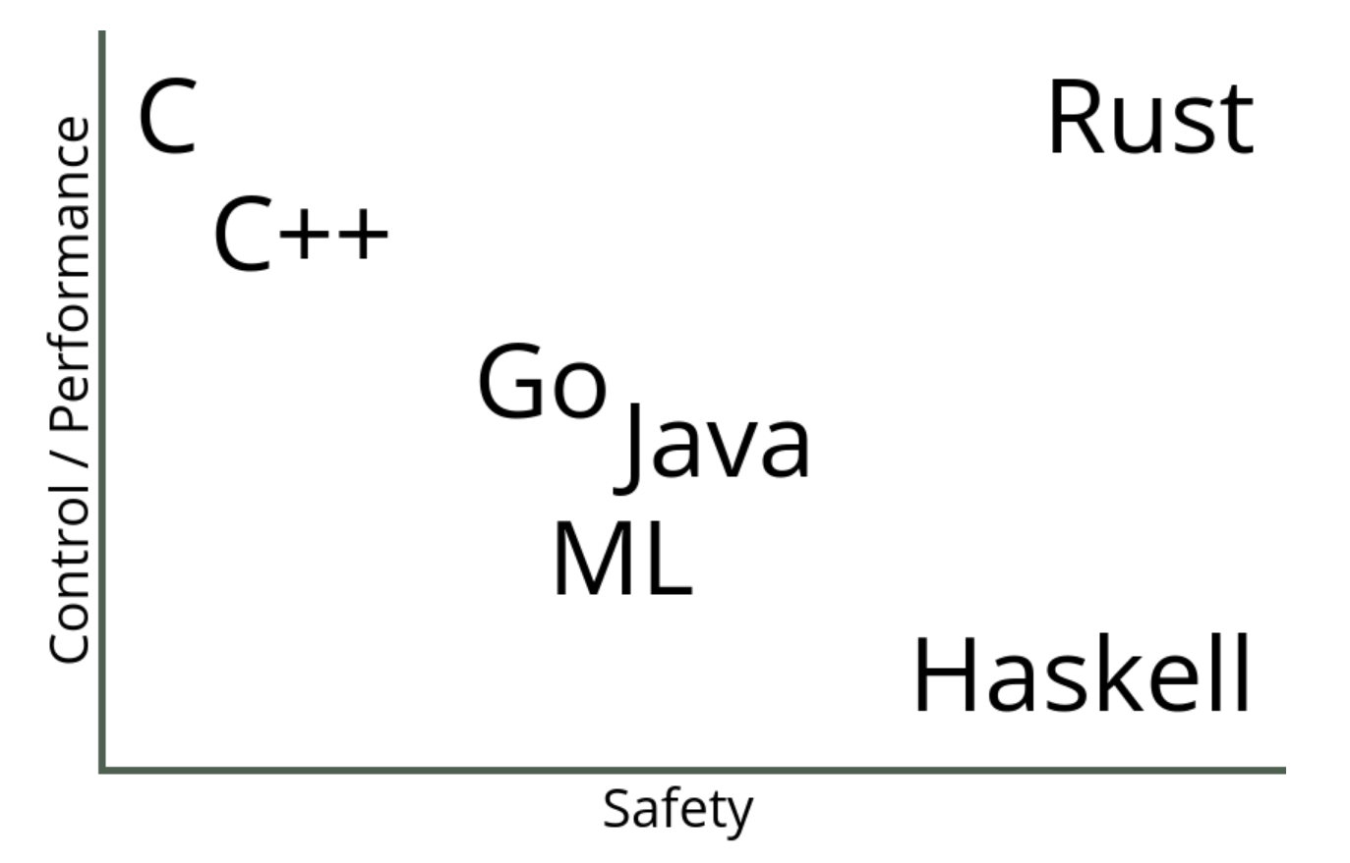
Why do people love Rust?
Systems programming language, but much safer than C
No "segfaults"
No memory corruption (without having a garbage collector)
Thread-safe code by default (no data-races)
Pattern matching, type inference, generics
Seamless interoperability with C
Tasteful language design
e.g., immutability by default, affine type system
Great community & eco-system
Strive to be helpful, friendly & inclusive
Good ecosystem (libraries, resources) which are easy to use (unified build, packaging, dependency management and documentation)
Source: https://thoughtram.io/rust-and-nickel/

Slide 5
A first program
fn main() { println!("Hello, world!"); }

Slide 6
Basic data types
fn main() { println!("Hello, world!"); basic_types(); } fn basic_types() { let a: u8 = 1 + 4;
let b: i64 = -3 * 2;
let c: bool = true;
let d: char = 'a';
}

Slide 7
Compound data types
fn main() { println!("Hello, world!"); compound_types(); } fn compound_types() { let mytuple: (i32, f64, char) = (500, 6.4, 'b');
let myarray: [i32; 5] = [1, 2, 3, 4, 5];
}

Slide 8
Structs
struct User { username: [char; 12], sign_in_count: u64, active: bool, }
struct UserInlined([char; 12], u64, bool);

Slide 9
Enums
enum IpAddressKind { V4, V6, }
enum IpAddress { V4(u32), V6(u128), }

Slide 10
Hands on!
Get some practice with: Functions, Data-types, Structs, Enums
Solve exercises for the following sections: variables, if, functions, primitive types, struct, strings, enums, test, modules <stop here>
Installation Instructions: https://gist.github.com/gz/fae0e0b91af7f2af3b34ad8799b0cd12
Demo

Slide 11
Rust Workshop
Part 1b: Introduction to affine types

Slide 12
What are affine types?
Types where its objects can't be used more than once:
let s1 = String::from("Hello"); let s2 = s1; // NOTE: s1 moved here println!("{}", s1); // ERROR: use of moved value println!("{}", s2); // OK

Slide 13
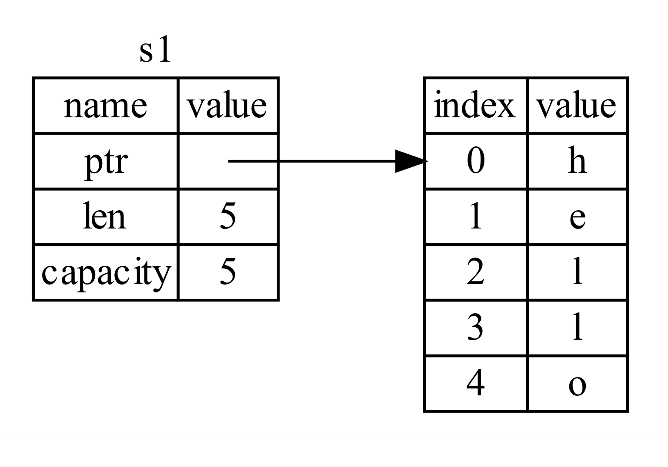
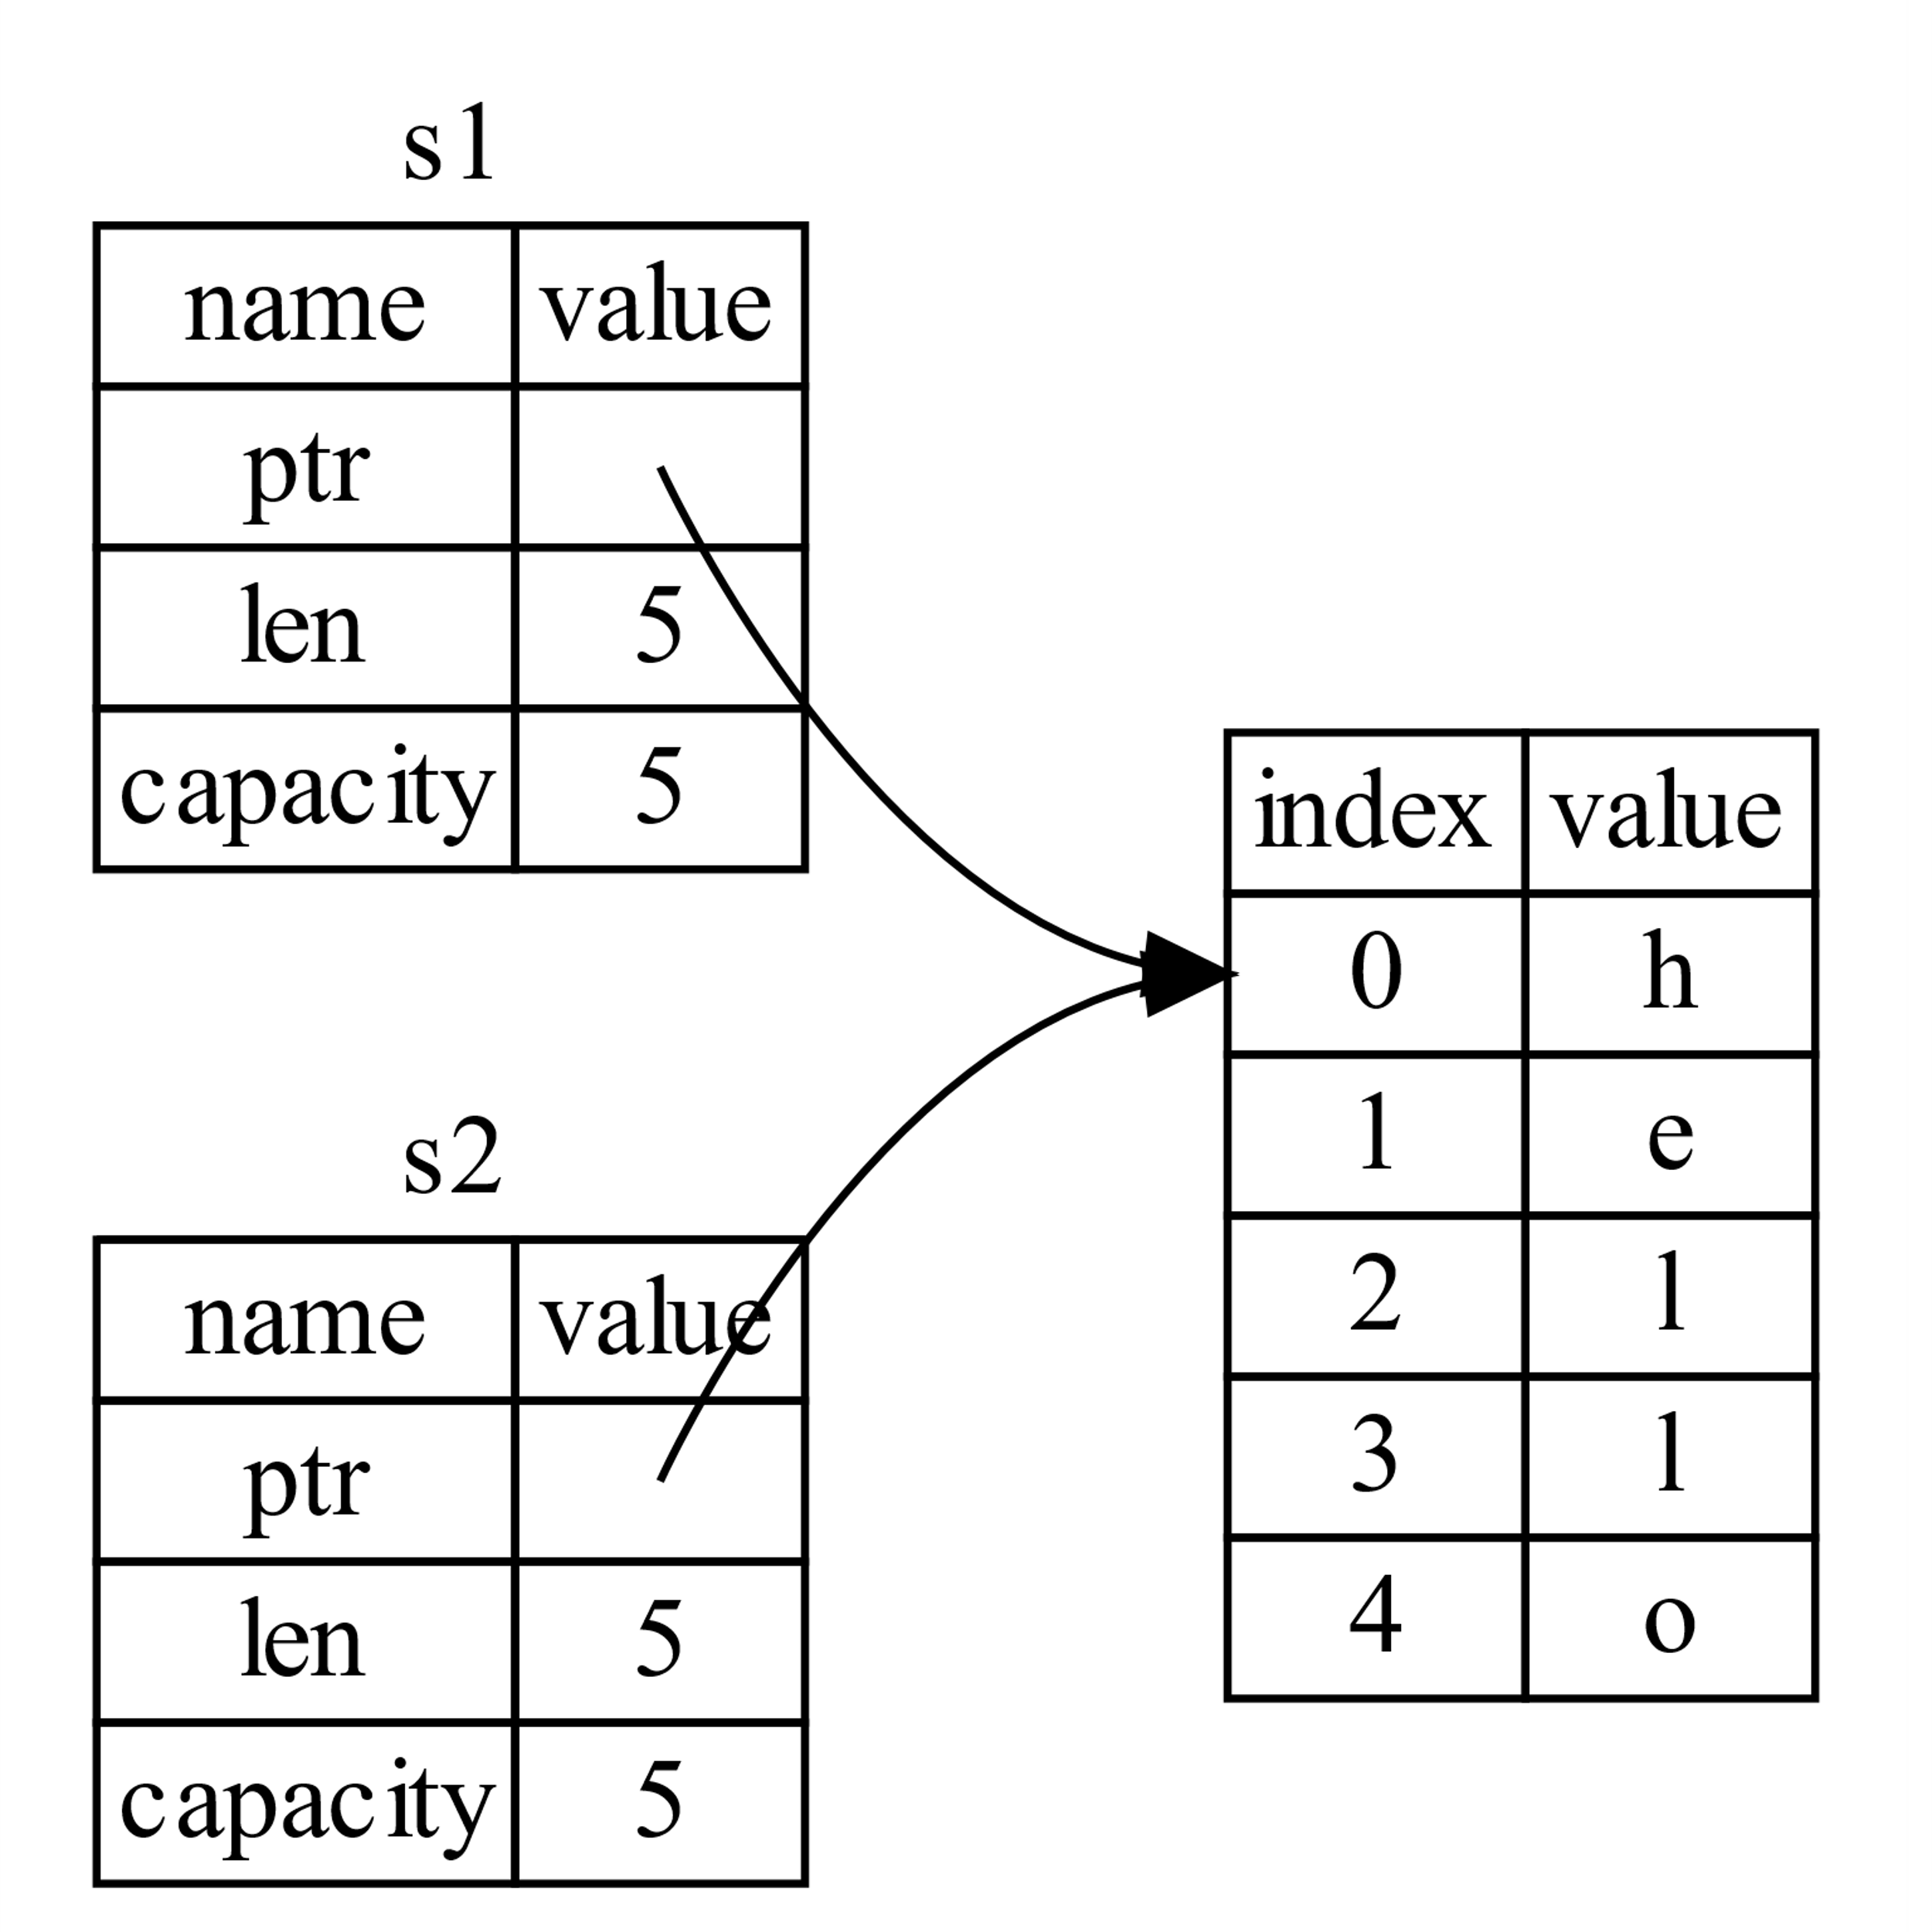
Why affine types are a good thing
let mut s1 = String::from("hello"); let s2 = s1;
??: s1.push_back("world")
??: println!("{}", s2);
Avoids aliasing: No side effects (mutation of s1 can't change s2)

Slide 14
Why affine types are a good thing
{
let mut s2: String;
{
let s1 = String::from("hello"); s2 = s1;
}
println!("s2 = {}", s2);
} // rust will free "hello" memory on the heap here
Automatic memory management (without garbage collection)!

Slide 15
Not everything is affine
By default any struct, enum, array etc. you declare in rust is affine.
Basic types (numbers, float, bool, characters etc.) are not affine (cheap to copy).
A type (isize) that implements the Copy trait (more on traits tomorrow):
let i1 = 1; let i2 = i1; // NOTE: i1 copied here println!("{}", i1); // OK println!("{}", i2); // OK

Slide 16
Rust' ownership model: Hands-on
Solve exercises for: move_semantics (4)
Finish the remaining exercises for Module 1a or directly try to solve some move_semantics exercises
You can skip exercises you have not yet done by invoking: rustlings run move_semantics1 rustlings run move_semantics2 rustlings run move_semantics3 rustlings run move_semantics4

