Slide 1
Tennis: A Journey Through Data Science

Slide 2
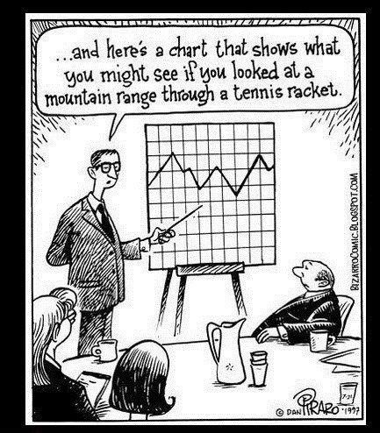
Introduction
Interested in what tennis match statistics are important in winning
Based on how you do compare to opponents?
What are the most important statistics?
Notes:
Do you need to compare how you are doing compared to your opponents, or look at opponents and yourself separately
When playing a match, what are statistics that you need to think about the most when trying to win?

Slide 3
Method
Data set from tennisabstract.com
Data Cleaning: down from ~2500 matches to ~1280 from ATP from 2015-2019
Used 2 versions of data sets to pick different sets of variables by stepwise regression/BIC
Fit variables using 4 methods: Logistic Regression, LDA, QDA, decision tree
Notes:
Tennisabstract is an open source website where individuals record tennis matches point by point. Each point tells you what happened. More statistics compared to official ATP website data
Three versions: look at statistics based on difference between opponents, statistics independently, both
e.g. Unforced errors difference, unforced1 and unforced 2, uediff+first serve %1+first serve %2

Slide 4
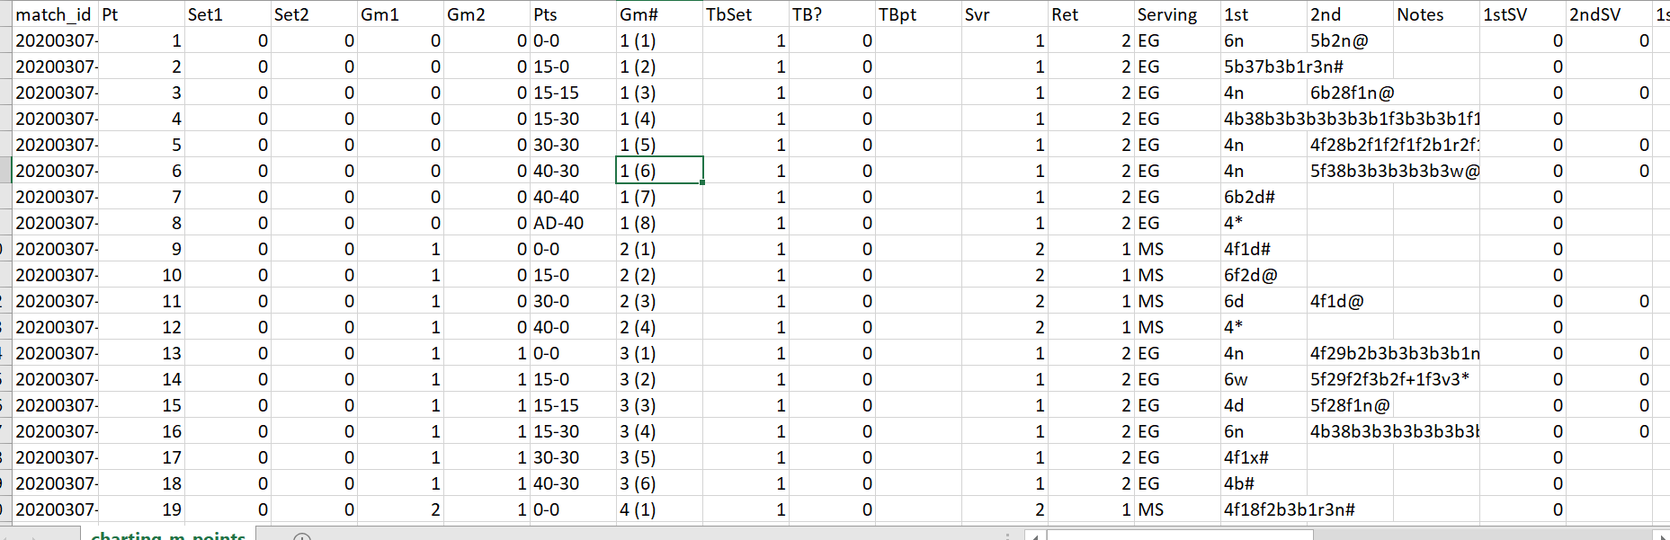
Method cont.

Slide 5
Method cont.
Used CV to evaluate model performances
Predict if “player 1” won
Difference variables based on “Player1-Player2”
“winner~df1+df2” vs “winner~dfDiff”
In total 8 models were observed
Notes:
80-20 training/test
We predict if player 1 wins in a match, who is the first person listed in the match
Difference variable by subtracting player2 stats from player1

Slide 6
List of Tennis Statistics
First Serve %
First Serve % Won
Second Serve % Won
Aces
Double Faults
Winners
Unforced Errors
Wins/UE Ratio
Forced Points
Unreturnable Serves
Net Points % Won
Break Points % Won
Break Points Faced
Break Points Saved
First Serve Return % won
Second Serve Return % Won
Points Won
Notes:
Last 3 are linear dependencies, so removed, Wins/UE ratio

Slide 7
Results
Method | # Vars | Log Reg | LDA | QDA | Tree
Difference | 8 | .043 | .047 | .051 | .125
No Difference | 15 | .062 | .066 | .093 | .156

Slide 8
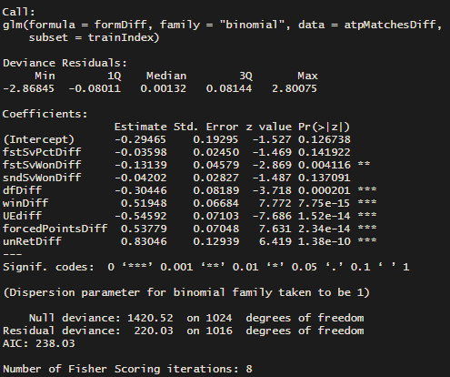
Results cont.
Notes:
If the difference of first serve % increase by 1%, your chances of winning goes down by 3%

Slide 9
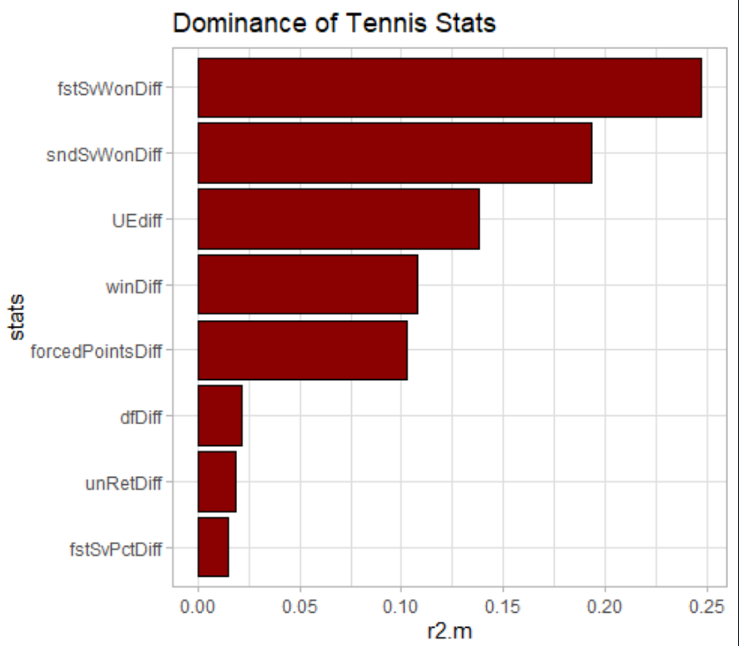
Results cont.
Notes:
Calculate variable importance that looks at the absolute value of the z statistic for the coefficient

Slide 10
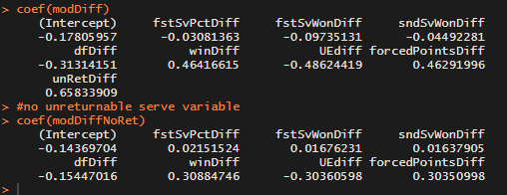
Results cont.
Interesting….

Slide 11
Discussion
Controlled Aggression is very important
Serve is important
Comparing how you do to opponents is important
Some questions about first/second serves vs. unreturnable serves
Big numbers?

Slide 12
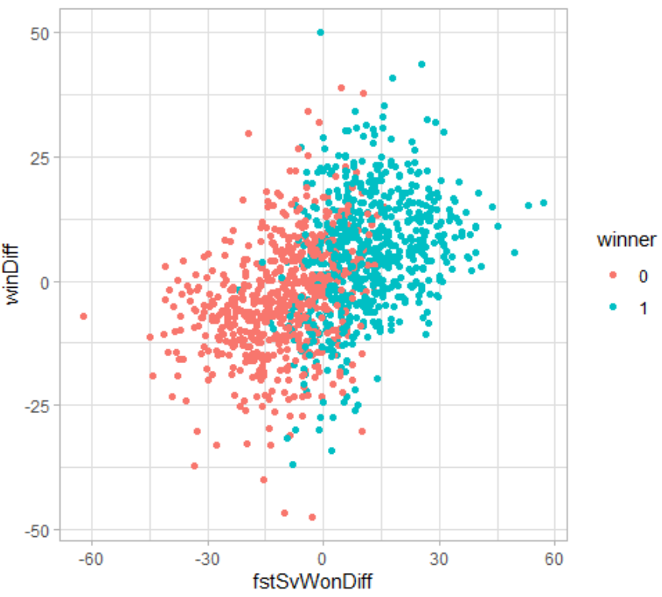

Slide 13
Consideration for the future
Stepwise regression is a bit outdated
Can’t look at all possible subsets
May look into Sequential Floating Forward Method
Allows to go backward as long as objective function increases
Data not a conclusive list of matches
In depth analysis on serve statistics
Look at WTA data

