Slide 1

Temporal Discounting in Anxiety Disorder

Slide 2
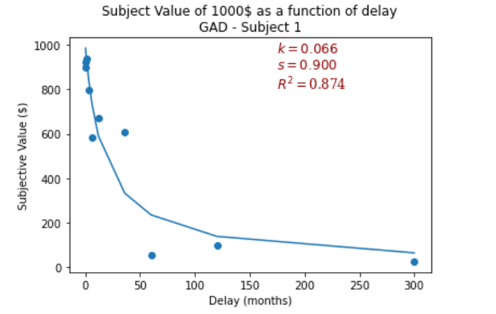
Temporal Discounting
The tendency of people to discount rewards as they approach a temporal horizon in the future or the past.
Measured by reaching middle ground between delayed and current reward. Reward is usually money.
Discounting function – The subjective value of a reward as function of delay of the reward

Slide 3
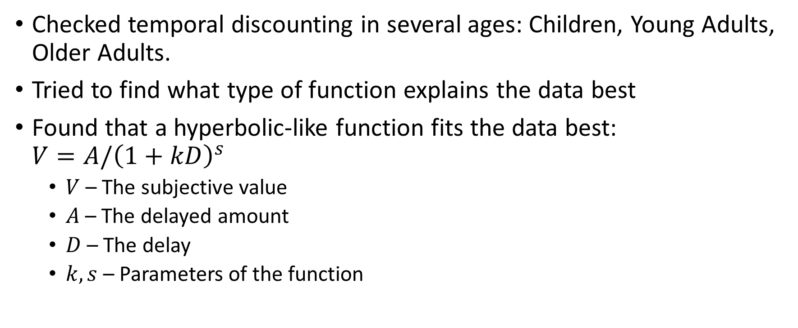
Temporal Discounting Across Life Span Green et al. 1999
Checked temporal discounting in several ages: Children, Young Adults, Older Adults.
Tried to find what type of function explains the data best
Found that a hyperbolic-like function fits the data best: $V=A/{\left(1+kD\right)}^{s}$
$V$ – The subjective value
$A$ – The delayed amount
$D$ – The delay
$k,s$ – Parameters of the function

Slide 4
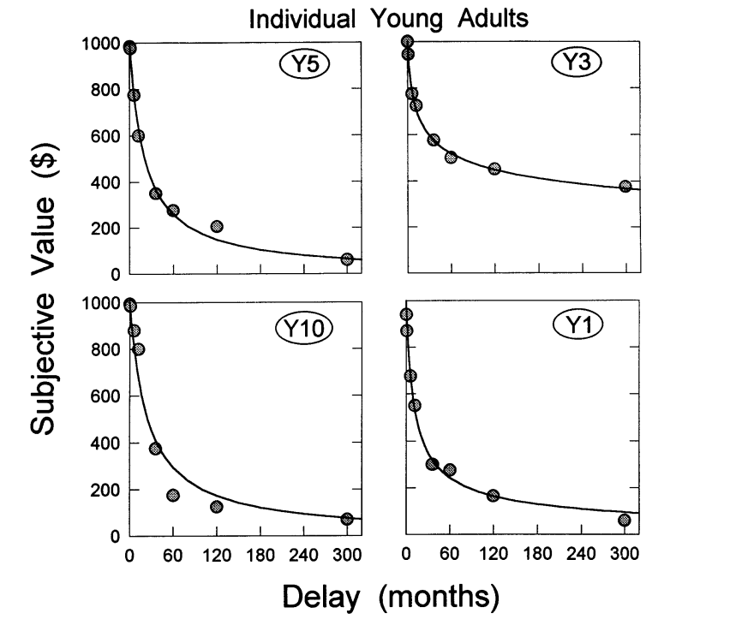
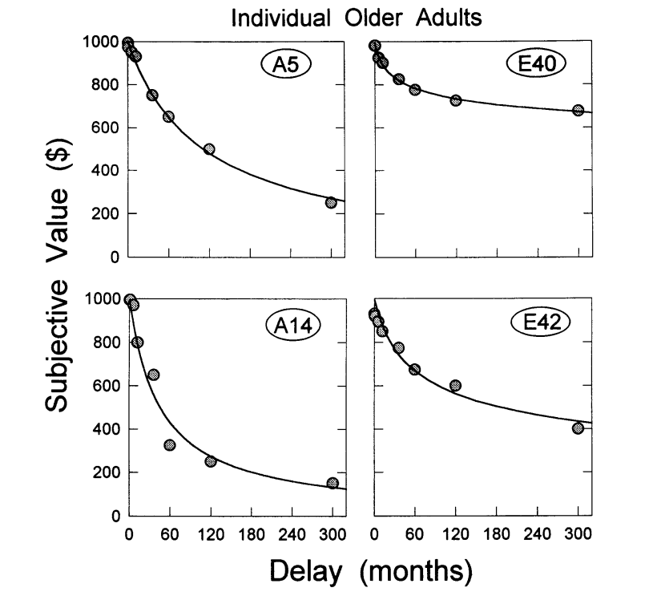
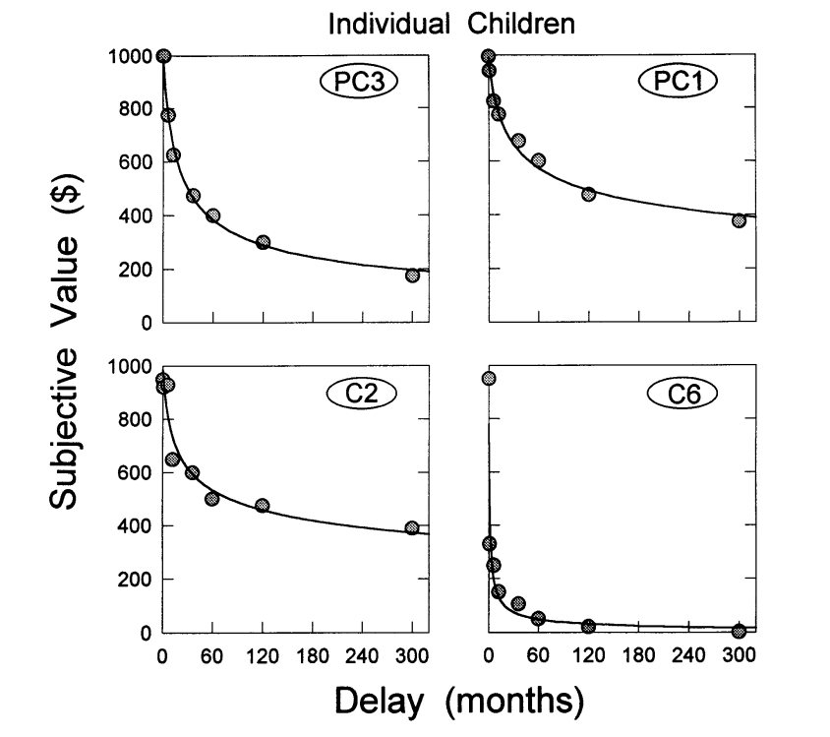
Temporal Discounting Across Life Span Green et al. 1999

Slide 5
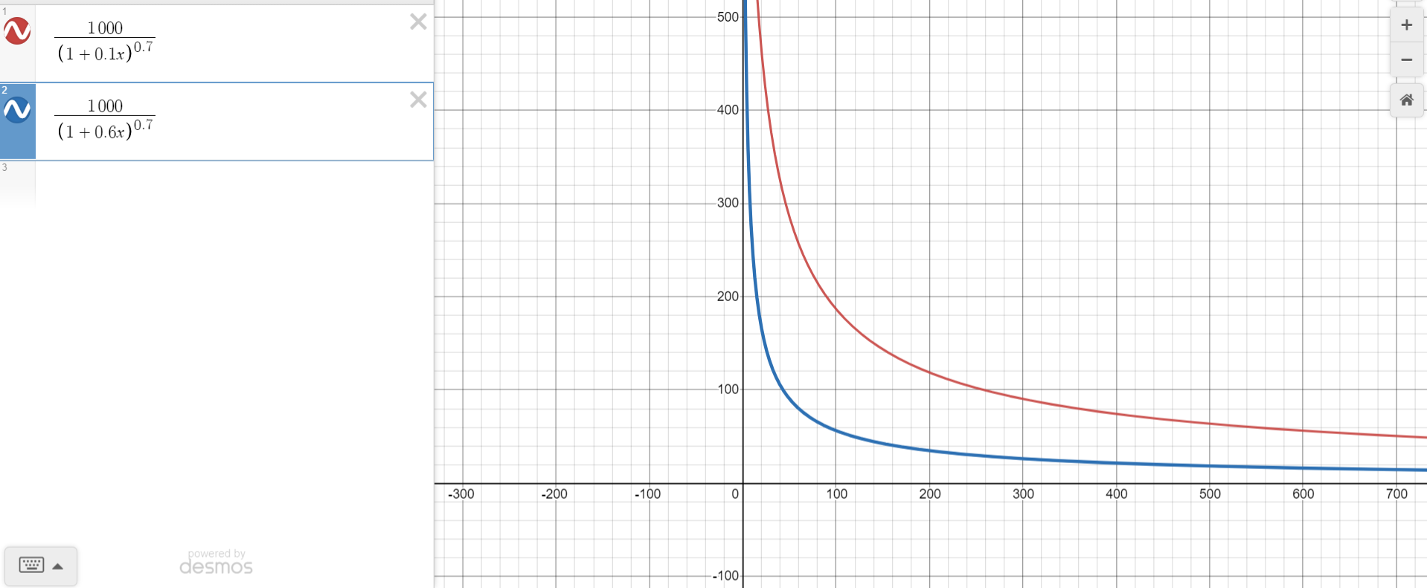
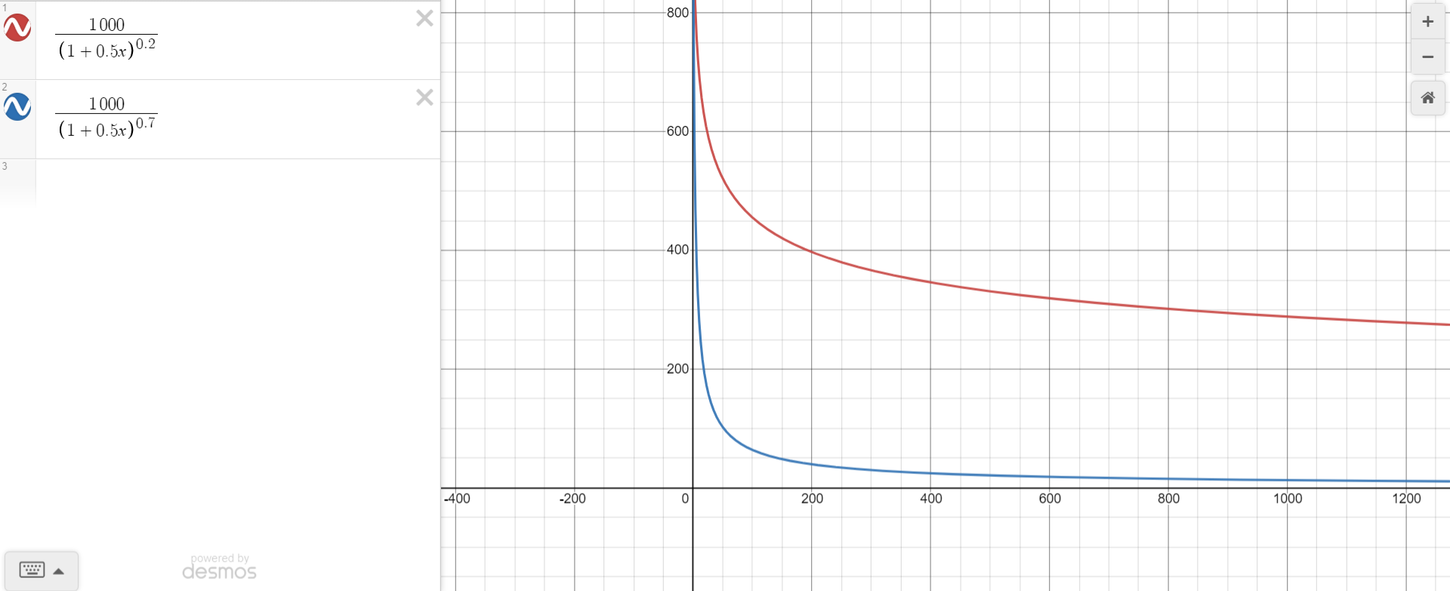

Temporal Discounting Across Life Span Green et al. 1999
The parameters of the function:
$k$ – Steepness of the hyperbole, The rate of the drop in the subjective value
$s$ – The rate of the negative acceleration of the function

Slide 6
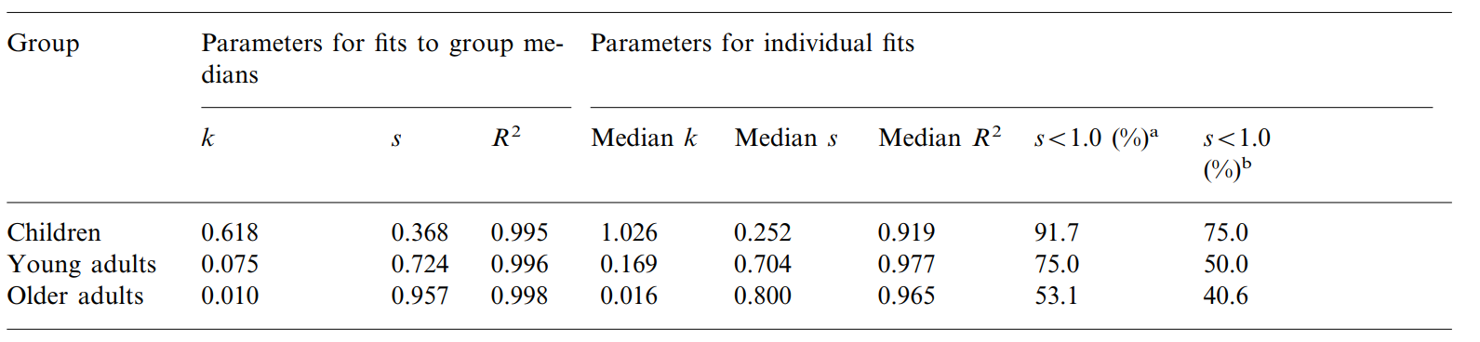

Temporal Discounting Across Life Span Green et al. 1999
Parameters of function varied with age:
$k$ – Decreased with age, Older adults can delay gratification better
$s$ – Increased with age, Change in the way time is scaled

Slide 7
Generalized and Social Anxiety Disorder
Generalized Anxiety Disorder (GAD) - persistent and excessive worrying.
Social Anxiety Disorder (SAD) - A type of anxiety disorder that causes extreme fear in social settings.
In both cases, the worrying is about event that are going to happen.

Slide 8
What are we looking for
Since people with GAD and SAD worry more about the future, they might discount differently delayed rewards.
We expect to see abnormal discounting functions regarding the results in Green et al. 1999.

Slide 9

Experimental Design
3 Subjects – 1 subject with SAD, 2 subjects that have not been diagnosed with GAD but score high on the GAD7 test.
Delayed amount of 1000$
8 different delay values
20 different current values.
Subjects need to choose between current reward and delayed reward.

Slide 10

Results
2 of the 3 subjects had abnormal $s$ parameter in the fitted discounting function regarding age group

Slide 11
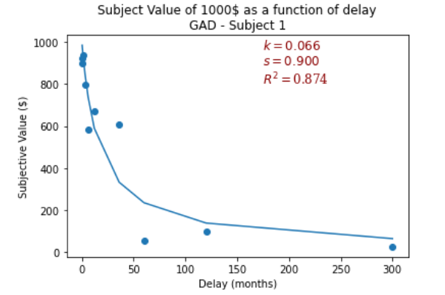
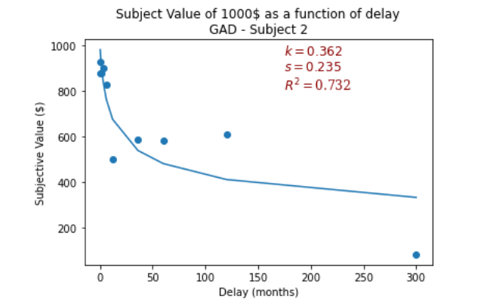
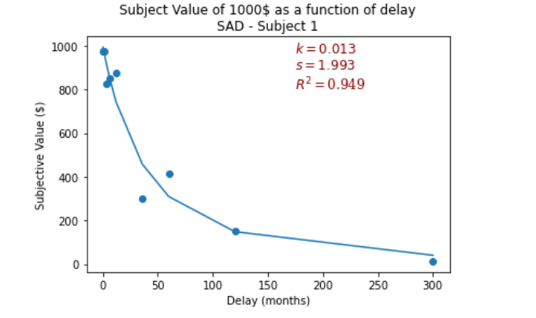

Slide 12
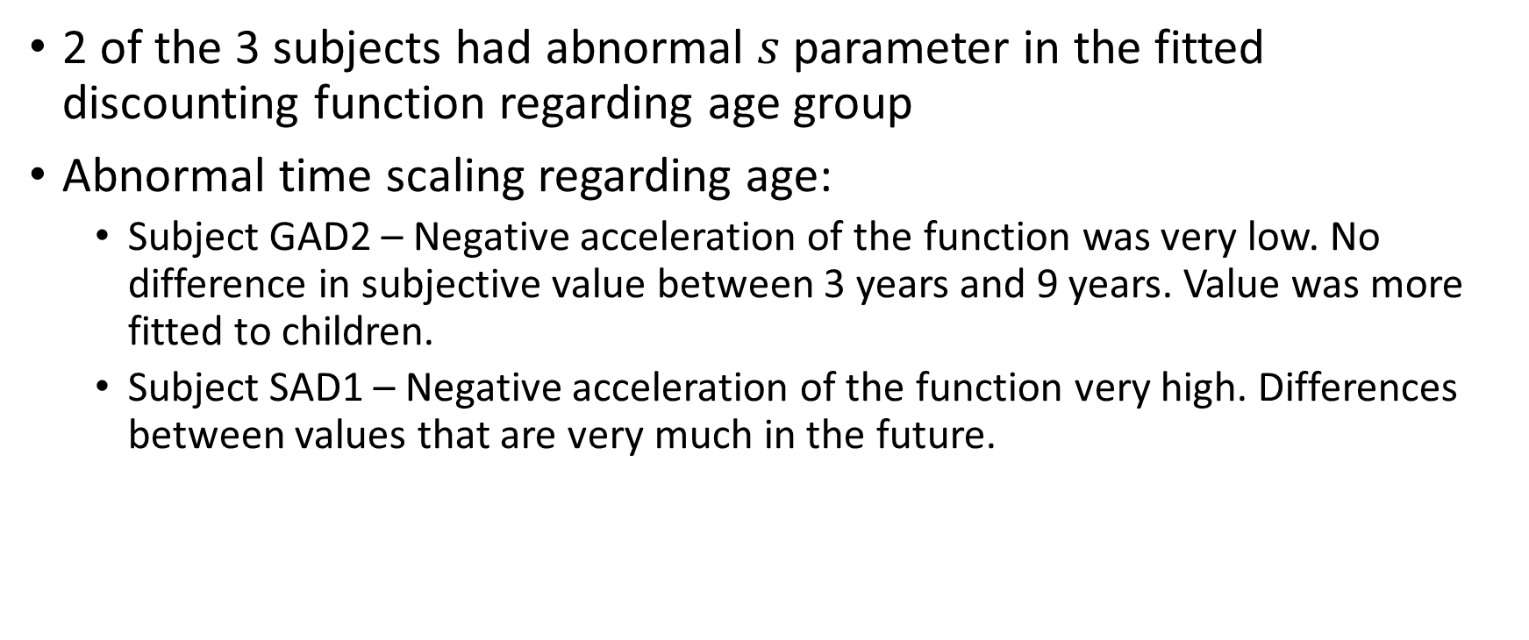
Results
2 of the 3 subjects had abnormal $s$ parameter in the fitted discounting function regarding age group
Abnormal time scaling regarding age:
Subject GAD2 – Negative acceleration of the function was very low. No difference in subjective value between 3 years and 9 years. Value was more fitted to children.
Subject SAD1 – Negative acceleration of the function very high. Differences between values that are very much in the future.

Slide 13
Possible problems
1000$ might be too small of an amount for such long future delays.
GAD subjects are not clinically diagnosed.
Not enough subjects.
Delays are very far apart for long delays.
Only 2 trials for each delay. Need more data.

