Slide 1
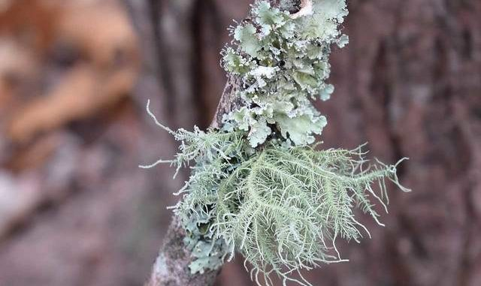
Symbioses:
Lichens
Topics (just the very basics):
- What is a lichen​?
- How to do phylogeny w/ lichens?
- Examples
- Diversity and distributions
- Ecology

Slide 2
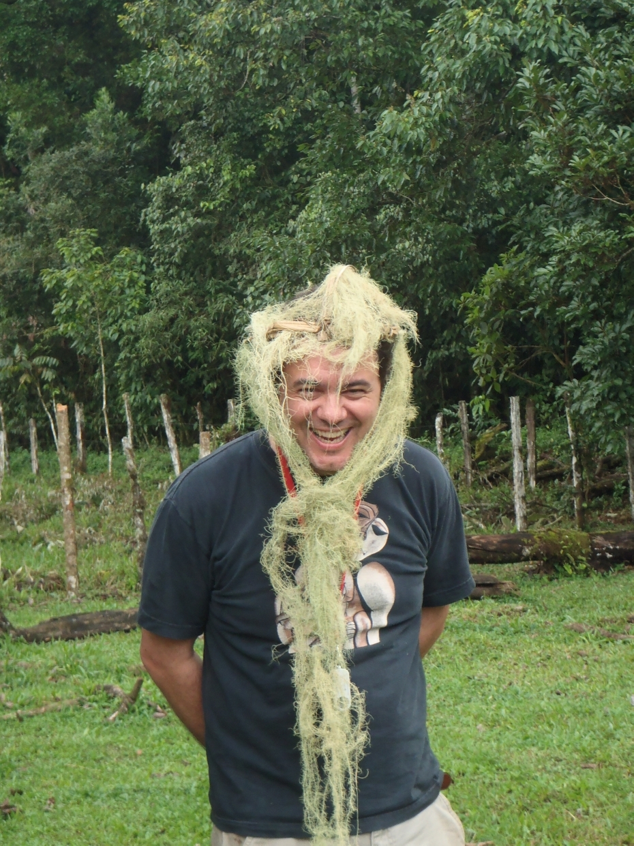
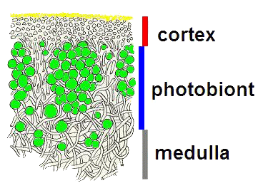
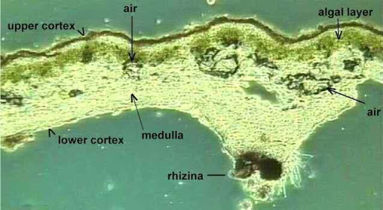
More than one species functioning as a single organism
"Fungi farming algae"
mycosymbiont + photosymbiont

Slide 3
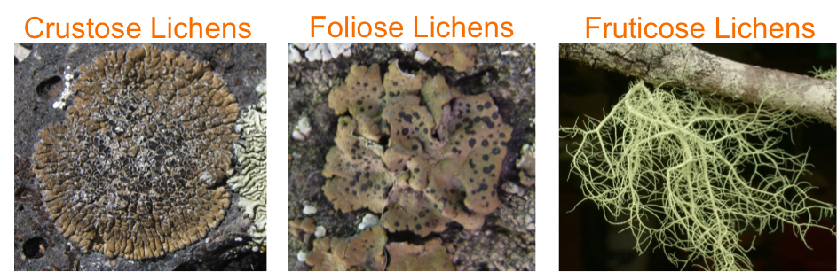
Major growth forms

Slide 4
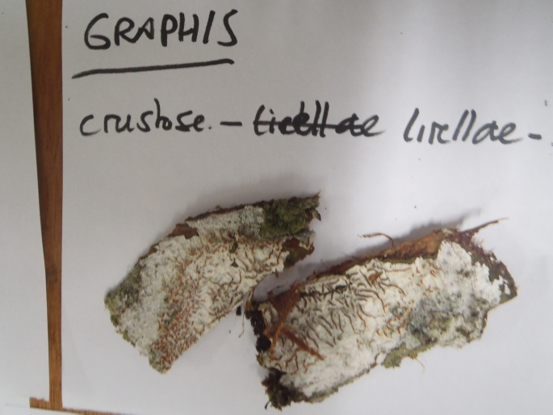
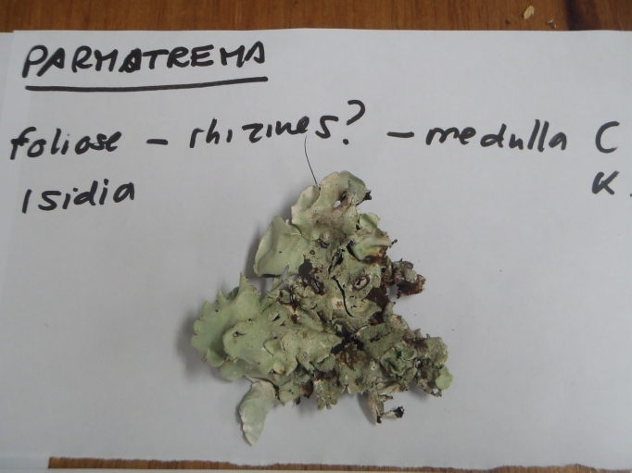
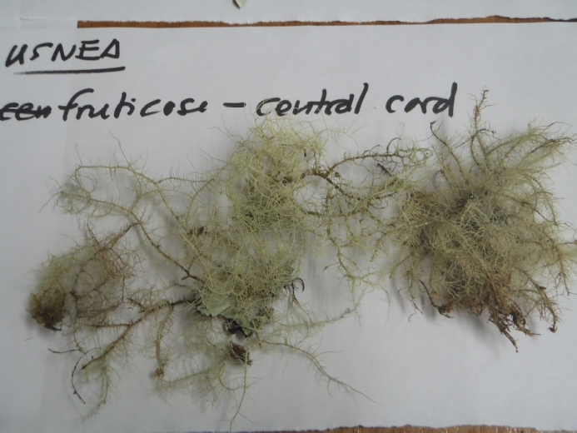
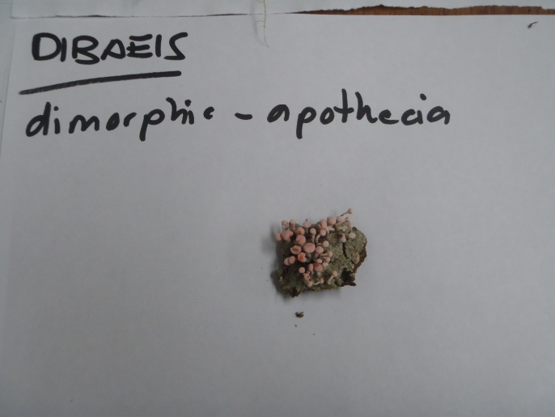
Growth form examples

Slide 5
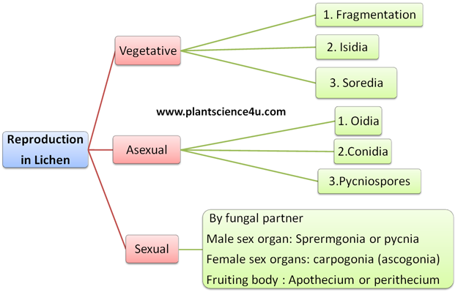
Lichen reproduction

Slide 6
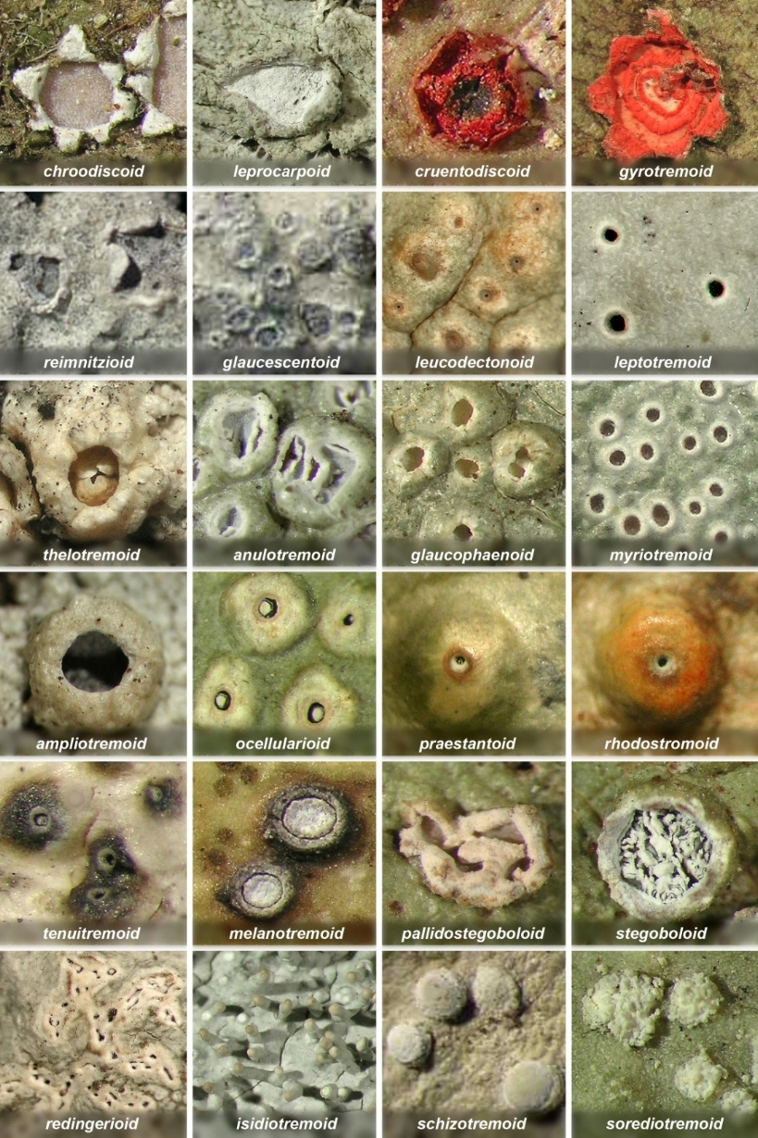
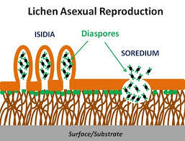
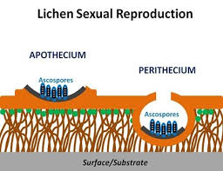
Lichen reproduction

Slide 7
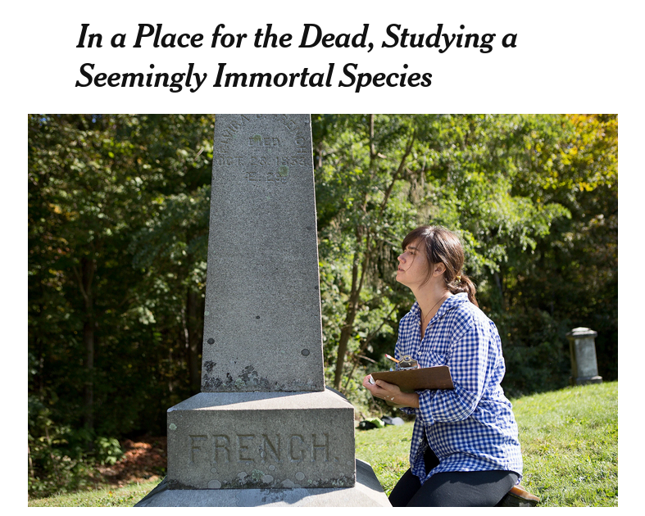
Lichen ecology factoids:
Can grow in horrible places like exposed rocks
Often the primary colonizers of new land (volcanic)
Very sensitive to air pollution; can be used as air quality indicators
Grow very slowly (~1-2 mm per year)
Dr. Anne Pringle

Slide 8
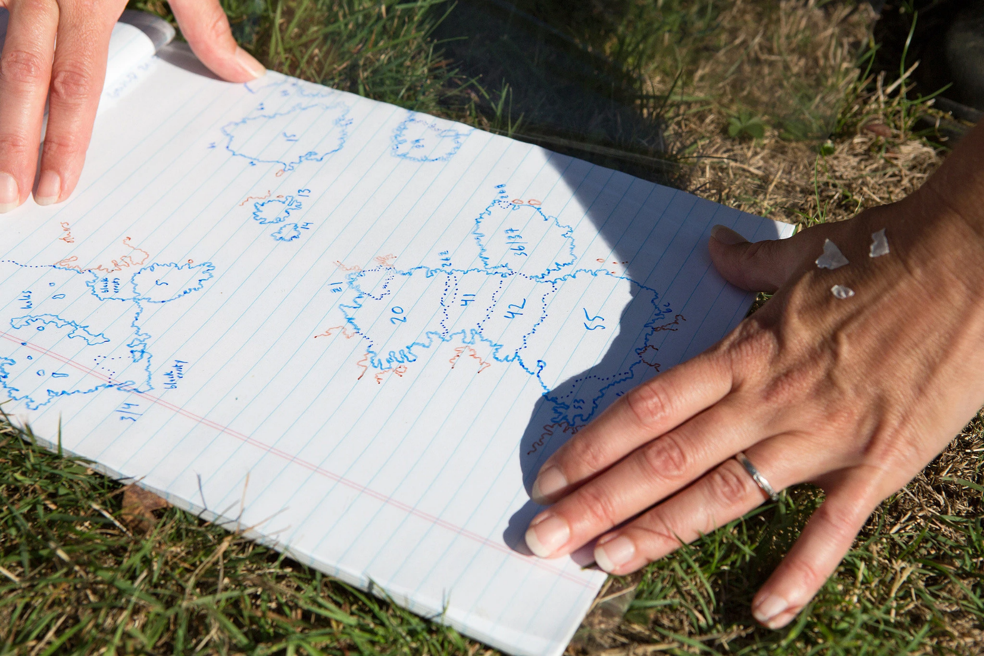

Slide 9
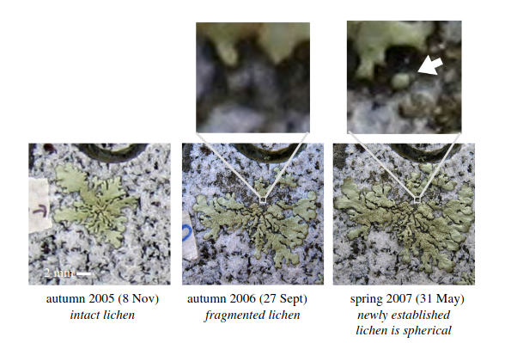

Slide 10
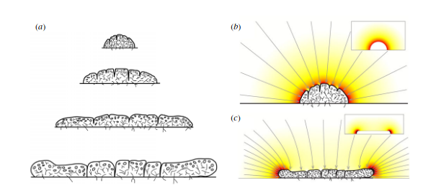
Diffusion of CO2 above the lichen enforces an upper limit for growth speed
Seminara et al., 2018

Slide 11
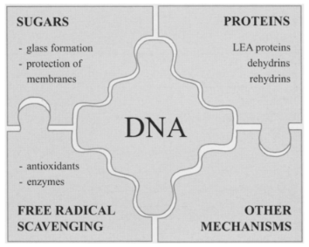
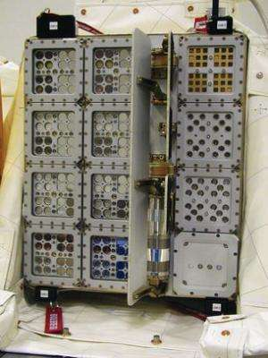
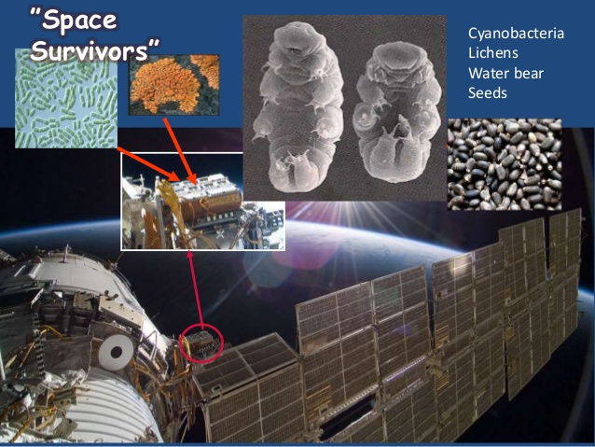
Lichens survived outer space for 1.5 years !!!

Slide 12
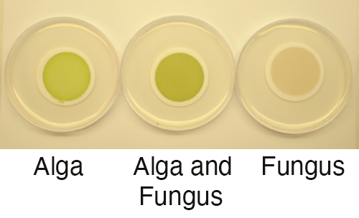
No gene transfer between symbionts!
Each can be grown separately, just fine.

Slide 13
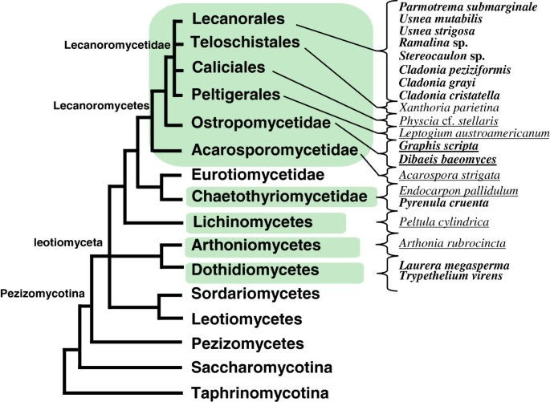
20,000 + named lichens
Have to study phylogeny via one or the other symbiont
Named after mycosymbiont
Mostly ascomycota (fewer than 200 Basidiomycete species)

Slide 14
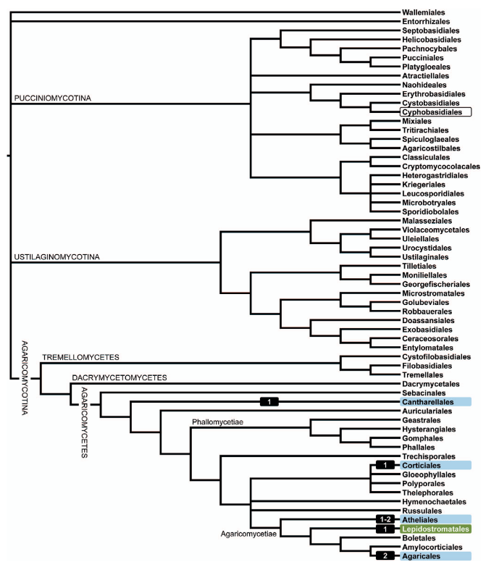
Lichen-forming groups in Basidiomycota

Slide 15
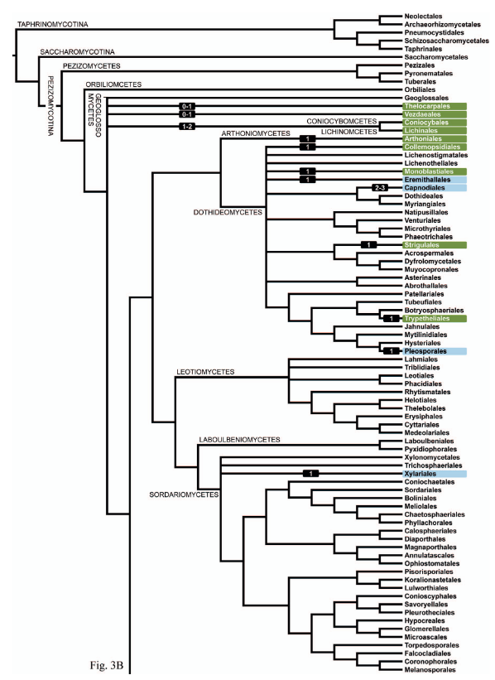
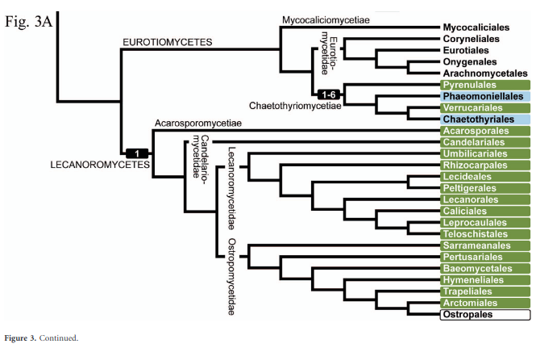
Lichen-forming groups in Ascomycota
Lücking, et al, 2017

Slide 16
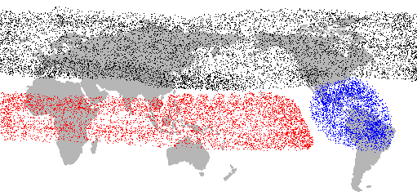
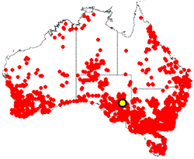
Lichen distributions
Endemic species
Lots of species have "limited" but giant distributions

Slide 17
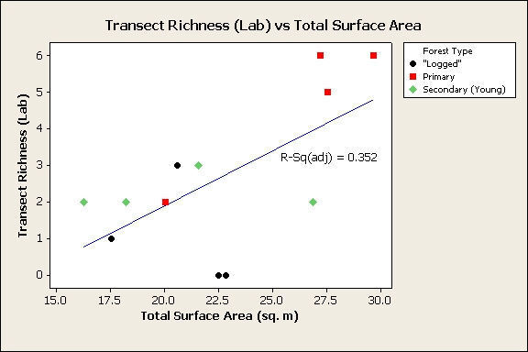
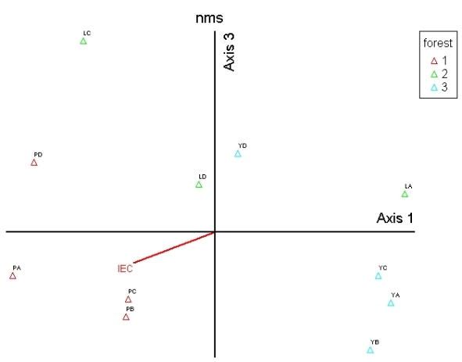
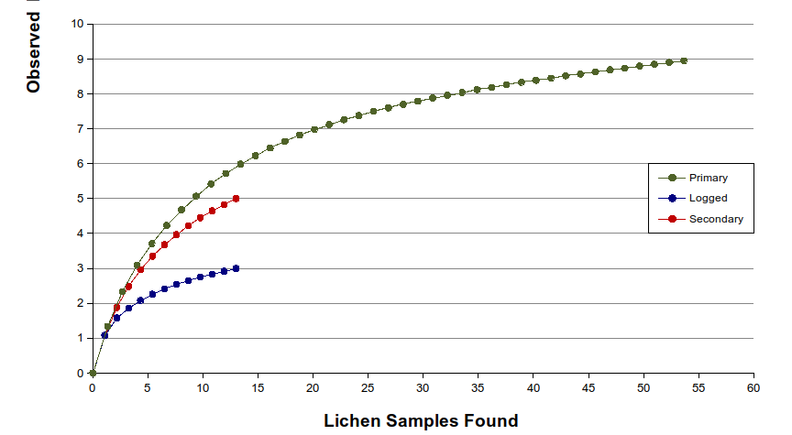
Lichen surveys can be used as a stand-in for lots of conservation measures

Slide 18
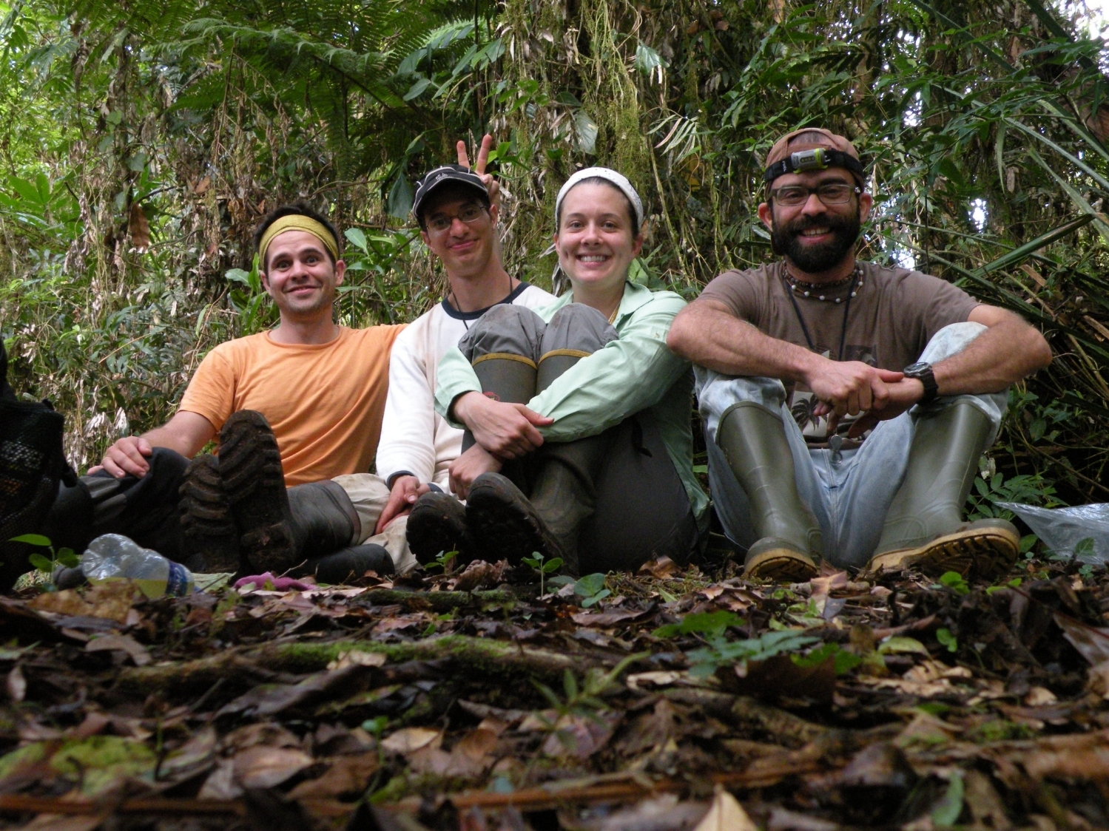

Slide 19
Assignments
1. Keep working on your lab assignments
2. Read Spribille et al., 2016
3. Quiz over reading before class Thursday

