Slide 1
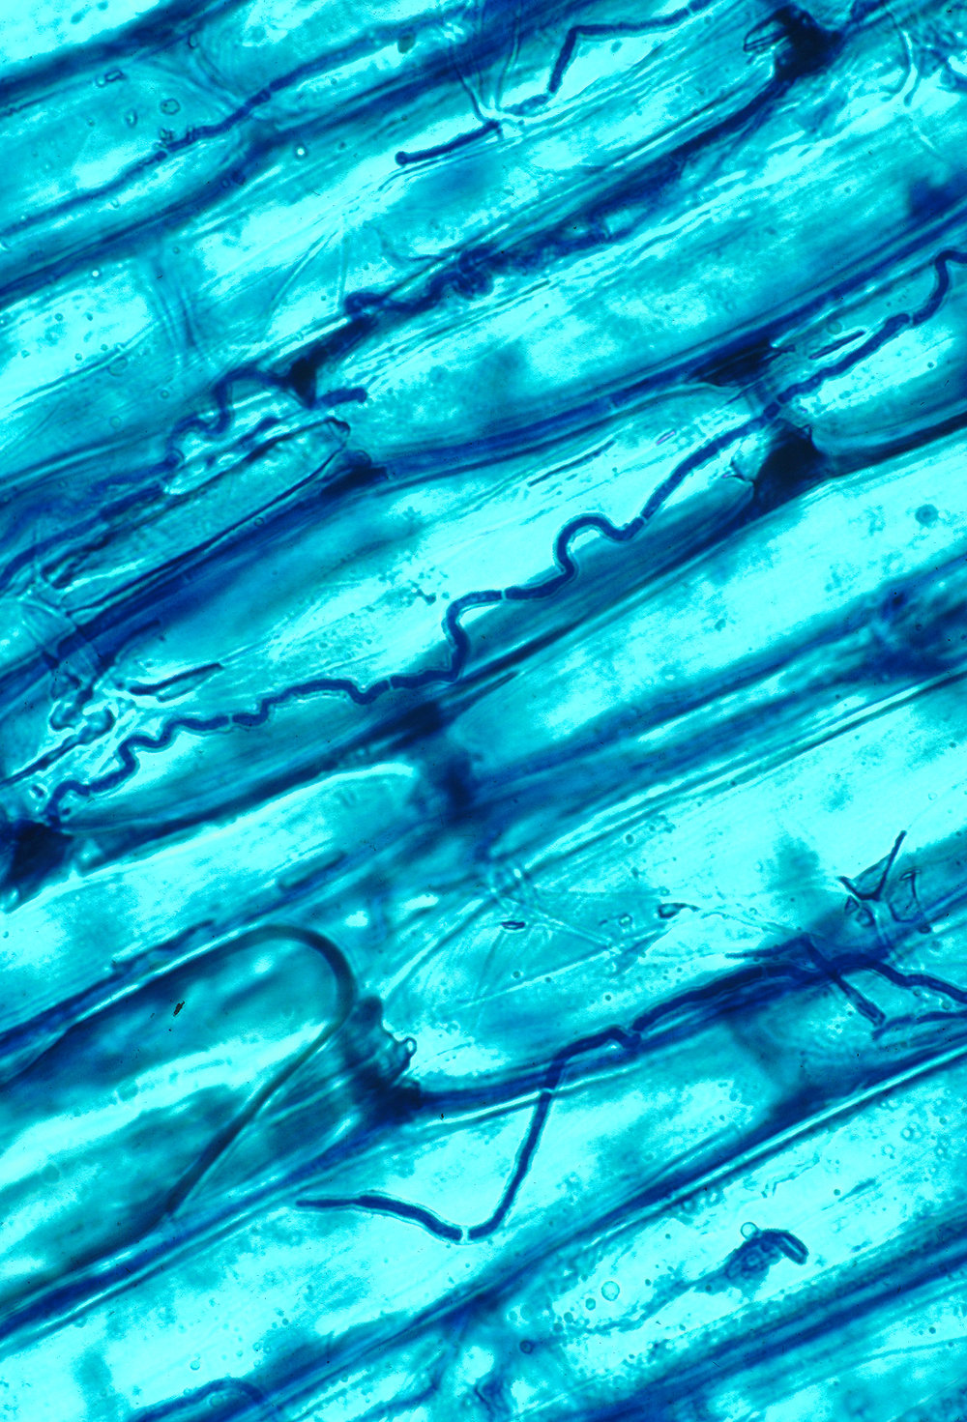
Symbioses:
Endophytes
Topics (just the very basics):
- How is an endophyte different from a biotroph or necrotroph?
- What are they doing? Latent decomposers?
- Endophytes as modifiers of plant disease
- Ecological roles
- Vertical vs horizontal transmission (monocot vs dicot)

Slide 2

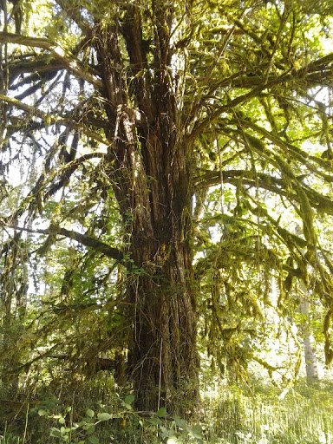
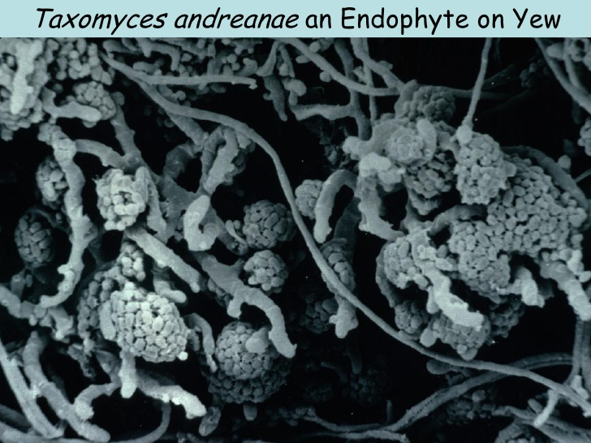
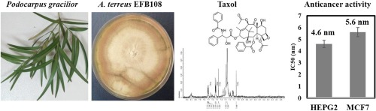
Comes from...
but really...
Pacific Yew - Taxus brevifolia

Slide 3
Fungal Endophytes: live within plant tissues without causing disease symptoms
What's the point?

Slide 4
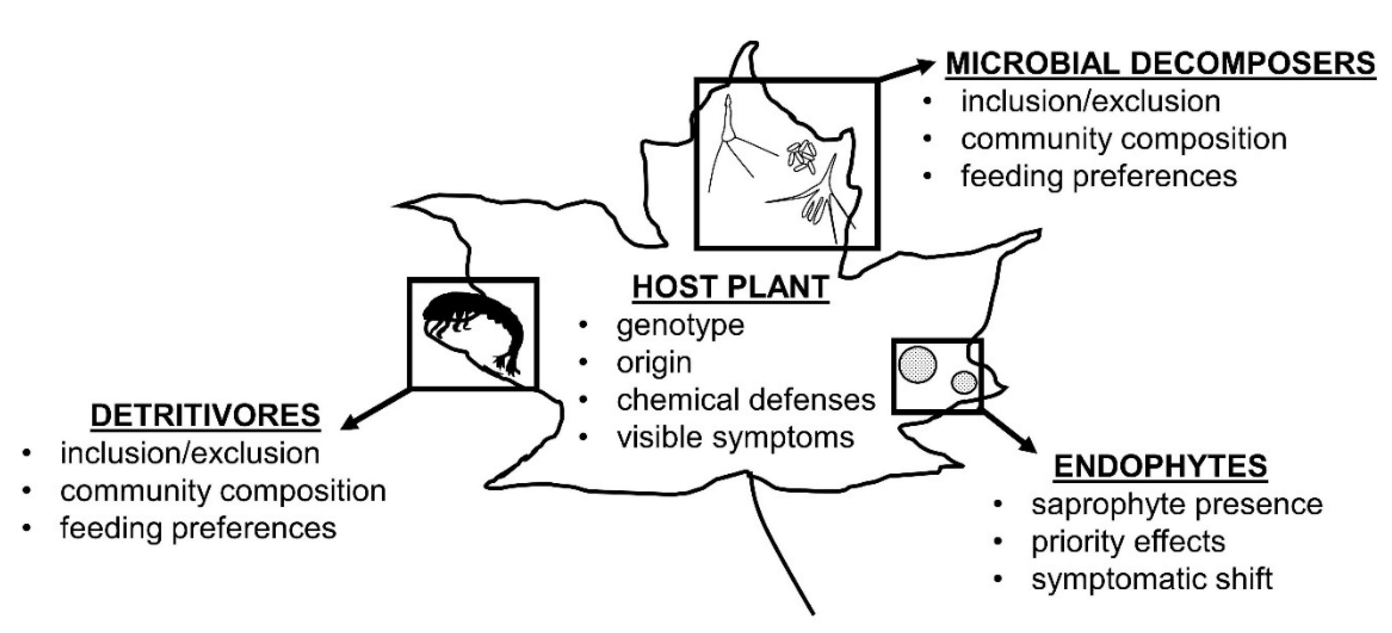
Fungal Endophytes: live within plant tissues without causing disease symptoms
What's the point?
Latent decomposer hypothesis

Slide 5
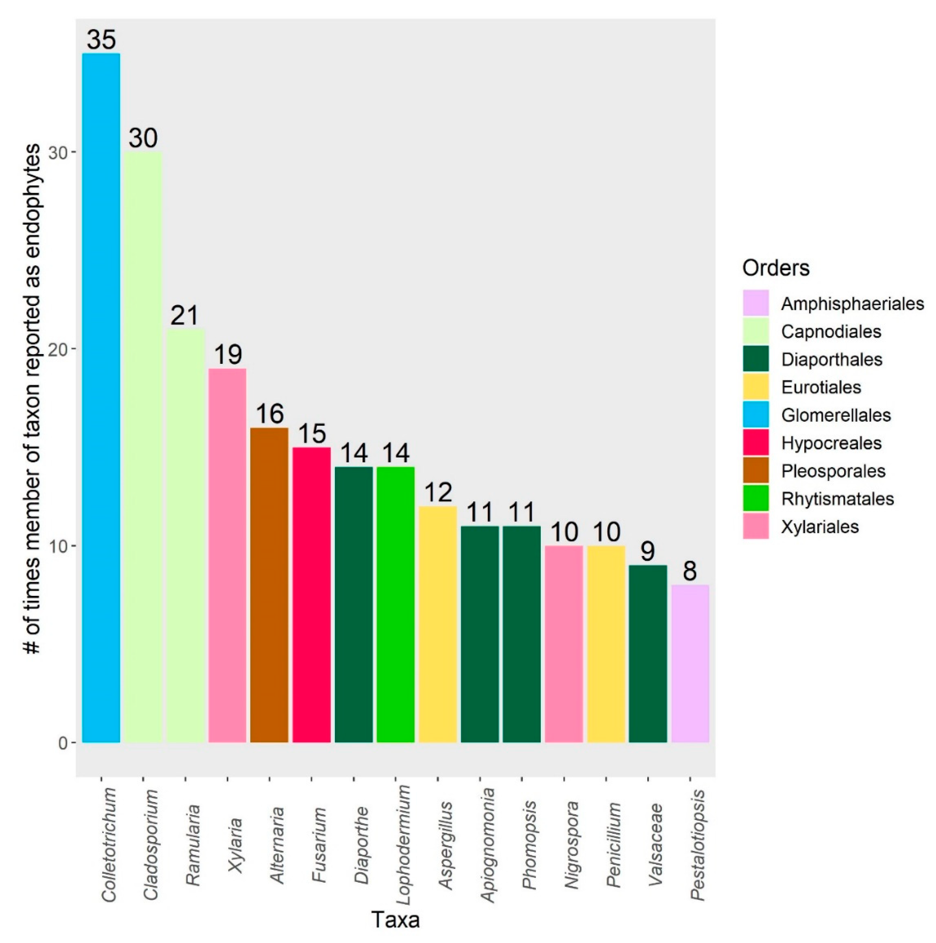
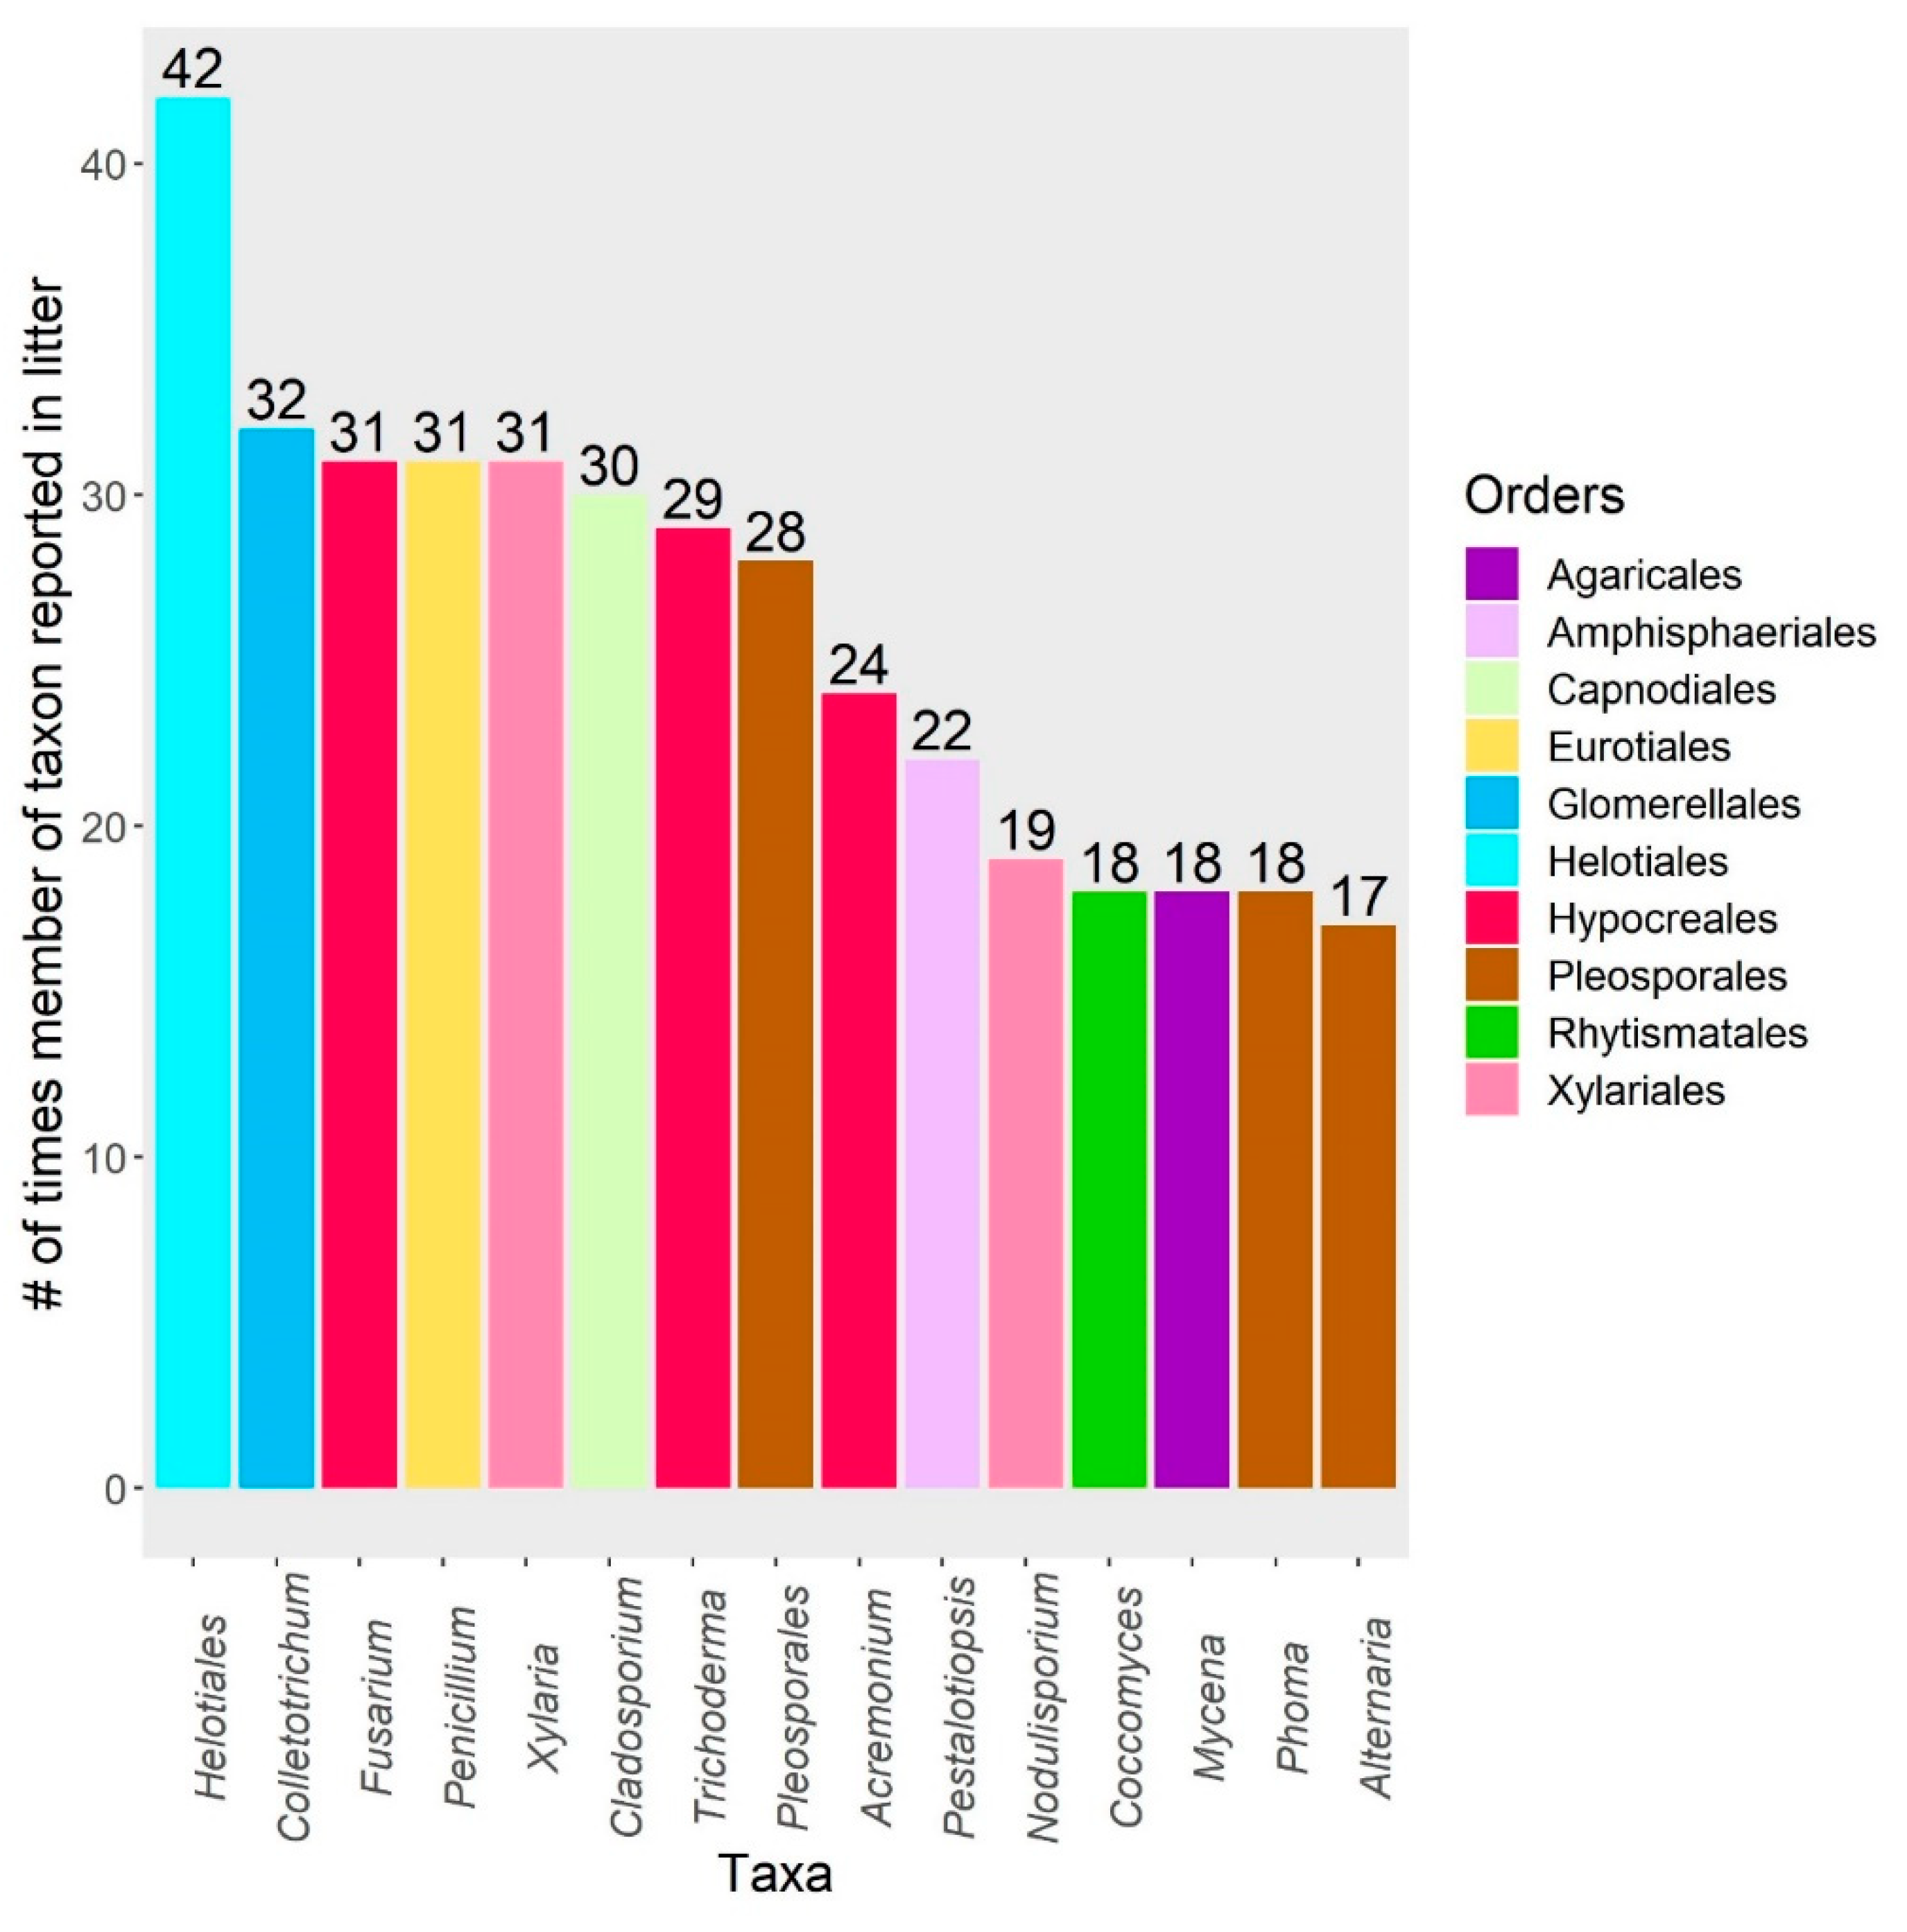
Common endophytic taxa vs common leaf litter taxa

Slide 6
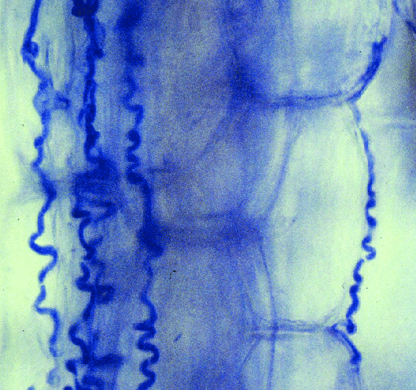
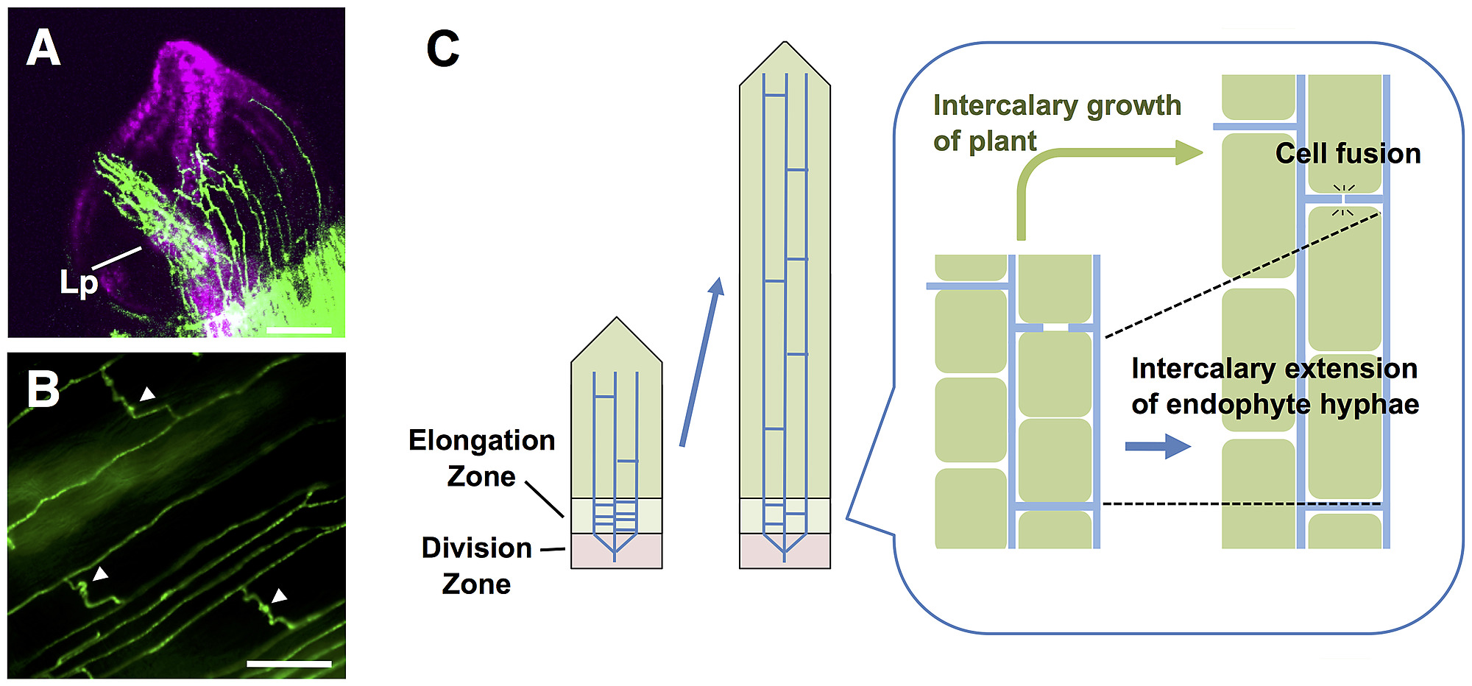
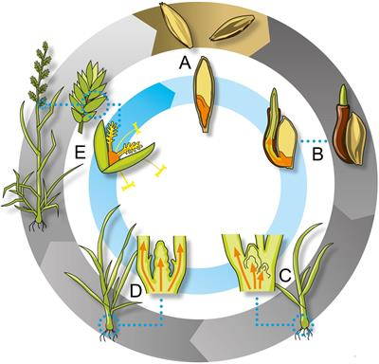
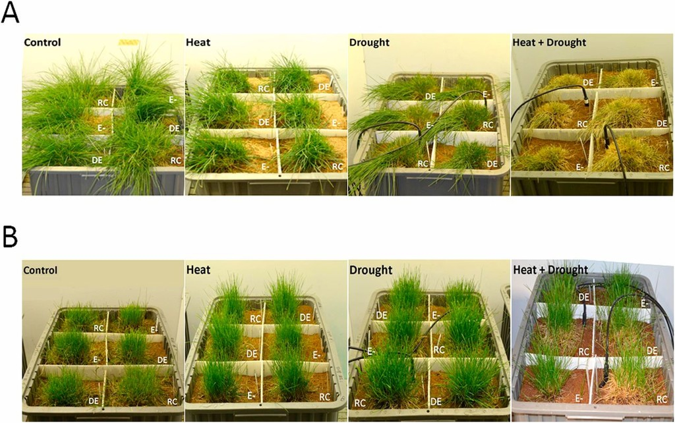
Endophytes in grasses: Epichloë
Transmitted to offspring in seeds
(vertical transmission)
A- No endophytes; B- Endophyte

Slide 7
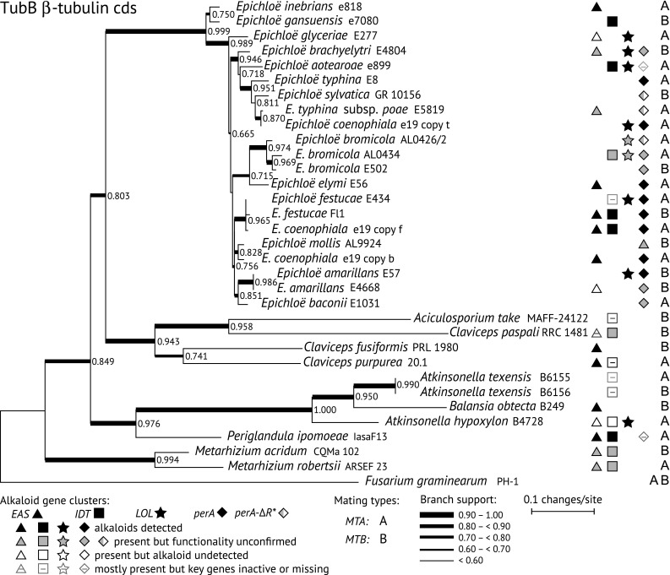
Epichloë phylogeny
Same/similar alkaloids as found in ergot (Claviceps purpurea)

Slide 8
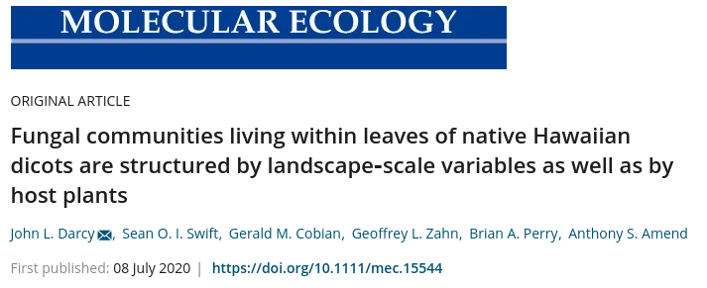
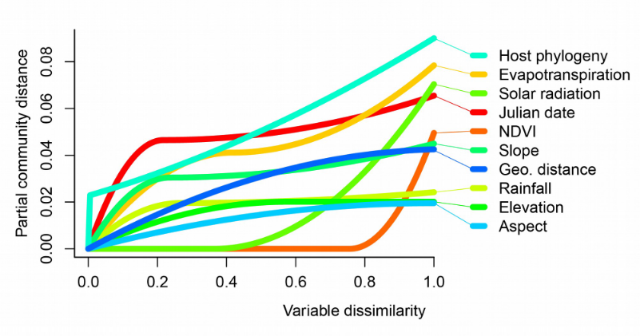
For dicots, what determines which endophytes they get?

Slide 9
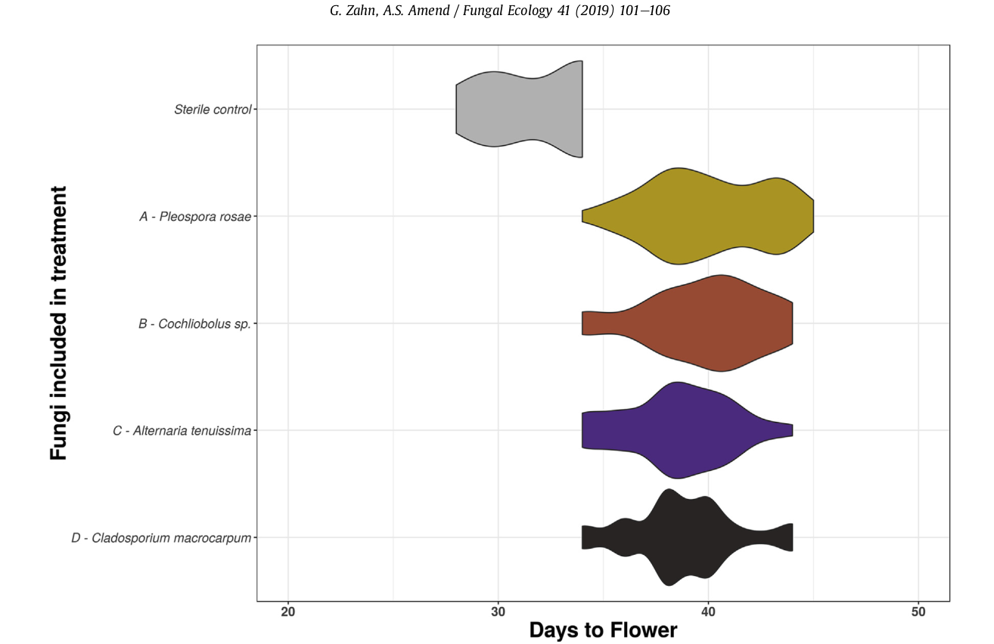
Some "plant traits" might actually be fungal endophyte traits... like flowering phenology, as seen in Arabidopsis thalliana.

Slide 10
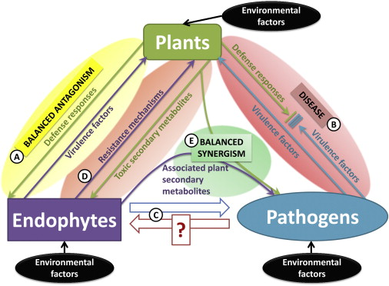
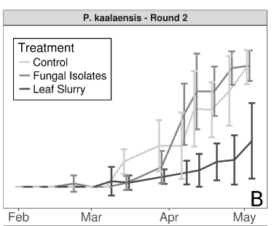
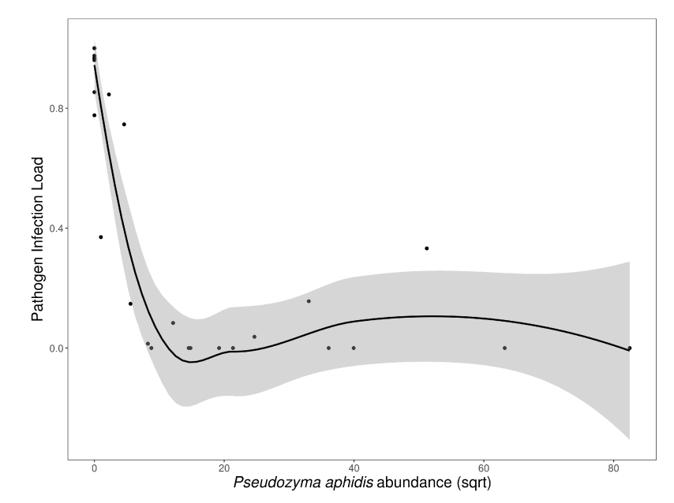
Sometimes, the story is simple... Usually it isn't.
Which endophytes are contributing to disease modification?
Synergistic effects
Arrival order
Host genotype
Environmental modifiers
Rare example of a simple, obvious answer:
Zahn and Amend, 2017

Slide 11
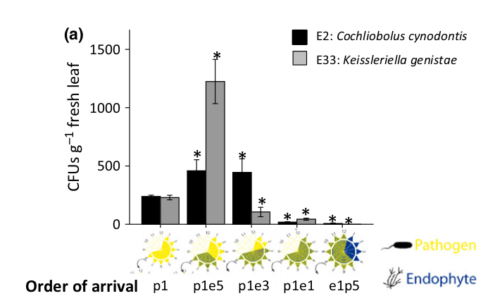
Disease modification is context-dependent!
In this case, if pathogen got there first, disease was made worse by the endophyte. If endophyte got there first, disase was nearly prevented entirely.

Slide 12
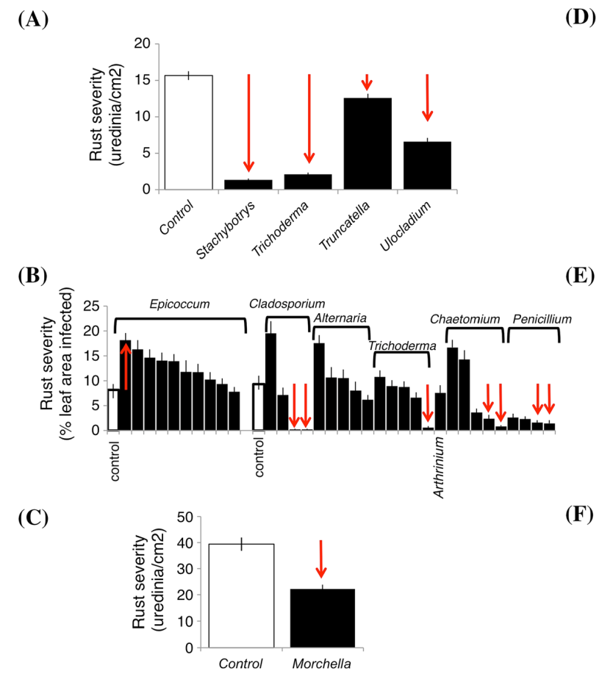
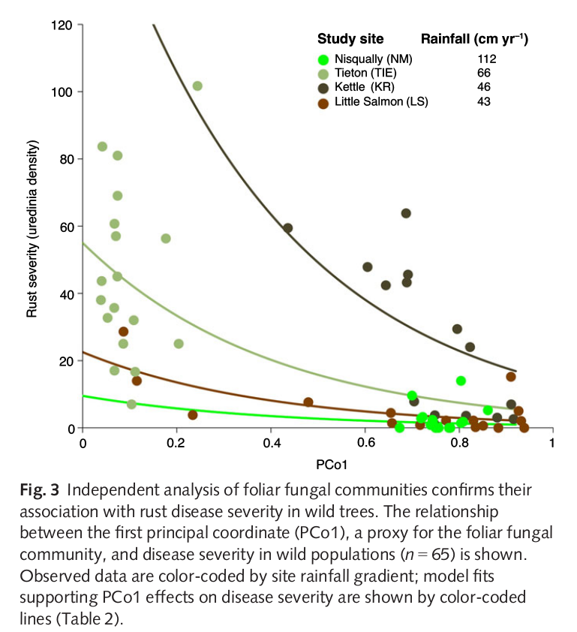
Fungal endophytes as modifiers of plant disease
Busby et al., 2015

Slide 13
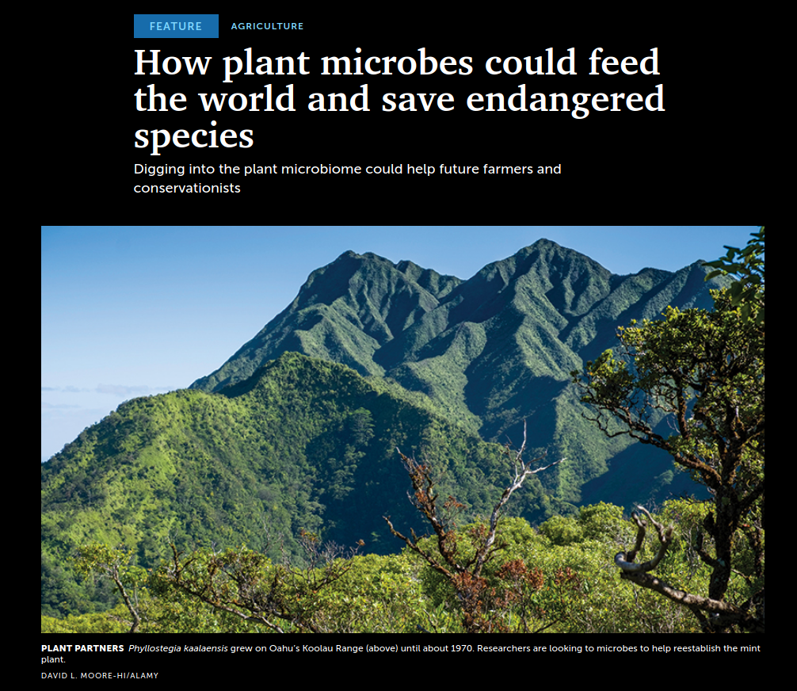
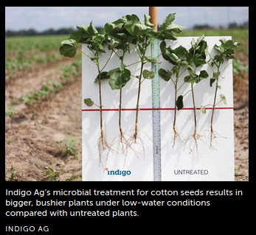
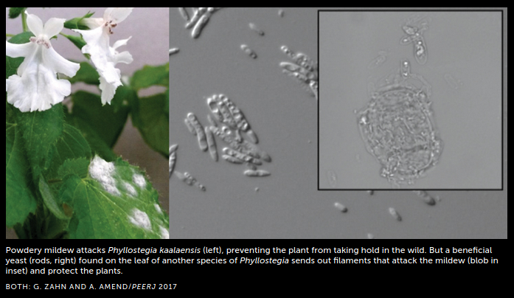
The new frontier: harnessing endophytes
Loophole in the disease triangle?
Reduction of pesticide use?
Improved conservation of endangered plants?

Slide 14
Assignments
1. Read Christian, et al., 2017
- This is a look at how endophytes affect plant disease in a real system
2. You will have a Canvas quiz on the assigned reading and will also have to participate in a Slack discussion about it.
3. Keep working on your lab assignments

