Slide 1
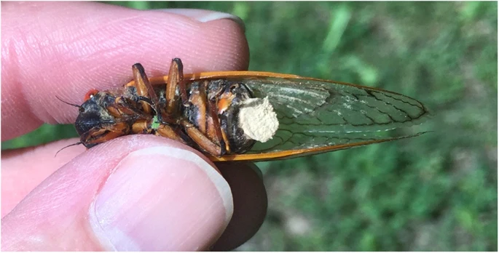
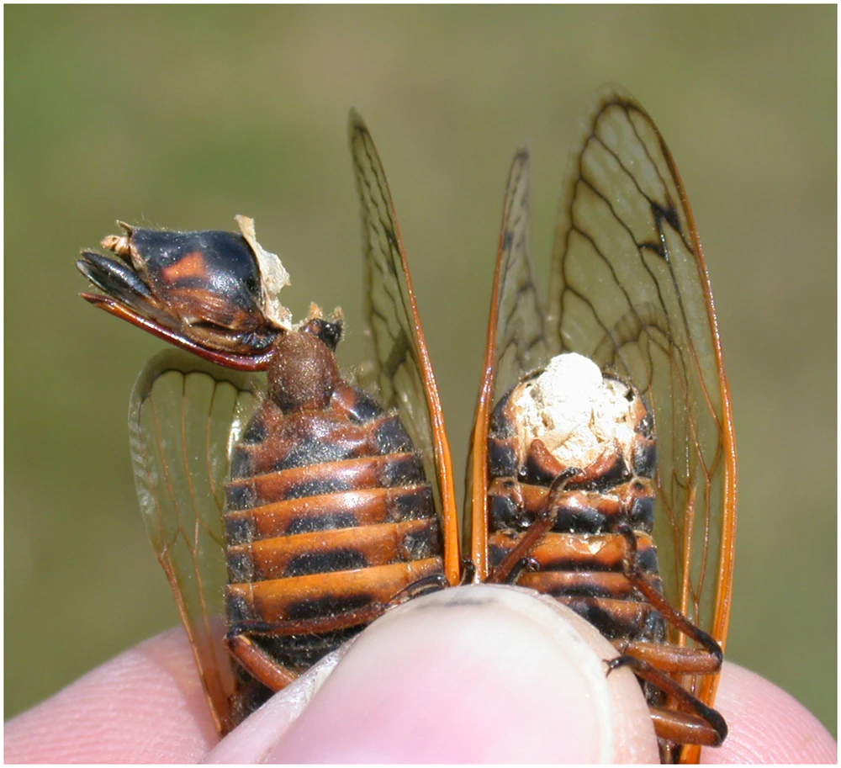
Storytime:
Fungi and ecosystems
Topics (just the very basics):
- Just interesting fungus stuff

Slide 2
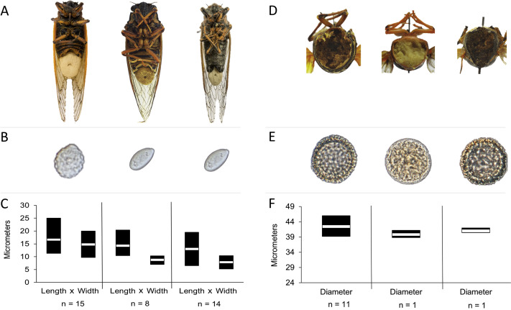
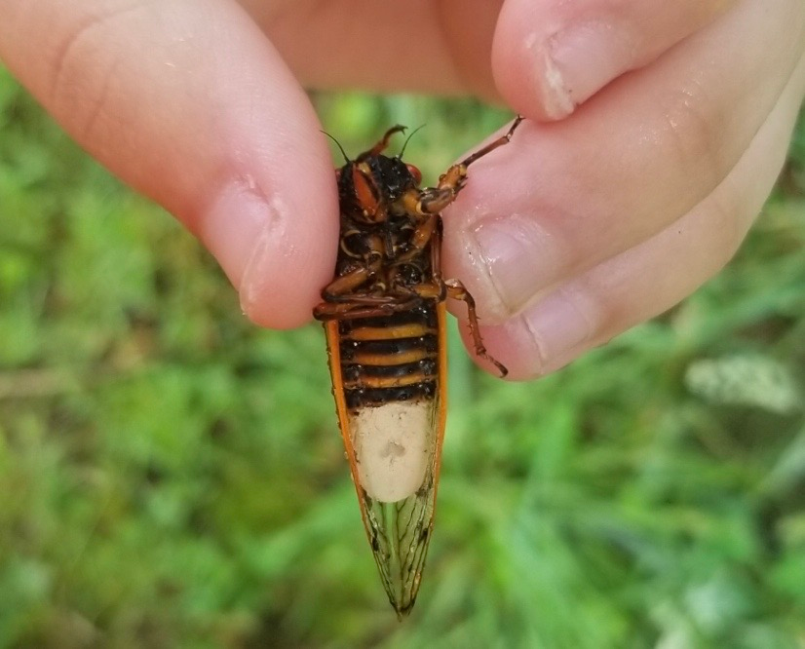
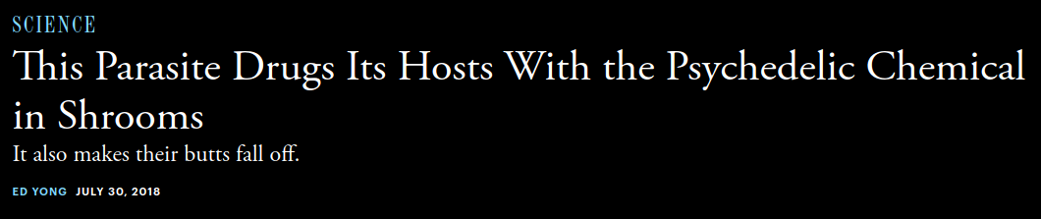
Infected cicadas behave strangely. Despite their horrific injuries, males become hyperactive and hypersexual. They frenetically try to mate with anything they can find, including with other males. They’ll even mimic the wing-flicking signals of females to lure males toward them. None of this does them any good—their genitals have either been devoured by the fungus or have fallen off with the rest of their butts. Instead, this behavior only benefits the fungus, allowing its spores to find new hosts.

Slide 3
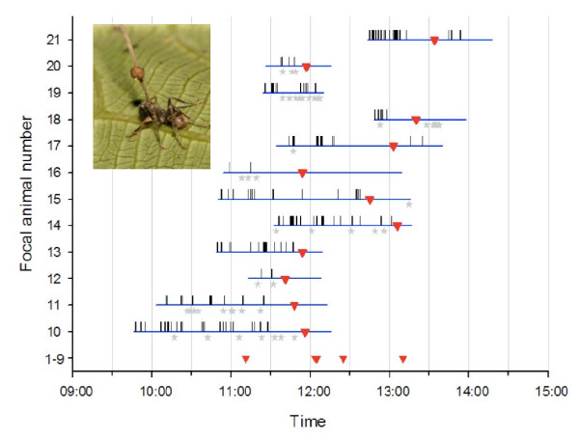
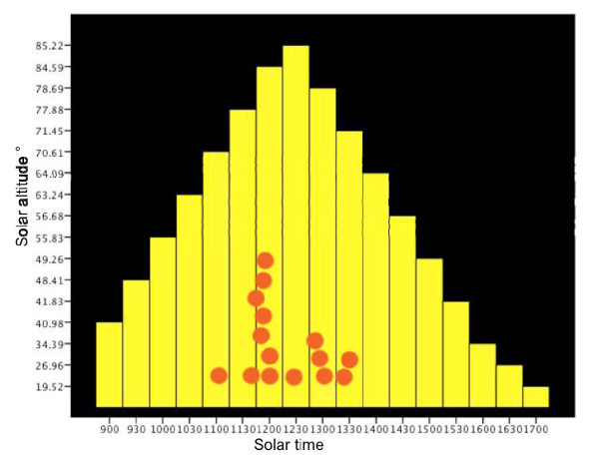
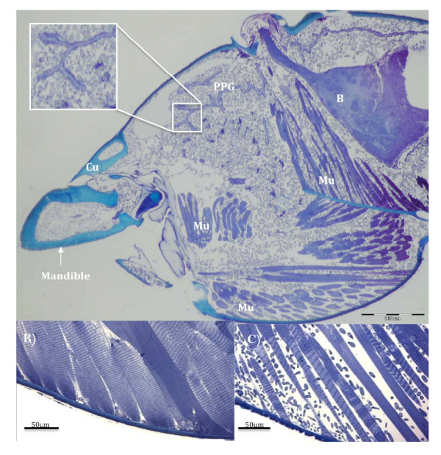
The blue horizontal bars mark the observation period, the red triangles mark moment of biting, the vertical bars mark spasm events and the grey stars the falling off events.
Heads of manipulated ants colonized by fungi. A (top panel) is a light micrograph (LM) saggital section through the head of an O. unilateralis s.l infected ant that was biting a leaf at the moment of fixation (i.e. alive). The small grey blobs are fungal hyphal bodies that fill the head and mandibles. Note the spacing between the muscle fibers. The insect shows a close up of hyphal bodies around the post-pharyngeal gland (PPG). B is the brain, Mu, Muscles and Cu is cuticle. B) is a LM of healthy muscle and C) is a LM of muscle from a behaviorally manipulated ant that was biting a leaf and alive when removed for fixation. The small blobs between the fibers are fungal cells.

Slide 4
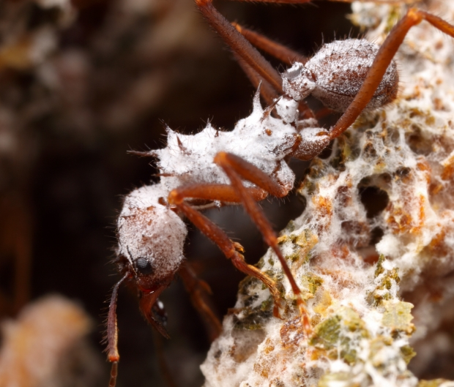
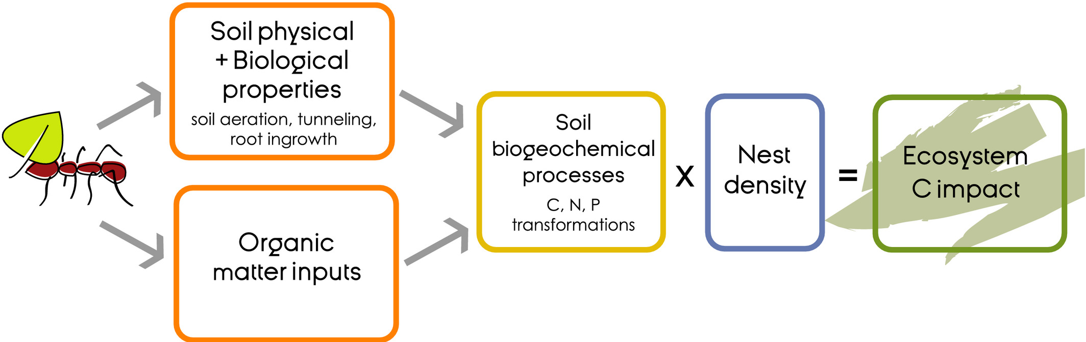
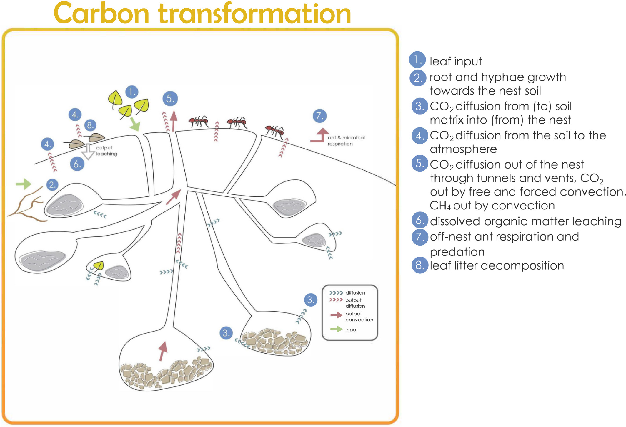

Slide 5
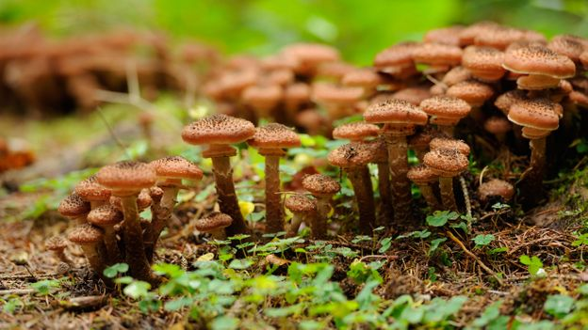
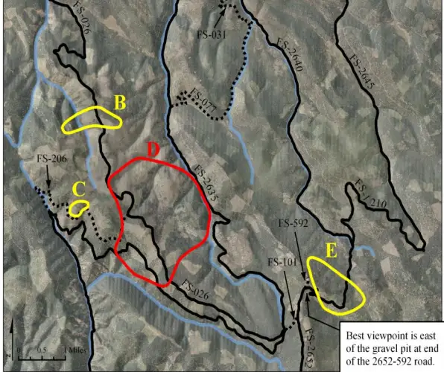
Largest organism on Earth: Armillaria ostoyae fungus parasitizing conifers in Orgeon
2,400 years old
2,384 acres in size
~200 tons of fungal biomass

Slide 6
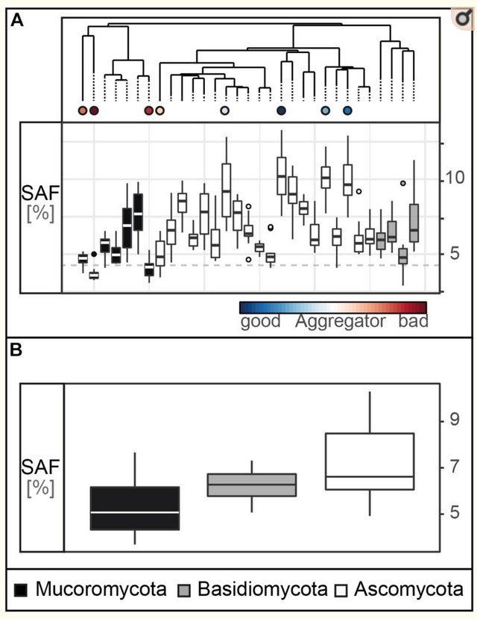
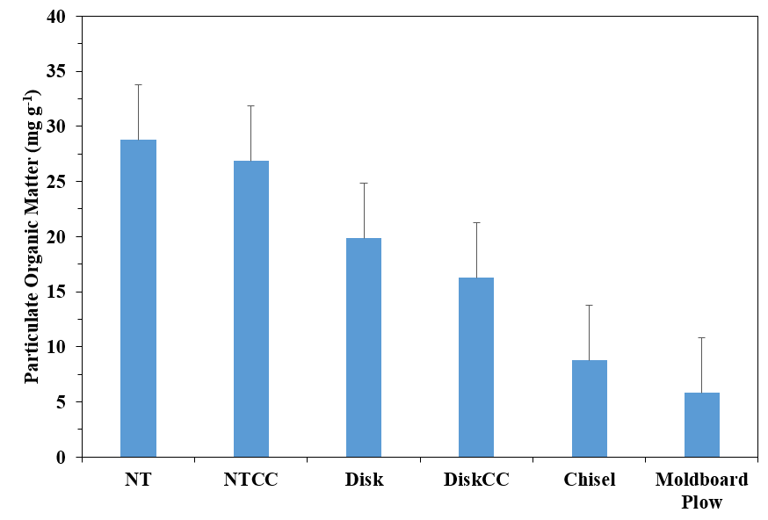
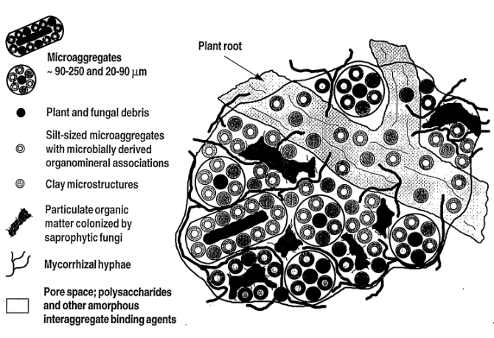
Soil structure strongly affects C storage
Fungal traits strongly affect soil structure

Slide 8
Soil structure strongly affects C storage
Fungal traits strongly affect soil structure

Slide 9
Soil structure strongly affects C storage
Fungal traits strongly affect soil structure

