Slide 1
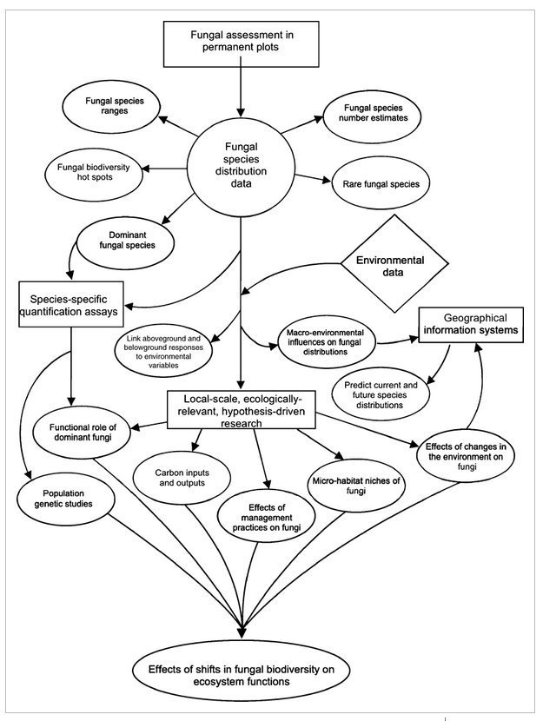
Fungal distributions
Topics (just the very basics):
- Where are fungi found and how do they get around?
- Do they have biogeographic patterns?
- Baas-Becking, moderate endemism, strong biogeography
- Dispersal vs environmental limitations
- The future of fungal distributions and why we might care

Slide 2
"Everything is everywhere, but, the environment selects..."
-- Baas-Becking and Beijerinck
"There are lots of cosmopolitan fungi, but plenty that have restricted geographies..."
-- Moderate endemism model
"The distributions of most fungi reflect the same major dispersal barriers (e.g. oceans and mountains) that drive vicariance events in other organisms..."
-- Strong biogeogrpahy

Slide 3
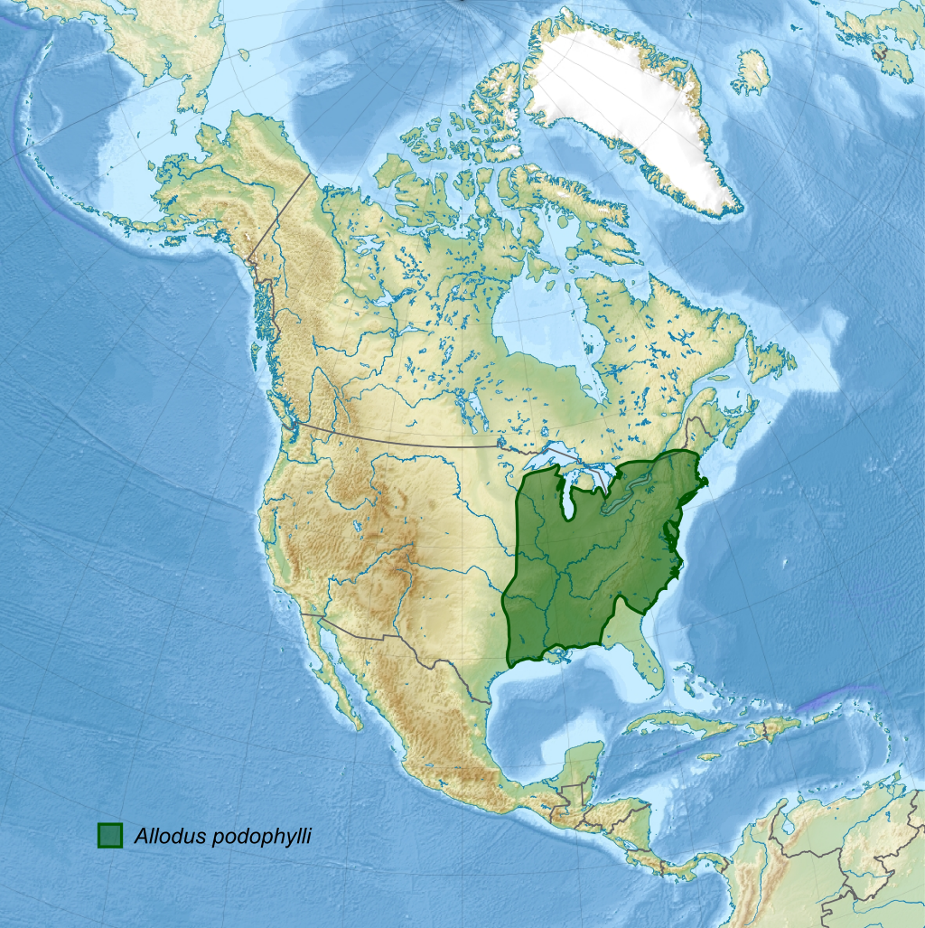
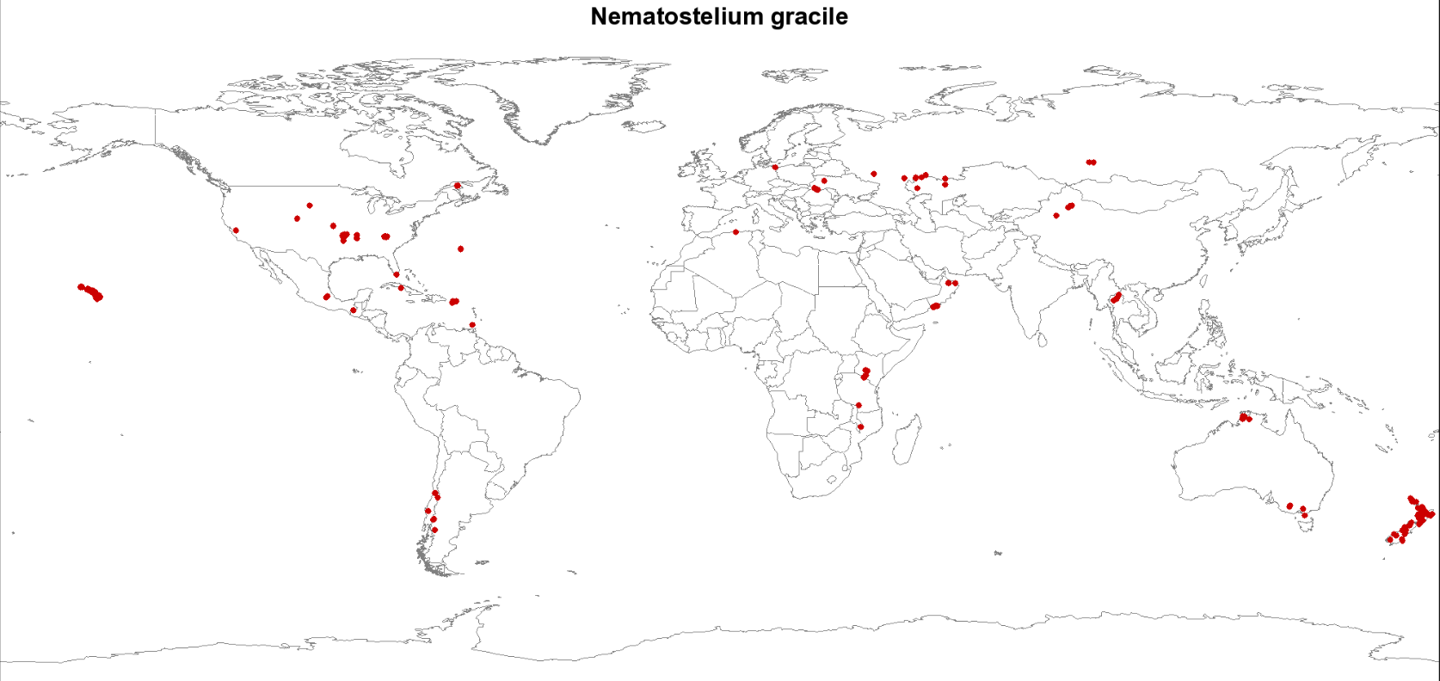
Which hypothesis best explains each of these maps?

Slide 4
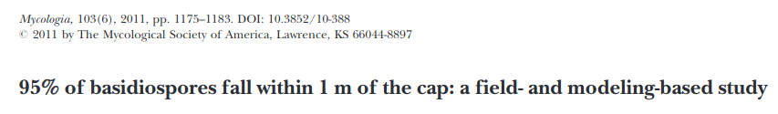
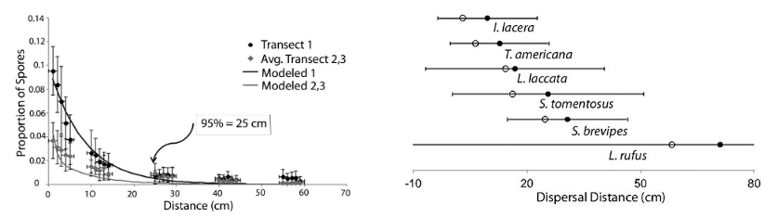
Potential dispersal barriers
Lack of vectors (wind, water, animals, etc.)
Mountain ranges
Oceans
Deserts

Slide 5
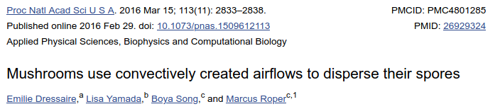
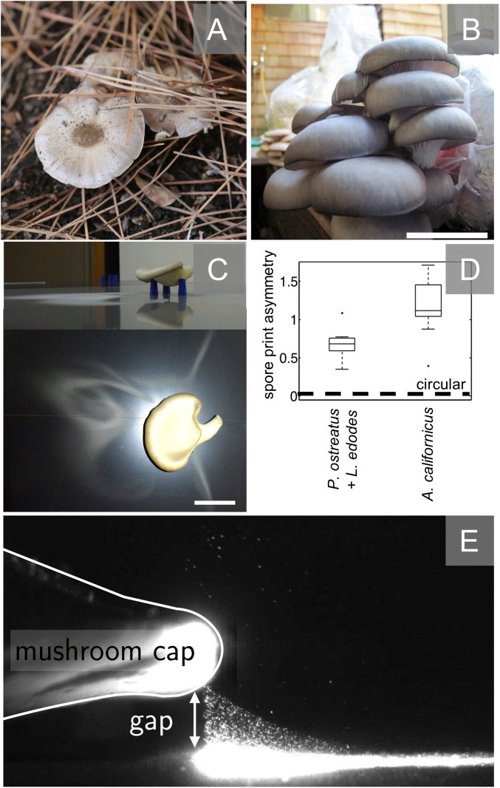
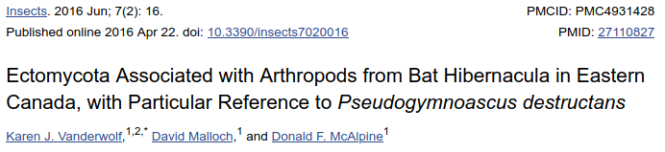
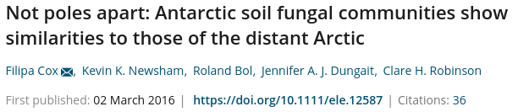
Potential dispersal helpers
Wind
Insects
Birds
Water
Humans

Slide 6
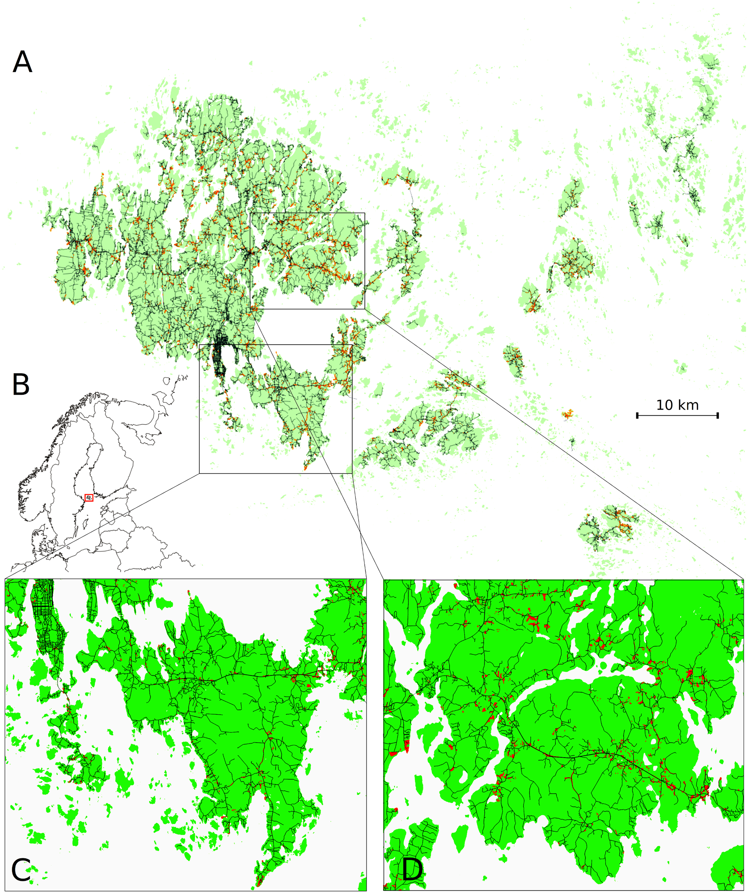
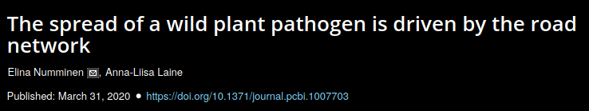

Slide 7
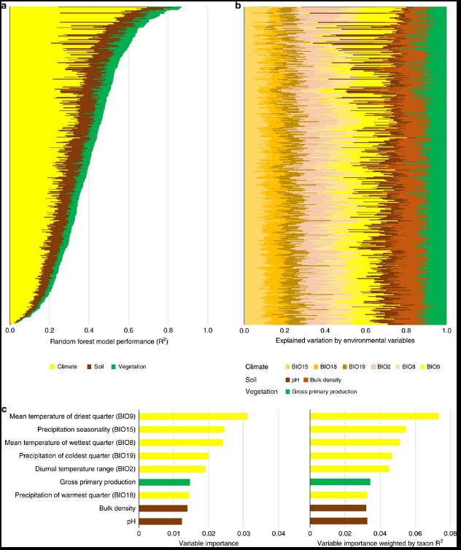
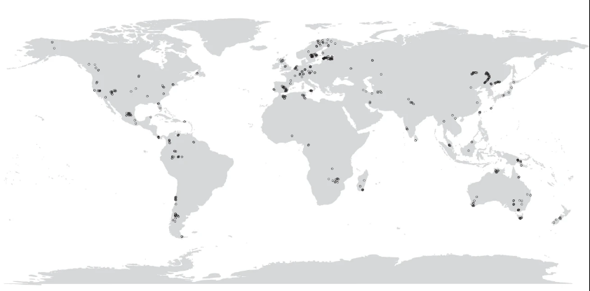
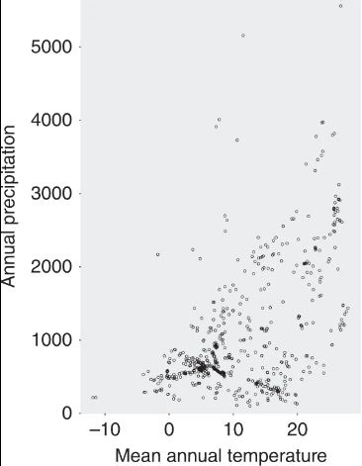
Tomáš Větrovský, et al., 2019

Slide 8
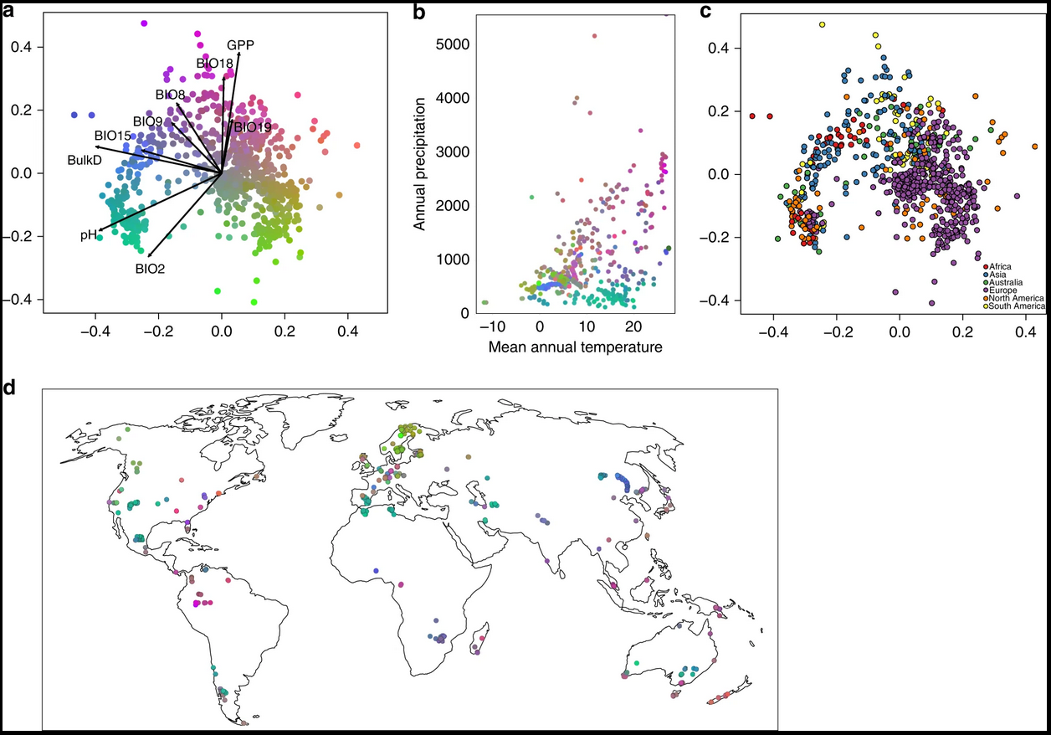
Tomáš Větrovský, et al., 2019

Slide 9
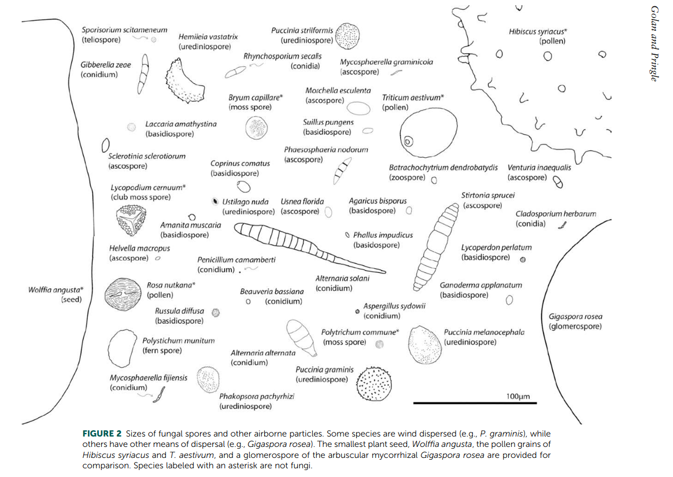
Maybe it just depends on the traits of each species...

Slide 10
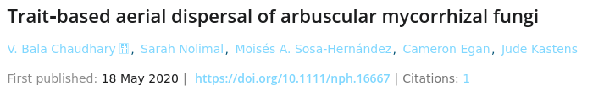
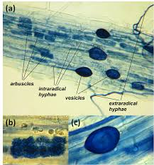
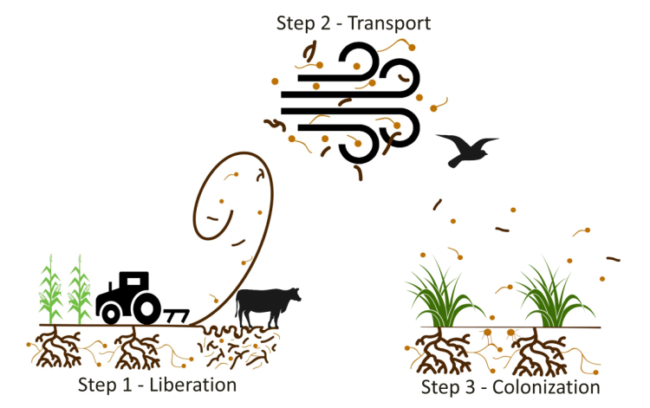
Chaudhary et al., 2020

Slide 11
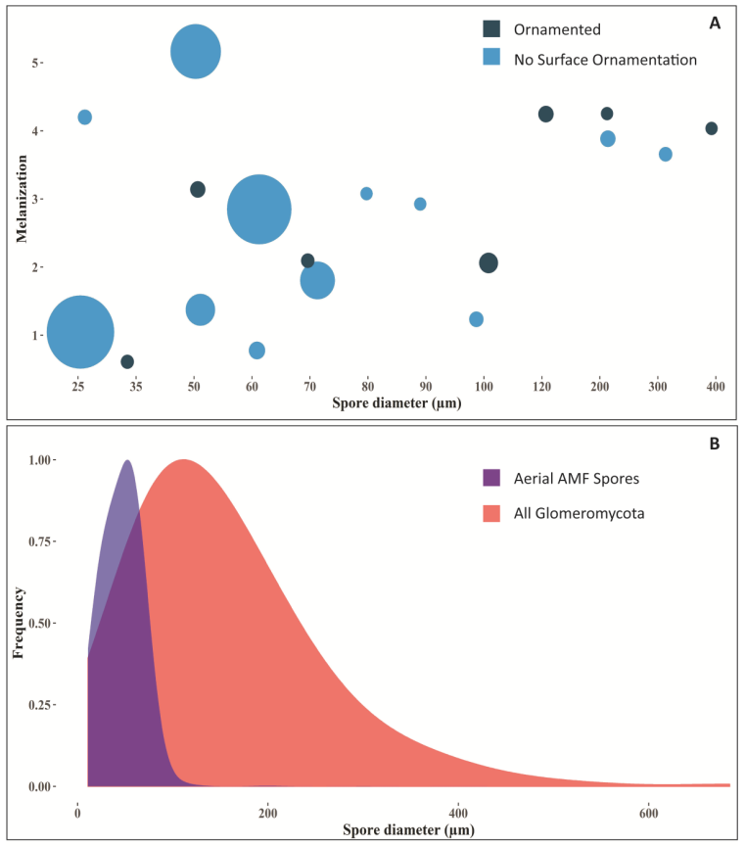
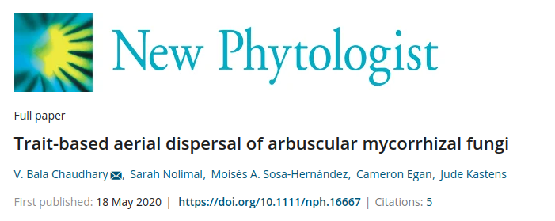
At 20 m elevation, airbourne AMF spores were smaller...
... but not more melanized or ornamented

Slide 12
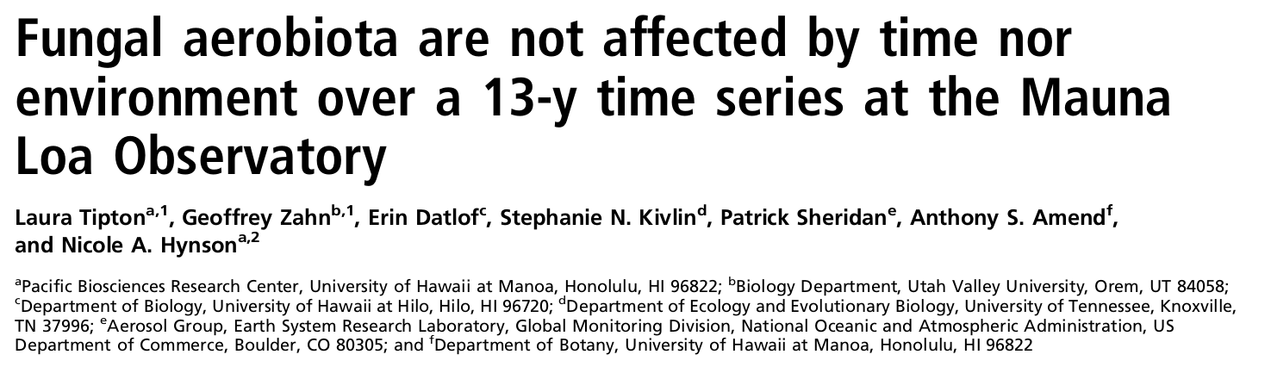
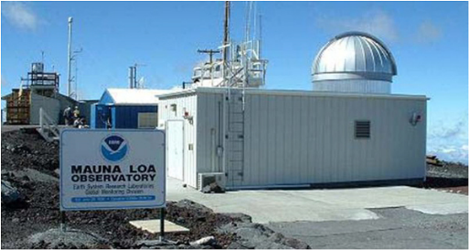
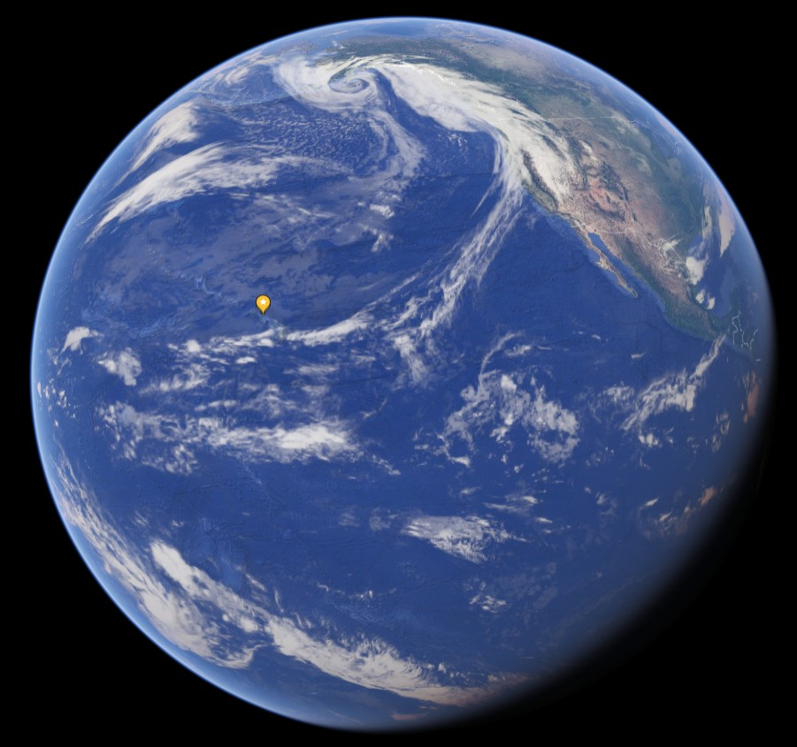
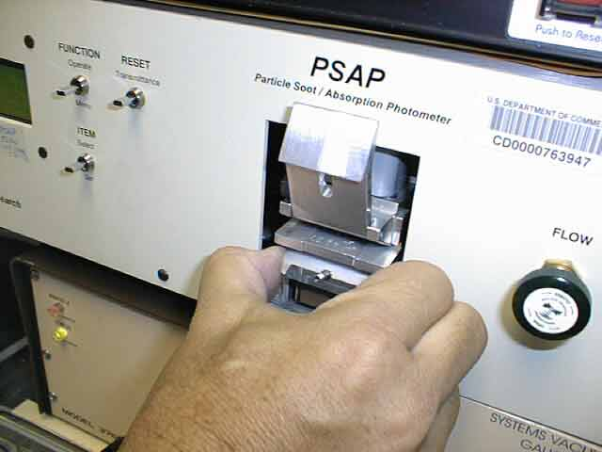
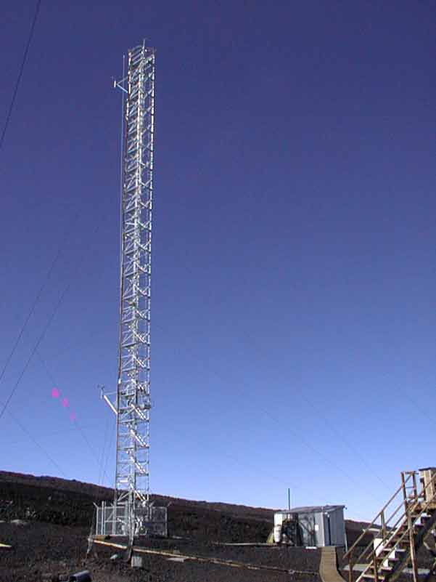
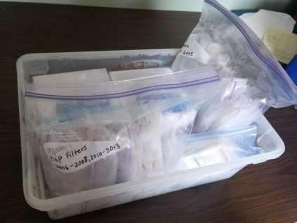

Slide 13
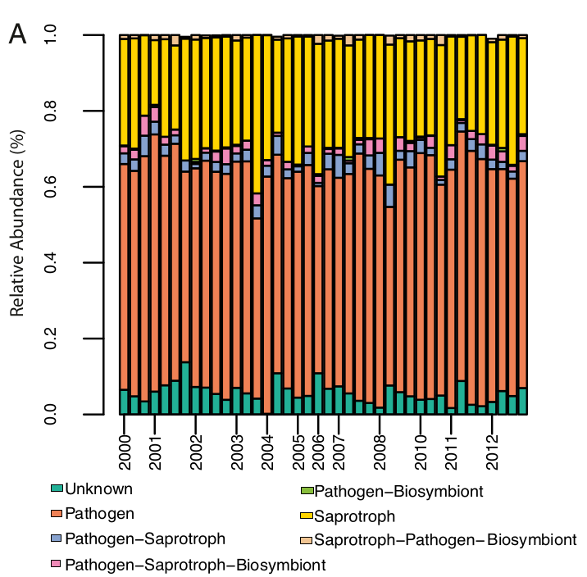

Slide 14
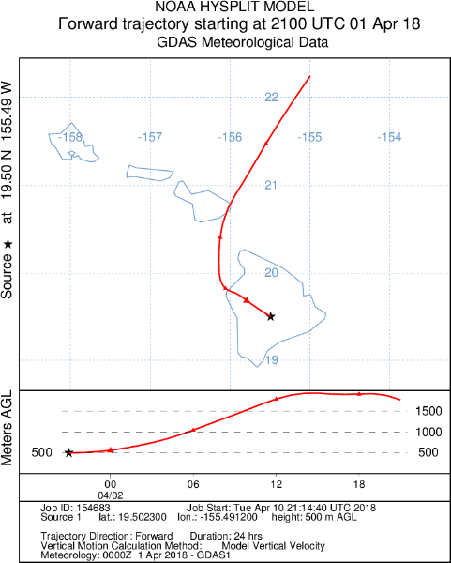
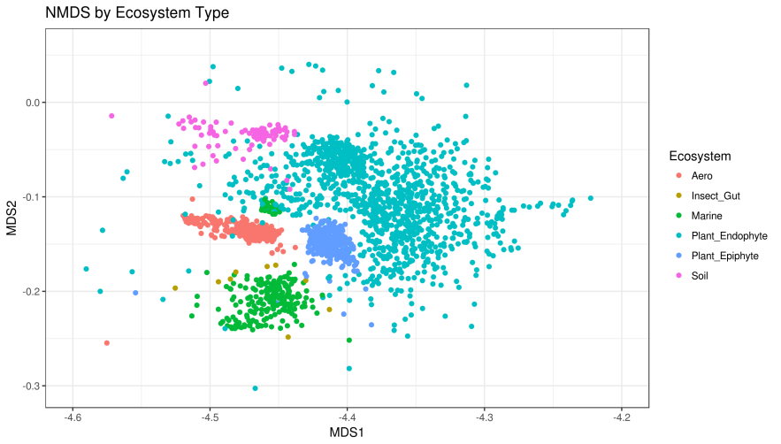
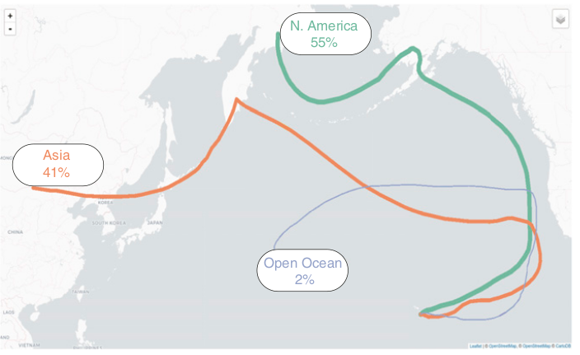
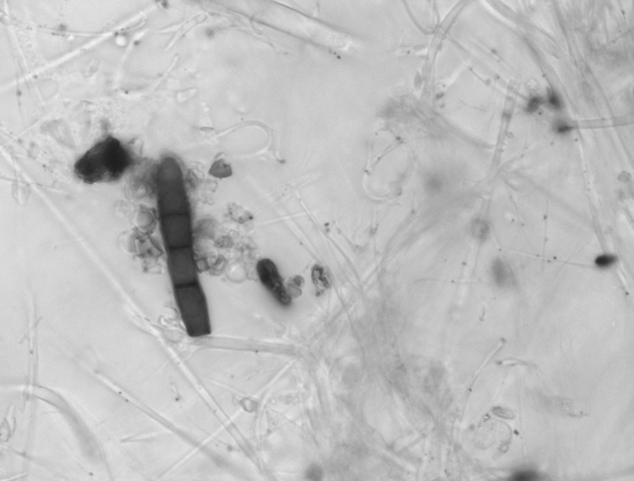
Backtracking fungal spores over last known land mass

Slide 15
We found absolutely no enrichment for size, color, shape, ornamentation, etc.

Slide 16
Assignments
1. Read Bacigalupe, et al., 2017
- This is a look at chytrid dispersal, climate change, and amphibians
2. You will have a Canvas quiz on the assigned reading and will also have to participate in a Slack discussion about it.
3. Keep working on your lab assignments

