Slide 1
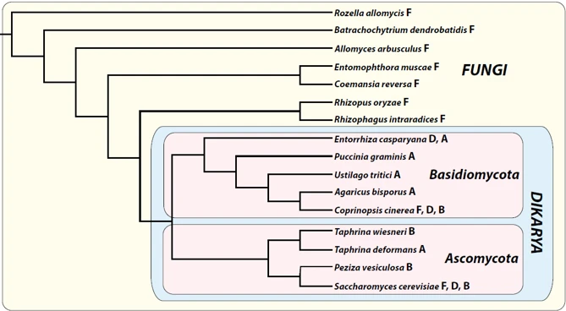
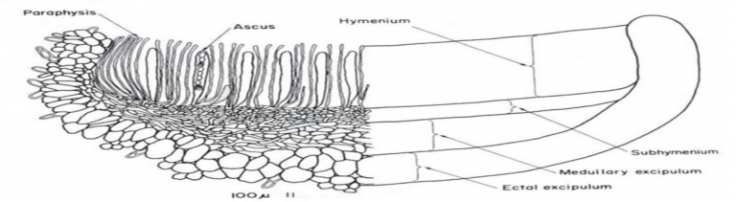
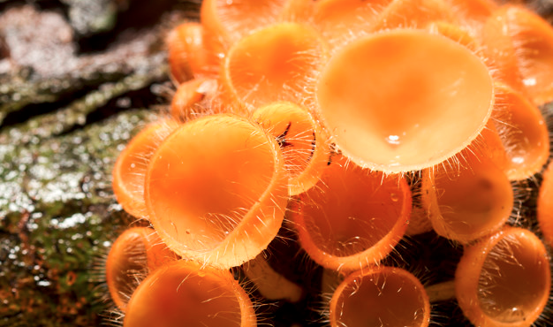
Ascomycetes and the limits of sex
Topics (just the very basics):
Ascomycetes
Characters
Phylogeny and evolution
Major groups
Life cycles
Ecology
The species concept in fungi
Dikaryotism
Closer look at several subgroups:
Saccharomycetales
Sordariales
Alternaria
Xylaria

Slide 2
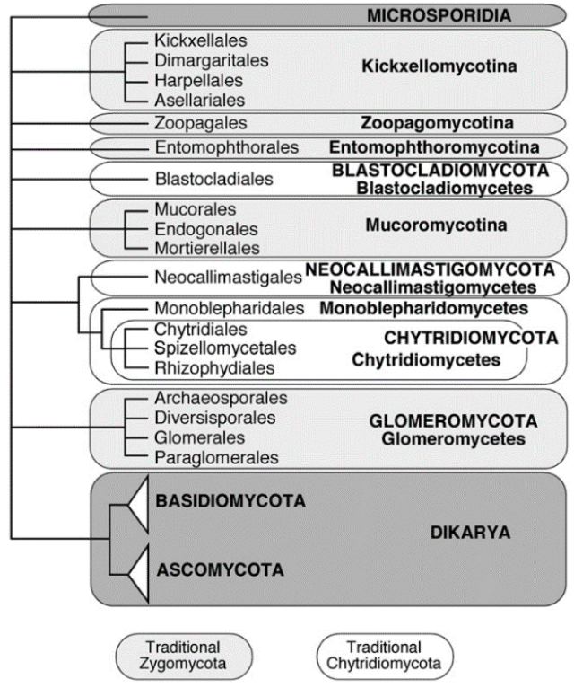
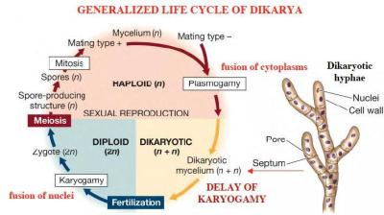
Dikarya
While there's still a degree of confusion about phylogenetic placement of the groups that tradiitionally have been known as Chytrids and Zygos, things are much more clear with the largest group of extant fungi known as Dikarya.
Dikarya:
- Composed of Ascomycetes and Basidiomycetes
- Named after "dikaryotic" genetic state (delayed karyogamy)
- Clearly monophyletic

Slide 3
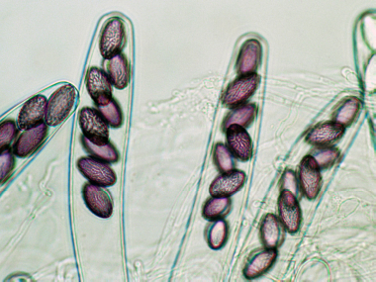
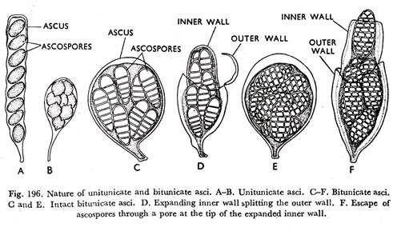
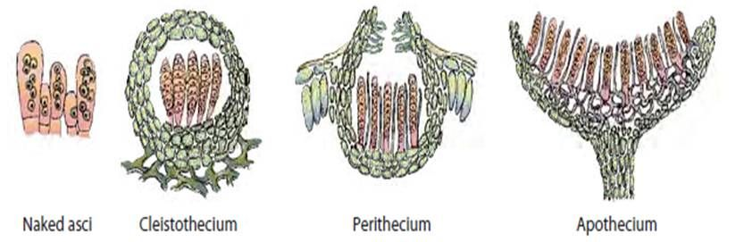
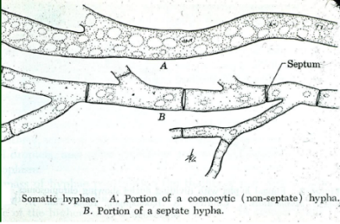
Ascomycota (the sac fungi)
Largest fungal phylum
Morphologically defined by presence of ascus (Plural: "asci")
Ascus means "sac" and contains spores
produced by sex/meiosis
Not ALL ascomycetes are known to undergo
sexual reproduction, so asci haven't been
observed in all species
Diversity of sexual macrostructures that house asci
Septate hyphae

Slide 4
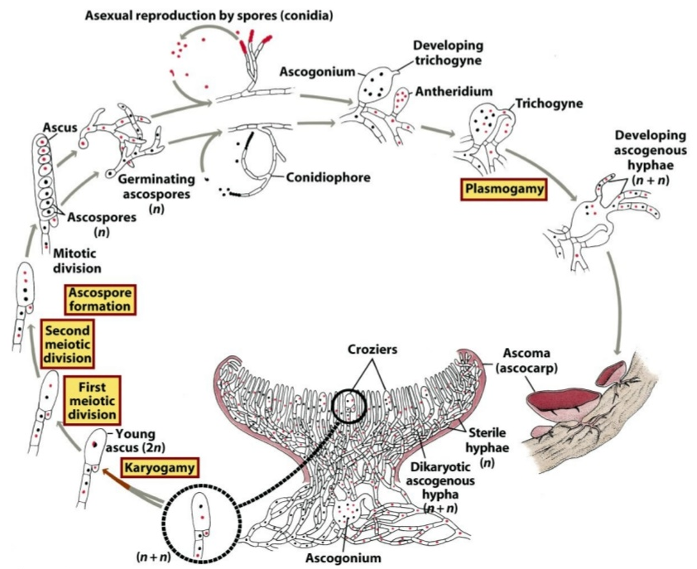
Ascomycota life cycle
Vast majority of fungal life cycle is spent in asexual reproduction!
Let's look at the life cycle.
Pay attention, because things in dikarya do something a bit weird...
Note the huge delay between
plasmogamy and karyogamy
When two compatible nuclei
are in the same cell, but do
not fuse to become diploid,
we call that "dikaryotic."
(n + n)
In dikarya, karyogamy only
takes place RIGHT BEFORE
meiosis.

Slide 5
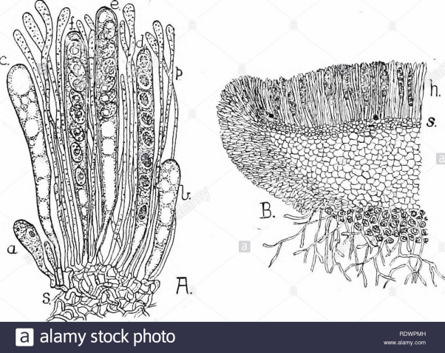
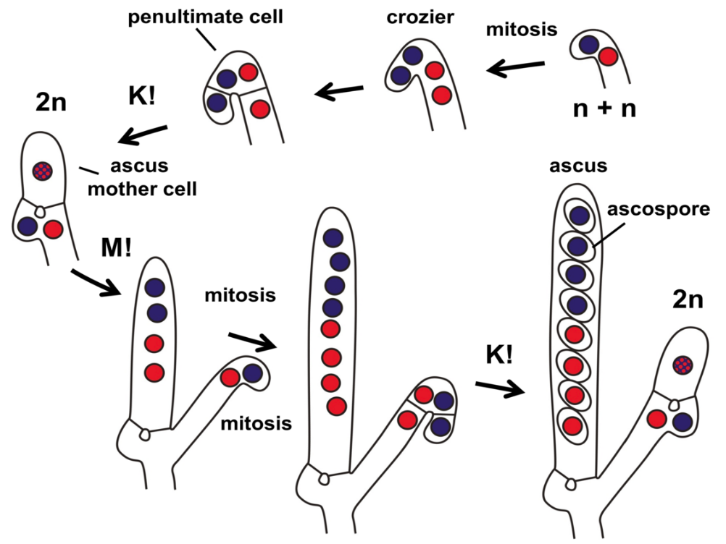
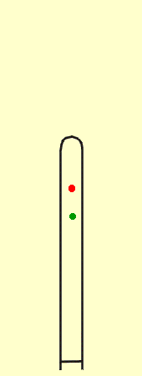
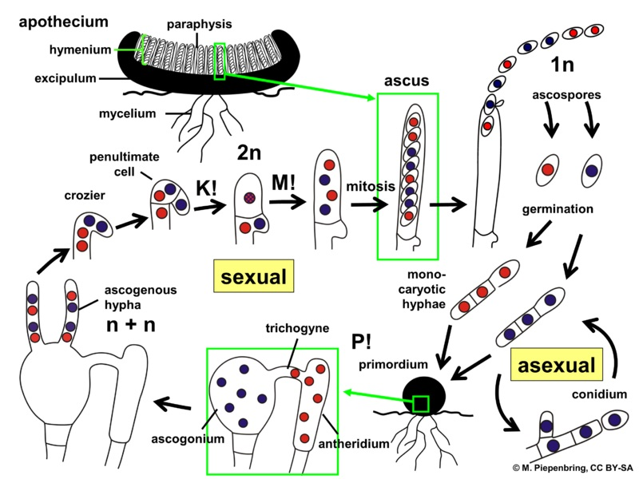
What goes on in an ascus?
lots of asci
ascus, zoomed in
Can you find karyogamy and meiosis?

Slide 6
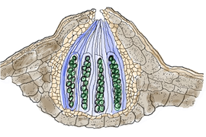
Terms so far:
Ascocarp - Macrostructure that houses all the asci (fruiting body)
Ascus - Sac that houses sexually produced spores
Ascospore - Sexual spore in ascomycetes
Hymenium - The "fertile" surface of a fruiting structure and only
place where asci are formed
When two compatible ascomycete hyphae come together for mating, one donates a nucleus and the other receives that nucleus...
Antheridium - The hyphal structure that donates a compatible nucleus
Ascogonium - The hyphal structure that receives a compatible nuclues
Conidium/Conidia - Asexually (via mitosis) produced spore(s)

Slide 7
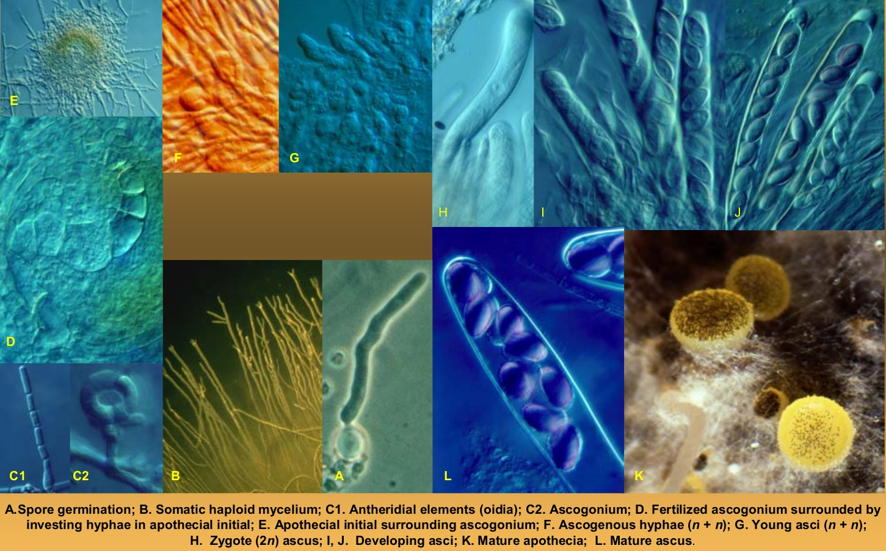
Ascomycete life cycle featuring real micrographs

Slide 8
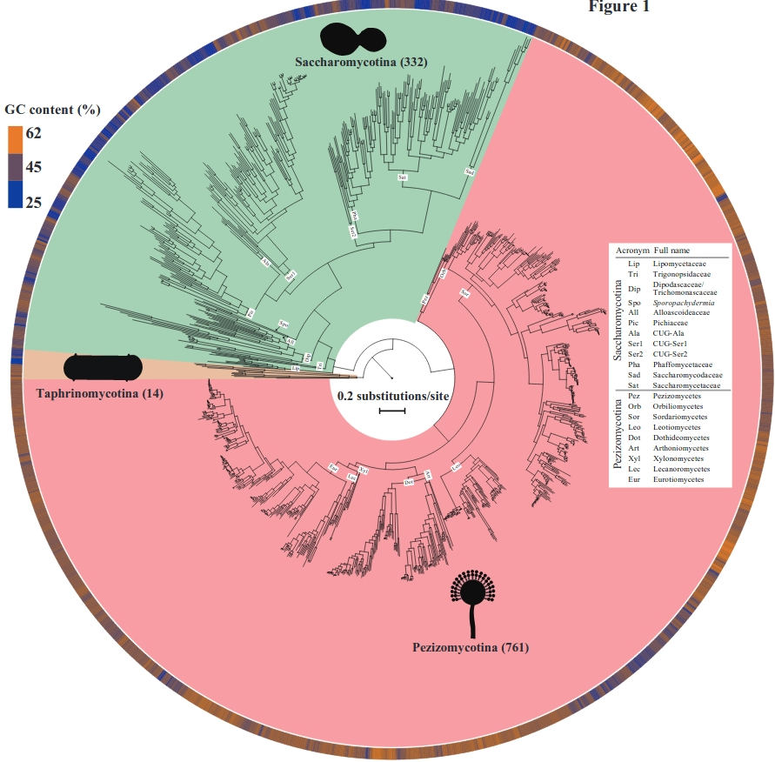
Ascomycetes can be categorized into 3 major well-supported groups
Taphrinomycotina
- Basal to the other 2 groups
- Used to be called Hemiascomycetes
- Contains "fizzion yeasts", weird dimorphic plant pathogens, and an important human pathogen
Saccharomycotina
- Contains most of the yeasts (budding)
- Many economically and environmentally important species
- Some basal species have retained hyphal growth
Pezizomycotina
- By far the largest ascomycete clade
- Almost all ascomycetes that make sporocarps are in this group
- Ecologically very diverse

Slide 9
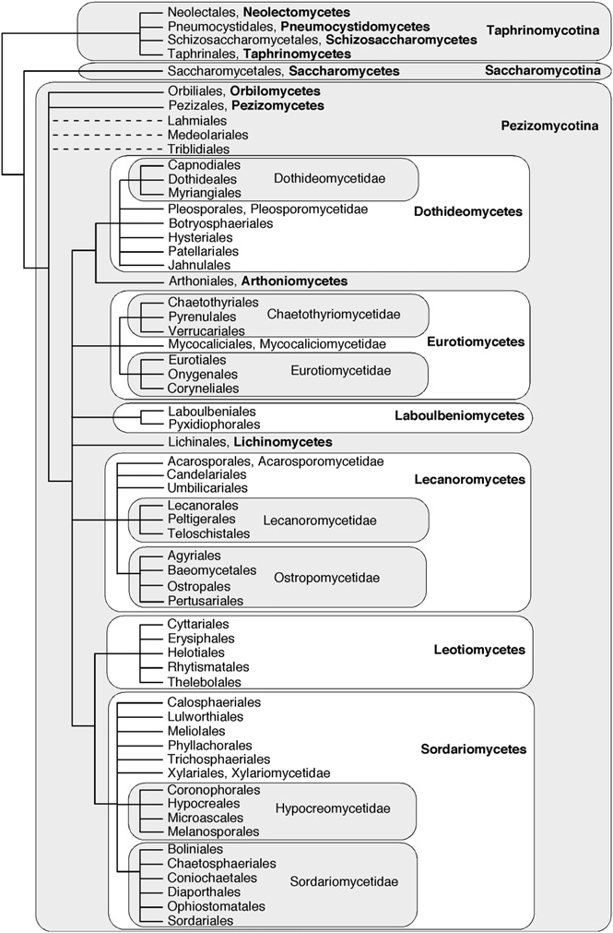
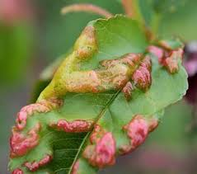
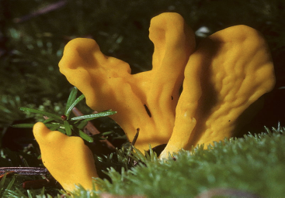
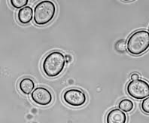

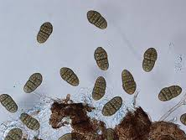
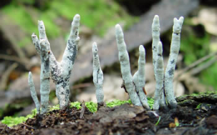
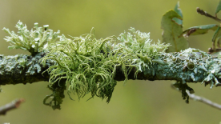
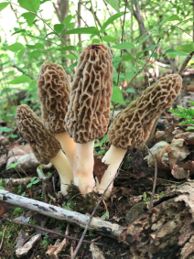
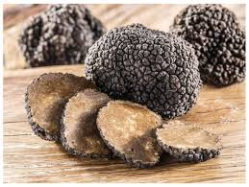
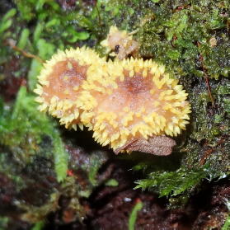
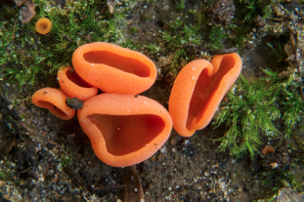
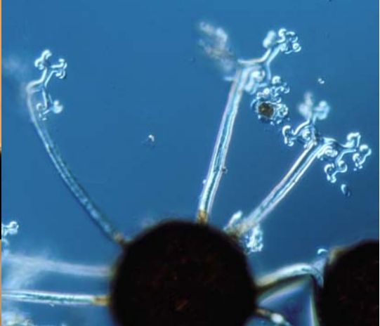
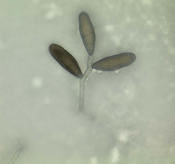

Slide 10
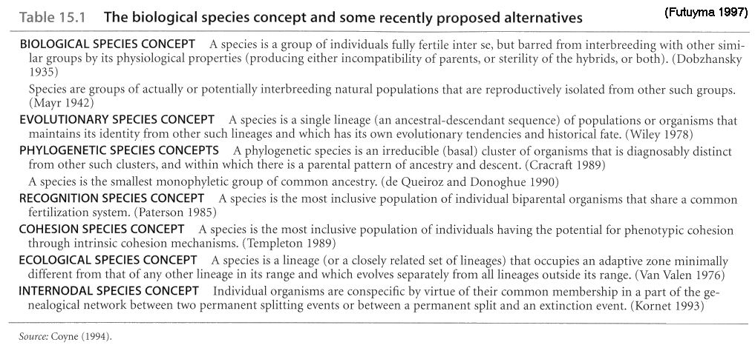
How do YOU define a species?
Seriously. Think about it...
Think about it even more for a while.

Slide 11
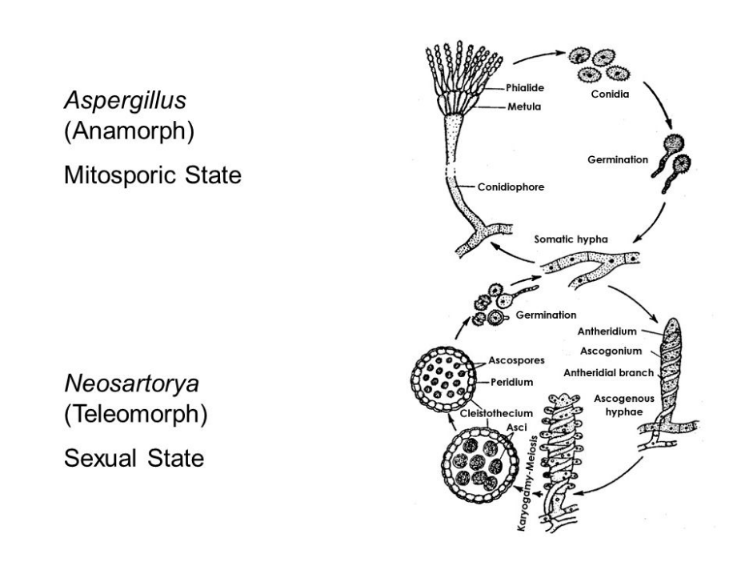
How would you define a species in a group like ascomycetes?
Lots of them seem to have lost the ability to undergo sexual reproduction.
Those that still can do sex/meiosis, it's a rather rare occurrence.
In the life cycle on the left, 99% of the time, the fungus is in the top loop.
...so, mycologists saw that structure and gave a name to the genus (Aspergillus)
...many moons later they saw the structure on the bottom loop and gave it a new genus name (Neosartorya) because it was a totally new group, right?!
Well, turns out using morphology of reproductive structures to define taxa wasn't maybe the best idea, given that nobody really knew that all these molds just had two different-looking life cycle parts.
Now, we have teleomorph names and anamorph names....

Slide 12
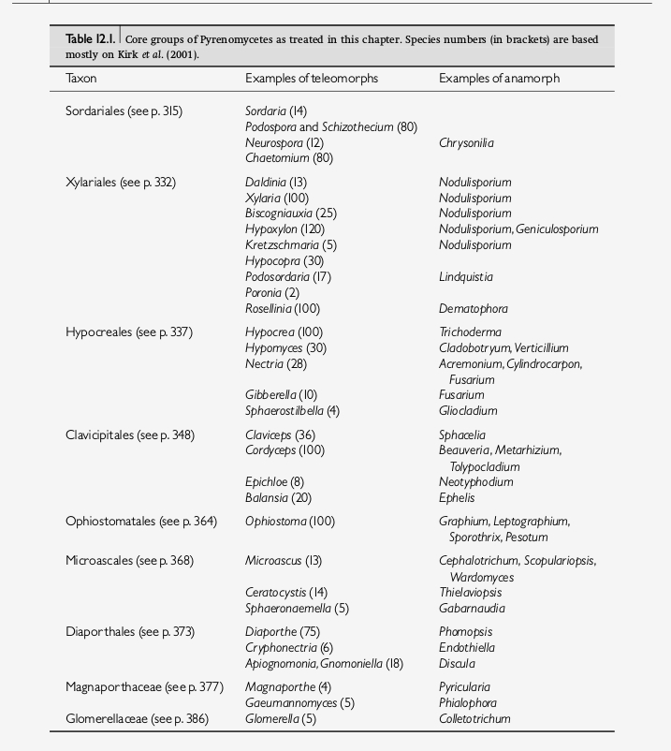
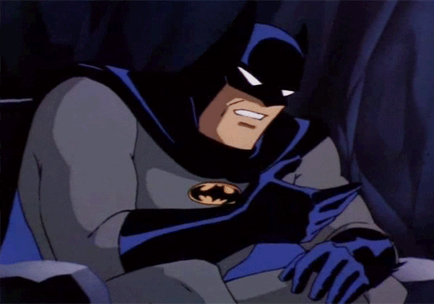
Here's a small example of the problem.
Multiple names for the same species!
People are still working on cleaning up this mess, but it's propagated errors all over the place and makes research rather annoying at times.

Slide 13
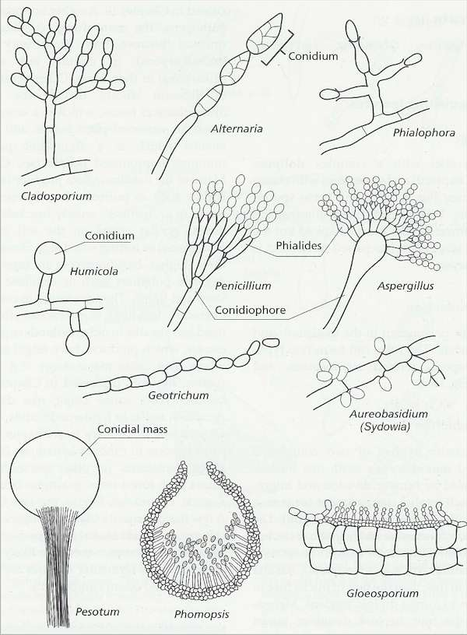
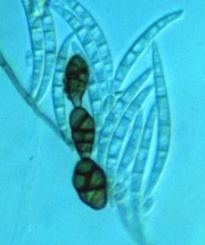
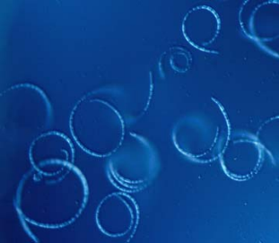
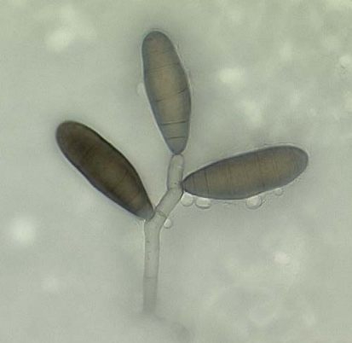
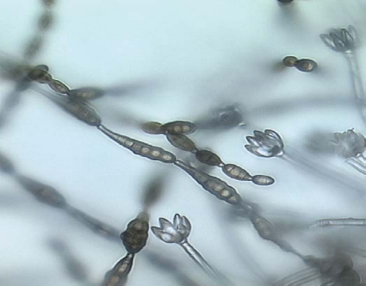
Thing is, not all ascomycetes have been discovered in a "teliomorph" state.
Sexual reproduction is ancestral to all extant eukaryotes, but a lot of ascomycetes have lost the ability (or they are just incredibly shy). So, we use molecular evidence and morphology of asexual structures to place them into the evolutionary tree.
Examples of asexual structures:
Examples of conidial diversity:

Slide 14
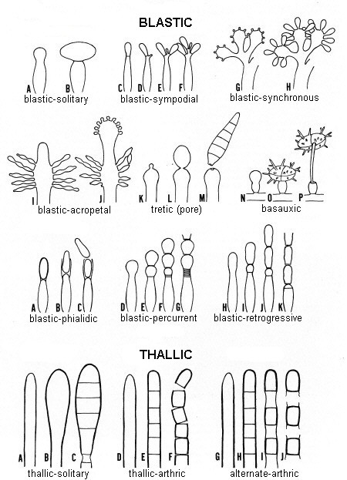
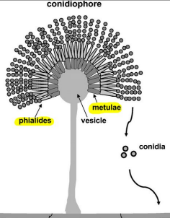


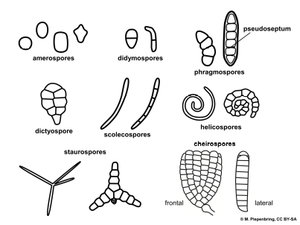
Conidia
Products of "mitosporic" reproduction
Several ways to reproduce clonally if you are hyphal...just break off a piece of hypha, and you're done! Or, make tiny, resistant, peices of hyphae and squeeze them out.
However you do it, it's just modified hyphae!
Blastic Thallic

Slide 15
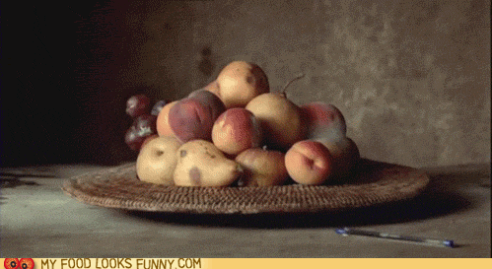
Asexual (clonal) reproduction is advantageous if conditions are favorable.
If you germinated somewhere and there's lots of food and moisture and you're happy, why would you want to roll the meiosis dice just to reproduce? Your offspring might very well not be happy there and then die. Better to just multiply yourself and enjoy life!

Slide 16
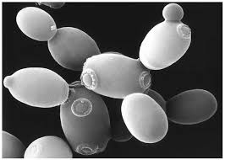
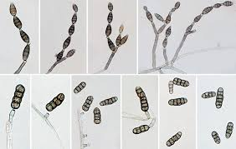
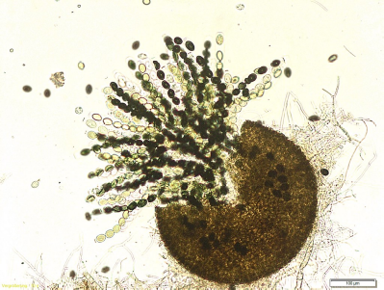
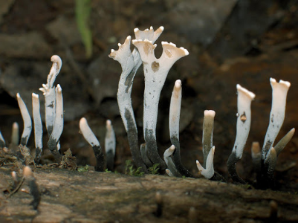
We're going to take a closer look at a few ascomycete groups and see how they fit into our concepts:
Saccharomyces Alternaria
Sordaria Xylaria

Slide 17
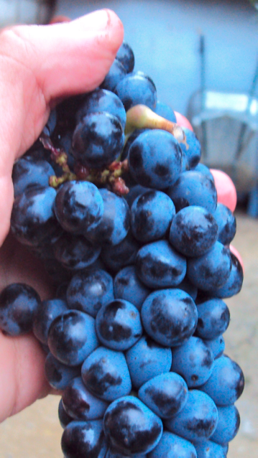
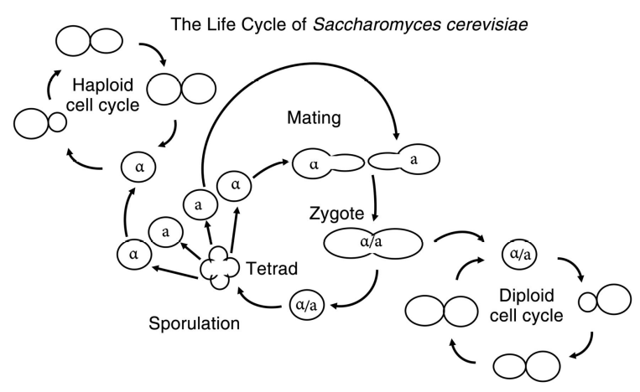
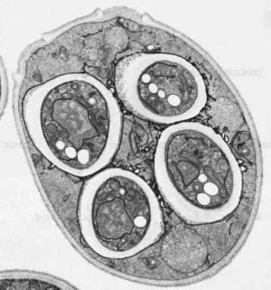
Saccharomyces cereviseae
(Brewer's/Baker's Yeast)
First domesticated microbe - responsible for civilization as we know it
First eukaryote to have a complete genome sequenced; main model organism for eukaryote genetics
Facultative anaerobe... when oxygen is low, it ferments glucose to ethanol and CO2
Often found in sugar-rich locations in nature
The dusty coating on every grape on Earth is Saccharomyces yeast
Ascus w/ 4 ascospores

Slide 18



Single genetic locus controls mating type (a or α)
Cells can actually switch mating type!
Like other dikarya, bulk of life history is hapoid
Can actually remain diploid for some time unlike most dikaryotic fungi

Slide 19

S. cereviseae is used as a model organism to study....almost everything.
Here's one example:
Net=18 ATP
Net=2 ATP
S. cereviseae can do respiration and fermentation
In the presence of oxygen, it would make sense to only use the respiration pathway as it increases energy yield per molecule of glocose. But if glucose concentrations are high enough, this yeast will still "choose" to undergo fermentation. Why?
Cancer biologists are using Game Theory and this little yeast to better understand metabolic trade-off strategies of tumor cells

Slide 20





Alternaria
Three species of Alternaria not known to have sexual states, have mating type gene sequences.
Species in this genus have diverse ecological roles:
Animal Pathogens, Endophytes, Plant Pathogens, and Wood Saprotrophs
Typically, no known teleomorph stages, but A. infectorium (an opportunistic human pathogen) has well-known teleomorph identity in Pleospora
See this link
most commonly found as plant pathogens

Slide 21





Sordaria
Used as a model of genetic crossing during meiosis and for mapping linked genes.
Asci with spore-color mutants
Perithecia on dead grass

Slide 22







Xylaria
Asexual
Sexual
typical anamorph

Slide 23
So, how do Ascomycetes fit into our picture of fungal evolution, morphology, physiology, diversity, and ecology?
Evolution -
Morphology -
Physiology -
Diversity -
Ecology -

Slide 24
Assignments
1. Read Webster & Weber, sections: 8, 10.2, 12.1, 12.2.1, 17.2.6
- These cover an introduction to Ascomycetes and then closer looks at some specific groups
2. You will have a Canvas quiz on the assigned readings and will also have to participate in a Slack discussion about them.
3. Go through the website materials and try to get a feel for ascomycetes. This will help you get used to the terminology and gain an appreciation for the insane diversity of this group.
4. Using primary sources (peer-reviewed, not our old text book), answer the following question: How many Ascomycete species are there?
Discuss your findings in 250-500 words. Include in-line citations. This will be turned in on Canvas next week.

