Slide 1
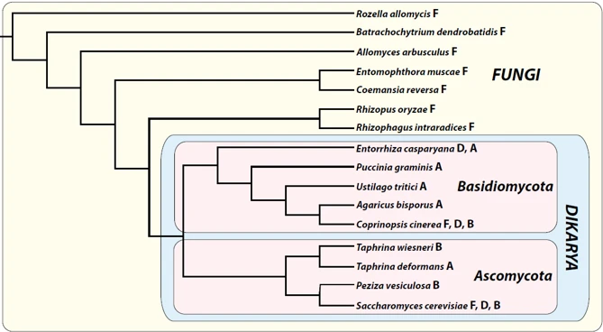
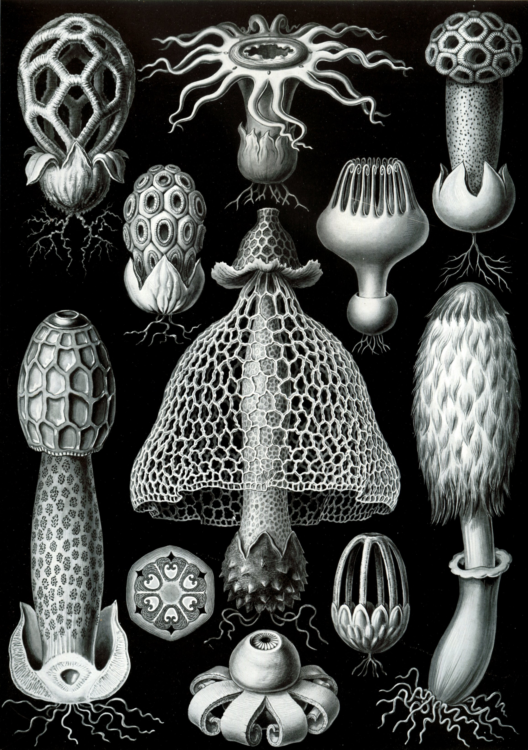
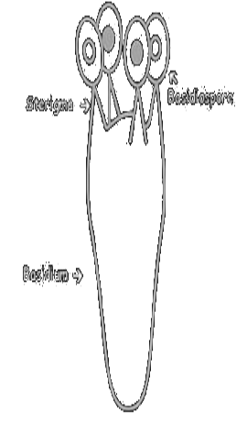
Basidiomycetes
Topics (just the very basics):
Basidiomycetes
Characters
Phylogeny and evolution
Major groups
Life cycles
Ecology
Closer look at several subgroups:
Pleurotus
Lycoperdon
Tremella

Slide 2
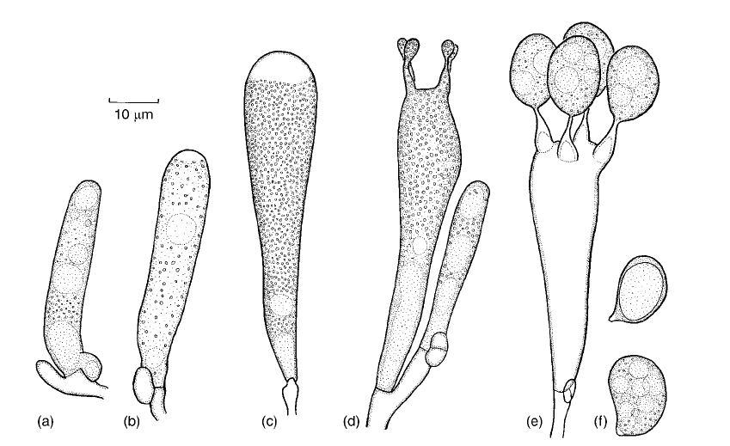

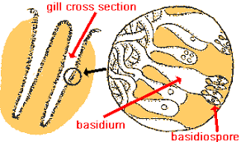
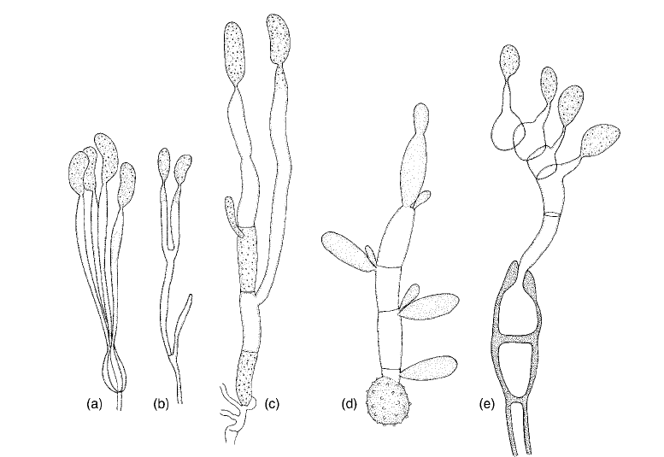
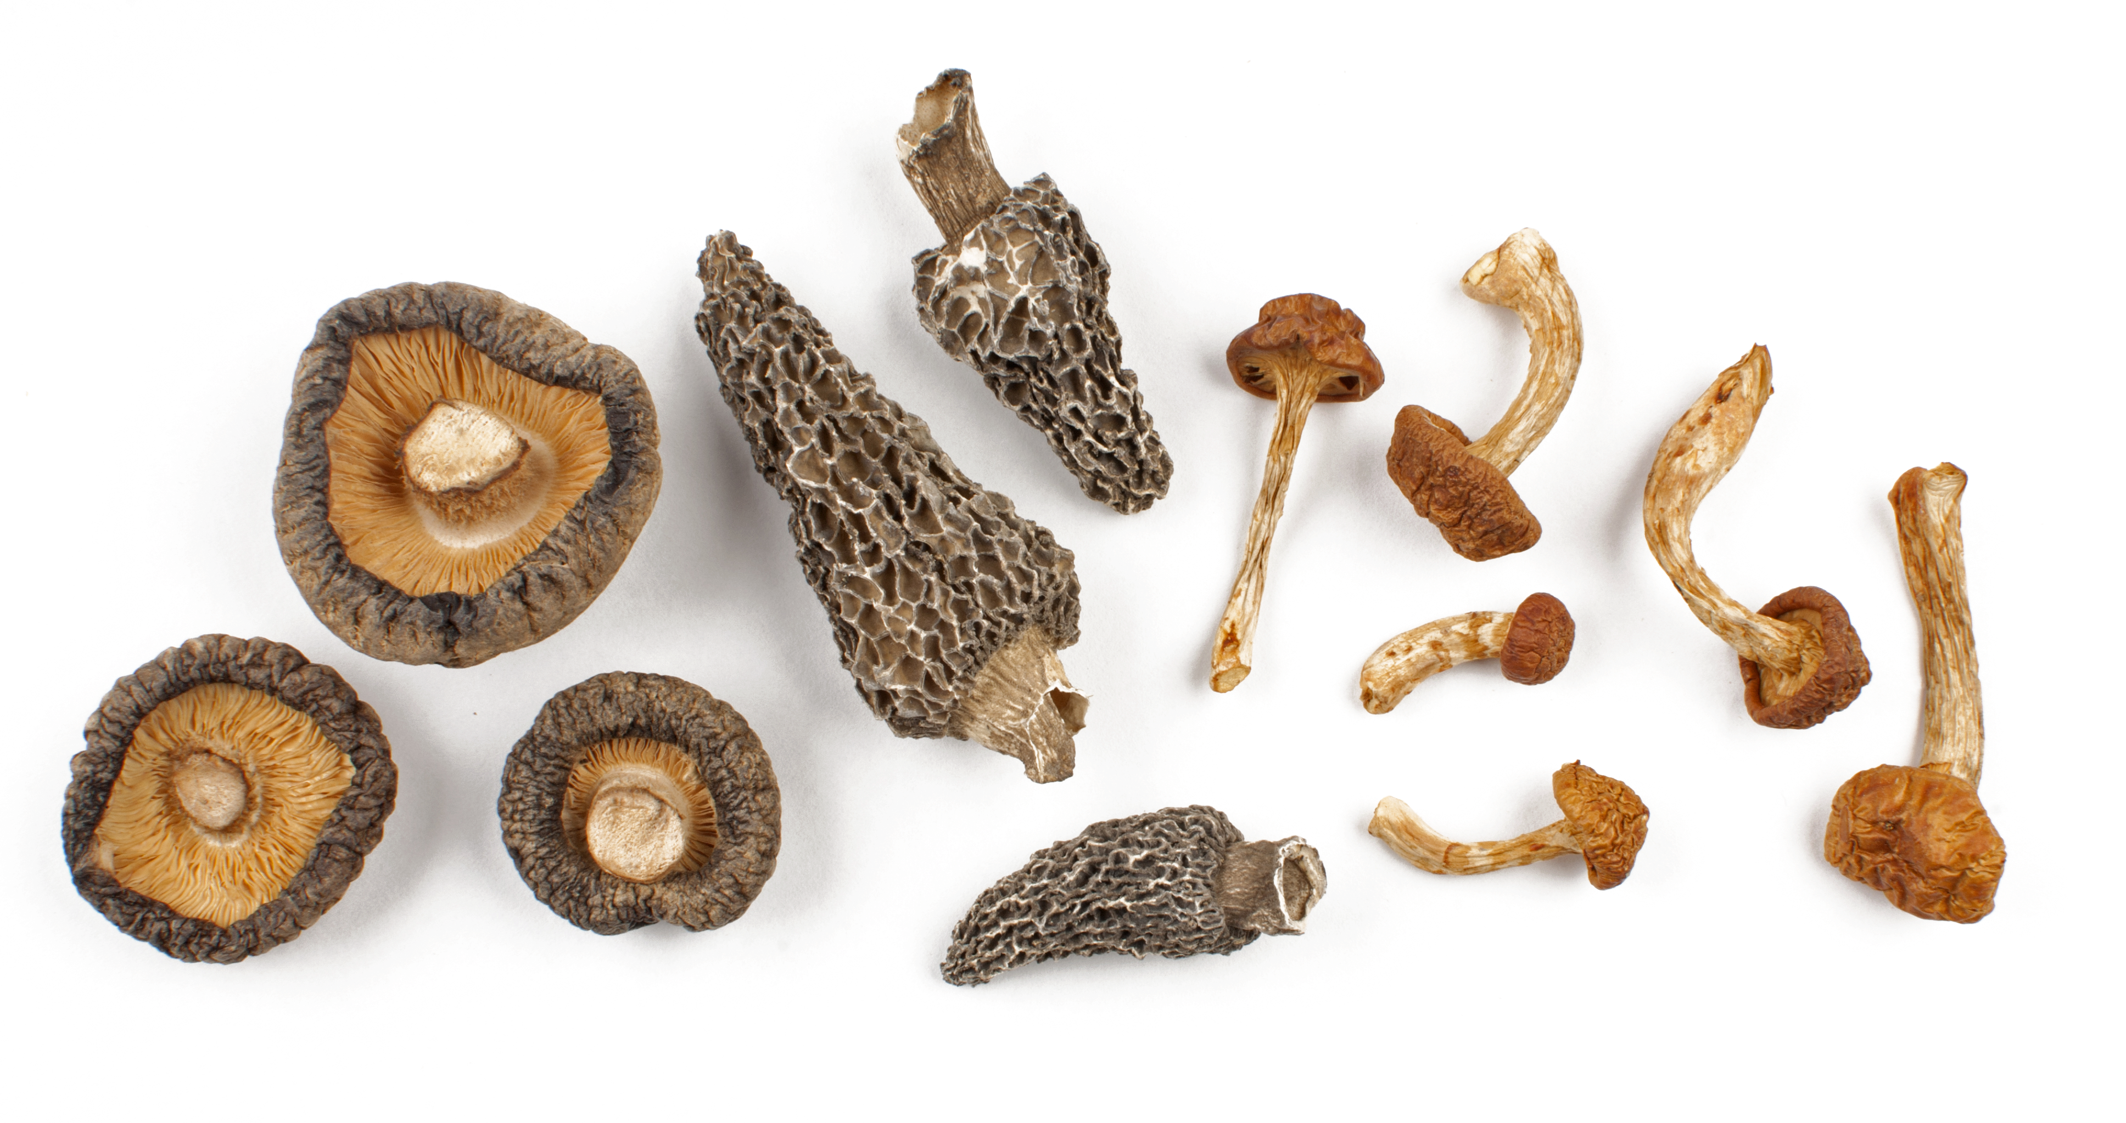
Basidiomycetes
"The other dikaryotes"
Named after the fact that they make "basidia"
Also known as the "club fungi"
(looks like a club, I guess?)
Very large group of fungi
"Clamp connections" common in hyphae
Most "mushrooms" fall into this phylum
Karyogamy and Meiosis only happen in the basidium
Basidiospore Basidium
Varieties of basidia

Slide 3
Life cycle

Slide 4
Basidia

Slide 5
Clamp connections

Slide 6
Phylogeny and major groups

Slide 7
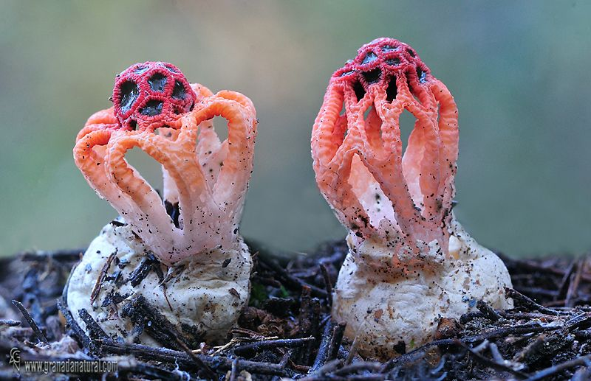
Homobasidiomycetes
agarics, boletes, polypores, gasteromycetes

Slide 8
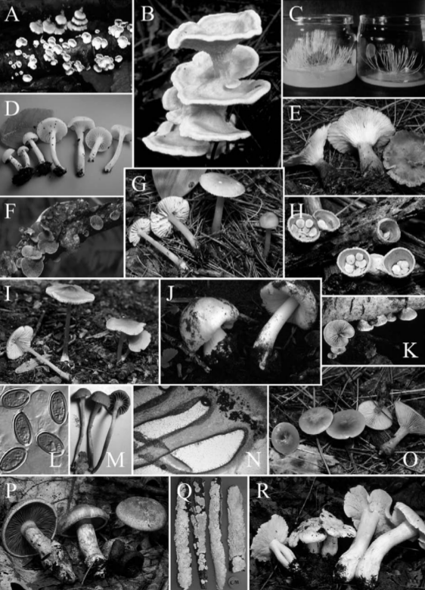
Agaricales

Slide 9
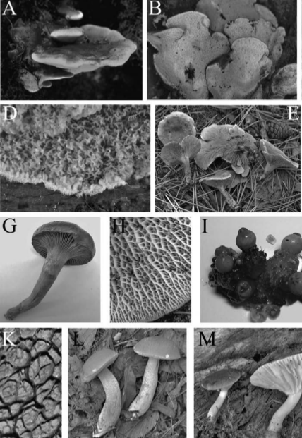
Boletales

Slide 10
Heterobasidiomycetes
dacrymyces, auricularia, tremella

Slide 11
Rusts and smuts

Slide 12
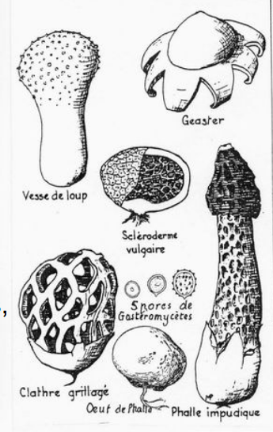
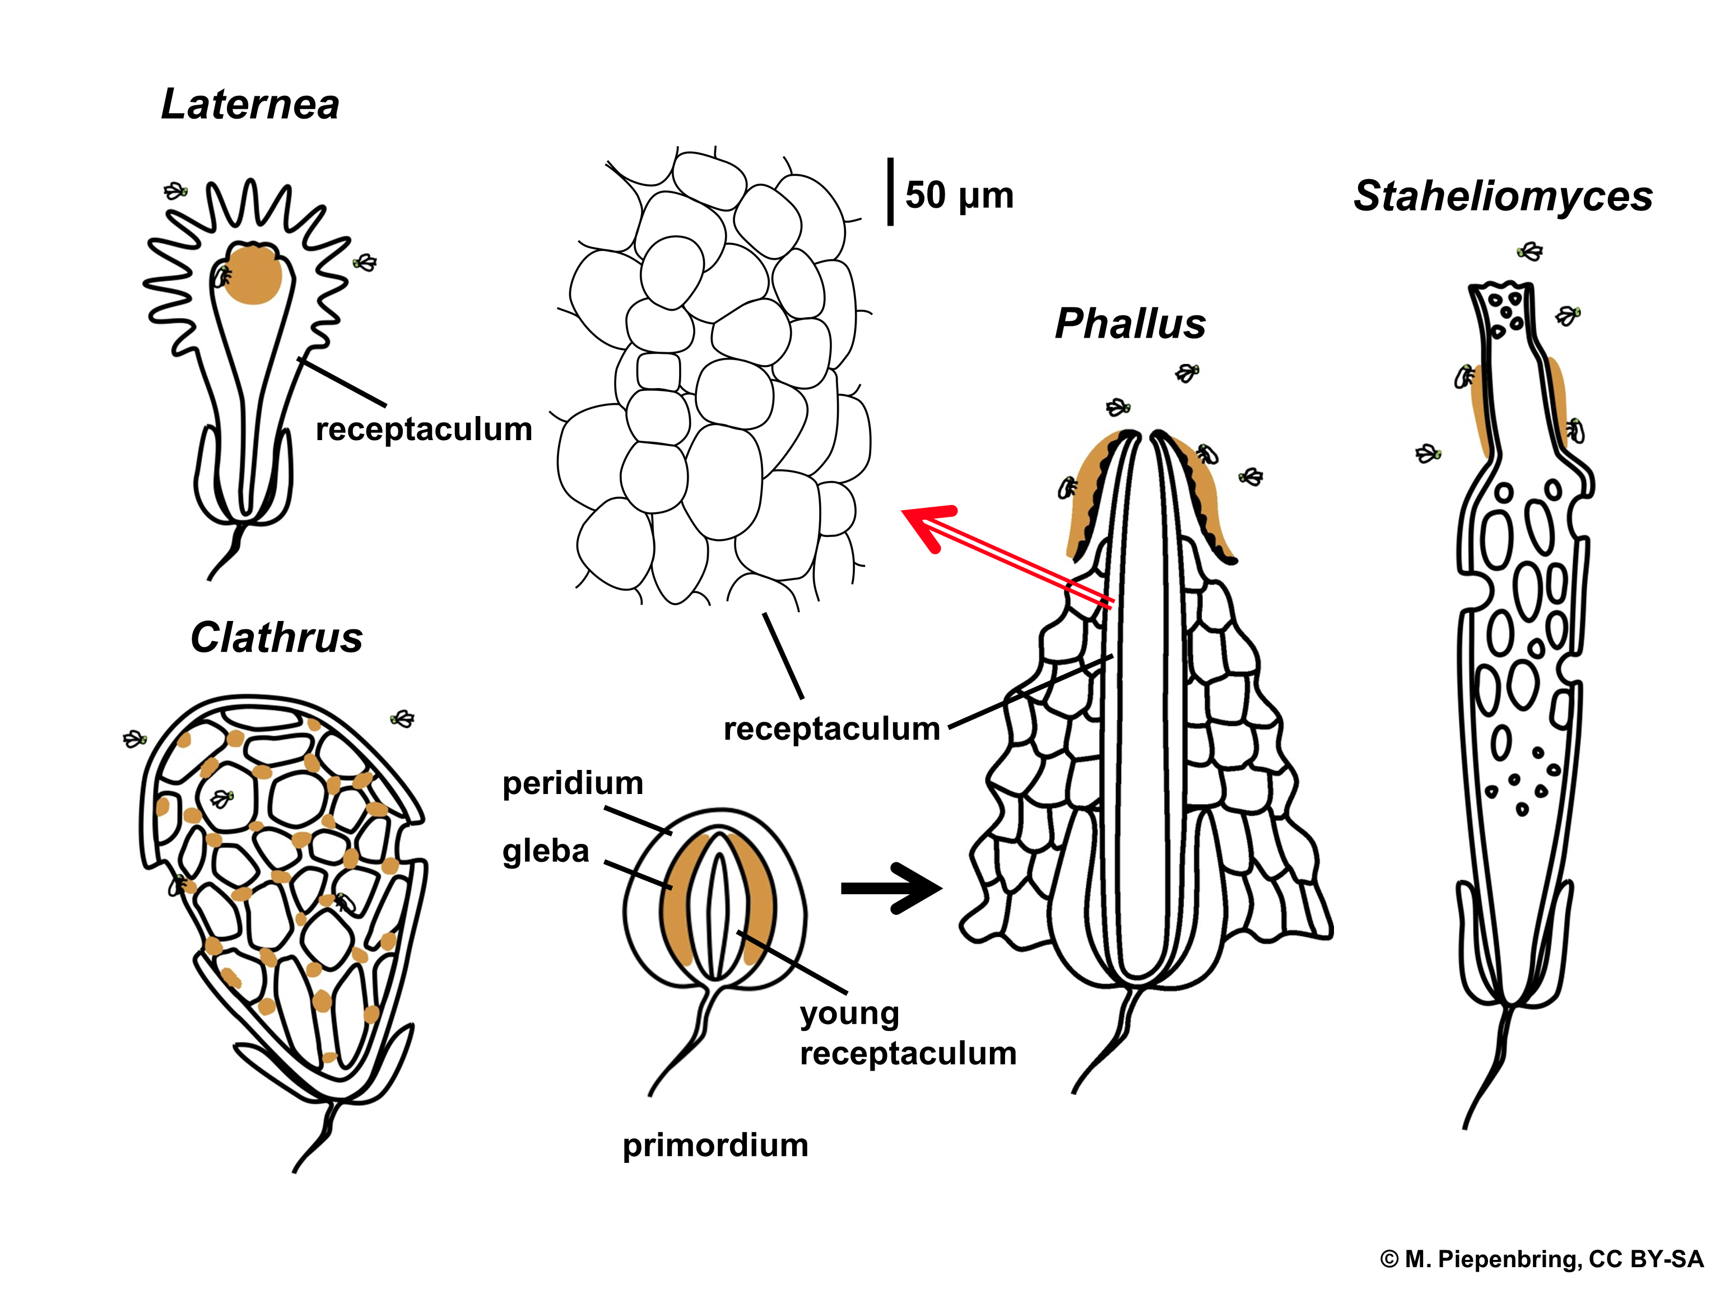
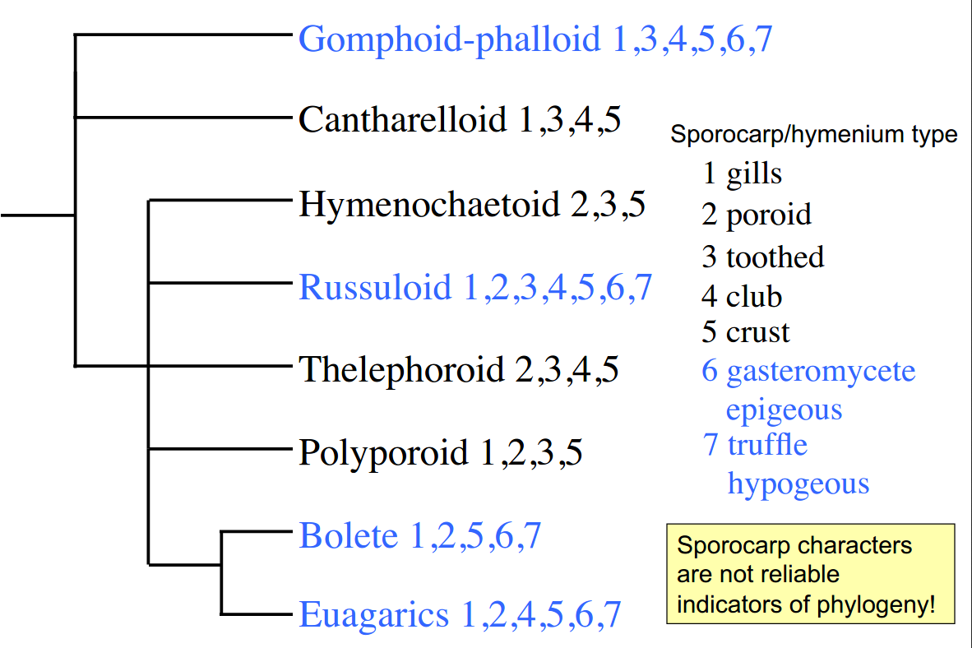
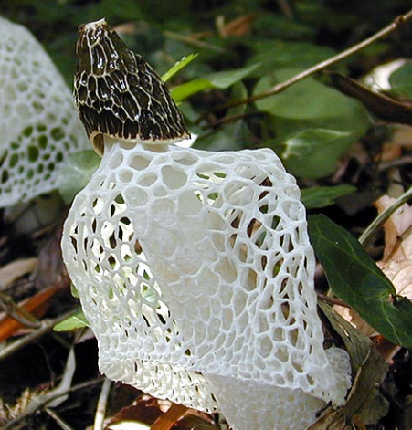
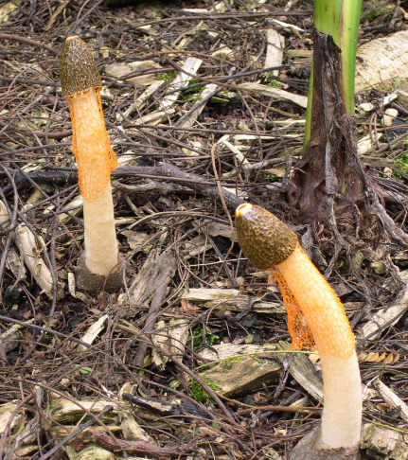
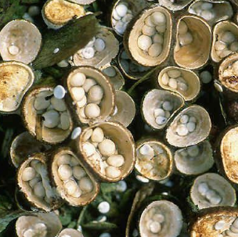
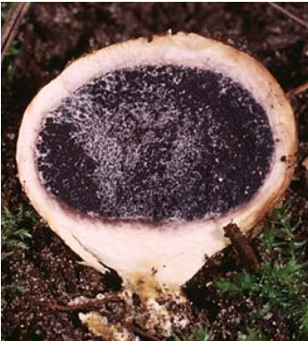
"Gasteromycetes" (not a real clade!)
Above-ground (epigeous)
Below-ground (hypogeous)
Basidiospores mature inside
basidiocarp
Basidiospores are not forcibly
discharged

Slide 28
So, how do Ascomycetes fit into our picture of fungal evolution, morphology, physiology, diversity, and ecology?
Evolution -
Morphology -
Physiology -
Diversity -
Ecology -

Slide 29
Assignments
1. Read Webster & Weber, sections: 18, 19.1, 19.4.5, 20.1, 20.3, 21.1, 21.5
- These cover an introduction to Basidiomycetes and then closer looks at some specific groups
2. You will have a Canvas quiz on the assigned readings and will also have to participate in a Slack discussion about them.
3. Go through the website materials and try to get a feel for Basidiomycetes. The terminology should be coming a bit easier now. Nothing is too different from the Ascomycetes. But having outside resources helps present the material in a variety of ways that help with retention.
4. Study for the first exam, which will be held on Canvas next week.

