Slide 1
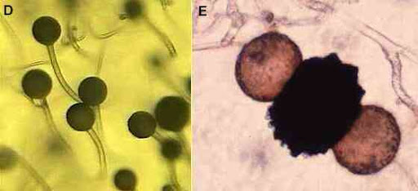
Fungal lifestyles
Topics (just the very basics):
Hyphal structure and growth
Mycelium and hyphal aggregates
Types of spores
Fruiting body terminology
Zygomycota
Phylogeny and evolution
Ecology
Closer look at two subgroups:
Mucoraceae and Pilobolaceae
Asexual spores Sexual spore

Slide 2
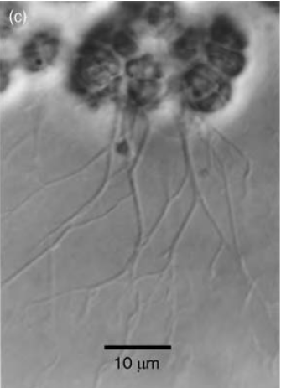
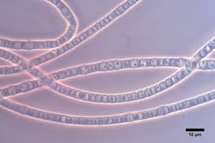
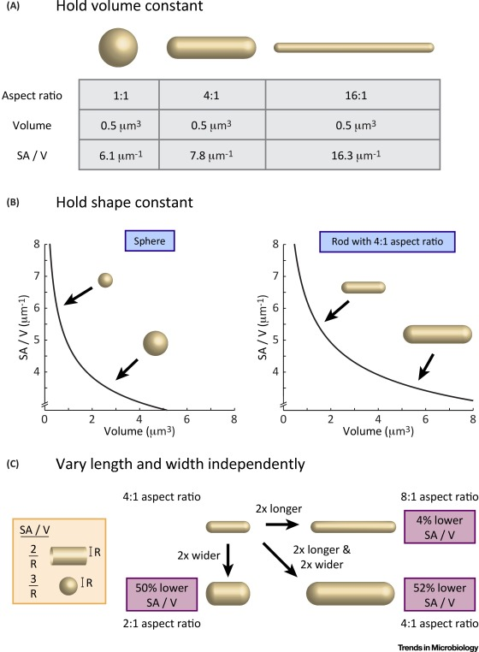
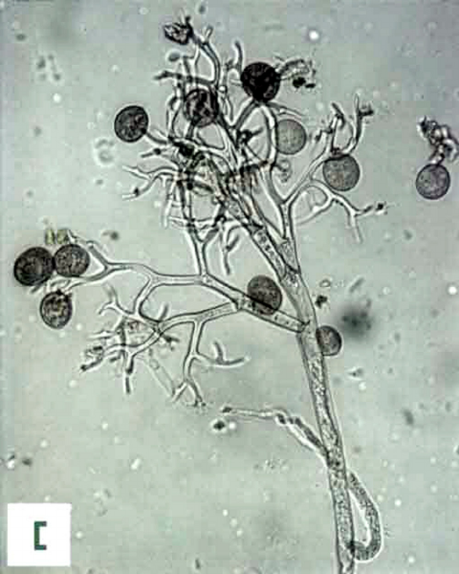
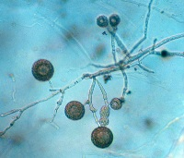
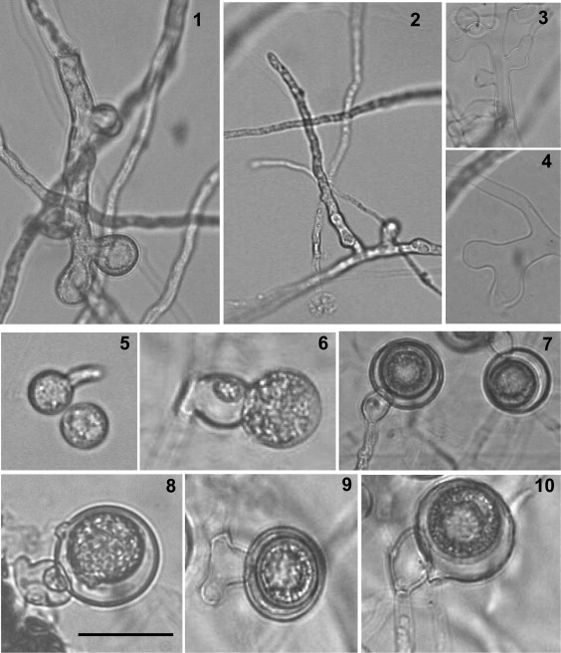
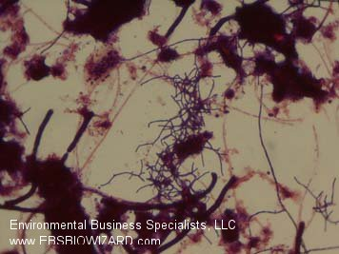
None of these images is of a fungus. Two are actually bacteria!
...but they all have filamentous growth
Filamentous growth has arisen independently many times because of physical constraints on lysotrophy

Slide 3
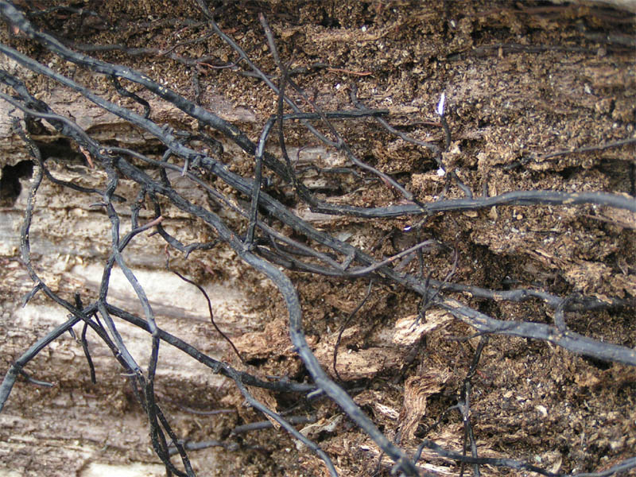
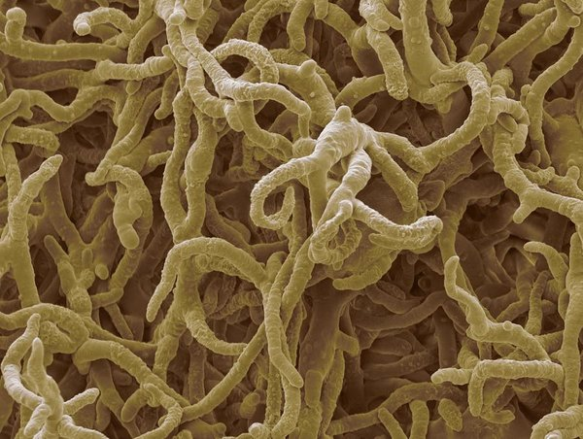
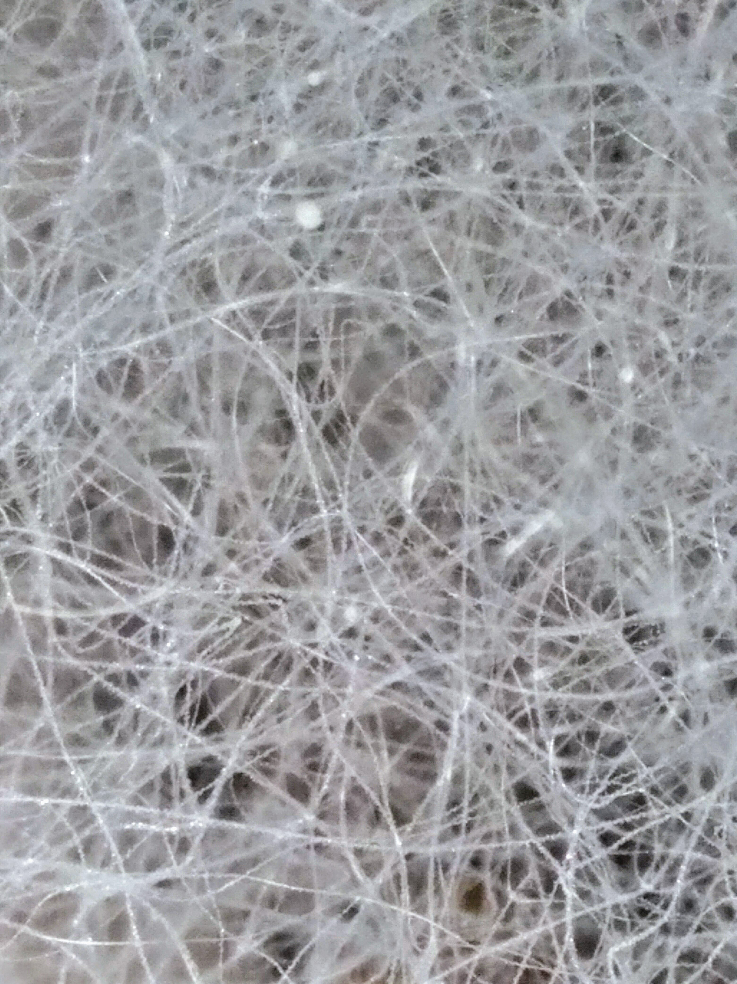
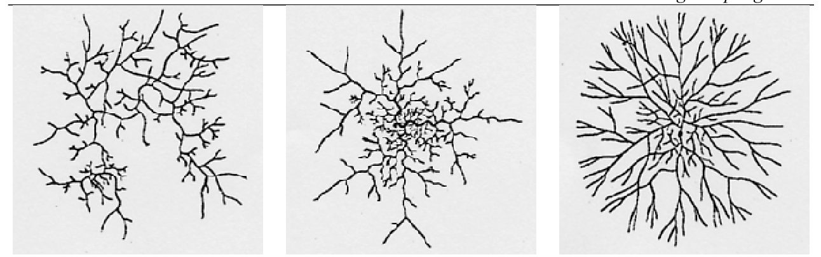
SEM - Credit: Steve Gschmeissner
Hyphae can aggregate into myriad forms. These aggregates take on lots of different functions. Sclerotia (dormant), rhizomorphs (aboveground competitive structures), ectomycorrhizae (surround plant roots), fruiting bodies (like mushrooms).
See website "resources" for a good web page on this.
Hyphal colony morphogenesis types
Rhizopus (Mucormycotina) hyphal mass

Slide 4
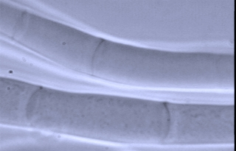
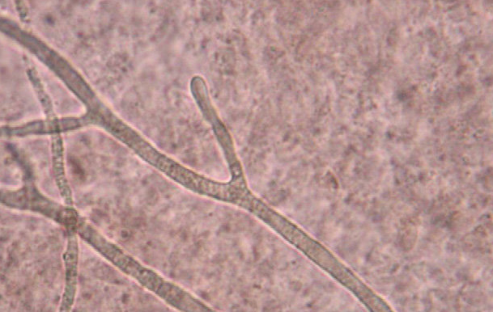
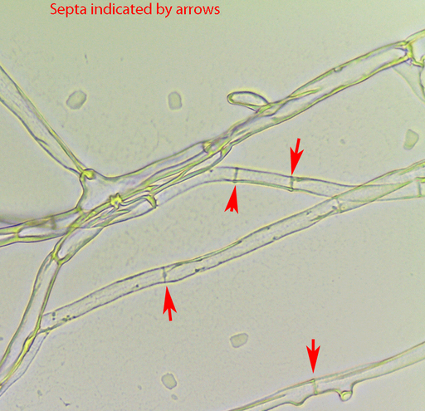
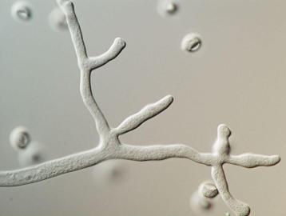
Hyphal divisions?
Dikarya Zygos and Chytrids
Septate hyphae Aseptate (coenocytic) hyphae

Slide 5
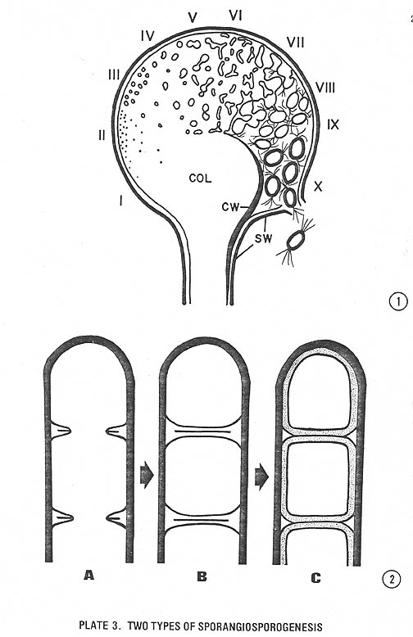
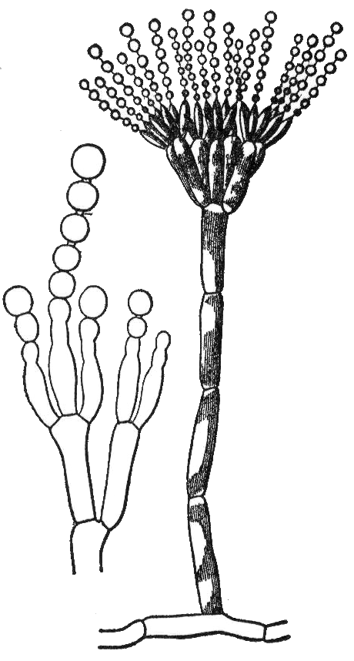
Fungi can produce spores in a lot of different ways.
Seems like every source of spores gets its own special name:
Sporangiospores: spores produced by a sporangium in many fungi such as zygomycetes.
Zygospores: spores produced by a zygosporangium, characteristic of zygomycetes.
Conidiospores: spores produced by an asexual conidium, typical of ascomycetes and zygomycetes.
.... and so on. You get the idea.
Sporangium
Conidium
Sporangiospores
Conidiospores
Credit: O'Donnell, 1979

Slide 6
Zygomycota
Vegetative stage – well developed aseptate (coenocytic) hyphae
Asexual reproduction by nonmotile sporangiospores
Sexual reproduction – Zygospore produced in a zygosporangium from fusion of two similar gametangia

Slide 7
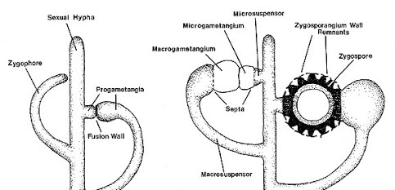
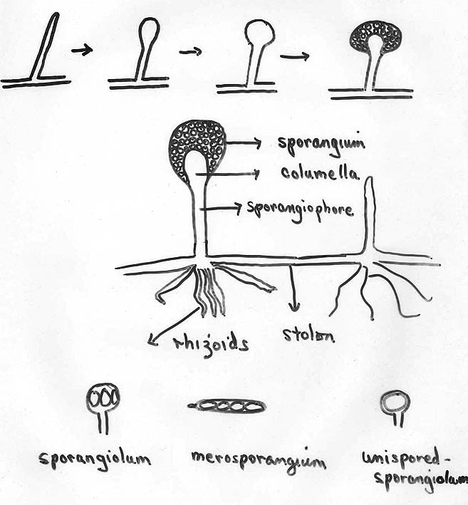
Zygomycete fruiting body anatomy and terminology
You'll see these terms in the readings.
Sexual reproductive anatomy
Asexual reproductive anatomy
What's the biological difference between a macrogametangium and microgametangium?
Think back to your botany terms...

Slide 8
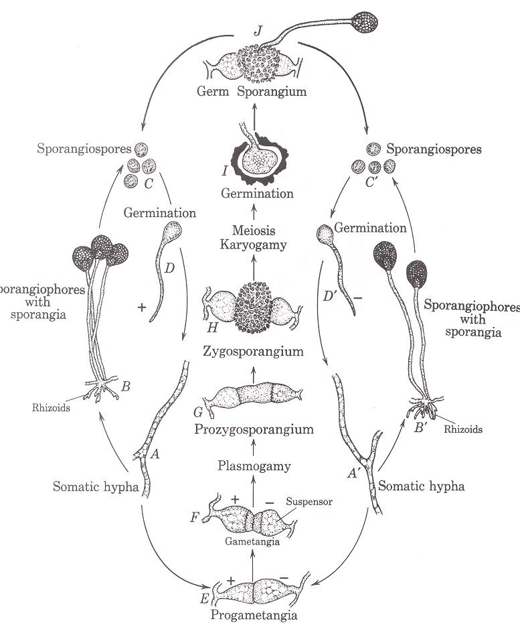
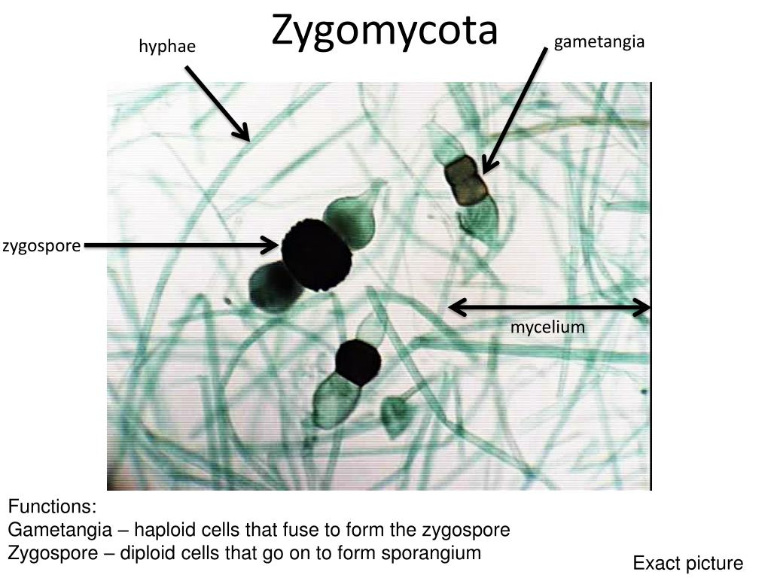
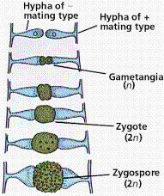
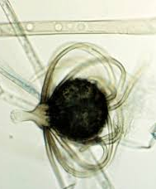
Life cycle (typical)
Note the alternate life cycle pathways
This group is named after the sexual zygospore structure

Slide 9
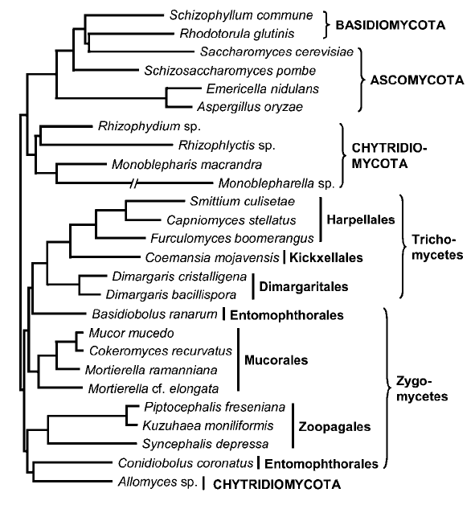
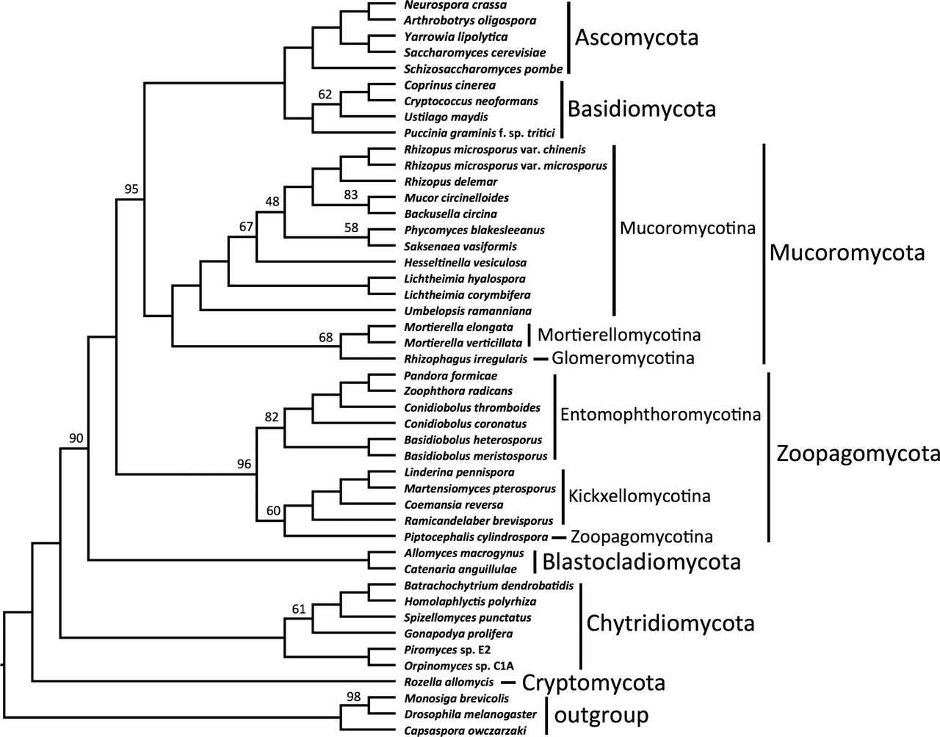
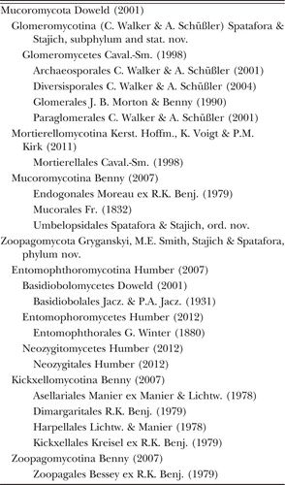
"Zygomycota" is not monophyletic
There seems to be general confusion about where these fit and their relationships to each other, but a few things are pretty clear:
1. "Zygos" are paraphyletic
2. Probably sister to "chytrids"
3. Or at least all mixed up with "chytrids"
4. Zygospores are a trait inherited from the common ancestor of Zoopagomycota, Mucoromycota, and Dikarya
5. Two main phyla:
Mucoromycota and Zoopagomycota
6. I'm so confused
Tanabe, et al., 2004
Zygospores
Spatafora, et al., 2016

Slide 10
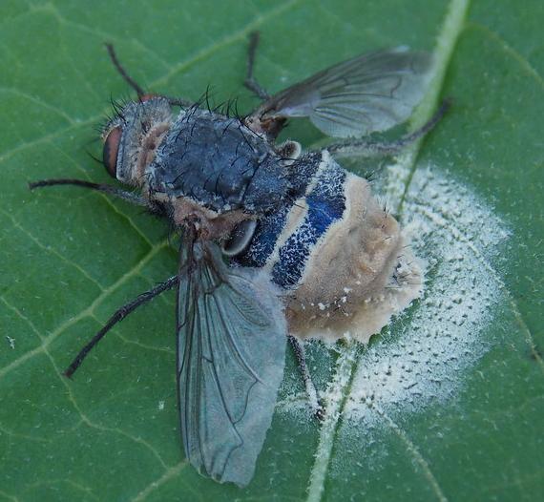
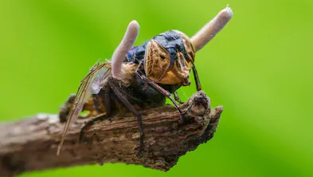
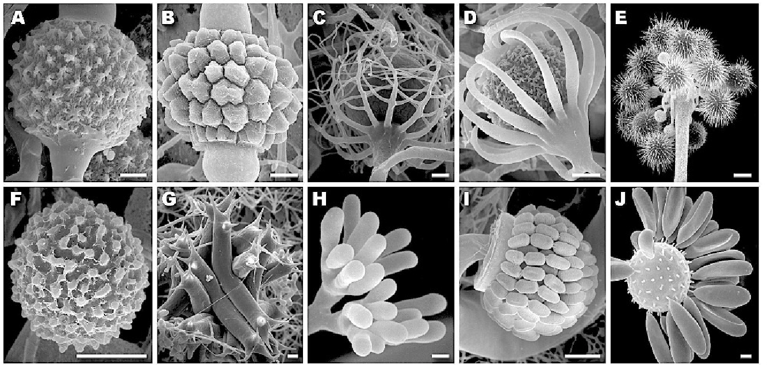
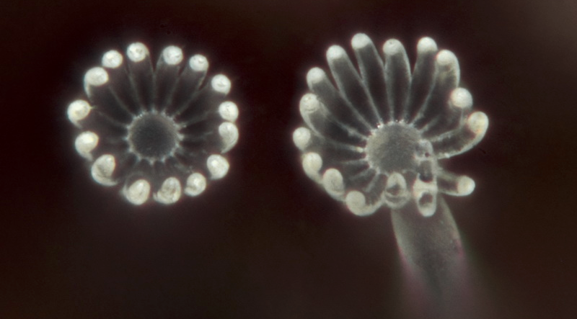
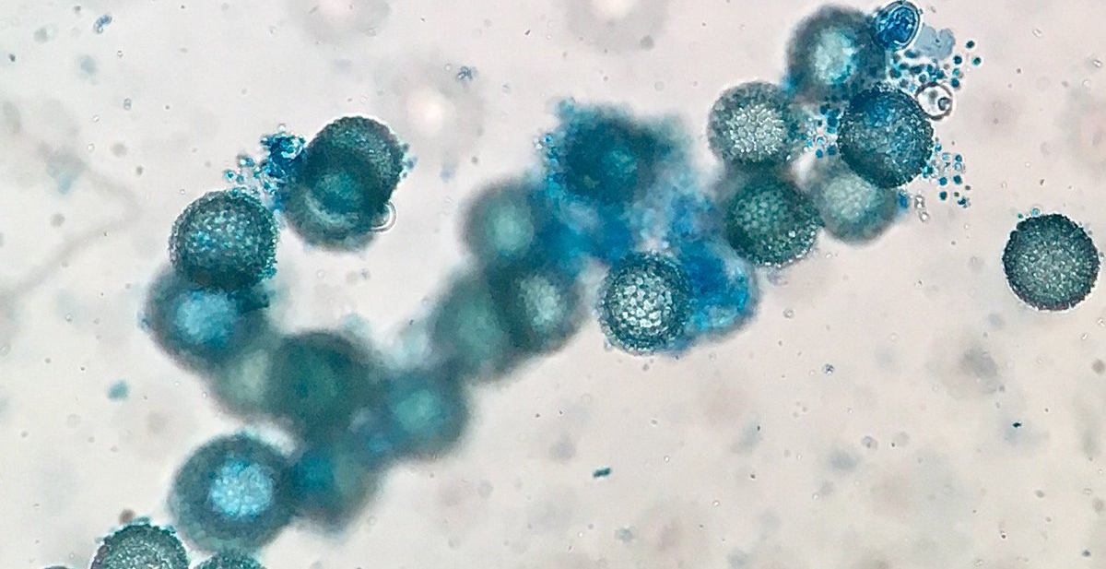
Zoopagomycota
Earliest diverging lineage of zygomycetes and contains species that are primarily parasites and pathogens of small animals (e.g. amoeba, insects, etc.) and other fungi, i.e. mycoparasites
Entomophtoromycotina
Saprobic and insect pathogenic fungi
Kickxellomycotina
Saprobes, mycoparasites, and symbionts of insects
Zoopagomycotina
Mycoparasites and predators or parasites of small invertebrates and amoebae
Very hard to grow in lab

Slide 11
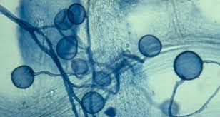
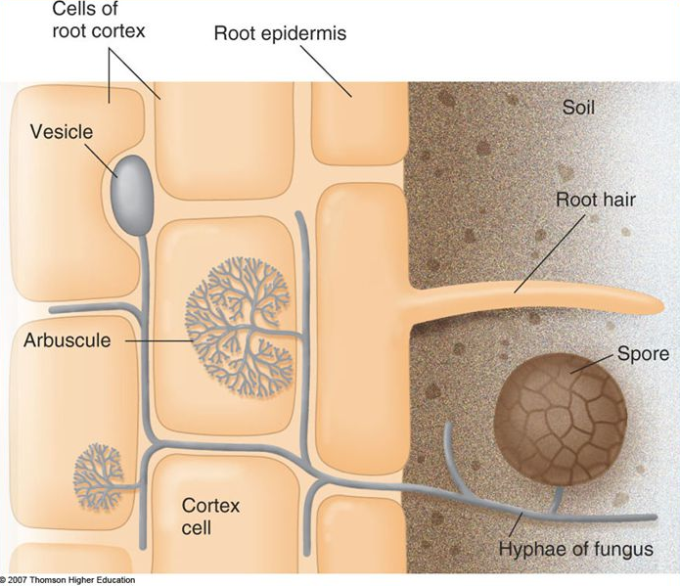
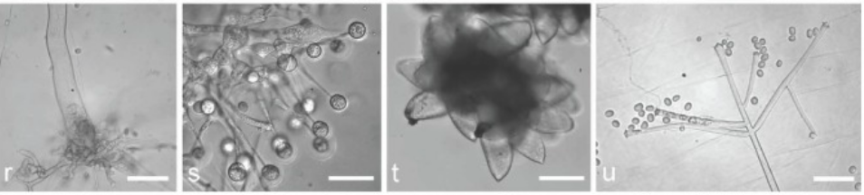
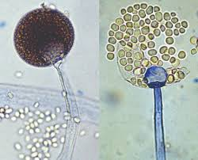
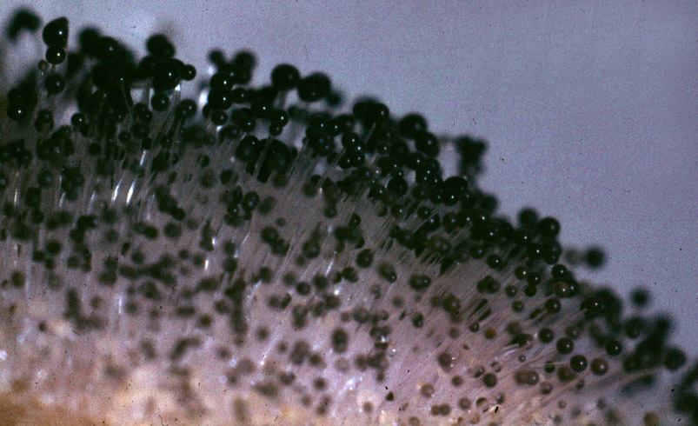
Mucormycota
Sister to dikarya - mainly consists of mycorrhizal fungi, root endophytes, and decomposers of plant material
Glomeromycotina
http://www.amf-phylogeny.com/
All form mycorrhizal associations with plant roots
Make arbuscles (thus, AMF - Arbuscular mycorrhizal fungi)
Most successful plant-fungal symbiosis on Earth
Might not belong in Mucormycota!
Mortierellomycotina
Mostly soil-dwelling saprotrophs
Some plant-root endophytes
Cryptic species complexes
Mucoromycotina
Most commonly-found "zygos" and
contains tons of described species
Frequently isolated from soil, dung,
plant debris, and sugar-rich plant parts
Wagner, et al., 2013

Slide 12
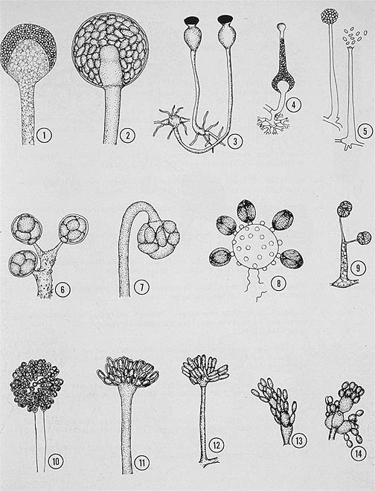
Sporangia (asexual reproductive structures) can take many diverse forms

Slide 14
Evolutionary trend is toward reduced sporangia
←“merosporangia”

Slide 15
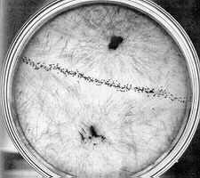
Sexual reproduction is via zygospores. These take on a wide variety of morphologies as well.
Zygospore

Slide 16
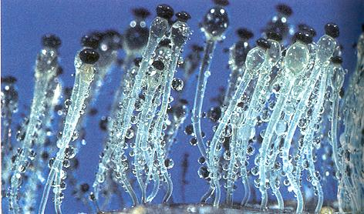
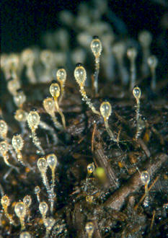
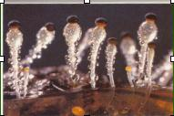
Passage through gut of herbivore activates spore germination
Sporangium is dark in color to prevent damage from UV when attached to grass
Pilobolus
[Mucoromycotina]

Slide 17
Pilobolus
[Mucoromycotina]
Uses water pressure to launch sticky spore mass great distances
By excreting sugars into the terminus of the spore-bearing hypha, water moves there through osmosis

Slide 18
Pilobolus
[Mucoromycotina]
Can launch spores at 20,000 G (equivalent to a human launching at 100x the speed of sound in 2 µs!)

Slide 19
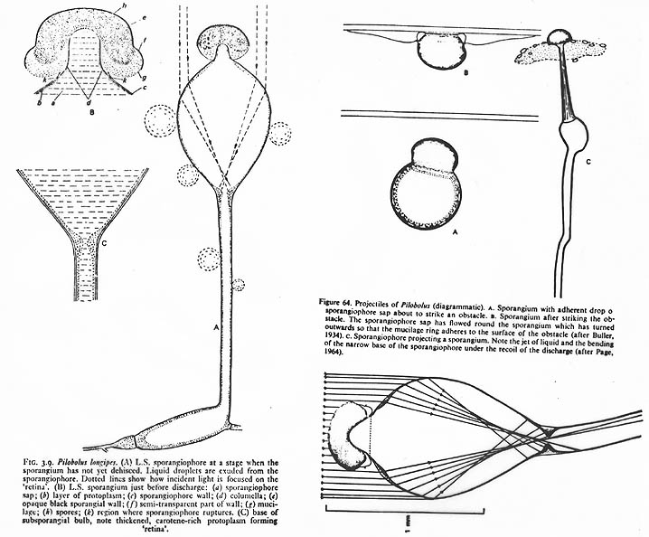
Crazy cool positive phototropism
(opposite of plant mechanism)
Pilobolus
[Mucoromycotina]
See Webster & Weber
Section 7.2

Slide 20
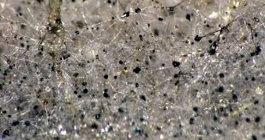
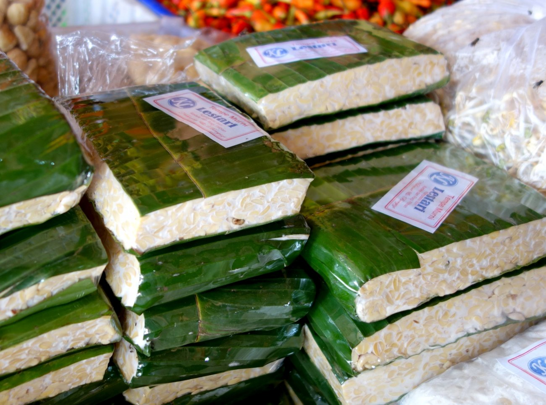
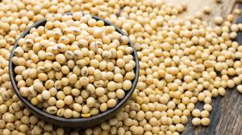
Zygos are commercially and industrially important
Rhizopus oligosporus
Delicious tempeh
+
=
Soybeans

Slide 21
Questions you should be able to figure out:
(from slides and readings)
Are sporangiospores haploid, diploid, or dikaryotic?
Glomeromycotina are not known to have zygospores. Is this trait derived from or homologous with other Mucoromycotina species?
Some zygomycetes have evolved "conidia" (merosporangia) secondarily from a primarily sporangial asexual reproduction mode. What might this say about evolutionary pressures on sporangia?
The spore mass shot from Pilobolus... what kind of spores are those? What is their ploidy level?
Explain why filamentous growth is so common across the microbial tree of life.
When did the Spitzenkörper likely evolve? Was it just once or multiple times?
What's the difference between homothallic and heterothallic zygomycete species?

Slide 22
So, how do zygomycetes fit into our picture of fungal evolution, morphology, physiology, diversity, and ecology?
Evolution -
Morphology -
Physiology -
Diversity -
Ecology -

Slide 23
Assignments
1. Read Webster & Weber, sections: 1.2, 1.3, 1.4, 7.1, 7.2, 7.3.1, and 7.3.2
- These cover an introduction to fungalphysiology, and then an introduction to zygomycetes and a couple major zygomycete groups
2. Read the Fisher, et al., 2018 paper (link on course website)
- This paper uses an obscure zygomycete species to investigate the evolution of the Spitzenkörper and polarized hyphal growth
- Keep a phylogeny of the Zygomycetes handy when reading. That will help you keep this paper in the context of evolutionary biology
3. You will have a Canvas quiz on the assigned readings and will also have to participate in a Slack discussion about them.
4. You should be able to photgraph your Zygomycetes on your bread trap by now. Photo of that is due Thursday (On Canvas)

