Slide 1
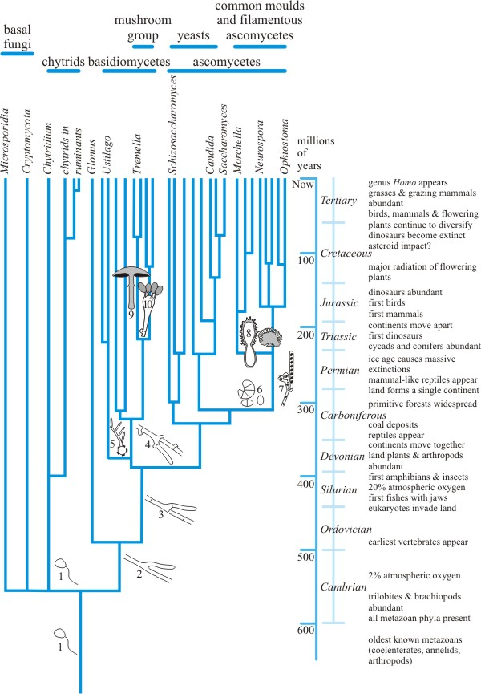
The beginnings of fungi
Topics (just the very basics):
What are fungi?
Evolutionary history
Growth habits
Physiology
Diversity
Chytridiomycota

Slide 2
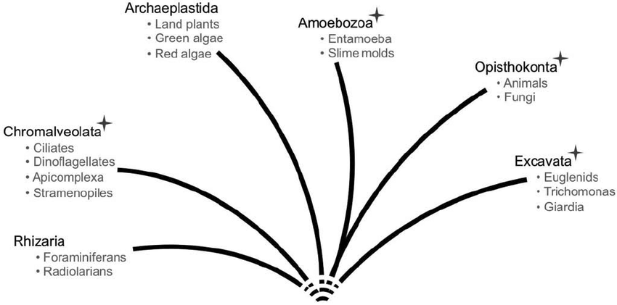
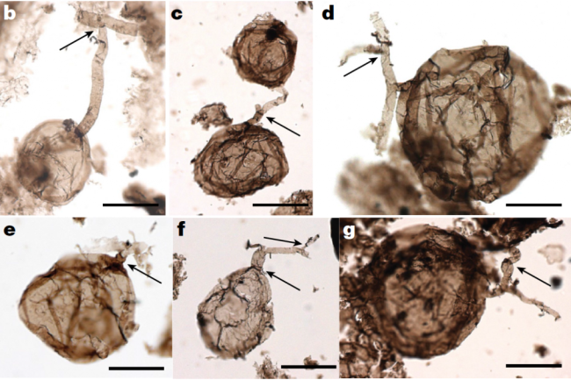
What are fungi?
The short answer is that eukaryote
phylogeny over there. The long answer
is this entire course!
Generally, though, fungi are closely related to animals. The most recent common ancestor (MRCA) of all fungi was single-celled, heterotrophic, flagellated, and sexual... Just like the MRCA of metazoans.
But, the ancestors of modern fungi diverged from the metazoan branch a loooong time ago (>1000 MYA).
Fossil fungi from 1BYA
Credit: Loron et al. 2019 Nature

Slide 3
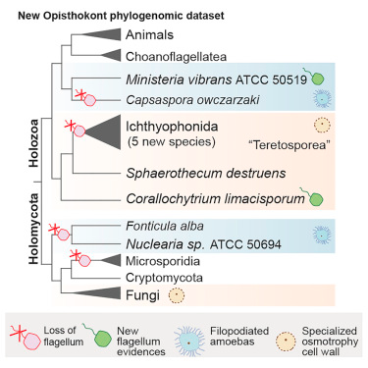
Of course, it's not as simple as just "animals and fungi" in Opisthokonta.
Phylogenomic evidence indicates that the MRCA of fungi and animals (and all the other groups shown here) had a complex suite of chitin synthase genes, and very similar flagellum genes.
This makes sense... after all, arthropods and fungi are some of the only organisms that synthesize chitin, and they do it differently than the rare bacteria that can do it.
Credit: Torruella, et al., 2015

Slide 4
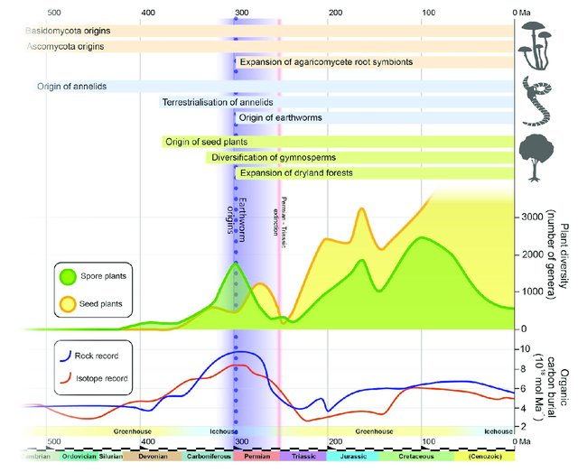
Fungi made it to land the same time as the earliest algae
Evidence shows clearly that fungi and plants are very closely intertwined, and have been from the start.
It can be said that plants are really just algae that figured out how to live with fungi.
Figure credit: Alastair R Tanner
In this figure, earthworm origins are shown because that signifies that soil was fully established on land. Soil is only possible through fungal biochemical processes.
Fungi are some of the only things that can oxidize lignin, a major biomolecule in vascular plants.

Slide 5
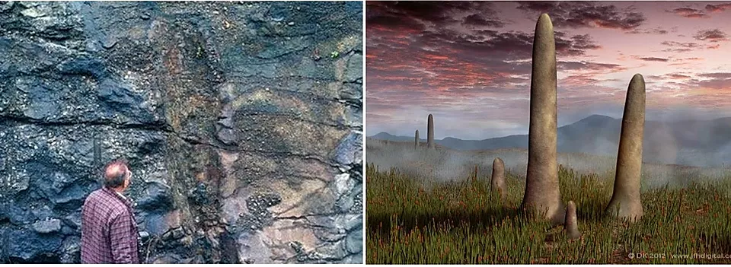
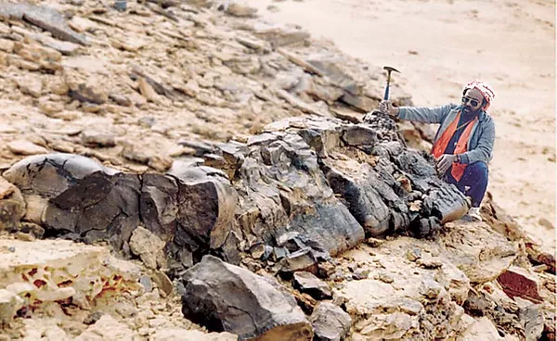
Fungal fossils show a weird landscape
~420-350 MYA, the largest living things on land were Prototaxites, giant fungi.
First animals on land (millipedes, etc.) were there ~500 MYA. Fungi was there too, long before, but by 450 MYA, fungi were the largest things on land.
Excavating a giant fungus fossil in Saudi Arabia
Photo credit: Francis Hueber

Slide 6
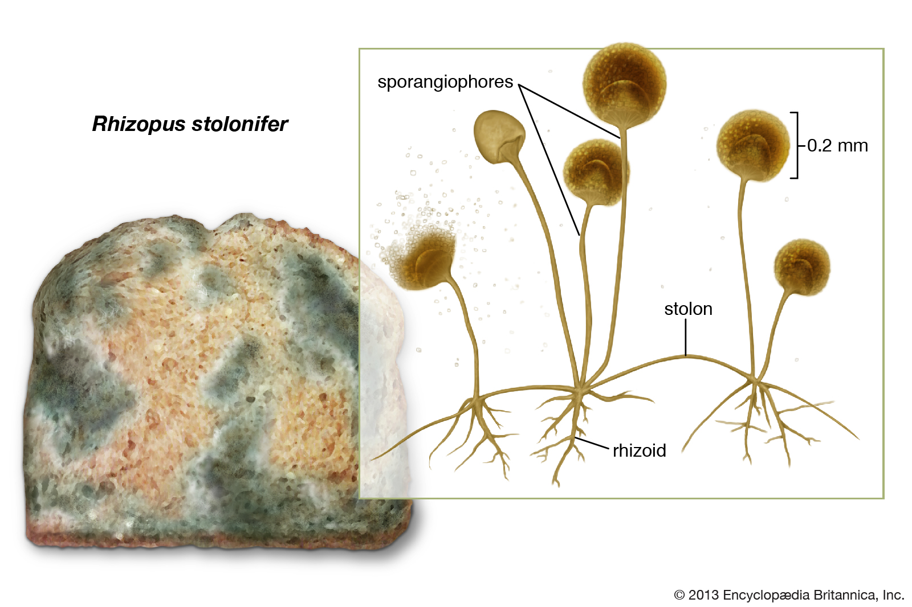
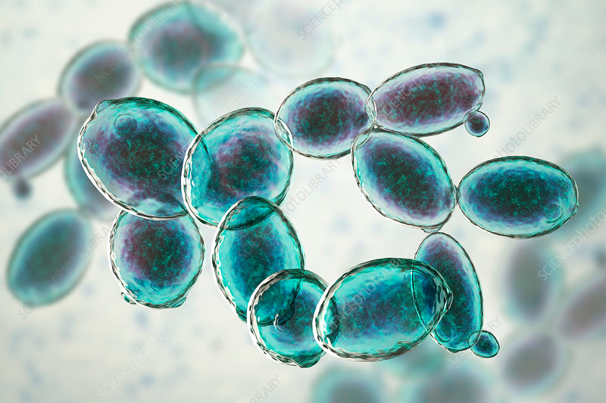
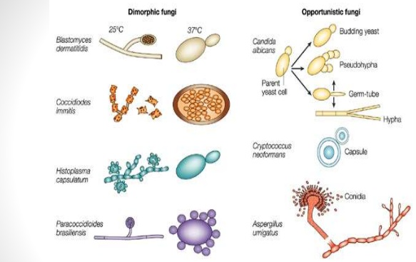
Growth habits
Mycelial growth
filaments known as "hyphae"
Yeast growth
single-celled
Dimorphic growth
Variously hyphal or yeast-like
medically important

Slide 7
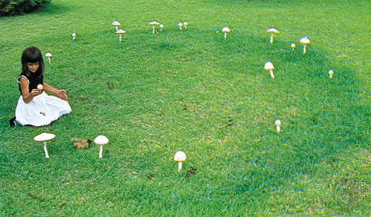
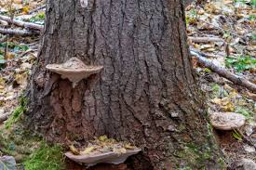

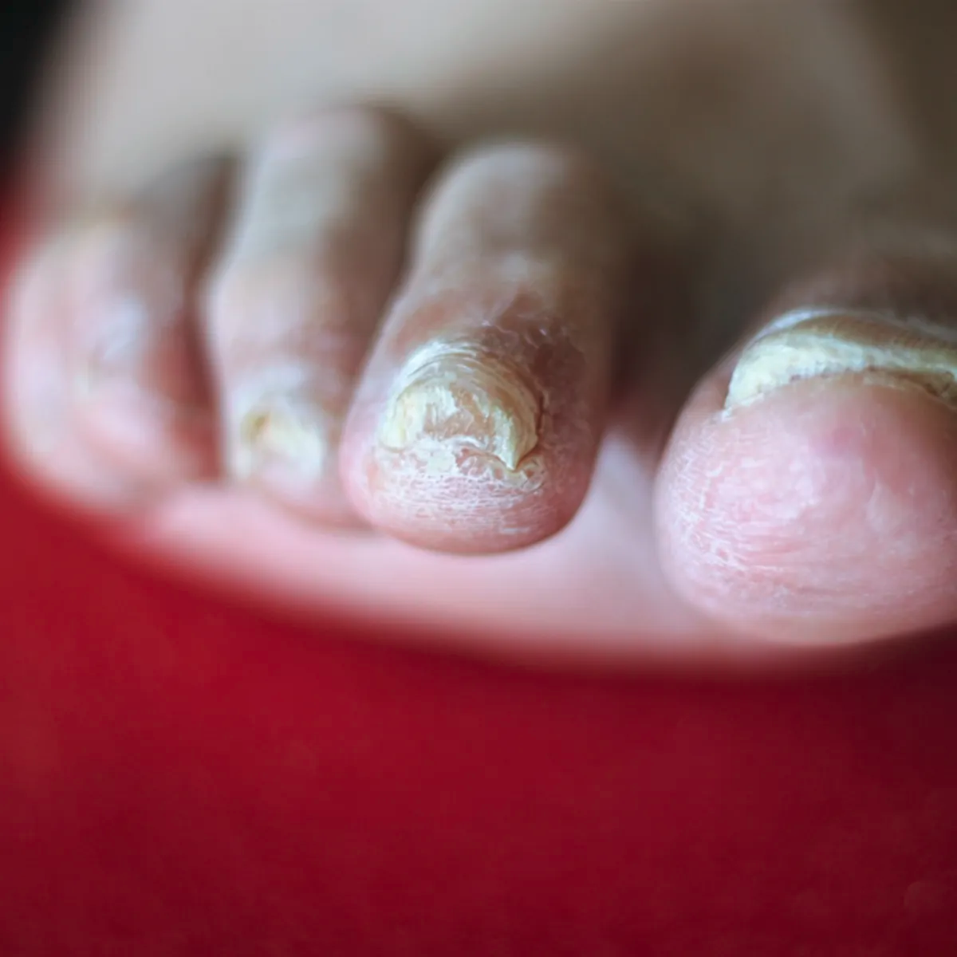
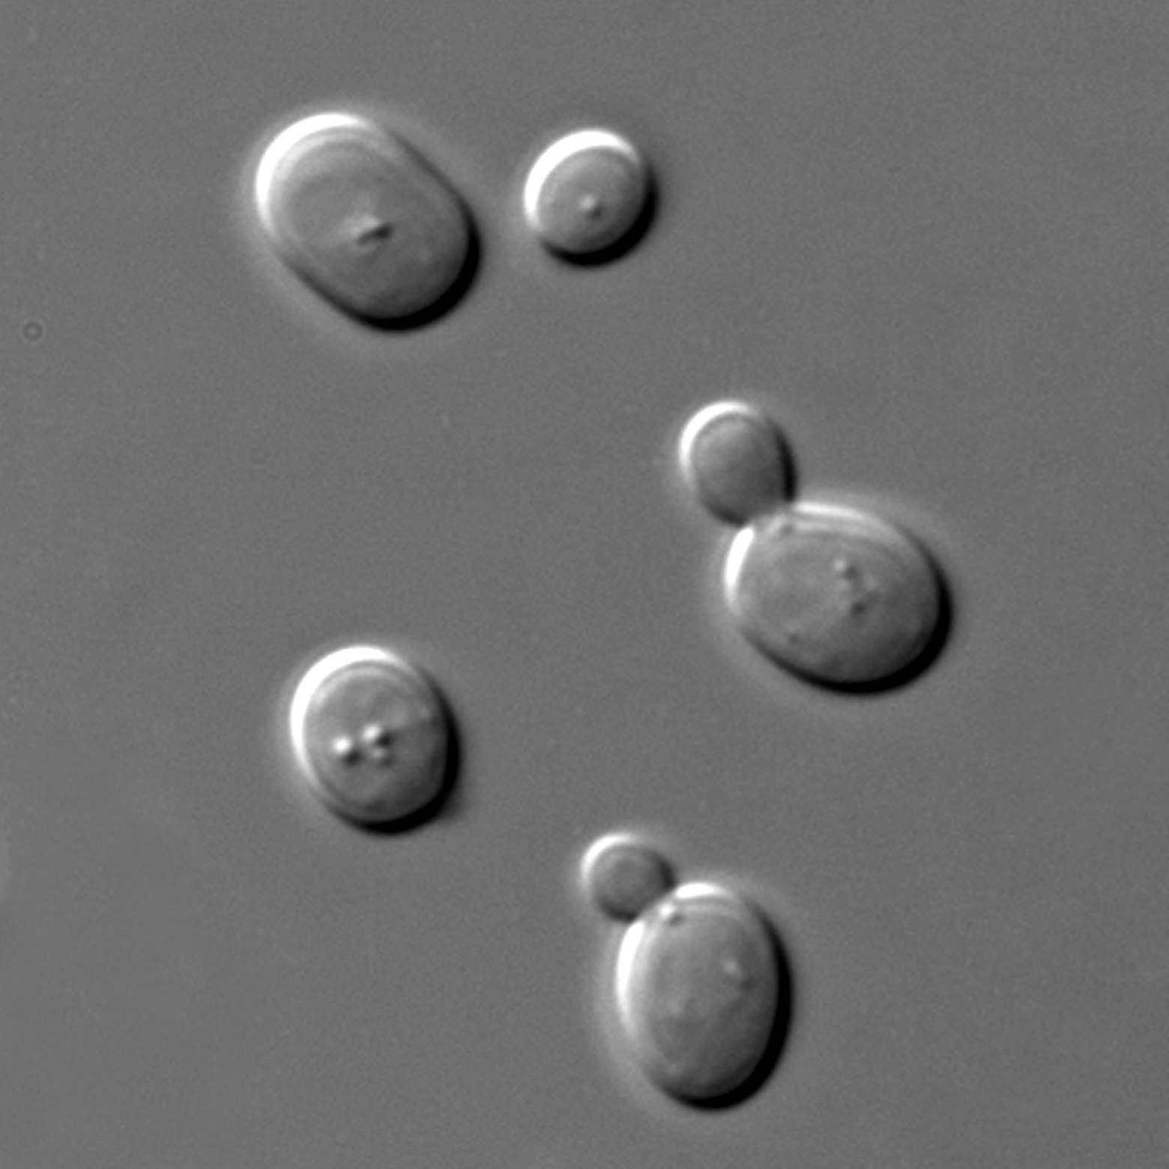
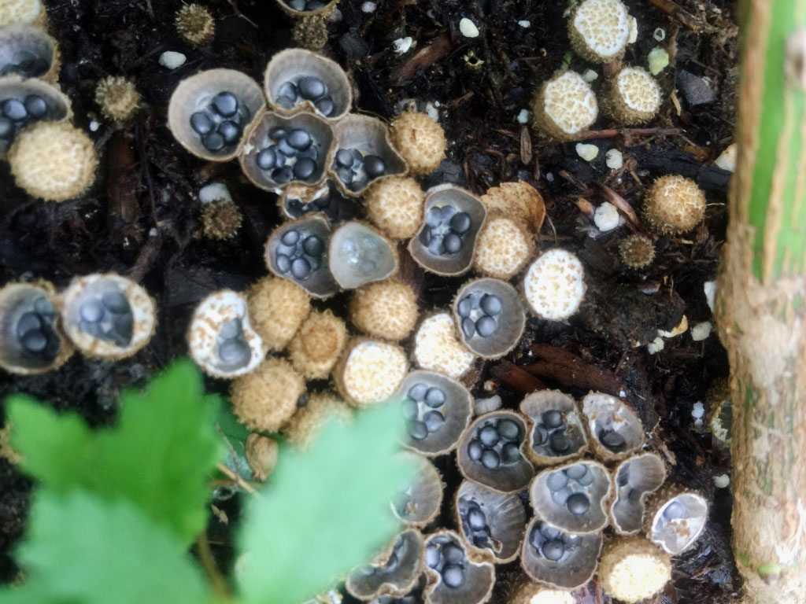
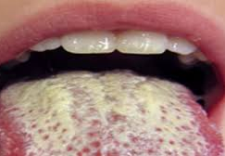
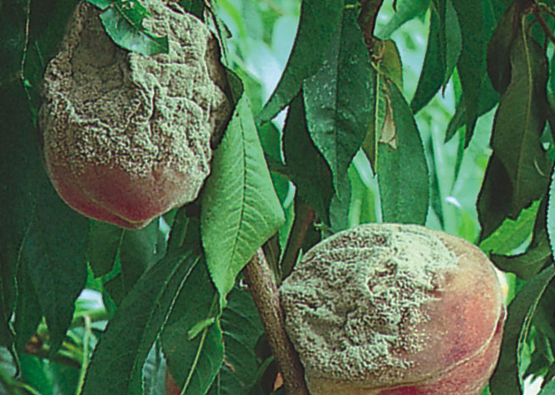
Can you name the fungal growth habits shown here?

Slide 8
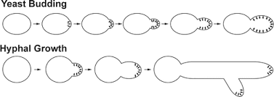
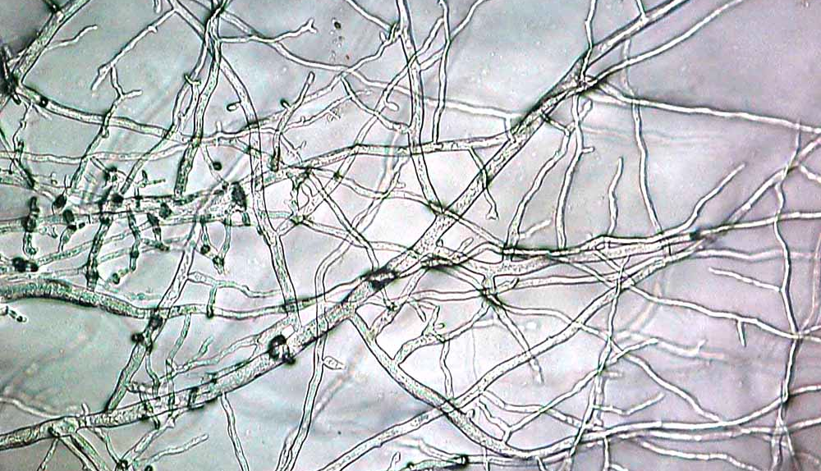
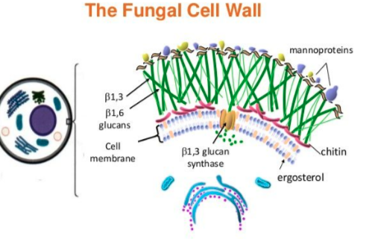
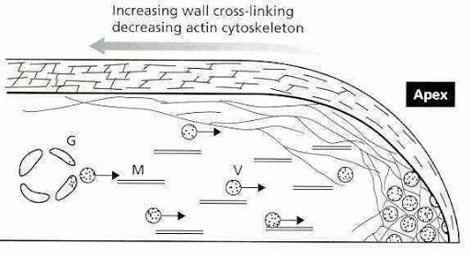
Physiology
- Cell wall is made of chitin, linked by β-glucans
- Cell membranes have ergosterols, not cholesterols
- Absorptive nutrition intake
- Tons of secondary compounds for degrading complex molecules can be excreted
-

Slide 9
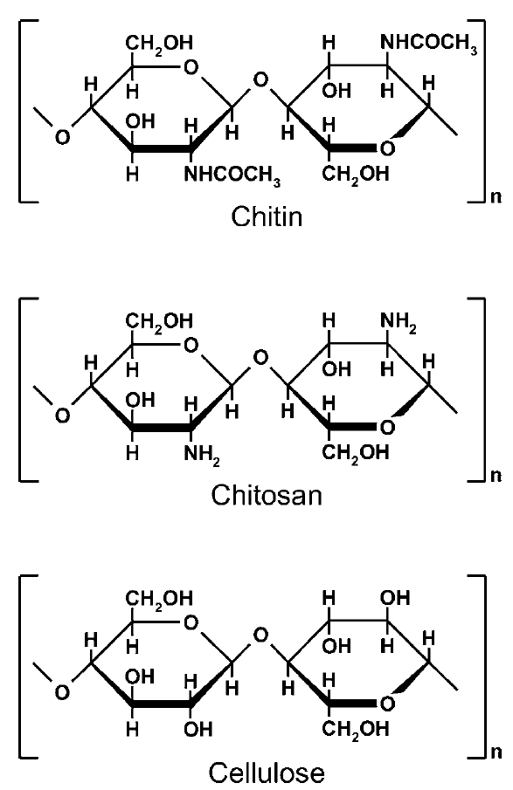
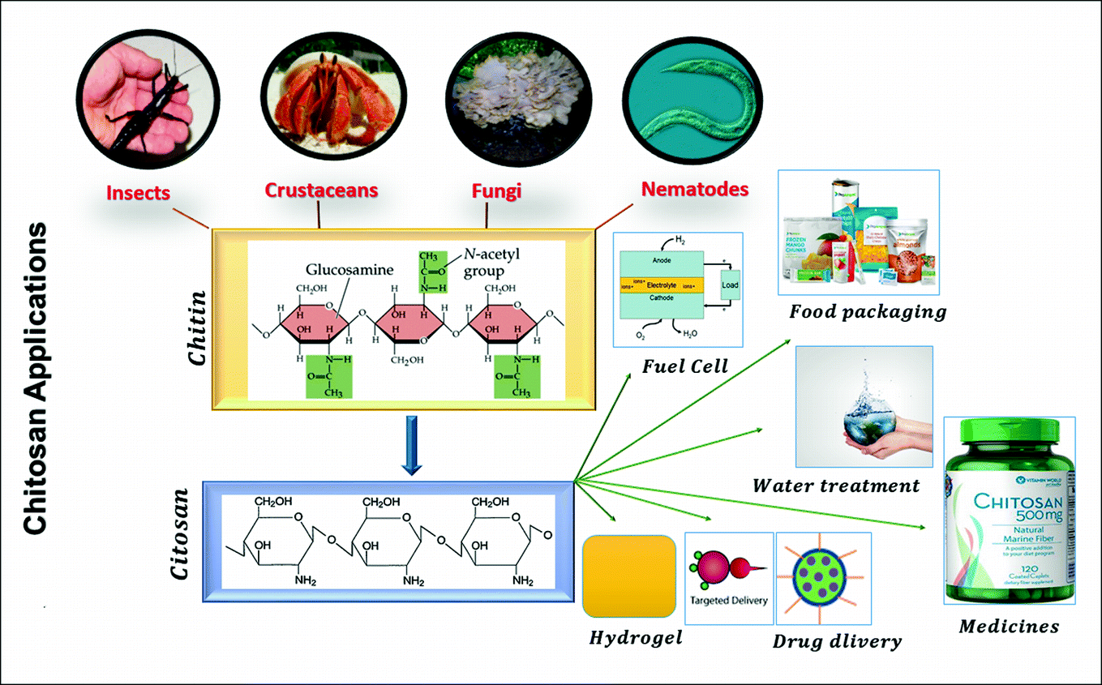
Chitin ...
It's basically cellulose, but with an acetyl-amine group replacing a hydroxyl group on each monomer
Made from modified glucose
(N-acetyl-D-glucosamine monomers) chained together
Take out the acetyl group from chitin and you get chitosan... used extensively in biomedical applications!
anti-microbial
but found in Zygomycetes

Slide 10
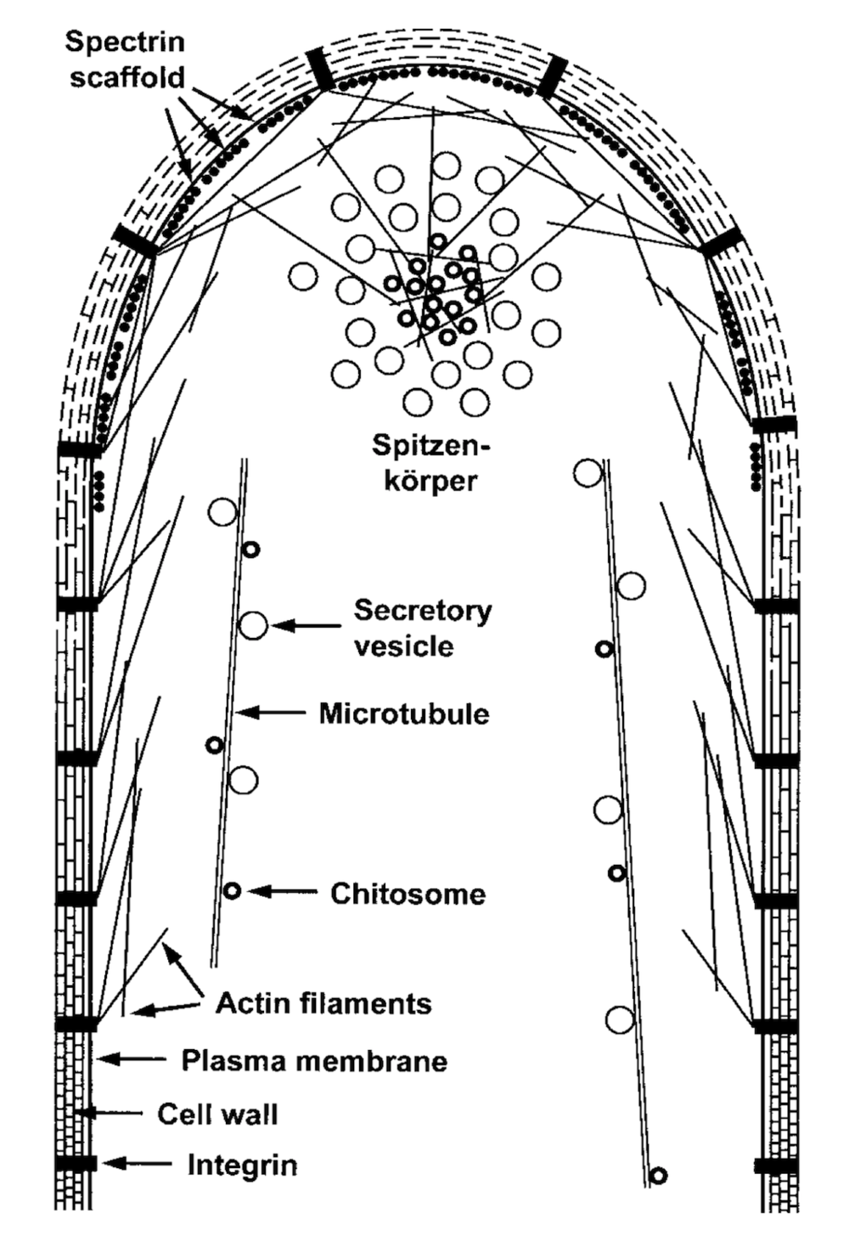
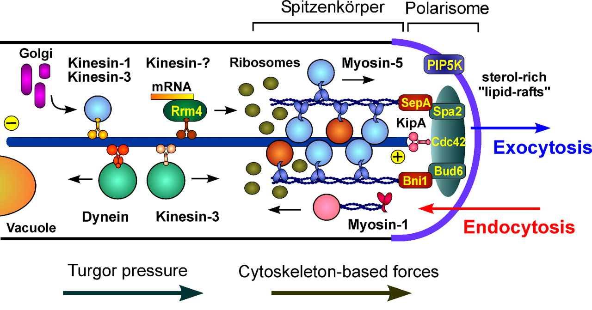
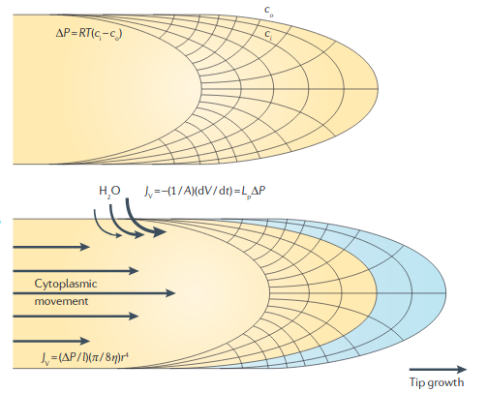
Hyphae grow from the tip (only)
Spitzenkörper: organizing center for hyphal growth;
found in germinating spores, hyphal tips, and branch points (almost only found in Basido- and Asco-mycetes
Internal water pressure pushes on "weak point" at tip
Credit: Lew, 2011

Slide 11
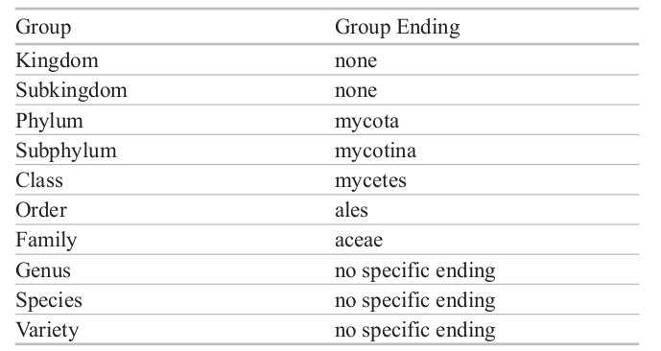
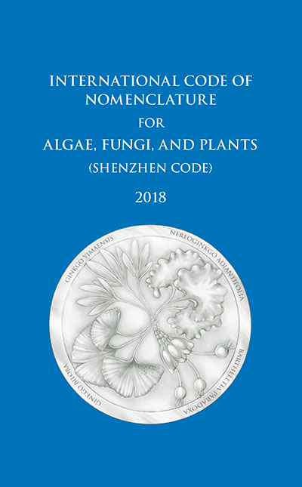
Fungal nomenclature
You'll be seeing a LOT of confusing-looking terms. But they're easy once you get used to them.
A few notes of fungal names:
myco = ancient greek root for "fungi" or "fungal"
eu = ancient greek root meaning "true" (usually implies a group is monophyletic)
-mycota (divisions or phyla)
-mycotina (subdivisions or subphyla)
-mycetes (classes)
-mycetales (orders)
Examples:
Basidiomycota = Phylum of fungi that have "basidia"
Agaricomycotina = Major group of fungi within basidiomycota
Eumycota = Group containing all of the "true fungi"
No fungi in the seal!?
Fungi are named and classified according to strict rules made by plant scientists, since people used to think fungi were plants. Why this is still the case is a mystery.

Slide 12
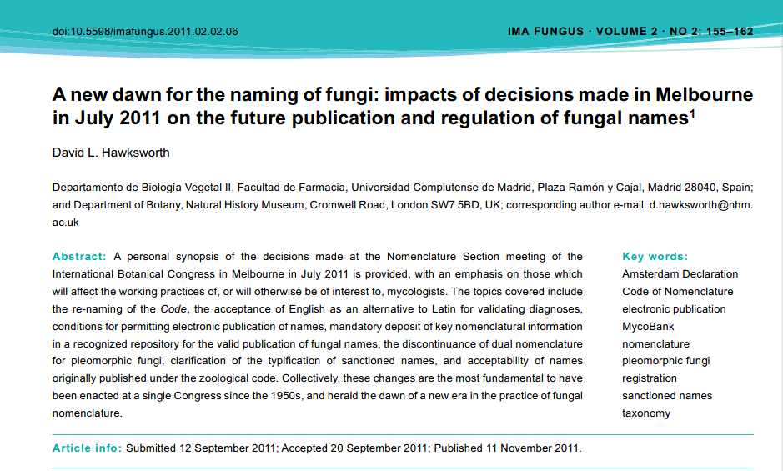
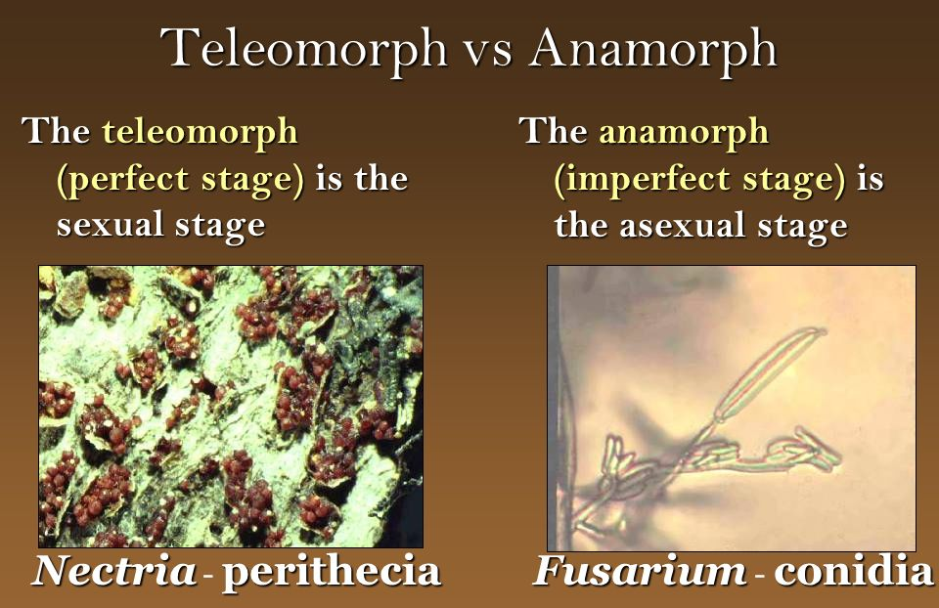
Sometimes fungal taxonomy/naming breaks because they have different life cycles than plants.
This is allowed to happen because....
Tradition? Recalcitrance? I have no idea.
We will cover these terms later when we look at life cycles. Suffice it to say that many fungal species currently have more than one latin name.
This is because fungi have been traditionally identified morphologically by reproductive structures... and they can reproduce sexually and asexually.
oops!
These are the same species

Slide 13
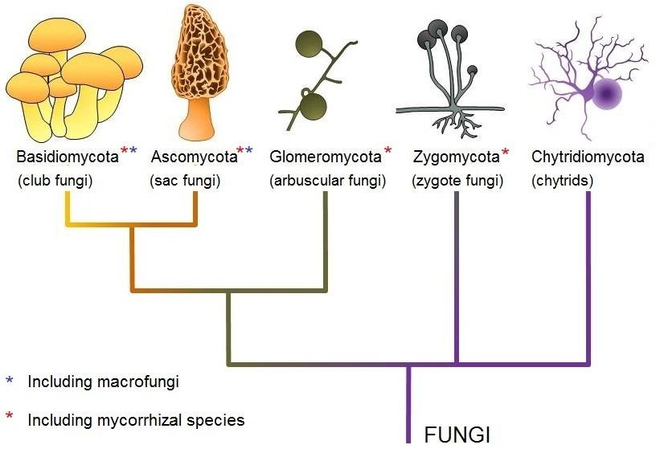
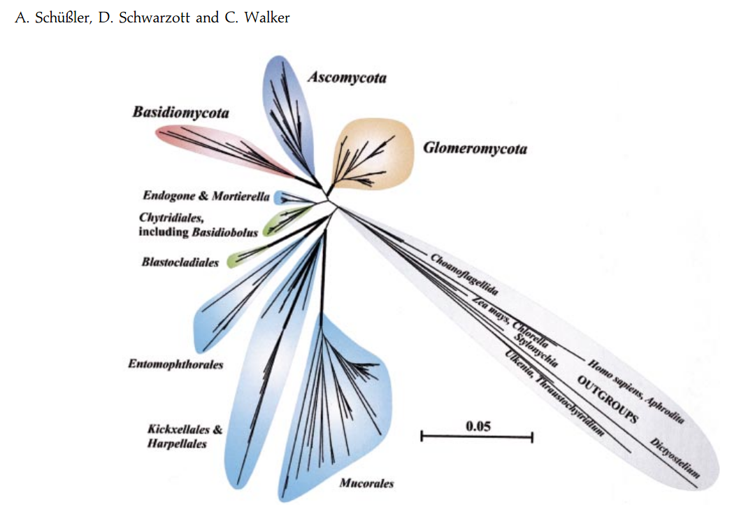
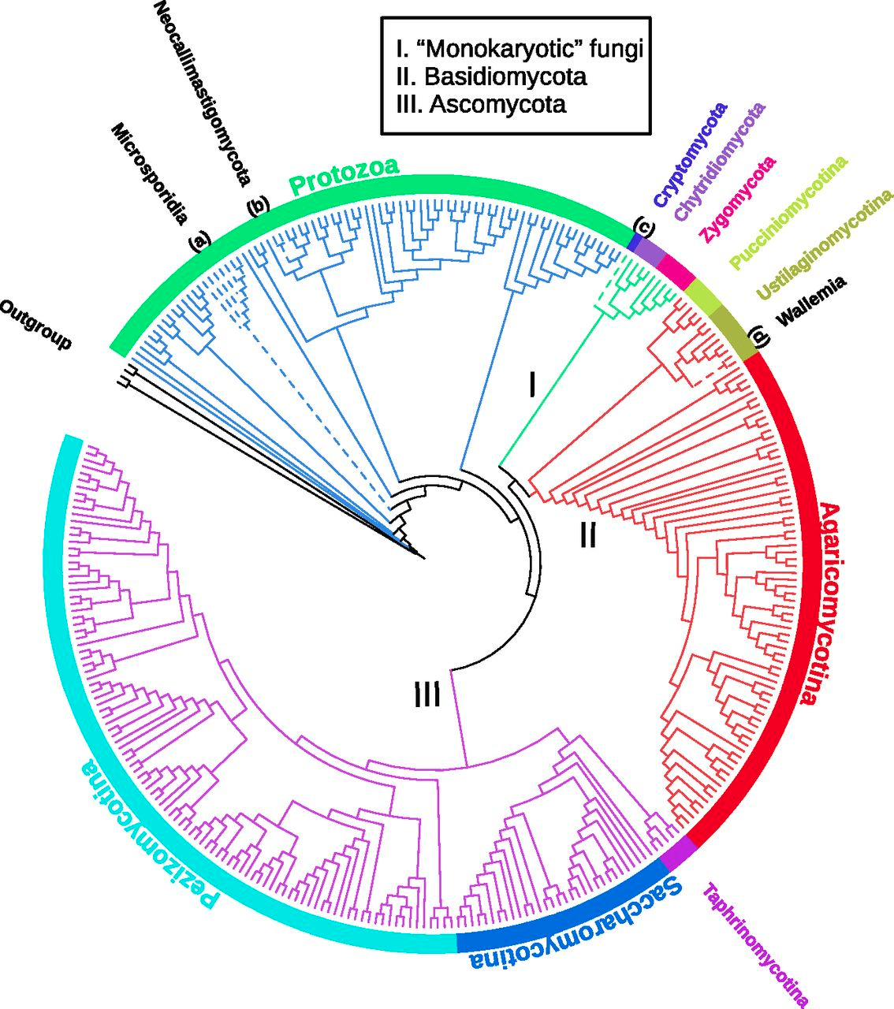
Extant eumycota groups
The cool kids call these:
Cytrids
Zygos
AMFs (Glomeros)
Ascos
Basidios
These trees all include different groups

Slide 14
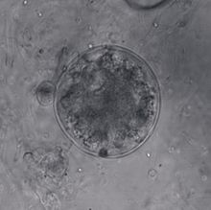
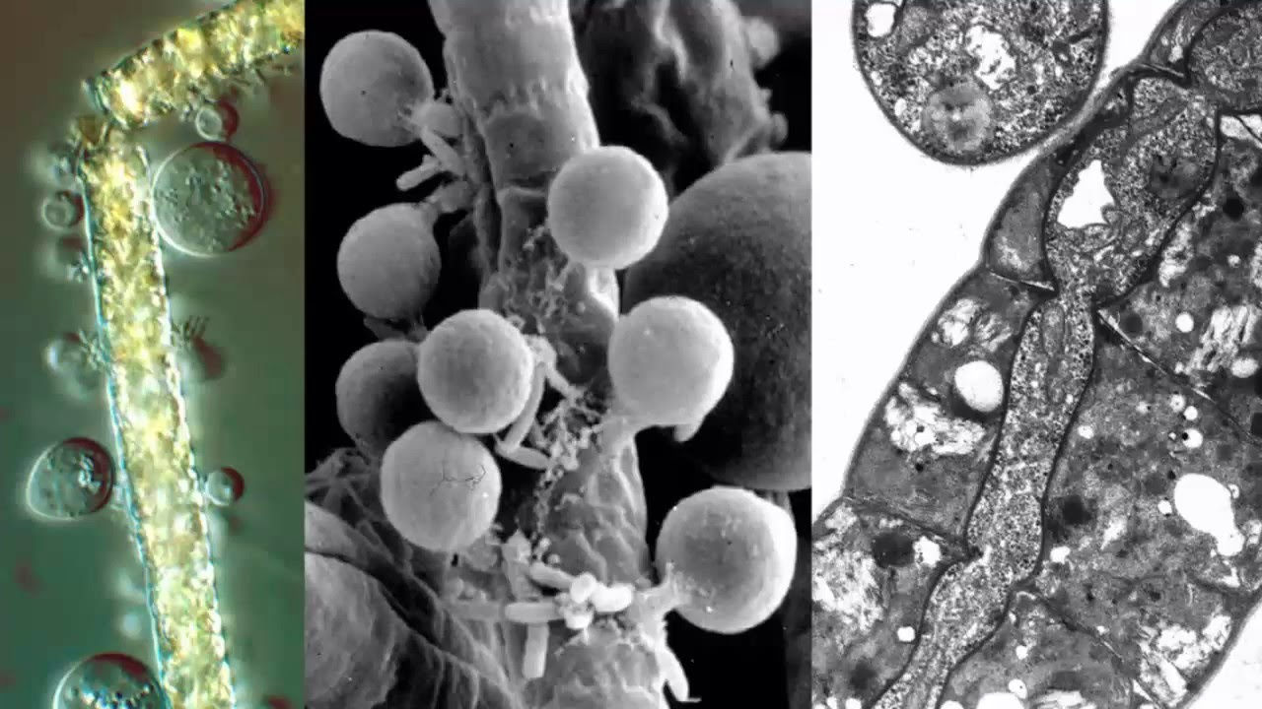
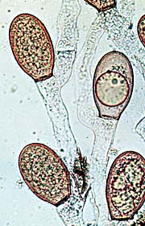
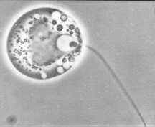
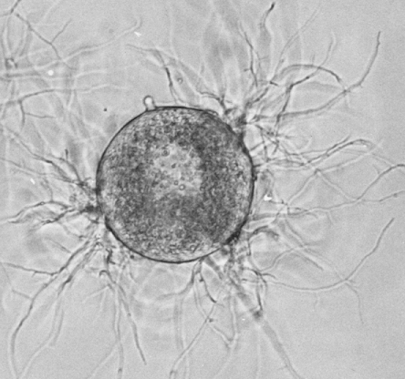
Of the extant eumycota, the earliest-diverging group is known as the Chytridiomycota.
You've got a nice paper to read about chytrids and the loss of the fungal flagellum. I won't repeat that material here.
"Chytrid" means "little pot," referring to the zoospore-containing structure. They are predominantly aquatic and still have opisthokont-like flagella during a life stage known as "zoospores."
"little pots"
Zoosporangium of Spizellomycetales
(getting the hang of the terminology yet? No worries, you'll get used to it.)

Slide 15
Zoospores (pronounced: zō ▪ ō ▪ spores) being "hatched" from a chytrid zoosporangium
Chytrids are a polyphyletic group of fungi... everything with zoospores.

Slide 16
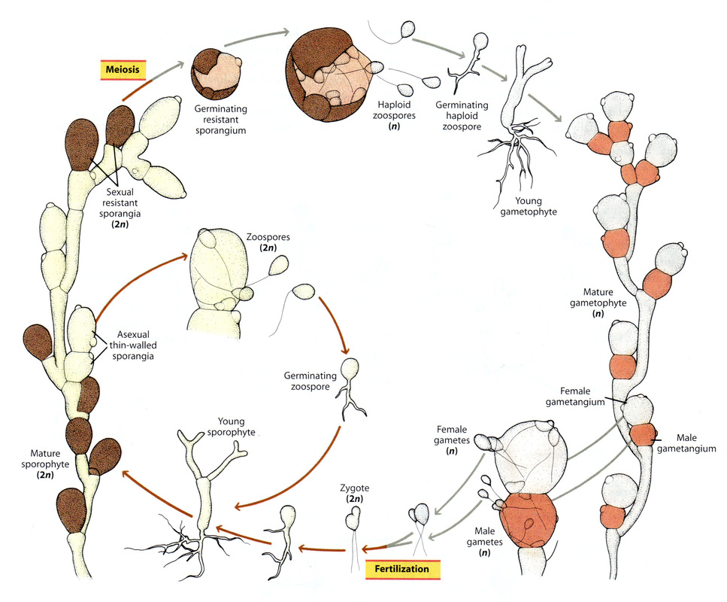
Generic Chytrid life- cycle
Note the asexual and sexual life cycles.
Zoospores can be either 2n or 1n, though in most chytrid groups they are haploid
Environment often determines whether a fungus undergoes meiosis
Allomyces sp., a group of chytrid fungi depicted here.
Note the botanical terms like "gametangium."

Slide 17
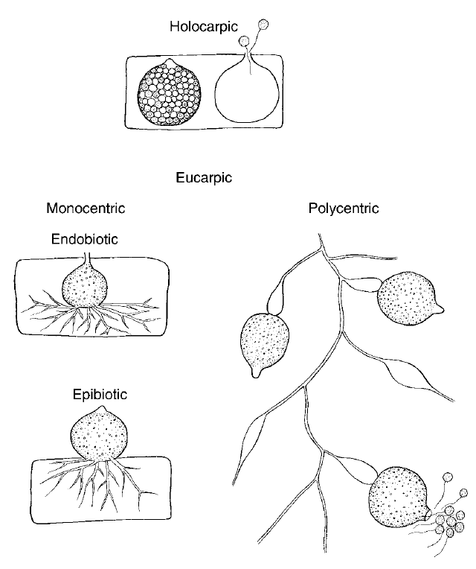
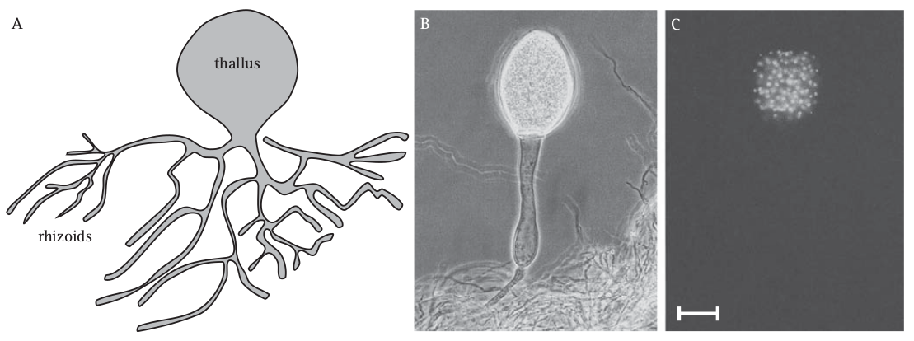
General morphology of chytrids
Shown parasitizing an algal cell

Slide 18
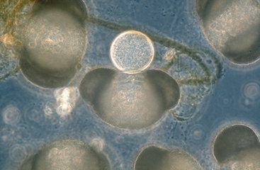
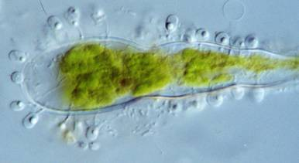
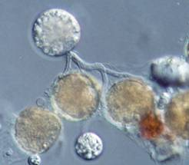
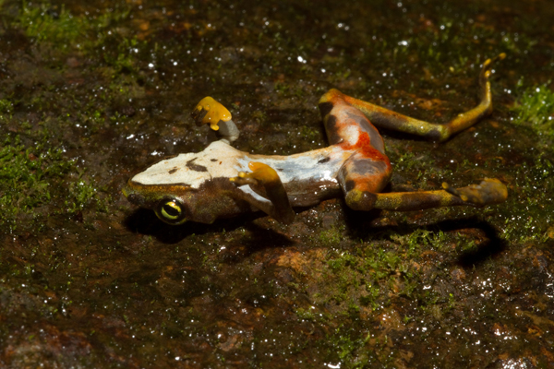
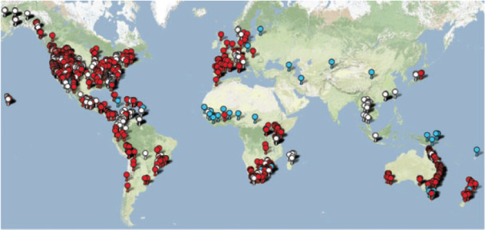
Chytrid ecological modes
eating pine pollen eating algae eating something
Chytridiomycosis: chytrids are wiping out entire amplibian populations around the world!

Slide 19
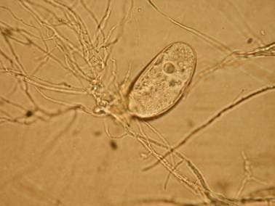
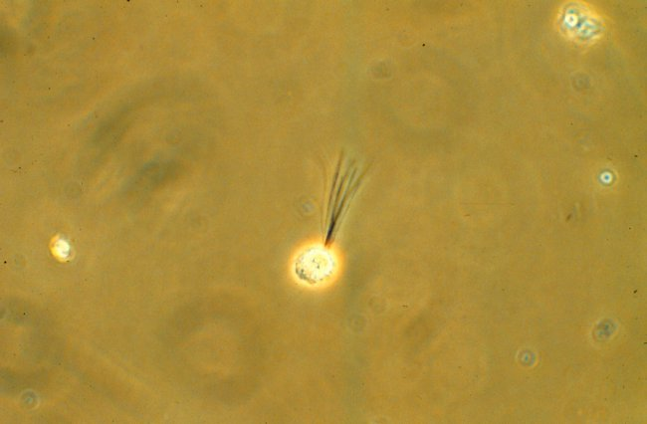
Chytrids have lots of ecological modes:
Saptrotrophs - eat dead stuff
Biotrophs - require living tissue to parasitize
Necrotrophs - kill stuff and then eat it
Even some obligate anaerobes (Neocallimastigales)
See Webster & Weber chapter 6 for an overview of how truly biochemically diverse chytrids are
This is Neocallimastix, a chytrid that lives in ruminant guts. It's the reason cows can digest grass, and you can eat cheeseburgers. It's got funky multi-flagellate zoospores and is an obligate anaerobe.

Slide 20
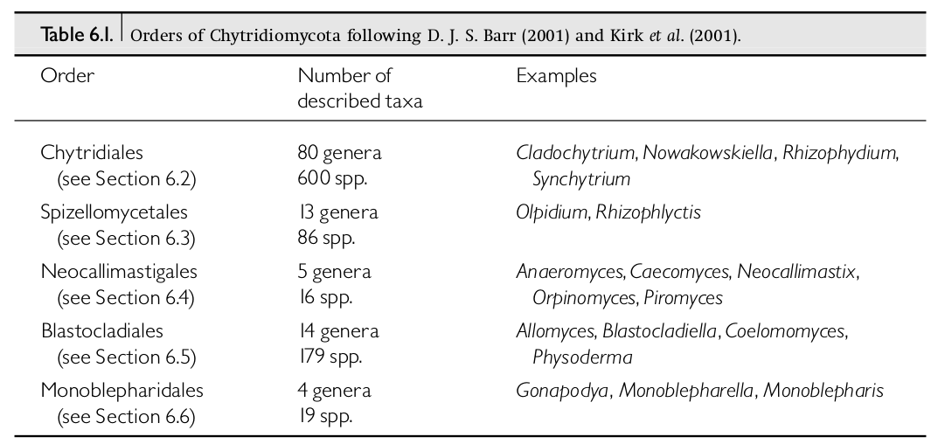
So, how do chytrids fit into our picture of fungal evolution, morphology, physiology, diversity, and ecology?
Evolution - Polyphyletic, early-diverging group; split from rest of fungi before the Cambrian radiation
Morphology - Have primitive hyphae, flagellated spores, can do both sexual and asexual reproduction,
Physiology - Cell walls and membranes resemble other extant fungi; simpler "hyphae"; contain many highly complex secondary compounds and excretory proteins; can digest a wide range of materials
Diversity - Represent at least 1000 species (possibly many many more). Many "species" are actually cryptic species
complexes that are difficult to study.
Ecology - Examples include
important plant pathogens and
devastating animal parasites;
Facultative and obligate anaerobes;
Most are obligate aerobes
Credit: Webster & Weber

Slide 21
Assignments
1. Read Webster & Weber, sections: 1.1, 1.5, and 6.1
- These cover an introduction to fungi and their classification, and then an introduction to chytrids
2. Read the James, et al., paper (link on course website)
- This paper looks at the early evolution of fungi with a focus on how only a few fungi now have flagellae
- It also gives a nice detailed phylogeny of all known fungal groups
- This will help you think like an evolutionary biologist
3. You will have a Canvas quiz on the assigned readings and will also have to participate in a Slack discussion about them.
4. You also need to order "Mr. Bloomfield's Orchard." We will be reading that together during the second half of the course. Might as well get it now.
5. Finally, you will need to start isolating zygomycete fungi. You'll need a plastic bag and some bread (without a ton of preservatives). Details on Canvas. This will be due next week, but it takes up to a week to work.

