Slide 1
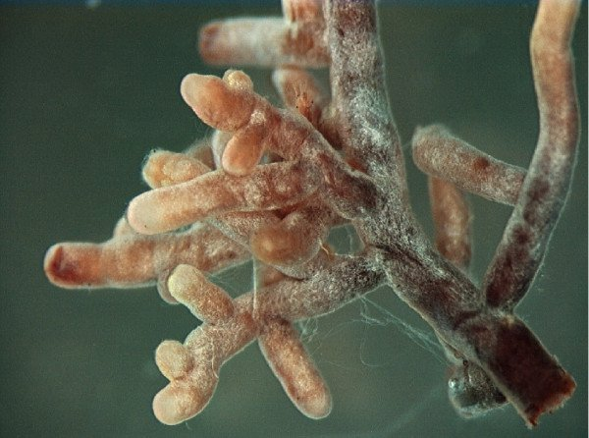
Symbioses:
Mycorrhizae
Topics (just the very basics):
- Fungus + root
- AMF vs ECM vs Ericoid
- Diversity
- Evolution of ECM and mycoheterotrophs

Slide 2
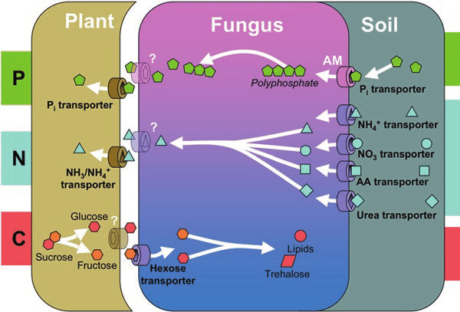
Specialized relationship between host plant and mutualistic fungus
Can't grow these fungi without host (biotrophic)
Many of the ECM fungi have lost previous C-aquisition methods

Slide 3
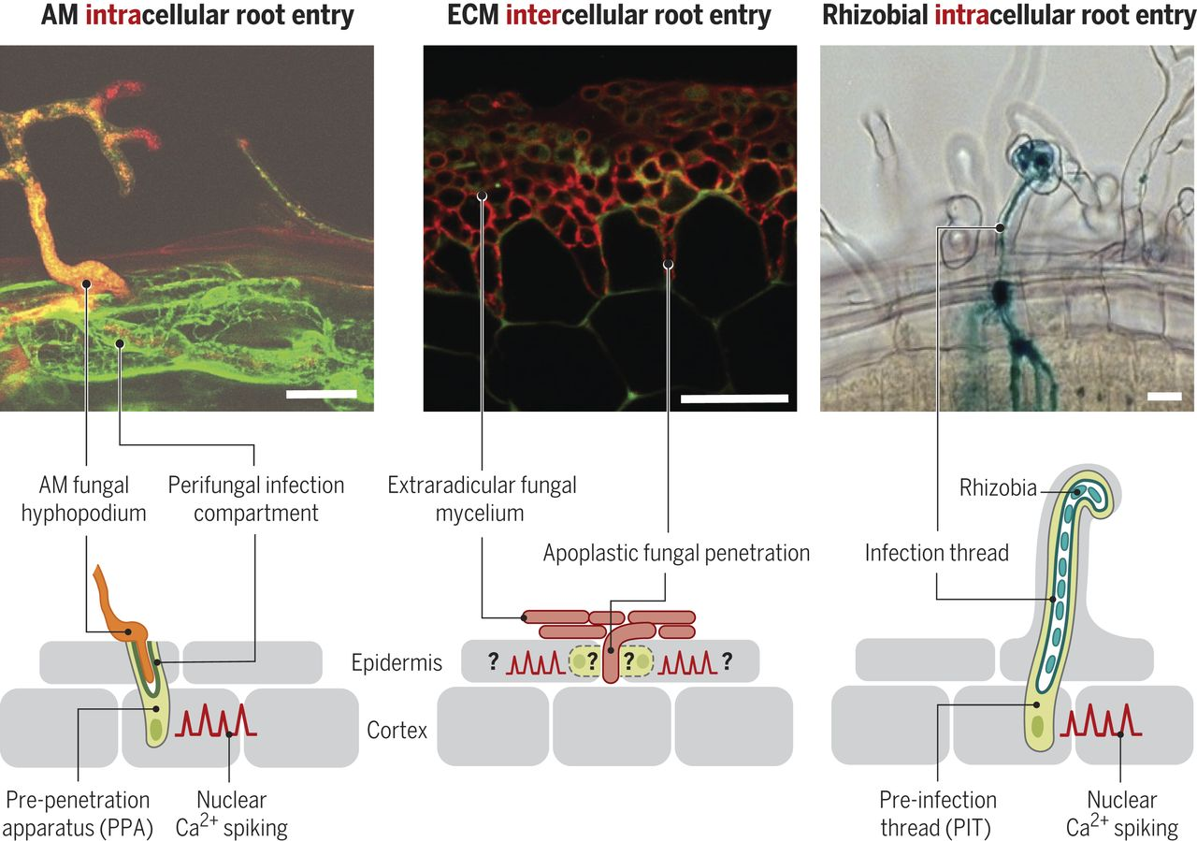
Arbuscular vs Ectomycorrhizal

Slide 4
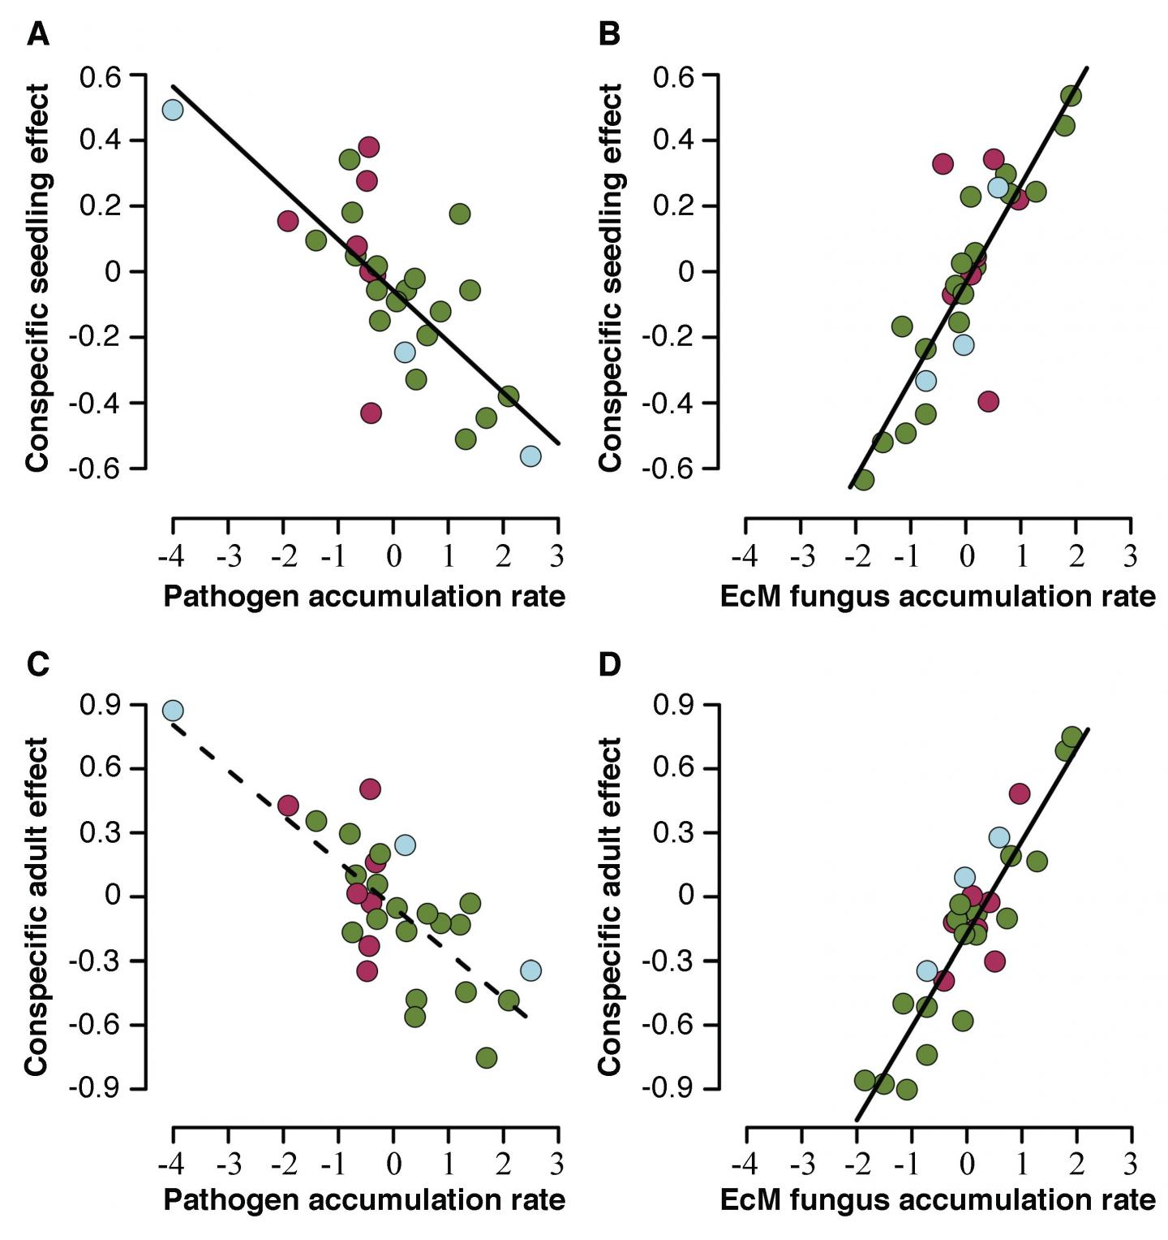
Even without enhanced N and P aquisition, plants benefit from ECM via reduced pathogens

Slide 5
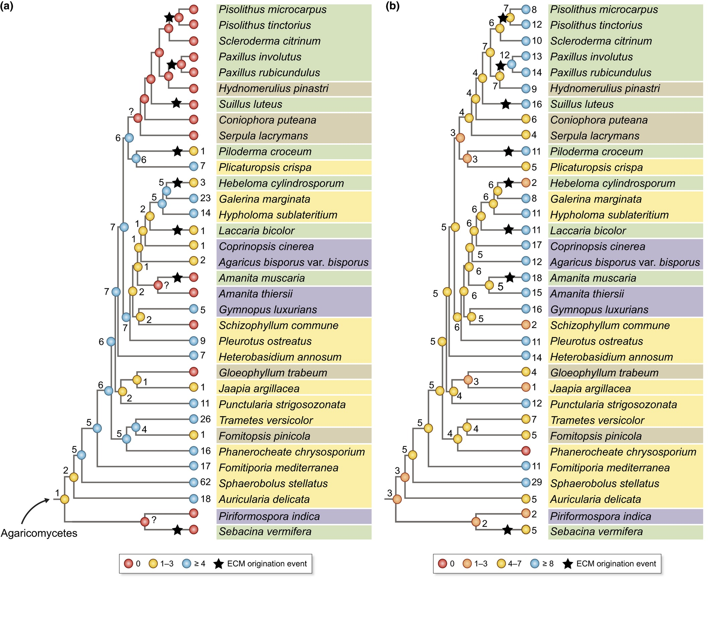
Multiple origins of ECM and co-option of saprotrophic genes to facilitate nutrient liberation and transfer (to plants)
Green = ECM; Numbers are gene copy number for retained saprotrophic peroxidases (left) and laccases (right).

Slide 6
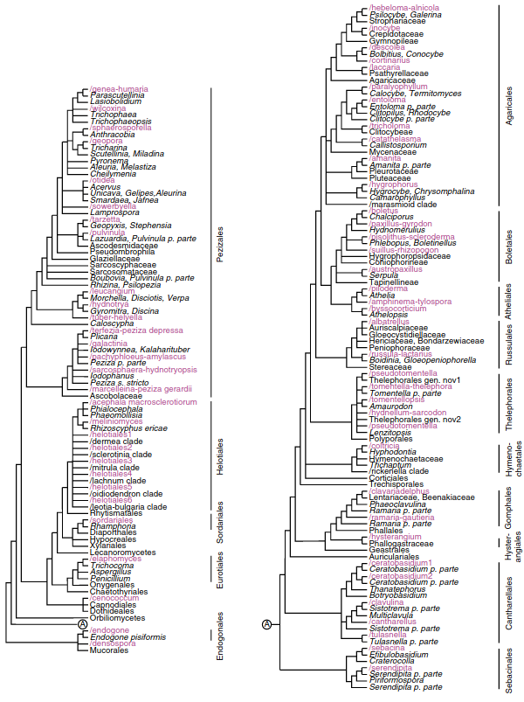
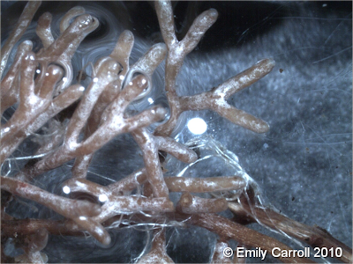
Tell-tale sign of ECM roots
Only 2% of plant species have ECM associations. But some very dominant plants are among them.
(e.g., the entire Taiga belt)
Purple = ECM clades present

Slide 7

These trees are dependent on ECM fungi

Slide 8
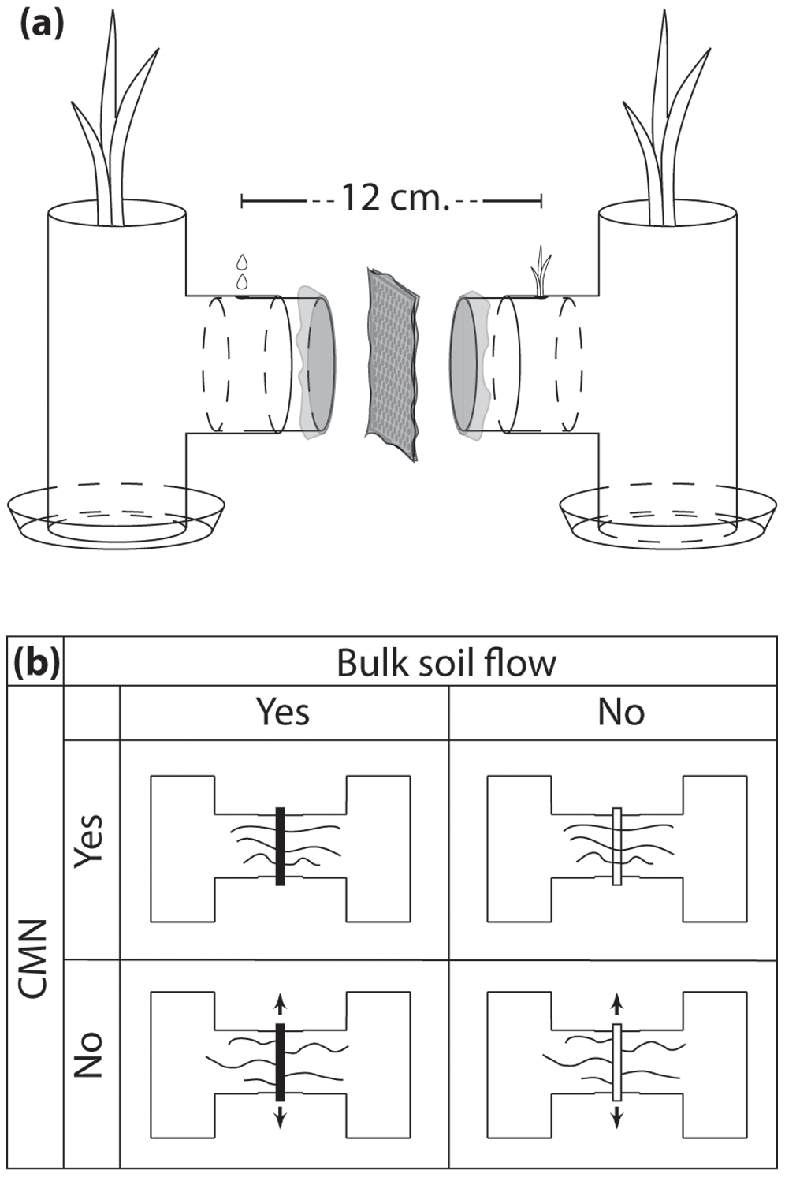
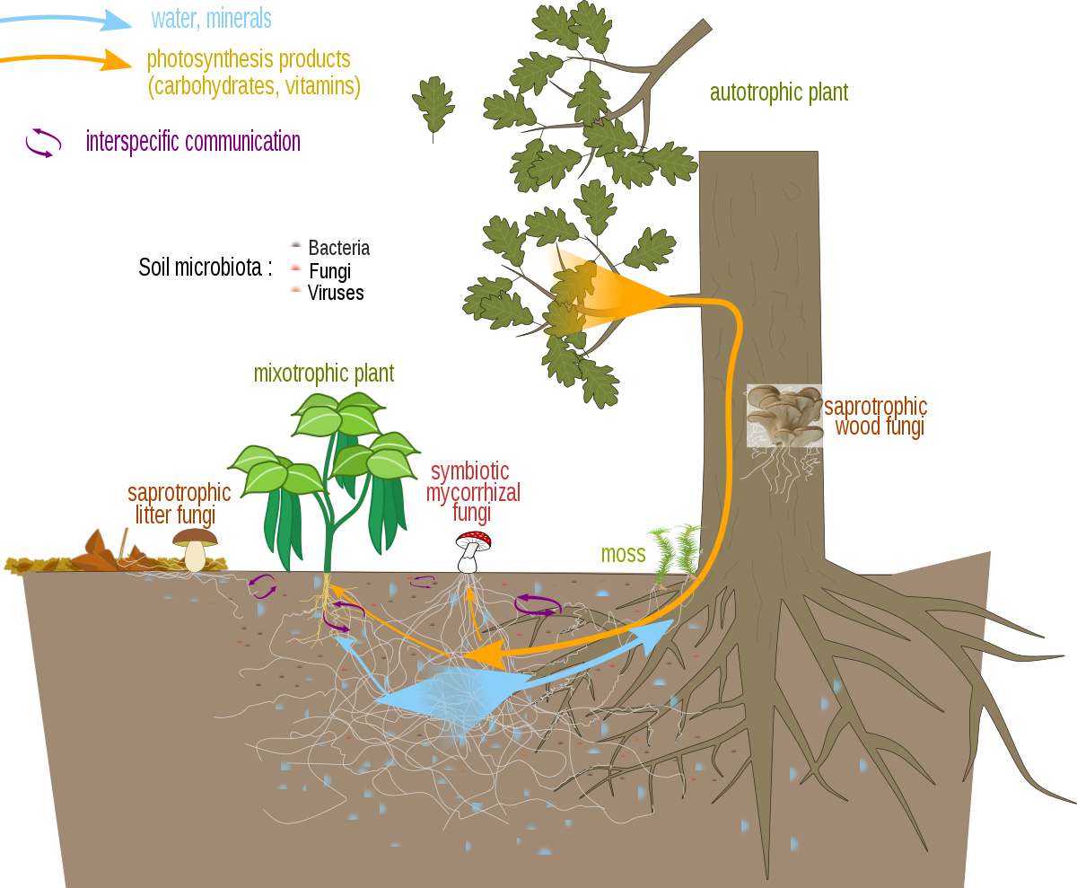
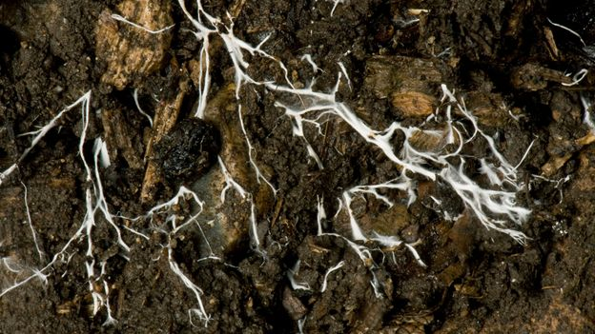
Mycorrhizal networks (the internet of the forest)
ECM fungi can transport lots of things between plants, including sugars, defense compounds, or even poisons.

Slide 9
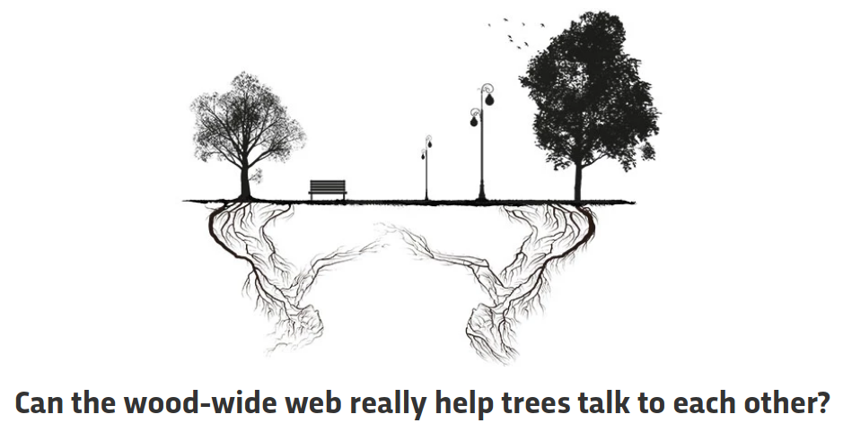
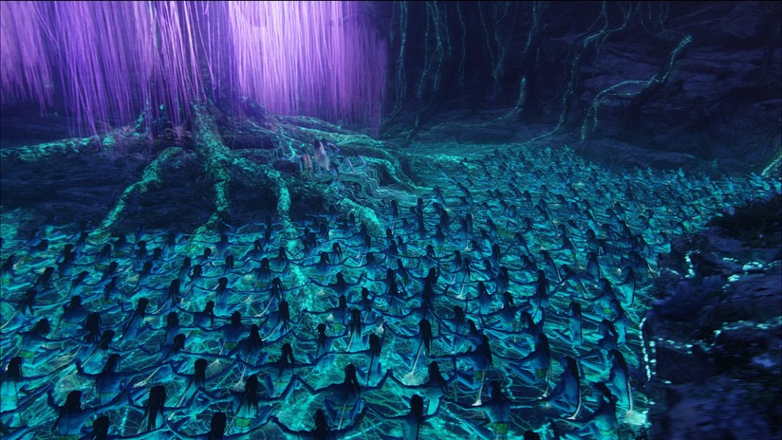
Well, it's complicated.
It isn't like Avatar.
What's in it for the fungus?

Slide 10
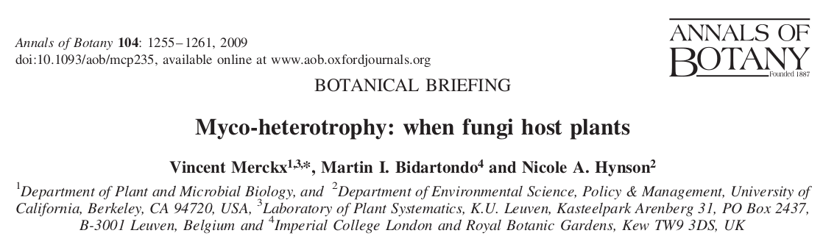
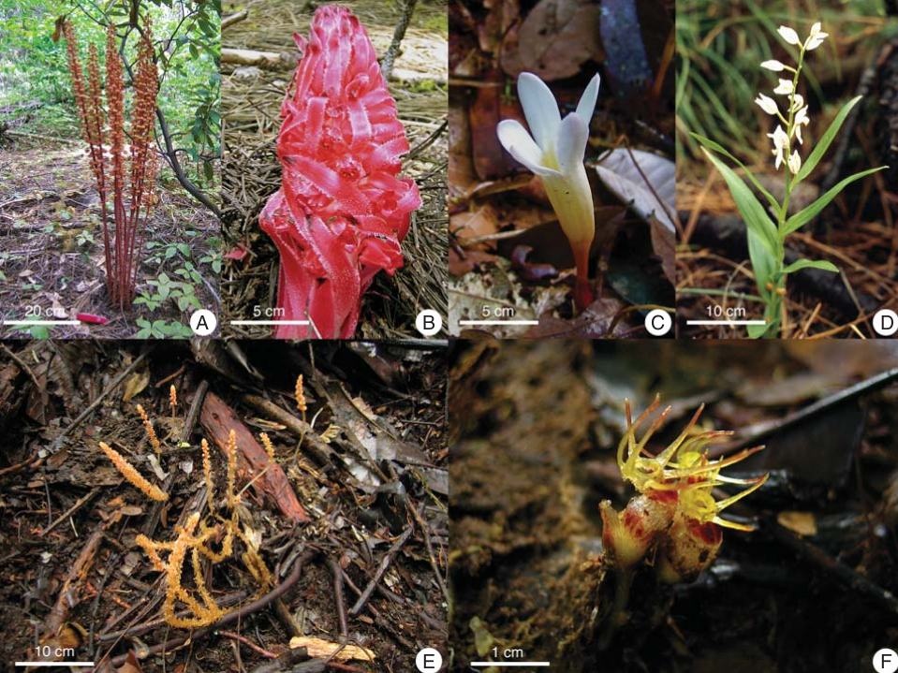

Slide 11
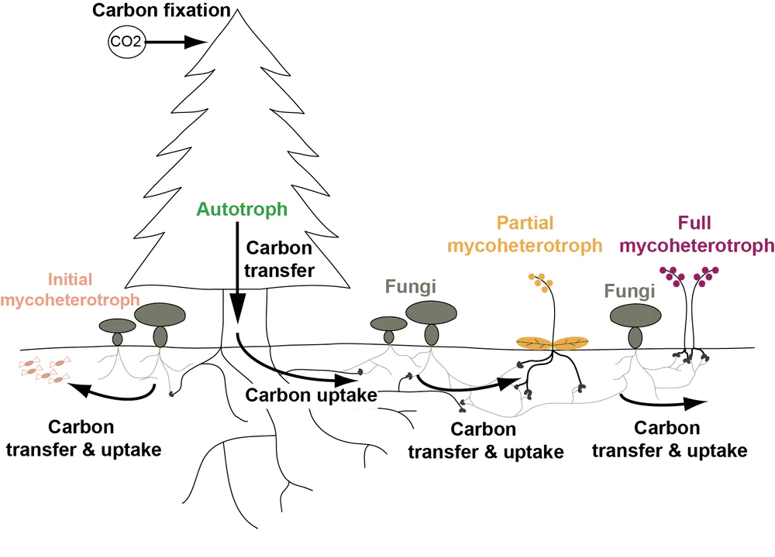

Slide 12
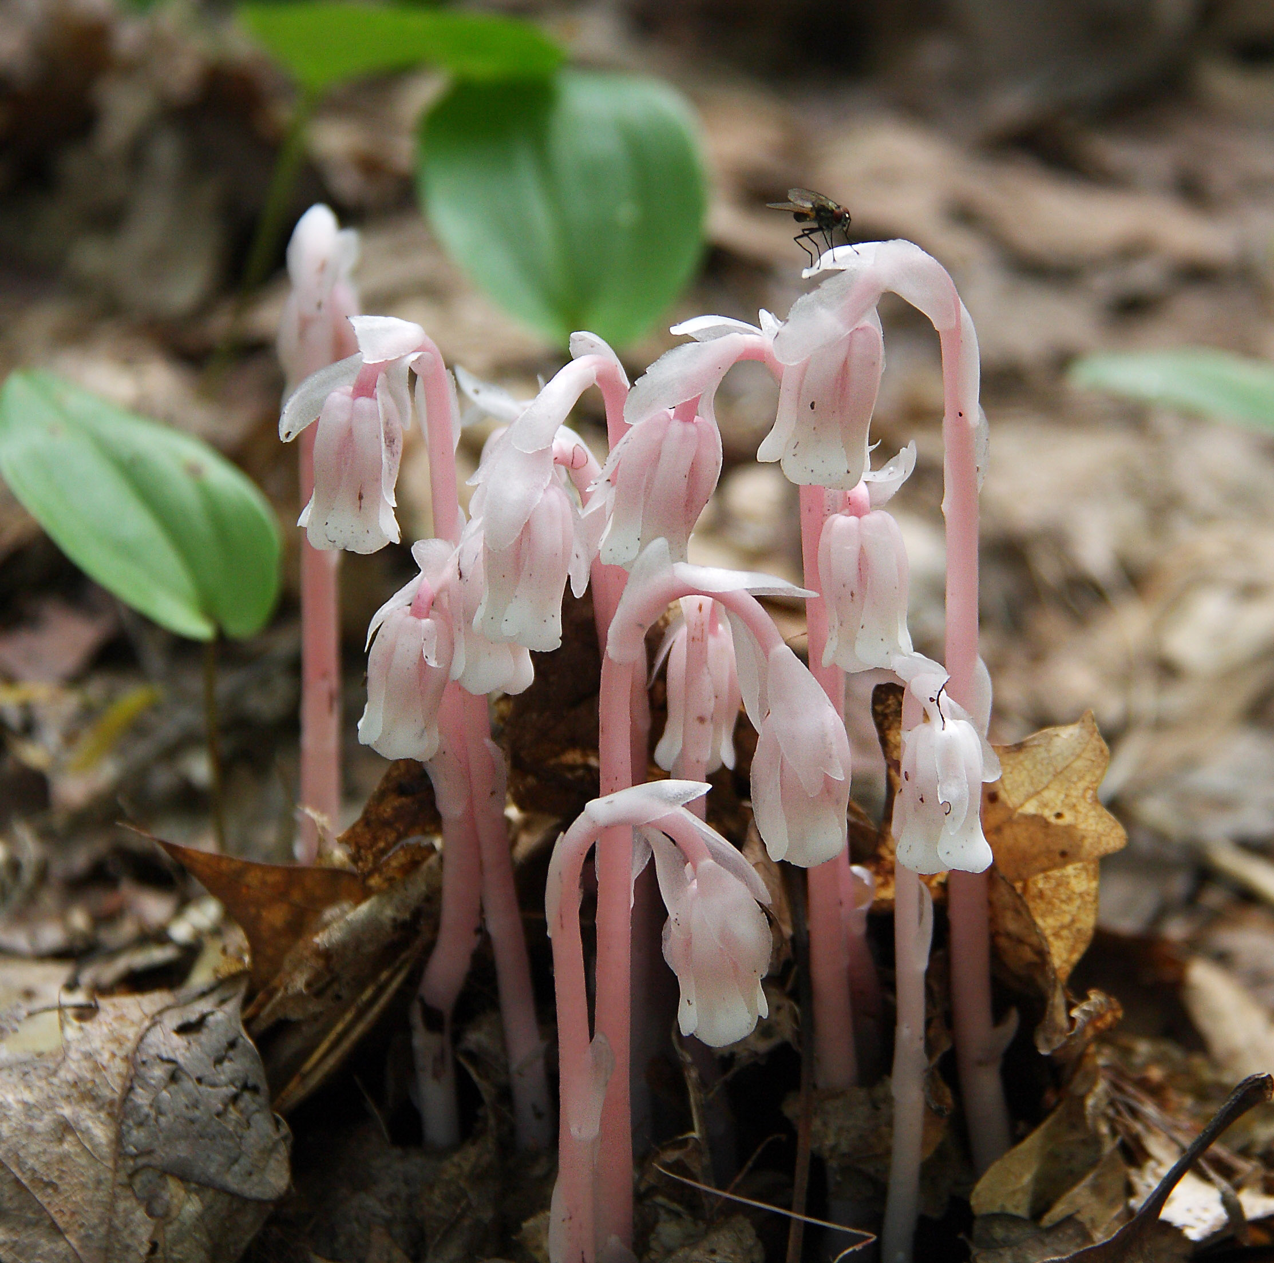
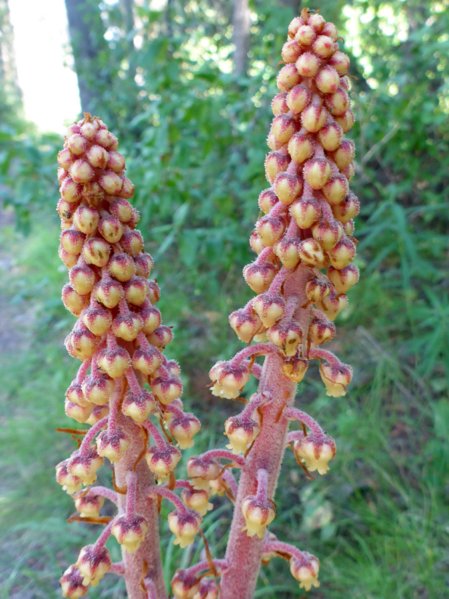
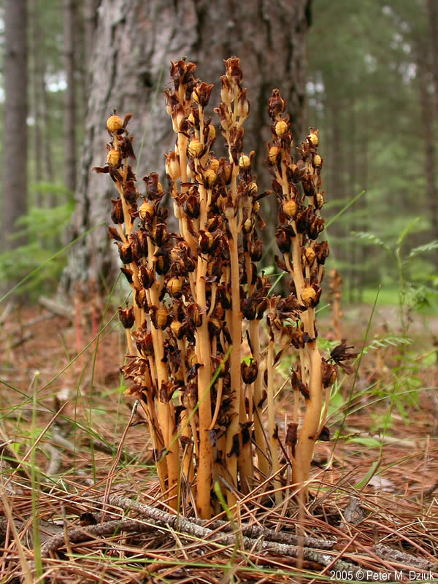
"Common" Utah mycoheterotrophs
Monotropa uniflora
Pterospora andromeda
Monotropa hypopitys

Slide 13
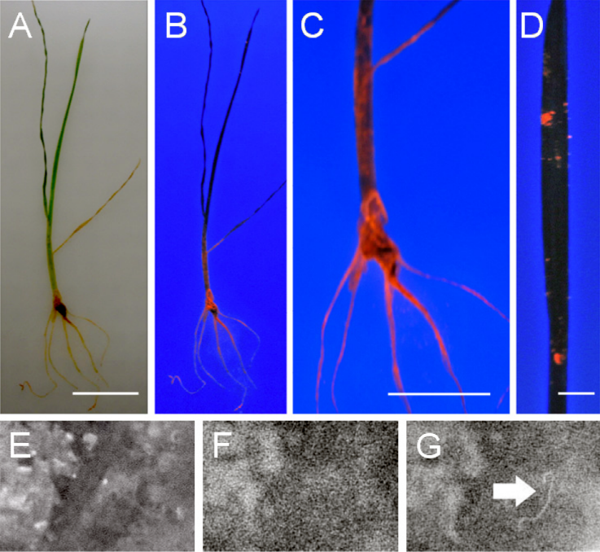
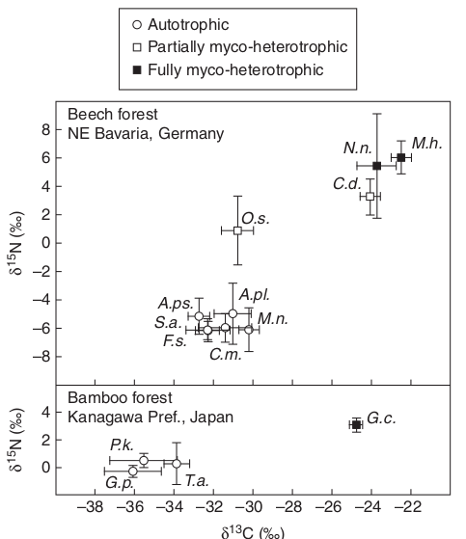
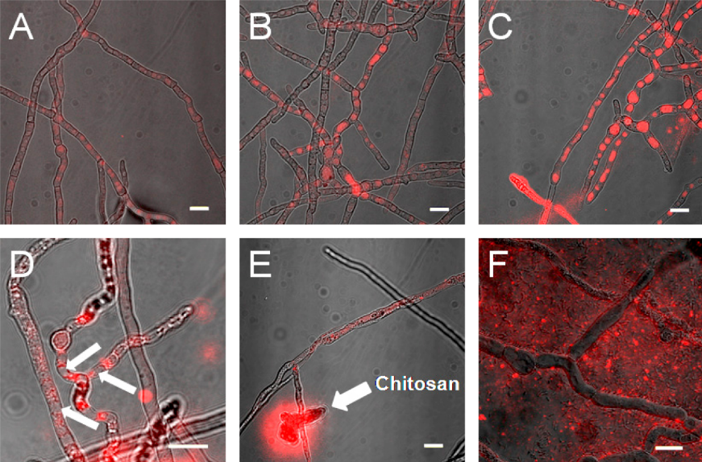
Isotope tracing and quantum dots help us follow and source the nitrogen and carbon.
Merckx et al., 2009
Whiteside et al., 2010

Slide 14
Assignments
1. Keep working on your lab assignments
Use this time to catch up on things!

