Slide 1
Fungal physiology and identification
Topics (just the very basics):
Fungal nutrition and metabolism
Fungal development
Mushroom mechanics
Active dispersal
Mushroom identification

Slide 2
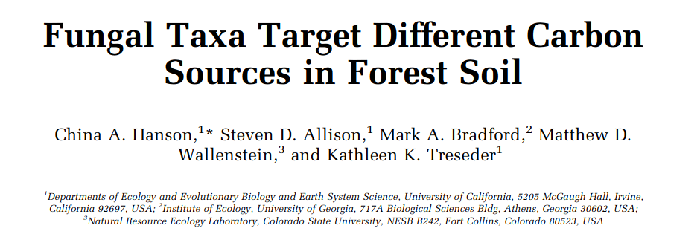
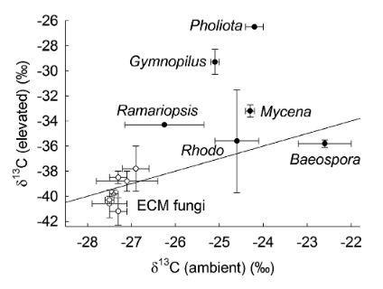
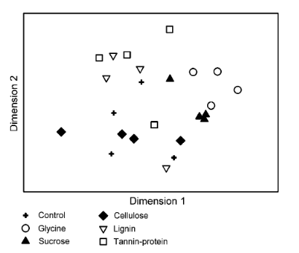
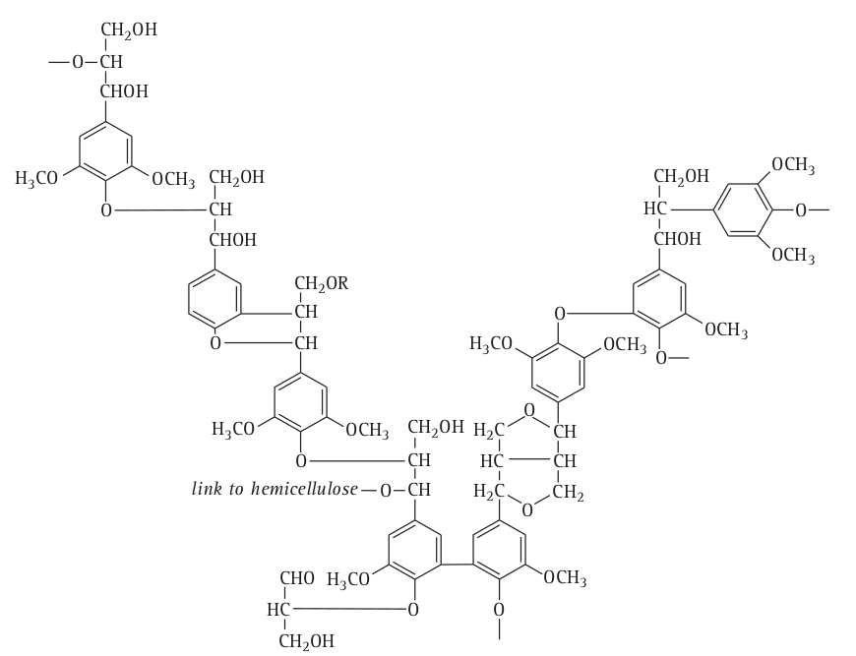
Fungi are biochemistry champions
Can metabolize the widest range of carbon sources of any organisms on Earth
Termites "eat wood" ... yeah but fungi do the digesting
Cows "eat grass" ... that's cute.
Fungi do most of the work.
Different fungi have different strategies for getting carbon
Fair game C sources include:
cellulose, hemicellulose, pectins, chitin,
starch, glycogen, simple sugars,
lignin, and even proteins
Angiosperm lignin. Good luck digesting that

Slide 3
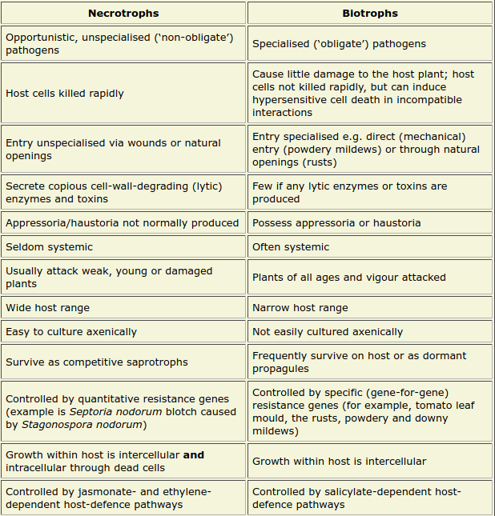
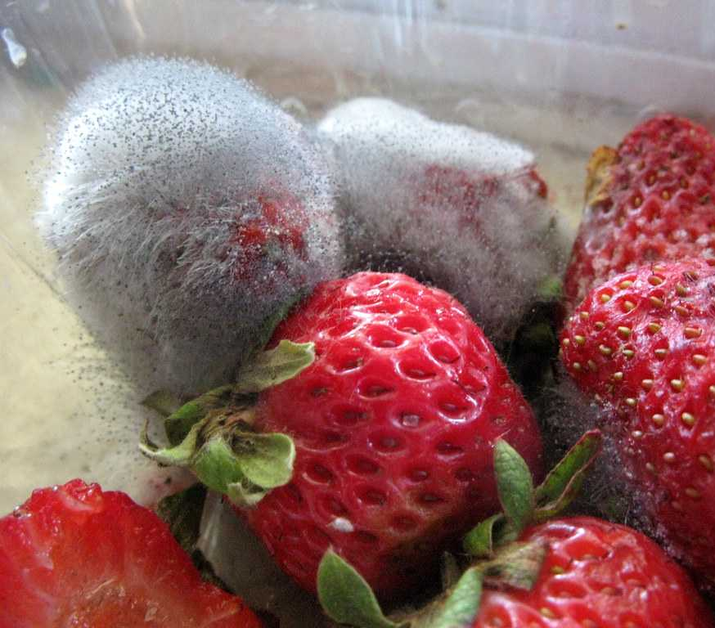
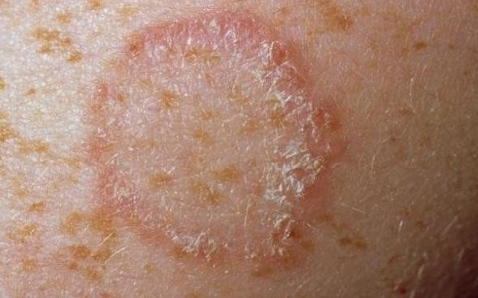
FunGuild website
Fungal trophic modes:
animal pathogens
arbuscular mycorrhizal
ectomycorrhizal
ericoidmycorrhizal
foliar endophytes
lichenicolous
lichenized
mycoparasites
plant pathogens
saprotrophs
Three main categories are reasonable:
Saprotroph (eats dead stuff)
Biotroph (needs host alive)
Necrotroph (pathogen, kills host then eats corpse as saprotroph)

Slide 4
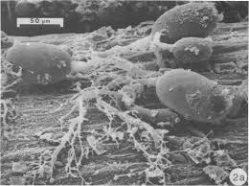
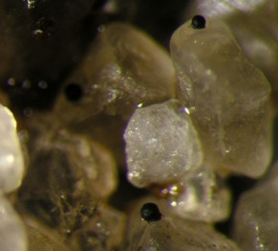
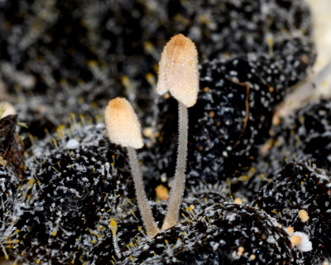
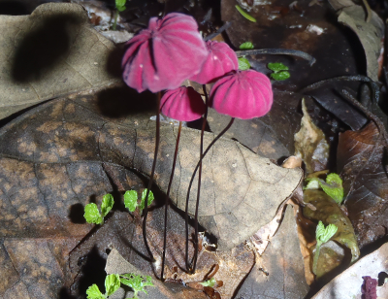
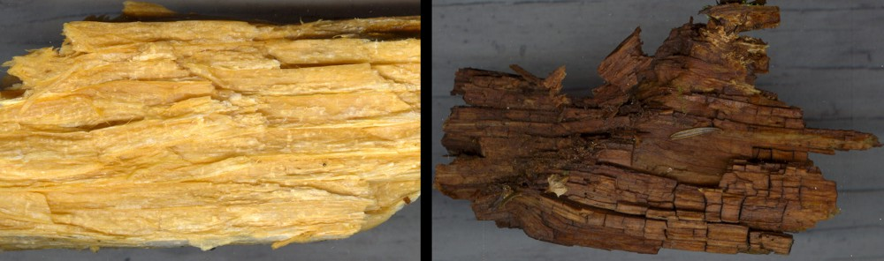
Saprotrophs
Definitely, the majority of fungi fall into this category. They break down and recycle dead material.
Rumen fungi on grass blade Living on sand Dung fungi Fallen leaves
Ever see a log that looks like either of these?
"White rot" (dissolve lignin first) "Brown rot" (leave lignin behind)

Slide 5
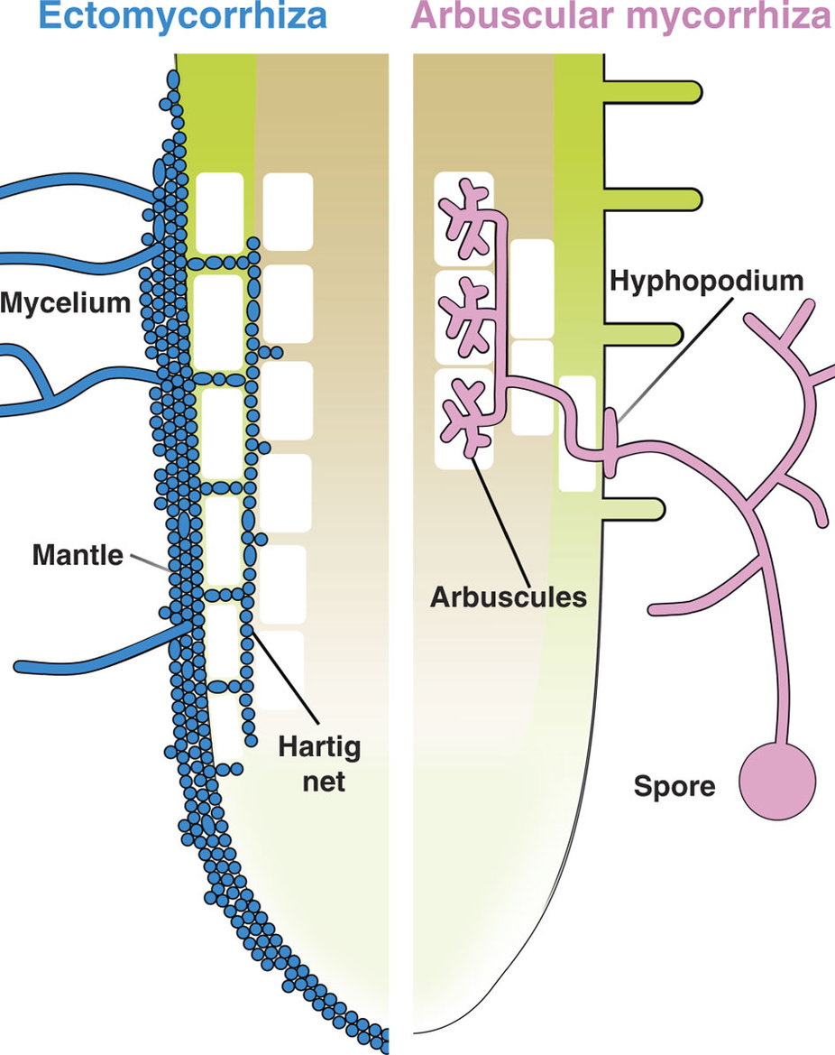
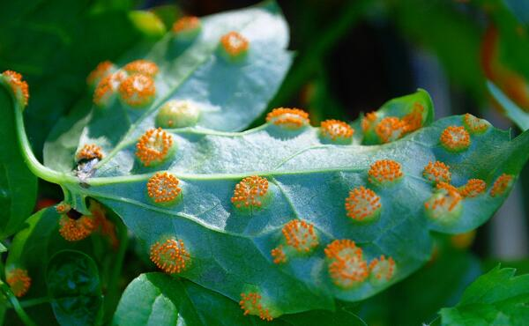
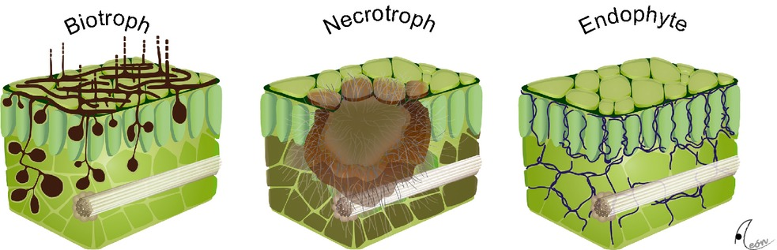
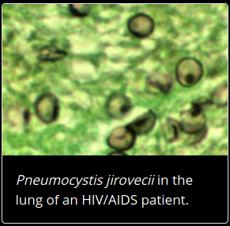
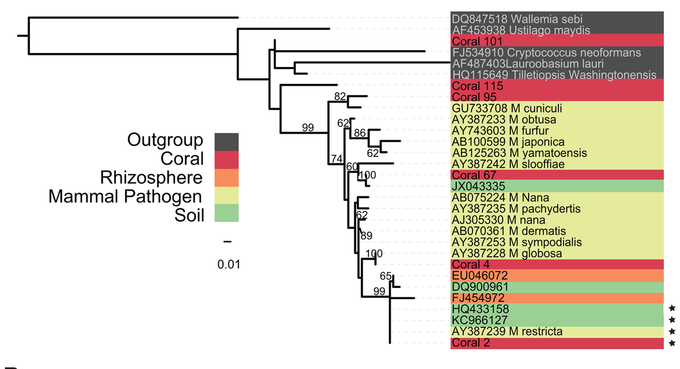
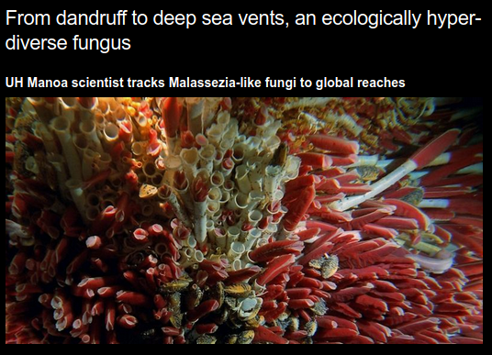
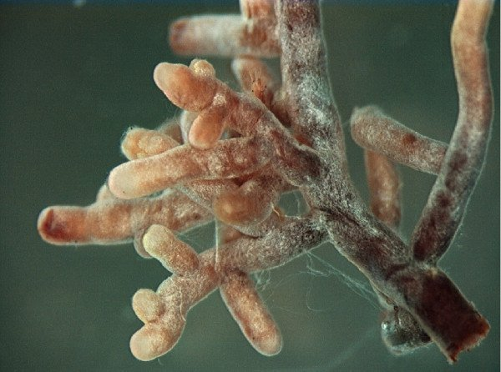
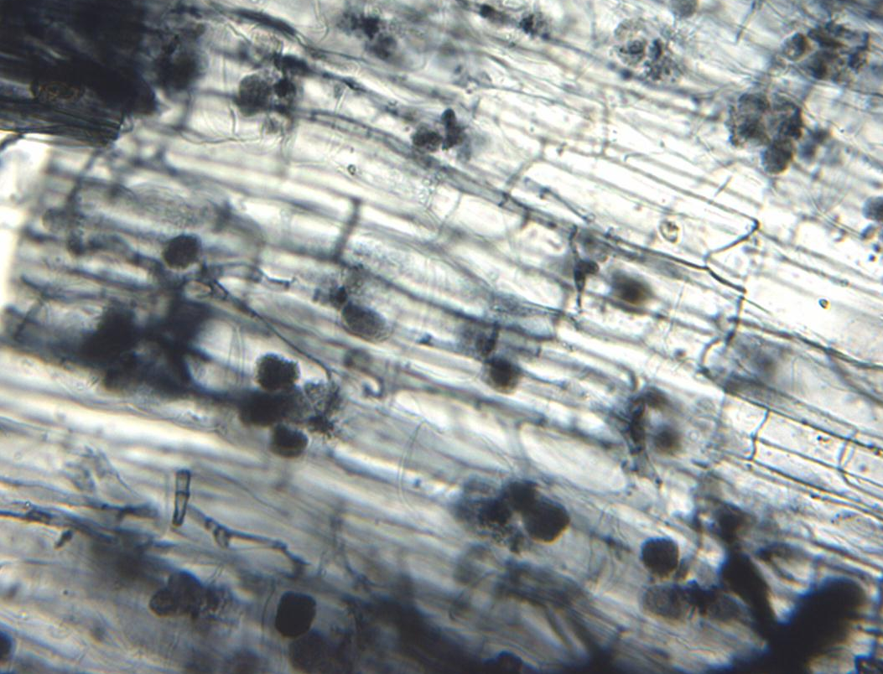
Biotrophs
Can't grow without living host....often, other way around too.

Slide 6
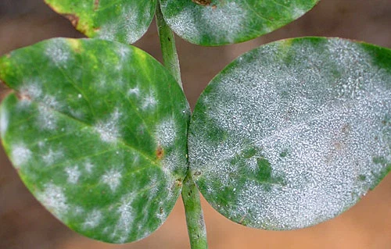
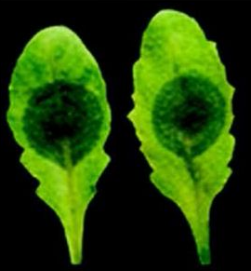
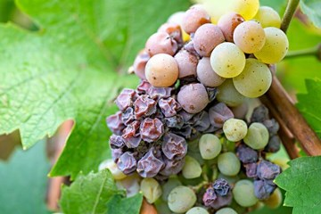
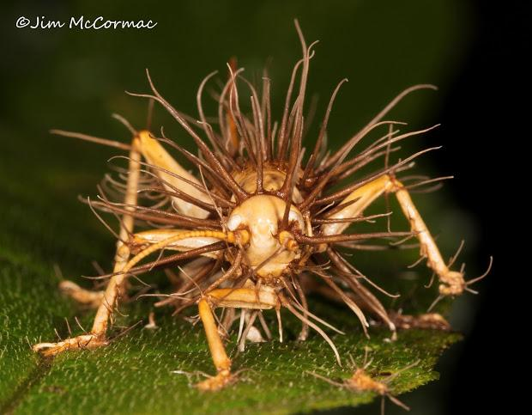
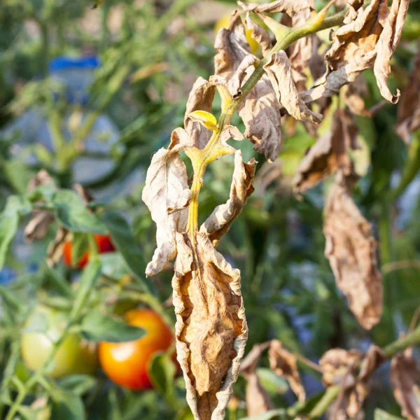
Necrotrophs
Kill their host pretty quickly, and then feast on the corpse.

Slide 7
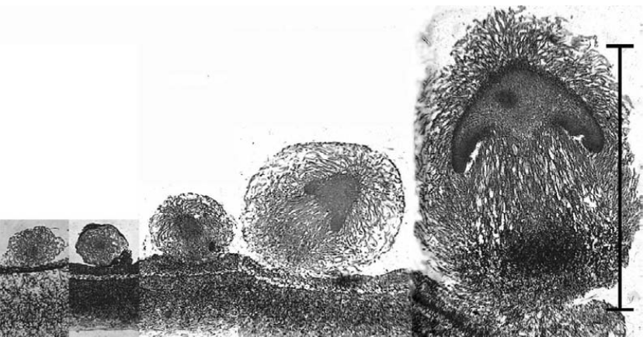
Fungal development
Name of the game is mycelial differentiation
Different from animal developmental biology. Fungal "organs" are actually appendages of the mycelum, not individual units. Similar to clonal corals. Fungi do multicellularity very differently than animals.

Slide 8
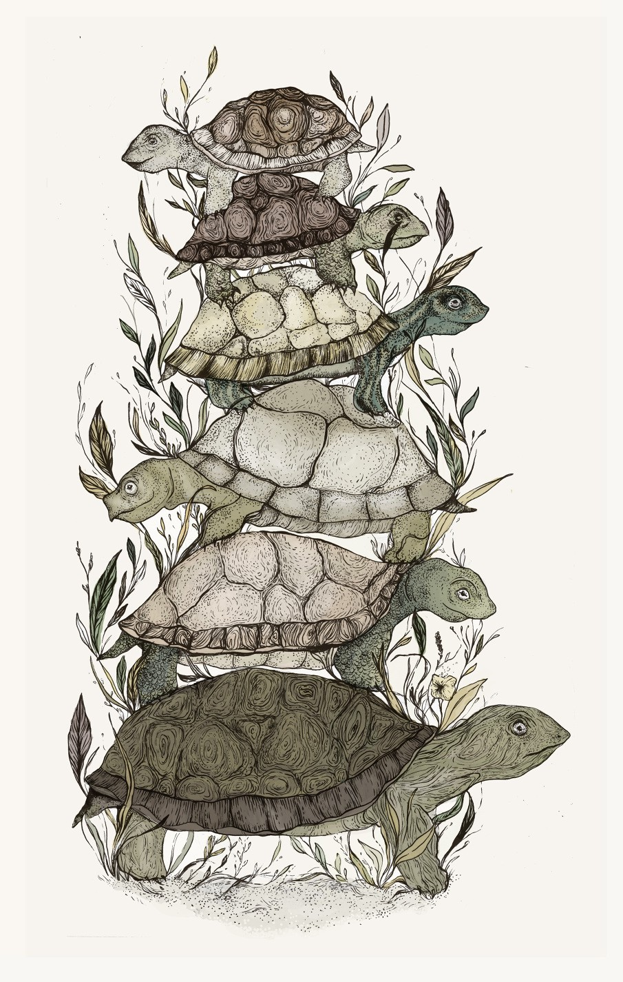
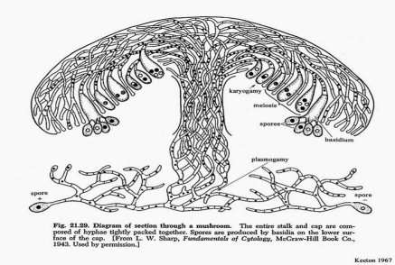
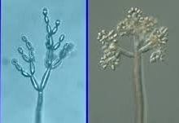
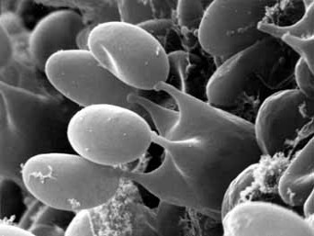
"It's hyphae all the way down..."

Slide 9
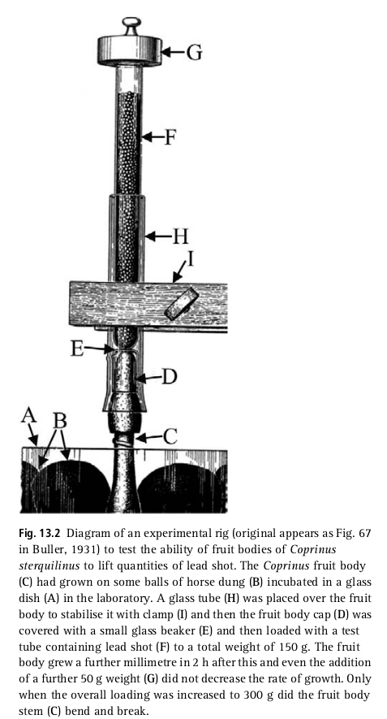
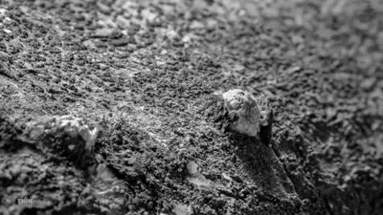
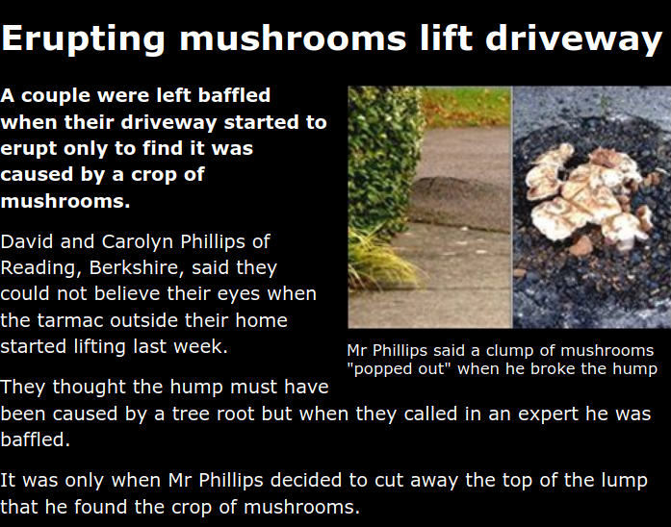
Hydraulics and cell inflation

Slide 10
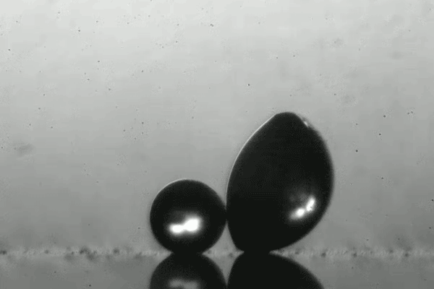

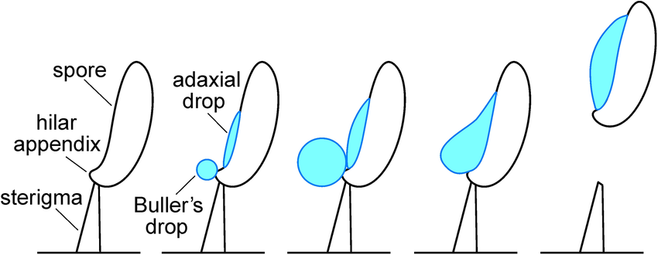
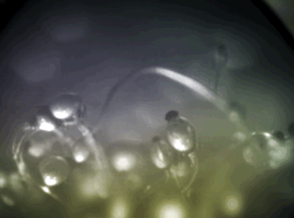
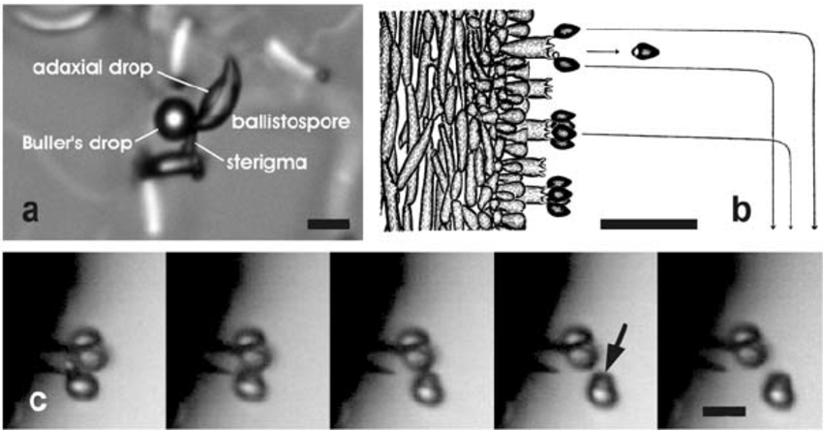
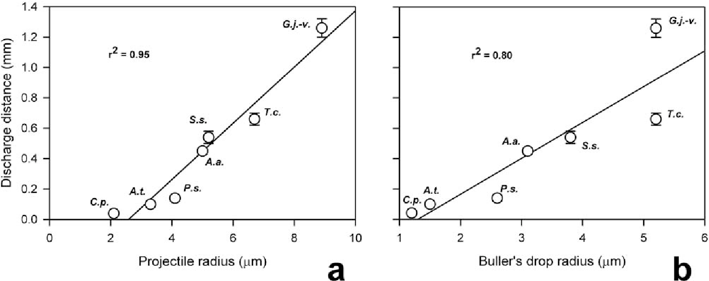
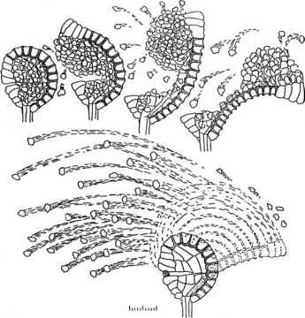
Active spore dispersal:
fungal mechanisms fling spore into environment
environmentally sensitive
fern

Slide 11
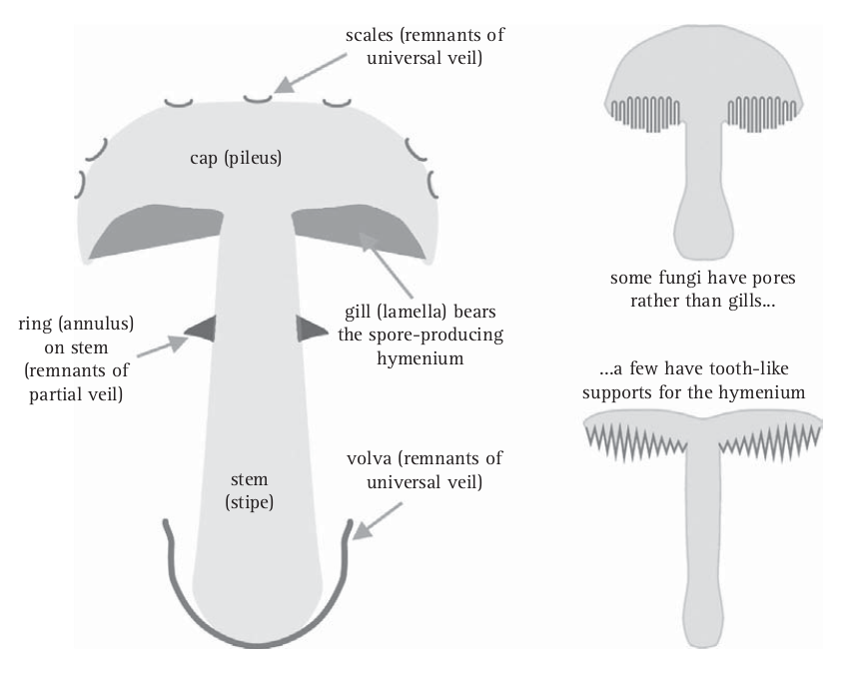
To identify a mushroom properly, you need a lot of characters:
anatomical morphology, ecology, spore shape and color, etc.

Slide 12
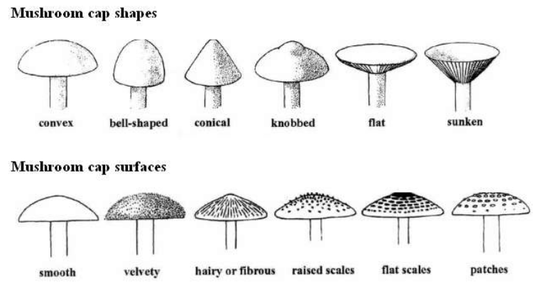
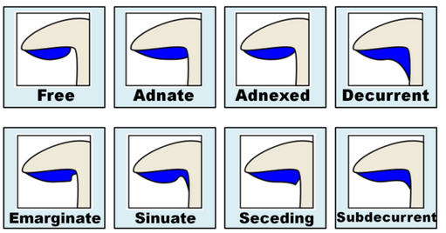
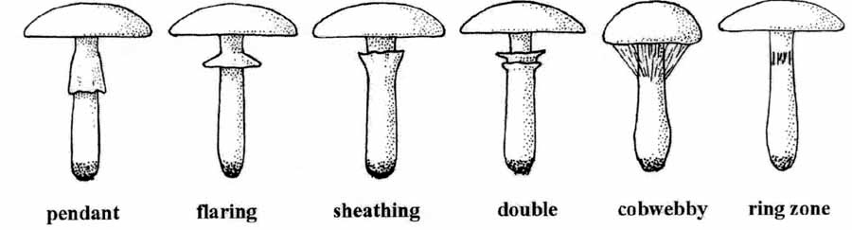
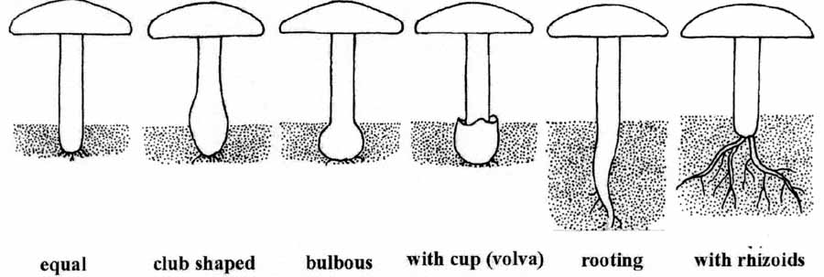
Lots of features...lots of jargon
Caps
Gills
Veil
Stipe
Body form / overall Shape
Cap shape, color, and texture
Stem shape, color, and texture
Flesh color and texture
Spore surface type (gills, teeth/tubes or pores)
Spore surface color
Color changes due to touch
Gill attachment
Presence or absence of a ring/anulus on the stem
Presence or absence of a volva
Spore color (may require making a spore print)

Slide 13
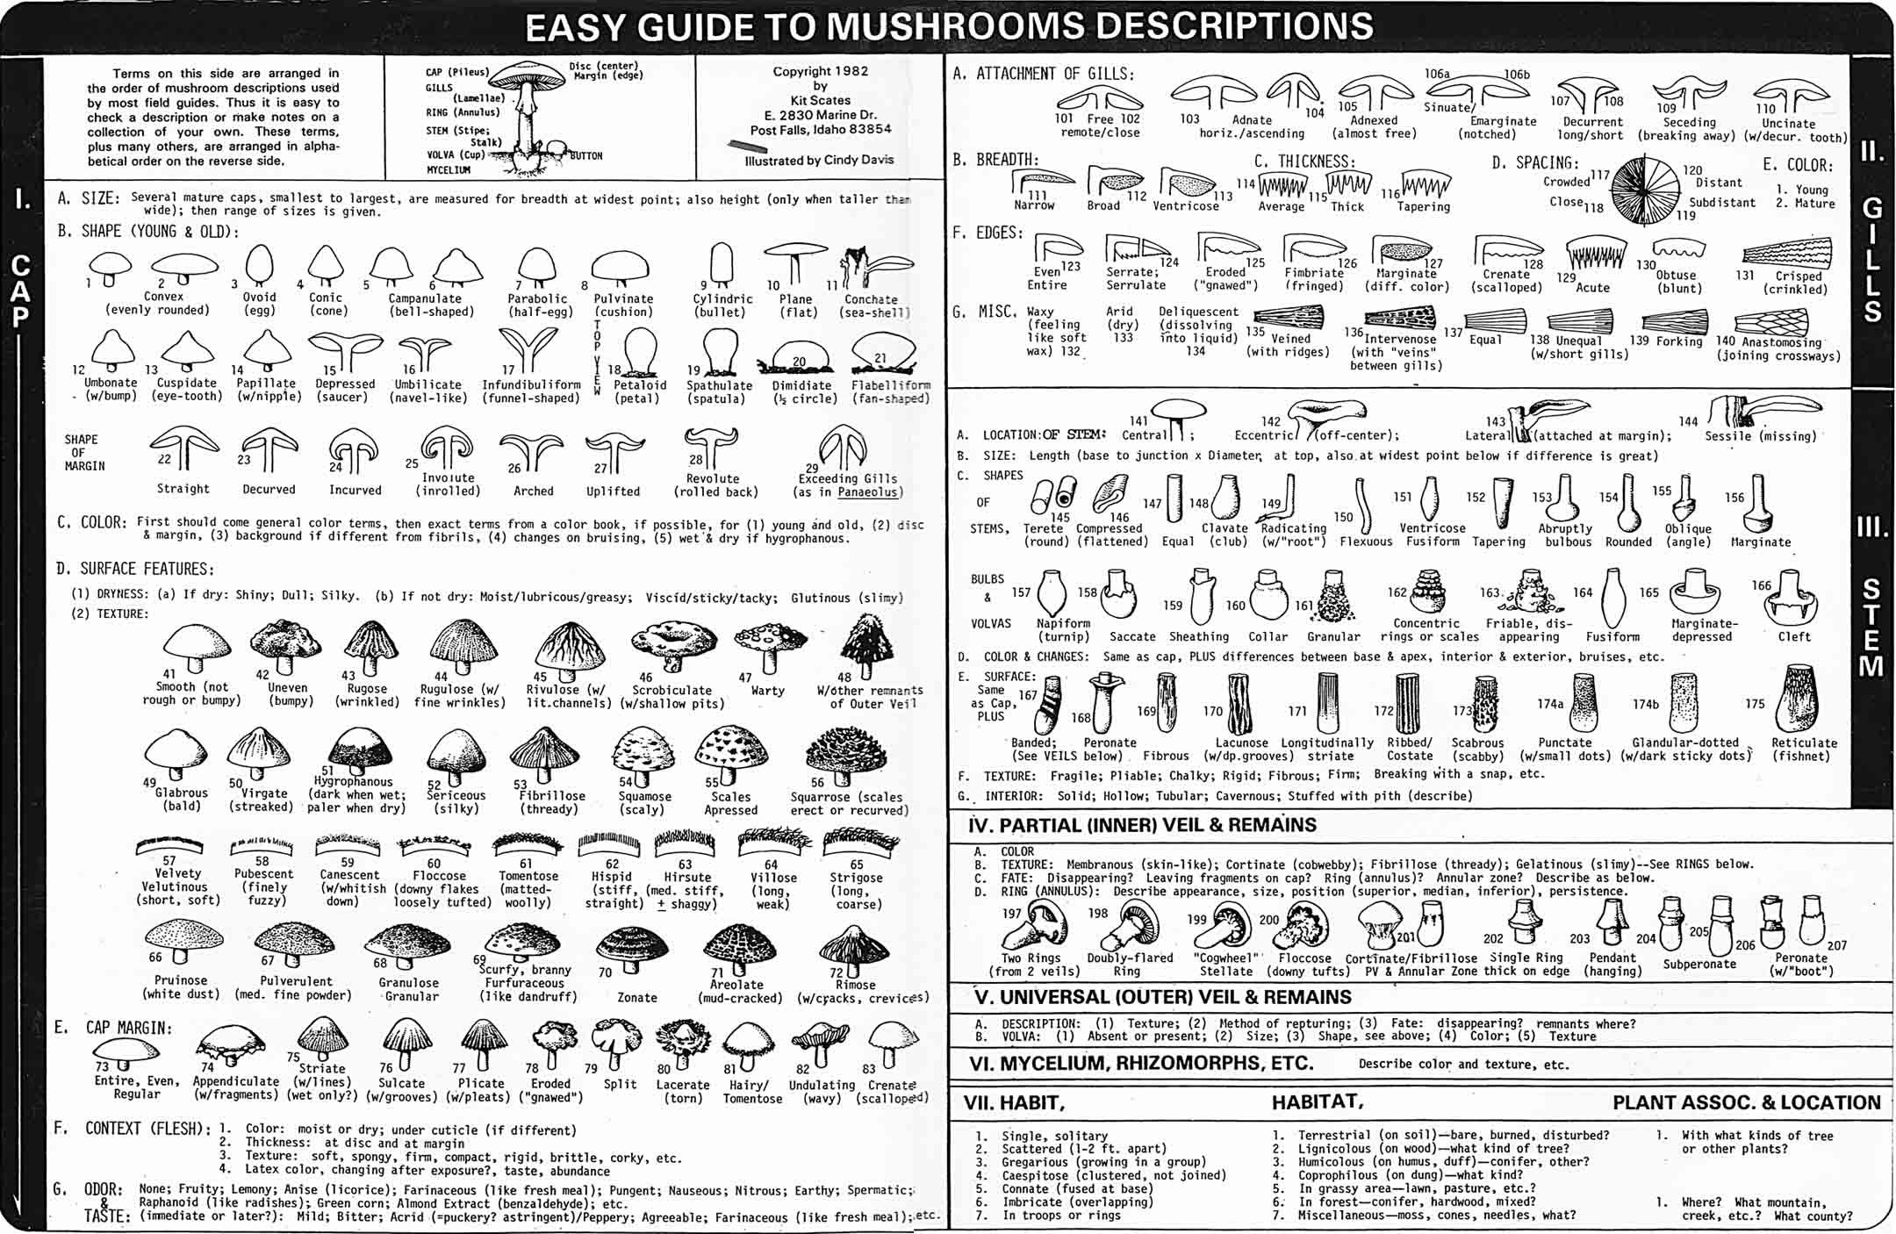
These are the traits you need to pay attention to when identifying a mushroom morphologically.
The "easy" guide! (this file is available in hi-res on the website)

Slide 14
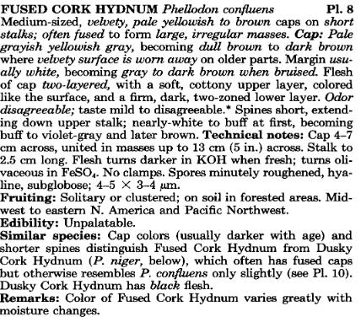
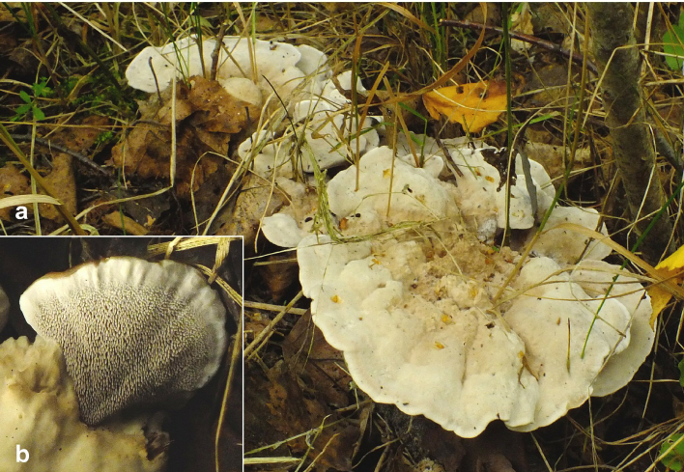
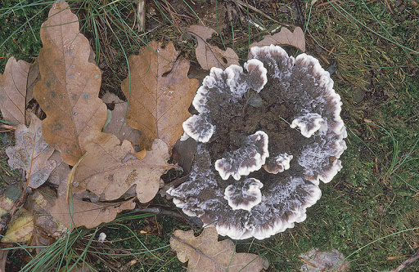
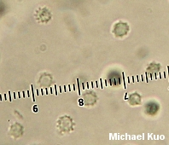
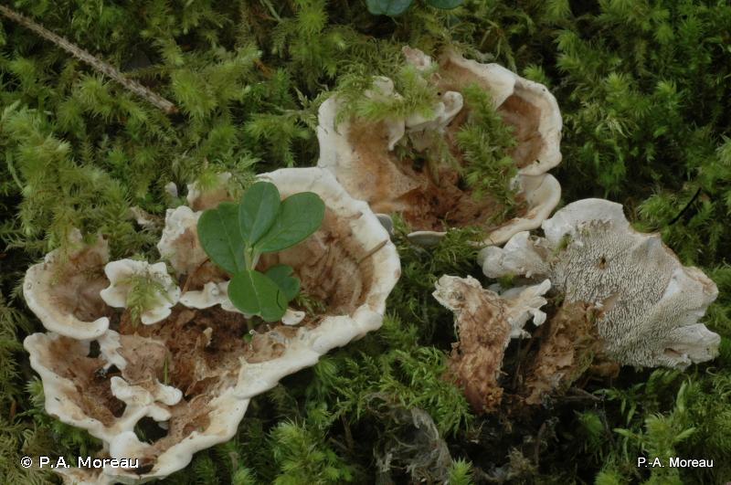
Typical mushroom guidebook description:
All images are this same species

Slide 15
What are some problems with identifying mushrooms using a guidebook?

Slide 16
Assignments
1. Read Kiss et al., 2019 [Link]
2. You will have a Canvas quiz on the assigned readings and will also have to participate in a Slack discussion about them.
3. Exam 1 is due by the end of the week. On Canvas.
4. Find 5 macrofungi, take proper photos and collection notes. Assignment on Canvas.

